Slide 1

Spreading Chinese Culture in Teaching Chinese as a Second Language
Chen Yanxi
English Interpreting
1

Slide 2



Contents
1
2
Test Assessment
Means&Methods
3
Textbook Compilation
2

Slide 3



Pt.1 Test Assessment--HSK
What is the HSK?
Designed and developed by the Hanban and the Confucius Institute Headquarters in 1990
The most well-known Chinese language proficiency test worldwide
Including: HSK (Basic); HSK (Elementary and Secondary); HSK (Advanced)
Held regularly every year in China and overseas
3

Slide 4



Pt.1 Test Assessment
When teaching Chinese to foreigners, what can we do?
Investigate foreign students’ understanding of social and cultural background knowledge of China
Improve foreign students’ ability to think with Chinese perspective in combination with Chinese traditional cultural knowledge
4

Slide 5
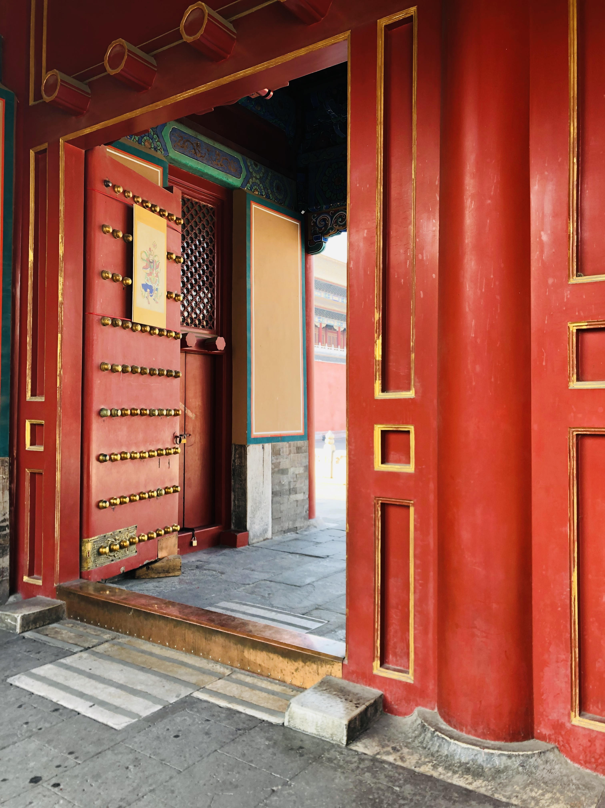
Pt.2 Means & Methods
A compulsory or optional Chinese culture course can be offered according to the students’ specific conditions
Follow the principles of systematic, gradual, practical and appropriate teaching according to students’ learning level, cultural background and mastery of language
Create a richer space for international students to experience and discover, instead of just sticking to the traditional monotonous pattern of teachers, textbooks and classrooms
5

Slide 6
Pt.3 Textbook Compilation
Scientificity
Practicality
Use the “Chinese Pinyin scheme”, use standardized simplified Chinese characters, and teach Putonghua
The organization of teaching content should conform to the law of language teaching (from easy to difficult, from shallow to deep...)
the practicality of teaching contents
the authenticity of language materials
the practicality of teaching methods
Knowledge
Interest
Absorb the knowledge of social politics, sci-tech knowledge, cultural customs, historical geography and other aspects
Primary stage: closely integrate the needs of learners’ daily life
Medium- and high-level: reflect real life; choose topics with rich cultural connotation
6

Slide 7

References
Ren Hai-yan，Cao Bo 任海燕，曹波(2013).中国传统文化的英语教学实践初探[On the traditional Chinese Culture Class for English Majors].Hunan:湖南师范大学教育科学学报 Journal of Educational Science of Hunan Normal University,vol.12 No.3 115-118.
Zheng Ji-e,Hu Mingliang 郑继娥，胡明亮(2013).汉语国际教育研究[Studies in Teaching Chinese to Speakers of Other Languages].Jinan:暨南大学出版社.
Pang Zengyu 逄增玉(2019).汉语国际教育与中国传统文化国际传
播.Beijing:中国传媒大学出版社.
Le Shouhong 乐守红(2019).中国传统文化传播与对外汉语教学.Jilin:吉林人民出版社.(Le Shouhong 2019, 5)
国家汉办 HSK 官网[Official website of Hanban HSK](2019-09-24).http://www.hanban.org/tests/node_7486.htm

