Slide 1

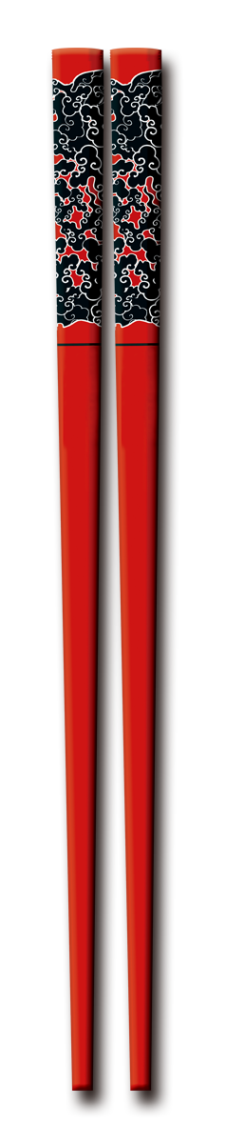
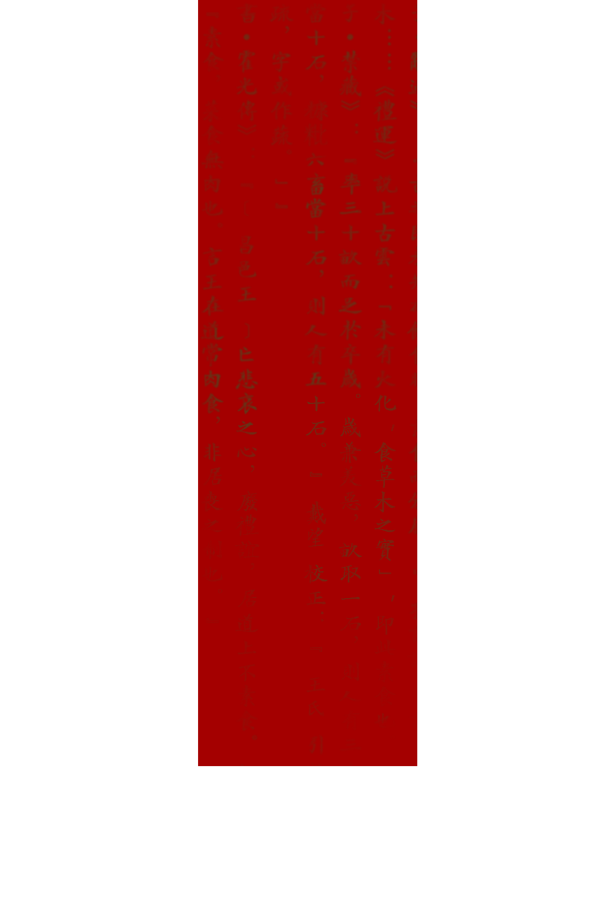
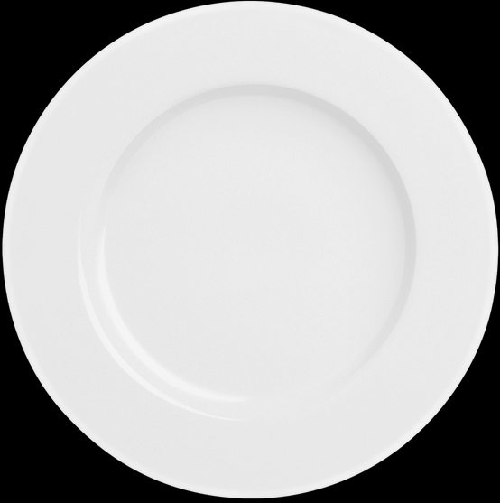

Manner
Table
Luo Yan

Slide 2
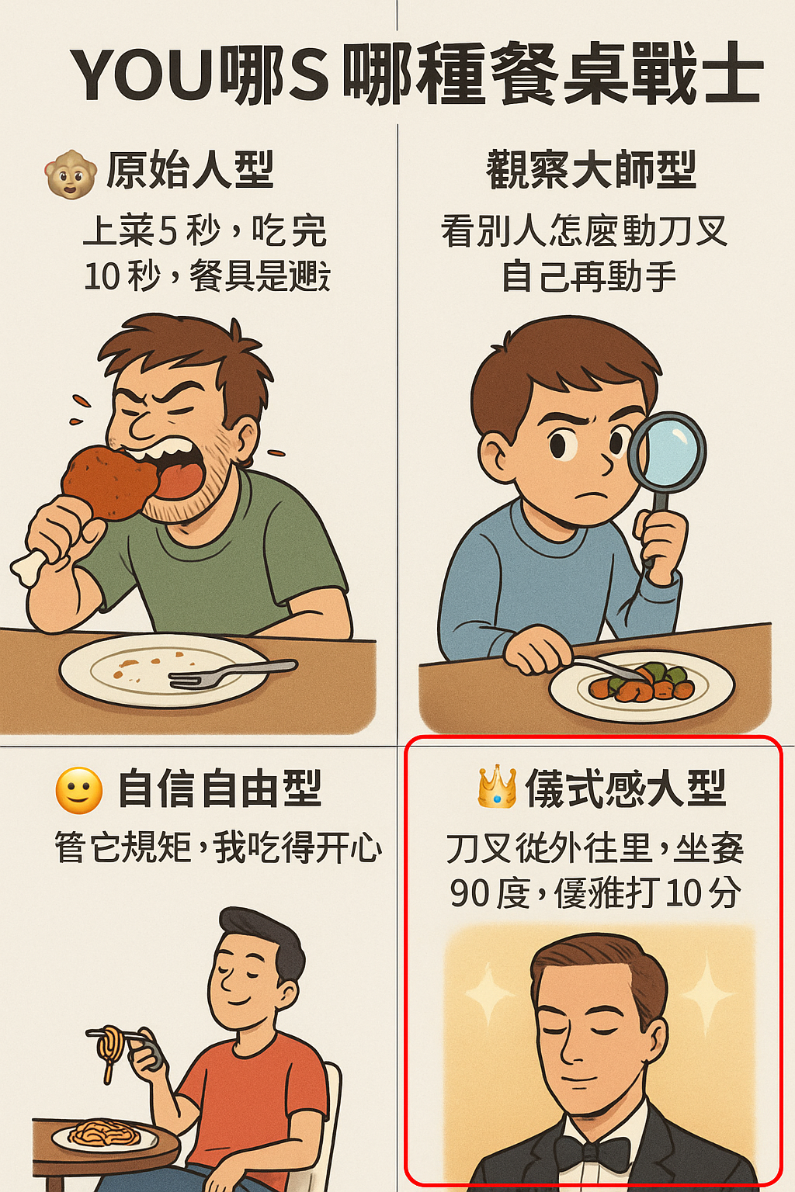
Which type do you belong to?

Slide 3
01 Seating Etiquette
02 Dining Etiquette
03 Table Manners in
Western Countries
目 录

Slide 4
0 1
Seating Etiquette

Slide 5
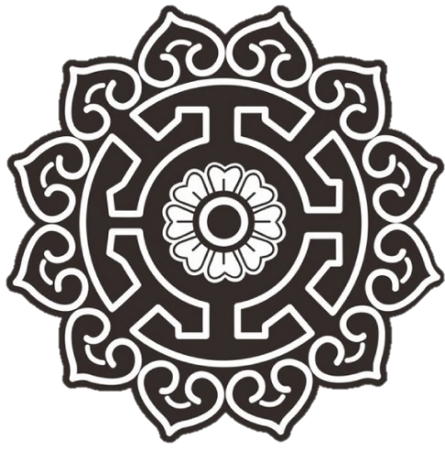

Seating Etiquette
The seat of honor is usually placed against the wall and facing the entrance, symbolizing a position of respect and importance.
Guests are typically seated according to the host’s arrangement, and it is considered inappropriate to choose a seat without guidance.
The principal guest is seated opposite the host, while secondary guests take the corresponding secondary seats, with seating also reflecting seniority and hierarchy.

Slide 6
Seating Taboos
❌ It is considered impolite to take the seat of honor without being invited.
❌ Traditionally, it is believed that sitting with one’s back to the door and without support is inauspicious, so important guests should not be placed in such positions.
❌ The seat of honor should not be left vacant, as this may be seen as a sign of poor hospitality or disrespect.

Slide 7
0 2
Dining Etiquette

Slide 8
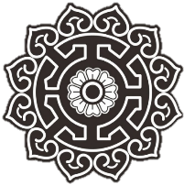
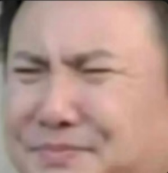
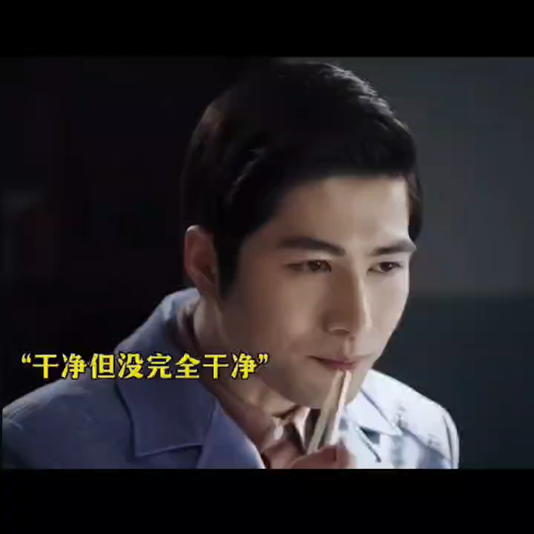
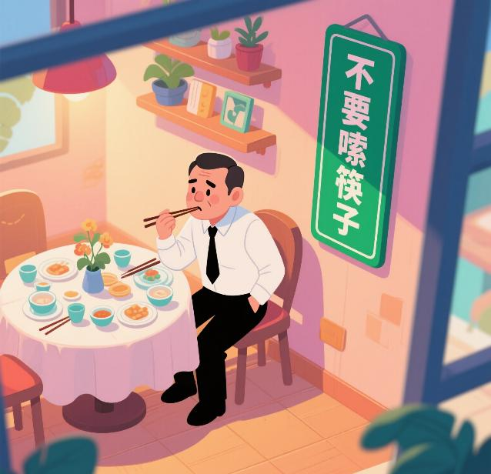
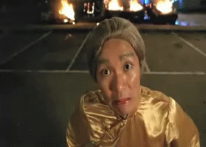
Dining Etiquette
lick chopsticks？

Slide 9
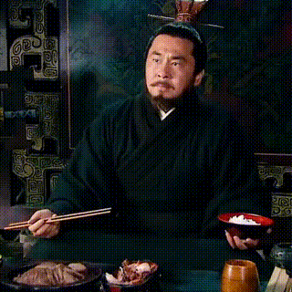
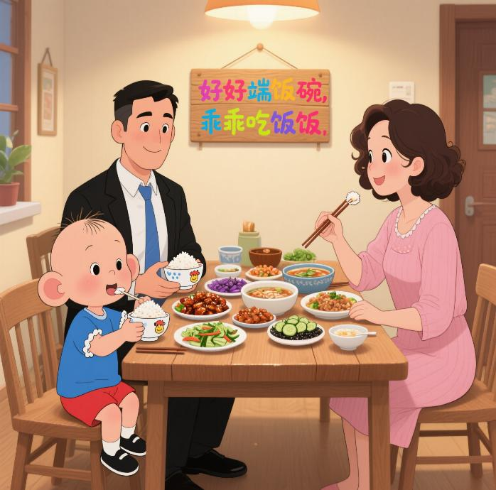
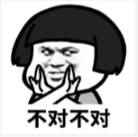
Dining Etiquette
flip over the rice bowl？

Slide 10
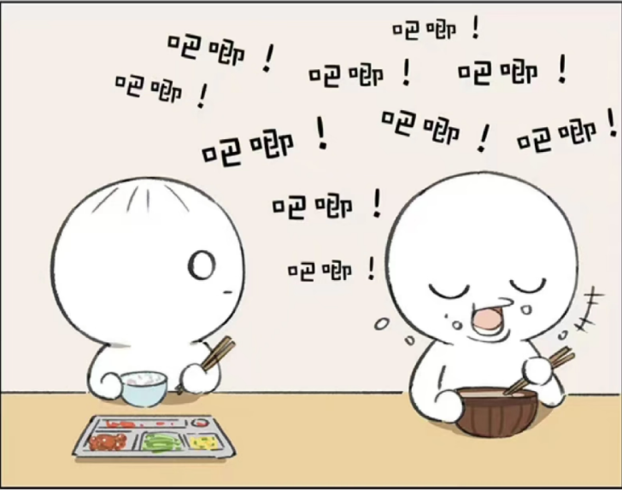
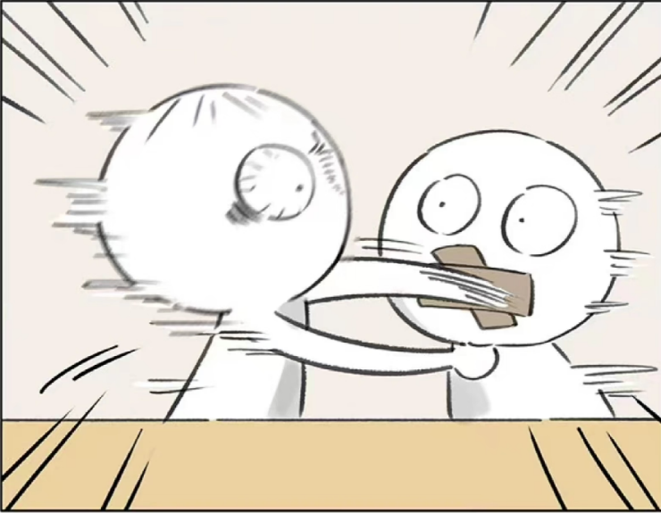
Dining Etiquette
smack one’s lips？

Slide 11
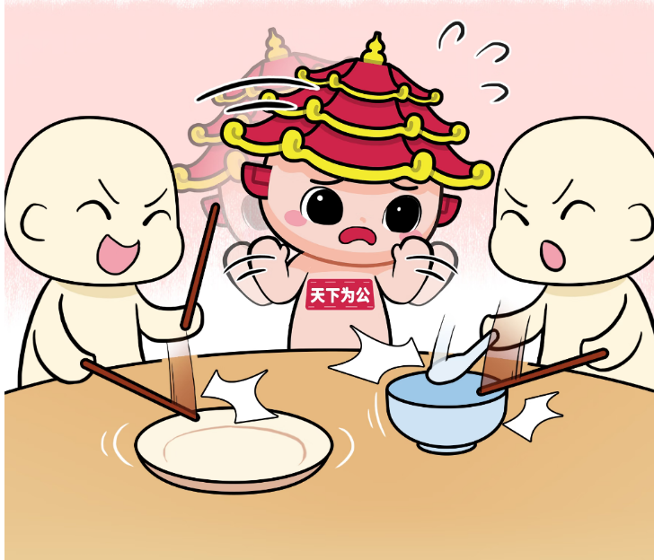
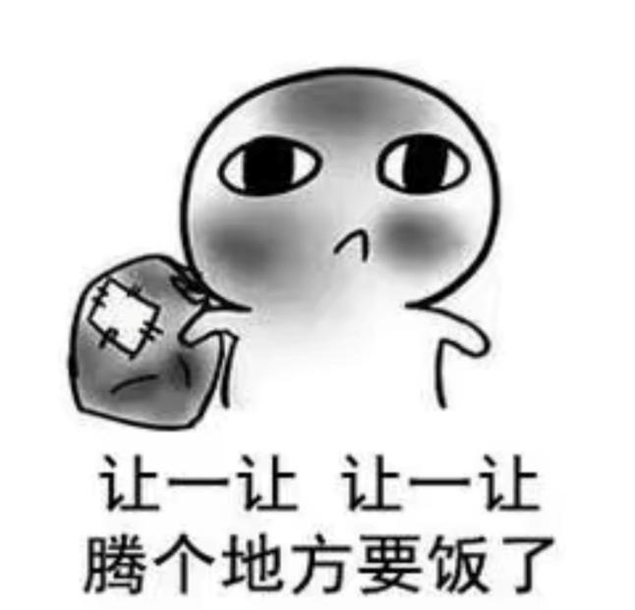

Dining Etiquette
bang one’s bowl rudely？

Slide 12
0 3
Table Manners in Western Countries

Slide 13
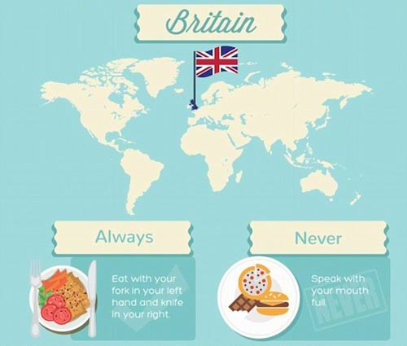
Table Manners in Western Countries
Britain
Always: Eat with your fork in your left hand and knife in your right.
Never: Speak with your mouth full.

Slide 14
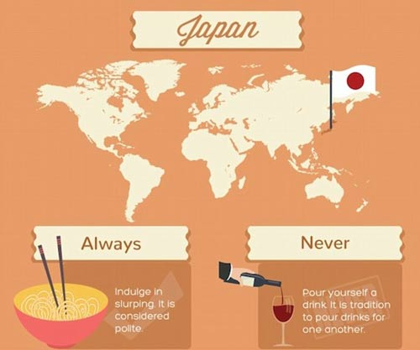
Table Manners in Western Countries
Japan
Always: Indulge in slurping. It is considered polite.
Never: Pour yourself a drink. It is tradition to pour drinks for one another.

Slide 15
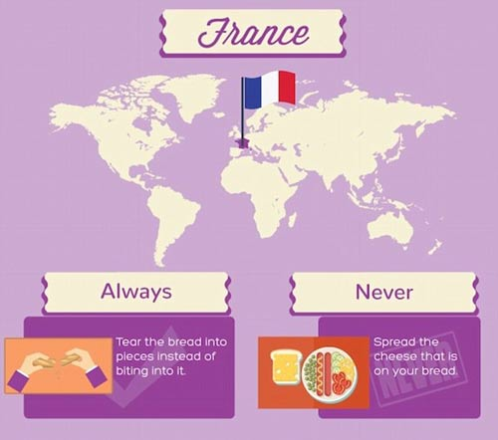
Table Manners in Western Countries
France
Always: Tear the bread into pieces instead of biting into it.
Never: Spread the cheese that is on your bread.

Slide 16
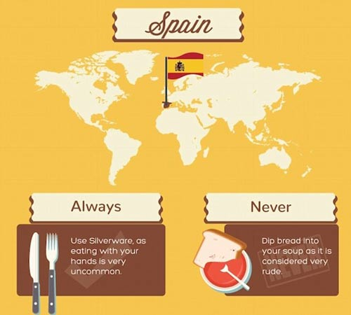
Table Manners in Western Countries
Spain
Always: Use silverware, as eating with our hands is very uncommon.
Never: Dip bread into your soup as it is considered very rude.

Slide 17
Thank
You

