Slide 1
Translation practice in domestication and foreignization
雷旷溪 吴子佳

Slide 2
The application
The Definition
Domestication
and Foreignization
Conclution

Slide 3
1
The Definition

Slide 4


1
The theory of Venuti
“Foreignization is an approach that the translator leaves the author in peace,as much as possible,and moves the reader towards him”
"Domestication is one that the translator leaves the reader in peace,
as much as possible,and moves the author towards him"(Lawrence Venuti)

Slide 5
2
The theory of Schuttleworth& Cowie
On the basis of Venuti's theory:
”it is identified with a policy common in dominant cultures which are aggressively monolingual,unreceptive to the foreign,and which he describes as being accustomed to fluent translations that invisibly inscribe foreign text with[target language] values and provide readers with narcissistic experience of recognizing their own culture in a cultural other.“(Schuttleworth& Cowie)
“Foreignizing translation in which a TT is produced which deliberately breaks target conventions by retaining something of the foreignness of the original."(Schuttleworth&Cowie)

Slide 6

3
The Definition
Foreignization is the strategy of retaining information from the source text, and involves deliberately breaking the conventions of the target language to preserve its meaning.
Domestication is the strategy of making text closely conform to the culture of the language being translated to, which may involve the loss of information from the source text.

Slide 7
2
Domestication
and
Foreignization

Slide 8

1
Domestication
Domestication takes the local culture as the starting point, takes the information receiver as the core, and emphasizes the authenticity and vividness of the translated text. Therefore, the foreign cultural color and language style characteristics in the original text are often modified to confine them within the framework of the local culture.
Lead a dog’s life 过着牛马一样的生活
Cry up wine and sell vinegar 挂羊头，卖狗肉
Put back the clock 开倒车
Kill the goose that lays the golden eggs 杀鸡取卵

Slide 9
2
Foreignization
a.Foreignization can occur at the phonetic level.
ballet——“芭蕾舞” jacket——“夹克”
b.Foreignization can appear at the word level.
“an olive branch”——“橄榄枝” “the cold war”——“冷战”
c.Foreignization can occur at the level of sentence structure.
《哈姆雷特》“You speak like a green girl．Unsifted in such perilous circumstance．”译为:“你讲的话完全像是一个不曾经历过这种危险的不懂事的女孩子。”

Slide 10
3
Domestication or Foreignization？
High buildings and large mansions are springing up like mushrooms in Beijing.
译文：在北京，高楼大厦犹如雨后春笋般地涌现。

Slide 11
3
Translation practice in domestication and foreignization

Slide 12
1
Translation practice in domestication and foreignization
Tourism brochure
Chinese cuisine

Slide 13
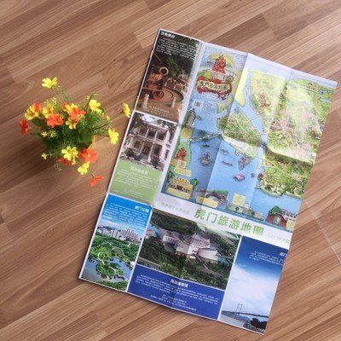
1
Foreignization and Domestication in tourism brochure
1 、Increase
例如:路左有一巨石, 石上原有苏东坡手书“云外流春”四个大字
To its left is another rock formerly engraved with four big Chinese characters
Yun Wai liu Chun (Beyond clouds and flows spring) written by Su Dongpo (1037—1101)
, the most versatile poet of the Northern Song Dynasty (960—1127) .
2、Decrease
例如: “云冈石窟——位于大同西北武周山 (又名云冈) 。创建于公元453 年 (北魏文成帝兴安二年) 。以后献文、孝文诸帝都在这里续建, 历百余年而成。这里有大小洞窟五十多个, 各窟佛像共约五万一千余尊。大者高十七米, 小者短到数寸。雕饰奇伟, 冠于一世。在中国历史、宗教上, 以及东方艺术上, 都具有巨大价值。”
Located in Datong , Shanxi Province , the Yungang Grottos are a complex of over 50 Buddhist grottos enshrining over 51 , 000 Buddhist statues as large as 17 meters tall or as short as a few inches. Built for over a hundred years, they are of great historic and artistic value.

Slide 14
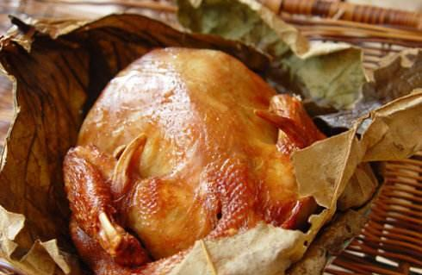
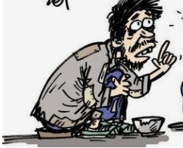
2
Foreignization and Domestication in Chinese cuisine
?
baked chiken
begger's chiken

Slide 15
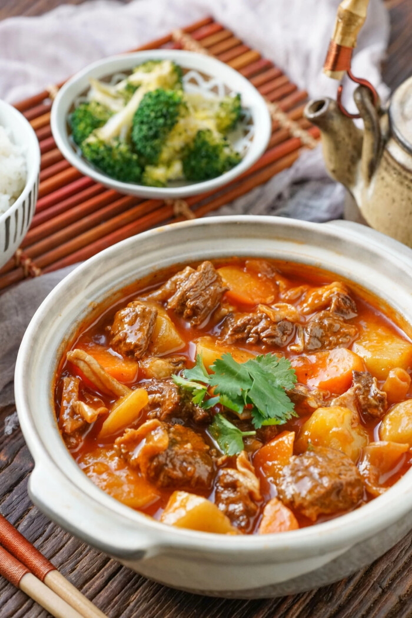
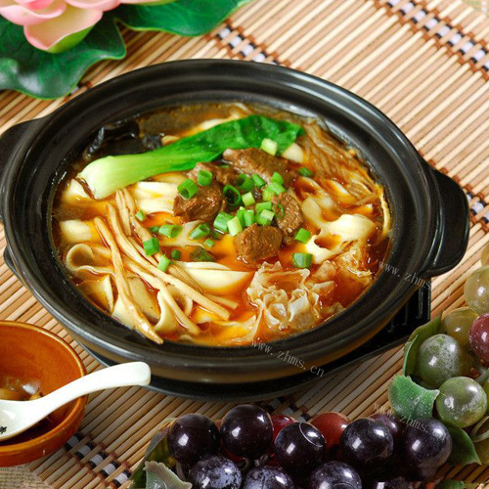
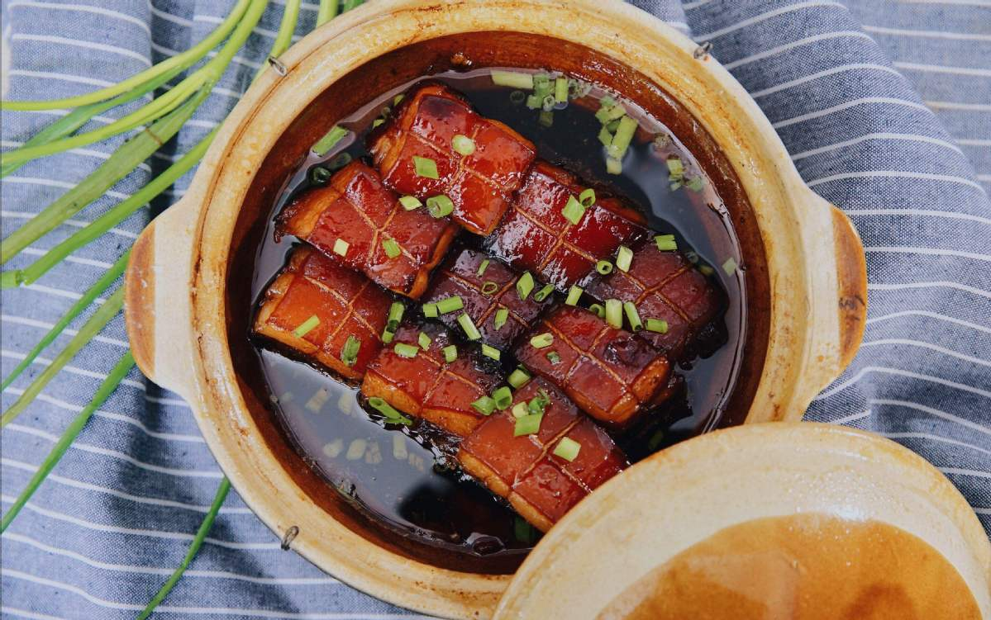
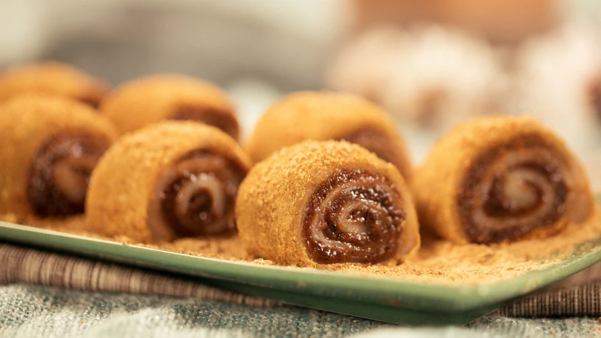
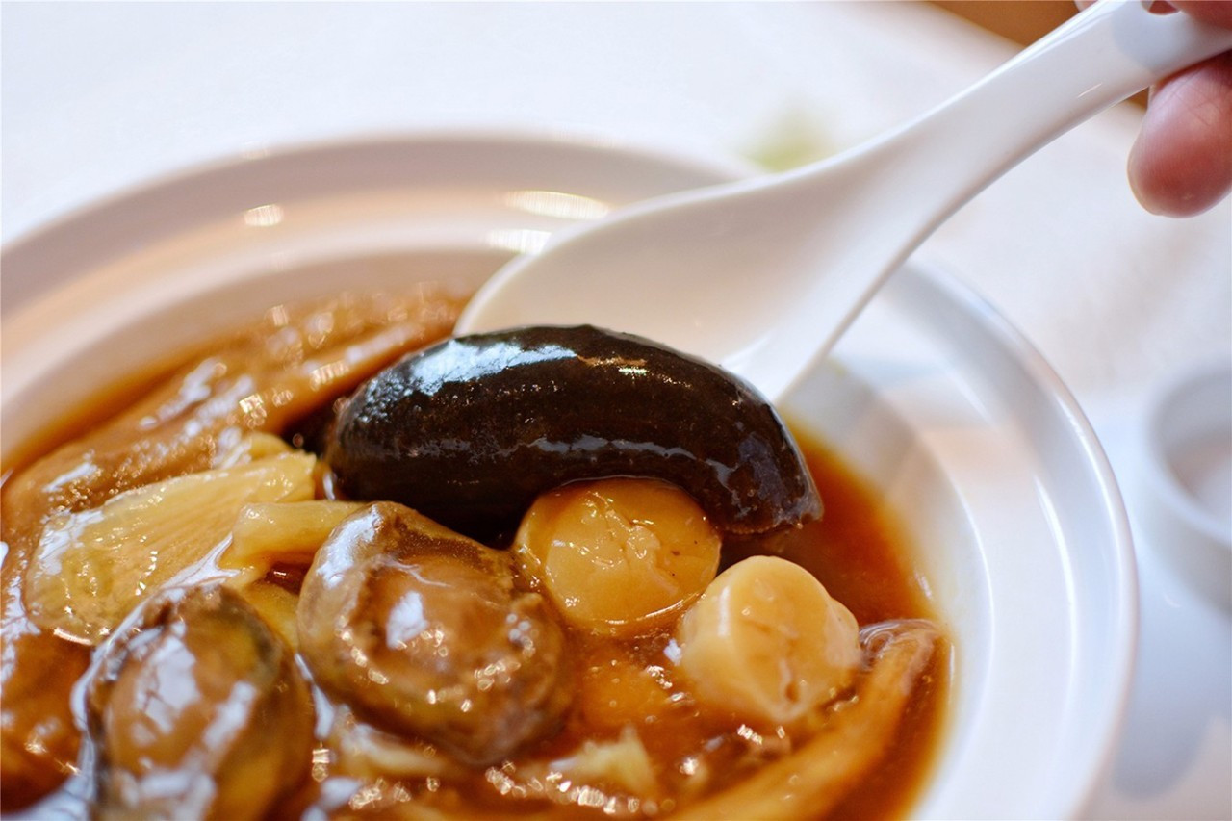
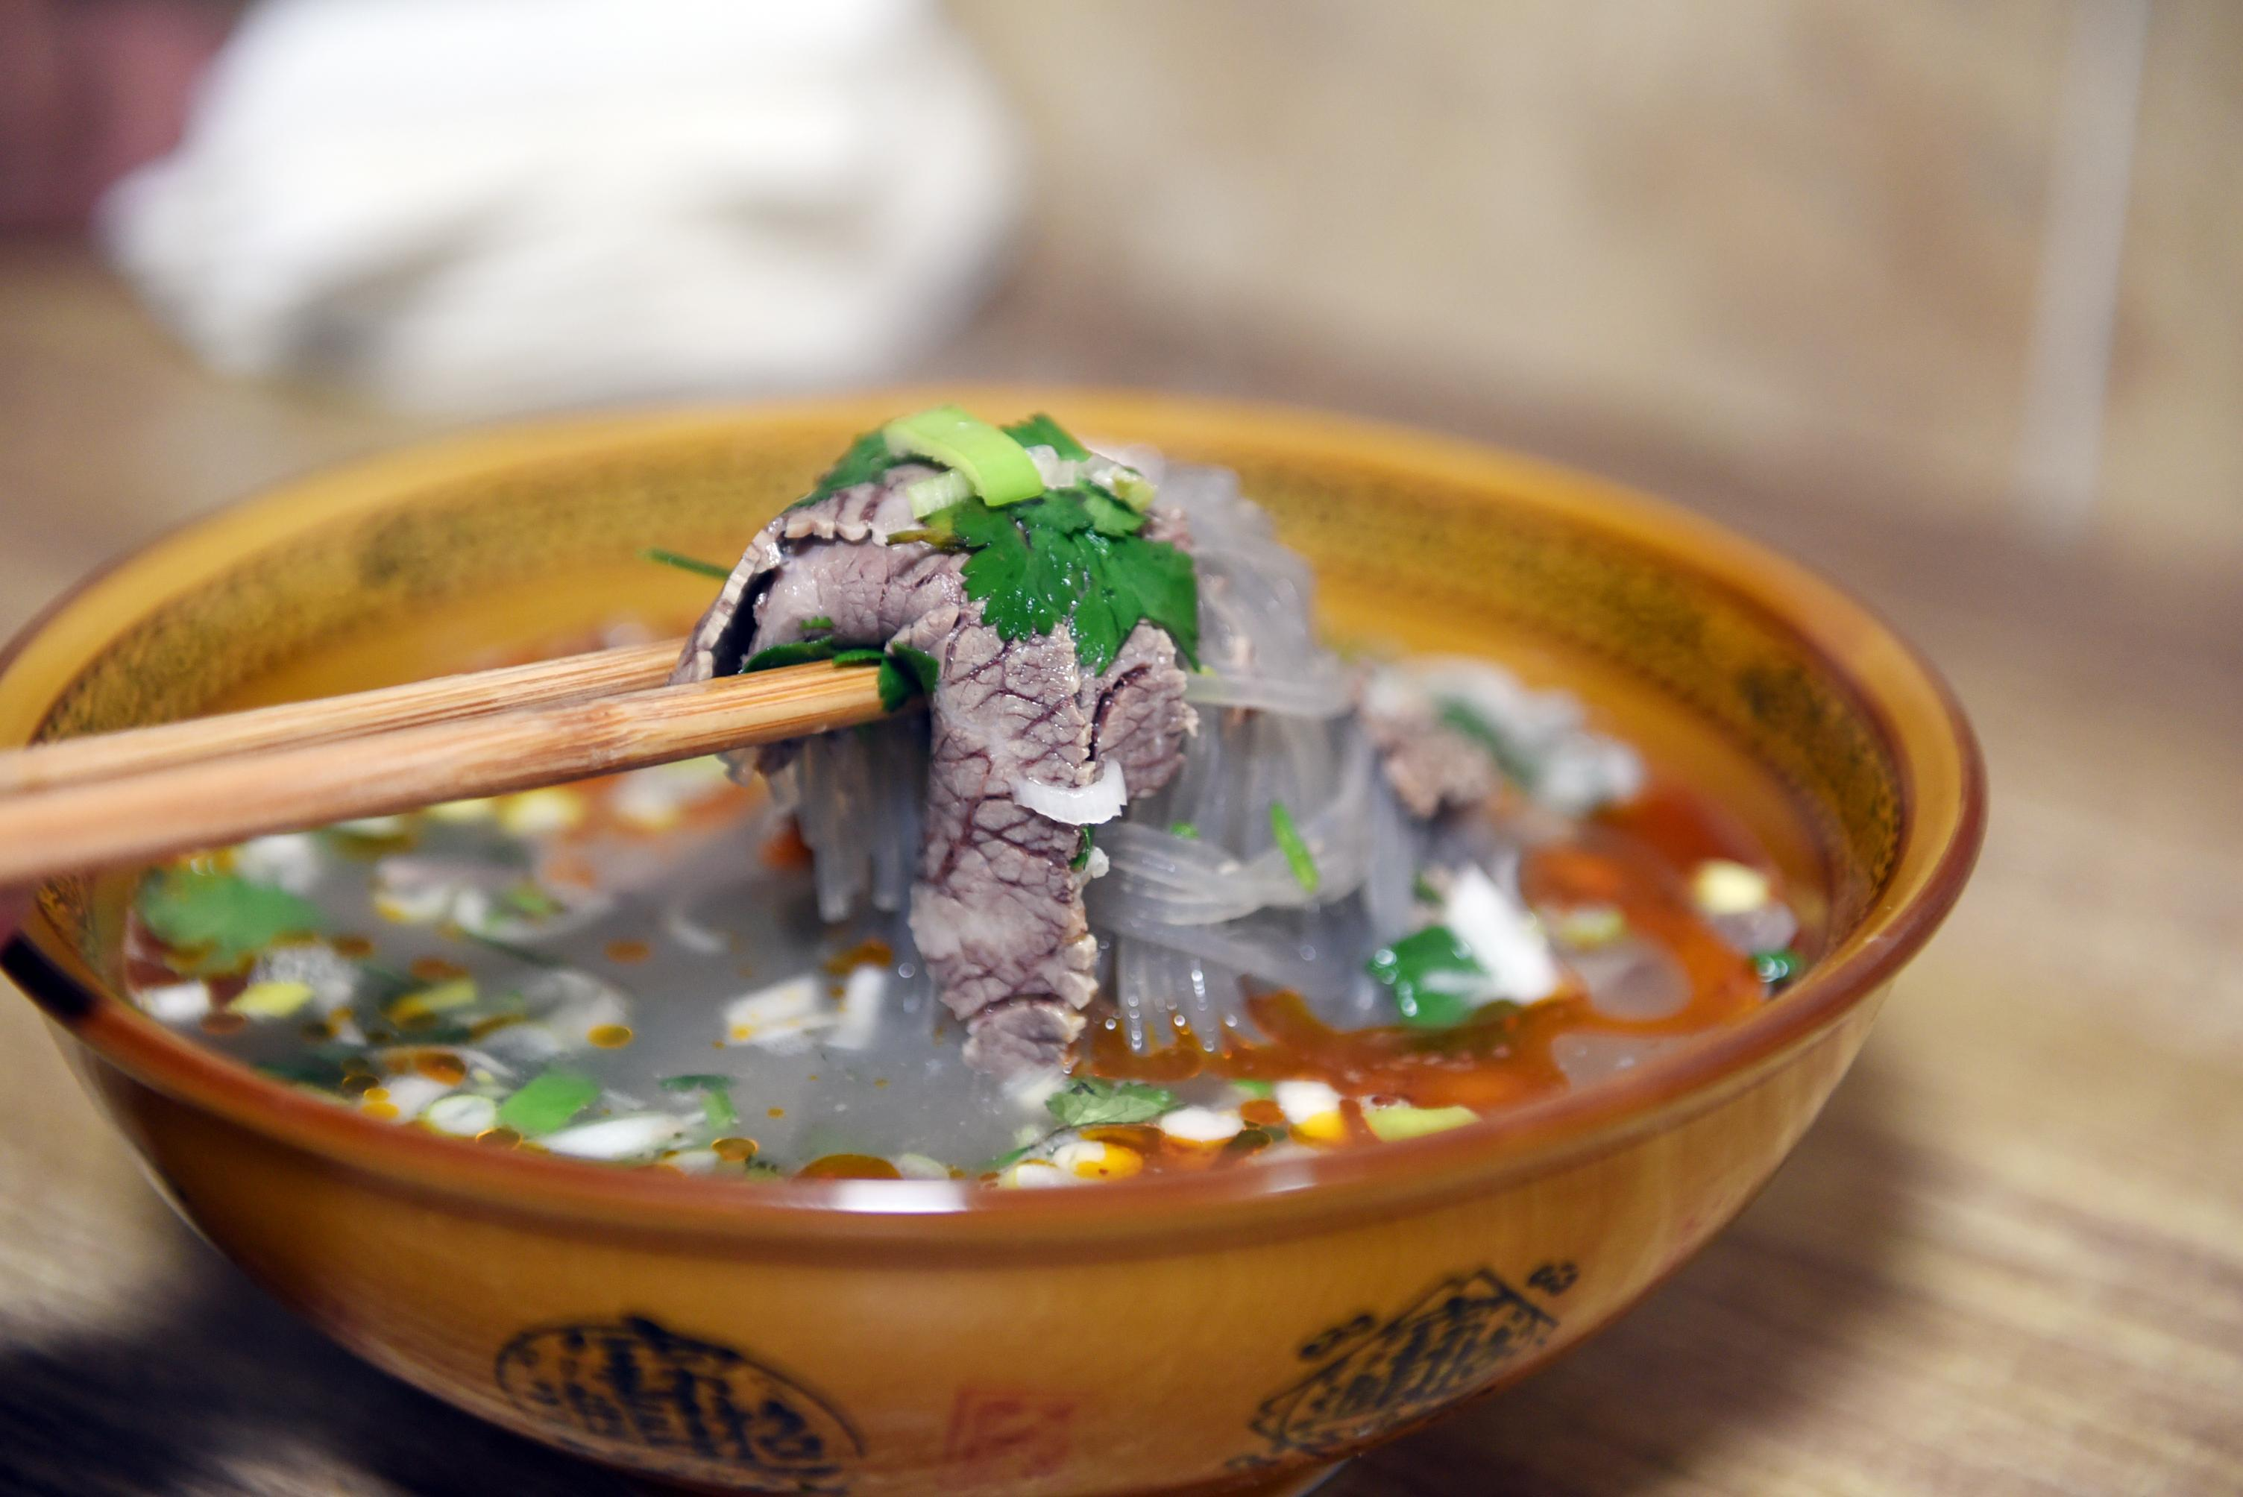
2
Foreignization and Domestication in Chinese cuisine
1、写实命名 literal translation
a.主料+配料 ：番茄牛腩
Main ingredient + ingredient: tomato and beef brisket
b.器皿+原料 : 砂锅面
Utensils + ingredients: casserole noodles
c.地名/人名+原料：淮南牛肉汤, 东坡肉
name+ ingredients:Huainan beef soup, Dongpo pork
d.烹饪方法/食用方法+食材：炒酸菜, 手抓饼
Cooking method/eating method + ingredients: sauerkraut, shredded cake
2、写意命名 free translation
a.Named according to the characteristics of the ingredients metaphorically
蚂蚁上树 (肉末粉条)—Ants on a tree (minced pork)
b.Named after historical allusions
霸王别姬 (甲鱼炖鸡)—Farewell my Concubine (turtle stewed chicken)
c.Named according to the production process metaphor
驴打滚 (打糕)—Donkey roll (beating cake)
d.Named after the meaning of good
佛跳墙 (福寿全)—Buddha jumps over the wall (Fu Shou Quan)

Slide 16
4
Conclution
PPT模板下载：www.1ppt.com/moban/ 行业PPT模板：www.1ppt.com/hangye/
节日PPT模板：www.1ppt.com/jieri/ PPT素材下载：www.1ppt.com/sucai/
PPT背景图片：www.1ppt.com/beijing/ PPT图表下载：www.1ppt.com/tubiao/
优秀PPT下载：www.1ppt.com/xiazai/ PPT教程： www.1ppt.com/powerpoint/
Word教程： www.1ppt.com/word/ Excel教程：www.1ppt.com/excel/
资料下载：www.1ppt.com/ziliao/ PPT课件下载：www.1ppt.com/kejian/
范文下载：www.1ppt.com/fanwen/ 试卷下载：www.1ppt.com/shiti/
教案下载：www.1ppt.com/jiaoan/
字体下载：www.1ppt.com/ziti/

Slide 17

1
Conclution
Domestication and foreignization have their own advantages and disadvantages. Therefore, in translation practice, we should combine the advantages of the two strategies and avoid the disadvantages, so that there is room for the common development of the two strategies. so, in the actual translation process, domestication and foreignization should complement each other and have complementary dialectical unity relationship.

Slide 18
THANK
YOU

