Slide 1
Comparison of the Development of Chinese and Western Translation
——刘艺（Liu Yi） 谭媛媛（Tan Yuanyuan）

Slide 2
Contents
01
Chinese Translation
02
Western Translation
03
Comparison of the Two

Slide 3
PART 1
Chinese Translation

Slide 4

Chinese Translation
There have been five high points in the history of Chinese translation, however, translation can be divided into six climaxes in the history of western translation.

Slide 5


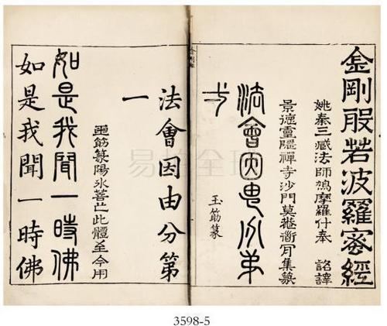
Chinese Translation
Translation of Buddhist scriptures from the Eastern Han Dynasty to the Northern Song Dynasty
1
This high point was followed by the emergence of various influential representatives in China, such as Zhiqian, Xuanzang, etc. These representatives made great contributions to the translation industry at that time.

Slide 6
Chinese Translation
The translation of western natural science works in late Ming and early Qing dynasties.
The translation activities from the Opium War to the May Fourth Movement.
2
3
After the Sino-Japanese War, some rulers and intellectuals infected with capitalist ideas demanded to defend against the foreign sea and change the law for self-improvement. During this period, translation received great attention,
Xu Guangqi and Li Zhizao were the main representatives.

Slide 7
Chinese Translation
The translation activity from May 4th Movement to the founding of New China.
4
The translation activity after the founding of New China. During this period, translation theories were constantly being improved.
5

Slide 8
PART 2
Western Translation

Slide 9

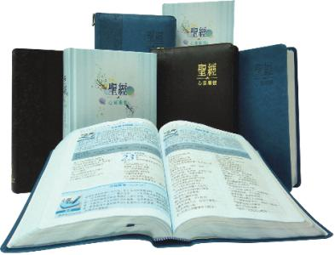
Western Translation
Around the 3rd century B.C, focusing on Bible translation.
01
02
Between the 4th and 6th centuries AD. It was closely related to the development of Christianity.

Slide 10
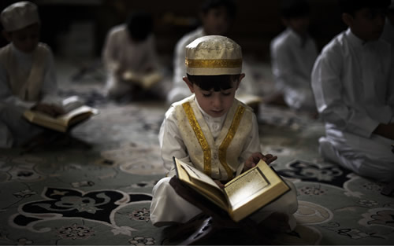
Western Translation
03
Between the 11th and 12th centuries.
Because of the deep interest of Christians and Muslims in each other's cultures, a large number of works were translated from Arabic into Latin, which lasted for almost a hundred years.

Slide 11
Western Translation
European Renaissance movement of 14th -16th century,
04
The fourth climax was caused by the European Renaissance movement of 14th -16th century, a movement of profound social change and intellectual, literary, and artistic innovation
The translation activity since the end of the Second World
05
During this long period of peace, the rapid development of economy , science and technology in the West has accelerated the development of the translation industry.

Slide 12
Comparison of the Two
PART 3

Slide 13
Similarities
01
They all share the same developmental approach.
That is, they both move from discussion of issues to personal opinions, to conscious critique, and then to systematic discourse.
02
Both originate from religious translations and are highly culturally permeable.
03
The characteristics of each translation high point are related to the social, political and other factors of the time.

Slide 14
Difference
01
The traditional emphasis of Chinese translation theory has always been on the practicality of the theory.
The Chinese demand for the purpose of translation is whether it can guide people's life and improve their living condition in practice.
02
The West seems to pay more attention to the abstractness, coherence and systematization of translation theory.

Slide 15
THANKS!

