Slide 1

Contemporary literature
PPT: Xie Ximin 谢茜敏 （English Translation)
Interaction: Li Weiyao 李玮瑶 (Korean Translation)

Slide 2
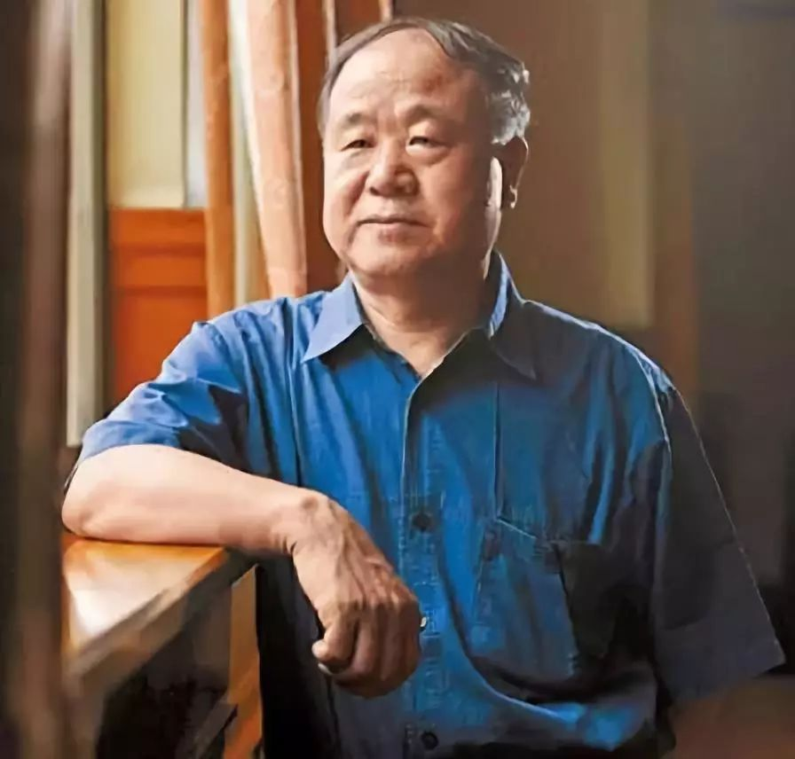
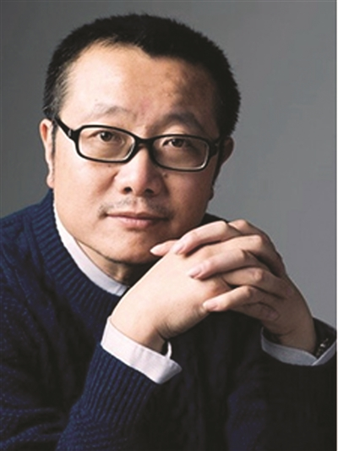
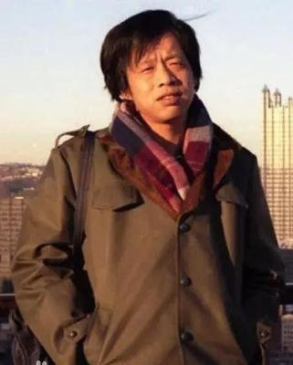
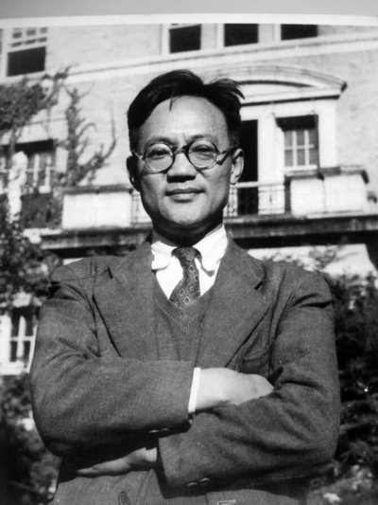
Interaction
1. Who is your favorite contemporary writer?
2. Which of his/her works do you like best?

Slide 3
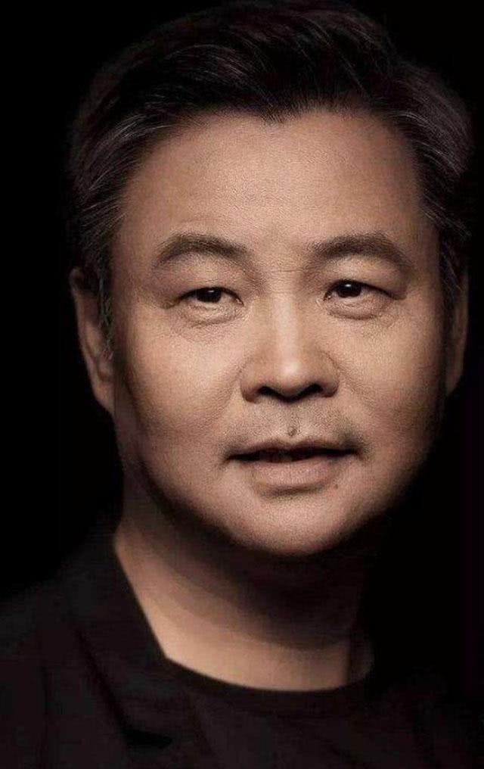
余华
Yu Hua, a contemporary Chinese writer, was born in Hangzhou, Zhejiang Province. He is a member of the Ninth National Committee of the Chinese Writers Association and now works for the Hangzhou Federation of literary and art circles. In 1984, he began to publish novels. Xu Sanguan's selling blood was selected as one of the ten most influential works of the 1990s by 100 critics and literary editors. In 1998, he won the garzana Carver prize for literature in Italy. In 2005, he won the Chinese Book Special Contribution Award.

Slide 4
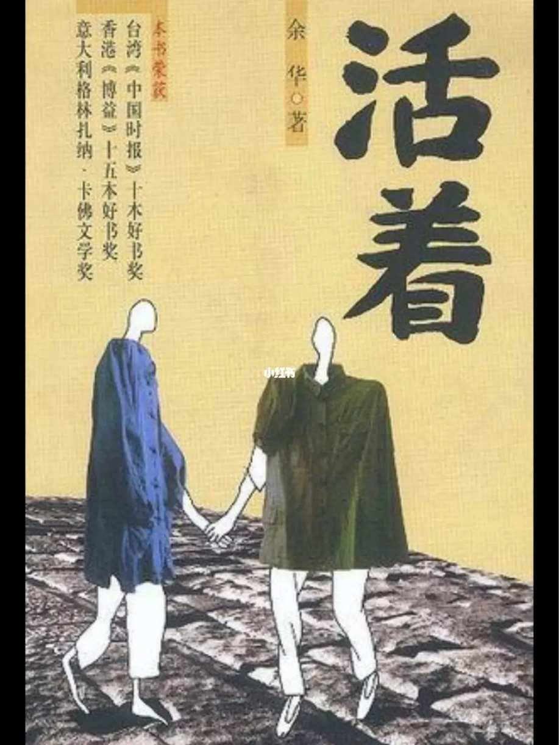
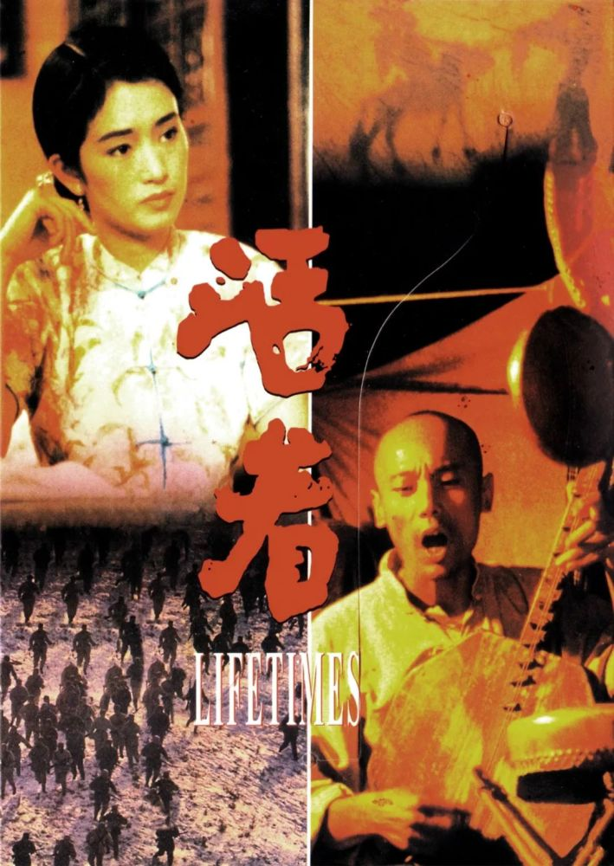
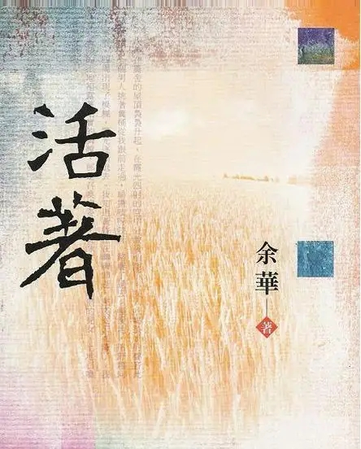
TO LIVE

Slide 5
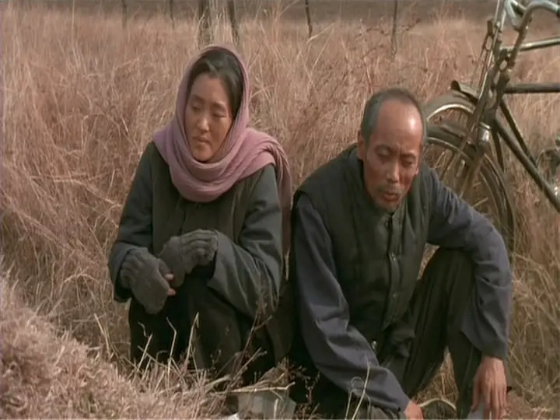
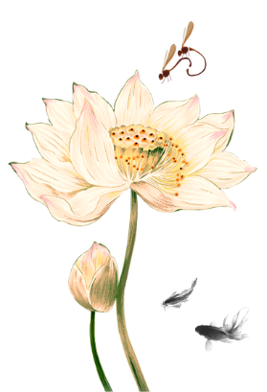
EXCERPT
Sometimes when I think back I feel sad, and sometimes I feel a kind of peace. I took care of the funerals for everyone in my family. I buried them all with my own hands. When the day comes that my body goes stiff, there will be no one left to worry about.
我是有时候想想伤心，有时候想想又很踏实,家里人全是我送的葬,全是我亲手埋的，到了有一天我腿一伸，也不用担心谁了。

Slide 6
Classic Words
1.In my younger days I wandered amuck, at middle age I wanted to stash everything in a trunk, and now that I’m old I’ve become a monk.
少年去游荡，中年想掘藏，老年做和尚。
2.As long as our family could be together every day, who really cared about good fortune?
只要一家人天天都在一起，也就不在乎什么福分了。
3.People are all the same: When they’re taking the money from someone else’s pocket, their faces light up and it’s all smiles, but as soon as it’s their turn to lose they all cry like they’re in mourning.
人都是一样的，手伸进别人口袋里掏钱时那个眉开眼笑，轮到自己给钱了一个个都跟哭丧一样。

Slide 7
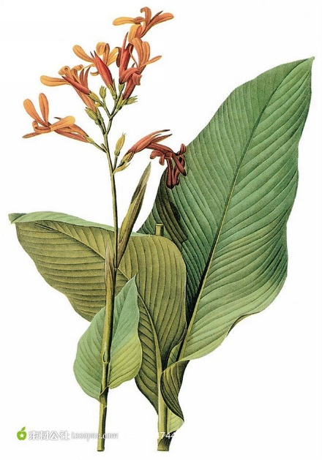
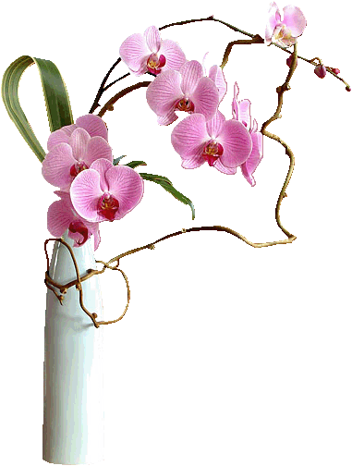
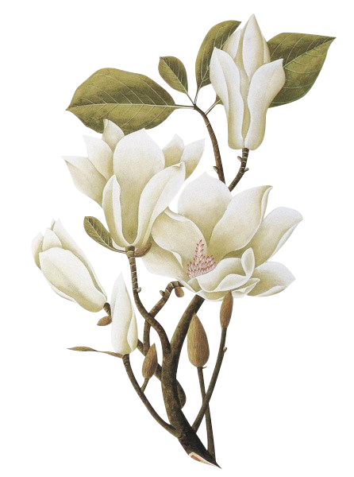
Contents
The definition of Contemporary Literature
The development of Contemporary Literature
Representative writers and their works
Translation and external communication

Slide 8
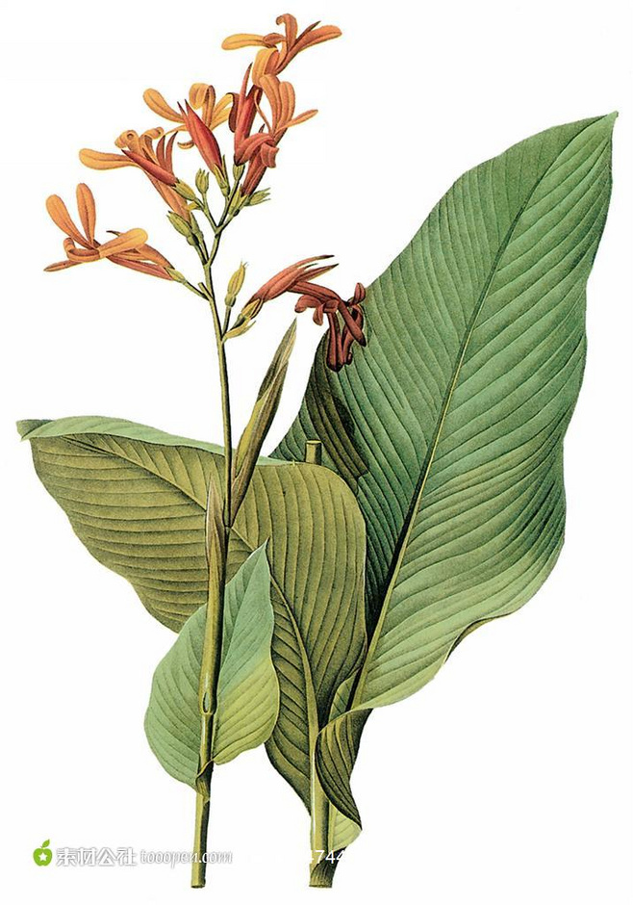
01
Definition

Slide 9
01
Definition
Chinese literature since 1949.
literature in the specific historical context of socialism.
literature in the early socialist period(1949-1978)
literature in the New period after the reform and opening up(1978-至今)
Chinese avant-garde literature
Modern Literature.png (1919-1949)
↨ ↨ ↨ ↨ ↨ ↨
Contemporary Literature（1949-至今）
Chinese free literature
popular literature

Slide 10
02
Development

Slide 11

02
Development
chronological order
the founding of CPR
the end of Cultural Revolution
3
1
1949
1966
1976
1978
2
the beginning of the Cultural Revolution
reform and opening up

Slide 12
Representative writers and their works
03

Slide 13
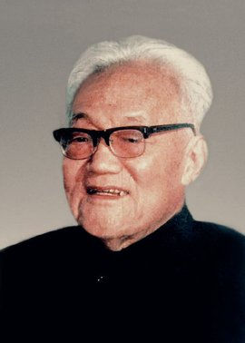
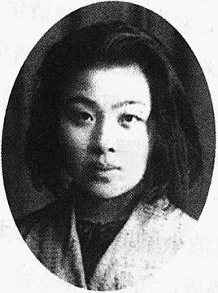
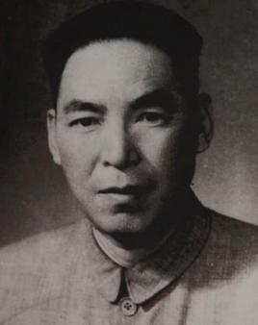
03
Representative writers and their works
巴金 Ba Jin(1904-2005)
丁玲 Ding Ling(1904-1986)
赵树理 Zhao Shuli(1906-1970)
《激流三部曲》
the Torrent Trilogy
《爱情三部曲》
the Love Trilogy
《太阳照在桑干河上》
The Sun Shines on the
Sanggan River
《李有才板话》
Rhymes of Li Youcai
《莎菲女士的日记》
Ms. Safi′s Diary
《小二黑结婚》
Xiao Er Hei’s Marriage

Slide 14

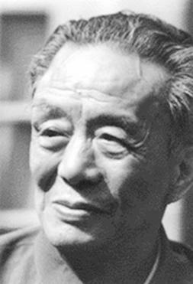
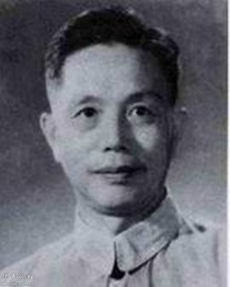
03
Representative writers and their works
周立波Zhou Libo(1908-1979)
艾青 Ai Qing(1910-1996)
杨朔 Yang Shuo(1913-1968)
《暴风骤雨》
The Hurricane
《湘江一夜》
One Light in Xiang River
《大堰河》
Dayanhe
《三千里江山》
A Thousand Miles of Lovely Land
《大堰河――我的保姆》
My Nanny Dayanhe
《香山红叶》
The Red Leaves on the Fragrant Hill

Slide 15
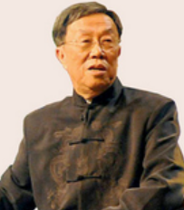
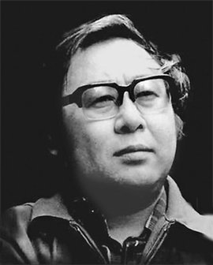
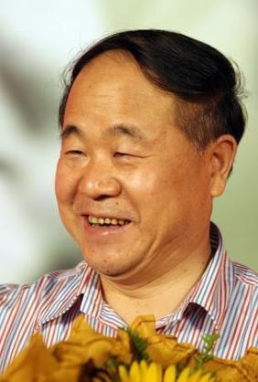
03
Representative writers and their works
王蒙 Wang Meng(1934- )
路遥 Lu Yao(1949-1992)
莫言 Mo Yan(1955-)
《青春万岁》
Long Live the Youth
《蝴蝶》
The Butterfly
《人生》
A Humble Life
《生死疲劳》
Life and Death are Wearing Me Out
《平凡的世界》
World of Plainness
《红高粱》
Red Sorghum

Slide 16
04
Translation & External communication

Slide 17
04
Translation & External communication
1, the mode of sponsorship by national publicity agency and publication by foreign language press.
2, the mode of initiation and translation by Chinese scholars and publication by western academic press.
3, the mode of initiation and translation by western sinologists and publication by western academic press.
4, the mode of initiation and translation by western sinologists and publication by western commercial press.
5. the mode of initiation and publication by western commercial press and translation by sinologists.

Slide 18
References
1.汪宝荣：《中国文学译介与传播模式研究》，浙江大学出版社2022年版.
2.王颖冲：《中文小说英译研究》，外语教学与研究出版社2018年版.
3.Li-hua Ying, Historical Dictionary of Modern Chinese Literature[M]. Lanham: The Scarecrpw Press, 2010.
4.Meng-lin Chen, A corpus-based study on imagery and symbolism in Goldblatt’s translation of Red Sorghum. Babel, Vol65,2019,399-423.
5.To Live, translated by Michael Berry.

Slide 19
THANKS
PPT: Xie Ximin 谢茜敏 （English Translation)
Interaction: Li Weiyao 李玮瑶 (Korean Translation)

