Slide 1
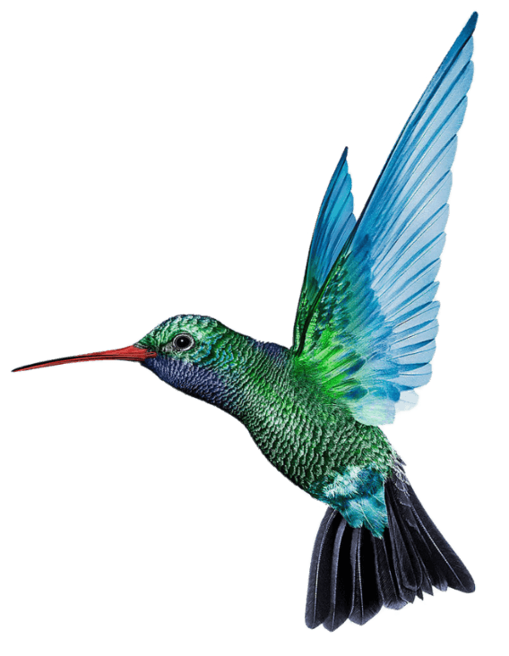
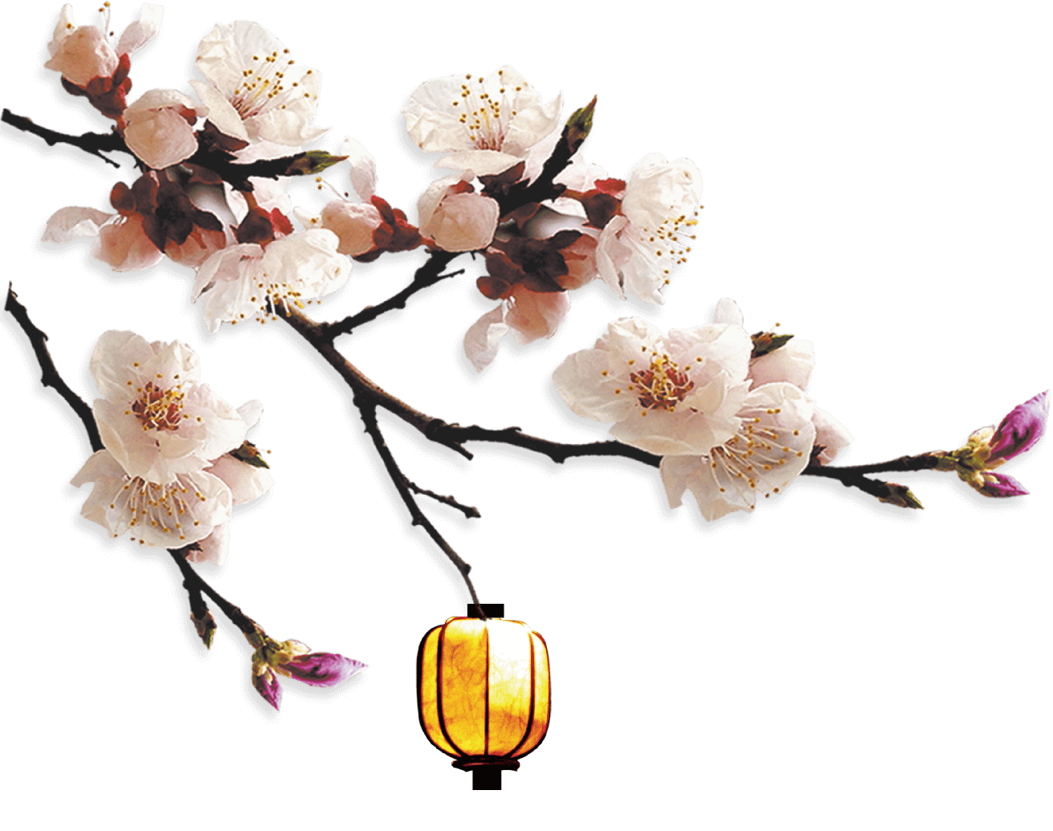
Modern Literature
Ch’ien Chung-shu
21级英语笔译
陈路瑶

Slide 2

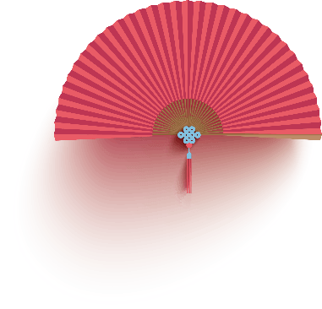
《圍城》
Fortress Besieged
第三章
作品及貢獻
Works and Contributons
第二章
個人簡介
Personal Introduction
第一章
目 录

Slide 3
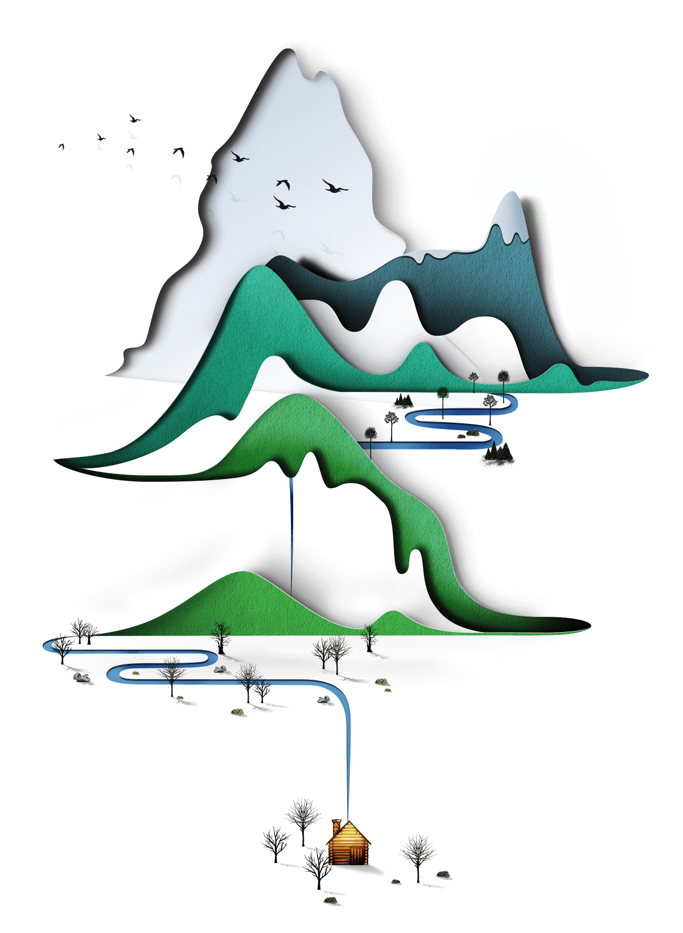
個人簡介
Personal Introduction
第一章
Part One

Slide 4
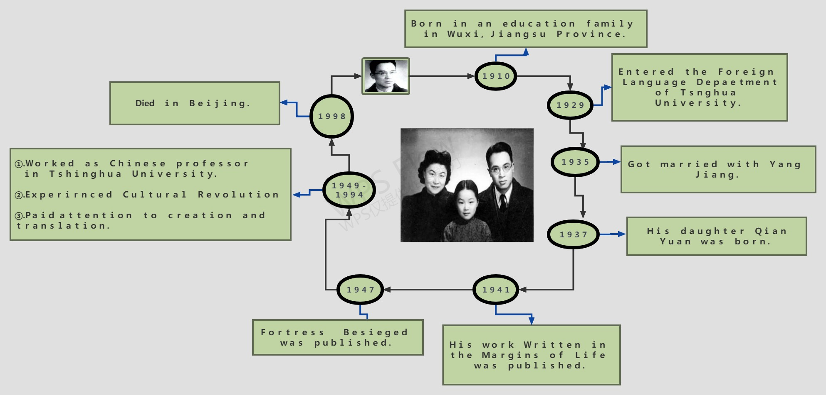
個人简介
Personal Introduction
個人簡介
Personal Introduction

Slide 5
作品及貢獻
Works and Contributons
第二 章
Part Two

Slide 6
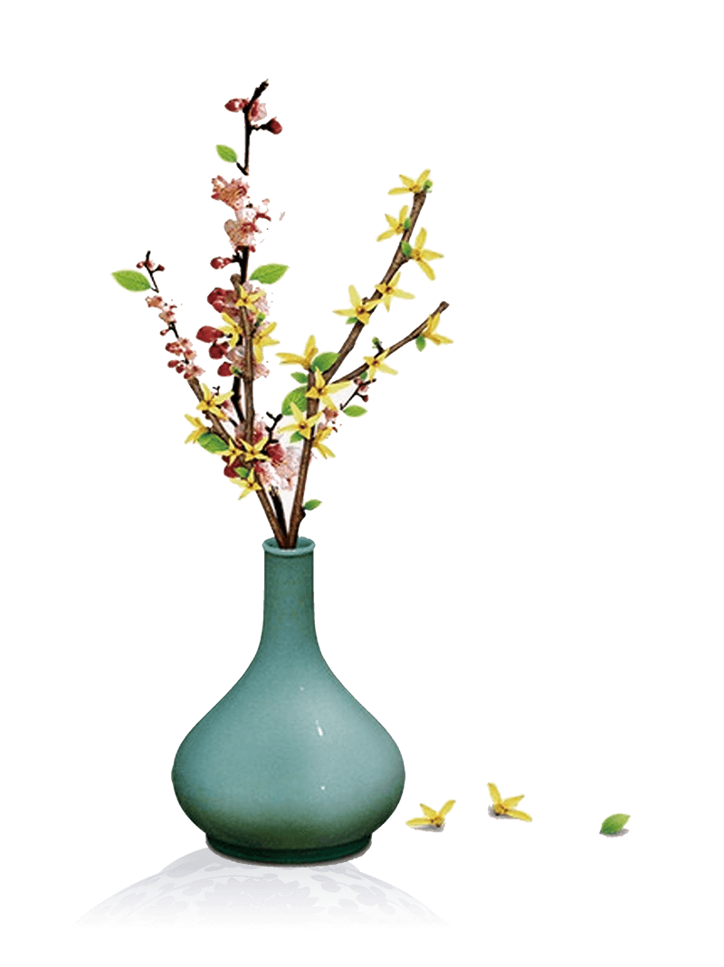
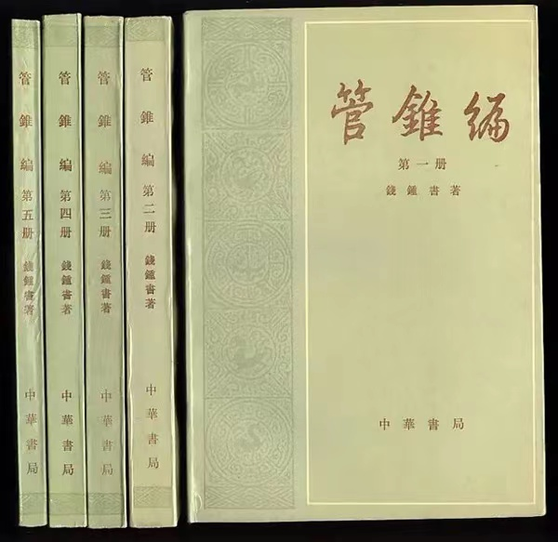
《管锥编》Limited Views
"管锥" comes from《庄子·秋水》: "譬如以管窥天，以锥刺地——所窥者大，所见者小，所刺者巨，所中者少." The book was written in ancient Chinese by Qian Zhongshu from 1960 to 1970. The book is praised as the "classics of Sinology". This book studies poetries and words, meanings and views of the article.It’s an academic work written by Qian Zhongshu with a lot of painstaking efforts, also one of his academic masterpieces.

Slide 7
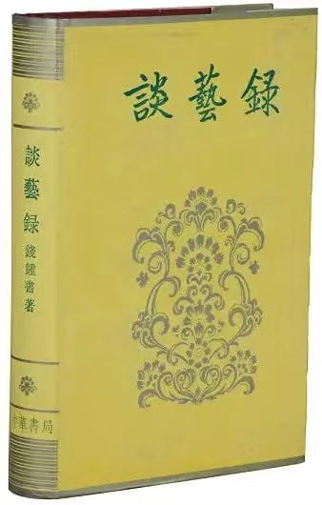
《谈艺录》On the Art of Poetry
On the Art of Poetry is a work about ancient Chinese poetry. It is a collection of Chinese traditional poetry. It takes traditional poetics as its main content, and also involves aesthetics, comparative literature, rhetoric and art theory.

Slide 8
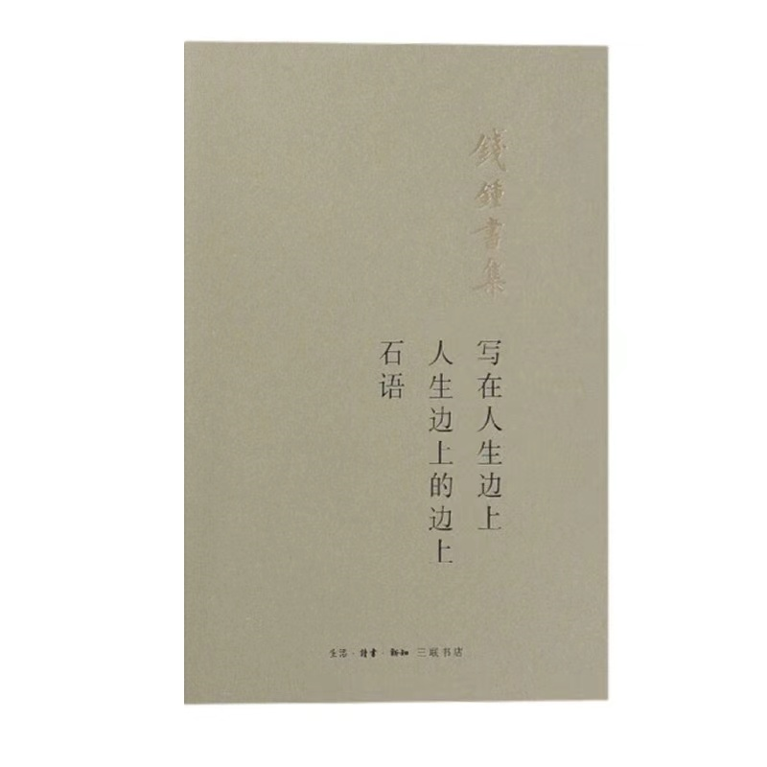
《写在人生边上》Write on the Edge of Life
Write on the Edge of Life is a collection of essays written by Qian Zhongshu, which contains ten essays he wrote before.

Slide 9
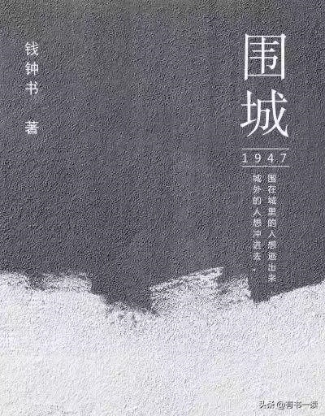
《围城》Fortress Besieged
The book Fortress Besieged is a novel written by Qian Zhongshu, which tells Fang Hongjian's study abroad, work and marriage.The book has been adapted into a TV play.

Slide 10
《圍城》
Fortress Besieged
第三章
Part Three

Slide 11
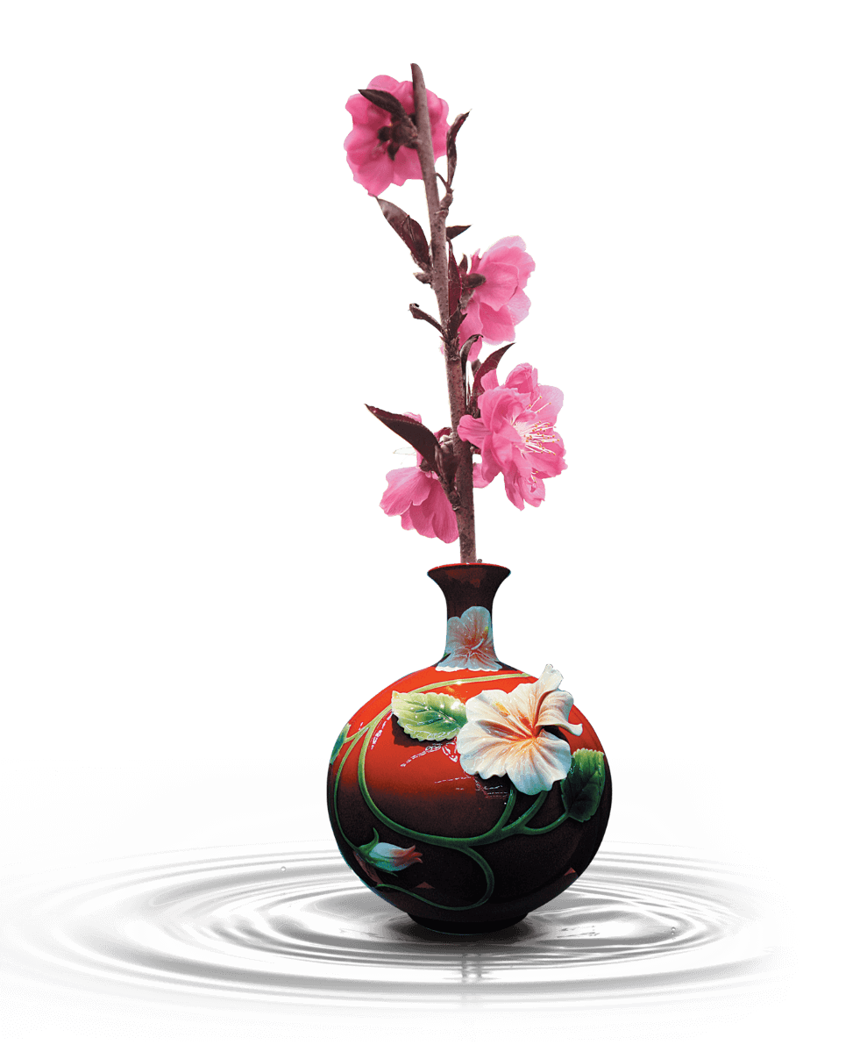
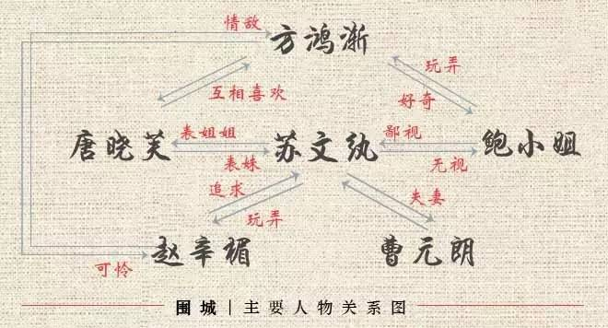
Relationship Between Characters

Slide 12
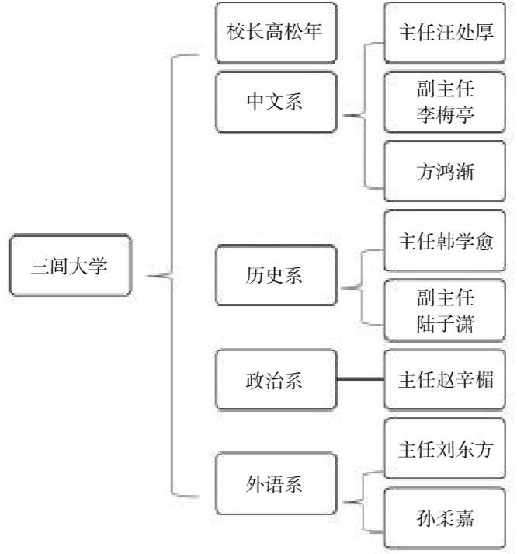
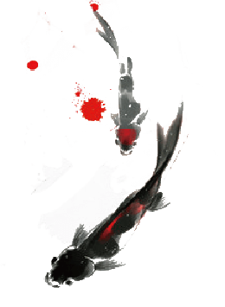
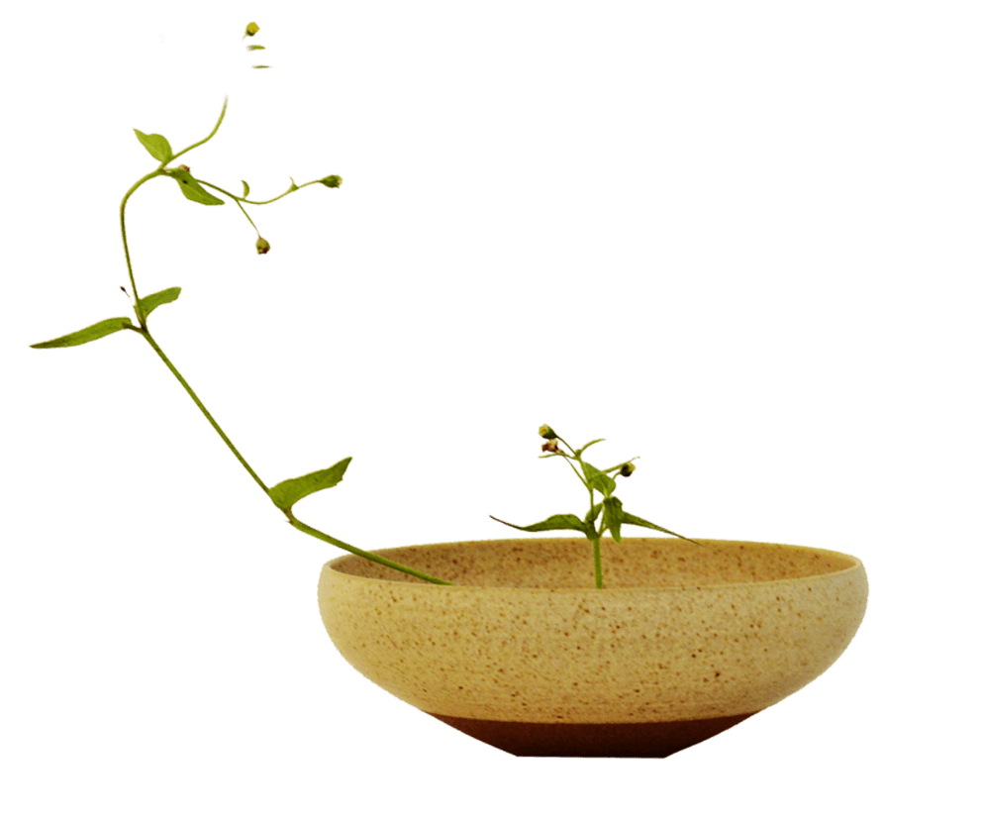
Relationship Between Characters

Slide 13
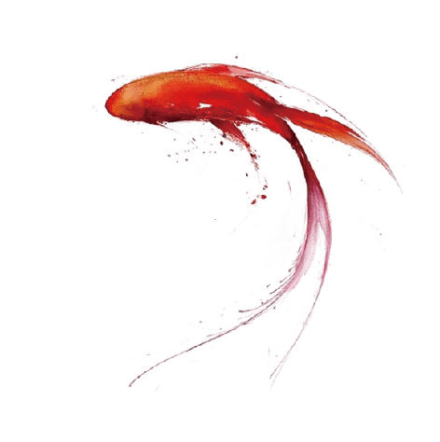
When it comes to the siege, you can only think of the famous sentence in the book: marriage is a siege. If people outside the city want to go in, do people in the city want to come out
When it comes to the book Fortress Besieged , you may remember the most famous sentence in the book: marriage is a fortress besieged. People outside the city want to go in, but people in the city want to come out.
So,is its main idea really about marriage?

Slide 14
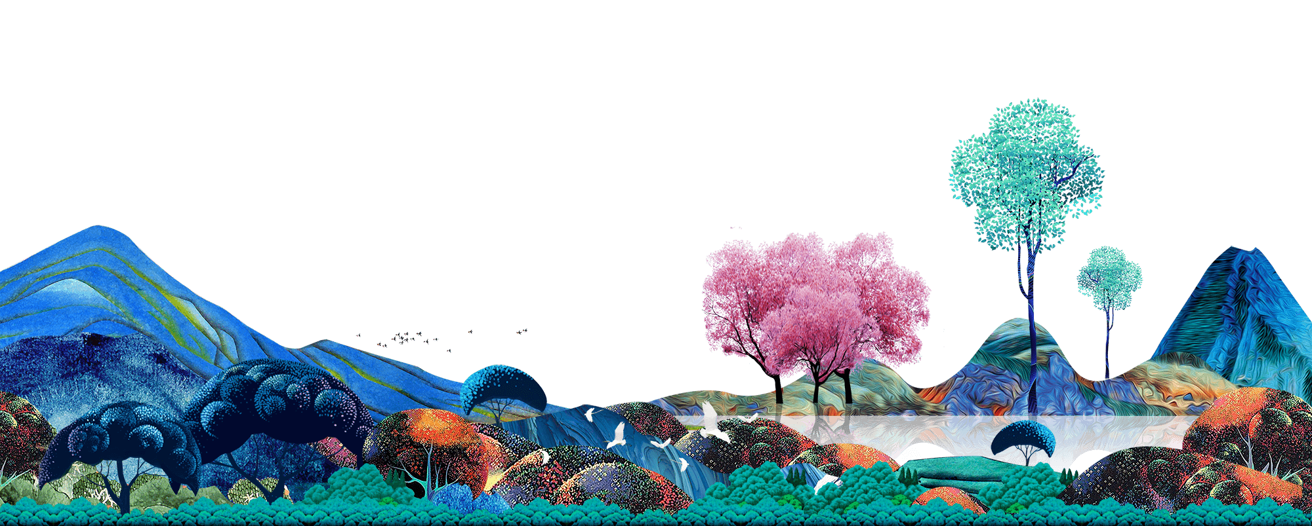
T H A N K S !

