Slide 1

Zhuazhou
汇报人：曾晓辉
汇报时间：2025.05.27

Slide 2

01 Definition
02 Origin and Development
03 Symbolic Meanings of Items and Specific Steps
Contents
04 Social and Cultural Significance

Slide 3


Part 01
The Definition of Zhuazhou

Slide 4







Definition of Zhuazhou
Shi'er (试儿), Shizui (试晬), Qiyang (期扬), orShizhou (试周)
Core ritual in the one-year-old ceremony
Items symbolizing various occupations or aspirations for the baby to grab
Cultural symbolism and blessings for the baby's future destiny

Slide 5
Part 02
The Origin and Development of Zhuazhou

Slide 6

The Origin and Development of Zhuazhou
Three Kindoms Period
Originated
Southern and Northern Dynasties
Shi’er, popular in the Jiangnan Region
Tang and Song dynasties
Shizui, spreading nationwide
Yuan and Ming dynasties
Qiyang, continuing to flourish
Qing Dynasty
Zhuazhou, having persisted to the present day

Slide 7
Part 03
Symbolic Meanings of Items and Specific Steps of the Ceremony

Slide 8
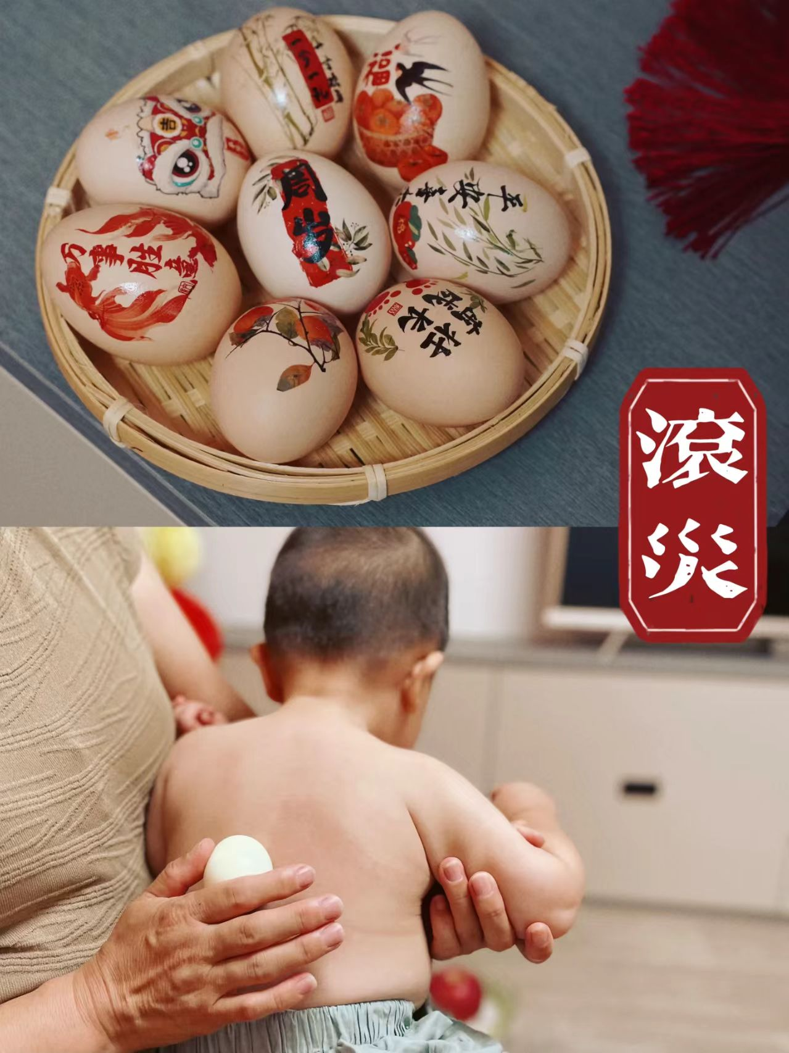
Specific Steps of the Zhuazhou Ritual
Before the Zhuazhou ritual
1.Opening remarks
Offering blessings to the baby.
2.“Rolling away misfortune”
A boiled egg is rolled over the baby’s body to ward off disasters.

Slide 9
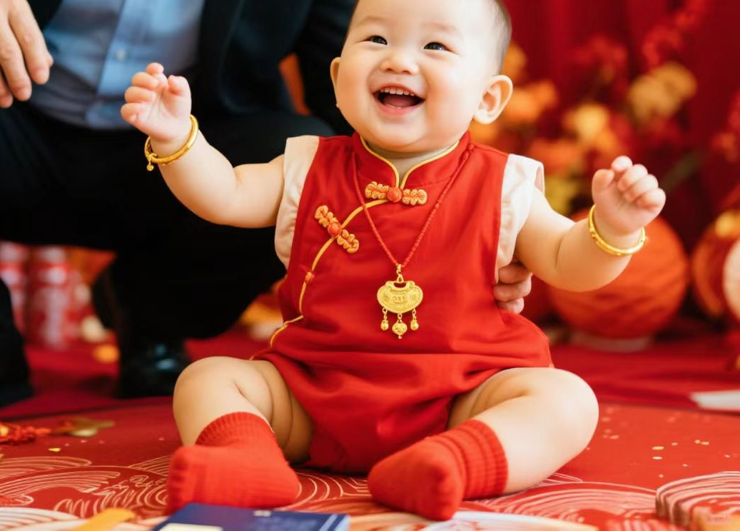
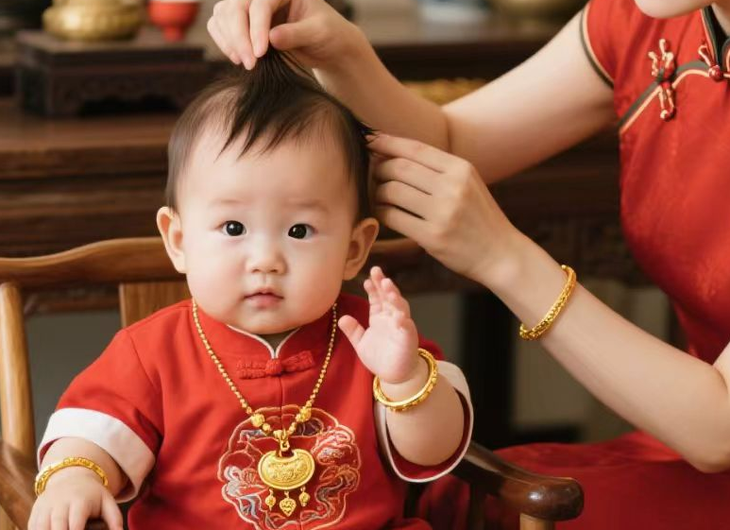
Specific Steps of the Zhuazhou Ritual
Before the Zhuazhou ritual
3.Dressing the baby
New clothes,gold ornaments.
The start of a new life.
4.Hair combing
Combing the baby’s hair.
Wisdom and health

Slide 10
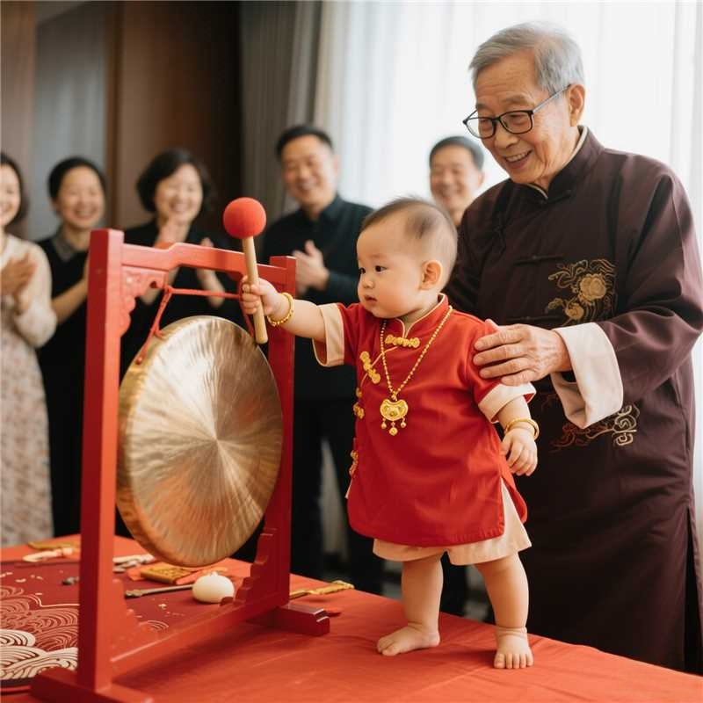
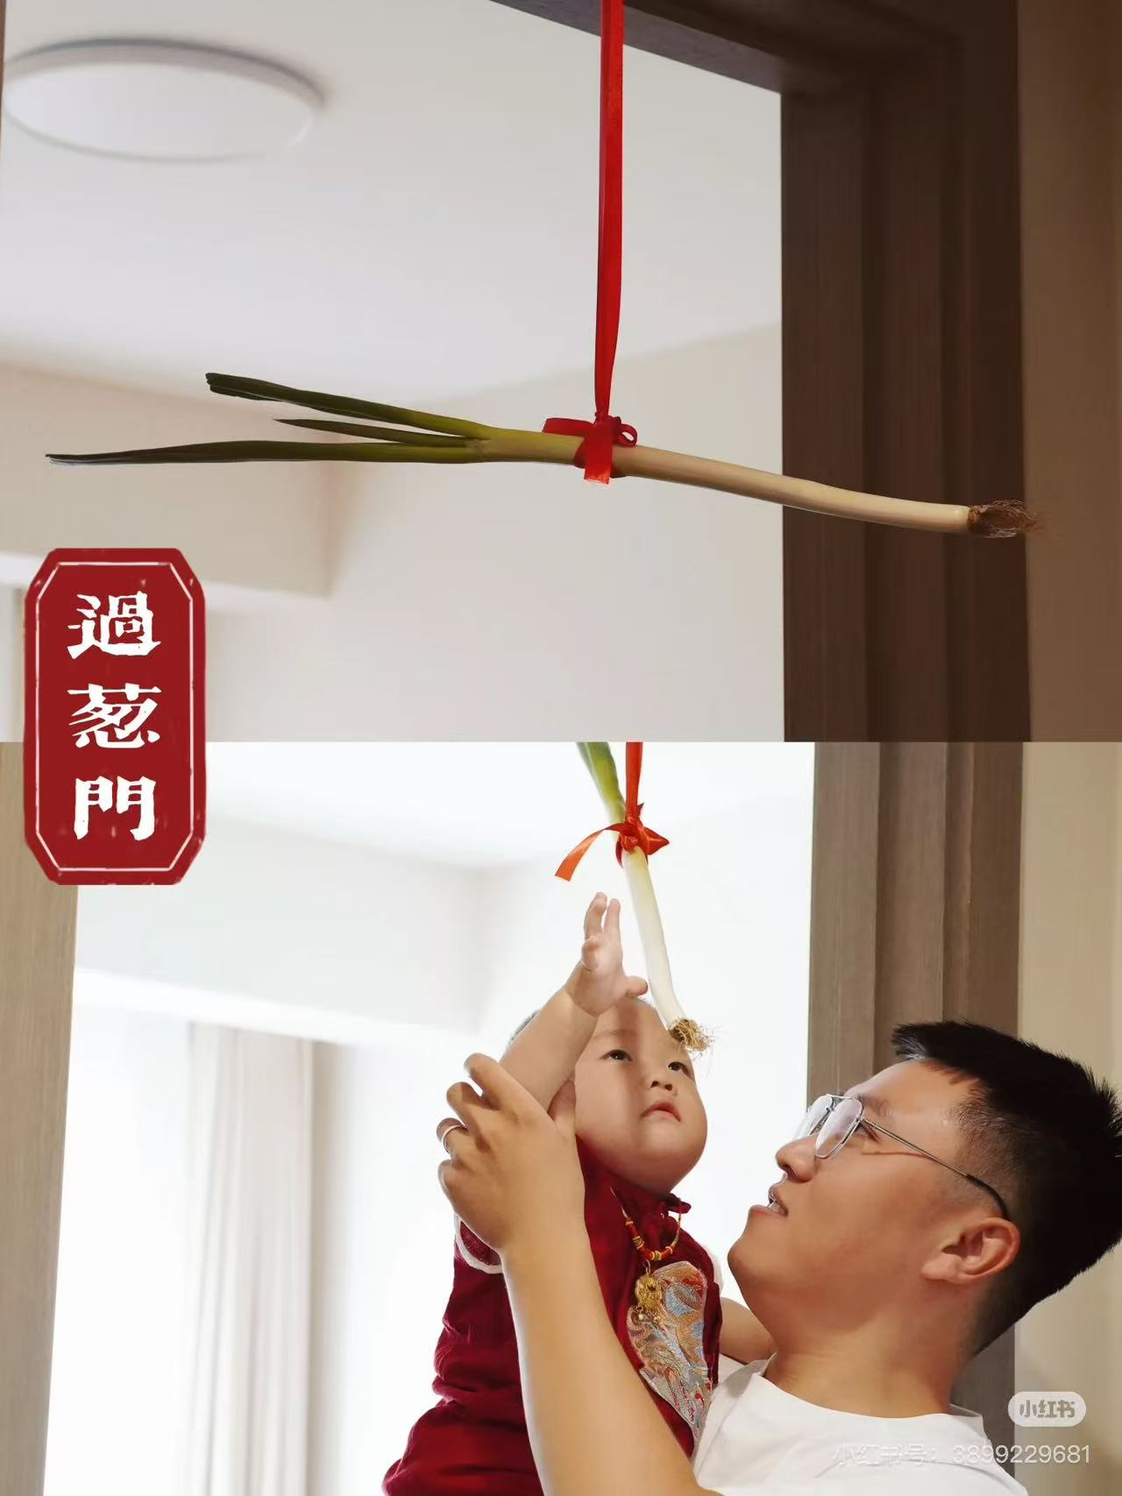
Specific Steps of the Zhuazhou Ritual
Before the Zhuazhou ritual
5.Striking the Gong to Awaken Wisdom
Striking the gong.
The beginning of intellectual growth.
6.Passing through the scallion door
Passing through a door hung with a scallion.
Cleverness.葱门→聪明clever

Slide 11
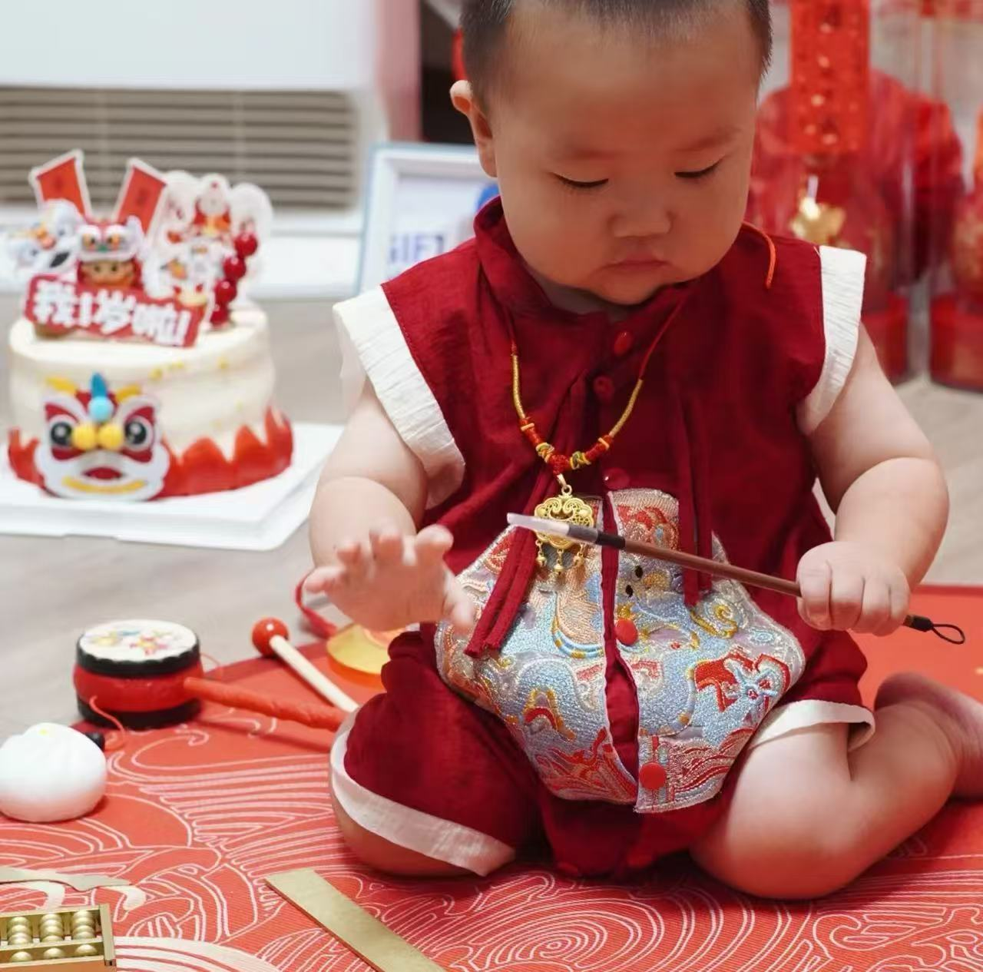
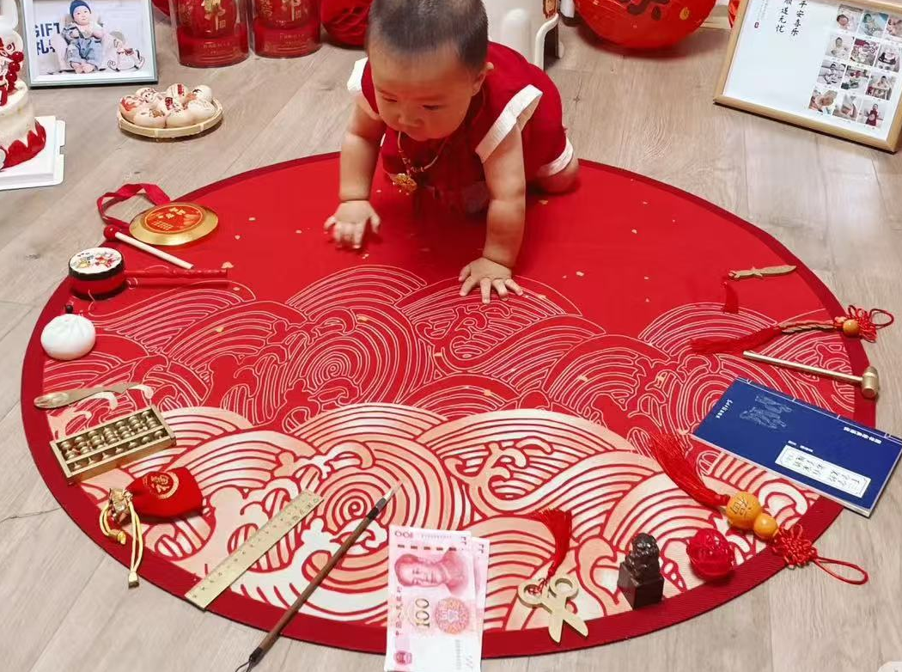
Specific Steps of the Zhuazhou Ritual
7.Zhuazhou ritual
Allowing the baby to grab the items placed before them.
The object the baby interacts with the longest is viewed as an indicator of the baby’s future personality and occupational inclination.

Slide 12
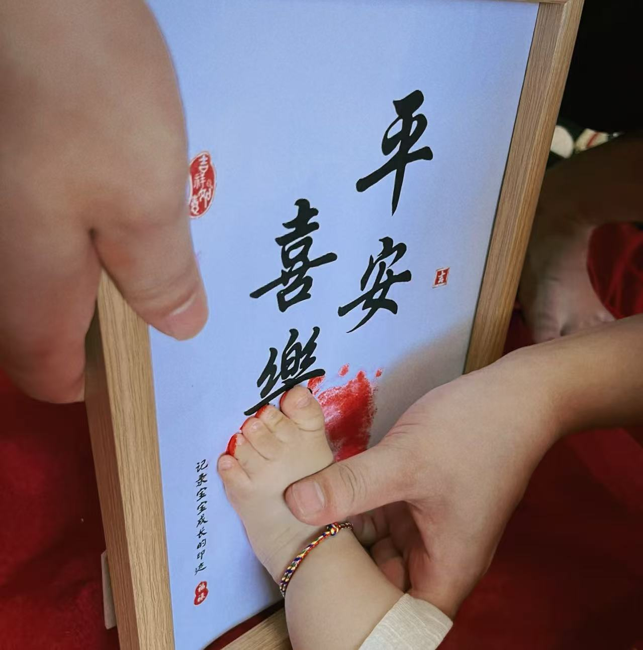
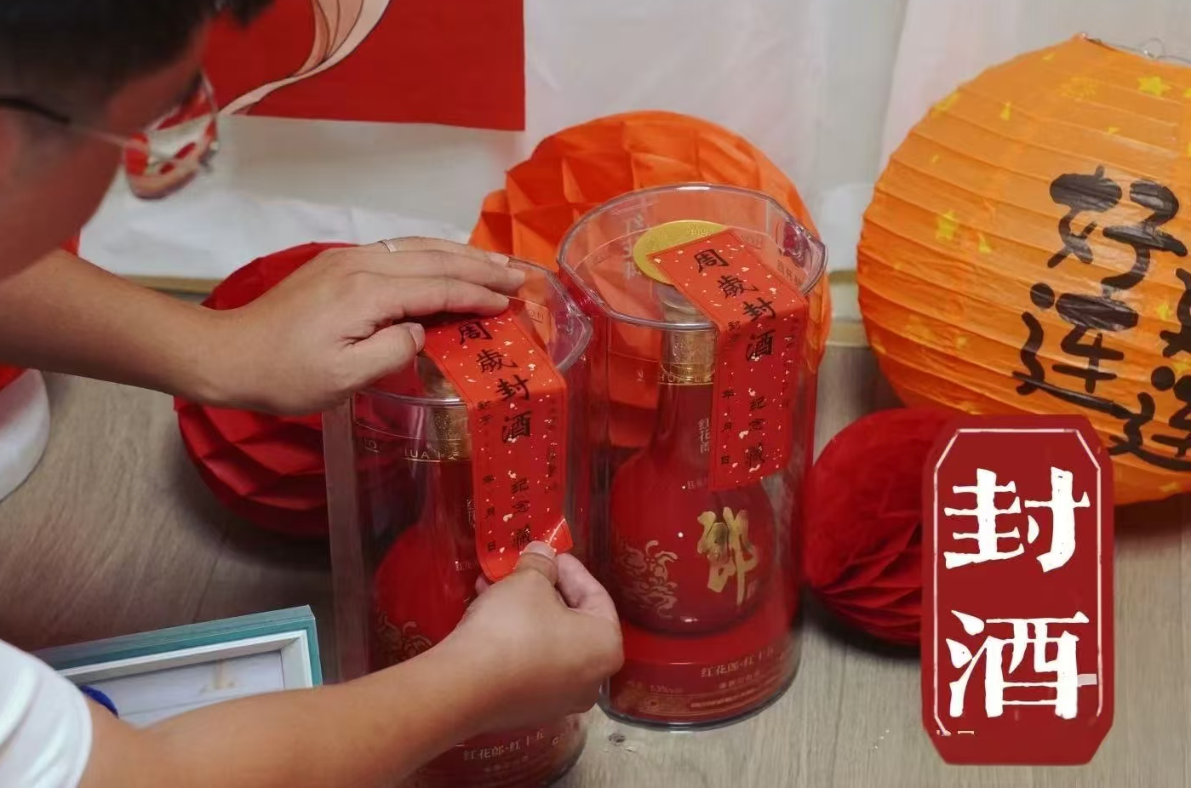
Specific Steps of the Zhuazhou Ritual
After the Zhuazhou ritual
8.Footprints stamping
Footprints captured in a frame.
A memento of growth.
9.Sealing wine
For future important moments.
Longevity and happiness.

Slide 13
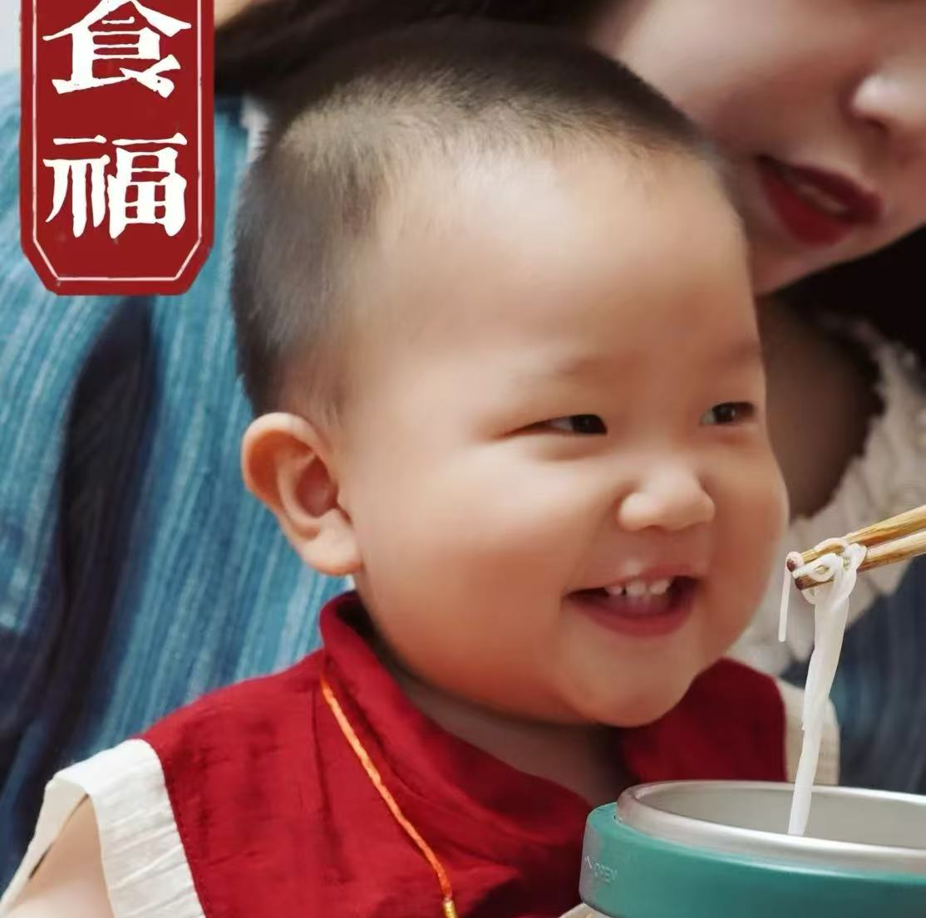
Specific Steps of the Zhuazhou Ritual
After the Zhuazhou ritual
10.Eating blessings
The parent feeds the baby noodles, wishing them a healthy and long life.

Slide 14
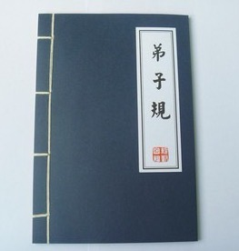
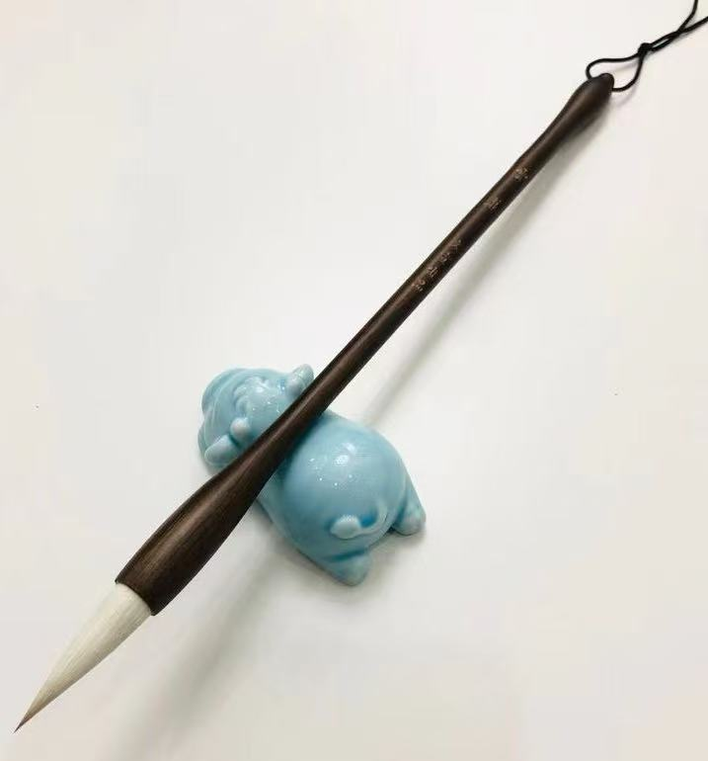
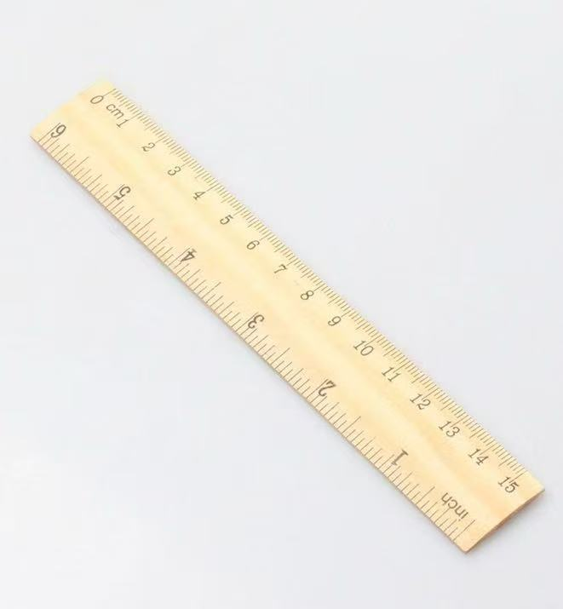
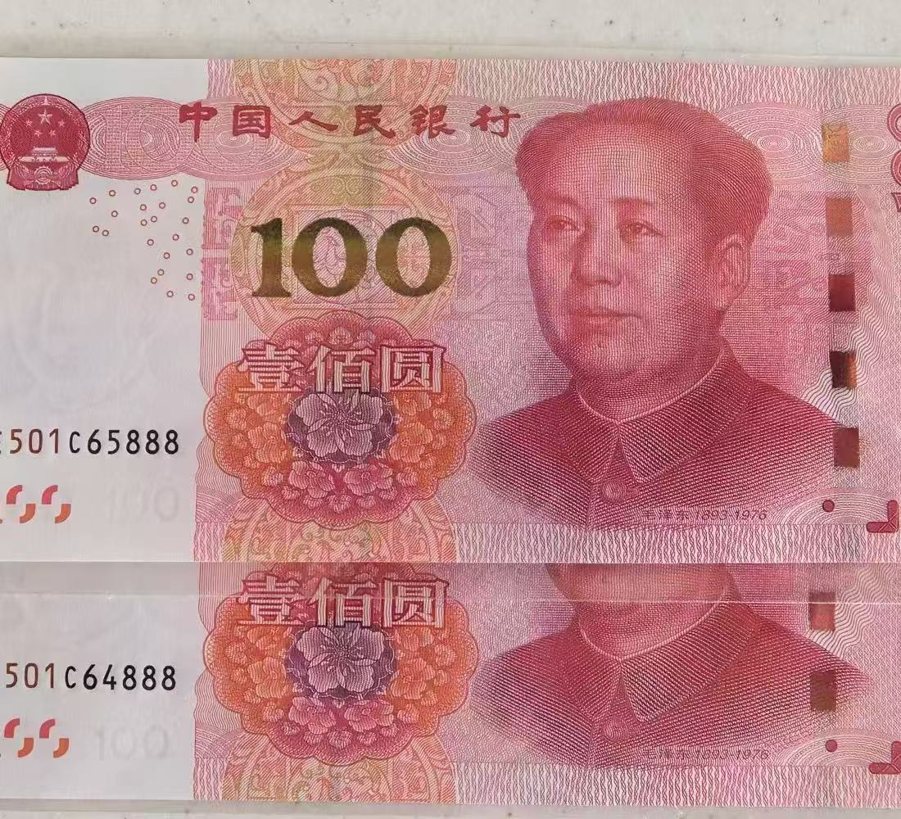
Symbolic Meanings of Items
Writing brushes
✿
Books
✿
✿
Rulers
✿
Cash
Academic achievement
Literary and artistic talent
Careers in law design, or engineering
Wealth

Slide 15
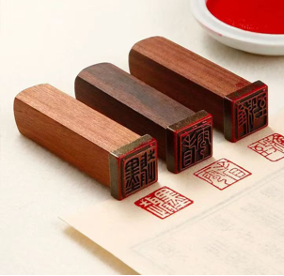
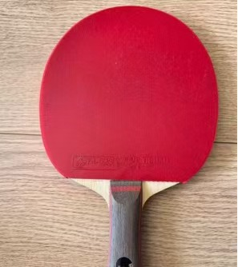
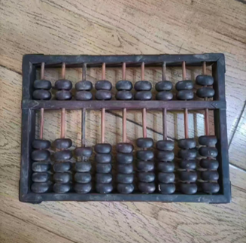
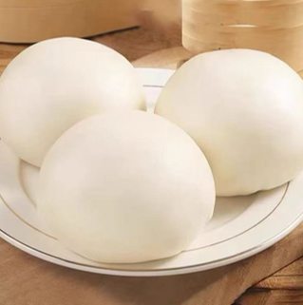
Symbolic Meanings of Items
Sports Equipment
✿
Seals
✿
✿
Abacus
✿
Steamed bun
Authority and status
Athletic talent
Business acumen
No worries about food and clothing

Slide 16
Part 04
Social and Cultural Significance

Slide 17





Social and Cultural Significance
1.Parents’expectations for their baby’s future.
The family's wishes for the new generation to carry forward the family legacy and drive its future growth.
2.The initial formation of cultural identity and the start of educational enlightenment.
3.A celebration of a milestone and an embodiment of family, educational, and social values within Chinese culture.
4.Connecting the past and the future, the individual and society, showing the profound heritage of Chinese culture and its boundless care for future generations.

Slide 18

Thank you!

