Slide 1



Chinese Bossy Fictions and Micro-drama
姚可欣

Slide 2
1
Origins
2
Rise of Microdramas
3
Reasons for Popularity
4
Future Trends and Impact

Slide 3
01 Origins

Slide 4

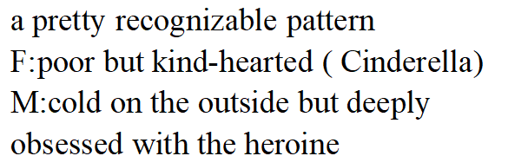
boss fictions

Slide 5
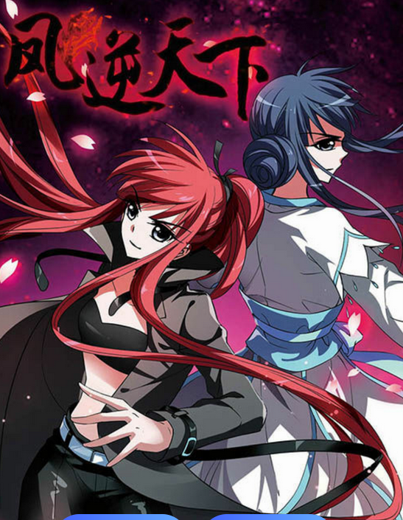
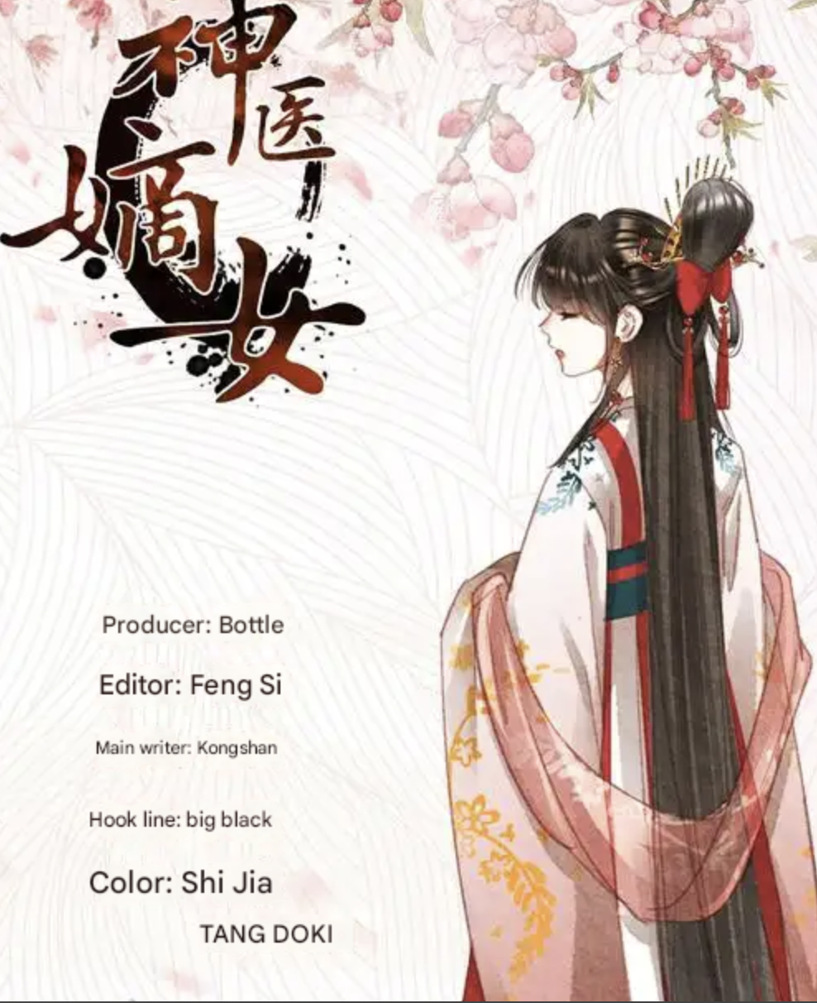
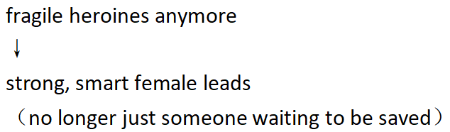
Powerful divine bird
noble female

Slide 6
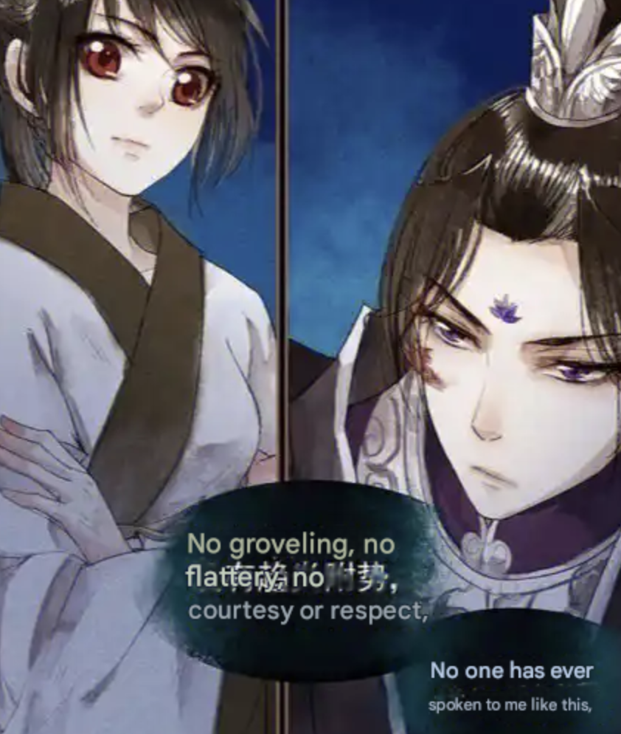
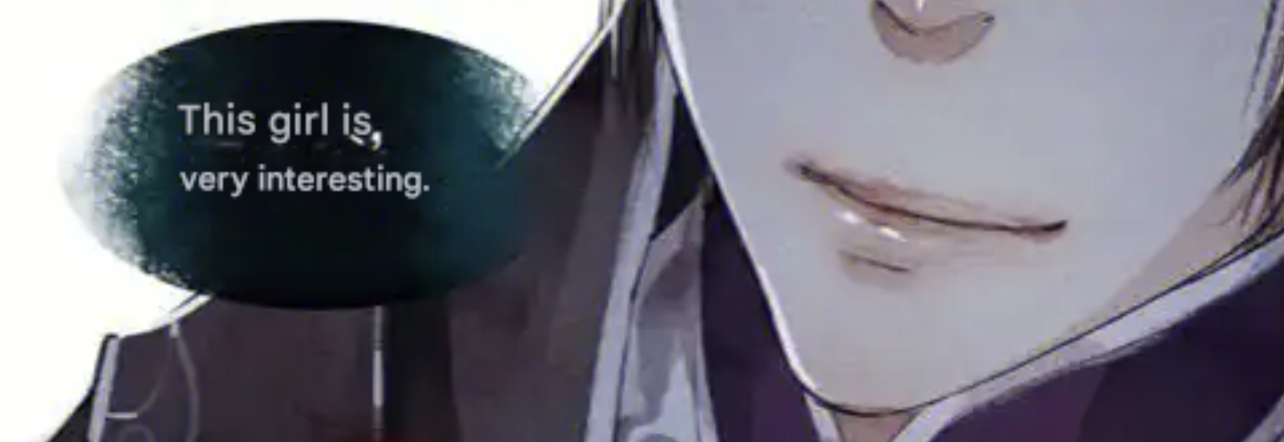

Still, some things never change.

Slide 7
Still, some things had not changed.
the lofty status
That tone of superiority—the bossy charm—is still a major part of the fantasy
a gaze of the high-ranking towards the subordinate

Slide 8

02 Rise of Microdramas

Slide 9
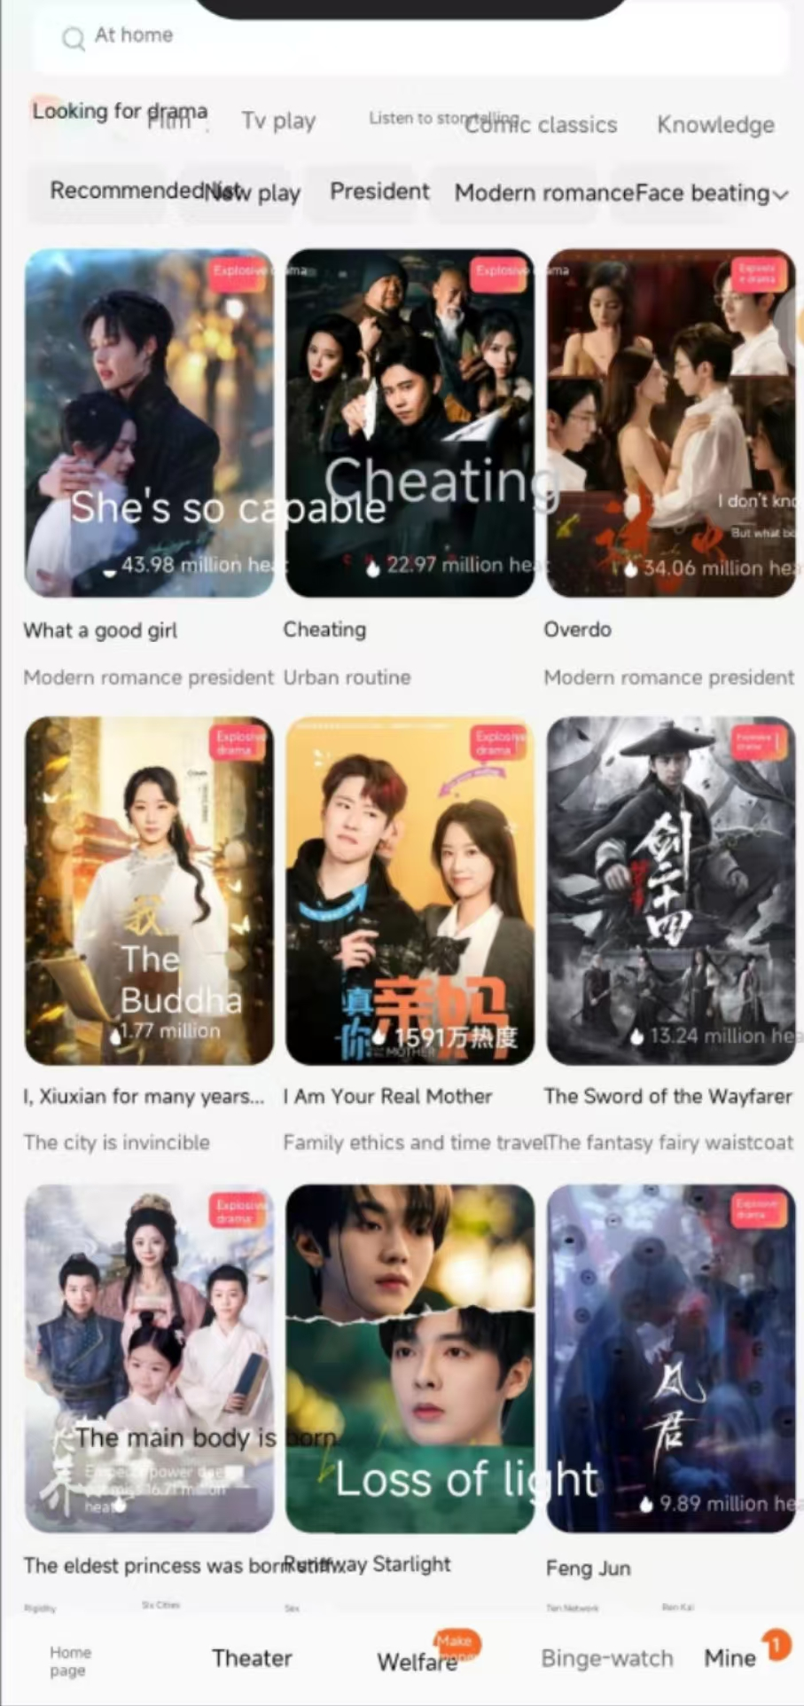
点击此处输入您的标题
Now, let’s fast forward to recent years.
These boss stories have found a new home in ultra-short videos called micro-dramas.
What’s a micro-drama?
They’re quick, punchy episodes—each one under 5 minutes.
And they’re everywhere, especially on platforms like Douyin, Kuaishou, and ReelShort.
请输入标题
在这里输入内本在这里输入内容文本在这里输入内容

Slide 10

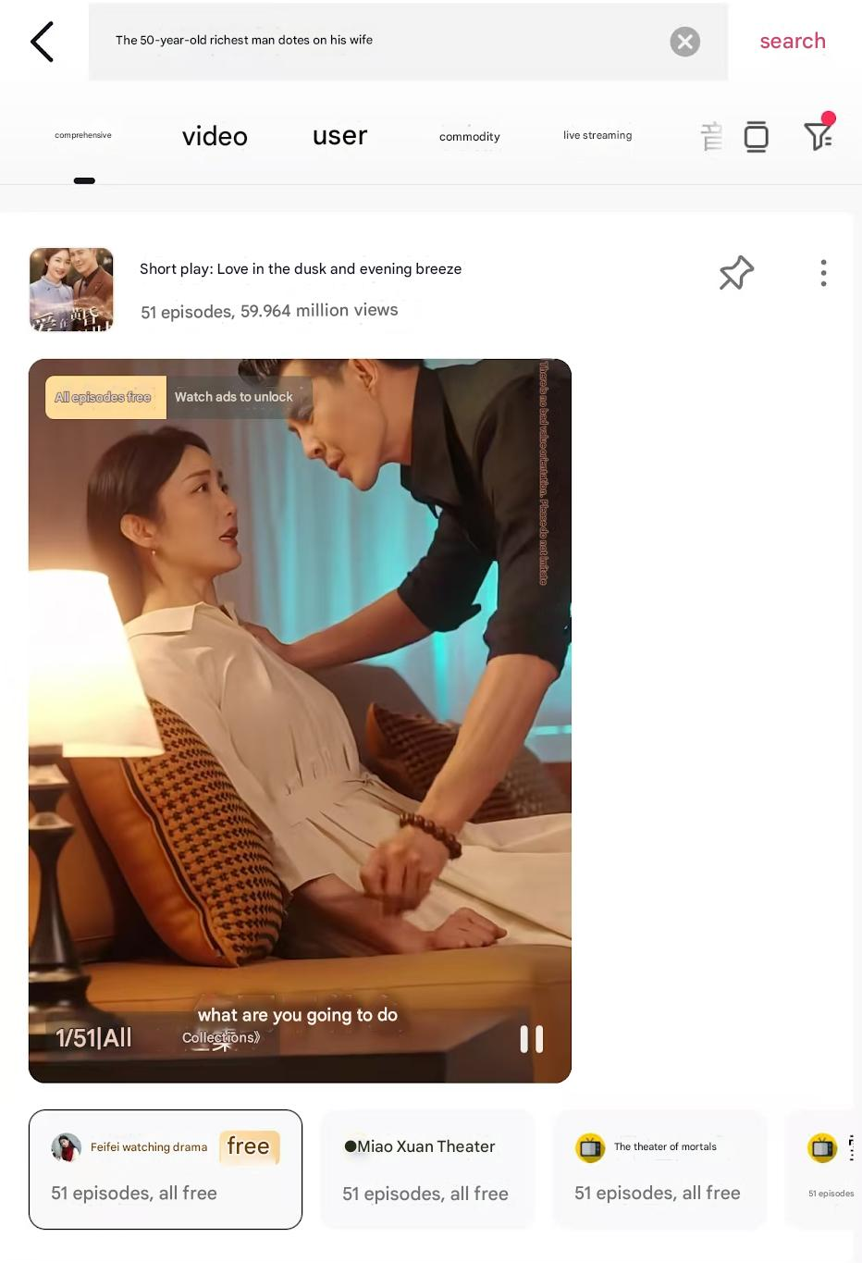
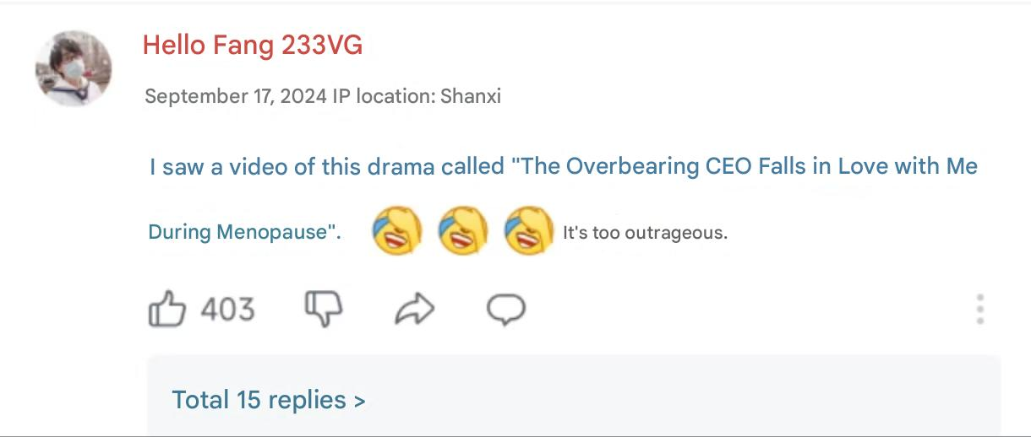
One example is The 50-Year-Old Billionaire Loves Me, which has nearly 60 million views.
请输入标题
在这里输入内本在这里输入内容文本在这里输入内容
not typical young people

Slide 11

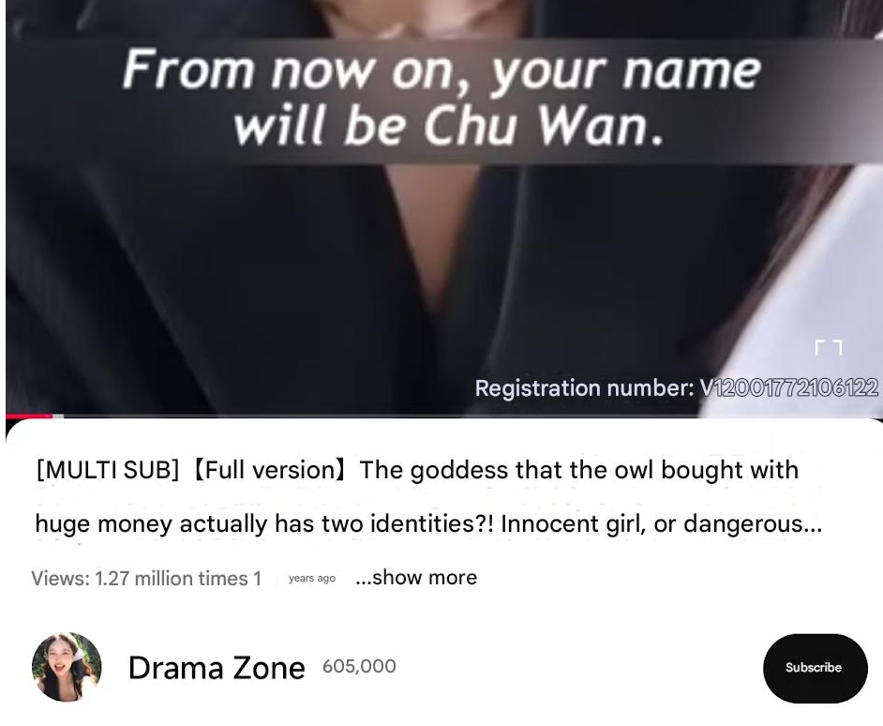
question :
Why do you think these kinds of dramas are getting popular overseas?
scan the QR code
请输入标题
在这里输入内本在这里输入内容文本在这里输入内容

Slide 12
03 Reasons for Popularity

Slide 13
Let’s break down why this and similar shows are going global:
1. Smart localization
2. Universal emotional fantasy
3. High drama, low time investment
4. Simple but intense characters
5. Fast-paced, addictive storytelling
在这里加文本内容在这里添加文本内容

Slide 14
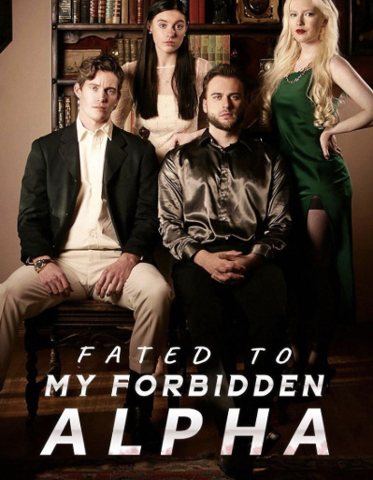
Fated to My Forbidden Alphad
在这里加文本内容在这里添加文本内容
vampires and werewolves

Slide 15
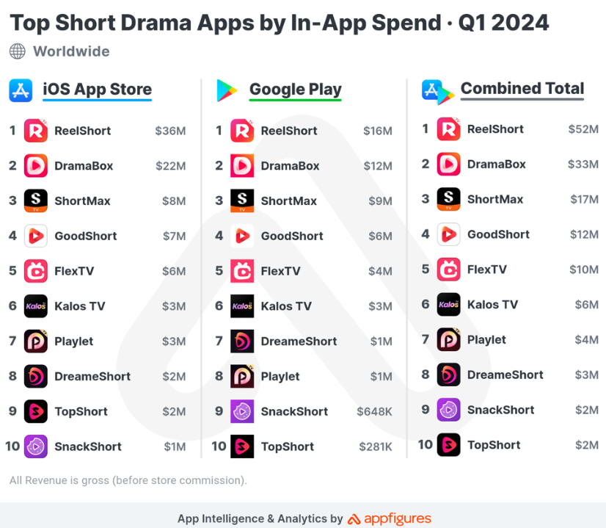
Realshot even beat Netflix and Disney+ on the U.S. App Store in 2024!
在这里加文本内容在这里添加文本内容

Slide 16
“This is so ridiculous. I love it.”
“I watched the whole season in one night. Help.”
“My boyfriend laughs at me for watching this. But I can’t stop.”
在这里加文本内容在这里添加文本内容
“Shuangju”
TIME
“soapy, dramatic, low-budget—but dangerously bingeable.”

Slide 17
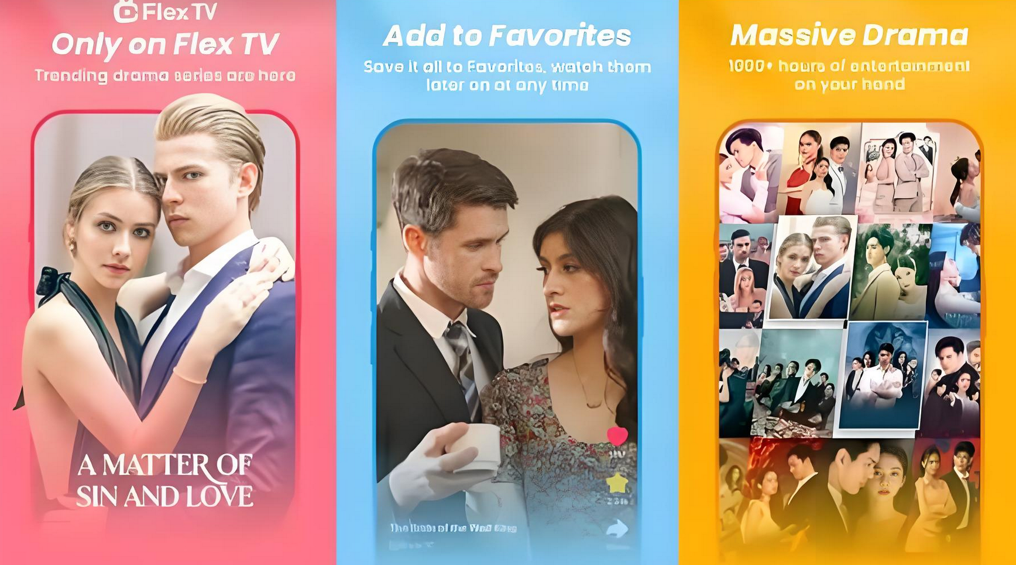
Criticism & Weaknesses
Some common criticisms:
.Too materialistic
.Female characters are too weak or stereotypically feminine
.The plotlines can feel repetitive
0.5 秒延迟符，无
意义，可删除.

Slide 18
04 Future Trends

Slide 19

Future Trends
So, where is this genre going?
We’re seeing more creativity and even self-awareness in newer shows.
a nanny character constantly breaks the fourth wall, roasting the ridiculous love triangles happening around her.
“Again? Another secret child? Another evil twin?”
0.5 秒延迟符，无
意义，可删除.

Slide 20

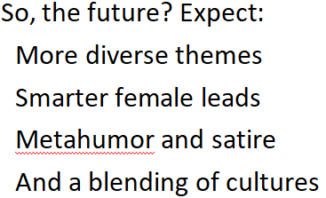
Future Trends
So, next time don’t laugh too quickly.
If you had to write a global boss drama, what twist would you add to make it fresh?
0.5 秒延迟符，无
意义，可删除.

Slide 21
THANK YOU

