Slide 1




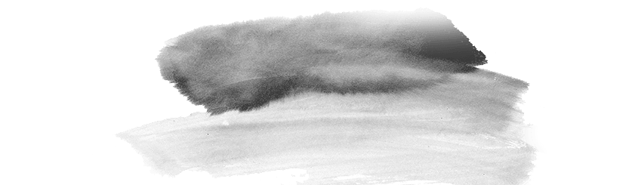
Daoism

Slide 2
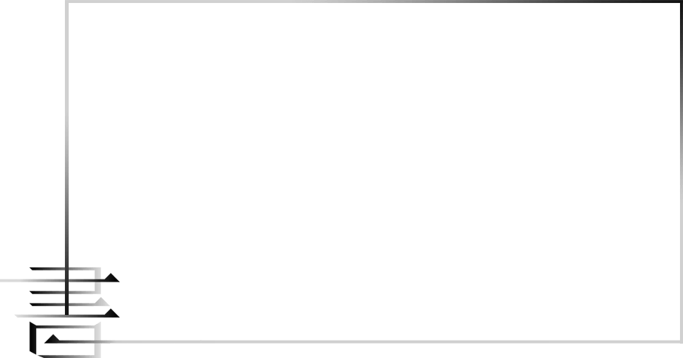
DAOISM
至人无己，神人无功，圣人无名。
——《逍遥游》

Slide 3

part 1 summery of this passage

Slide 4
壹
Daoism is attributed to the Chinese philosopher Lao Zi (Lao Tze) and Zhuang Zi.
贰
Daoists believe in immortality.
叁
Daoism was also associated with alchemy, which was at one time a practical way of seeking the elixir of life by the transmutation of base matter into gold.
肆
Daoism has valued freedom from time, from care and from entanglement with bureaucracies and power.

Slide 5
伍
Daoism has a god for almost everything
陆
Daoism has a great many classics.

Slide 6

贰
God

Slide 7
“可以外生死、极虚静、超脱自在、不为物累”
Daoism has valued freedom from time, from care and from entanglement with bureaucracies and power.

Slide 8
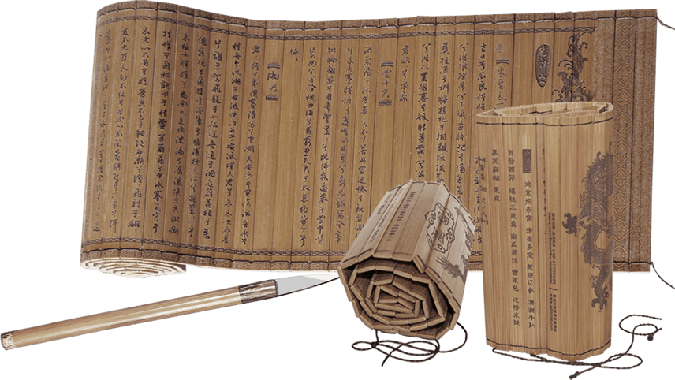
taoist system are different from those in Western Greek mythology. Taoist immortals usually possess excellent spiritual qualities because only those who have made significant contributions to the people will be revered as immortals after death. Furthermore, immortals have a guiding and constraining role in educating people.

Slide 9
俗信称官赐福，地官赦罪，水官解厄。
Heavenly God blesses the people,
Earth God pardons the people and
Water God dispels disasters.

Slide 10
壹
天官是授福禄的神人，每逢正月十五，即下人间，校定人之罪福，故称“天官赐福”。
The Heavenly God bestows blessings and fortunes upon humanity, descending to earth every fifteenth day of the first lunar month to assess the sins and blessings of individuals
地官大帝每逢七月十五日，即来人间，为狱囚受苦的人赦罪。
The Earth God Emperor comes to earth every fifteenth day of the seventh lunar month to pardon the sins of those suffering in prison.
贰
叁
水官每逢农历十月十五日，即来人间，为人消灾减厄、解冤释结。
The Water God appears on the fifteenth day of the tenth lunar month to alleviate disasters, reduce hardships, and resolve grievances for people.

Slide 11
壹
“三官鼓笔”其职责与功用演变为
贰
“三官考召”
叁
“三官书过”
肆
“三官不录”
“考核善恶，司人功过，鼓笔簿录，列言上天。”
"assessing good and evil, presiding over human actions, recording with writing brushes, reporting to heaven".

Slide 12
叁
“Wuwei ”and“Youwei” (action)

Slide 13
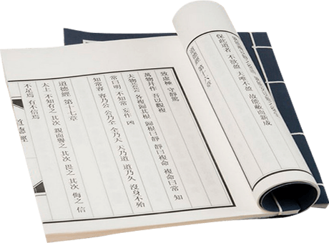
第2章
“圣人处无为之事，行不言之教”
"The sage practices non-action and teaches without words"
第3章
“为无为，则无不治”
"Those who practice non-action can handle everything,"
第37章
“道常无为而无不为”
"The Dao always practices non-action and yet everything is accomplished,"
第48章
“无为而无不为”
"Non-action leads to accomplishing everything,"
教
化

Slide 14
Therefore, it can be understood that while the central theme of Daoist thought is based on individual self-cultivation, the ultimate goal is to elevate the moral standards of society through the self-discipline of believers. The "wu wei" in this context can be seen as a significant "wei" (action) in the human world.

Slide 15
肆
significance

Slide 16
Is it truly necessary to become a reclusive immortal in order to "achieve the way"?
Or is it more meaningful to embrace the philosophy of "my destiny is shaped by my own hands, not by the god"?

Slide 17
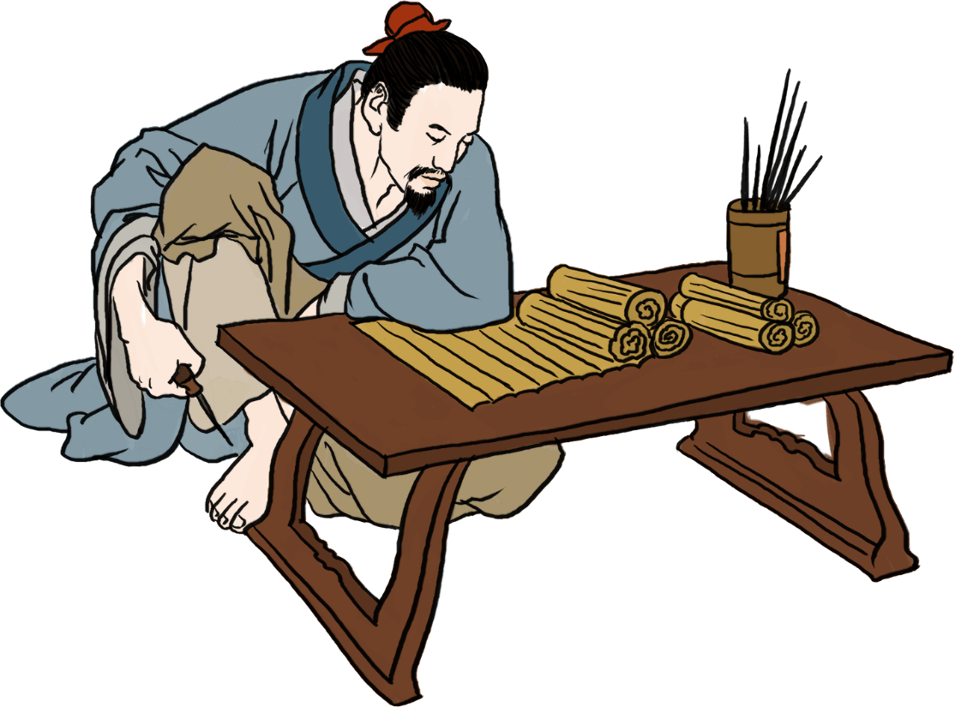
“甘其食，美其服，安其居，乐其俗”
enjoy their food, dress beautifully, live in peace, and take pleasure in their daily life," .

Slide 18
True faith is not limited to religions or deities, but allows individuals to discover their inner truth and continuously enhance their understanding of the principles of truth, goodness, and beauty. Therefore, if you wish to believe in a religion, any religion will welcome you. In the context of Daoism, even if you do not adhere to a religion, you are still within the natural order, and by aligning your actions with the laws of nature, you are embodying "wuwei." As this article states, wuwei means not so much inactivity as doing nothing out of harmony with the flow of things.

Slide 19
thank you

