Slide 1
Chinese Ancient Mythology
speaker：胡煜杰

Slide 2
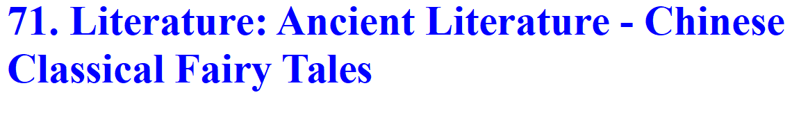
Jingwei Tries to Fill the Sea 精卫填海 The Great Flood of Gun-Yu 大禹治水 The Legendary of Nian 年的传说
the title of my text
the contents of my text
fairy tales? mythologies?

Slide 3
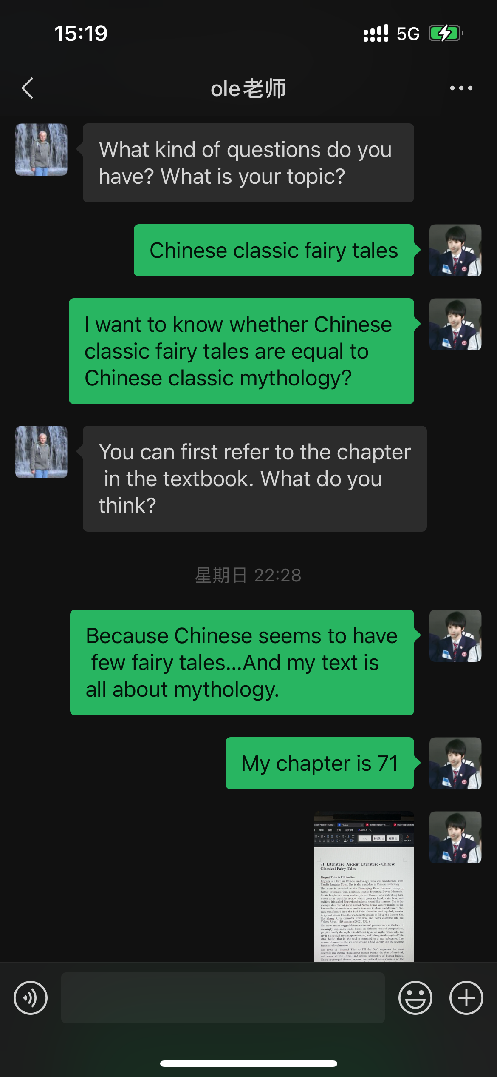
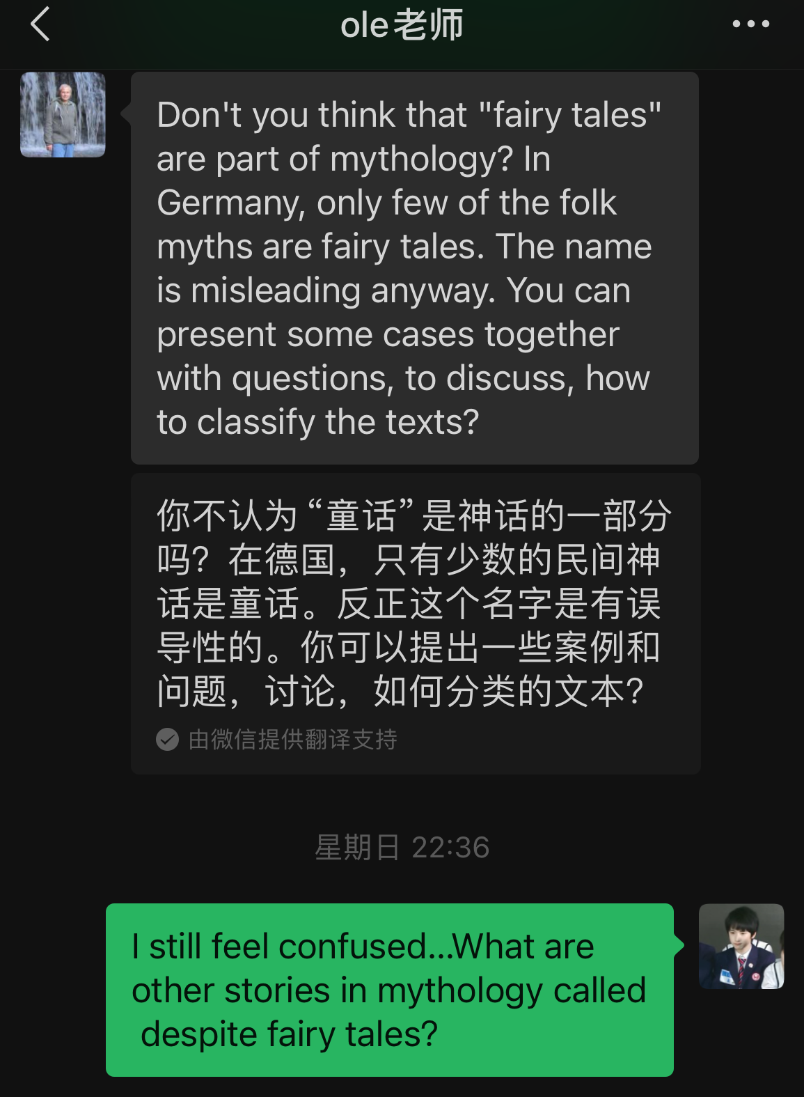
fairy tale
folk tale
...
in German:mythology
mythology
fairy tale
novel
...
in China:literary genre

Slide 4
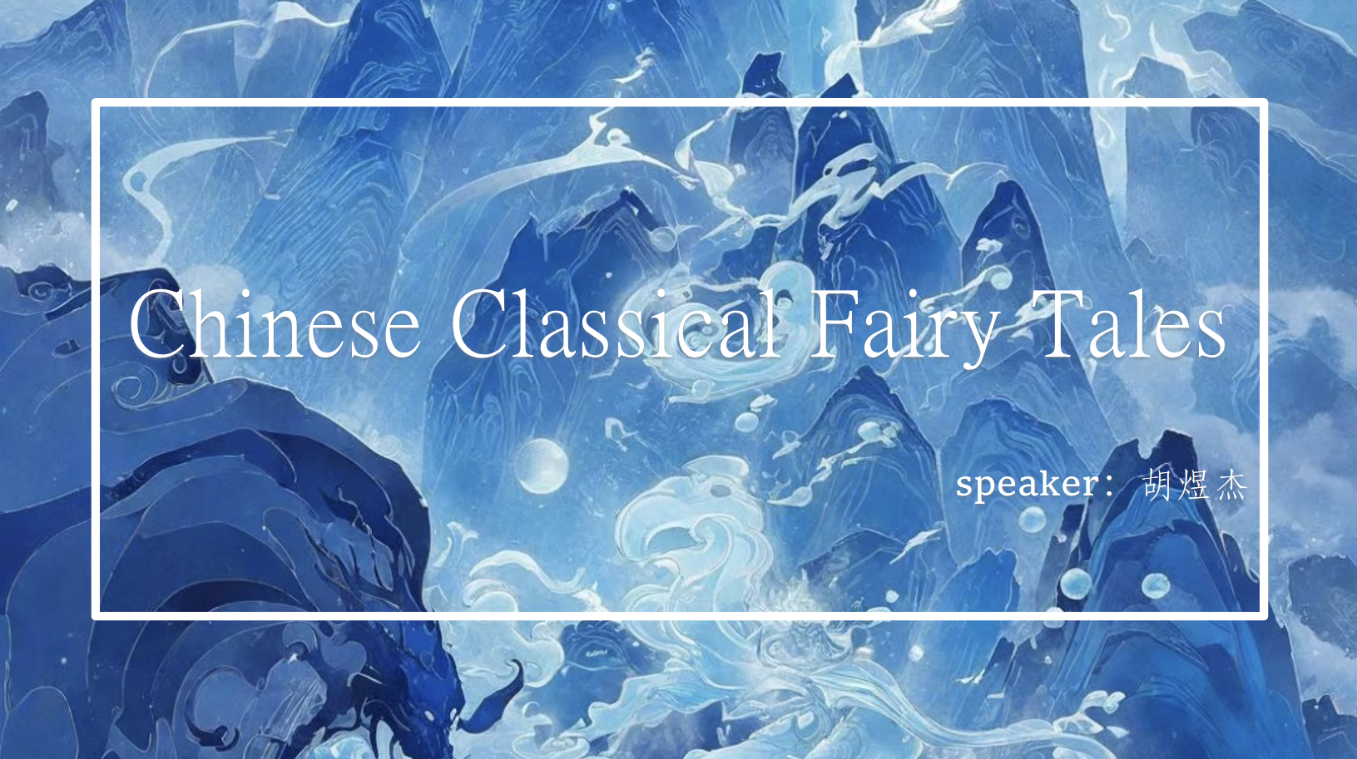
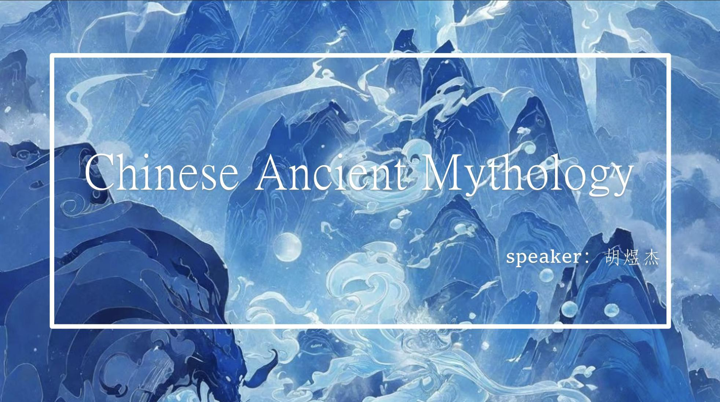

Slide 5
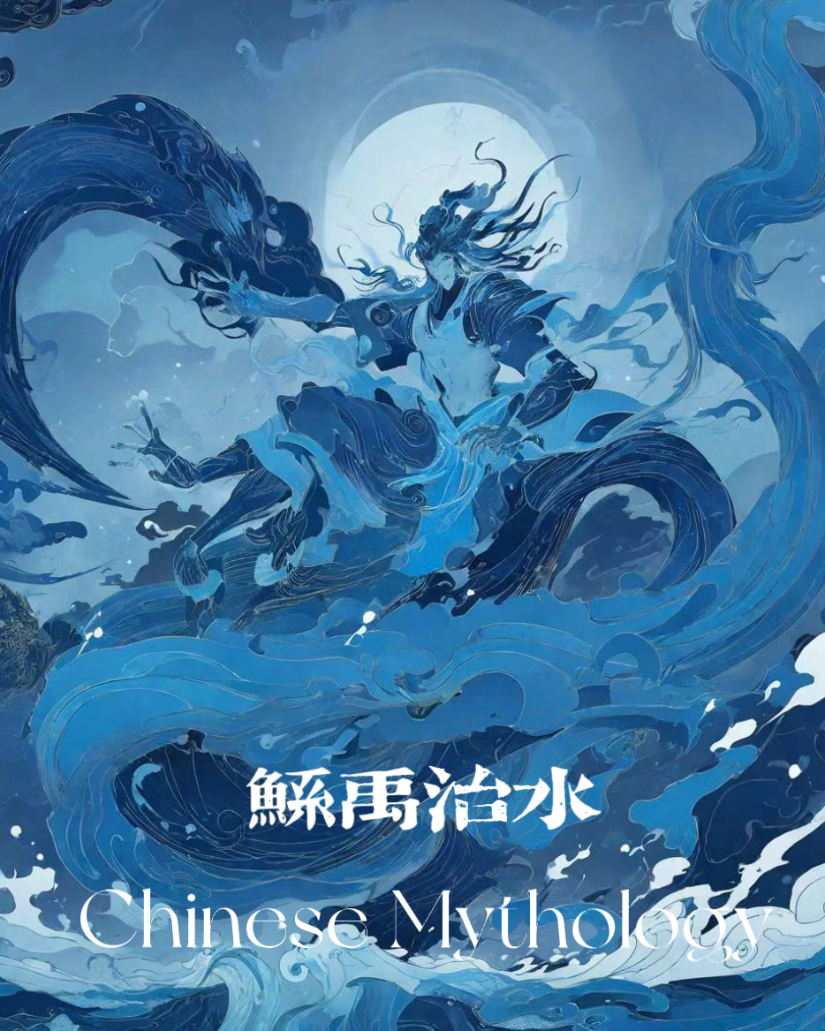
As Gorky put it, "Generally speaking, myth is a reflection of natural phenomena, of the struggle against nature, and of social life in a broad artistic generalization." 恰如高尔基所言:“一般说来，神话乃是自然现象，对自然的斗争，以及社会生活在广大的艺术概括中的反映。”
What is mythology?

Slide 6
three questions
1.Why would ancient Chinese create mythologies?
2.What are the differences between Chinese mythology and other nations’mythology?
3.What impact do these stories have on later generations?

Slide 7
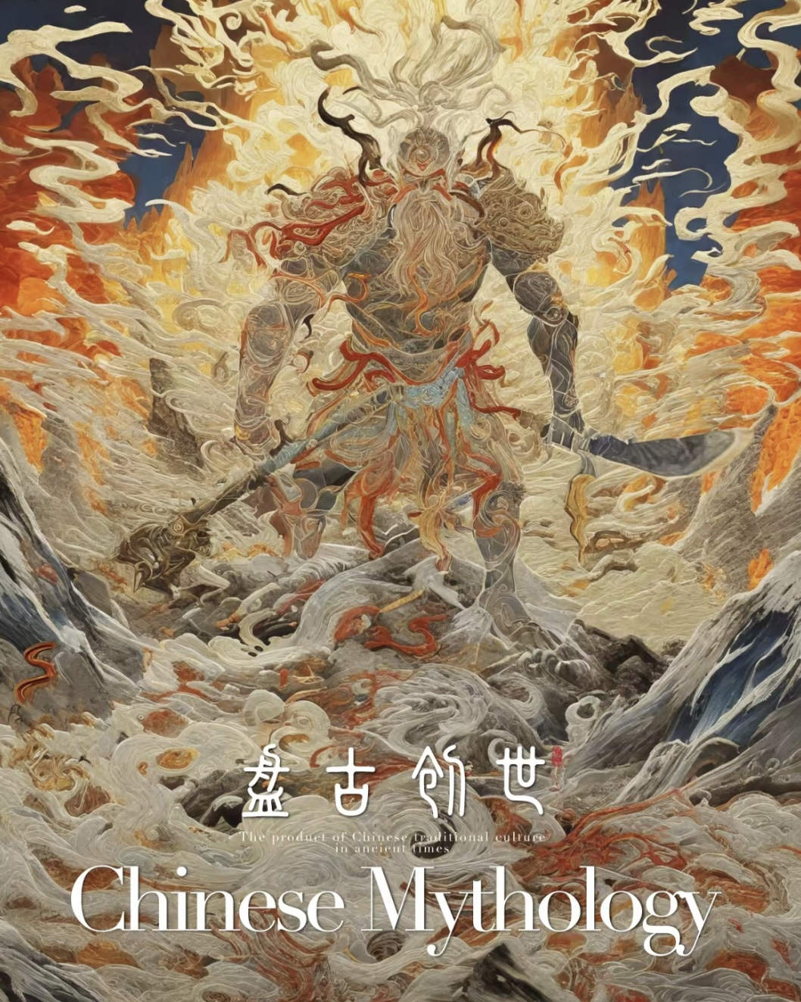
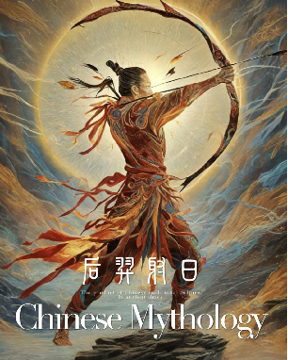
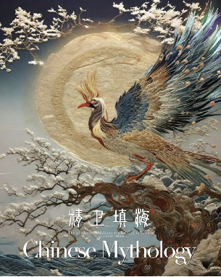
1.Why would ancient Chinese create these stories?
1.ancestors' understanding of natural and social phenomena
2.The imagination and worship of supernatural
3.The desire to conquer nature and transform society

Slide 8
2.What are the differences between Chinese mythologies and other nations’mythologies?
 | Chinese mythologies | Western mythologies
general situation | more complex selfless,devoting God the close and harmonious relationship between man and nature | relatively simple unique,supreme God the antagonistic relationship between man and nature

Slide 9
2.What are the differences between Chinese mythologies and other nations’mythologies?
 | Chinese mythologies | Western mythologies
the process of creating world | tragic affirmation of labor praise for dedication the spirits of working hard and not afraid of bloodshed | easy with his own spirit and mind the master of all things in heaven and earth

Slide 10
2.What are the differences between Chinese mythologies and other nations’mythologies?
 | Chinese mythologies | Western mythologies
relationship between man and God | unity of heaven and man （天人合一） the spirit of self-sacrifice the cultural value that values the whole | relatively simple unique,supreme God the antagonistic relationship between man and nature

Slide 11
2.What are the differences between Chinese mythologies and other nations’mythologies?
 | Chinese mythologies | Western mythologies
The theory of human nature | God exists to save mankind. Human nature is good. | A man needs atonement to enter heaven. Human nature is bad.

Slide 12
2.What are the differences between Chinese mythologies and other nations’mythologies?
 | Chinese mythologies | Western mythologies
summary | 1.China emphasizes the unity of heaven and man, 2.China attaches great importance to collectivism, emphasizes responsibility and obligation, sacrifice and dedication; 3.In China, God serves man, and the relationship between man and God in China is unified and harmonious. | 1.heaven and man are opposites, 2.they emphasize individualism and liberalism. 3.In addition, Western culture is often closely linked with religion. The West believes that people are born sinful and need to constantly repent and atone for SINS. God is supreme, and people need to believe in and obey God unconditionally.

Slide 13
3.What impacts do Chinese mythologies have on later generations?
Literary material
A way to let off steam
The refinement and transmission of image
on later literary works
on Chinese ethics
on the national spirit
“heaven and man are united as one”
The worship of morality
spirit of unremitting self-improvement
spirit of exploration and creation
spirit of indomitable fighting
spirit of responsibility to sacrifice oneself and benefit the group

