Slide 1
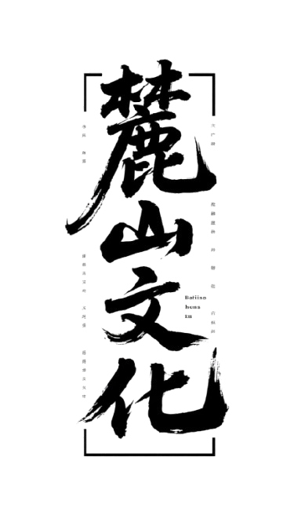
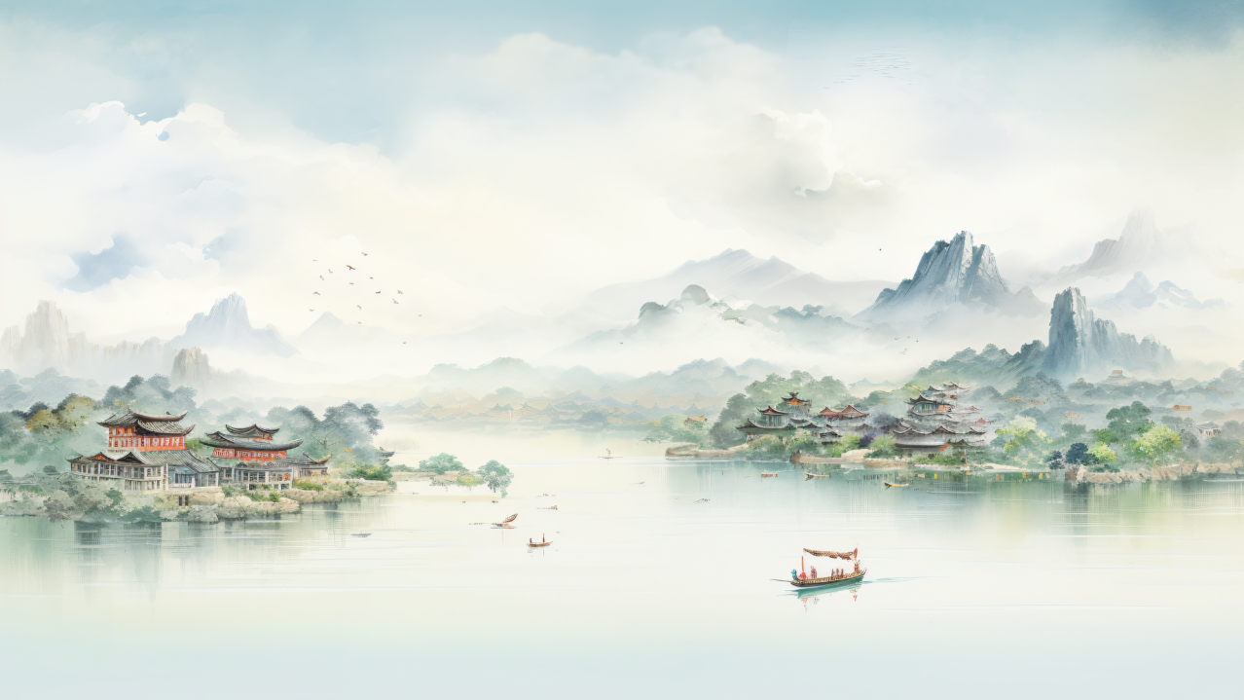


主讲人：邓欣雨（英语笔译）
Speaker：Deng Xinyu
Notes:
A Cultural Journey Up Yuelu Mountain
Good evening, everyone! My name is Deng Xinyu.Today, I want to take you on a special cultural trip to Yuelu Mountain Scenic Area. OK Let’s dive in.

Slide 2

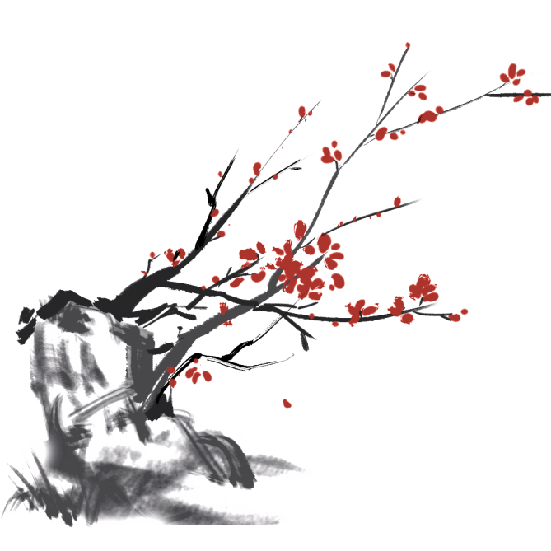
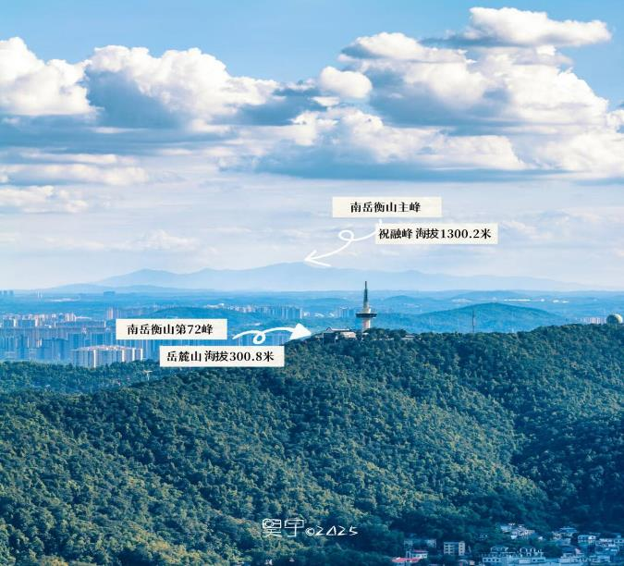
Bird's-eye view of Yuelu Mountain（岳麓山全貌）
Notes:
This is a bird's-eye view of Yuelu Mountian
Its main peak only has a height of 300.8 meters, buy it is a renowned mountain with a long history and breathtaking scenery. It’s fair to say that it is“a living museum of Chinese culture,”

Slide 3
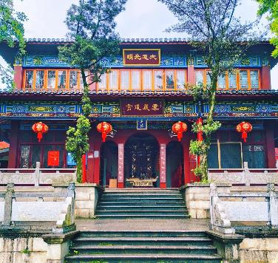
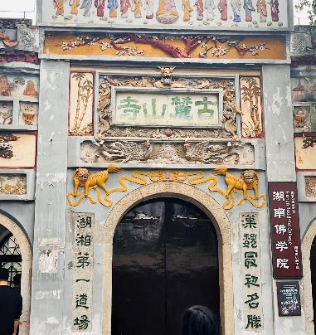
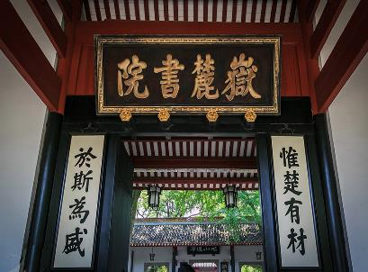
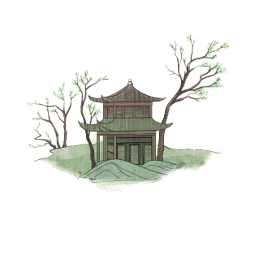
山不在高，有仙则名
Three great cultural traditions coexist.
Yunlu Palace（云麓道宫）（明）
Taoism
Lushan Temple (麓山古寺)（西晋）
Yuelu Academy (岳麓书院)（北宋）
Buddhism
Confucianism
Notes:
First of all, it a convergence place of three great cultural traditions :Confucianism, Buddhism and Taoism.
So, we can see Yuelu Academy at the foot of the Mountain, Lushan Temple halfway up it, and Yunlu Palace at the top of it, representing the culture of Confucianism, Buddhism, and Taoism respectively.
These three places’origin all can be traced back to over one thousand years ago.
Founded in the Northern Song Dynasty (976 AD), Yuelu Acadamy is the origin of Huxiang culture or Hunan cultural.
And Lushan temple marks the birthplace of Buddhism in Hunan. It took root here in the Western Jin Dynasty
And Yunlu Palace was built in the Ming Dynasty (1478)
Over a thousand years, these three cultures didn’t just exist side by side—they blended. They learned from each other, and that’s how we got the “coexistence of Confucianism, Buddhism, and Taoism” we see today.These cultures are still alive and well today.

Slide 4

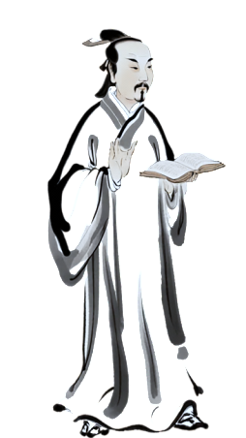
Yuelu Academy（岳麓书院）
千年学府
The Thousand-Year Old Academy
北宋开宝九年（976年），潭州太守朱洞在僧人办学的基础上，由官府捐资兴建，正式创立岳麓书院。
湖湘文化发源地
Notes:
It was finally named Hunan University in 1926. And Its education activities continues in Hunan University.
The first thing you’ll notice at its gate is a famous couplet: “Wei Chu You Cai, Yu Si Wei Sheng (the Kingdom of Chu, the unique home of talents; the Academy of Yuelu, the very cradle of all.”

Slide 5
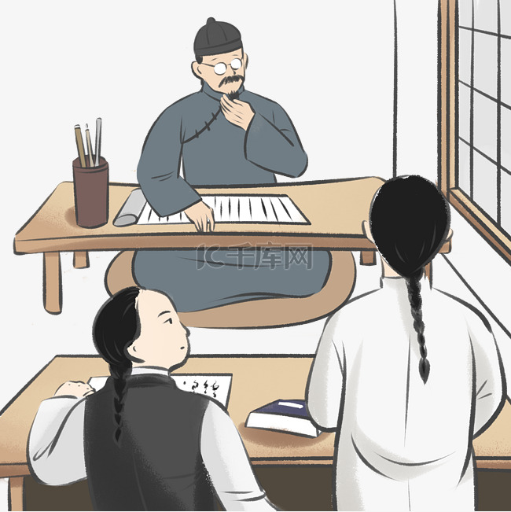
Yuelu Academy（岳麓书院）
惟楚有才
惟楚有才，于斯为盛
山长（院长）袁名曜
“The Kingdom of Chu, the unique home of talents; the Academy of Yuelu, the very cradle of all.”
于斯为盛
人才辈出：王夫之、曾国藩、左宗棠、谭嗣同、黄兴、蔡锷、杨昌济、毛泽东、何叔衡、蔡和森……
贡生张中阶
Notes:
The first thing you’ll notice at its gate is a famous couplet: “Wei Chu You Cai, Yu Si Wei Sheng (the Kingdom of Chu, the unique home of talents; the Academy of Yuelu, the very cradle of all.”
It was written around the Jiaqing era of the Qing Dynasty.
The academy’s headmaster, Yuan Mingyao, came up with the first line and asked his students to pair it. A student named Zhang Zhongjie quickly replied with the second line.
It originally was a hope of master Yuan—to nurture more talents. And now, that hope came true! Yuelu Academy has produced countless great figures who shaped China’s history, such as Wang Fuzhi, Wei Yuan，Zeng Guofan and so many other great figures.

Slide 6
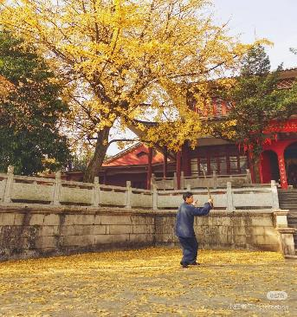
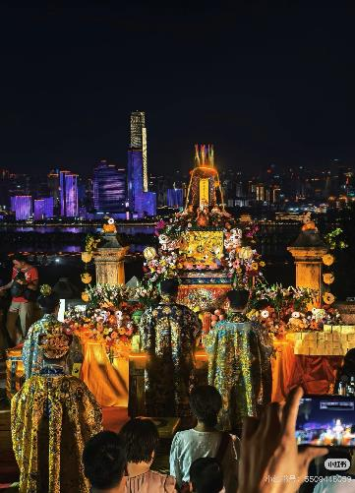
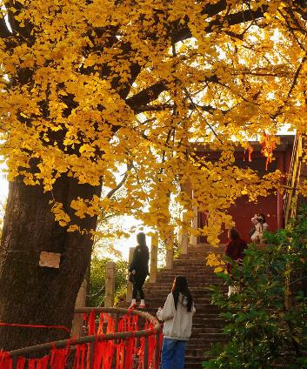
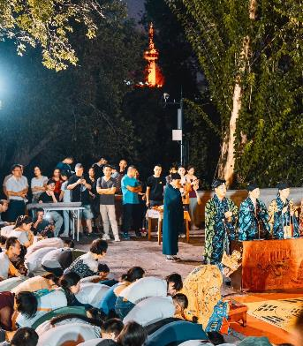
道家文化—云麓道宫
Taoism-Yunlu Palace
武当太极 Tai Chi
中秋拜月会
The moon-worshiping
ceremony on the Mid-autumn Festival
古银杏树 Old ginkgo tree
Notes:
As for the Yunlu Palace, it taoist cultural has attracted countless believers to come and worship.
Here you can parctice Tai Chi with the master and particitpate some Taoist ceremonies or make the best wishes under the 700-hundred-year-old Ginkgo tree
武当太极
飞来石
中秋拜月会
千年银杏树

Slide 7
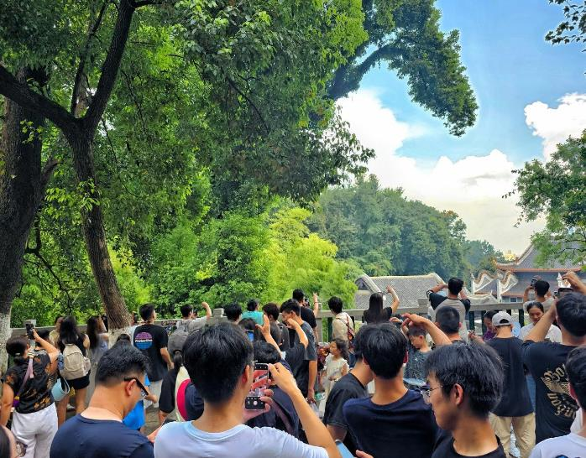
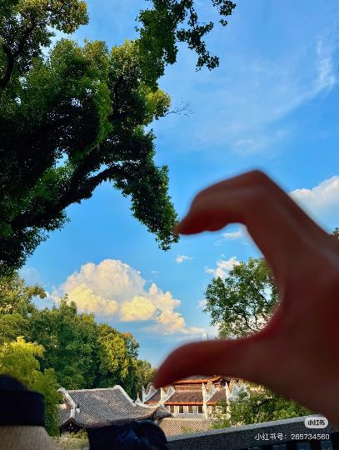

岳麓书院Yuelu Academy
岳麓书院的一种神秘仪式?
网红打卡文化
Wechat-moment-worthy location(网红打卡点-比心树)
Notes:
如果你前往岳麓书院参观，可能会看到书院旁有一群人在举行一种神秘的仪式，大家一手举着手机，另一只手举向天空，你能猜到他们在干嘛吗？
哦，原来大家在和这颗树比心，拍合照，这里就是红遍网络的爱心树打卡点。
They’re all holding up one phone, and their other hand is reaching toward the sky, making a little heart shape. You might think, “What on earth are they doing?”
Well, let me spill the secret – they’re not doing some mysterious ritual! They’re taking photos with a very special tree here, known online as the “Heart-shape Tree” – Yuelu Academy’s super viral photo spot! It

Slide 8
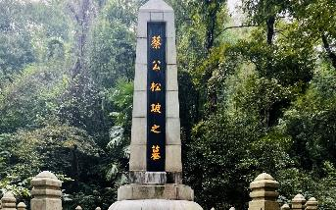
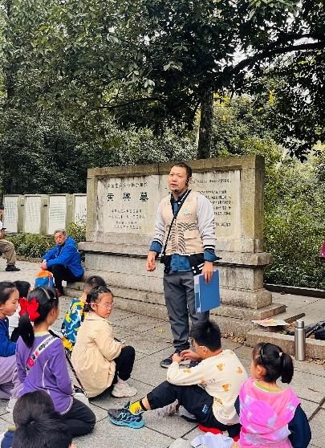
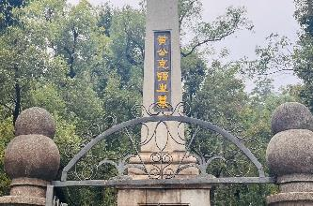
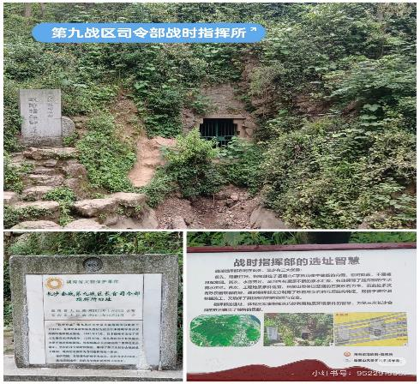
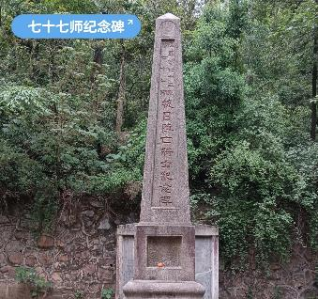
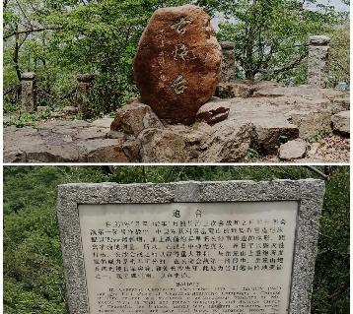
一座岳麓山，半部近代史
The Cemetery of Revolutionaries of the 1911 Revolution and monuments of the War of Resistance against Japanese Aggression
Tomb of Cai E（蔡锷墓）
Tomb of Huang Xing（黄兴墓）
77th Division Martyrs’ Monument
Ancient Artillery Battery
The 9th War Zone Command Post
Notes:
And the second part is a the red revolutionary culture of the Yuelu Mountain represented by the cementery of Revolutionaries of the 1911 Revolution and the monuments of the War of Resistance against Japanese Aggression
During the anti-Japanese war, Yuelu Mountain had served as the core defensive position in the three Changsha Campaign
.
Many soldiers fought with their lives to defend our country.
People say, “Yuelu Mountain holds half of modern China’s history in its green hills.”
Due to the time limit, I can’t introduce them all , When you climb the Mountain in person, you can follow the tour guide to learn these heroic stories .
Tomb of Huang Xing（黄兴墓）
Tomb of Cai E（蔡锷墓）
77th Division Martyrs’ Monument 七十七师纪念碑
Ancient Artillery Battery 古炮台
9th War Zone Command Post 第九战区司令部战时指挥部The command post of the 9th War Zone

Slide 9
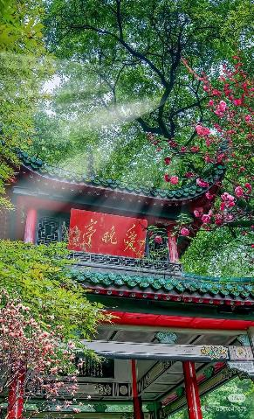
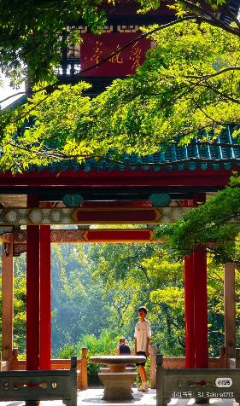
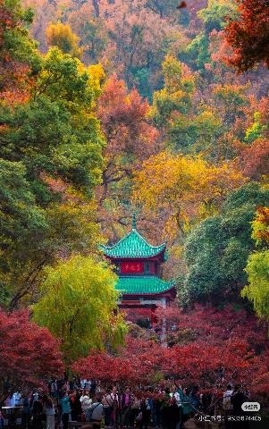
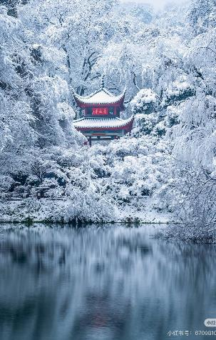
Aiwan Pavilion (爱晚亭 )
Spring
Summer
Autumn
Winter
Notes:
Now，lets end our cultural journey by enjoy some breathtaking scenery of Aiwan pavilion.
It combines the elegant architecture and natural beauty perfectly and feels like a living poem.
It is known as one of the Four Famous Pavilions in China

Slide 10
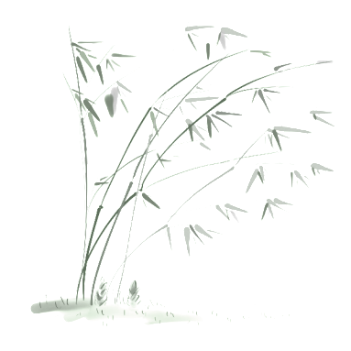
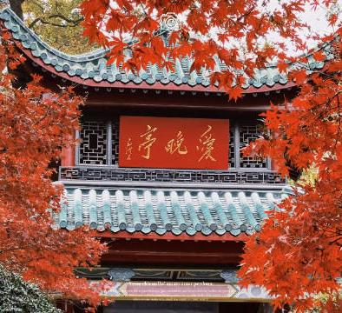
Aiwan Pavilion (爱晚亭 )
远上寒山石径斜
白云生处有人家
停车坐爱枫林晚
霜叶红于二月花
——杜牧《山行》
Going up the Hill
I go by slanting stony path to the cold hill;
Where rise white clouds, there appear cottages and bowers.
I stop my cab in maple woods to gaze my fill;
Frost-bitten leaves look redder than early spring flowers.
(Translated by Xu Yuanchong)
原名“红叶亭”“爱枫亭”
Notes:
This is the origin of its current name Aiwan Pavilion which as we all know takes inspiration from the line of Du Mu’s poem: “I stop my cab in maple woods to gaze my fill; Frost-bitten leaves look redder than early spring flowers.”
The three characters on its sign“Aiwan Pavilion 爱晚亭” sign is Mao Zedong’s handwriting.

Slide 11
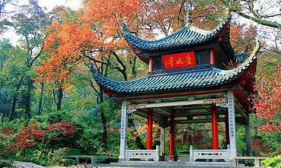

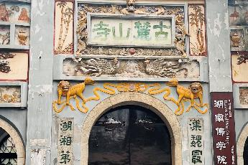
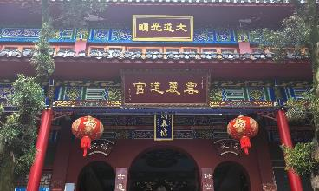
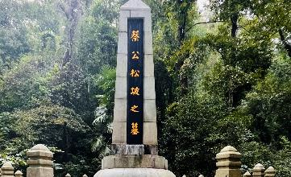
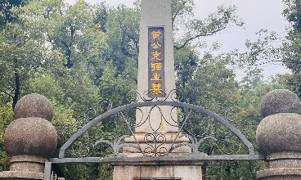
岳麓山精华景点一览 Overview of Highlights
Aiwan Pavilion(爱晚亭)
Yuelu Academy (岳麓书院)
Lushan Temple (麓山古寺)
Yunlu Palace（云麓道宫）
Tomb of Cai E（蔡锷墓）
Tomb of Huang Xing（黄兴墓）
Notes:
These are six key cultural spots on the Yuelu mountain.
Though these cultural spots, we can conclude that Yuelu mountain has witnessed the continuation of our Chinese civilization and the wakening of our national spirit.

Slide 12
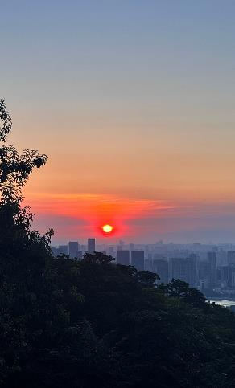
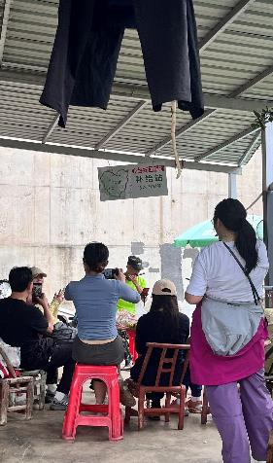
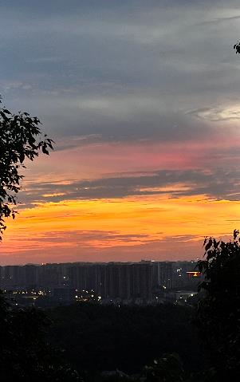
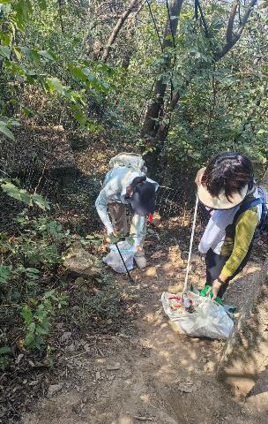

我的岳麓山日常 My moments on Yuelu Mountain
Sunrise
Making friends
Sunset
Garbage cleaning
Notes:
Last but definitely not least, if you want to learn more cultural stories of Yuelu Mountain, you need to climb it in person again and again by taking different routes.
And my friends would know that I am an enthusiastic hiker.This year alone, I have climbed Yuelu Mountain 60 times.
I want to share some of my moments on Yuelu Mountain.
Chasing sunrise and sunset
, making new friends on the road
even participating in public welfare activities of cleaning the garbage in the woods.
Every time I climb it, I gain some new experience. So Trust me Yuelu Mountain is worth visiting again and again.
岳麓山虽然不高，承载的文化非常多元，美景四季各有不同，值得反复攀爬，每次都有不同的体验，我自己今年已经爬了60次岳麓山（展示我在山上的一些照片），爬岳麓山已经成为我的日常锻炼项目。
日出爬
晚上爬
过节爬
心情好时可以爬
心情不好时可以爬

Slide 13
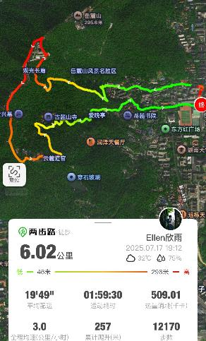
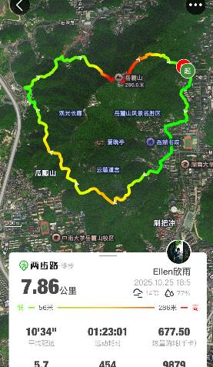
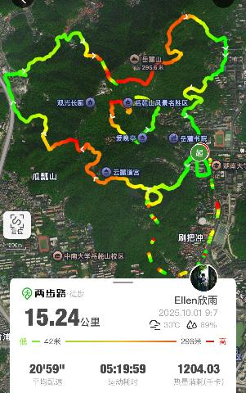
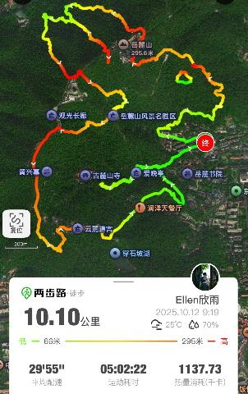
岳麓山的一千种爬法——线路图
Hammer
Heart
Map of China
Rabbit
Notes:
正如一千个人眼中有一千个哈姆雷特，一千个人爬岳麓山便有一千种爬法，除了常规的景区路线，我更喜欢沿着下面这些趣味路线图徒步爬山（展示我爬过的线路图，可以让大家互动一下猜形状）
There are a thousand ways to climb Yuelu Mountain. Beyond the conventional scenic routes, I prefer hiking along the following interesting trail maps (displaying the routes I've taken, allowing everyone to interact and guess the shapes).

Slide 14
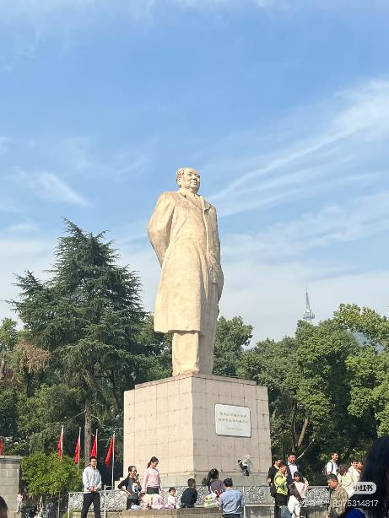
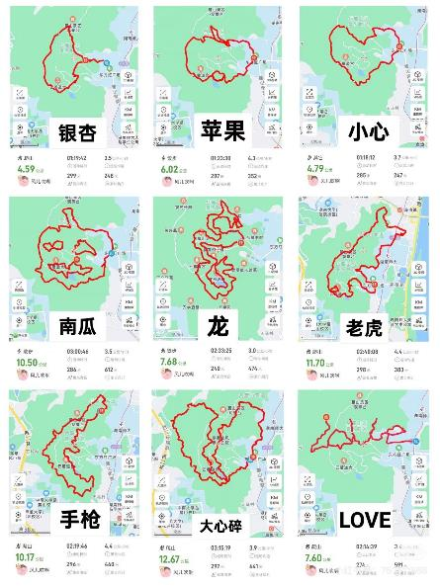
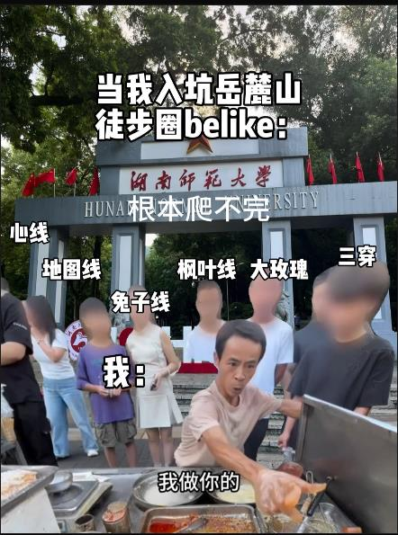
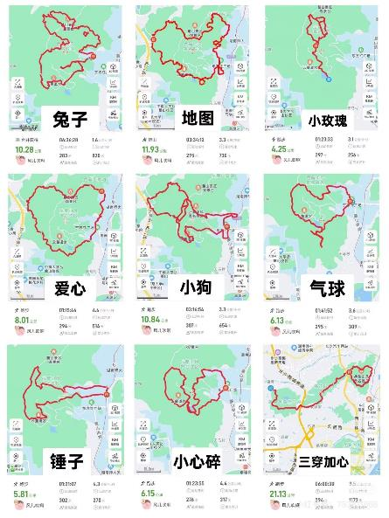
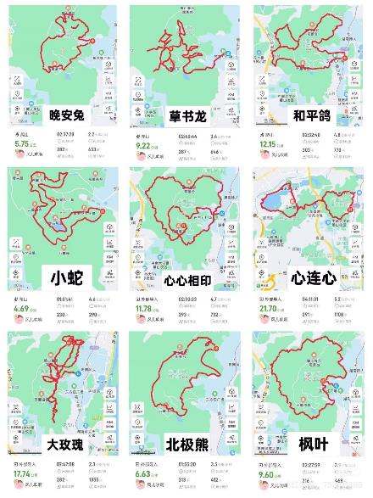
岳麓山的一千种爬法
Notes:
There is always new route to explore on Yuelu Mountain. These Routes have attracted numerous people from Changsha even around Changsha to climb mountain.
Every day you will see many people gather at this gate of Hunan Normal University or on the Dongfanghong Square of Hunan University to climb Yuelu Mountain.
I think it has become a special hiking culture of Yuelu mountain.

Slide 15
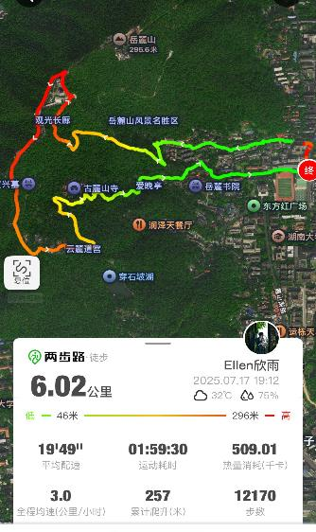
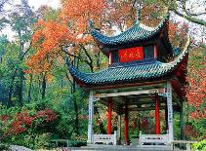

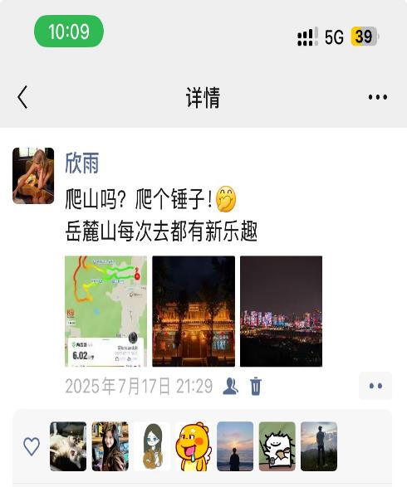
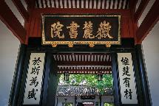


Welcome to join our mountain-climbing club（一起爬山！）
Notes:
It’s autumn now. The maple leaves on the Yuelu Mountain are going to turn red very soon. So I plan to organize a mountain climbing activity. We choose the Hammer Route along which we can visit all these key cultural spots. So welcome to join our mountain climbing club, and let’s enrich our minds and strengthen our bodies together.
You can scan the WeChat group QR code to join us.
岳麓山上的枫叶将红，正是登高赏景好季节，我组建了一个专属爬山约伴群，日常可以约伴一起去爬山赏景，有兴趣的伙伴可以扫码进群（展示“重生之我在师大爬岳麓山”），或者加我微信
最近的活动是11月中旬等枫叶红了，银杏黄了，去爬打卡锤子路线（展示锤子路线图和相关精华景点）
爬完后，你的朋友圈文案可以是：一起去爬山吗？爬个锤子！（展示朋友圈截图）
欢迎大家约我去爬岳麓山，
让我们一起文明其精神，野蛮其体魄！

Slide 17


目录
壹
山不在高，有仙则名
Three great cultural traditions coexisting —Confucianism, Buddhism, and Taoism
贰
一座岳麓山，半部近代史
Red revolutionary heritages
叁
岳麓山新徒步文化
Vibrant hiking culture
Notes:
To sum up
First: the culture of Confucianism, Buddhism, and Taoism.
Second: the red revolutionary culture.
Third: the new vibrant culture of hiking along routes of shape

Slide 18
Thanks for listening!

Slide 19






岳麓山小众景点一览 Overview of Highlights
Zibei Pavilion(自卑亭)
Double Nan’s Stela (二南诗刻)
King of Yue’s Pavilion (岳王亭)
Chuan Shi Po Lake（穿石坡湖）
King of Yu’s Stela（禹王碑）
Chufeng Stela（楚风碑）
Notes:
二南诗刻
自卑亭
岳王亭
穿石坡湖
禹王碑
楚风碑

Slide 20
佛家文化—麓山古寺
Buddhism-Lushan Temple
大师兄
小师弟
528 years
1748 years
Pines from the Six Dynasties（六朝古松）
Notes:
But the real stars here are two huge podocarpus (/ˌpɒdə'kɑːpəs/) trees in front of the Guanyin Pavilion. One on the left, one on the right—one big, one small—like two warriors guarding the temple. You can have a guess how old is the big one and how old is the small one?
The big one is over 1,700 years old! People call them “Pines from the Six Dynasties .” Just imagining how much history they’ve witnessed.

