Slide 1
Prague School
Western Theories
布拉格学派
You Yuting &Xu Jing

Slide 2
一
Introduction Of Prague School
Content
二
Roman Jakobson As The Represntative
三
Summary

Slide 3
Introduction Of Prague School
一

Slide 4
1.When Tan Zaixi introduced western translation theories, he divided them into four schools:
Prague School
London School
American structuralists
School of Communication Theory

Slide 5
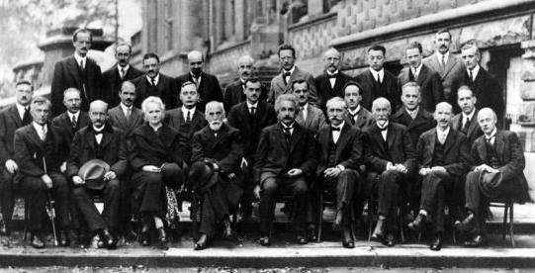
2.The school was founded by Vilem Mathesius, Nikolay S. Trubetskoy and Roman Jakobson.

Slide 6
3.The main arguments of this school :
functions of language
cognitive function
expressive function
instrumental function
comparison of languages
semantics
grammar
pronunciation

Slide 7
Roman Jakobson As The Represntative
二

Slide 8
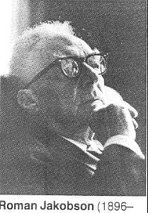
1.Biography
The most influential translation theorist of The Prague school.
Russia
Czech Republic
US

Slide 9
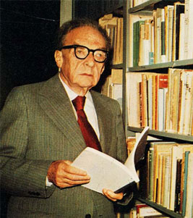
On Linguistic Aspects of Translation:
1)importance of translation
2)the relationship between language and translation
3) the existing problems.

Slide 10

2.Translation Theories
intralingual translation
interlingual translation
intersemiotic translation
There are five main points :
(1)Translation is divided into three categories from the perspective of semiotics:

Slide 11
(2)The understanding of the meaning of a word depends on the translation.
(3) Accurate translation depends on information symmetry.
(4) All languages are equally expressive.

Slide 12
(5) Grammatical category is the most complicated problem in translation.
sex
tense
semantic level

Slide 13
a. Tense
present perfect progressive
present
perfect
  in English-to-Chinese translation

Slide 14
b. Sex
death
feminine
in Russian
masculine
in German

Slide 15

c.semantic level
  “captain”
  上校?
  大副?
  船长?

Slide 16

三、Summary

Slide 17
Advantages
studies translation from the perspective of linguistics
provides a new perspective for further study
Disadvantages
fail to reach the textual level of translation
his theory was not systematic

Slide 18
Thank You!
work hard and play hard!

