Slide 1

Gideon Toury’s Descriptive Translation Studies
By: Benjamin Wellsand

Slide 2




Descriptive Translation Studies
Function-Oriented Research
Process-Oriented Research
Product-Oriented Research
Three Points of Research Orientation

Slide 3
Function-Oriented
Function-oriented research examines the context of the translation more than the translation itself and notes its impact on the target audience.

Slide 4
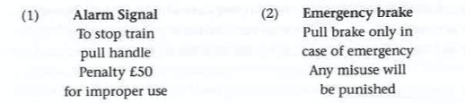
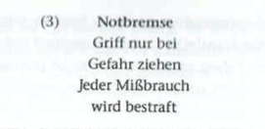
Function-Oriented Example
British Train Warning
West German Train Warning
German (SL) Train Warning

Slide 5
Process-Oriented
Process-oriented research deals with the mental process that the translator goes through as s/he translates.

Slide 6
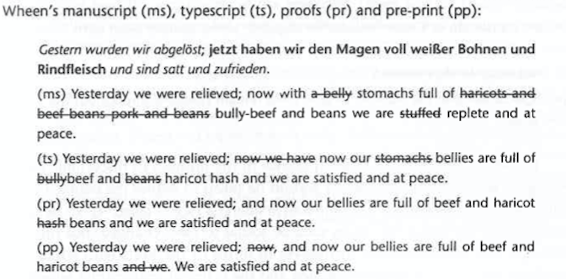
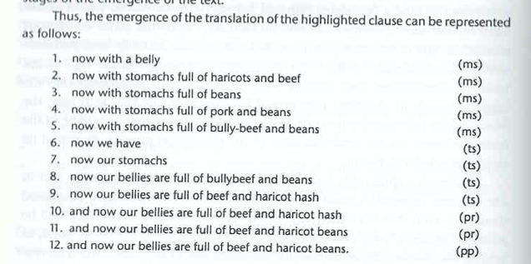
Process-Oriented Example

Slide 7
Product-Oriented
Product-oriented research focuses on the finished translation product either by comparing several translations—translations that are either in one language or multiple languages—of a single source text.

Slide 8
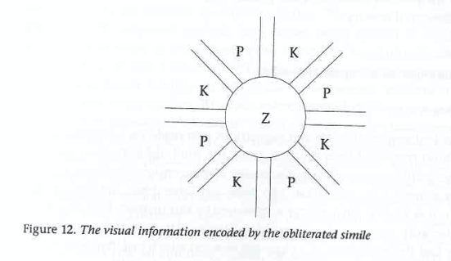



Product-Oriented Example
Translation: The main streets, which lead from the centre (Z) [ ], divide the city into districts alternately inhabited by Catholics (K) and Protestants (P), so that each group always feels threatened from both sides.
German Image
English Image

Slide 9
Concluding Thoughts

