Slide 1
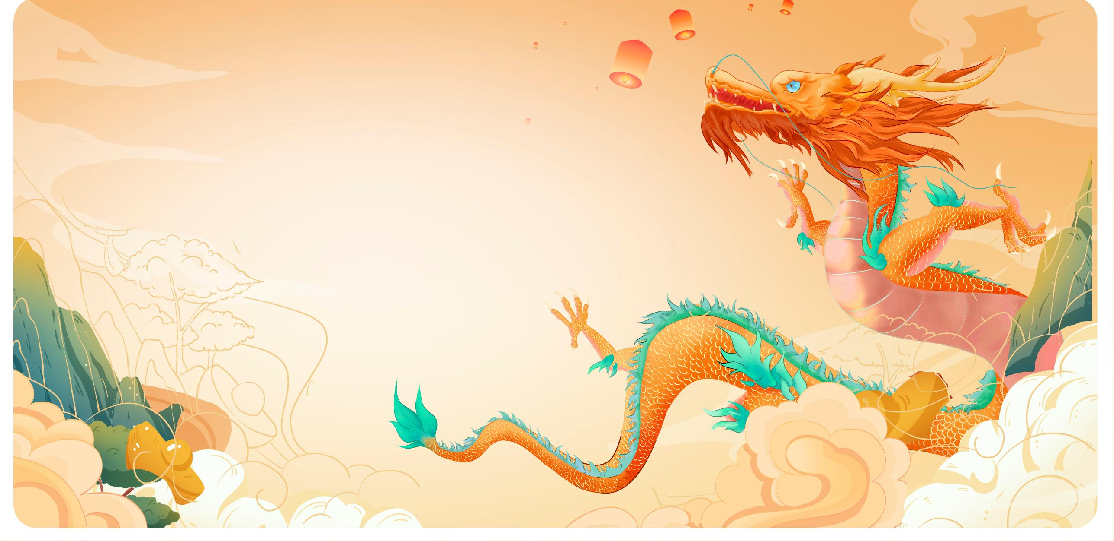
Dragon Lantern Dance
Speaker: Jin Yichen (金奕辰）

Slide 2



PART 01
Introduction
PART 02
History & Cultural Roots
Contents
PART 03
Craftsmanship & Performance
PART 04
Video of the Bench Dragon

Slide 3
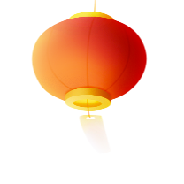
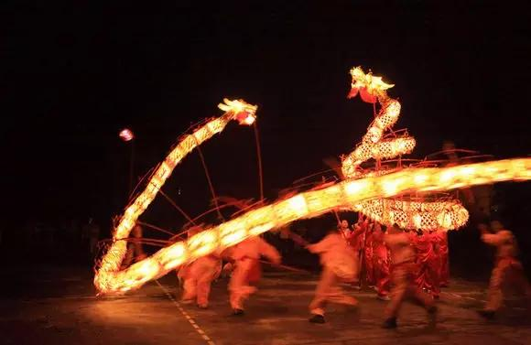
01
Introduction
Definition
The Dragon Lantern Dance is a ritualistic folk performance where a team of dancers manipulates a long, flexible dragon puppet to rhythmic drumming. It’s typically performed during festivals like the Lunar New Year and Lantern Festival to ward off evil spirits and invite good fortune.

Slide 4
01
Introduction
Symbolism
The dragon represents imperial authority (historically) and natural forces (rain, yang energy).
The lanterns symbolize illuminating darkness (hope) and ancestral reverence.

Slide 5
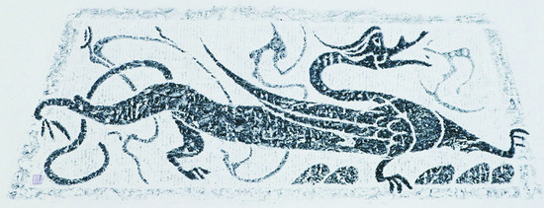
02
History & Cultural Roots
Origin
1. Ancient Origins (Han Dynasty, 206 BCE–220 CE)
Roots: Linked to dragon worship (symbol of rain/power) and agricultural rituals (prayers for rain/harvest).
Early Forms: Shamans performed “dragon dances” to appease deities; straw or cloth dragons used.

Slide 6
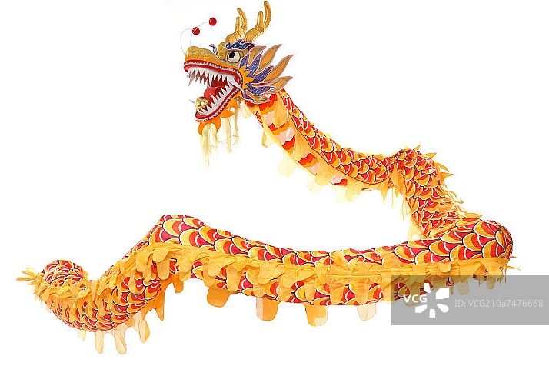
02
History & Cultural Roots
Origin
2. Imperial Golden Age (Tang & Song Dynasties, 7th–13th Century)
Festival Integration: Became central to Lunar New Year and Lantern Festival celebrations.
Artistic Refinement: Added lanterns, music, and acrobatics; dragons grew longer.

Slide 7
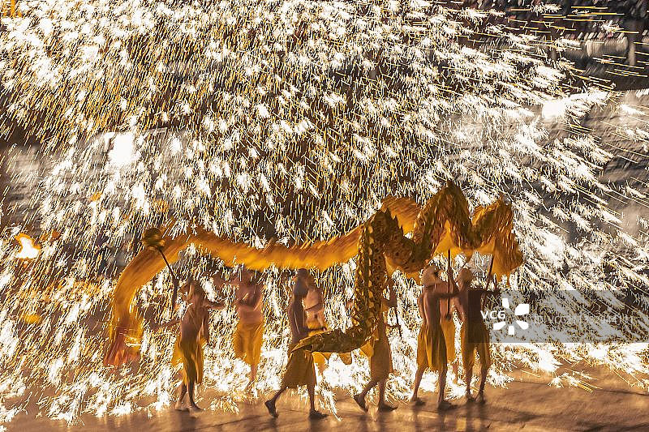
02
History & Cultural Roots
Origin
3. Ming/Qing Dynasties (14th–19th Century)
Cultural Symbol: Associated with imperial power (e.g., emperors’ parades) and folk unity.
Regional Styles: Diversified (e.g., Sichuan’s “Fire Dragon,” Guangdong’s “Yarn Dragon”).

Slide 8
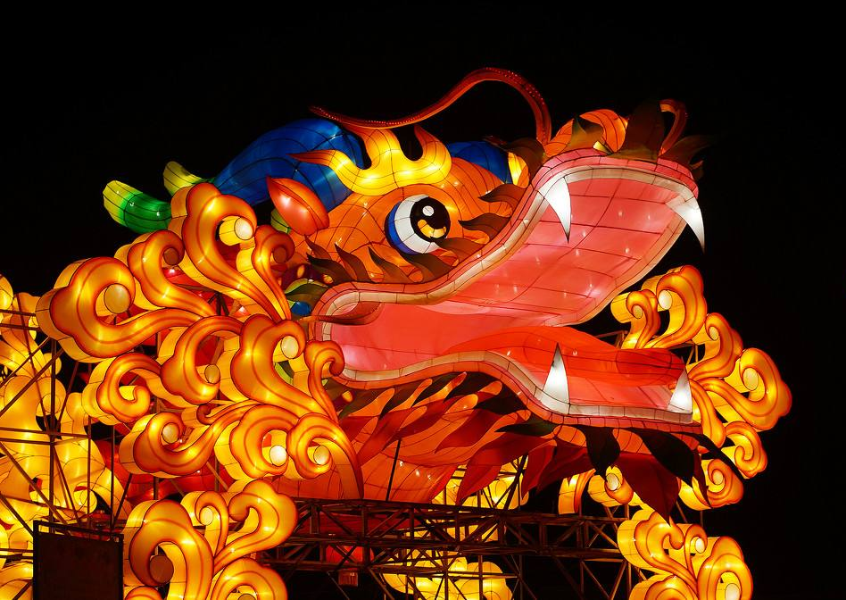
02
History & Cultural Roots
Origin
4. Modern Era (20th–21st Century)
Globalization: Spread via diaspora (Chinatowns worldwide) and cultural exchanges.
Innovations: LED lights, drone dragons, AR performances; recognized as intangible heritage in China.

Slide 9
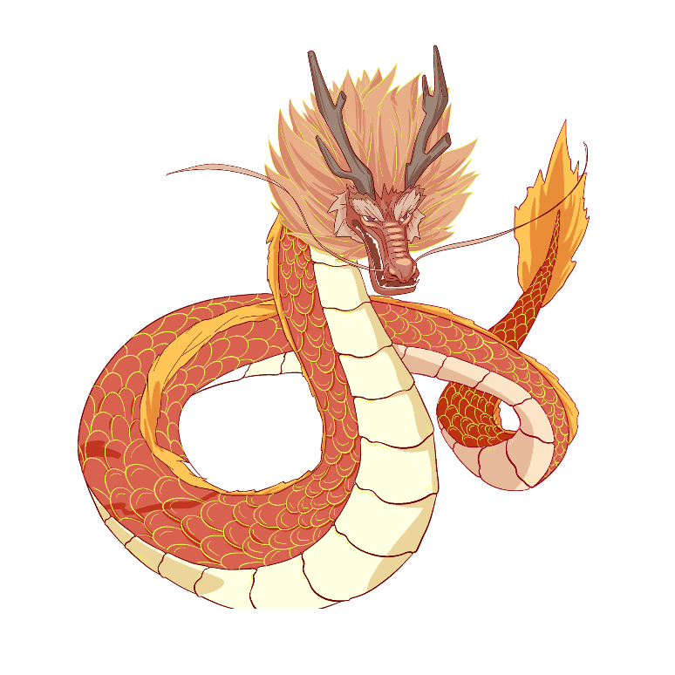
02
History & Cultural Roots
Key Evolution Drivers:
Religion→ Festival Entertainment → Cultural Diplomacy.
One-Sentence Timeline:
From Han rain rituals to Tang spectacles, Qing folk art, and today’s high-tech shows, the dragon lantern dance has mirrored China’s cultural journey.

Slide 10
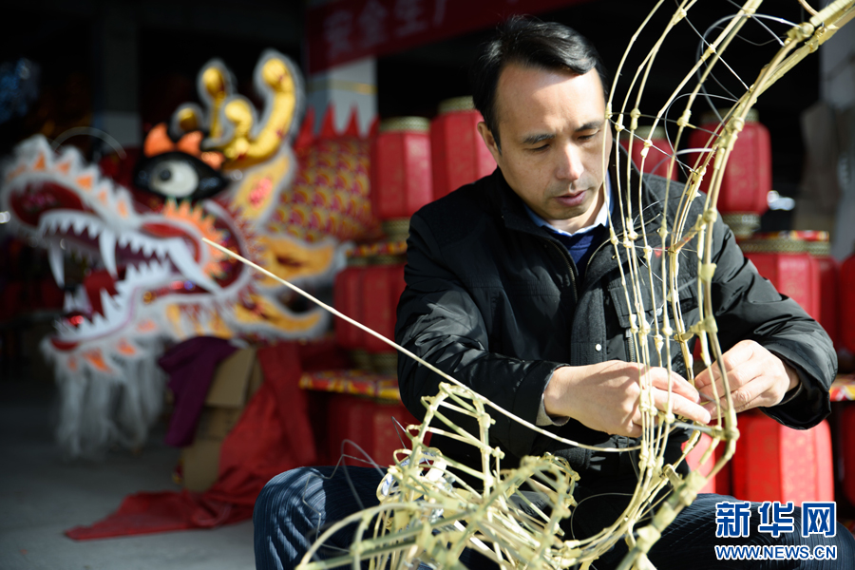
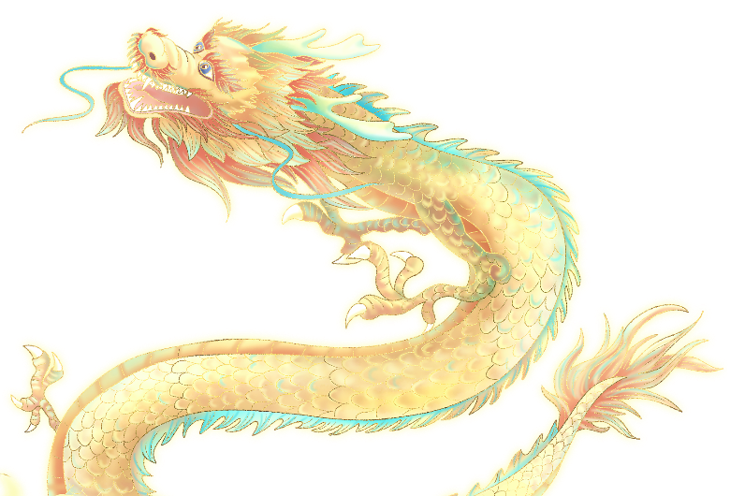
03
Craftsmanship & Performance
1. Craftsmanship: Building the Dragon
A. Materials & Structure
Frame: Bamboo strips bent into segments (typically 9–25), connected by flexible cloth or ropes.
Body: Covered with painted silk/paper (traditional) or synthetic fabrics (modern), often in red/gold for prosperity.
Head & Tail: Intricately carved wood or molded papier-mache, with movable jaws, eyes, and horns.

Slide 11
03
Craftsmanship & Performance
1. Craftsmanship: Building the Dragon
B. Lantern Integration
Traditional: Candles or oil lamps inside (risky, now rare).
Modern: Battery-powered LED lights (brighter, safer), sometimes with remote-controlled color changes.
C. Decoration
Scales: Hand-painted or glued metallic foil.
Accessories: Bells, mirrors, or tassels for sound/visual effects.

Slide 12
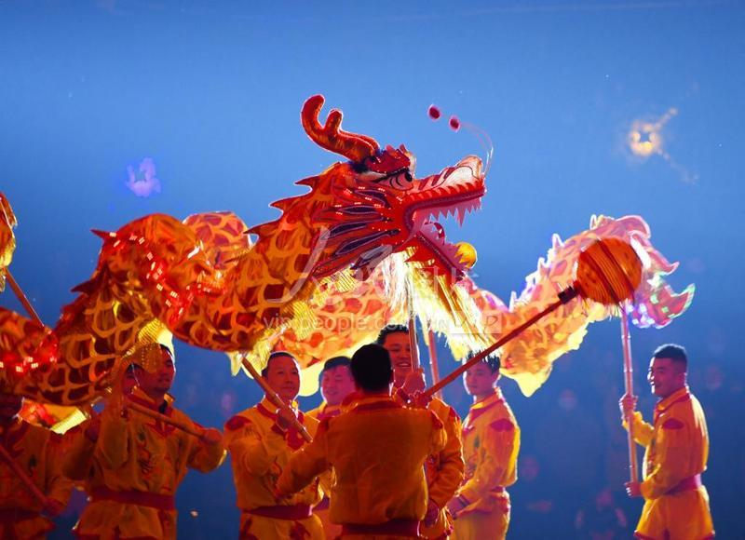
03
Craftsmanship & Performance
2. Performance: Bringing the Dragon to Life
A. Team & Roles
Dancers: 9-15+ performers (must be strong and coordinated).
Head: Leads movements, controls dramatic expressions (e.g., nodding, biting).
Body: Follows in wave-like motion.
Tail: Often the most agile, executing spins and flicks.
Musicians: Drummers, gong, and cymbals set the rhythm (fast beats = energetic; slow = majestic).

Slide 13
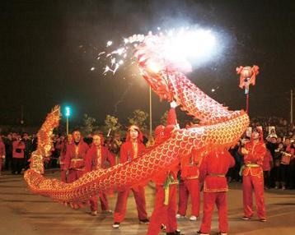
03
Craftsmanship & Performance
2. Performance: Bringing the Dragon to Life
B. Signature Moves
Chasing the Pearl: A “pearl” (ball on a stick) lures the dragon, symbolizing wisdom pursuit.
Threading the Cloud: Dancers weave through poles or crowds in figure-8 patterns.
Coiling & Uncoiling: Dragon spirals inward, then bursts open (represents awakening).

Slide 14
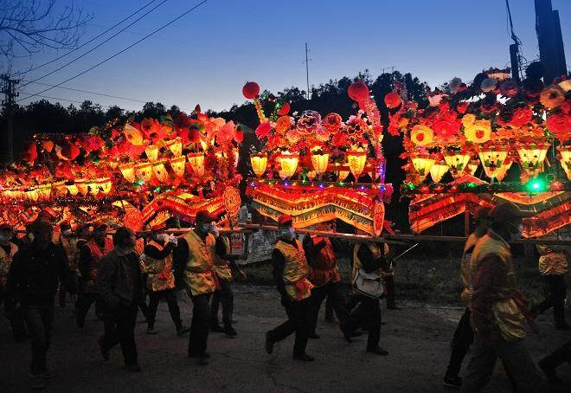
03
Craftsmanship & Performance
2. Performance: Bringing the Dragon to Life
C. Styles by Region
Fire Dragon (Sichuan): Iron-wire frame with burning incense, sprayed with sparks for drama.
Night Dragon (Guangdong): LED-lit, performed on water for reflections.
Bench Dragon (Fujian): Made of wooden benches, carried by villagers.

Slide 15
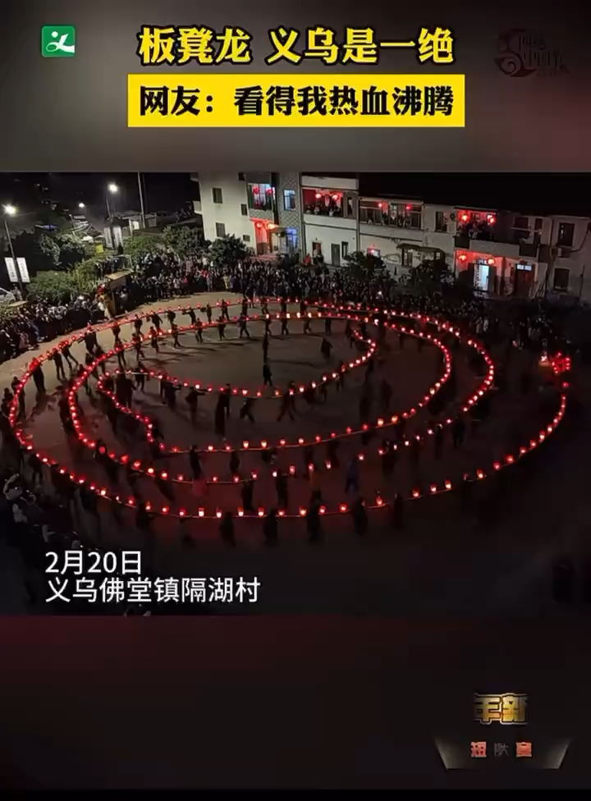
04
Video of the Bench Dragon

Slide 16
Thanks for Listening

