Slide 1
Principles of Translation
Presented by Xiao Yiyao 肖毅瑶

Slide 2
Principle of Yan Fu
(1)Faithfulness 信
(2)Expressiveness达
(3)Elegance 雅
Most Controversial

Slide 3


The First Group: Broadening meaning of the third character “雅”

Slide 4
The First Group：Maintaining the three original characters
1.The first group accepts the original three characters, and in the meantime, adds some new concepts to the character "雅".
2.According to them, "雅" means far more than the English word "elegance". Apart from the traditional interpretation, it also means classicism, the adherence to the original style and flavor.

Slide 5
The Second Group: Replacing the third character “雅”

Slide 6
B
Replacing the “雅”
The second group argues that the word "雅" is out of place in translation. While adopting the first two characters of Yan Fu's principle, it discards the character "雅" and tries to find some other new criteria instead.

Slide 7
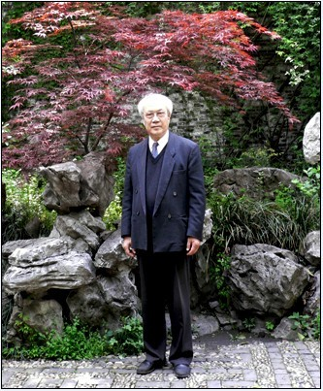
Liu Chongde’s three-word principle
Three Criteria: Faithfulness, Expressivenes, Closeness
Closeness means to conform to the style of the original text.
(This view has synthesized Tytler’s Three Principles of Translation )
1PPT.COM PPT
Presentation Designer
Example:
Senior Student
(1914-2008)
Proficient In PPT
1）你这该死的家伙!
Damn it! ----Translated by Zhang Peiji
Video Design

Slide 8
The Third Group: Casting away the three-character guide

Slide 9
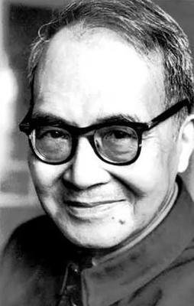
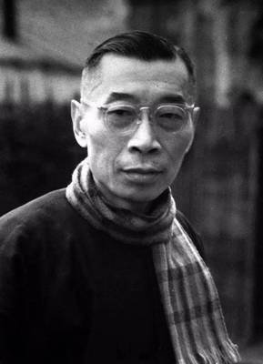
Two Representatives:Qian Zhongshu and Fu Lei
Fu Lei
Qian Zhongshu
Born to death:1908-1966
Masterpiece: Fortress Besieged 《傅雷家书》
Theory of Translation:
Resemblance in Spirit (神似论)
Born to death:1910-1998
Masterpiece: Fortress Besieged 《围城》
Theory of Translation:
Sublimation (化境说)

Slide 10
Resemblance in Spirit
1. Fu compared the act of translating to painting and considered that what is sought is not formal resemblance but spiritual resemblance.
Spiritual Resemblance >>> Formal Resemblance
Example：
1)Le Père Goriot 《高老头》
-----Translated by Fu

Slide 11
Theory of Sublimation
1.First proposed: The Translation of Lin Shu
2.From his point of view, a piece of writing transformed from one language to another without showing strain inflicted by differences in language customs while perfectly preserving the original style can be said to be a sublimation.
Example：
Marriage and waving comes and goes by destinity. 婚嫁有命
-----Translated by Qian

Slide 12
Theory of Sublimation
More on Sublimation：
1.A transmigration of the soul.
2.The highest ideal of translation but unattainable in an absolute way.
3.Qian did make great contributions to settling the long lived argument between literal translation and liberal translation, foreignnization and domestication

Slide 13

Thank You！

