Slide 1


The Claissic of Mountains and Seas
By He Lina Majoring in English Translation

Slide 2

CONTENS
01
Overview
02
Authorship
03
Mythical Creatures
04
Influence

Slide 3


Overview
PART
01
The Classic of Mountains and Seas is a Chinese classic text and a compilation of mythic geograghy and beasts.The book is divided into eighteen sections; it describes over 550 mountains and 300 channels.
As for the content, it is not a narrative. The "plot" involves detailed descriptions of locations in the general direction of the "Mountains(五藏山经), Regions Beyond Seas（海外经）, Regions Within Seas（海内经）, and Wilderness（大荒经）". These descriptions are usually about medicines, animals, and geological features.

Slide 4
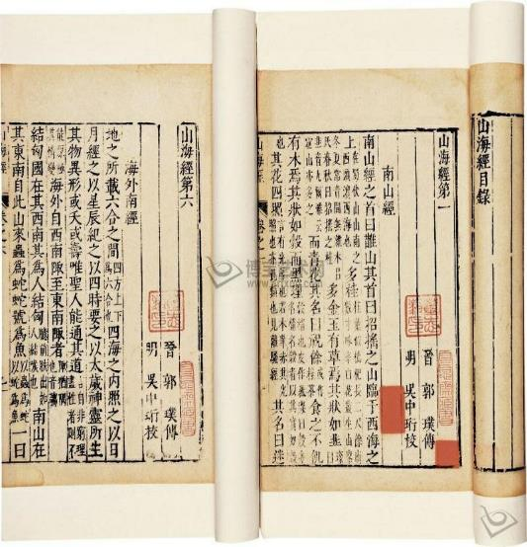
PART
02
Authorship
Who wrote the book and when it was written are controversial. It was originally thought that mythical figures such as Yu the Great（大禹） or Bo Yi （伯益）wrote the book.
The consensus among modern Sinologists is that the book was not written at a single time by a single author, but rather by numerous people from the period of the Warring States to the beginning of the Han dynasty.

Slide 5
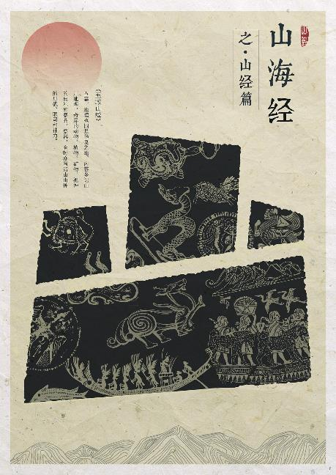
PART
03
Mythical Creatures
The mythical creatures portrayed in the book are a combination of ancient ancestors' awe and admiration for morality, power, life and nature, and the result of ancient ancestors' wisdom.
Although these creatures are different from each other, they have certain features in common：
1.Ancient ancestors' original concept of life.
2.The qualities of a spiritual leader.
3.Transcendent deities.

Slide 6
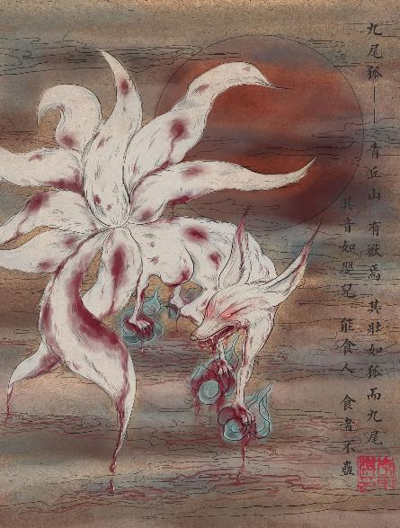
PART
03
Mythical Creatures
青丘之山有兽焉，其状如狐而九尾，其音如婴儿，能食人，食者不蛊。
In the Mountain Qingqiu, there is a kind of wild animal, shaped like a fox but with nine tails, and its sound is like the cry of a baby. It can devour people,while eating its flesh will protect you from the poisonous gas.
Nine-tailed Fox

Slide 7
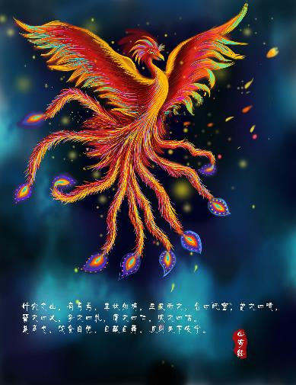
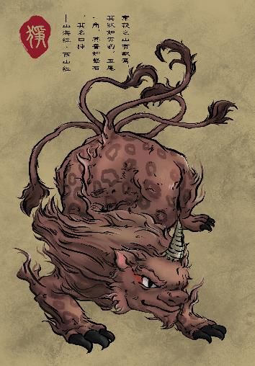
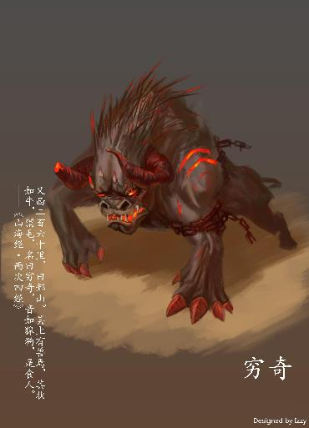
PART
03
Mythical Creatures
Pheonix
Zheng
Qiongqi

Slide 8
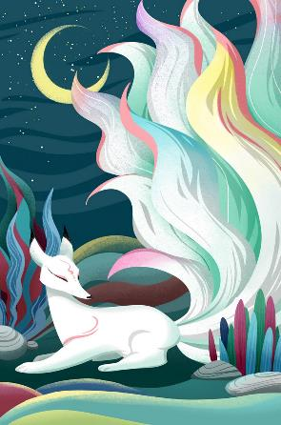
Part
04
Influence
"The Classic of Mountains and Seas" represents the earliest systematic repository of the myths and deities from ancient and early China, and this work has served as the primary inspiration for later Chinese mythology.It has no plot, but the mythological creatures in the book have been extensively quoted in Chinese literature.
In terms of narrative methods, the Classic is simple and concise in its descriptions but rich in imagination, which profoundly influences the narrative style and techniques of the early Chinese novels.

Slide 9
THANKS

