Slide 1
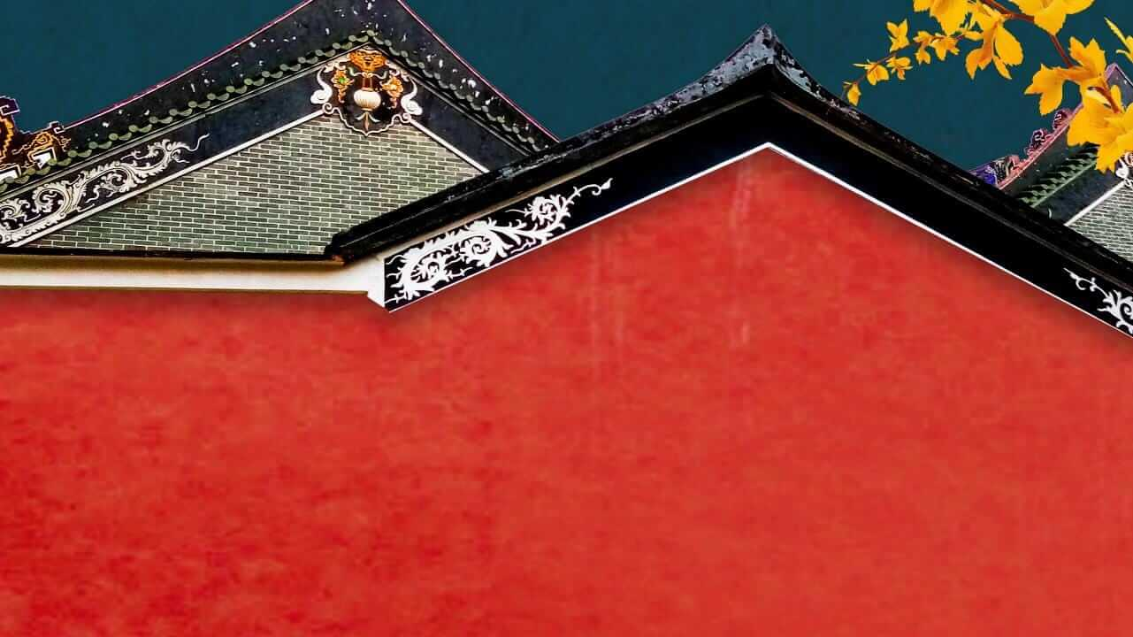




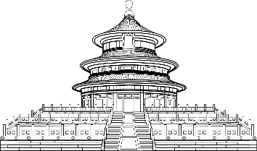

Presenter: 严哲文

Slide 2
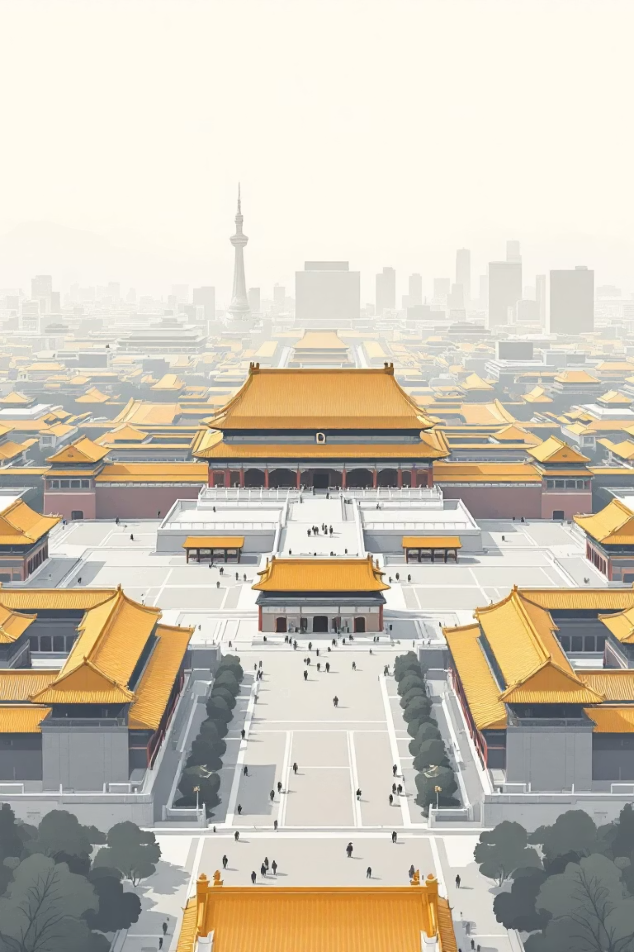
The Imperial Heart of Beijing: Overview
For nearly five centuries, the Forbidden City stood as the political and ceremonial center of China. This immense palace complex, covering 180 acres, housed emperors, their families, and countless officials, serving as the nerve center of imperial power. Its meticulously planned layout reflects traditional Chinese cosmology and social hierarchy.

Slide 3

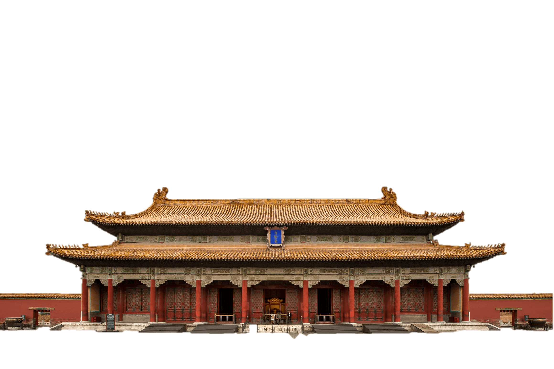
目 录
CONTENTS
故宫四门
外廷建筑
内廷建筑
文化内涵

Slide 4

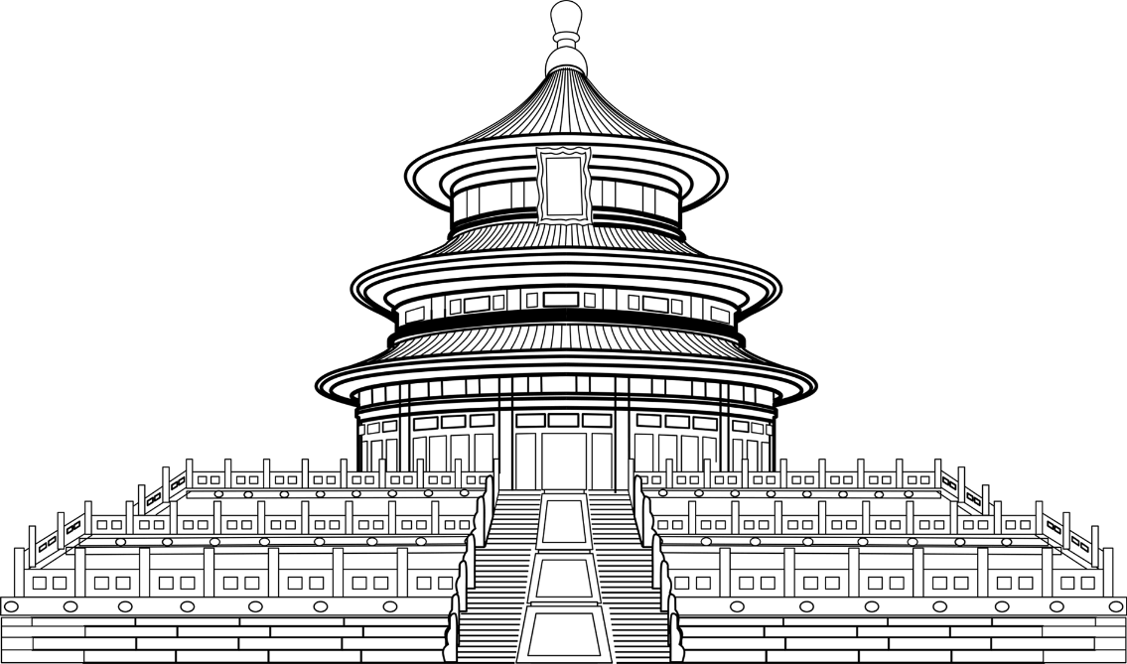




https://www.ypppt.com/
故宫四门

Slide 5

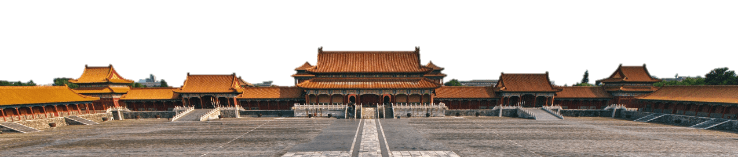
故宫四门
Meridian Gate (Wumen)
Gate of Divine Prowess (Shenwumen)
The magnificent southern gate, used for major ceremonies.
The northern gate, used by the imperial family and officials.
East Prosperity Gate (Donghuamen)
West Prosperity Gate (Xihuamen)
The eastern gate, responsible for daily palace operations.
The western gate, used for administrative affairs.

Slide 6
外廷建筑

Slide 7
外廷建筑
外
The Outer Court was the ceremonial heart of the Chinese Empire, where the emperor exercised supreme authority through grand ceremonies and state affairs.
廷
雕栏玉砌应犹在
香径小船通，菱歌绕故宫。

Slide 8
外廷建筑
太
This magnificent hall was the venue for the emperor's major ceremonies, such as coronations, weddings, and birthday celebrations, symbolizing supreme imperial power.
和
殿
荷叶桥边雨，芦花海上风。
https://www.bilibili.com/video/BV1qj411K7Lg/?share_source=copy_web&vd_source=f834188e870266be5900ff58f5afe3fd
Notes:
https://www.ypppt.com/

Slide 9
外廷建筑
中
黄琉璃瓦，鎏金宝顶
和
Before presiding over grand ceremonies in the Hall of Supreme Harmony, the emperor would prepare and receive high-ranking officials here.
殿

Slide 10
保
外廷建筑
和
This hall was used for grand banquets and also served as the final examination venue for the imperial examinations, where the most brilliant scholars were personally assessed by the emperor.
露草诗歌雅，云天易象需。
殿

Slide 11
内廷建筑

Slide 12
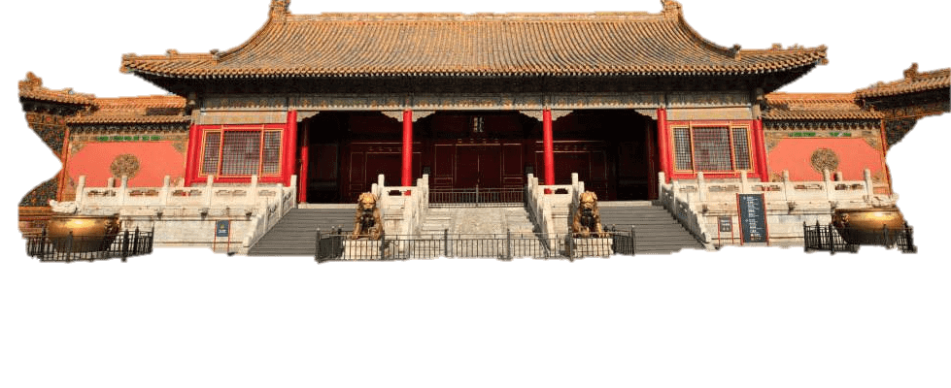

内廷中路
乾清宫
赤阑桥下记停桡，细雨菰蒲响莫潮。说与行人莫回首，故宫烟柳正萧萧。
Temperor's primary residence and political headquarters during the Ming dynasty, where daily governance and private audiences occurred.

Slide 13
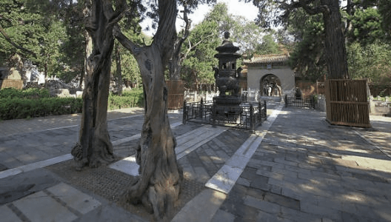
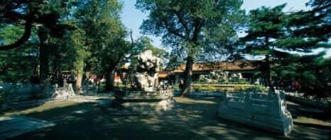
内廷中路
御花园·故宫
御花园 (Imperial Garden) covers over 11,000 square meters of meticulously designed landscape, offering emperors and empresses a tranquil retreat from ceremonial duties. This masterpiece of classical Chinese garden design harmoniously blends architecture with nature.

Slide 14
内廷中路
坤
坤宁宫是内廷后三宫之一
宁宫
The
Forbidden City
Originally the empress's residence, later transformed into a shamanic ritual space during the Qing dynasty.

Slide 15
Cultural Connotation
1987
1.8M
600+
UNESCO Heritage Site
Precious Artifacts
Years of History
Recognized globally as a World Heritage Site, symbolizing Chinese cultural identity and architectural genius for all humanity.
The palace museums house over 1.8 million artifacts, including ceramics, paintings, calligraphy, bronzes, and imperial archives spanning millennia.
Over six centuries of continuous preservation, representing an unbroken chain of cultural stewardship and architectural maintenance.

Slide 16
source
百度，谷歌以及b站

Slide 17
谢谢观看

