Slide 1
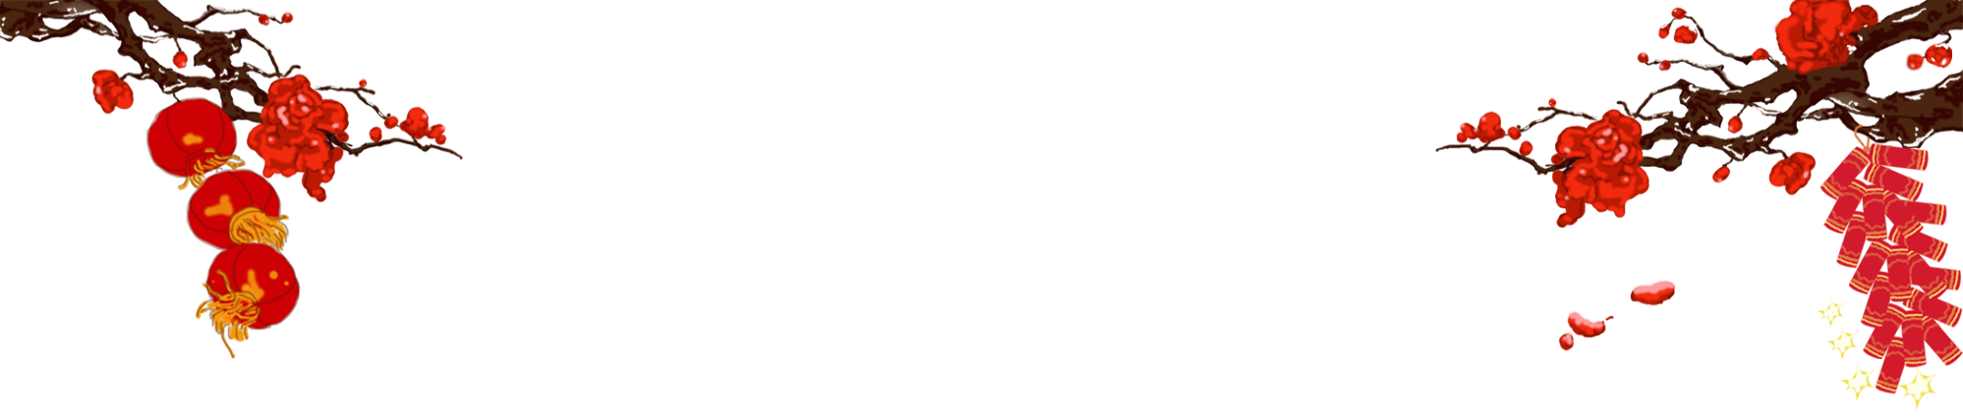

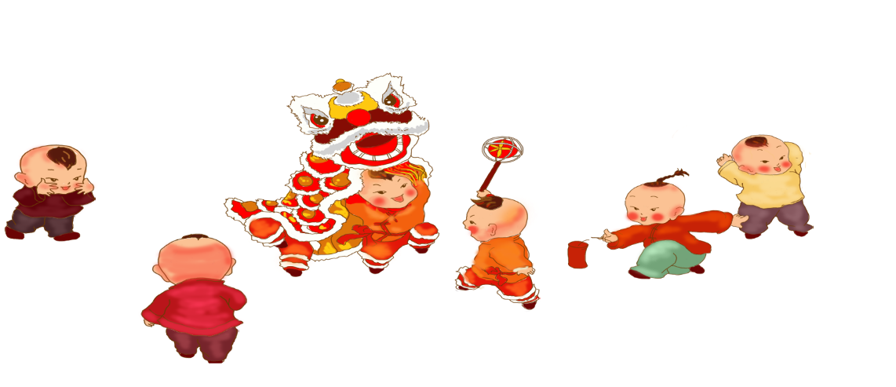
舞狮
Chinese Lion Dance

Slide 2
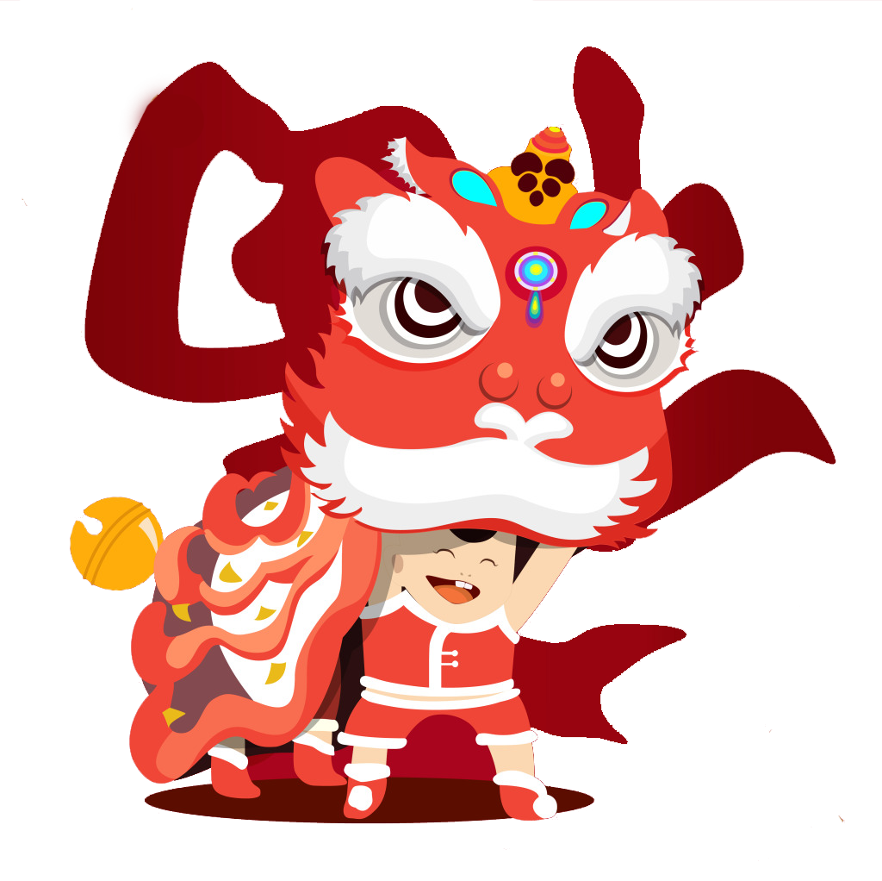
Content
History and Origin
Two Types of Dance
Basic Movement
Cultural Significance

Slide 3
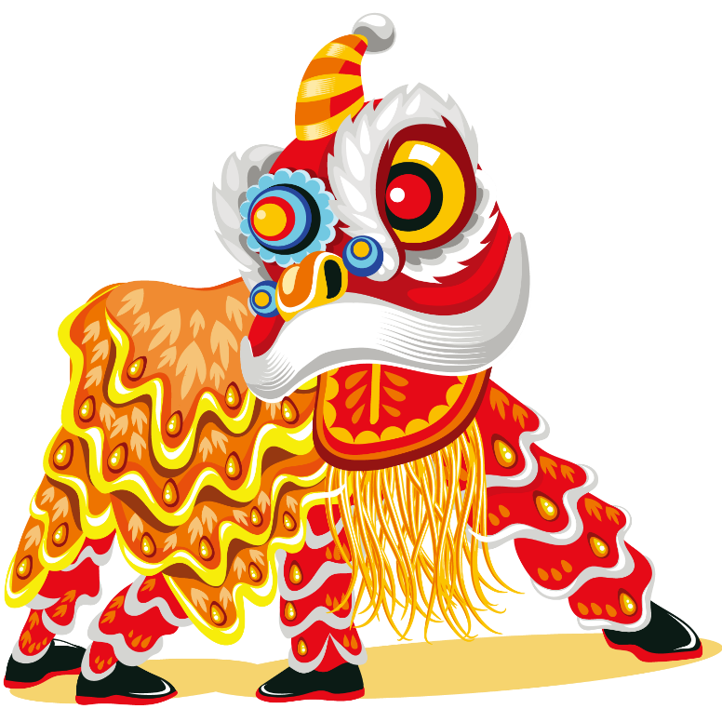
History and Origin
the Eastern Han Dynasty
It originated from ancient exorcism rituals designed to drive away evil spirits and pray for peace and good harvests. Over time, the Lion Dance gradually evolved into a popular folk performance.
Tang Dynasty —— royal court entertainment
performed for the emperor, symbolizing prestige and prosperity
Five Dynasties and Ten Kingdoms period
as people from northern China migrated south, the Lion Dance spread to the Lingnan region, where it eventually developed into two distinct styles
—— the Southern Lion and the Northern Lion

Slide 4
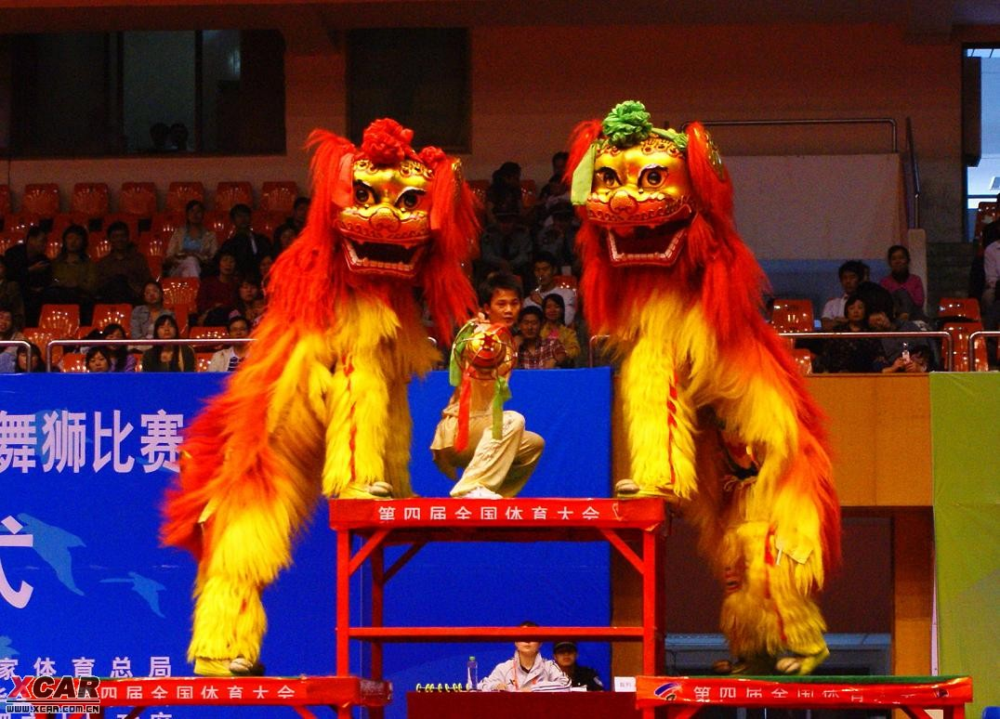
Northern Lion Dance
The Northern Lion looks more like a real lion. It has a furry golden body and simple head design. It has close relations to kungfu Chinese martial arts. Northern lions often performed in pairs. One male lion and one female lion. The Northern Lion focuses more on acrobatic movements like jumping, rolling, and flipping.

Slide 5
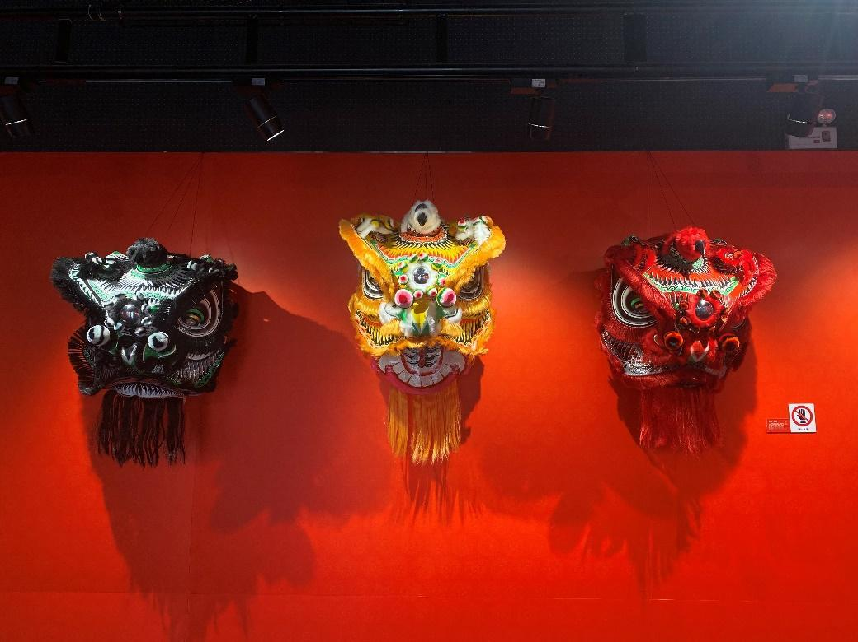
Southern Lion Dance
the Southern Lion, also known as awake lion, looks more expressive and vivid. The southern lion dance is a performance based on the study of a lion’s behavior, with an emphasis on actions like scratching and shaking of the body. Traditionally, Southern Lions are designed based on famous heroes like Liu Bei, Guan Yu, and Zhang Fei, each with different colors and personalities.

Slide 6
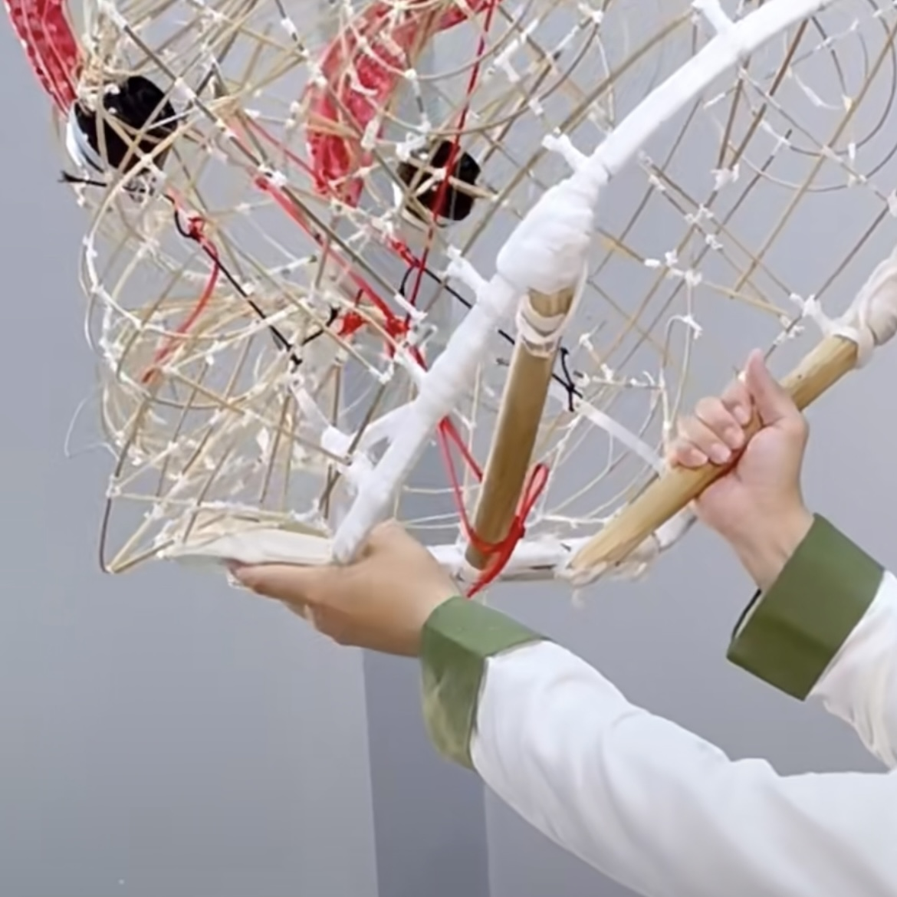
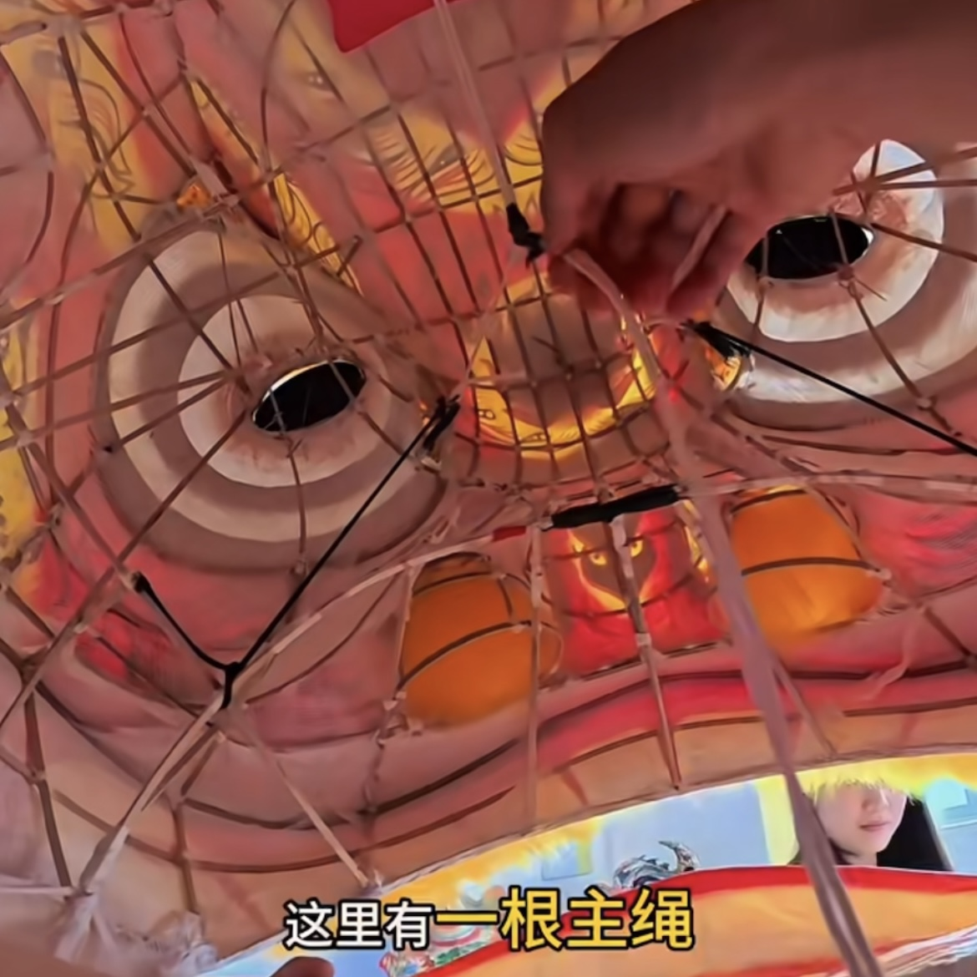

Slide 7
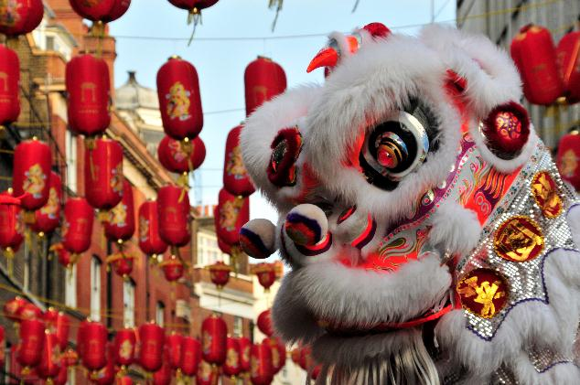
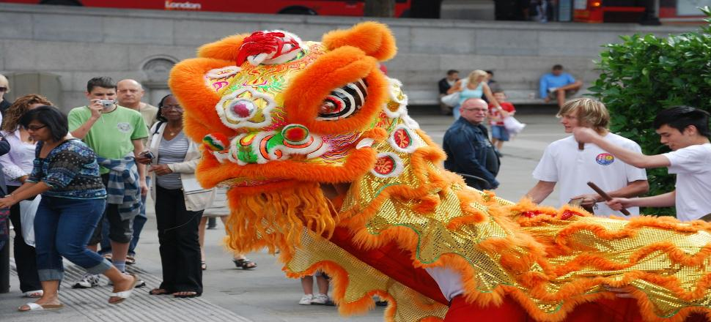
Cultural Significance
As a unique art form, the Lion Dance carries rich history and profound cultural meaning, showcasing the wisdom and creativity of the Chinese people. People perform lion dances at big occasions to bring good fortune and chase away evil spirits.
Today, the Lion Dance is also a vital cultural link among Chinese communities around the world, uniting people through shared heritage.

Slide 8

图片信息来源于知乎、百度、bilibili、课本

