Slide 1

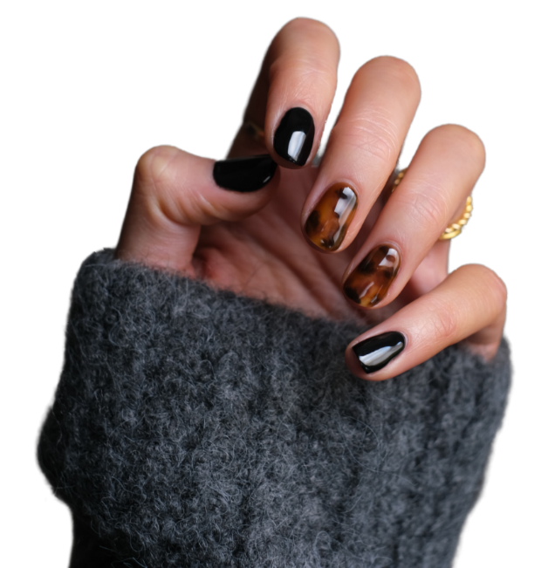
Nail Art
The Journey of Chinese Nail Art Culture: From Ancient to Modern Times
Speaker: Luo Jiaxin

Slide 2

CONTENTS
The Evolution of Nail Art Over Millennia
01
The Cultural Symbolism of Nail Dyeing in Ancient Times
02
Ancient vs. Modern: How Vastly Our "Nail Philosophies" Differ!
03

Slide 3
01
The Evolution of Nail Art Over Millennia

Slide 4
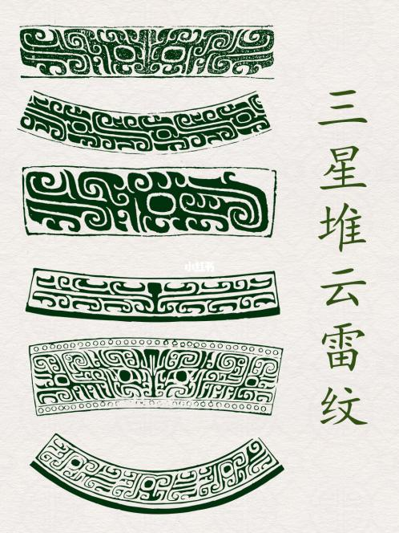
The Origins of Nail Art Culture: the Shang and Zhou Dynasties
01
For priests
During rituals, priests painted cloud-and-thunder patterns on their nails to seek blessings from their ancestors.
02
For noblewomen
Noblewomen applied a mixture of beeswax and egg whites to their nails, making them gleam with a translucent luster.

Slide 5
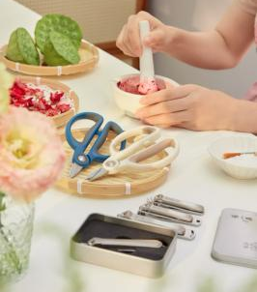
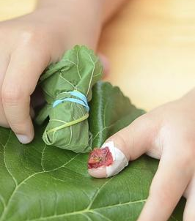
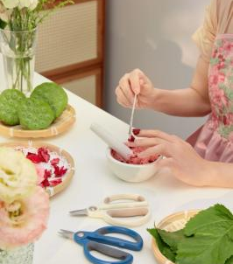
The Prosperity of Nail Art Culture: the Tang and Song Dynasties
Application
Applying the paste evenly to the nail surface, covering up to the cuticle
Crushing
Wrapping
Crushing petals into a paste and mixing with a small amount of alum
Wrapping nails in cloth or lotus leaves and securing with cotton thread

Slide 6
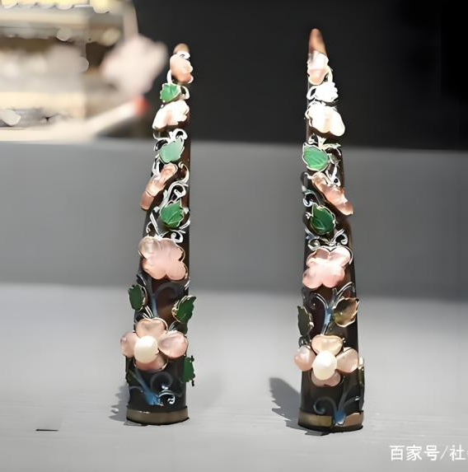
The Opulence of Nail Art Culture: the Ming and Qing Dynasties
01
02
Nail Guards
Craftsmanship
Empress Dowager Cixi’s gold nail guards weighed 80g, inlaid with 12 Dongzhu pearls.
A single openwork chased floral nail guard required three craftsmen to work for 45 days.

Slide 7
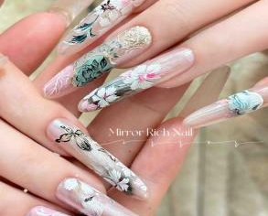
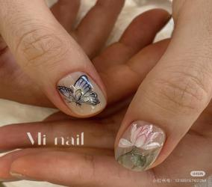
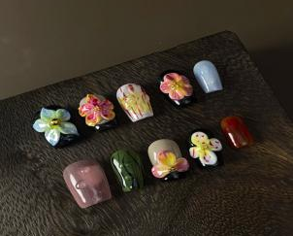
The Diversity of Nail Art Culture: the Modern Era
Gel Nails
Nail Tips
3D Gel Sculpture

Slide 8
02
The Cultural Symbolism of Nail Dyeing in Ancient Times

Slide 9

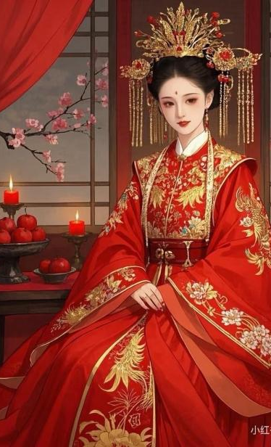
Crimson Vows at Fingertips
Brides dyed their nails with cinnabar (a vermilion-red mineral pigment), embodying fidelity. And the deeper the color, the stronger it symbolized marital fidelity.

Slide 10
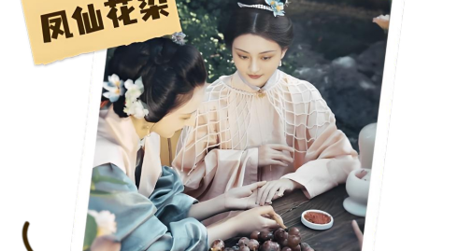
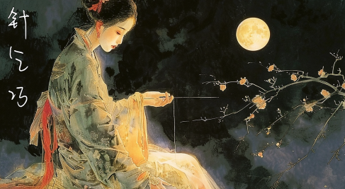
Qixi and the Quest for Skillfulness
On this festival, dyeing nails has become a ritual. Females stained their nails with balsam flowers, praying for dexterity and craftsmanship.

Slide 11
03
Ancient vs. Modern: How Vastly Our "Nail Philosophies" Differ!

Slide 12
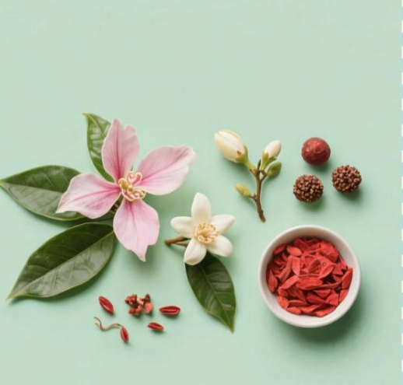

Materials
VS
Balsam petals (pink/red)
Gardenia(pale yellow)
Cinnabar(vermilion)
Traditional nail polish
Gel polish

Slide 13
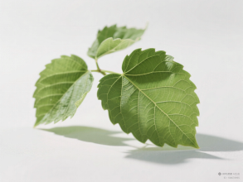
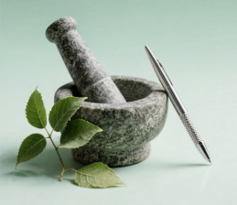
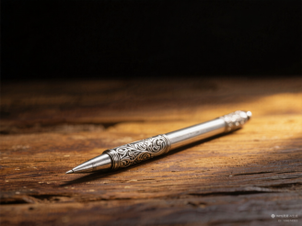
Tools
Cloth or Mulberry leaves
Mashing flowers
Drawing patterns
01
02
03
Brushes or Silver-tipped styluses
Mortar and Pestle
Wrapping nails

Slide 14
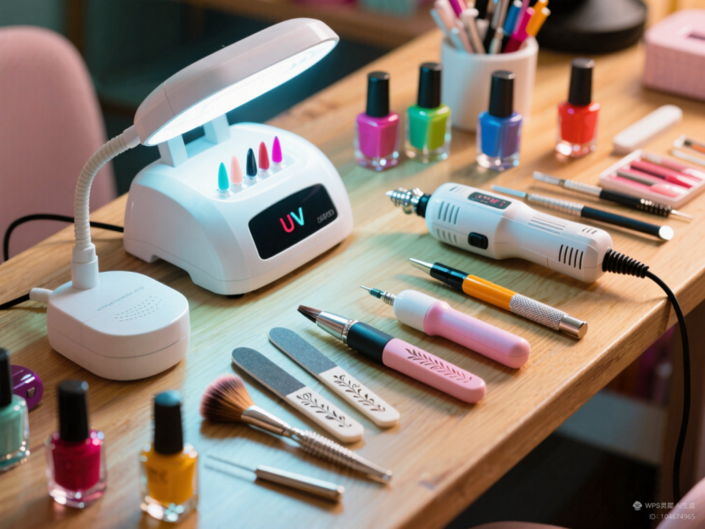
Tools
an UV lamp
an electric nail drill
a carving pen
a nail file
a nail brush

Slide 15
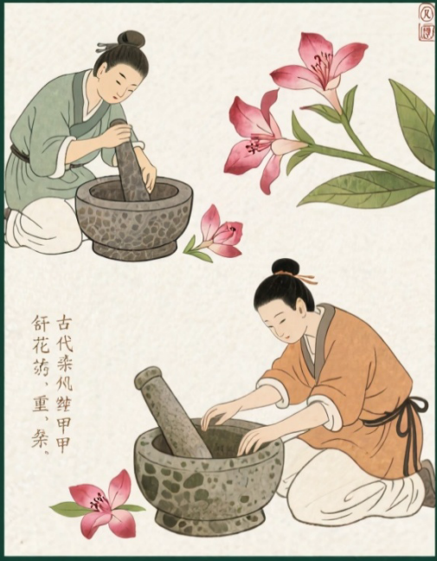
Techniques
25 hours
Mashing
Repeating
About 30 minutes
Three times
01
02
03
Wrapping
More than 8 hours

Slide 16
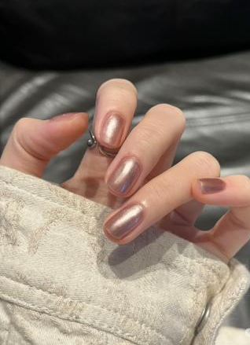
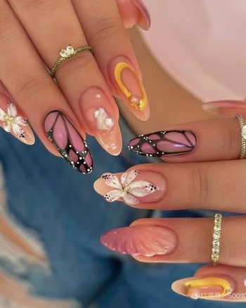
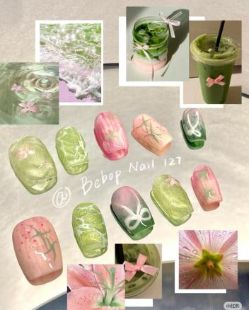
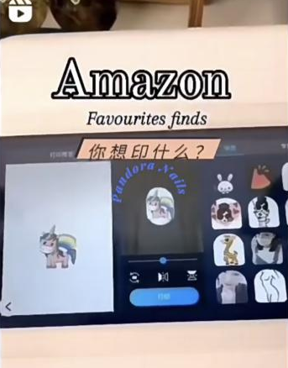
Techniques
Traditional Nail Polish
3D Gel Sculpture
Nail Tips
Tech Integration

Slide 17
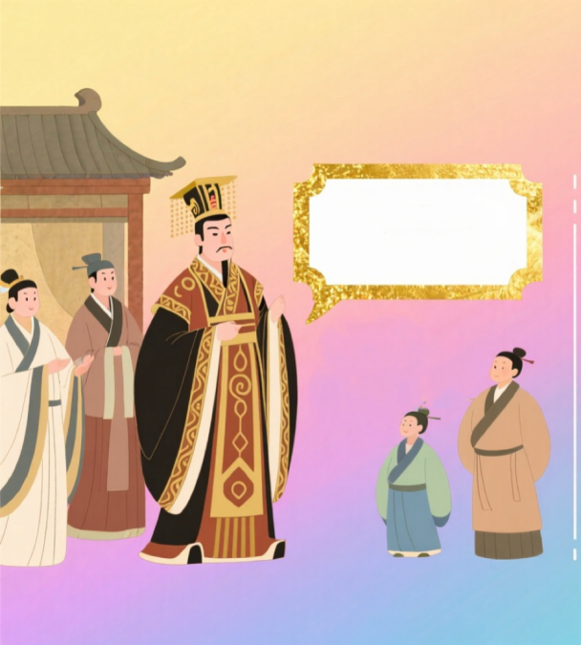
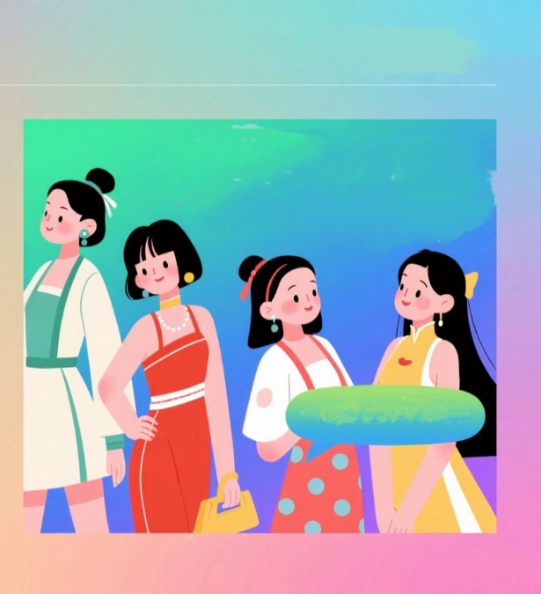
Functions
Red nails = I’m confident today
Cartoon nails = I’m still a girl at heart
The color of my nail represents my social rank.
Time to glam up for the holiday!
French Manicure=I want to be gentle

Slide 18
THANKS
感谢您的观看

