Slide 1
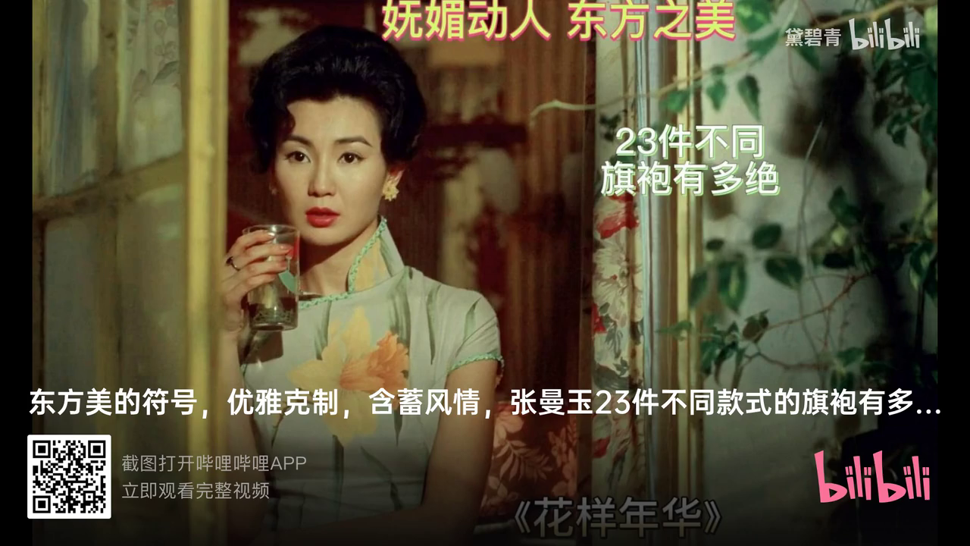

Slide 2
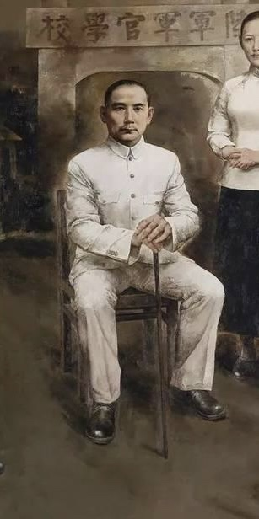
4. Chinese Tunic Suit(Zhongshan Zhuang)
Also called the Yat-sen Suit , it is designed by Dr. Sun Yat-sen by combining the western-style suit and Chinese attire. It has a turn-down collar and four pockets with flaps. As Chairman Mao Zedong worn it quite frequently, it is also called the Mao Suit by westerners. It is the main attire from the founding of the People's Republic of China in 1949 till 1980, s. The country's leaders still wear it today when attending important occasions, such as military parades.

Slide 3

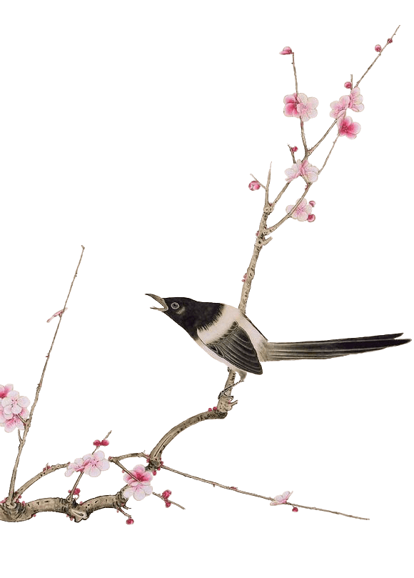
Ⅲ. Chinese Traditional Clothing Elements

Slide 4
There are many old stories in ancient Chinese civilization, and Chinese traditional elements come up with the tenacity of the Chinese nations long history. Different times has their unique cultural connotations and form elements, which include Chinese architecture, costumes, traditional Chinese painting and folk art etc and those cultural connotations and form elements are precious heritage that the ancestors leave to their off-springs(后代）.

Slide 5
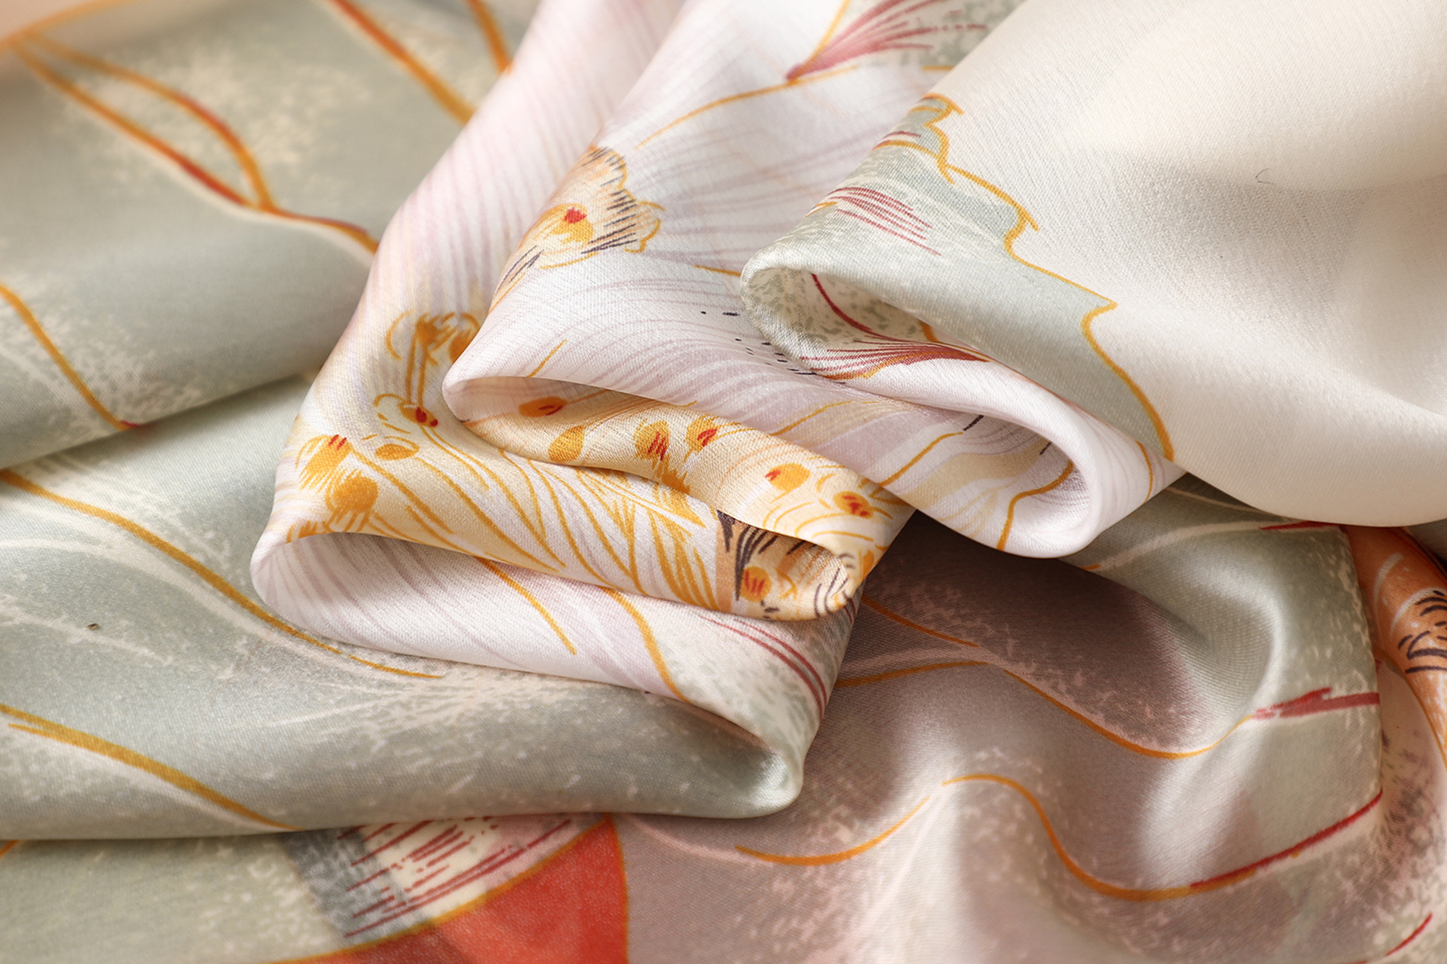
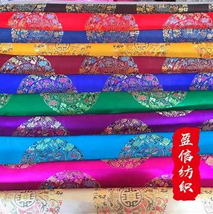
Chinese Traditional Elements
Chinese Silk
cloth of brocade
Chinese tunic suit

Slide 6
Ⅳ. Chinese Traditional Clothing Design

Slide 7
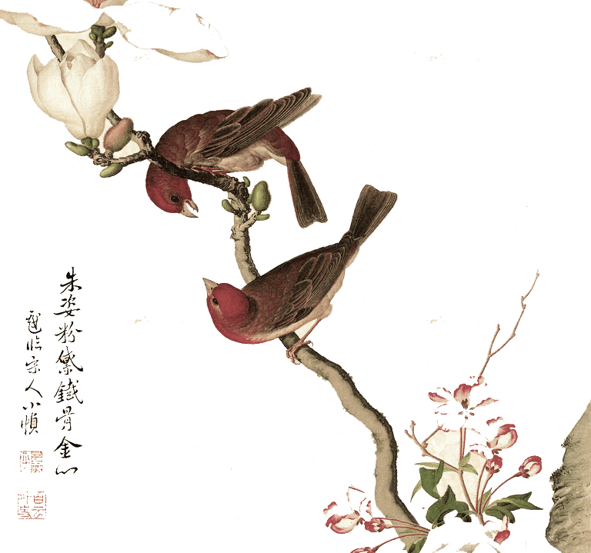
Chinese clothing always emphasizes symmetry and balance.（对称和平衡）
Chinese traditional clothing design is particular about proportion（比例）.

Slide 8
Ⅴ. Chinese Traditional Clothing Colors

Slide 9
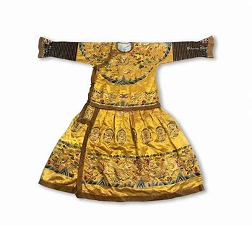
Green, white, yellow, red, black , the five colors, form the Chinese traditional color system. They have obvious implied meaning and identification.
Black stands for that the dark heaven, and yellow stands for the earth at dusk, and black and yellow stand for the heaven and the earth , and they are mostly used in the Kings' clothing.
In Chinese traditional clothing colors red has evoluted from the original noble characteristic to the civilians characteristic.

Slide 10
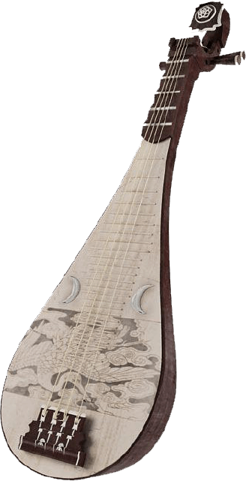
Ⅵ. Conclusion
Chinese traditional culture is an indispensable source of inspiration in fashion design. Therefore, we should advocate the national advanced culture, make the Chinese traditional culture achieve the development in the clothing design.

Slide 11
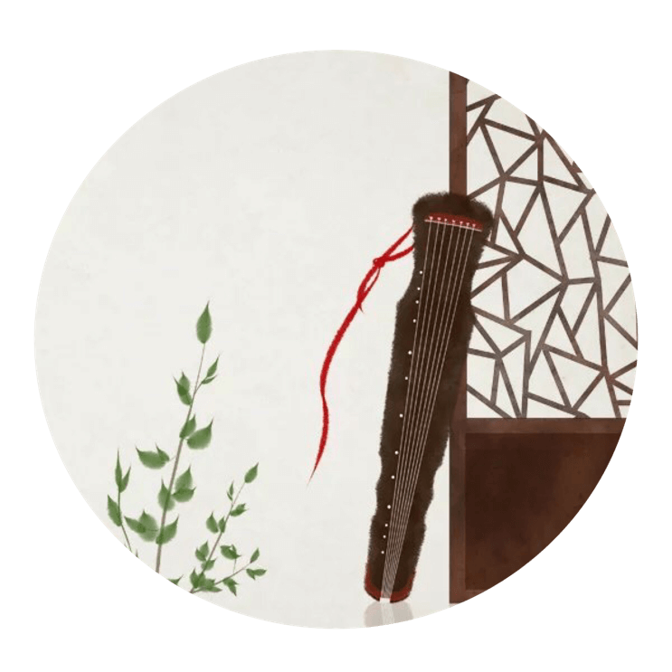
Thank you for your listening

