Slide 1
The Eastward Spreading of Western learning
Xi Shuhan
Wang Qi
English Translation

Slide 2
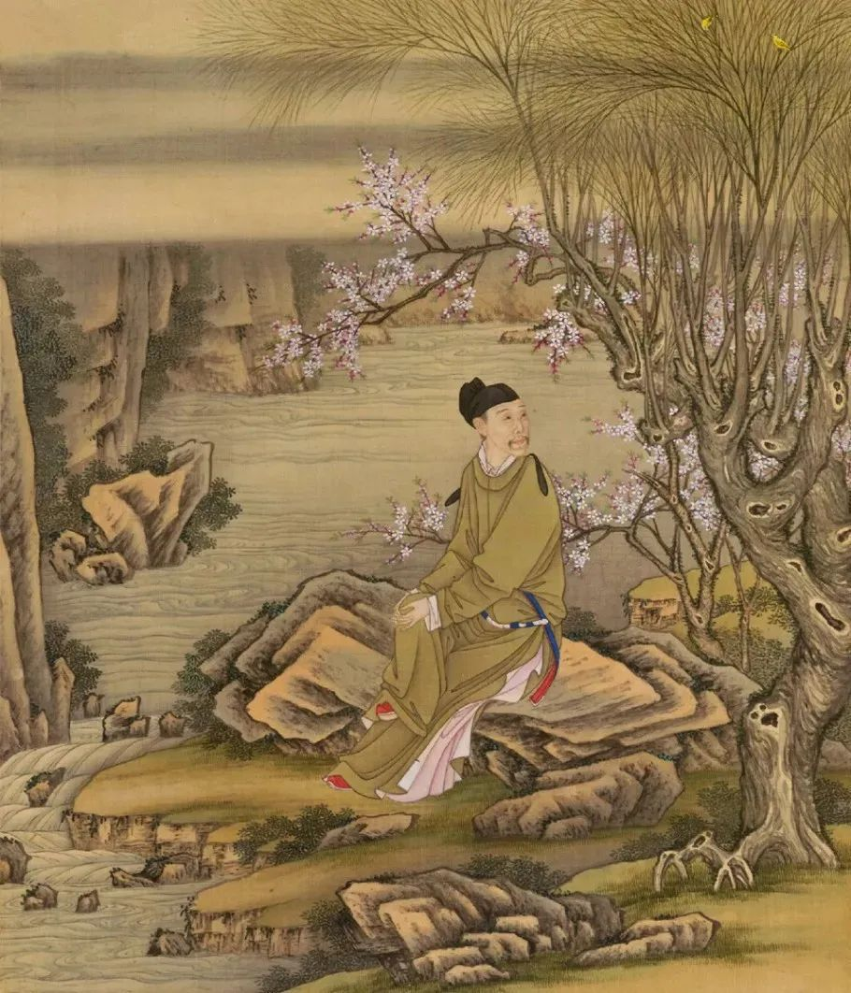
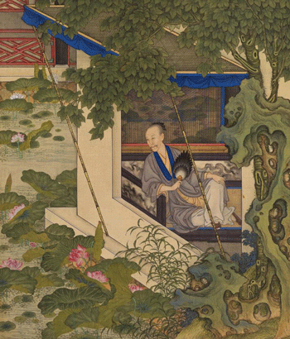
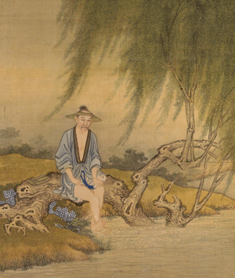
WHO

Slide 3
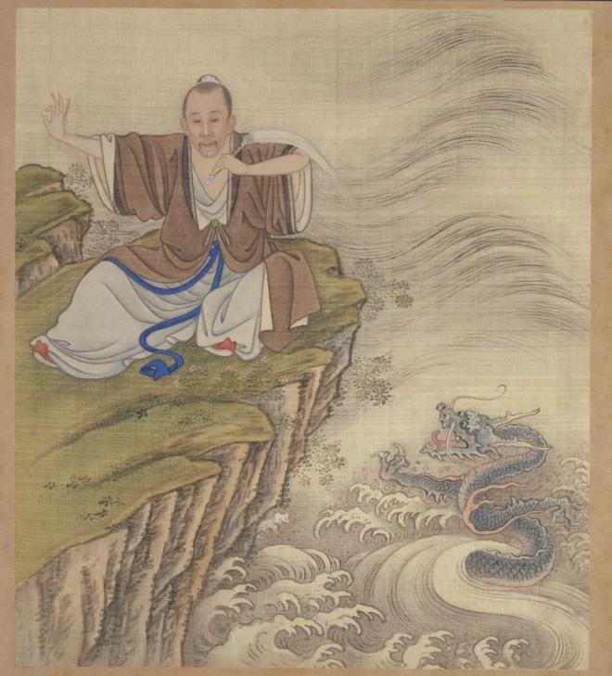
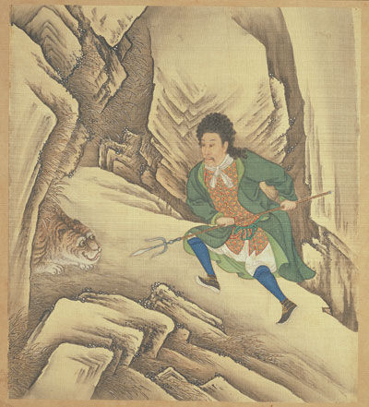
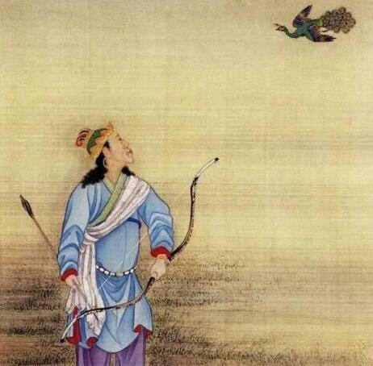
Which one attracts you most

Slide 4
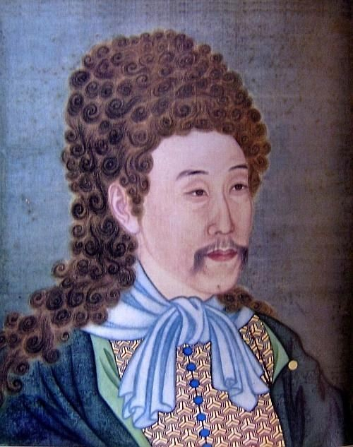
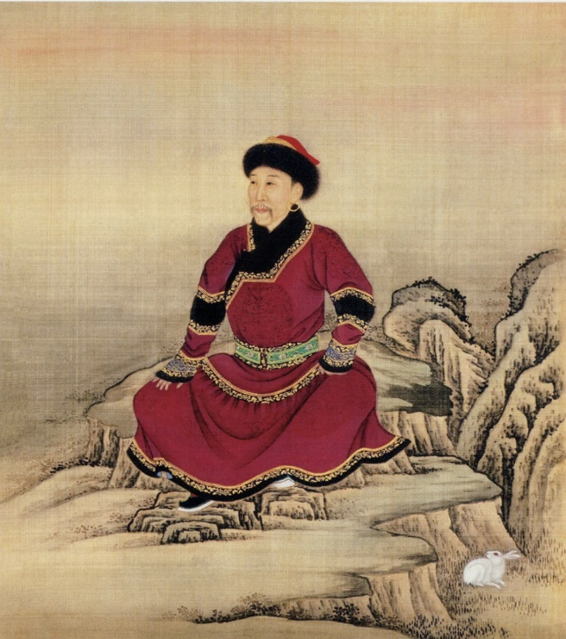
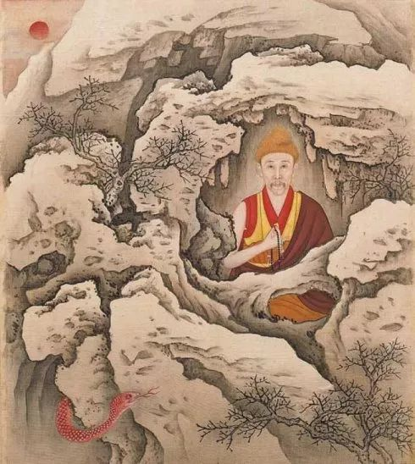
WHY
-- Yongzheng play figure

Slide 5
to keep a low profile in the contention for the throne
to show his embrace towards different ethnics and religions
to please his father – Emperor Kangxi

Slide 6
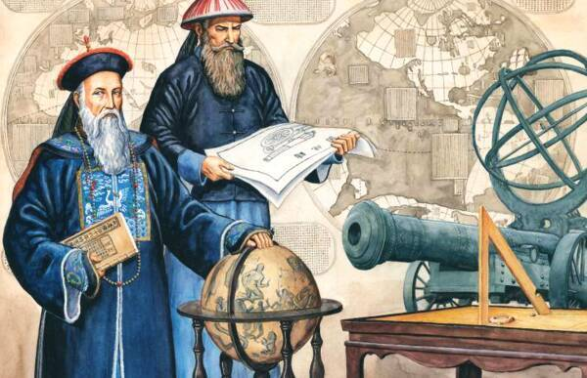
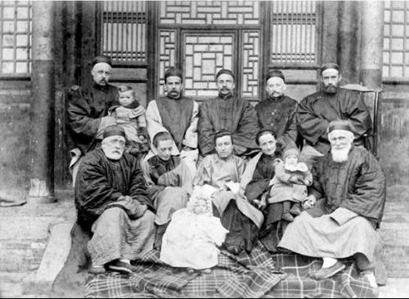
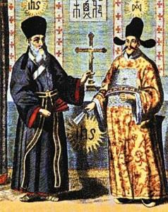
The Eastward Spread of Western Learning

Slide 7
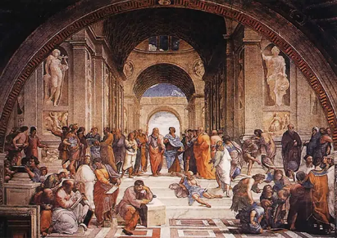
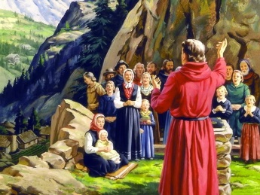
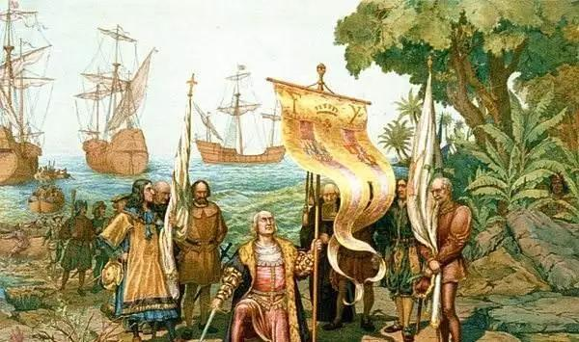
Background
Renaissance
New Shipping Route
Religion Reform
14c-16c
16c
15c-16c

Slide 8
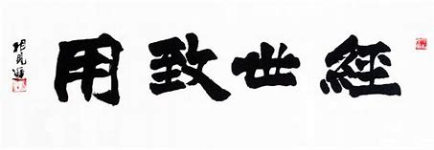
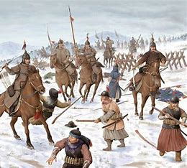
pragmaticism
The war between Ming dynasty and Qing dynasty

Slide 9
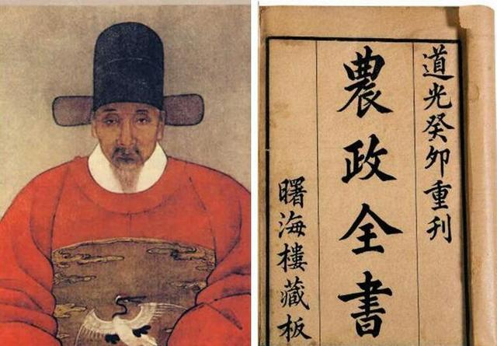
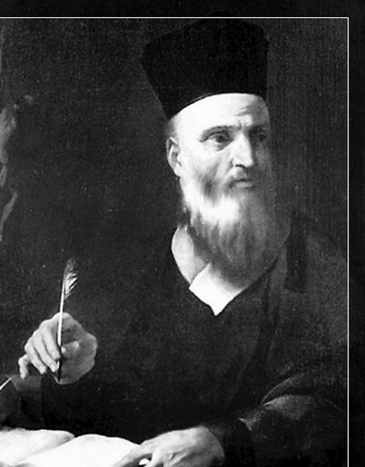
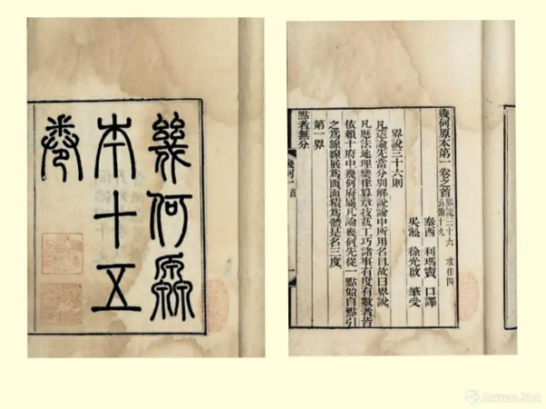
Matteo Ricci
Italian
Taixi Confucian scholar
泰西儒士
《几何原本》
The Elements
徐光启

Slide 10
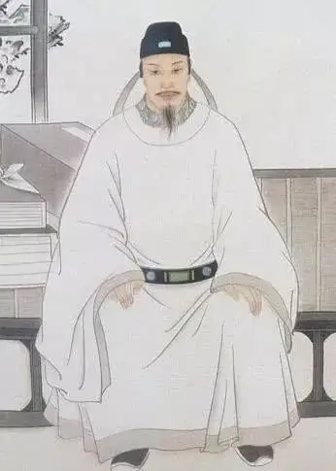
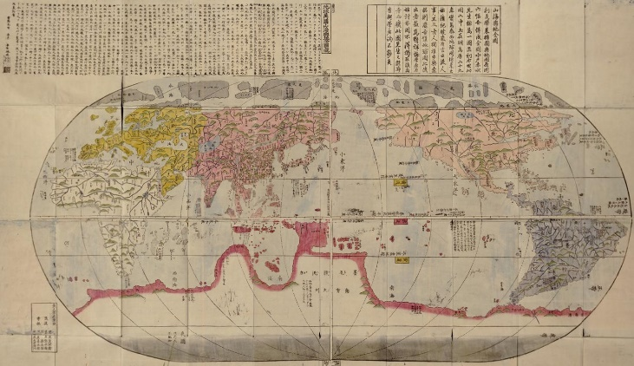
Matteo Ricci
《坤舆万国全图》
Great Universal Geographic Map
李之藻

Slide 11
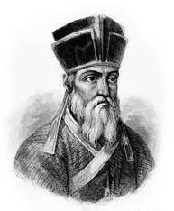
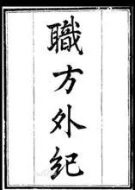
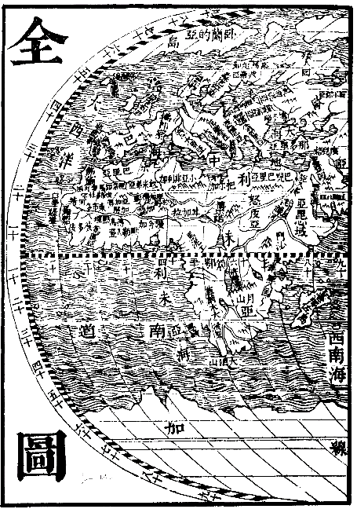
Giulio Aleni
Italian
艾儒略
Confucius from the West
西来孔子

Slide 12
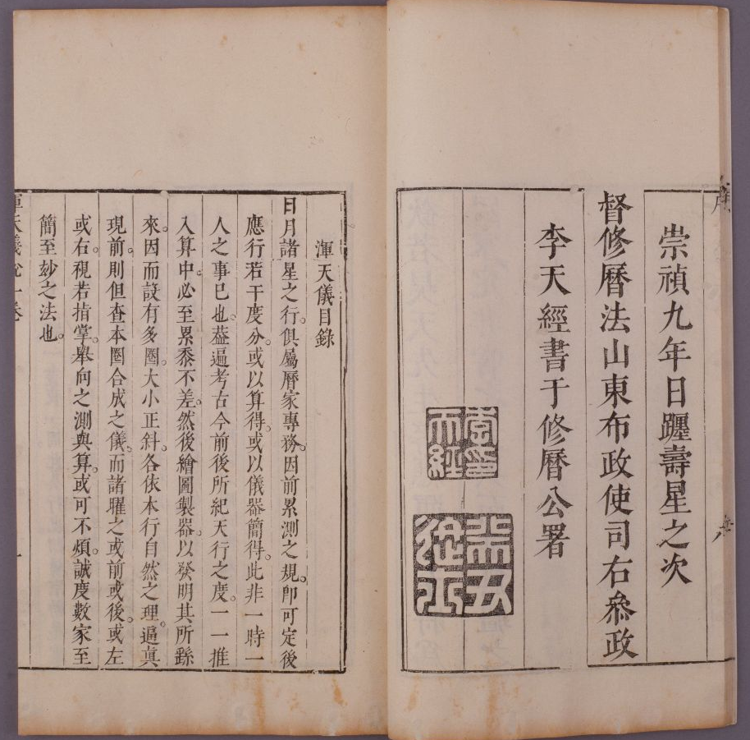
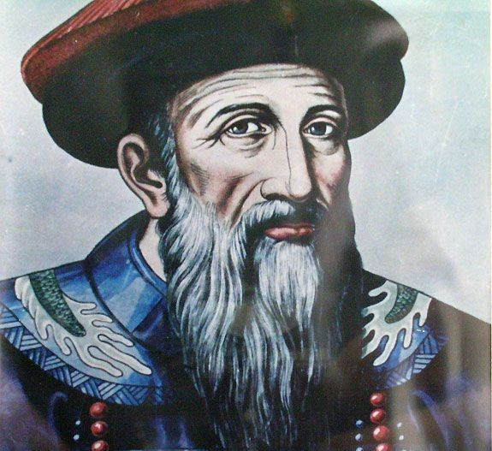
J.A.Schall Von Bell
German
汤若望
The Chongzhen Almanac
《崇祯历书》

Slide 13
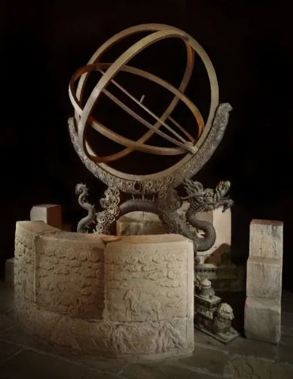
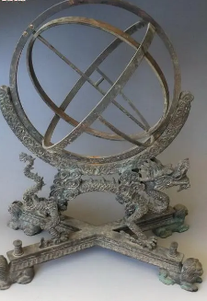
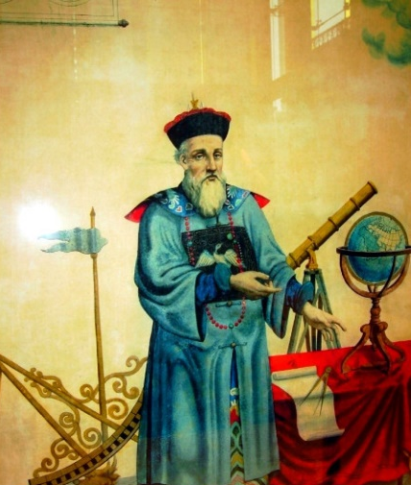
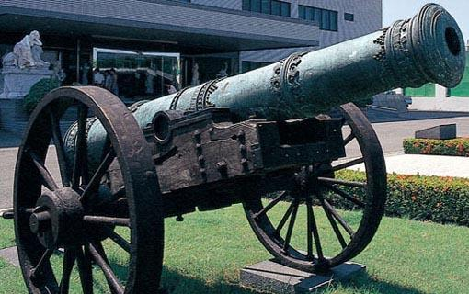
Ferdinand Verbiest
南怀仁
ecliptic armillary sphere
黄道经纬仪
equatorial armillary sphere
赤道经纬仪
Shenwei General Gun
神威将军

Slide 14
|| Behind the decline ||
Religion
Ideology
Economy
Ethnic division
Politics

Slide 15
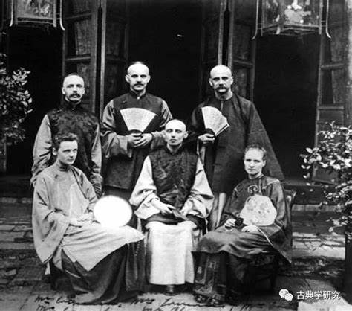
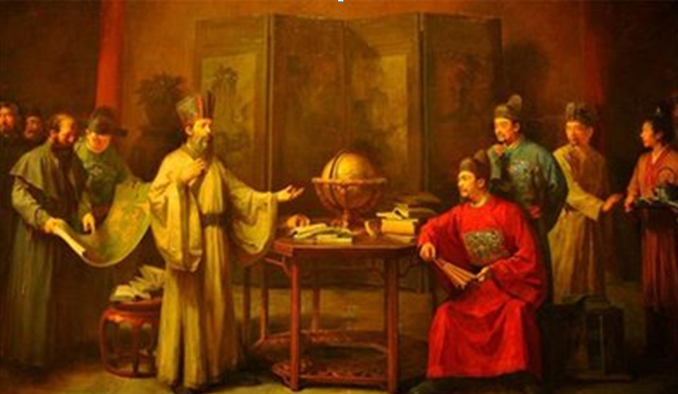
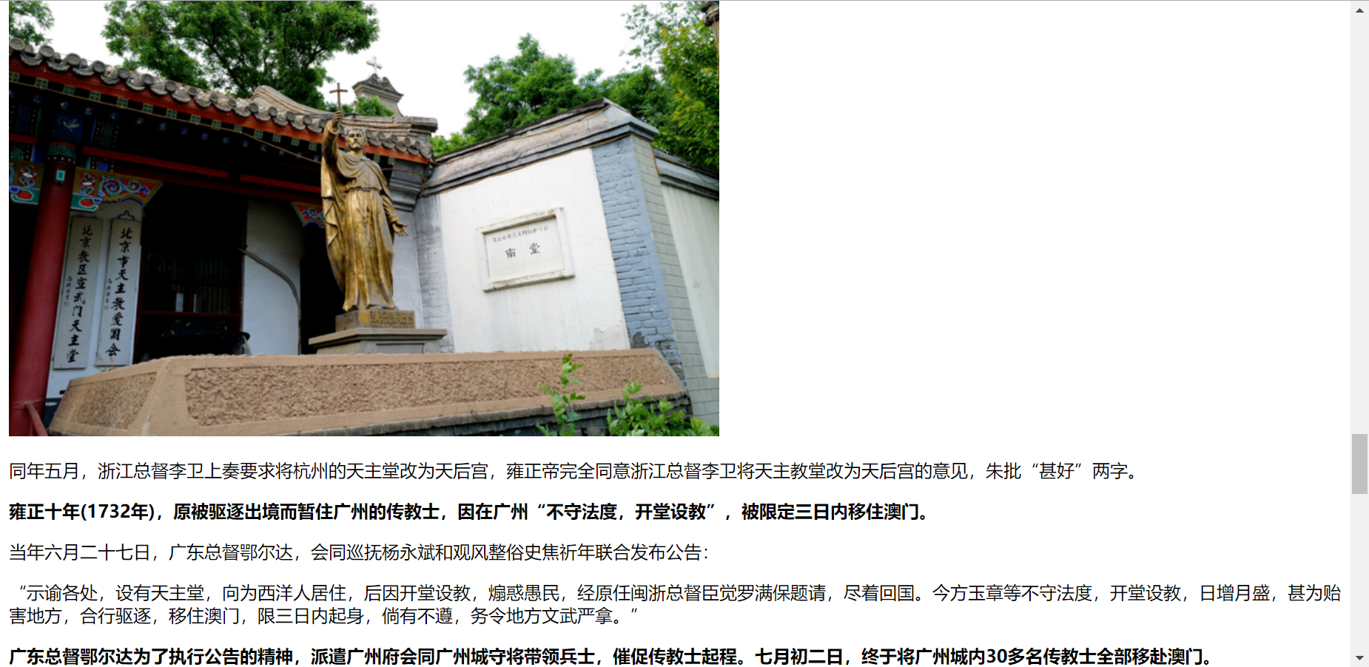
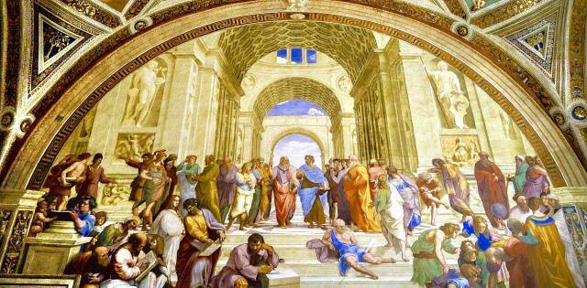
Chinese
Rites Controversy
→
↓
“Fusion of Catholicism and Confucianism”
Prohibition against
the Catholicism

Slide 16
References
[1]刘波.略论明末清初“西学东渐”之成因[J].成都师范学院学报,2013,29(12):121-124.
[2]刘大椿.明末清初的西学东渐与中国近现代科技转型[J].中国人民大学学报,2018,32(06):152-158.
[3]骆利红.明末清初的“西学东渐”论述[J].黑龙江史志,2014(08):55-57.
[4]徐先知.明末清初西学东渐成因浅析[J].新西部(下半月),2007(03):170+207.

Slide 17

谢谢观看
敬请指正
thanks

