Slide 1

中华典籍外译
Chinese Classics Translation for Master Students of Translation Studies
湖南师范大学 2022年2月25日-2021年6月10日
中国文化基础 周五第九和第十节课14:30-16:10，
上课地点：外国语学院大楼502室
助教：Li Xin 李欣 – Session no. 3
吴漠汀特聘教授 Distinguished Professor Dr. Martin Woesler
培高德 教授 Professor Dr. Cord Eberspächer
湖南师范大学外国学院 Foreign Studies College, Hunan Normal University

Slide 2
Schedule 学期题目
1 2.25 Organizational things, intro to the concept of a „classic“
2 3.4 Canonization
3 3.11 Early Translation of Chinese Literature
4 3.18 Reception of the Red Chamber Dreams in the West
5 3.25 How to make people read classics again?
6 4.1 Western Classics in Chinese clothes: The example of Utopian Literature
7 4.8 Attractiveness of Chinese Classics as part of softpower
8 4.15 Chinese Classics in the West: The Example of Germany
9 4.22 Sinicization – Politics for Cultural Export: The Example of the Chinese classics
10 4.29 Chinese Classics in World Lit. Anthologies and World Literary History Books
11 5.6 Translation of Modern Classics: Mo Yan, Yu Hua, Liu Cixin etc.
12 5.13 Chinese Classics on Overseas Bookfairs
13 5.20 Cinema Movie Adaptions of Chinese Classics
14 5.27 Lessons to learn from the Classics: Integration or Sharpening the Cultural Profile?
15 6.3 Final Discussion
16 6.10 Final Exam

Slide 3




中国文学早期翻译
Early Translation of Chinese Literature
for Master Students of Translation Studies
吴漠汀教授
Prof. Dr. Martin Woesler
Hunan Normal University
Spring 2022

Slide 4
早期中国文学在西方（尤其是德国）的译介 (Early Chinese Literature in the West, especially in Germany)
The first full translations of Chinese literature into Western languages are, except the early translation of the Shijing mostly unknown texts and not representative for national Chinese literature. （早期中国文学的西语(全)翻译大都非著名也非典型）
The first translations were even doubted to be originally Chinese. （受到质疑）
This lecture asks for the historical setting, the role of the translators etc.（考察历史背景和译者角色）

Slide 5
早期中国文学译成西语
First translations from Chinese into Western languages
年代 | 作品 | 语言 | 译者 | 有没有 代表性
647 | 《老子》Laozi [not literature] | 梵文 Sanskrit | 玄奘 Xuan Zang | (非文学)
1254-1569 | 没有提到文学：Did not mention literature: 意大利商人、旅行家 马可·波罗 Marco Polo (1254-1324) : 《马可·波罗游记》 | 威尼斯商人、旅行家 尼科洛·达·康提 Niccolò de' Conti (1395–1469) | 多明我会葡萄牙传教士 达克鲁斯Dominican Gaspar da Cruz: 《中国志》zhì Treatise on Things Chinese (1569))
1585 | 《中華大帝國史》(中译：何高濟譯，北京：中華書局，1998), 里面提到了《三国》小故事 (mentioned stories of the Three Kingdoms 1522), in: Historia de las cosas mas notables, ritos y costumbres del gran reyno de la China | 西班牙语 Spanish（在罗马发表了）再版了 46次，翻译成7种语言：拉丁语，意大利语，德语，荷兰语，法语，英语 | 門多薩 (Juan González de Mendoza, 1545-1618) – 没有到过中国 | 有代 表性 YES
1592 | 明心宝鉴 – Beng Sim Po Cam (Enlighten und purify the heart) | 西班牙语 Spanish | Juan Cobo (高母羨 Gāo Mǔxiàn, c. 1546–1592) | 没有 代表性

Slide 6
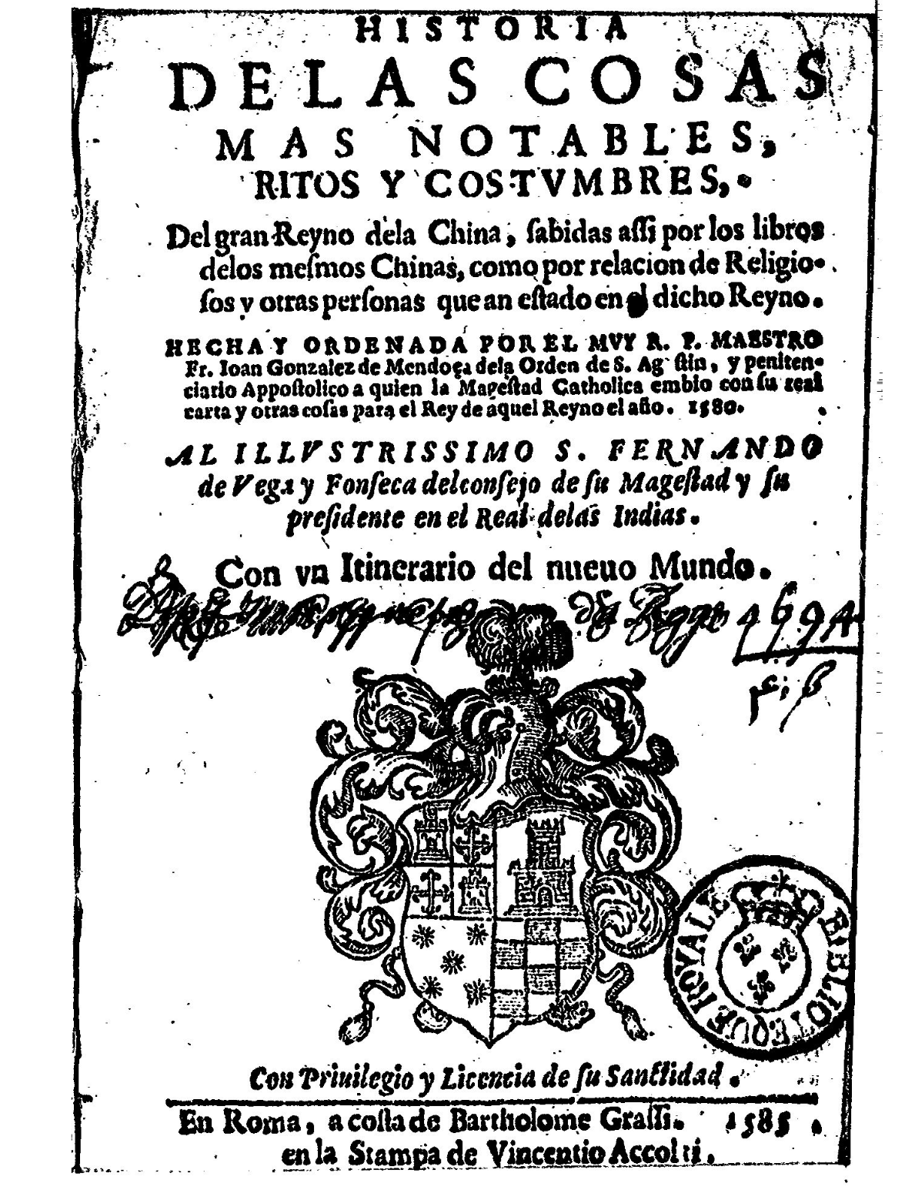

Slide 7
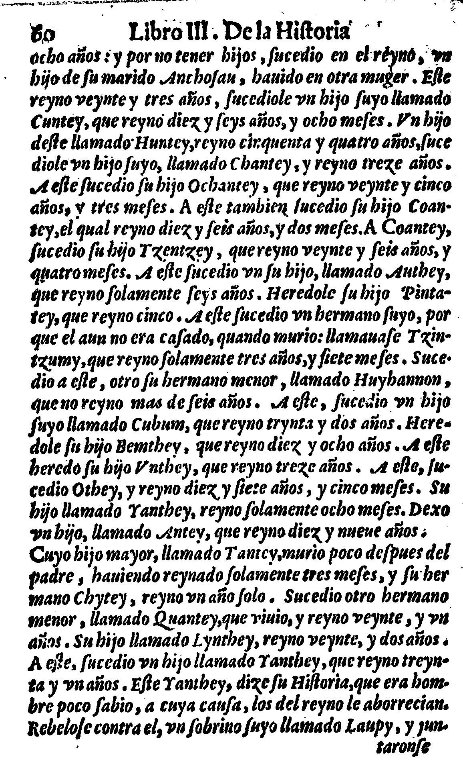

Slide 8
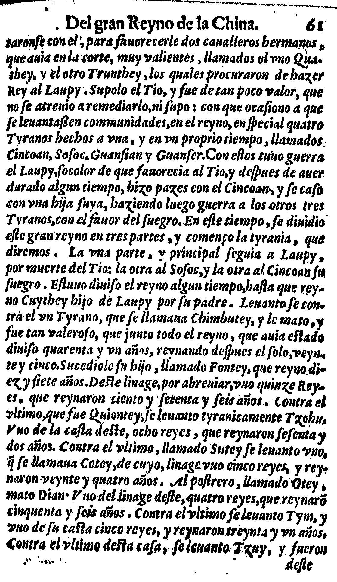

Slide 9
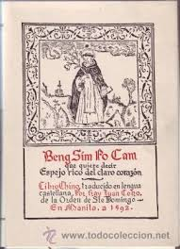

Slide 10
First translations from Chinese into Western languages 早期中国文学译成西语
Year | Title | Language | Translator译者 | Representativity代表性
1593 | Four Books 《四书》 | Latin 拉丁语 | Matteo Ricci | yes
1626 | Five Classics 《五经》(incl. Shijing 诗经) | Latin | Nicolas Trigault | yes
1703 | 《华语官话语法》(Arte de la lengua manda­ri­na): 元杂剧和《水浒传》、《好逑传》、《玉娇梨》等小说 | Spanish | Francisco Varo | no
1719 | Hau Kiou Choaan — The Pleasing History 好逑传》 | 75% English, 25% Portuguese 英，葡 | Wilkinson | no
1720 | Daodejing 《道德经》 | Latin | Jean-Françoi.Noëlas | yes
1722 | 中国的风俗 (incl. 爱情故事) | French法语 | Francois Xavier d’Entrecolles 殷弘绪 | no

Slide 11
早期中国文学译成西语
First translations from Chinese into Western languages
年 | 作品 | 语言 | 译者 | 有没有 代表性
1593 | 《四书》Four Books | 拉丁语 Latin | 利玛窦 Li Madou Matteo Ricci | (非文学)
1626 | 《五经》Five Classics Pentabiblion Sinense (包含《诗经》Book of Songs) 遗失 （Alexandre de la Charme S.J. (1695-1767) as Con-fucii Che-king, ex latino, interpretation P. de la Charme (Stuttgartiae 1830)） | 拉丁语 Latin | 金尼阁 Jin Nígé Nicolas Trigault | 有代 表性
<1646 | Feng Menglong (Li Yu: <1680) | 四大奇书的经典化

Slide 12
早期中国文学译成西语
First translations from Chinese into Western languages
年 | 作品 | 语言 | 译者 | 有没有 代表性
1703 | 《华语官话语法》(Arte de la lengua manda­ri­na): 元杂剧（赵氏孤儿 Zhao shi gu er，老生儿?）和 《水浒传》、 《好逑传》、 《玉娇梨》等小说 | 西班牙语 Spanish | 方济各 瓦罗 Francisco Varo | 元杂剧和《水浒传》有代表性
1719 | 《好逑传》Hau Kiou Choaan — The Pleasing History [怀疑] | 75% 英Eng-lish, 25% 葡萄牙语Portuguese | 詹姆斯 · 威尔金森 James Wilkinson | 没有 代表性
1720 | 《道德经》Daodejing | 拉丁语 Latin | 聂若翰[?] Jean-François Noëlas | （非 文学）

Slide 13
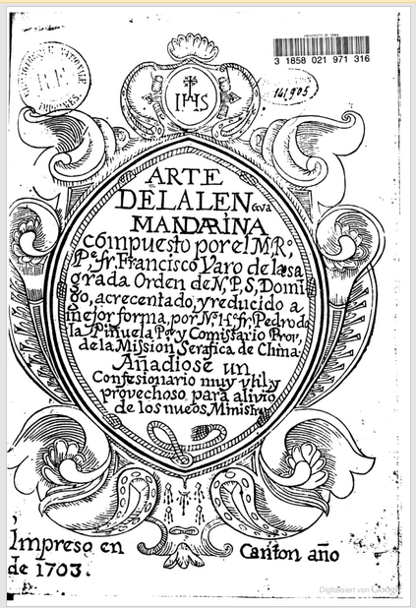
Arte de la lengua Mandarina (1703)
[Ms. 1682]
Copy available in Rome, Bibliotheca Apostolica Vaticana R. G. Oriente III, 246 int. 7

Slide 14
Overview 概览
The earliest translations from Chinese literature into Western languages, is similar. Jesuits translated philosophical texts into Latin in order to find proof for the belief in a single god. The first translations of pure literature were chosen mostly randomly and following personal preferences.
早期中国文学译成西语，与西方文学译成中文的进程相似。耶稣会士将中国哲学文本译成拉丁语，仅志于证明所信之上帝的唯一。早期译成西语的（中国）纯文学作品很大程度上出于机缘和个人的偏好。

Slide 15
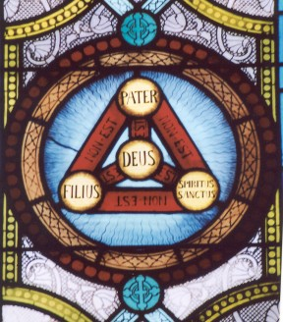
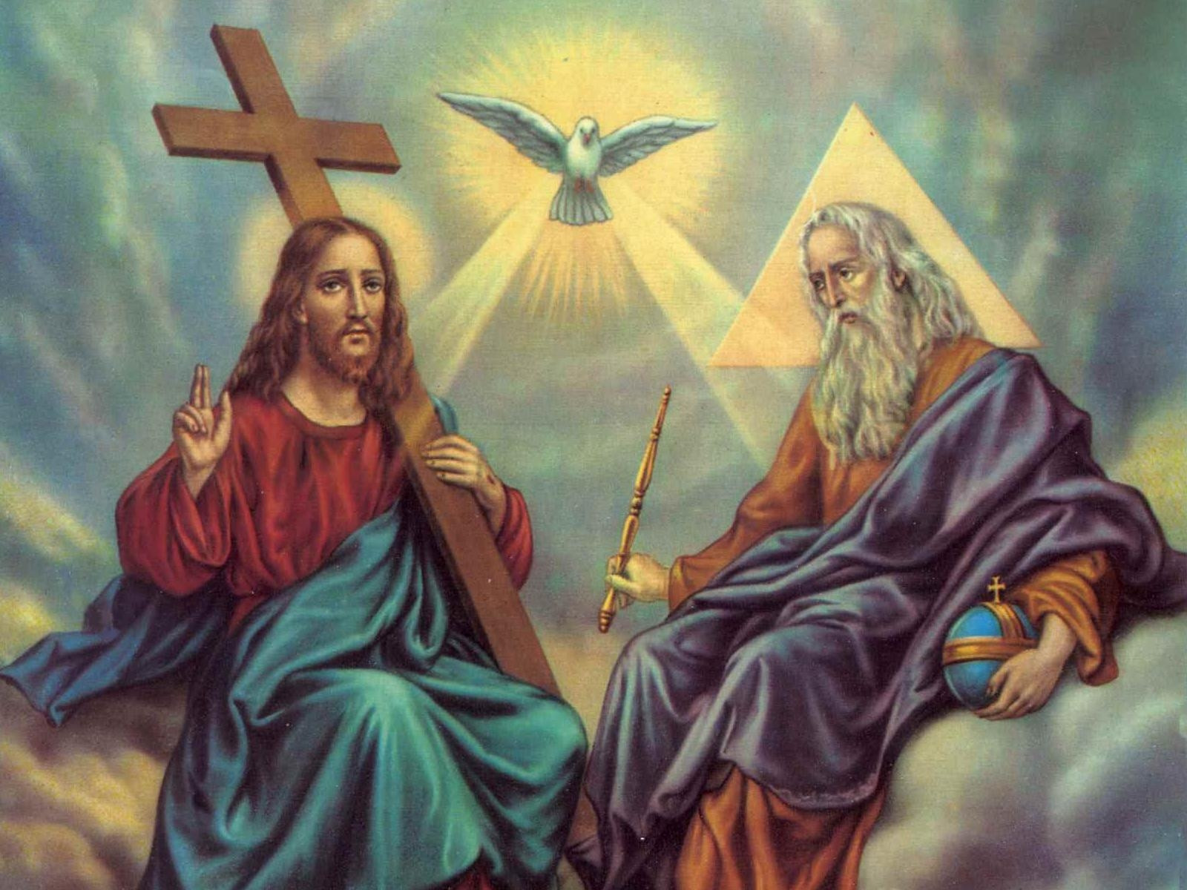
道生一, 一生二, 二生三, 三生萬物
"符象論"(Figurism)

Slide 16
First translations from Chinese into Western languages早期中国文学译成西语
Year | Title | Language | Translator译者 | Representativity代表性
1734 | 赵氏孤儿 Zhao shi gu er (Yuan Drama about Chunqiu )、诗经—中华帝国全志—伏尔泰改编成剧作在法国上演 | French法语 | 马若瑟（Joseph de Premare 1666-1736） | no
1735 | Short Stories《庄子休鼓盆成大道》、《怀私怨狠仆告主》和《吕大郎还金完骨肉》--中 华帝国全志（来源：中国古典小说的早期翻译和传播— 以《好述传》英译本为中心 宋丽娟/孙逊，文学评论，2008-07-15） | French法语 | 殷宏绪(Pered’Eentecro Ues 1662 一1741 ) | no
1761 | Hau Kiou Choaan — The Pleasing History 《好逑传》 | English | Percy | no

Slide 17
1766 | Haoh Kjöh Tschwen, d. i. angenehme Geschichte des Haoh Kjöh《好逑传》 | German | Murr | no
1766 | Hau Kiou Choaan, Histoire chinoise 《好逑传》 | French | Eidous | no
1767 | Chineesche Geschiedenis, behelzeende de gevallen van den Tieh-Chung-u en de jongvrouw Shuey-Ping-Sin 《好逑传》 | Dutch 荷兰语 | Houttuyn | no

Slide 18
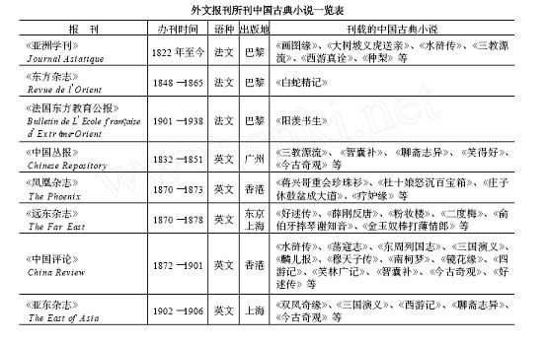

Slide 19
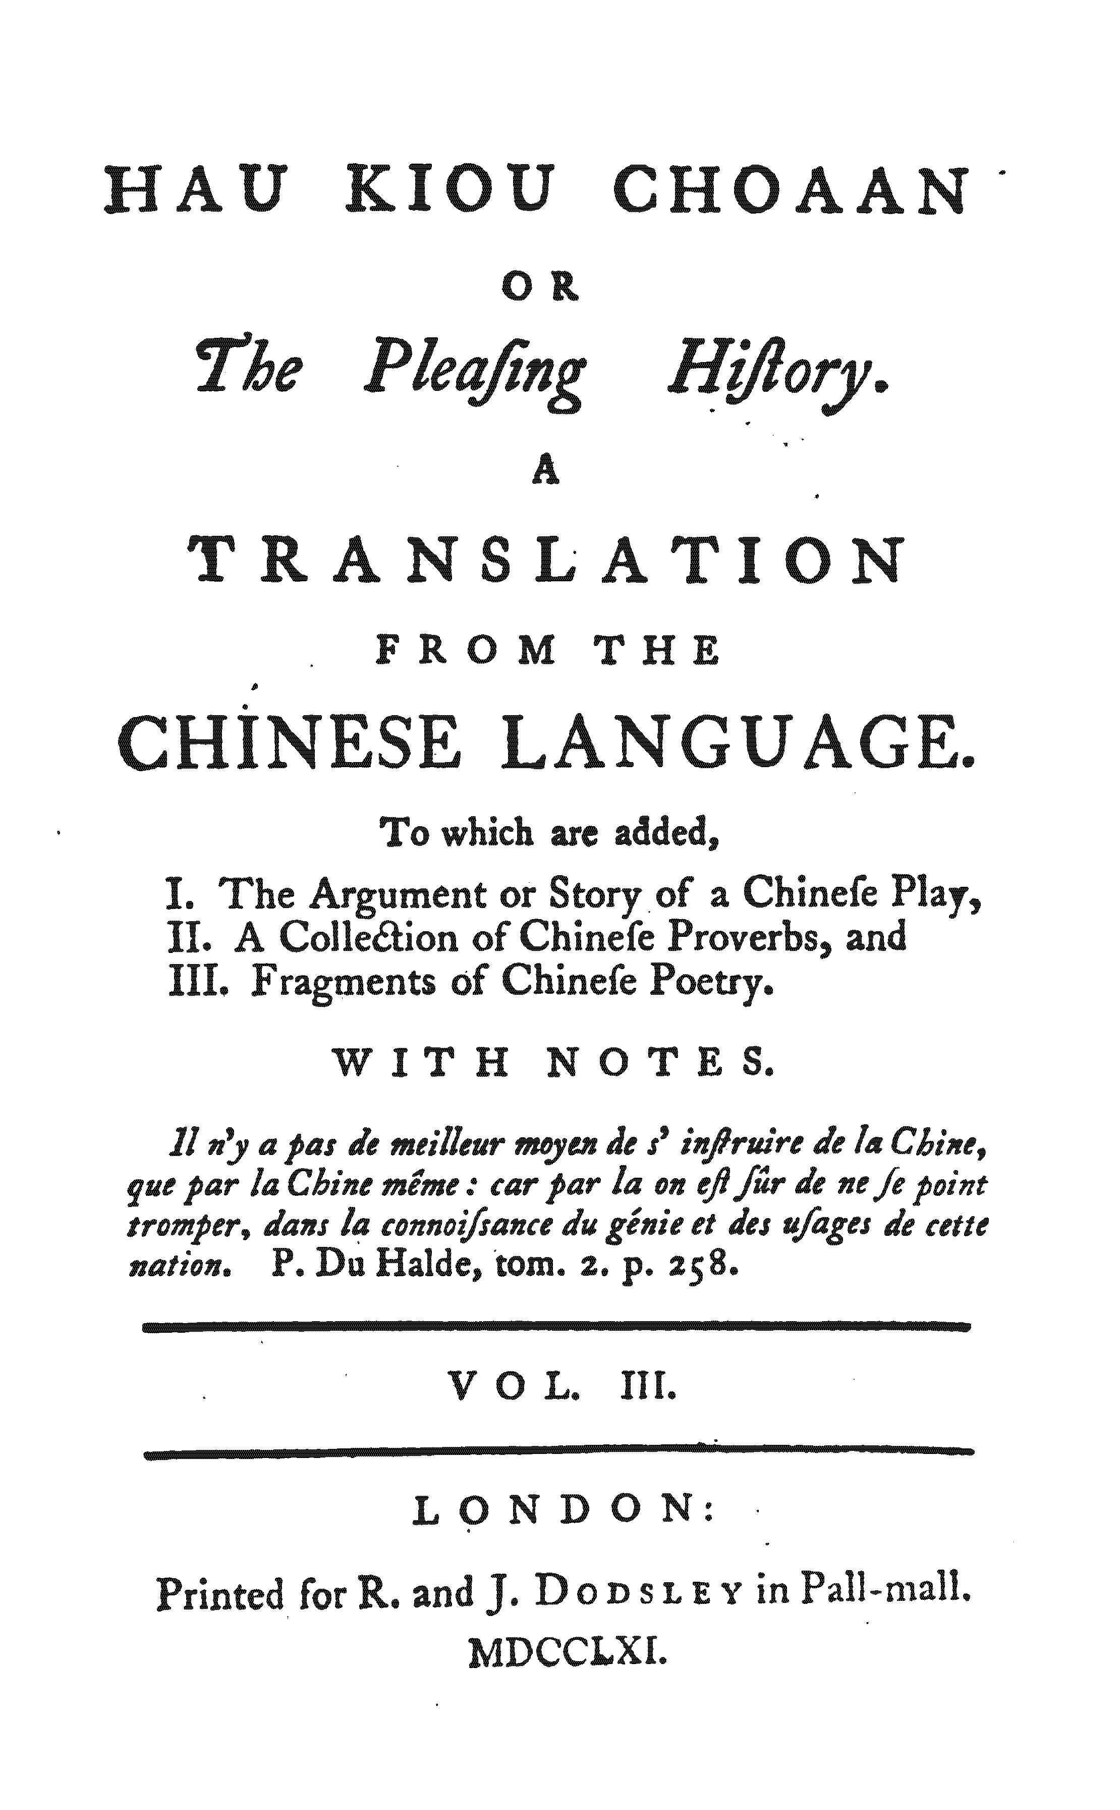
第一部译成西方语言的中国纯文学作品之一《好逑传》的封面1761

Slide 20
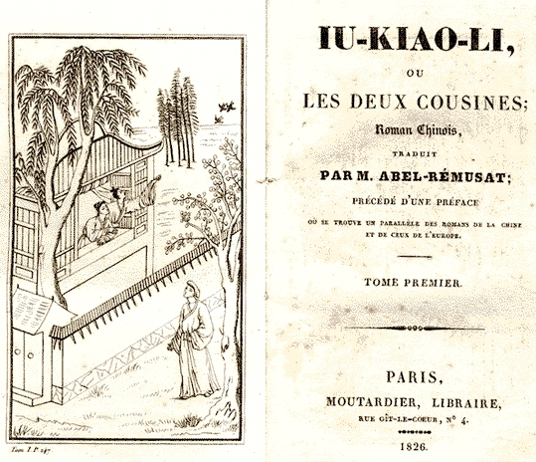

Slide 21
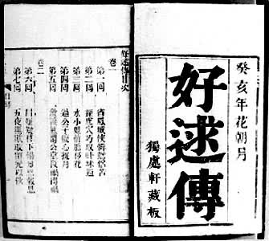
Introduction

Slide 22
年 | 作品 | 语言 | 译者 | 有没有 代表性
1761 | 《好逑传》 Hau Kiou Choaan — The Pleasing History | 英English | 托马斯·帕西 Thomas Percy | 没有 代表性
1766 | 《好逑传》Haoh Kjöh Tschwen, d. i. angenehme Geschichte des Haoh Kjöh | 德German | 穆尔 Christoph Gottlieb von Murr | 没有 代表性
1766 | 《好逑传》Hau Kiou Choaan, Histoire chinoise | 法French | 埃杜斯 M. A. Eidous | 没有 代表性
1767 | 《好逑传》Chineesche Geschiedenis, behelzeende de gevallen van den Tieh-Chung-u en de jongvrouw Shuey-Ping-Sin | 荷兰语Dutch | Erven Vail E Houttuyn | 没有 代表性

Slide 23
1. Forced Marriages (包办婚姻) in History
1，历史上的包办婚姻
The topic of arranged marriages and conventions (like that the gentry/nobility and commoners could not marry) has a long historical tradition in both cultures. It has to be distinguished between an arranged marriage, which may be done by singles looking for a partner on the internet, as well as a forced marriage, which is implemented with pressure by the parents, and the special form of a child marriage, which is considered forced because the children lack the knowledge and maturity.
中西双方的文化中都有很久远的包办婚姻历史。通过婚恋平台来促使年轻人找到伴侣，以及用压力促使双方结婚，这两者有显著的区别。除此之外，还有因为孩子而结婚的，这种是因为年轻人缺少文化或者还不成熟。
Among country leaders, arranged marriages were a common tool of political strategy, since two enemy kingdoms may coexist peacefully if the son and daughter of each rulers marry. This archetype is known in histories both in China and the West. The sons and daughters of the royal families in Europe often married daughters and sons of neigboring countries.
在领主时代，包办婚姻是一种常见的政治战略，两国间通过联姻达到双方的停战及和平。这在中西方历史中都比较常见。欧洲贵族的子女常常与领国的后代结婚。

Slide 24
1. Forced Marriages (包办婚姻) in History
1，历史上的包办婚姻
The most famous examples are from Tang Dynasty China, when Tang Taizong gave Wen Cheng as a Princess to marry a Tubo prince Song Zanganbu. Also starting from Han dynasty, strategic marriages were common.
最著名的是唐朝的文成公主远嫁吐蕃的松赞干布。自汉朝起，这种战略性的联姻就已经很普遍了。
There were some exaggerations夸张, like when the circle of people to choose from became too small, we find degeneration because the genetic pool became too small.
有时候这种挑选很夸张，像是欧洲贵族圈内的挑选余地太小，而各自家族的遗传疾病问题会很大。
Also the priviledged classes (gentry, later also merchants and bourgeois中产阶级, see Thomas Mann: Buddenbrooks) practiced forced marriages. In the Middle Age a forced marriage between noblemen was called a “munt marriage”. The main outcome of this kind of convention is to sustain wealth among the priviledged families. It also reduces the chance for social mobility of underpriviledged people.
作为特权阶级（基因、商人和中产阶级，参见：托马斯曼的布登波洛克一家）常常会强制性的包办婚姻。在中世纪，贵族间的包办婚姻被称为“穆恩特婚姻”，这种婚姻主要是维护家族内的财富。与此同时，这也降低了底层人民向上发展的机会。除此之外，贵族也有初夜权。

Slide 25
1. Forced Marriages (包办婚姻) in History
1，历史上的包办婚姻
In both, China and Europe, merchants rose as the second power after nobility/scholar official gentry and also started to use the tool of arranged marriages to secure longterm survival of their clans and lineages.
在中国和欧洲，在贵族/绅士之后，商人也效仿贵族阶层，对后代包办婚姻，以保证家族后裔的生活。
However, in China even ordinary people would go to a matchmaker 媒婆 and in the West, even among ordinary people the parents would select their children’s partner. This only changed in the 19th century, with Romaticism and the love marriage.
除此之外，在中国即使普通人也希望去婚恋市场，在西方，年轻人的家长甚至也希望为自己的孩子挑选伴侣。因为浪漫主义和自由婚姻的出现，上述之事在19世纪得到了改变。
Money makes sexy. 宁愿坐在宝马车里哭，也不愿意坐在自行车上笑。

Slide 26
2. The forced marriage in literature
2，文学作品中的强制性包办婚姻
Molière frequently uses the archetype of a “forced marriage” in his comedies, e.g. in Tartuffe as well as in “The Forced Marriage”, premiered 1664, 19 years before Hao qiu zhuan was written.
莫里哀在他的喜剧作品中常常引用“强制性的包办婚姻”。例如：在《答尔丢夫》以及在“强制性的包办婚姻”，初版于1664年，这比《好逑传》早19年。
References:
Hayriye Yerlikaya: Zwangsehen. Eine kriminologisch-strafrechtliche Untersuchung. Nomos, Baden-Baden 2012, ISBN 978-3-8329-7762-7 (Zugleich Doktorarbeit an der Universität Bielefeld 2012).

Slide 27
3. The love marriage in literature
3，文学作品中的自由婚姻
In 1761, the French writer and philosopher Jean-Jacques Rousseau: Julie or The New Heloise: love instead of rationality/force. This concept was taken over by Romanticism in 1788 “Paul and Virginie“ by Bernardin de Saint-Pierre and in “Lucinde” by Friedrich Schlegel (1799).
1761年,法国作家/哲学家###
Reference:
Niklas Luhmann: Liebe als Passion. Zur Codierung von Intimität. Suhrkamp, Frankfurt am Main 1982.

Slide 28
Goethe
歌德
To Goethe, the inventor of the concept of world literature, only a few Chinese love novels and drama were available; such as The Pleasing History, (which he read in German), An Heir in His Old Age 《老生儿》 (which he read in English) and The Two Cousins 《玉嬌梨》, (which he read in French). Even after better quality Chinese literature was available in translation, it was not immediately accepted into the world literature canon; it was considered of lesser value. Only in recent years do Chinese works appear regularly in Western editions of world literature canons.
歌德是“世界文学”概念的创始人，那时候只有很少的中国爱情故事和戏剧存在：如好逑传（他读了德译版），老生儿（他读了英文版），以及玉娇梨（他读了法文版）。甚至到后来已经出现了很多更高质量的中国文学译作后，中国文学作品也没有立刻进入世界经典文学作品之列；中国文学总是被西方认为是低价值的作品。直至近年，中国文学作品才被频繁的出现在西方读者的眼帘，并进入世界经典文学作品之列。

Slide 29
Table 3: some of the first translations from other European into Chinese
早期其他欧洲文学汉译举目
Year | Work | Author | Translator | Relevance in foreign literature
1608 | Aesop’s Fables [excerpts] 《伊索寓言》 | Aesop | Matteo Ricci | yes
1625 | Aesop’s Fables | Aesop | Nicolas Trigault | yes
1898 | La dame aux camélias《巴黎茶花女遗事》(1848) | Alexandre Dumas fils | Wang Shoulü 王寿吕, Lin Shu 林纾 | yes

Slide 30
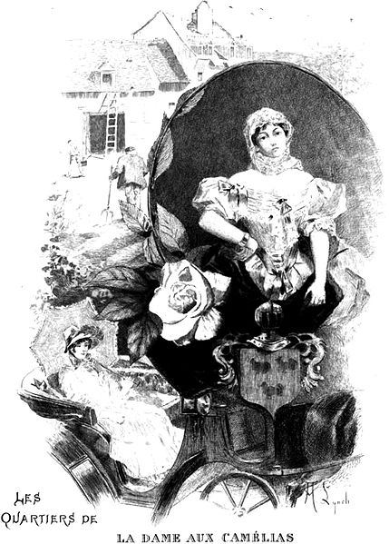
《巴黎
茶花
女遗事》

Slide 31
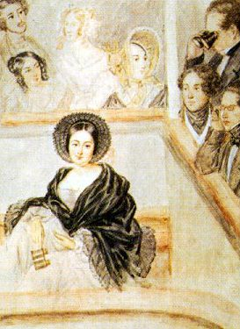
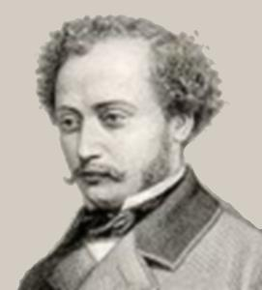
原形：Marie Duplessis (20) Alexandre Dumas (20)
小说人物：Marguerite Gautier Armand Duval

Slide 32

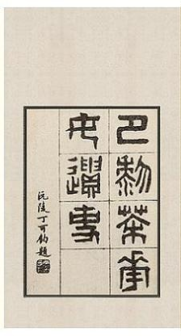
早期西方文学作品的全译本封面例举——《巴黎茶花女遗事》

Slide 33
Table 1: Translations (德文汉译年表)
Year | Work (excl. short poems by Heine etc., which appeared since 1914) | Author | Translator | Relevance in German literature
1871 | What is the Germans’ motherland?（《祖国歌》） | E.M.Arendt | Wang Tao（王韬）、Zhang Zhi xuan | No
1901 | Faust (part)（《浮士德》） | Goethe 歌德 | Gu Hongming（辜鸿铭） | Yes
1904-1905 | Cat’s Bridge《猫桥》（又名《卖国奴》）(1890) | Sudermann 苏德曼 | Wu Dao | No
1906 | Adventure at New Years Eve night 《除夕夜》 (1818) | Zschokke | ? | No

Slide 34

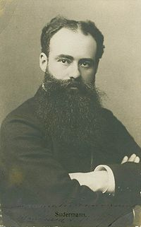
Hermann Sudermann 《猫桥》

Slide 35
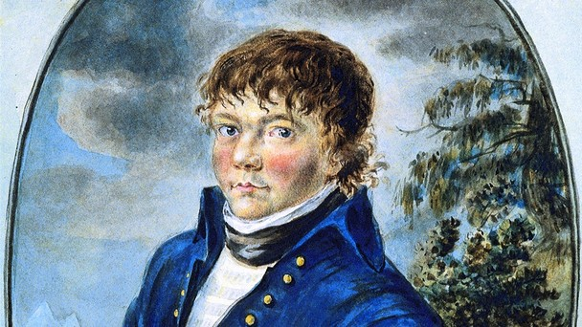
《除夕夜》 Heinrich Zschokke

Slide 36
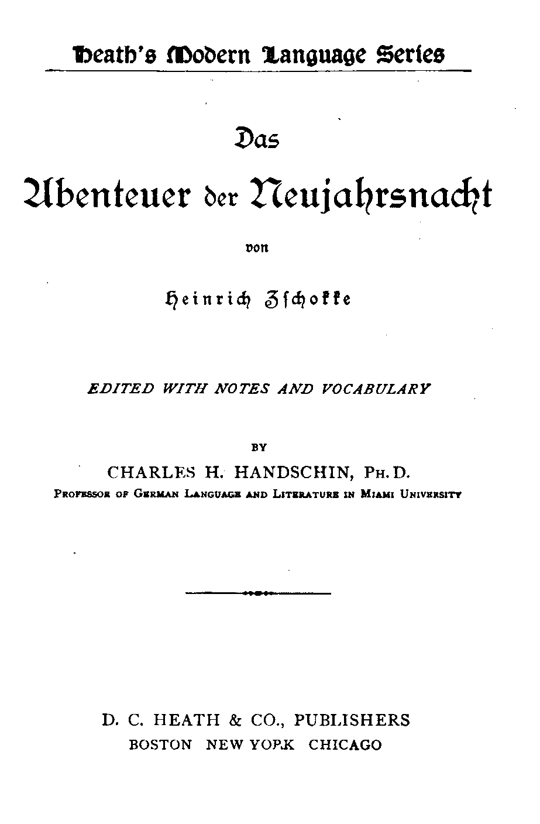
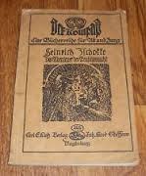
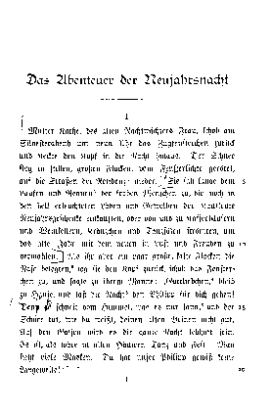
《除夕夜》 Heinrich Zschokke

Slide 37
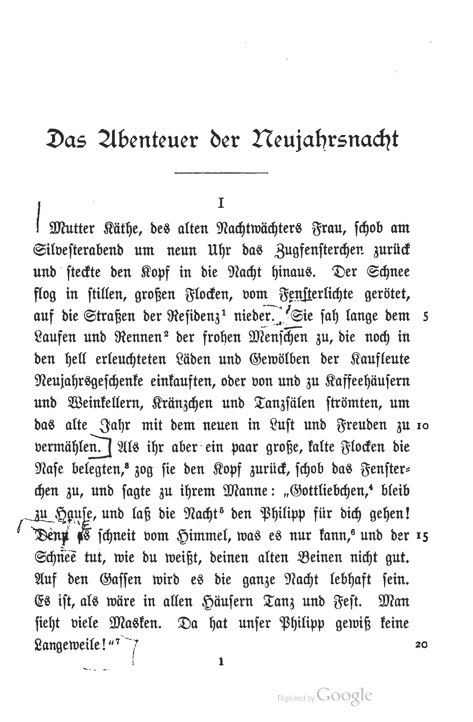
《除夕夜》
Mutter Käthe, des alten Nachtwächters Frau, schob am

Slide 38

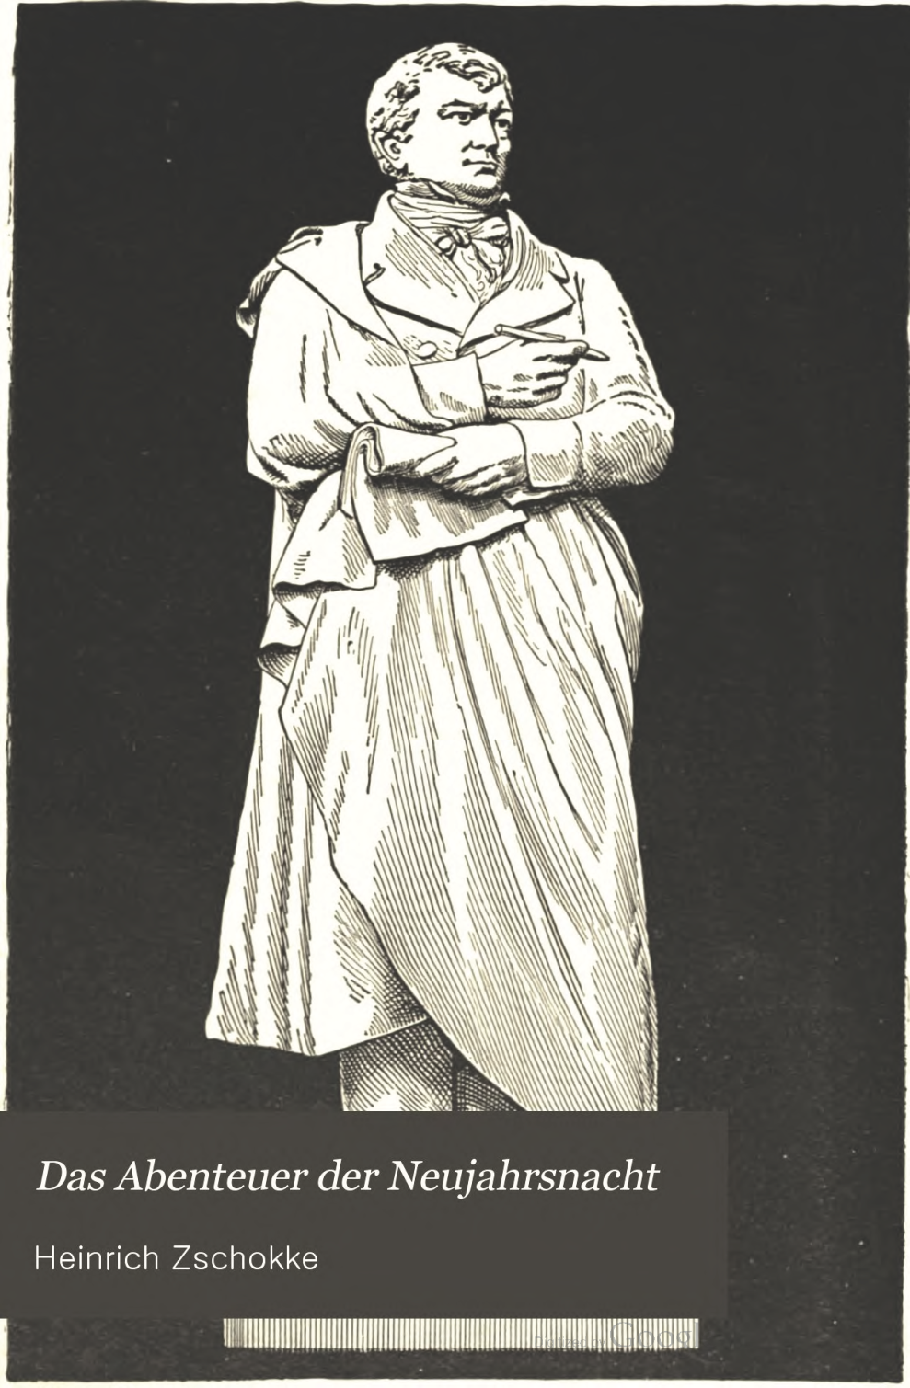
Heinrich Zschokke

Slide 39
四大名著+金瓶梅的早期翻译结果总结表
1592 | 西游记 | 1895 （303） | 英语摘译
 |  | 1977 （385） | 英语全译本
1602 | 水浒传 | 1850 （248） | 法语摘译
 |  | 1929 （327） | 英语节译本
 | 被禁 |  | 「清」中国
1617 | 金瓶梅 | 1688-1704（71） 江户元禄、宝永年 | 日语全译本
 | 被禁 | 1609- | 「清」中国
 | 被禁 | 1932-1941 | 德国
 | 被禁 | 19__-1979 | 法国
1522 | 三国演义 | 1689-92(167) | 日语全译本
 |  | 1820(298) | 英语摘译
1791 | 红楼梦 | 1814（23） | 英语摘译
 |  | 1927 （136） | 英语全译本

Slide 40
Preparation for next session
1 2.25 Organizational things, intro to the concept of a „classic“
2 3.4 Canonization
3 3.11 Early Translation of Chinese Literature
4 3.18 Reception of the Red Chamber Dreams in the West
5 3.25 How to make people read classics again?
6 4.1 Western Classics in Chinese clothes: The example of Utopian Literature
7 4.8 Attractiveness of Chinese Classics as part of softpower
8 4.15 Chinese Classics in the West: The Example of Germany
9 4.22 Sinicization – Politics for Cultural Export: The Example of the Chinese classics
10 4.29 Chinese Classics in World Lit. Anthologies and World Literary History Books
11 5.6 Translation of Modern Classics: Mo Yan, Yu Hua, Liu Cixin etc.
12 5.13 Chinese Classics on Overseas Bookfairs
13 5.20 Cinema Movie Adaptions of Chinese Classics
14 5.27 Lessons to learn from the Classics: Integration or Sharpening the Cultural Profile?
15 6.3 Final Discussion
16 6.10 Final Exam

Slide 41

謝謝觀賞

