Slide 1
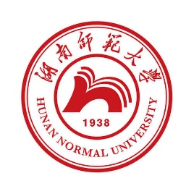
中国文化基础 Foundation of Chinese Cultures for Bachelor Students of Translation Studies
湖南师范大学 2022年2月21日-2021年6月6日 中国文化基础 周一第七和第八节课14:30-16:10，
上课地点：外国语学院大楼605机房 session 5
第四周2022年3月14日。助教：Deng Lulu 邓鲁露
吴漠汀特聘教授 Distinguished Professor Dr. Martin Woesler
湖南师范大学外国学院 Foreign Studies College, Hunan Normal University

Slide 2
Session 5 第五周 Celadon Song and TikTok
Silk and porcelain: Celadon and Celadon Song[edit]
喻锦博 student presentation This is the ppt by Yu Jinbo on Silk and porcelain: Celadon and Celadon Song.
Science and Technology: Douyin (Tik Tok)[edit]
欧欣榆 student presentation This is the ppt by Ou Xinyu on Science and Technology: Douyin (Tik Tok) .
Homework of Session 5 for Session 6[edit]
Please do your homework here.
Do the translation homework. Here is the link to the homework of session 5 for session 6 Mar 28 .
Here is the link to the Joint translation terms .
Do the correction of the translation of your fellow student. Here is the link to the homework of session 5 for session 6 Mar 28.
Read textbook text Silk and porcelain: Celadon and Celadon Song Page674
Take the quiz on Silk and porcelain: Celadon and Celadon Song : https://www.wjx.cn/vm/PiuMQ9V.aspx
Read textbook text Science and Technology: Douyin (Tik Tok) Page 645
Take the quiz on Science and Technology: Douyin (Tik Tok) : https://www.wjx.cn/vj/wbUktb0.aspx
Produce a Bilibili or TikTok Video and link it here

Slide 3
Schedule 学期题目
1 2.21 Organizational things, intro to intercultural communication
2 2.28
3 3.7
4 3.14
5 3.21
6 3.28
7 4.4
8 4.11
9 4.18
10 4.25
11 5.2
12 5.9
13 5.16
14 5.23
15 5.30
16 6.6
2 1 Aesthetic ideals and social customs: The Four Most Handsome Men in Ancient China 78%陈锟
2 8 Education: Historical Figures, The Four Talented Women of Ancient China 64%
3 10 Architecture: Fengshui in Chinese Architecture 61%陈诚
3 19 Architecture: The Forbidden City 55%禹紫琪
4 27 Mythology: Gods and Immortals 51%袁灵
4 30 Literature: Ancient literature: Chinese Mythology 50%李婉莹
5 2 Silk and porcelain: Celadon and Celadon Song 《青花瓷》歌词 72%喻锦博
5 11 Science and Technology: Douyin (Tik Tok) 61%欧欣榆
6 23 Beverages: Tea 53% 李思文
6 12 Beverages: Milk Tea 60%由馨凝
7 6 Traditional Cuisine: Hotpot 66%陈心怡
7 24 Traditional Cuisine: Breakfast Culture of Wuhan 53%魏静婷
8 4 Literature: Ancient literature: Chinese Classical Fairy Tales 68% 邓鲁露
8 20 Chinese Movies 55% 马菲菲
8 21 Stage entertainment: Crosstalk 相声 54% 周思睿
9 7 Clothing: Chinese Clothing 64% 刘倩仪
9 14 Facial Make-up 58% 邹享睿
10 9 Games: Mahjong: An Ancient Chinese card play 62% 李琳玉
10 29 Games: Kite Flying 51% 韩静茹
11 28 Social: Round Table Culture 51% 陈天钰
11 5 Beverages: The Liquor Culture of Ancient China 66% 燕妮
12 22 National Symbols: National Flag 54% 邓蕊欣
12 25 Chinese cultural influence on other cultures / Culture Export / Softpower 53%徐致远
13 16 Aesthetic ideals and social customs: Chinese Marriage Customs 57% 刘可仪
13 18 Money culture: The tradition of Red Envelope and Lucky Money 56%杨磊
14 3 Animals: Panda 70% 刘亦欣
14 17 Astrology: Twelve Animals of the Chinese Zodiac 56% 汪柔
14 26 Astrology: Calendar, The 24 Solar Terms 52%何明慧
15 13 Fine Arts: Painting 60%郭子瑞
15 15 Gender: Wu Zetian: The Only Female Emperor of Imperial China 58%雷珩

Slide 4
Celadon
5 2 Silk and porcelain: Celadon and Celadon Song 《青花瓷》歌词 72%喻锦博

Slide 5
Questions Concerning Section D
1. Why does celadon appear green?
2. Why was the celadon industry prosperous in Hangzhou?
3. Why was Chinese green porcelain named Celadon?
4. What do you know about crackleware?

Slide 6
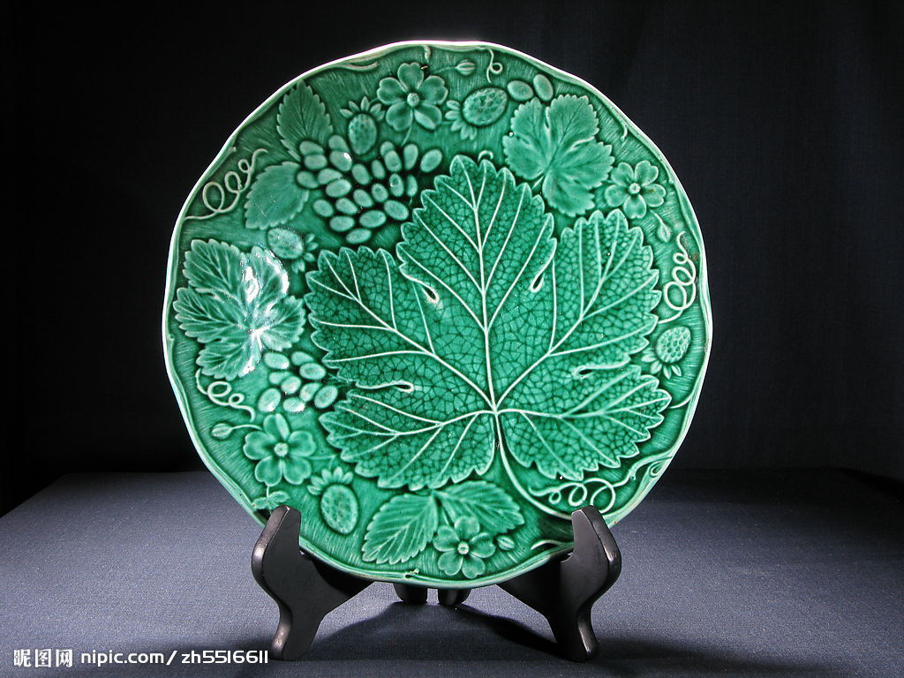
Why does celadon appear green?
Celadon plate

Slide 7
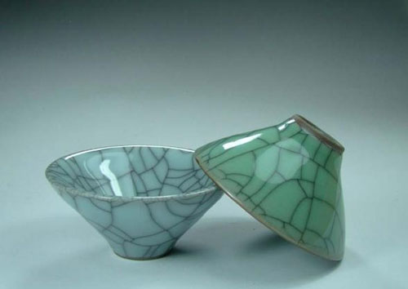
What do you know about crackleware?
Celadon crackleware

Slide 8


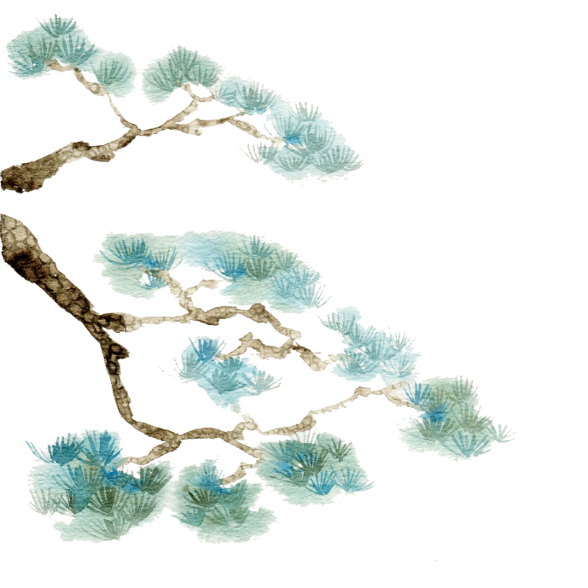

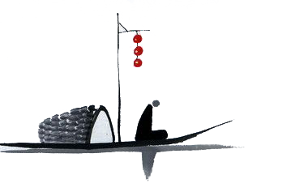
BY YUSHEN
Celadon

Slide 9
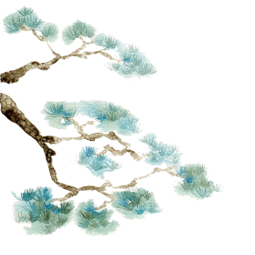
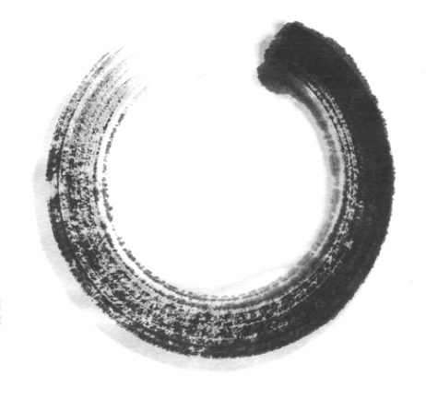

目
A brief introduction of celadon
录
CONTENTS
Longquan celadon
Translation difficulties and skills

Slide 10



PART 01
A brief introduction of celadon

Slide 11
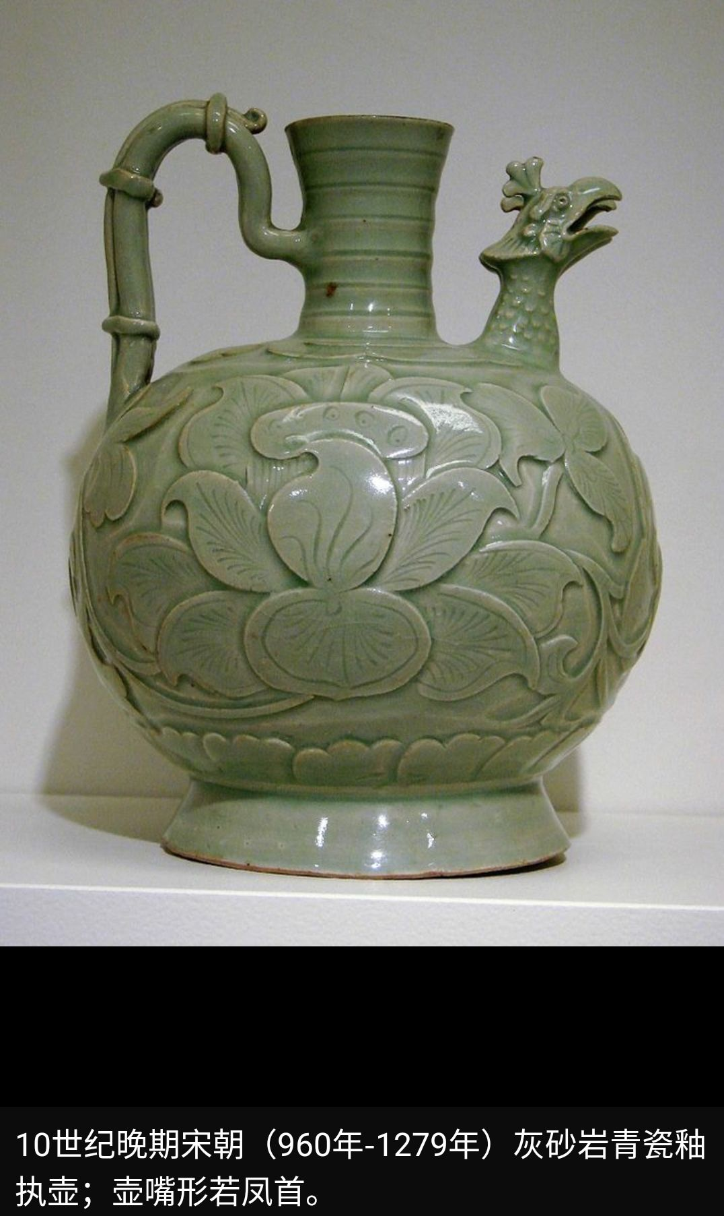
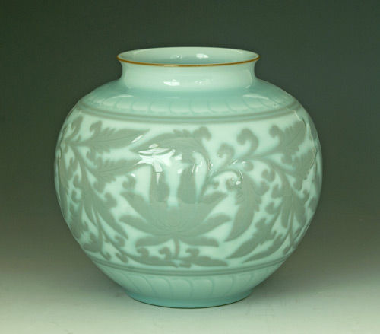
Celadon is a term for ceramics denoting both wares glazed in the jade green celadon color, also known as greenware (the term specialists tend to use) and a type of transparent glaze, often with small cracks, that was first used on greenware, but later used on other porcelains.

Slide 12
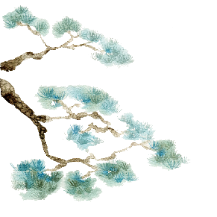

Shang and Zhou Dynasties
Three Kingdoms,Jin and Southern and Northern Dynasties
Eastern Han Dynasty
Greenwares are found in earthernware from the Shang dynasty onwards and was called primitive celadon.
The celadon firing technology in the Eastern Han Dynasty has reached a mature stage.
The celadon fired in the south and the north had their own characteristics.

Slide 13
PART 02
Longquan celadon

Slide 14
It reached its peak in the Southern Song Dynasty.
The ancient Longquan famous kiln was one of the five famous kilns of the Song Dynasty "Guan, Ge, Ru, Ding and Jun".
Longquan celadon began in the Southern Dynasty.
It flourished in the Northern Song Dynasty.
Longquan celadon
一
二

Slide 15
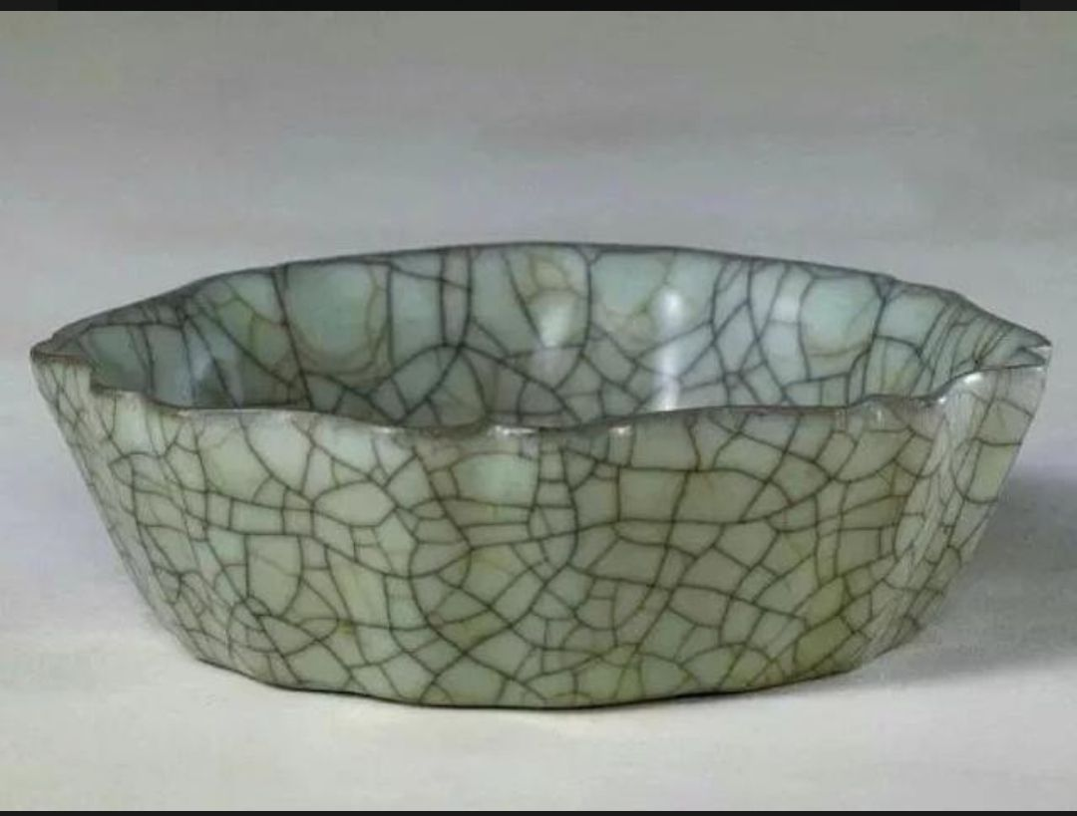
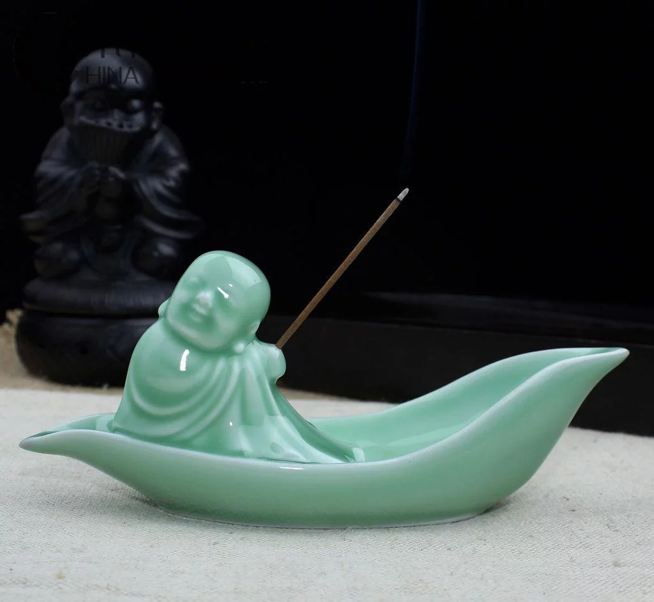



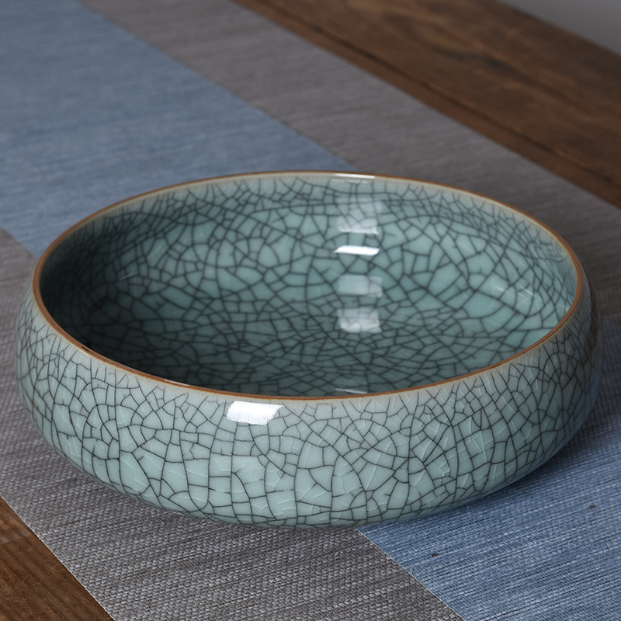

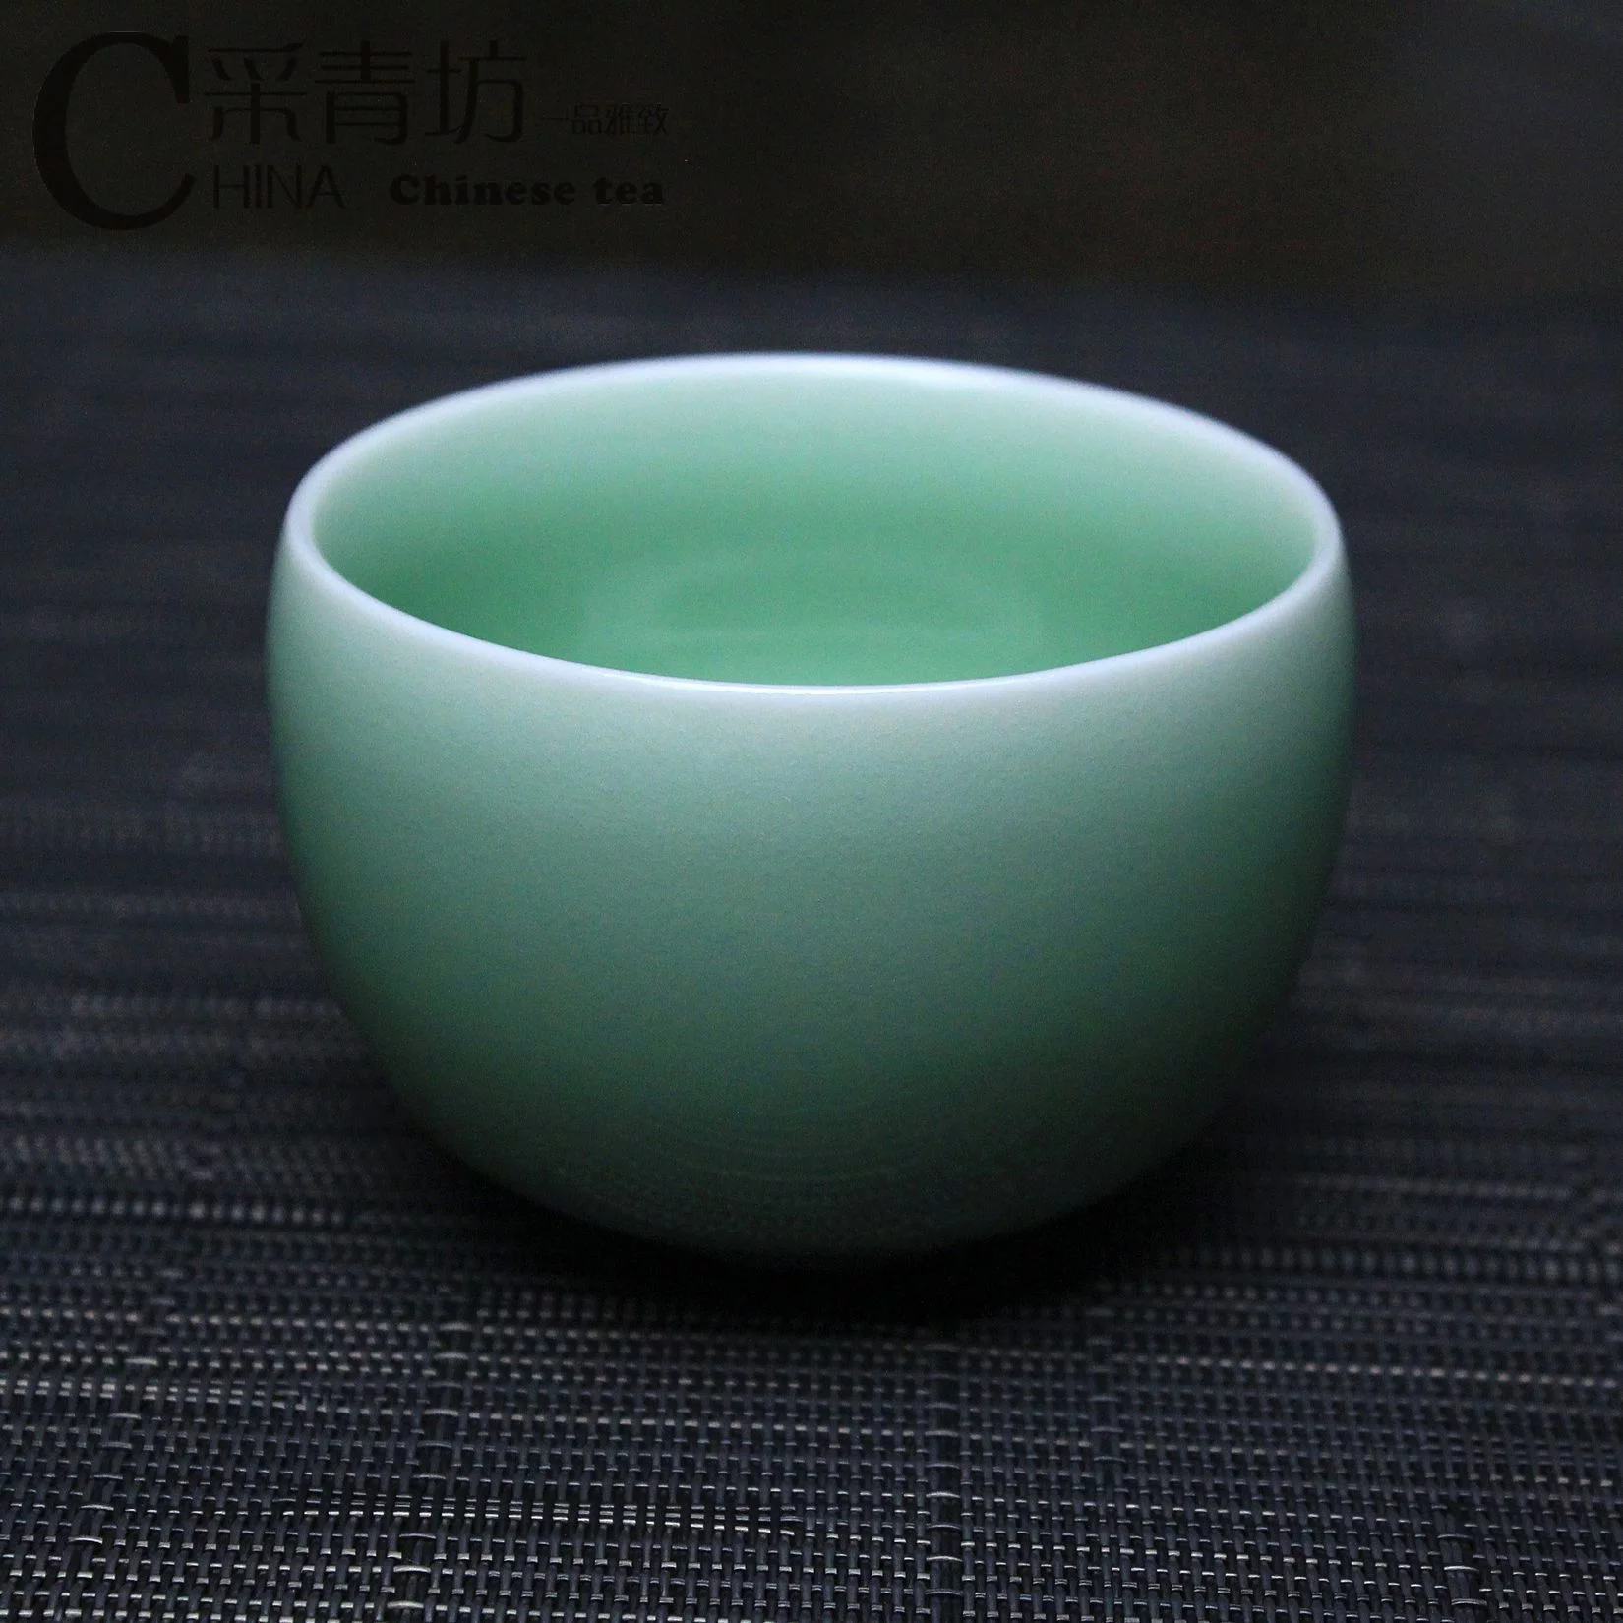
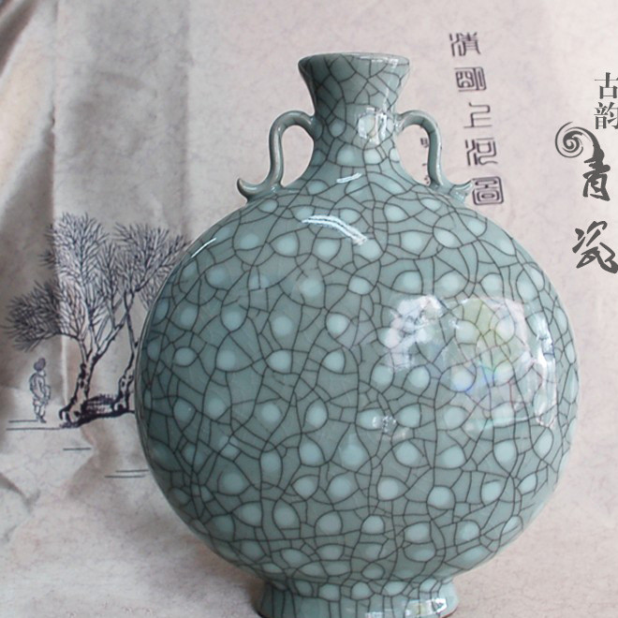
.
Di kiln
Ge kiln
.

Slide 16

“Ge kiln”
history
specialty
It appeared in the middle and late Southern Song Dynasty, together with the famous Guan, Ru, Ding, and Jun, they were called the five famous kilns in Song Dynasty.
The fetus is as thin as paper, and the glaze is as thick as jade. The glazed surface is covered with patterns, purple-mouthed iron feet, and the fetal color is gray and black.

Slide 17
“Di kiln”
specialty
history
It has white glaze green. The glaze colors are powder green and plum green.The glaze layer of the di kiln is rich, the glaze is blue, and the luster is soft, crystal, better than jade.
From the middle and late Southern Song Dynasty, especially in the Yuan Dynasty, a large number of works using exposed fetus appeared.

Slide 18
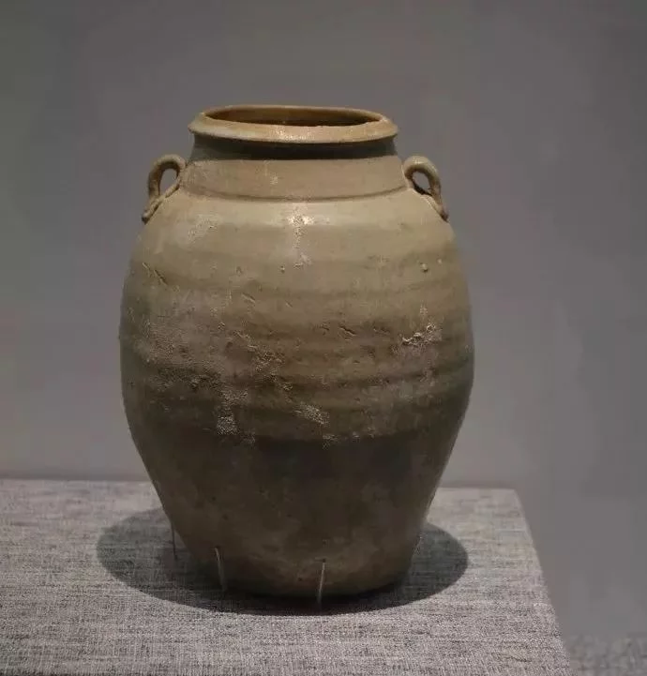
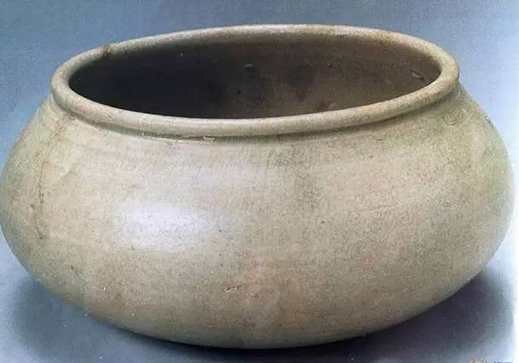
features of Longquan celadon in different periods
the Five Dynasties
light cyan glaze color
fetal bone gray-white
while a few gray-black
solid texture

Slide 19
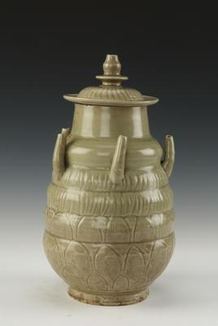
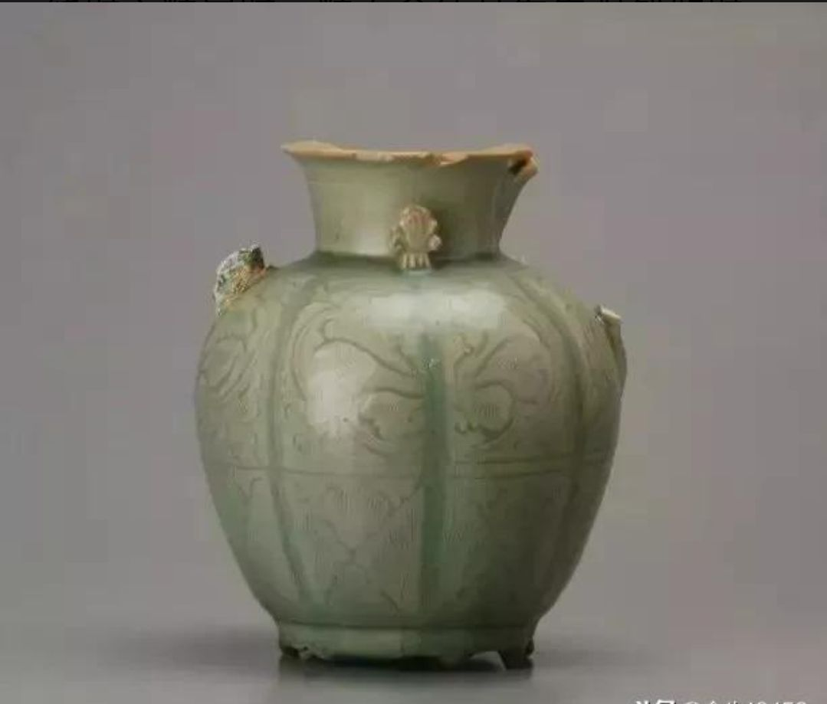
features of Longquan celadon in different periods
Patterns such as cluster flowers, waves, and burnt leaves appeared
the early Northern Song Dynasty

Slide 20
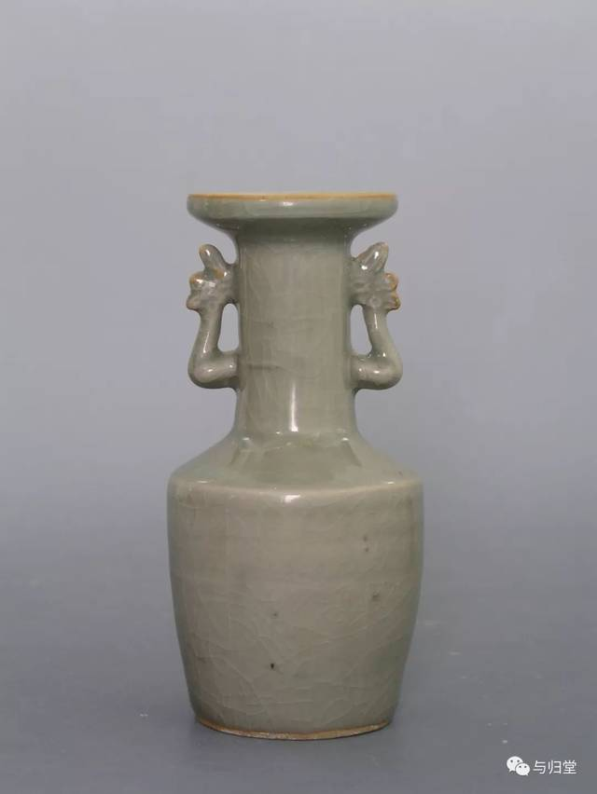
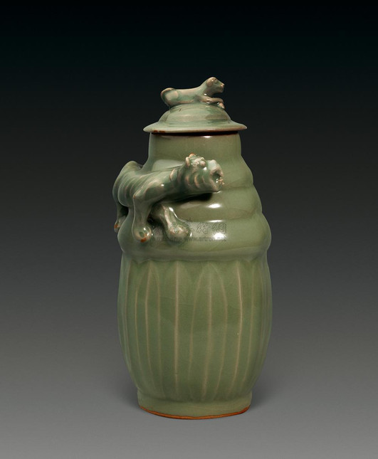
features of Longquan celadon in different periods
the Southern Song Dynasty
glaze color is like jade,
the shape is rich and varied,
the decoration is quite creative

Slide 21
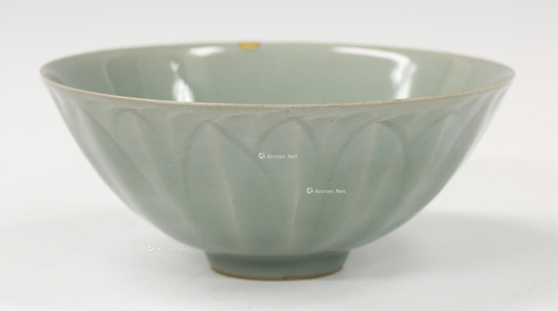
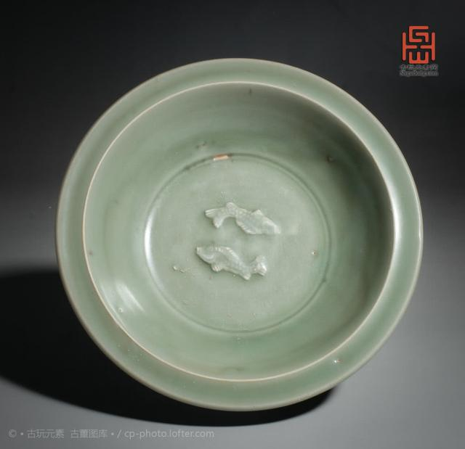
features of Longquan celadon in different periods
the Yuan Dynasty
light cyan glaze color
fetal bone gray-white
while a few gray-black
solid texture

Slide 22
PART 03
Translation difficulities and skills

Slide 23
translation of some kinds of celadons
transliteration and explanation
transliteration
一
二
龙泉窑，龙泉青瓷
Longquan kiln, Longquan celadon
尊式瓶
zun-shaped vase (a kind of vessel, means the bottom is smaller than the top

Slide 24
其中的白胎和朱砂胎青瓷釉层丰润，釉色青碧，光泽柔和，晶莹滋润，胜似翡翠，以梅子青，粉青，豆青等釉色最为珍贵。
translation of four-character words
三
..., the enam of layer of white and vermilion embryo is plump, smooth and green like jade.

Slide 25


The Name “Celadon”

Slide 26



Celadon is the most widespread type of ancient Chinese porcelain.
celadon:
1. a pale grayish green color
2. Chinese porcelain with a grayish green glaze
porcalain:
a hard white shiny substance made by baking clay and used for making delicate cups, plates and decorative objects
china:
white clay which is baked and used for making delicate cups, plates, etc.

Slide 27
The original meaning of “celadon” is “tender lover”.
“Celadon” came to mean green porcelain from China because of a 17th century drama by Honore d'Urfe that was played on the stages of Paris. The hero, named “Celadon”, was clad in delicate green.
Through the efforts of Chinese and Arab travelers and businessmen, large quantities of this high-quality celadon found its way into West Asia, Egypt and Europe. When the drama was played, the Parisians liked the green porcelain from China so much that they renamed it after the hero of Honore d'Urfe's play.
Metonymy:
the same colour
the hero - the porcelain

Slide 28
The History of Celadon

Slide 29
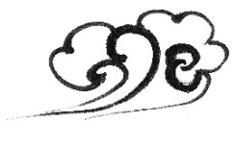
Han Dynasty
The Southern Song Dynasty
first appeared in East China
simply known as green porcelain.
After the establishment of the southern capital in Hangzhou in 1127 during the Song Dynasty, the manufacturing of the green porcelain reached new heights.
New imperial kilns (or official kilns) near Hangzhou and kilns in Longquan, southwest Zhejiang, produced a type of porcelain that was of extraordinary delicacy and purity.
Tang Dynasty
the art of making celadon matured

Slide 30
A Famous Brand of Celadon

Slide 31
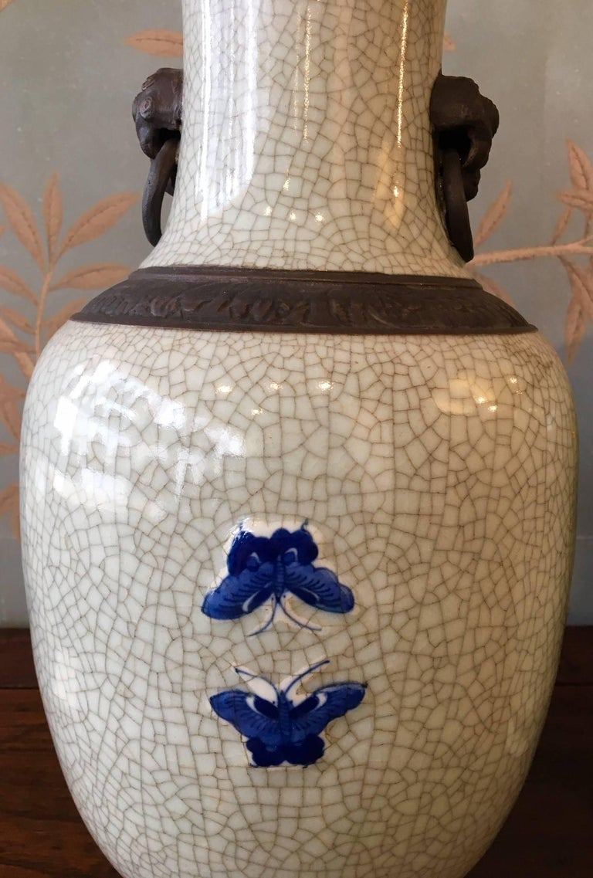

Crackleware
crackle (n. characteristic) + ware (n. object)
Crackleware has broad and fine cracks on its surface. These characteristics appear in the glaze as a result of the firing process when the glaze shrinks more than the body of the pottery. The potters from the Song Dynasty cleverly used the crackle in the glaze for a decorative effect. That is how a world-famous brand of ceramics was born in ancient China.

Slide 32
The Celadon Song

Slide 33
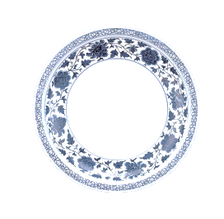
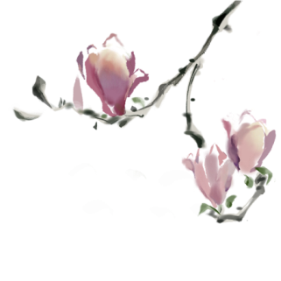
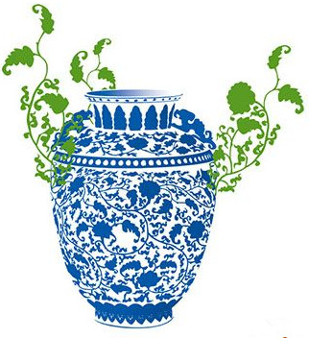
A Question
Celadon Song?
Song of the Blue-and-white Porcelain?
?
{
celadon(青瓷)
porcelain
white porcelain(白瓷)
blue and white porcelain(青花瓷)
an independent category
...

Slide 34

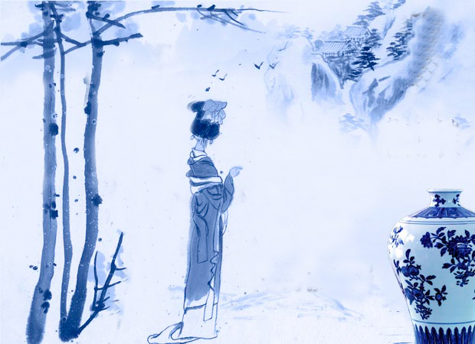

素胚勾勒出青花，笔锋浓转淡
瓶身描绘的牡丹一如你初妆
冉冉檀香透过窗，心事我了然
宣纸上走笔，至此搁一半
釉色渲染仕女图，韵味被私藏
而你嫣然的一笑如含苞待放
你的美一缕飘散，去到我去不了的地方
天青色等烟雨，而我在等你
炊烟袅袅升起，隔江千万里
在瓶底书汉隶，仿前朝的飘逸
就当我为遇见你伏笔
天青色等烟雨，而我在等你
月色被打捞起，晕开了结局
如传世的青花瓷自顾自美丽，你眼带笑意
色白花青的锦鲤跃然于碗底
临摹宋体落款时却惦记著你
你隐藏在窑烧里千年的秘密
极细腻，犹如绣花针落地
帘外芭蕉惹骤雨，门环惹铜绿
而我路过那江南小镇惹了你
在泼墨山水画里，你从墨色深处被隐去
天青色等烟雨，而我在等你
炊烟袅袅升起，隔江千万里
在瓶底书汉隶，仿前朝的飘逸
就当我为遇见你伏笔
天青色等烟雨，而我在等你
月色被打捞起，晕开了结局
如传世的青花瓷自顾自美丽，你眼带笑意

Slide 35
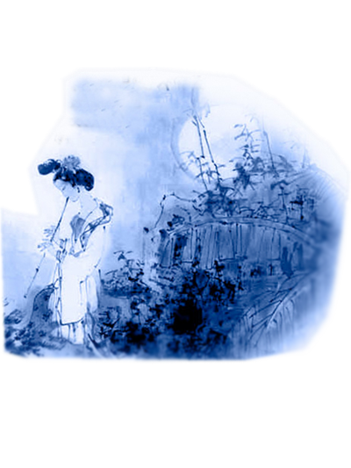
The sky is crying blue, as I wait for you
The fire in my heart burning white and true
A thousand miles the smoke is rising high both sides
I see your shadow outlined through
The sky still dark as I make my way to you
White moon light guides our way, fields of morning dew
Our world is greener on the other side so free
The time is calling.
天青色等烟雨，而我在等你
炊烟袅袅升起，隔江千万里
在瓶底书汉隶，仿前朝的飘逸
就当我为遇见你伏笔
天青色等烟雨，而我在等你
月色被打捞起，晕开了结局
如传世的青花瓷自顾自美丽，你眼带笑意

Slide 36
TikTok (Douyin) and Bilibili
5 11 Science and Technology: Douyin (Tik Tok) 61%欧欣榆

Slide 37
Preparation for next time
6 23 Beverages: Tea 53% 李思文
6 12 Beverages: Milk Tea 60%由馨凝

Slide 38
Always here for you! 随时为你们服务
Professor Dr. Martin Woesler 吴漠汀 湖南师范大学特聘教授，博士导师
Office / 办公室: 外国语学院415
国际汉学中心309
Phone / 电话: (150) 1138 8818 (德国+49 178 2073538) Email / 电子邮件: wmt@hunnu.edu.cn

Slide 39
Thank You

