Slide 1
中国园林匾额与对联
The Plaque and Couplet in Chinese Garden
王宇鑫

Slide 2
匾额与对联的起源
Chinese Garden Plaque and Couplet
Chinese garden inscriptions, including horizontal inscribed boards (匾额 biǎn é) and couplets (对联 duì lián), trace their roots to ancient Chinese literati culture and architectural traditions, evolving into iconic elements of classical garden art.

Slide 3

Origin and Development
Integration with Garden Culture (Tang to Song Dynasty)
Early Origins (Pre-Qin to Han Dynasty)
Golden Age (Ming to Qing Dynasty)

Slide 4
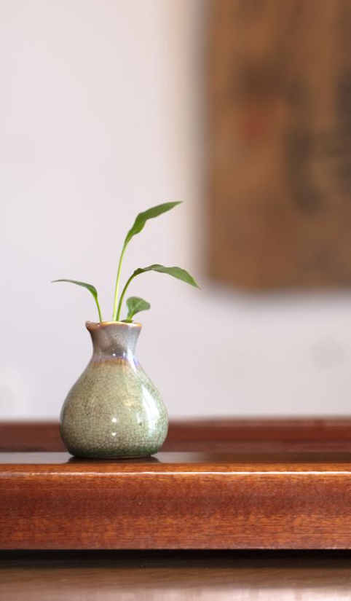
「与谁同坐轩」 With whom Shall I Sit Pavillion
——出自苏轼《点绛唇》词“与谁同坐？明月清风我”。
With whom shall I sit? The bright moon, the gentle breeze, and I.

Slide 5
「曾三颜四；禹寸陶分」
——苏州网师园濯缨水阁
How many literate quotations are contained within this couplet?

Slide 6

典故解析：
“曾三”指曾子“三省吾身”；Zeng's Triple Reflections
“颜四”指颜回“非礼勿视、听、言、动”；Yan's Quadruple Filters
“禹寸”喻大禹惜时;Yu the Great's inch-by-inch time management
“陶分”指陶侃珍惜分阴。Tao Kan's fen-level time valuation

Slide 7
上联： 「清风明月本无价」 下联： ？？？
hints: 对仗(antithesis)
意象(images)
——风、月、？、？
园林里有？

