Slide 1


TAOBAO.
As the world's largest e-commerce exchange platform, Taobao's development has caught the world's attention and its distinctive strategy has not only made it stand out in a short time but also made it bigger and bigger

Slide 2
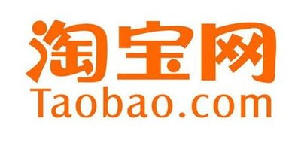
1
01
The History of Taobao
2
02
The reasons of Taobao’s success
CONTENTS
3
03
The impact of Taobao on lives

Slide 3
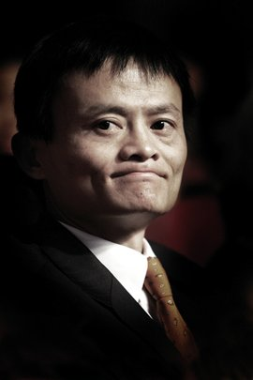
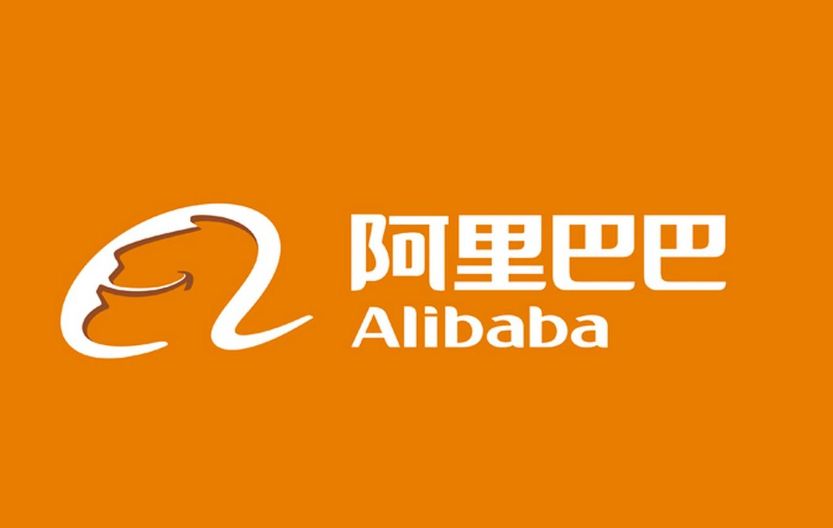

Jack Ma
马云
1988-1995: English teacher, English translator
1995: Joined the Internet industry
1998: Founded Alibaba
2003: Founded Taobao
2004: Founded Alipay
......

Slide 4
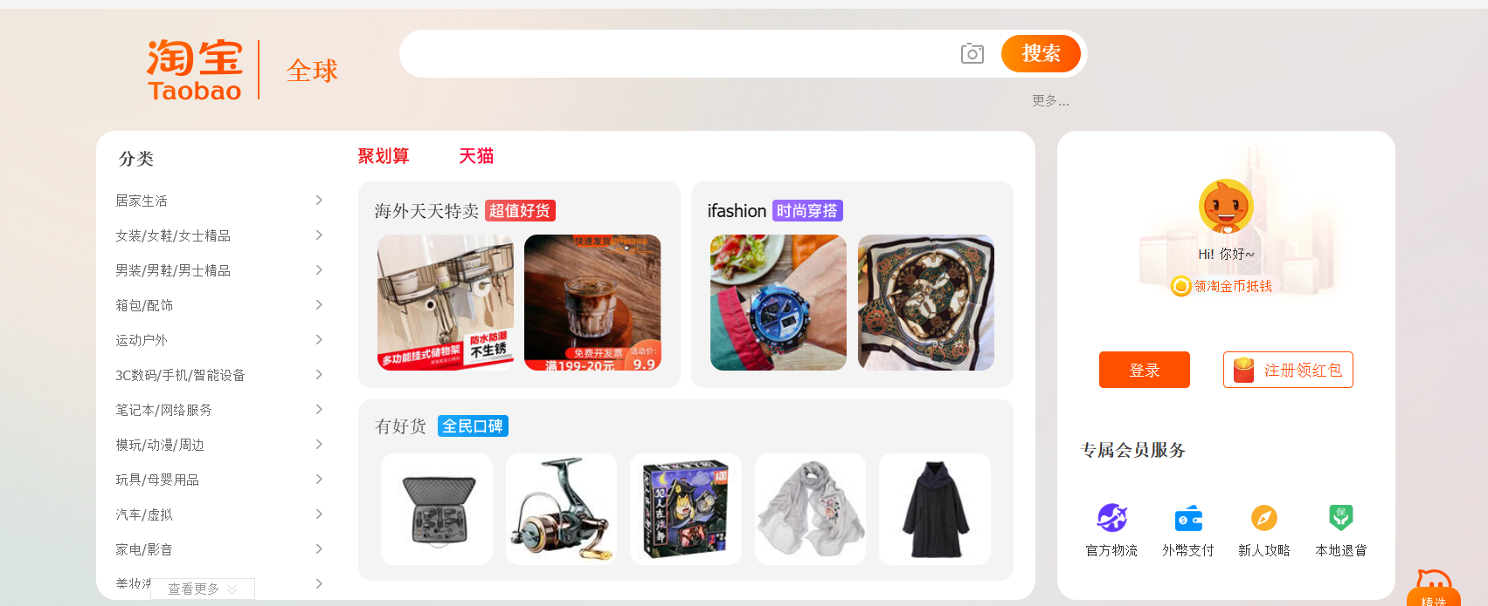
May 10, 2003 Taobao was established with investment from Alibaba Group.
In October, Alipay, a third-party payment tool, was launched to create consumer trust in Taobao's transactions with a "guaranteed transaction model".
In 2003, the annual turnover (全年成交总额)was 34 million RMB.
In 2004, Taobao Wangwang was launched, linking live chat tools with online shopping.
In 2005, Taobao surpassed eBay and began to leave its competitors far behind.
In May, Taobao overtook Yahoo Japan to become Asia's largest online shopping platform, and in 2005 its turnover exceeded (成交额)8 billion yuan, surpassing that of Wal-Mart.
In 2006, Taobao became Asia's largest shopping site, and it was in this year that Taobao made it possible for the first time in China - that the Internet would not just exist as an application tool, but that it would eventually become a fundamental element of life, with survey data showing that nearly 9 million people go "shopping" on Taobao every day.
YOUR TITLE TEXT HERE
The History of Taobao

Slide 5
FREE
SAFE
Advantages
SYSTEM
LOCAL

Slide 6
FREE
SAFE
Taobao does not charge registration or transaction fees for products, a sign that should have been most attractive when it was competing with eBay. And it has low threshold to entry for merchants.
Alibaba has Taobao Wangwang and Alipay under its banner.
SYSTEM
LOCAL
As a native-born local company, Taobao understands the external environment, the Chinese market and consumer psychology better. China's population of 1.3 billion is a large market with 1.3 billion people consuming and much demand for consumer goods.
As an online trading platform, Taobao has a relatively mature system for protecting consumer rights and Merchant Management.
Advantages

Slide 7



TAOBAO.
SAFE
Ali wangwang is a platform for sellers and buyers to communicate, and Alipay is currently the most secure third-party payment tool.
The biggest difficulty with online transactions is that the two sides of the transaction do not meet each other and fraud is common. On the basis that the buyer and seller still lack trust, the goods are sent out while the money is credited to an independent third party. When the buyer has no more complaints about the quality, the third party then remits the money to the seller. This is Paypal, with protection for both the buyer and the seller.
Ali Wangwang 阿里旺旺
Alipay 支付宝

Slide 8
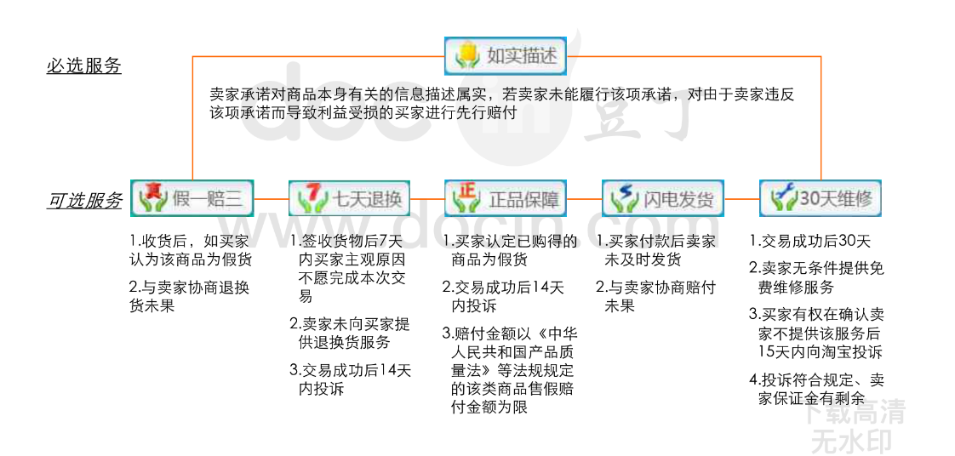
YOUR TITLE TEXT HERE
SYSTEM
Consumer Protection System

Slide 9
How Taobao change our lives?

Slide 10

How Taobao change our lives?
1、The shopping habits of consumers have changed, and online shopping has become the mainstream of consumer shopping.
2、The business situation of entity shops（实体店） is affected by the impact of online shopping.
3、The rapid development of the logistics industry has been brought about by online shopping.
4、Through the platform of Taobao and Ali, online self-employment has become an important way to solve employment.

Slide 11

TAOBAO.

Slide 12

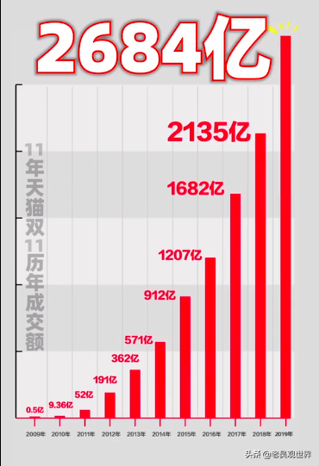
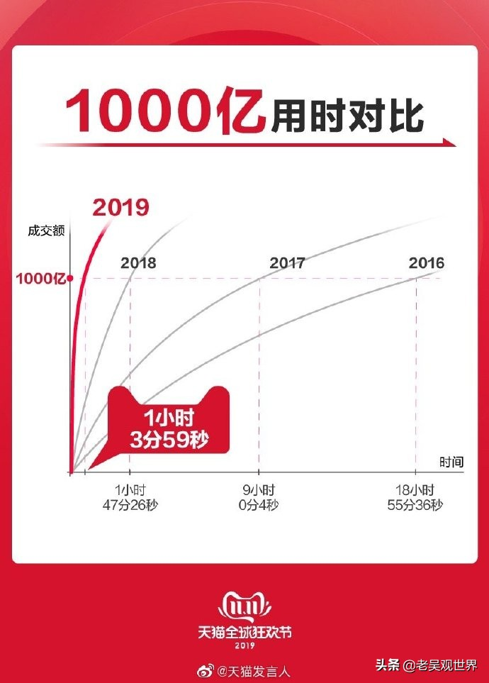

YOUR TITLE TEXT HERE
The Success of Taobao

Slide 13


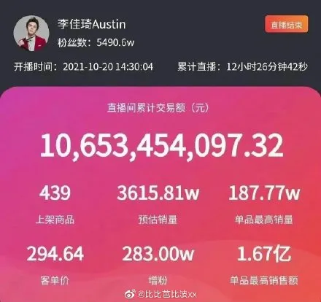

How Taobao change our lives?
Taobao Live

Slide 14

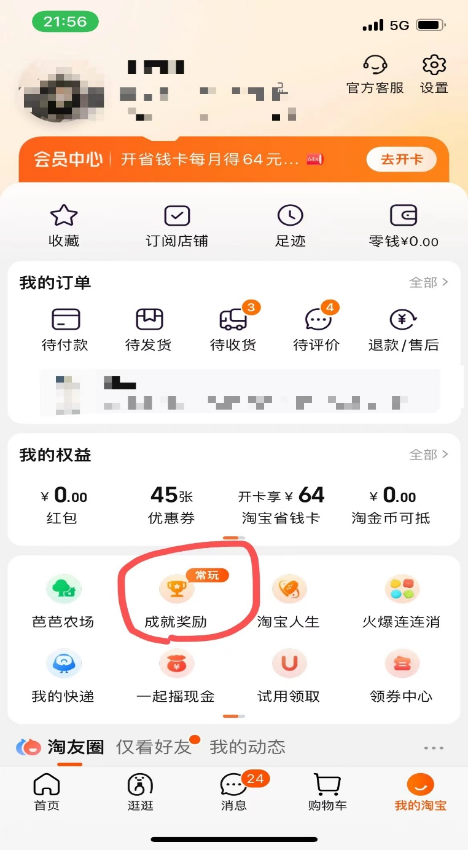
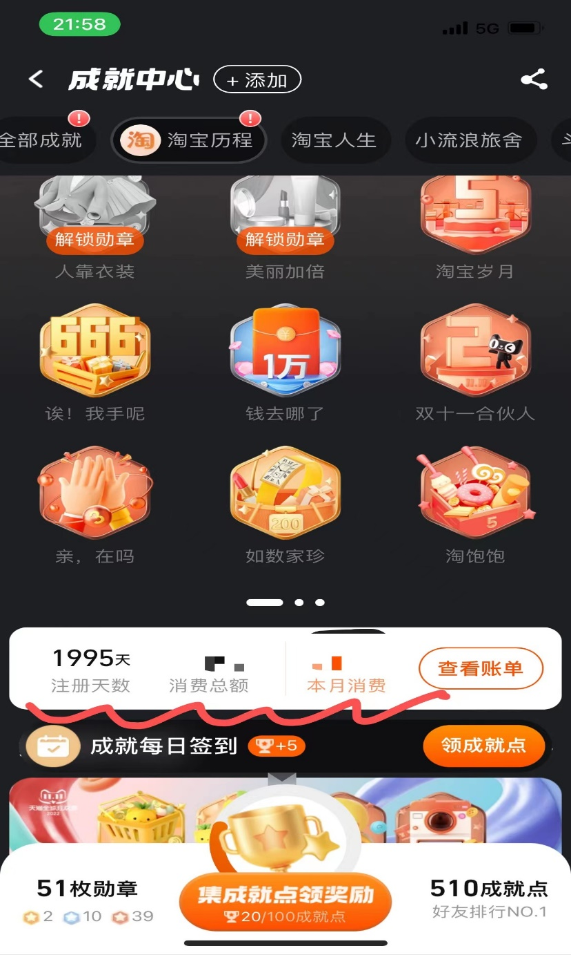
How Taobao change our lives?

Slide 15

E N D

