Slide 1



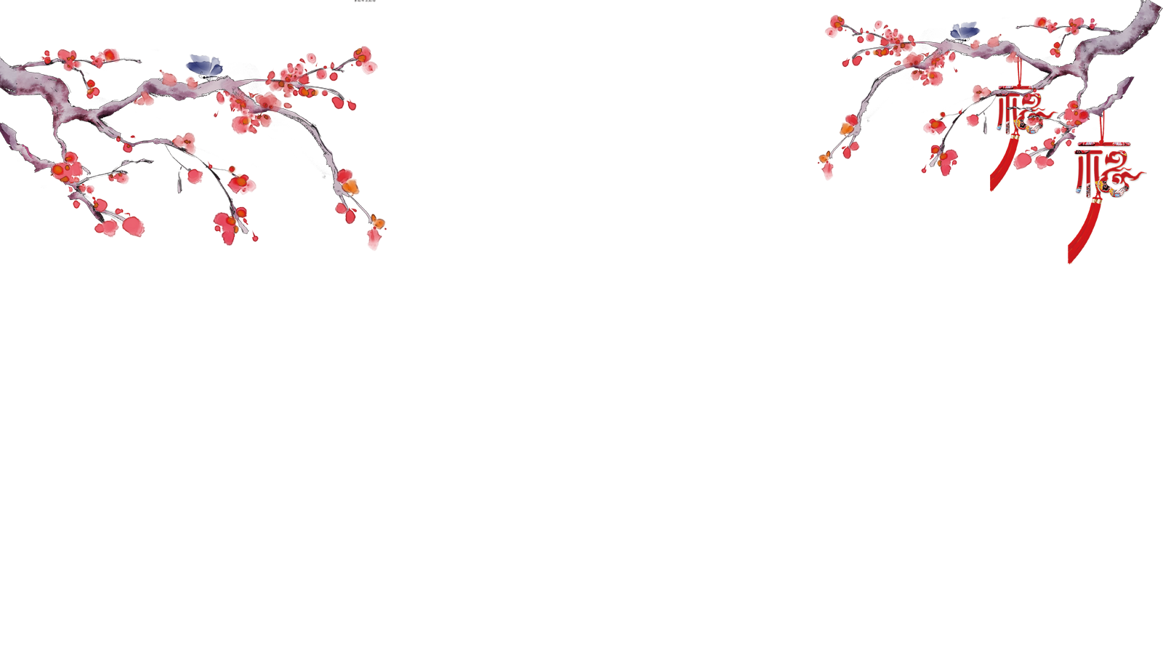

How to Make People Read Classics Again?
Reporter: Zheng Dongqin

Slide 2

Contents
Part Ⅰ Why should people read classics again?
Part Ⅱ What should people read in classics?
Part Ⅲ How to read classics again effectively?

Slide 3

Part Ⅰ
1、Why should people read classics again?
As the old saying goes: "Books are like medicine, and good reading can cure fools." When reading the classics, we can communicate with great souls, gain the courage to get out of difficulties from the inspiring stories of the ancients, and find answers to the problems of contemporary society from the wisdom of the wise.

Slide 4

Part Ⅰ
Especially in the era of fragmented reading, most young people are addicted to electronic online novels, and perhaps they have ignored or even forgotten the classics. So we need to make people read the classics again in order to inherit, disseminate and enrich the classics.

Slide 5

Part Ⅱ
2、What should people read in classics?
We must distinguish between superior books and inferior books before reading. In a broad sense, classics include both Chinese classics and Western classics. The classics we are familiar with include The Four Books and Five Classics in China and The Bible in the West.

Slide 6
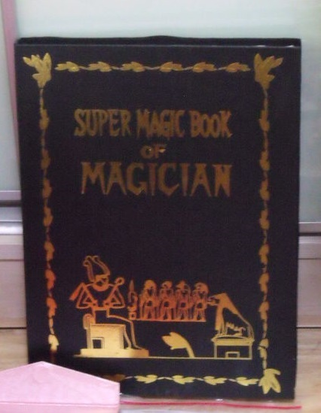


Part Ⅱ
However, there are some backward ideas which are inconsistent with modern social values in classics. So we need to adopt the attitude of "take the essence and discard the dregs". We should actively study the elements of the classics that help to improve personal qualities, enrich people's spiritual world and promote national progress. We must abandon the concepts of "blind loyalty" and "blind filial piety".

Slide 7
Part Ⅲ
3、How to read classics again effectively?
Although people can get to know the classics through movies, TV series, videos and talk shows. It is just a kind of shallow reading, which is impossible for people to deeply understand the connotation of the classics. Instead, we need to systematically read and study the classics so as to discover the value of the classics.

Slide 8

Part Ⅲ
Besides, we need to avoid "cramming reading" and "utilitarian reading". For example, some parents force their children to memorize classics in order to get higher scores in exams. And some companies try to create the corporate culture of "foolish loyalty" by instilling the idea of unconditional obedience in employees. It will make people more resistant to the classics. So it is very important to stimulate people’s interest in reading the classics. Only by regarding "reading" as "enjoy reading" will people be more active to read the classics.

Slide 9

Part Ⅲ
Classics are the essence of national culture, which still have a huge influence in contemporary society. The purpose of re-reading the classics is not only to teach people how to behave in the world, but also to cultivate excellent successors of a nation. People need to have cultural self-confidence, and respect and learn from other national cultures. So we should read all valuable and beneficial classics widely so as to promote the exchange and prosperity of world cultures.
PPT模板 http://www.1ppt.com/moban/

Slide 10
THANK YOU

