Slide 1

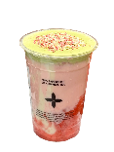
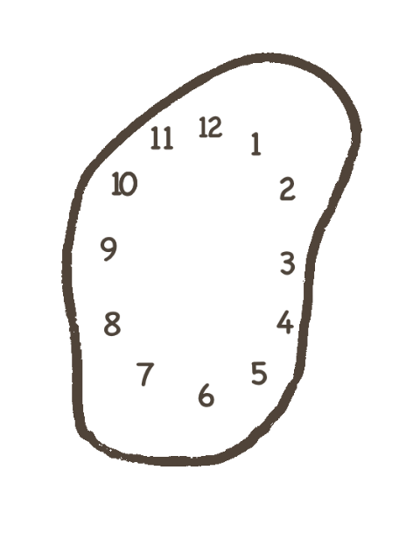

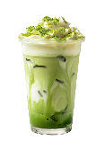

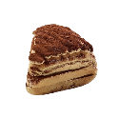

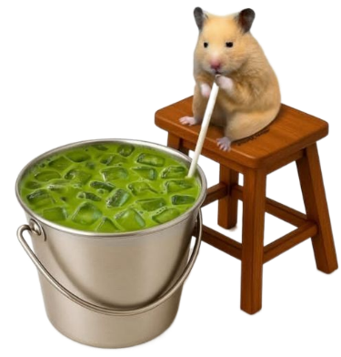
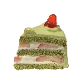


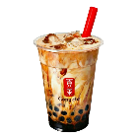
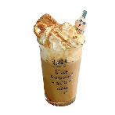
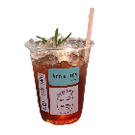
Why Are We So Obsessed with Milk Tea?
Presented by: 杨宇轩

Slide 2
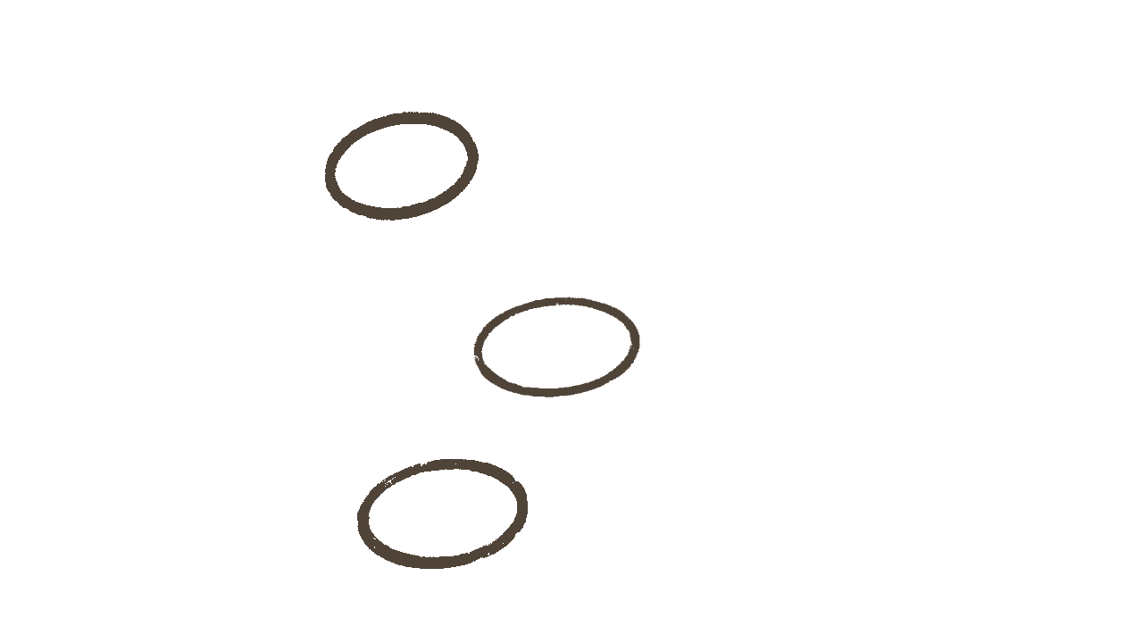
Part 1 The Ancient History of Milk Tea
CONTENTS
Part 2
How Our Favorite Milk
Tea Was Born
Part 3 Why We Are So Obsessed ?

Slide 3

Part 1
The Ancient History

Slide 4
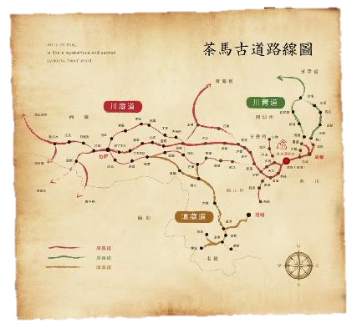
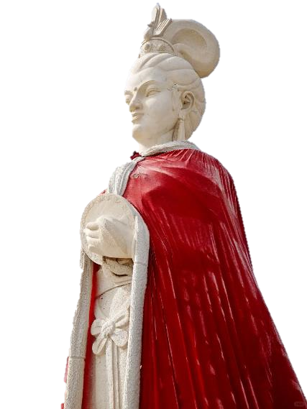
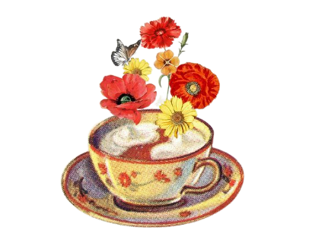
A Royal Beginning
A. Tang Dynasty: Tea introduced to Tibet through Princess Wencheng's marriage.
B. A New Tradition: Nomadic cultures began mixing tea with milk, creating the earliest form of milk tea.
C. Tea-Horse Trade: This exchange also grew into a trade route that spread tea across Central Asia.

Slide 5
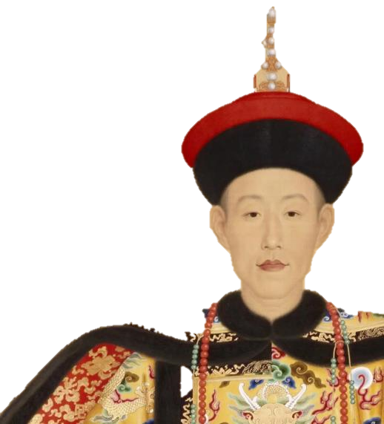
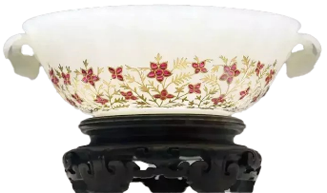
Imperial Perfection
This custom was then brought right into the imperial court by the Qing Dynasty’s Manchu rulers, who, with their own nomadic roots, took it very seriously.
total perfectionist
Fresh Milk!
Hetian Jade Bowl!

Slide 6
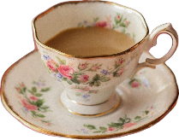
Part 2
How Our Favorite Milk Tea Was Born

Slide 7
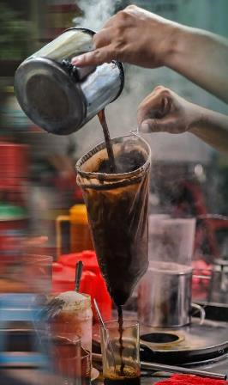
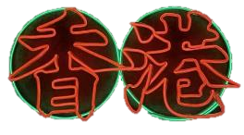
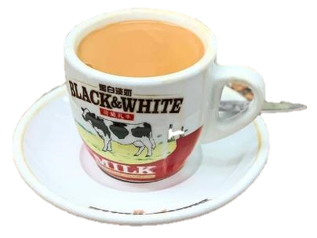
Hong Kong's Innovation
To save money and create a silkier texture, local chefs there swapped out expensive fresh milk
for evaporated milk and
filtered the tea through a
cloth bag—which gave us the
iconic ‘silk-stocking milk tea’.

Slide 8
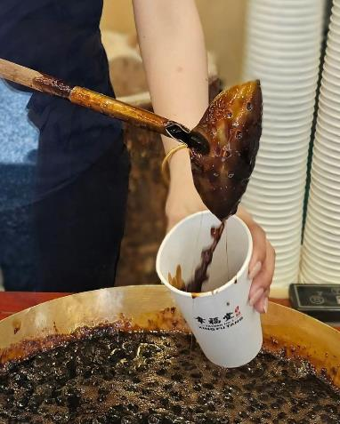
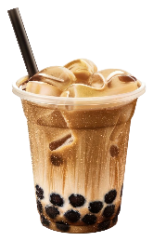
The "Bubble" is Born (1980s)
Add chewy tapioca balls into the milk tea, creating what we now call bubble tea. The moment that happened, the drink just exploded globally.

Slide 9
Part 3
Why We Are So Obsessed

Slide 10

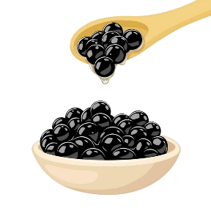
Sensory Experience (口感)
The core appeal is the amazing mouthfeel. Plus, you can customize everything: sweetness, ice level, toppings… It's a drink made just for you. The brands are constantly rolling out new products, so there's always something new to try.

Slide 11
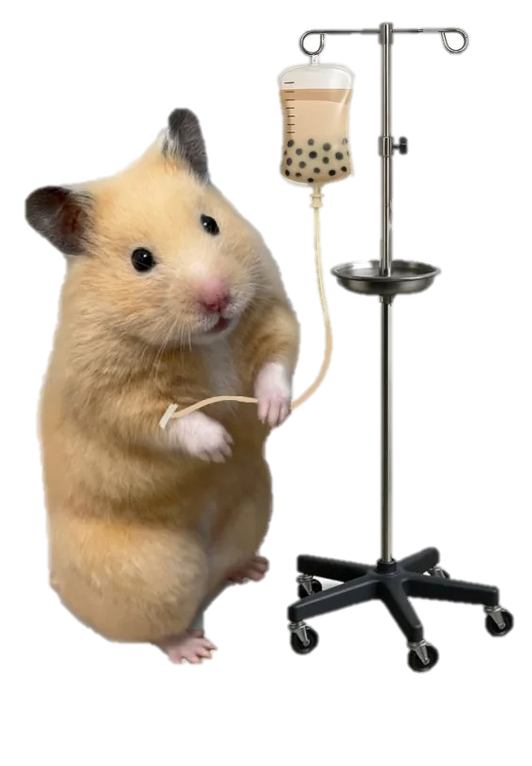
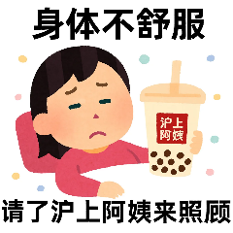
Healing Potion (续命水)
Milk Tea
Me
After a tough week of classes or right before a big deadline, that sweet, milky tea just feels like an instant reward. It’s our ‘healing potion’ that helps us to just keep going.

Slide 12
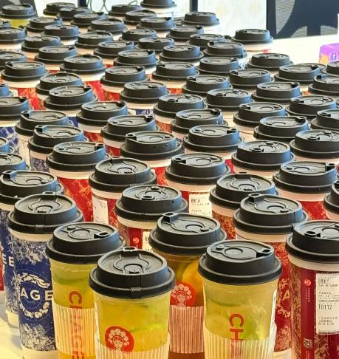
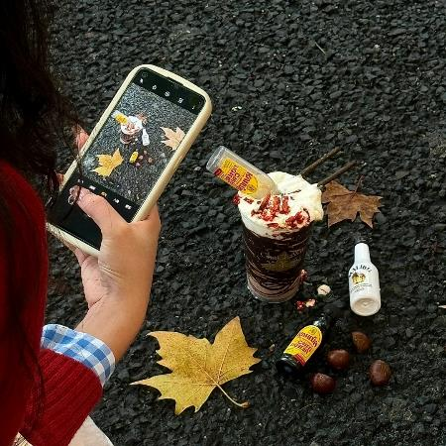
Social Connector (社交工具)
The first cup of milk tea in autumn
A group order for milk tea

Slide 13
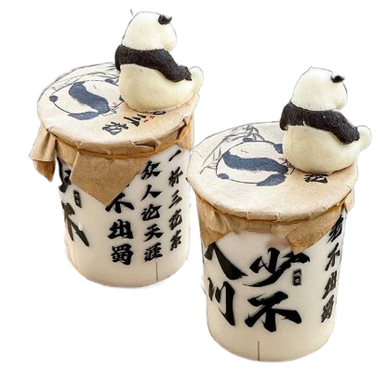
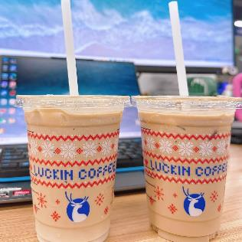
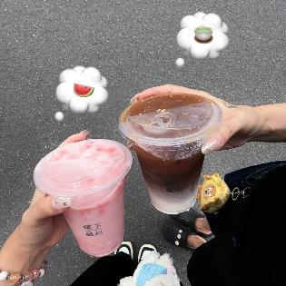
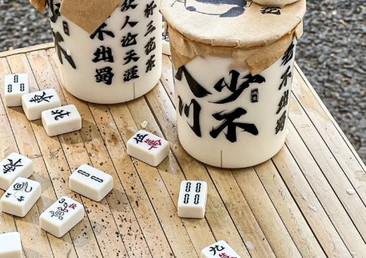
Identity (身份认同)
The brand you drink is like you're part of a certain "tribe."

Slide 14

Conclusion
Taste
It’s more than just a drink! It’s for that exciting new taste, that feeling of connection, that little moment of comfort, and a way to be part of what's cool. It's a whole story in a cup.
Connection
Comfort

Slide 15
Thank you!
Presented by: 杨宇轩
2025.11.13

