Slide 1
Translation & Style
Zeng Yanhu 曾雁湖
Hu Huifang 胡慧芳

Slide 2
Cotents
The definitions of translation style
The formation of translation style
The translatability of style
The conversion style

Slide 3
Part 1. The definitions of translation style

Slide 4
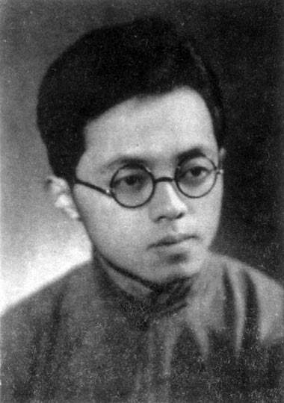
Zhou Xuliang's definition of translation
Zhou Xuliang, a famous British literary translator in China
Style cannot exist independently of language.
Different word can not express the same style.

Slide 5
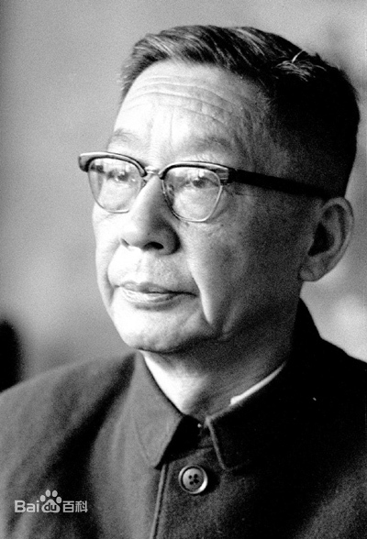
Lau Shaw
Maintaining the style of the original work is very difficult, but if we can really have a deep understanding of a foreign writer and know his artistic status and characteristics, we can still express his style with our textual expressions.

Slide 6
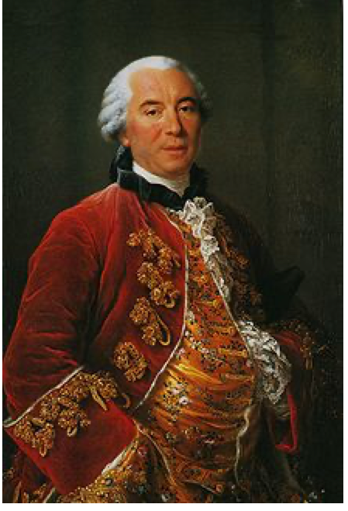
Buffon
The style is the man himself
（风格即人）

Slide 7
To sum up, the translation style is the atmosphere and style that the translator uses to express the characteristics of language in the translation process.

Slide 8
Part 2. The formation of translation style

Slide 9
Man for the field and women for the hearth
Man for the sword and for the needle she
Man with the head and women with the heart
Man to command and women to obey
--- Alfred Tennyson

Slide 10
男人耕作女持家 男上战场女纺纱 男人冷静女优柔 男施命令女听话
男人主外女主内 男人舞剑女缝衣 男人理智女多情 男人吆喝女相随

Slide 11
丈夫劳作在田间，女子持家灶炉边； 丈夫挥舞刀枪剑，女子织补拿针线。 丈夫威武智勇全，女子贤德真心善； 丈夫统帅声令下，女子遵命垂首间。

Slide 12
男耕女织，
男武女文
男刚女柔，
男尊女卑。

Slide 13
Although the four translations had different formats and words, they are from the same original text, so we can see the ideas and language in the target text. We can say that the original is a factor for style formation.

Slide 14
I love you
Japanese writer 夏目漱石（Natsume Soseki）：
月が綺麗ですね
张爱玲：为了你的幸福，我愿意放弃一切-----包括你。
I am willing to give up everything for your happiness, including you.

Slide 15
From the two translation works, we can see that different translators had different styles even with the same text. Form this, we can know that the subjective factors are also imprtant for forming the translation style.

Slide 16
Part 3. The translatability of style

Slide 17
The supporters think that the style has its own discipline and method of combination and association. When translating, the translator should continue to communicate with the original author's minds, and get inspired. Retaining the style of the original author, to a certain extent, is to bring the original text to the readers.

Slide 18
Translation style is actually translatable, but the degree depends on the translator's skills and similarity with the original author.
This is why most translators only translate works that are similar to their own temperament.

Slide 19
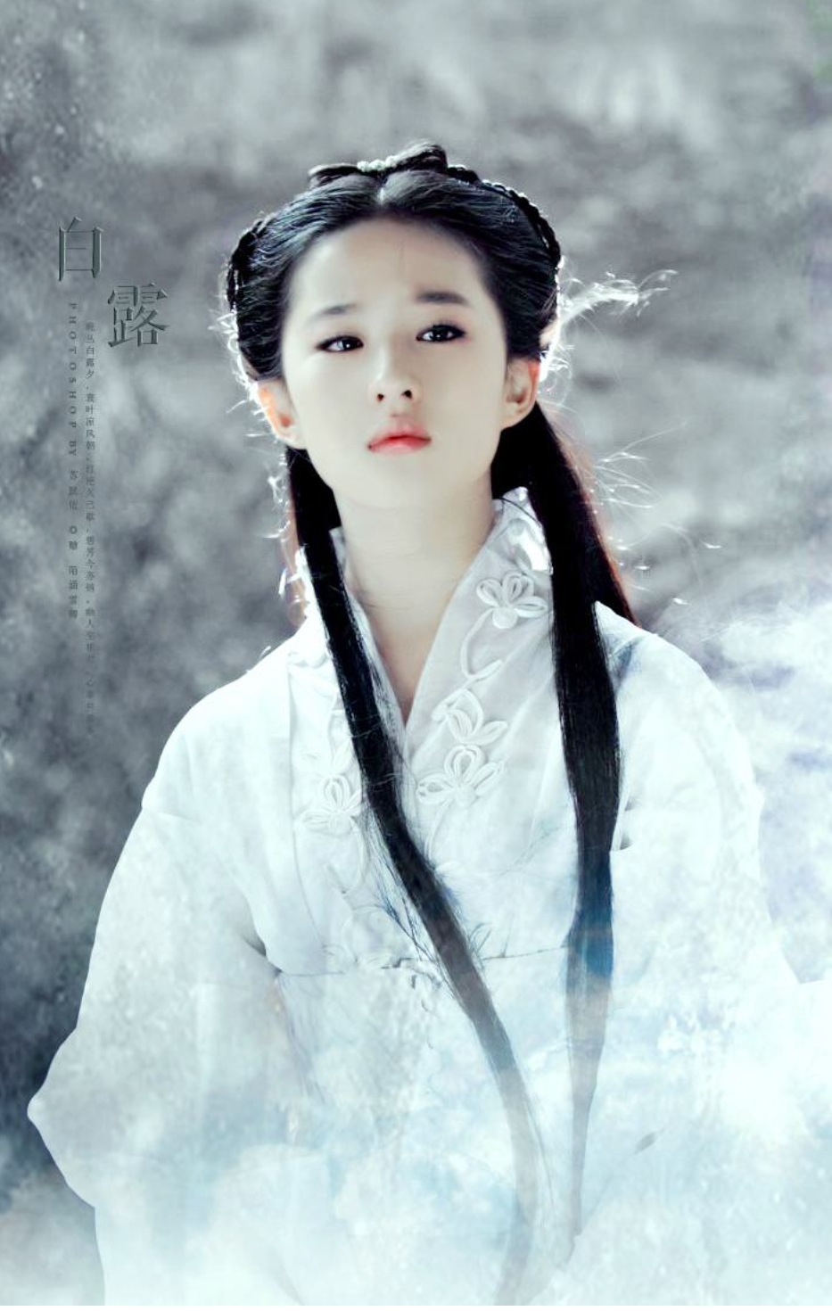
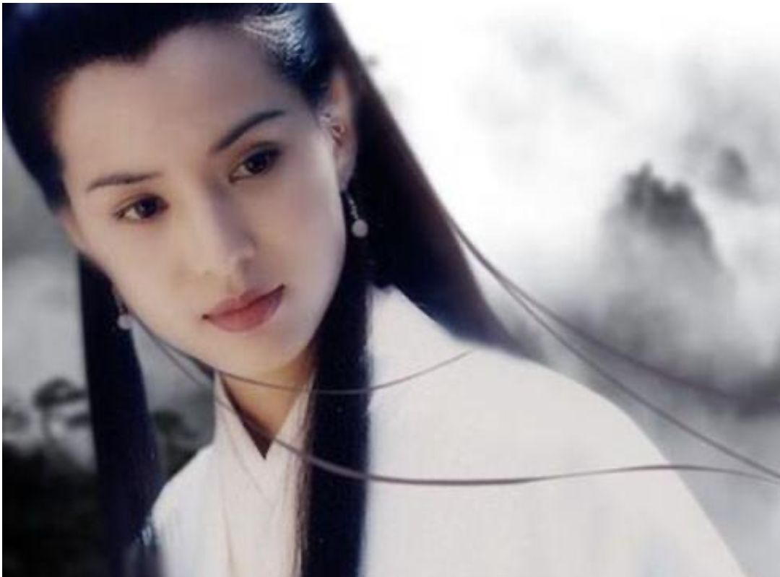

Slide 20
The opponents believes that the style itself is mysterious and untranslatable. It contains subjective emotions of the author and was influenced by the writer's long time writing works and life experience. So It's hard to translate.

Slide 21
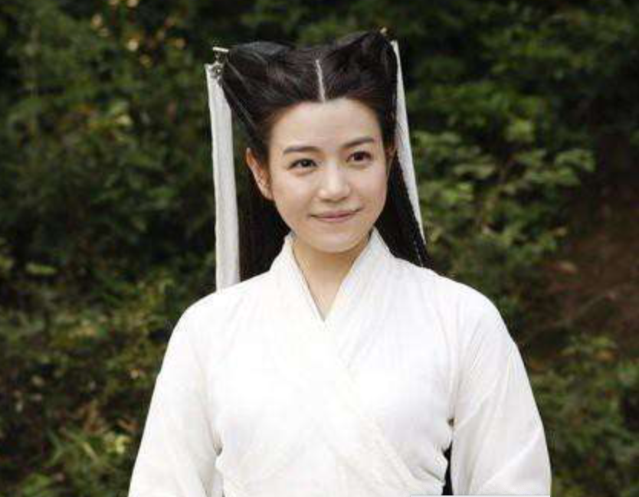

Slide 22
Part 4. The Conversion of style

Slide 23
To realize the conversion of style, we must understand the three main characteristics of style firstly.
1. Formal characteristics
The characteristics of the translation in terms of language signs
2. Informal features
The inner temperament of the author
3. Cultural color
The characteristics of the article that are affected by factors such as the era and culture.

