Slide 1
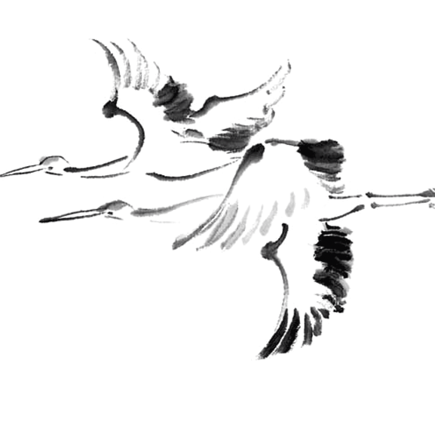
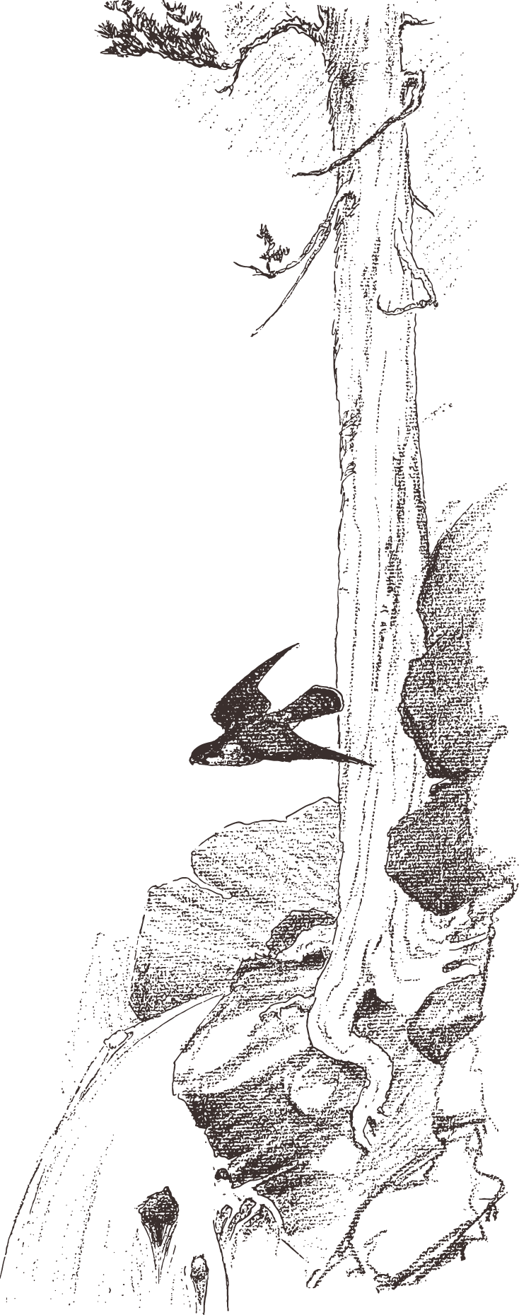
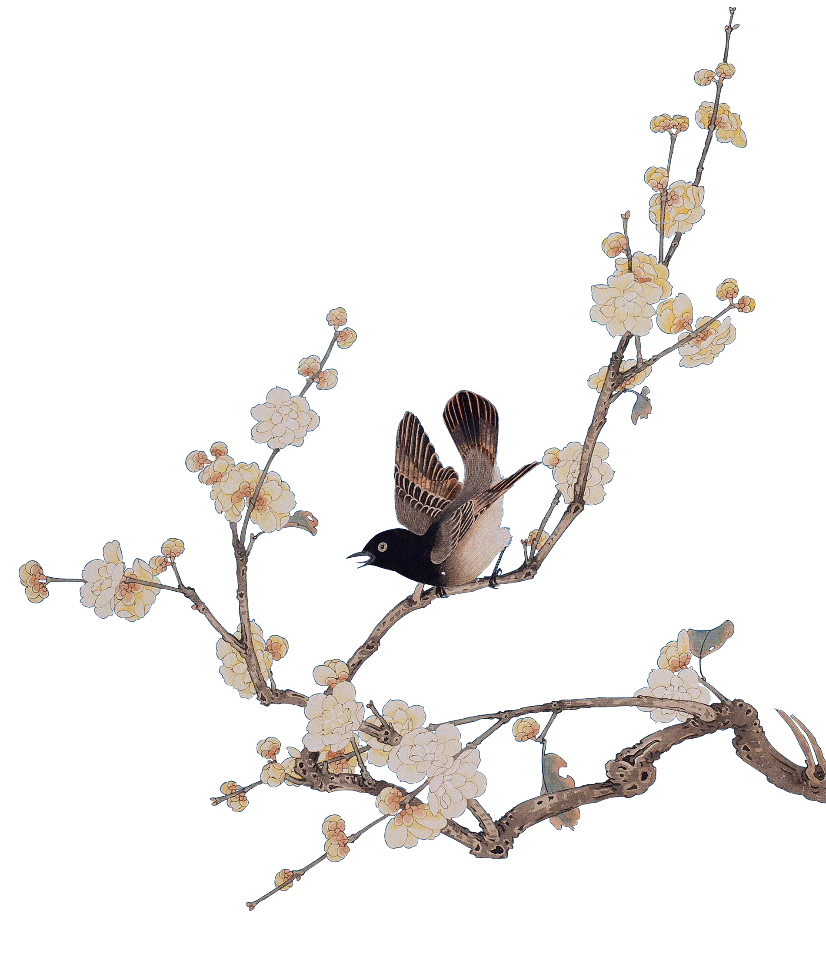
Traditional crafts: Moon-shaped Fans
Le Yuxuan/Lydia

Slide 2
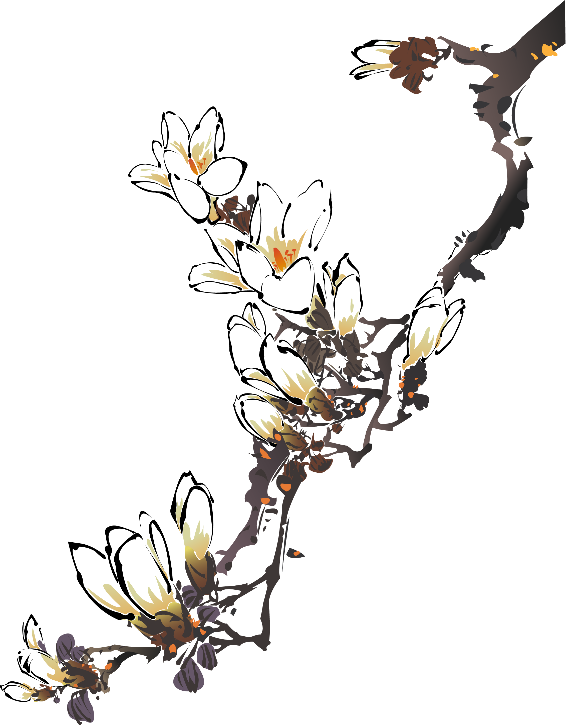
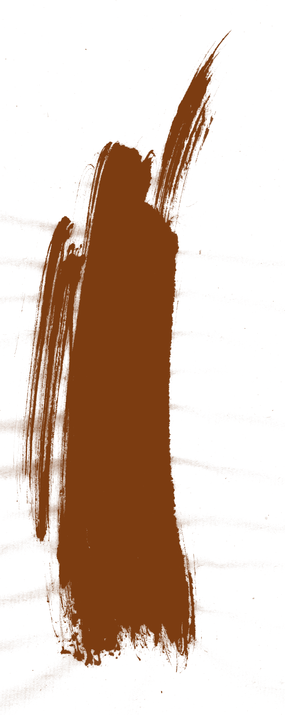
c
o
n
01 The Origin and Development
02 The Production Process
t
e
n
03 The Folklore and Symbols
04 The Difference between Chinese and Japanese Moon-shaped Fans
t
s

Slide 3

01
The Origin and Development

Slide 4
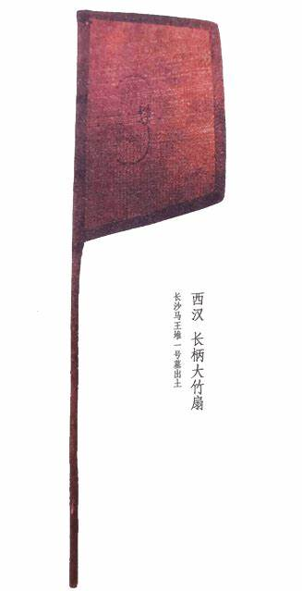
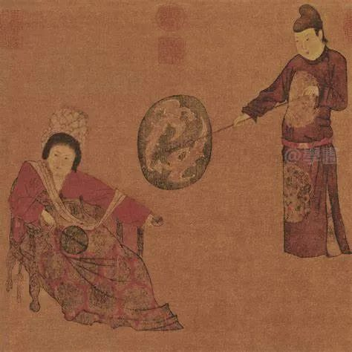
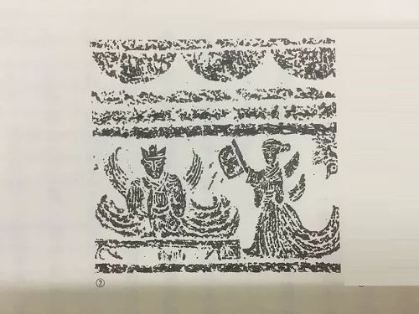
The Origin and Development
The Warring States Period
The Tang Dynasty
The Western Han Dynasty
“便面扇”
《挥扇仕女图》（周昉）中的长柄扇

Slide 5
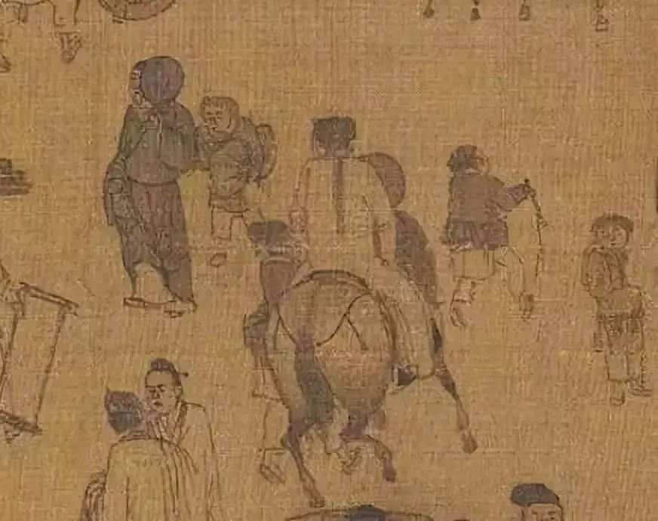
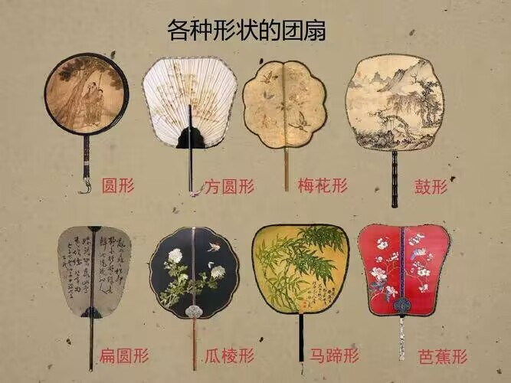
The Origin and Development
The Northern Song Dynasty
The Yuan, Ming and Qing Dynasties
(张择端《清明上河图》中以扇遮面的男子)

Slide 6
02
The Production Process

Slide 7
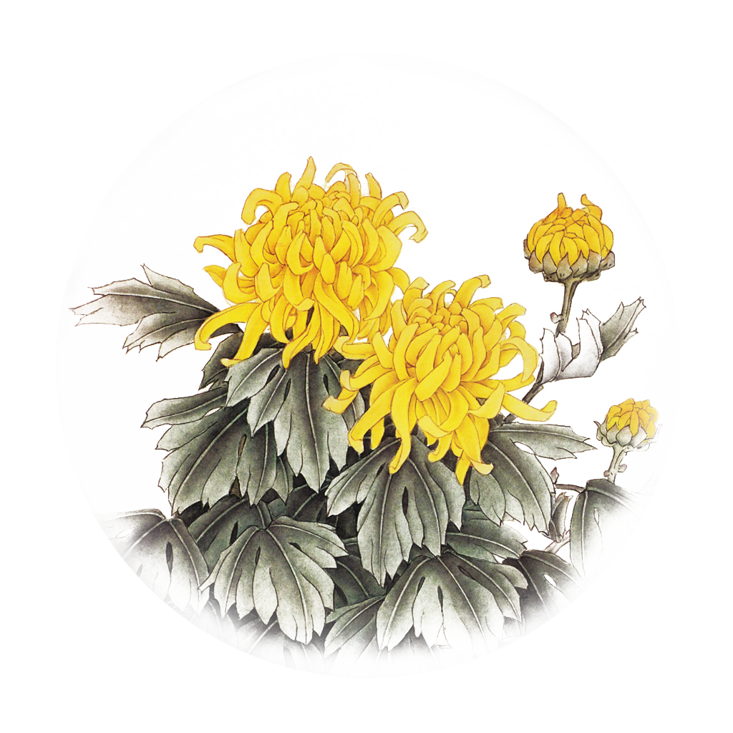
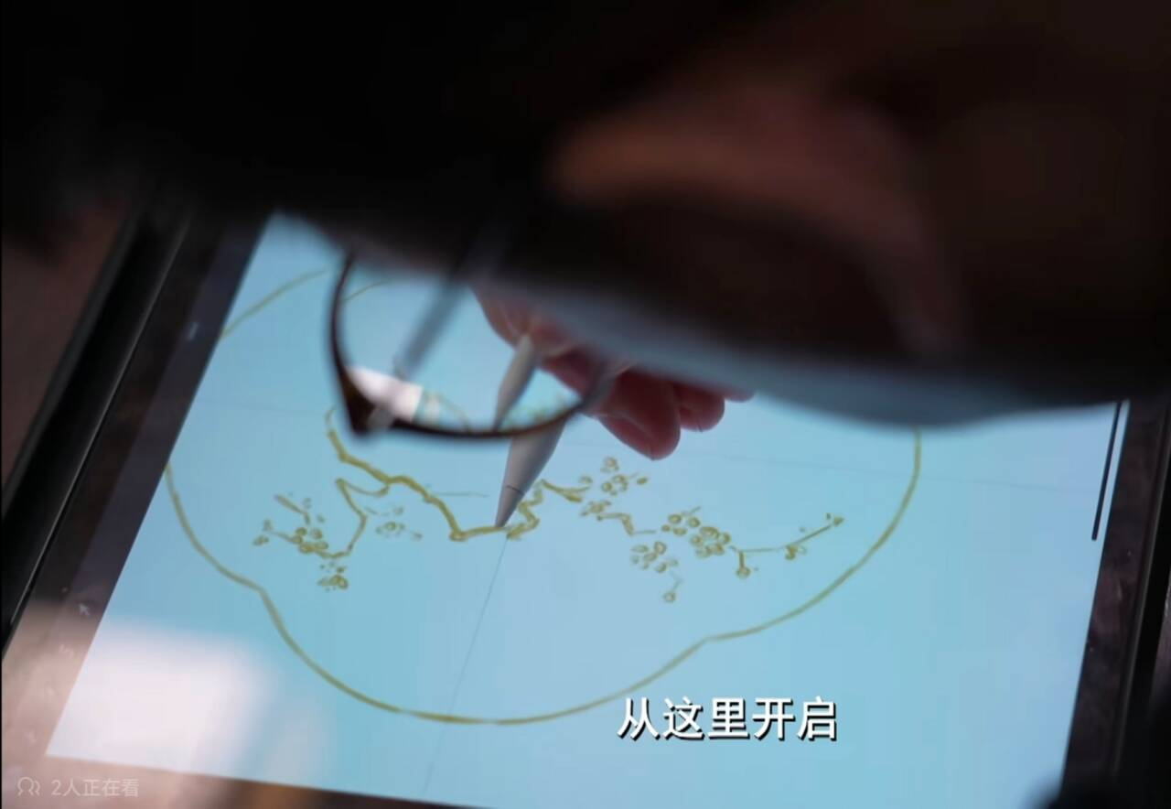
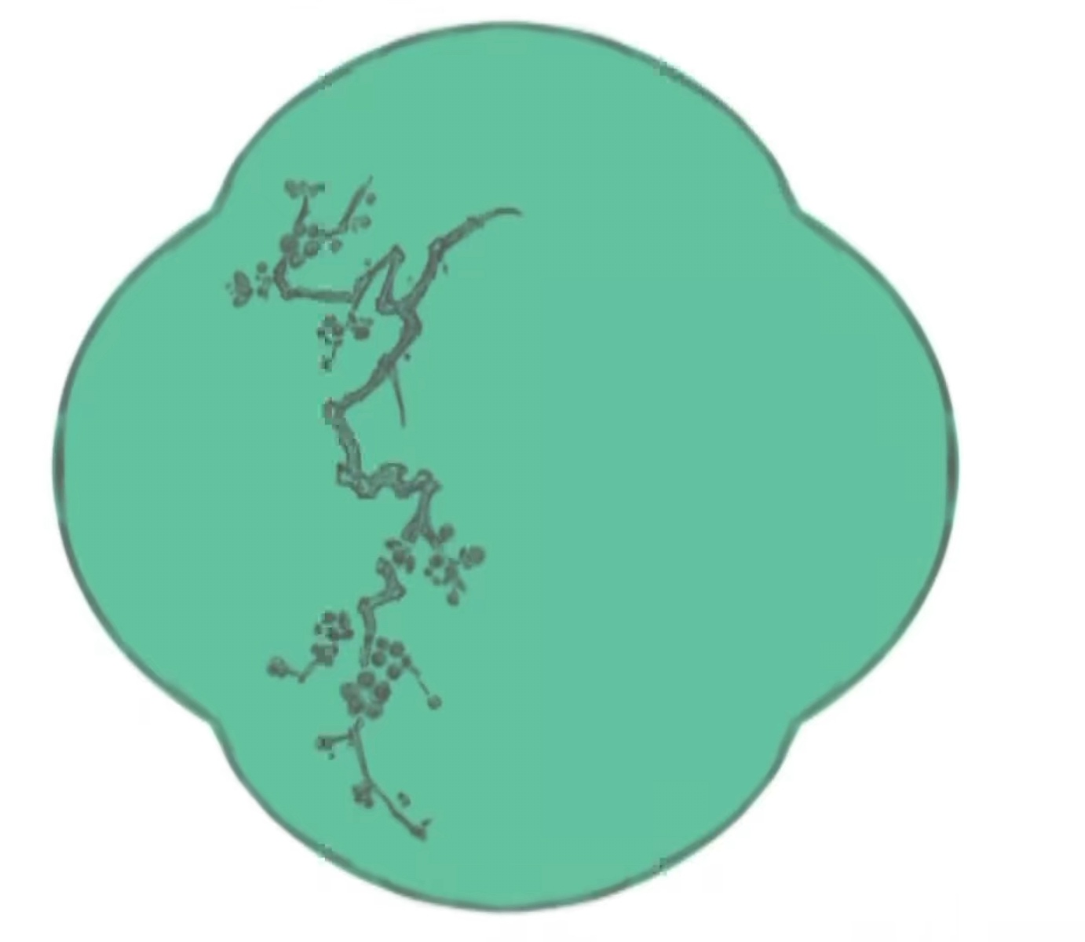
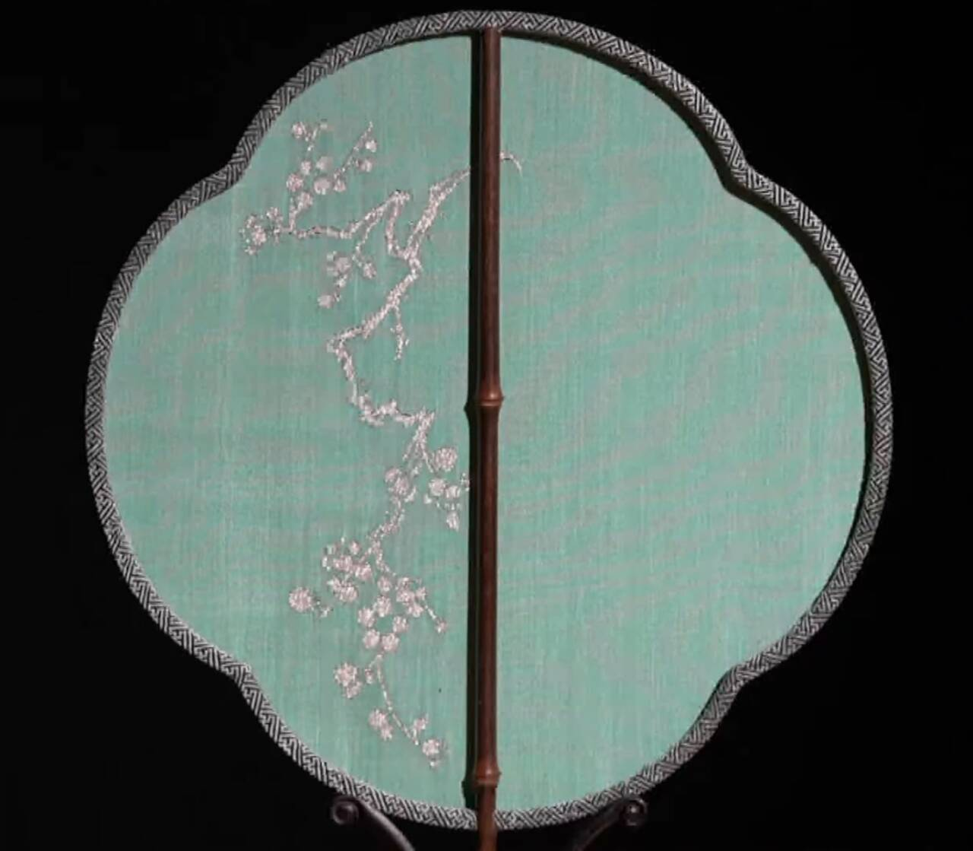
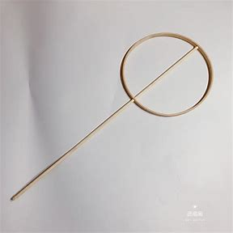
The Production Process
the mounted part
the frame
（装裱）
（扇骨）
the sector
（扇面）

Slide 8
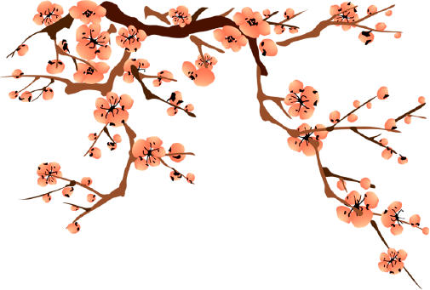

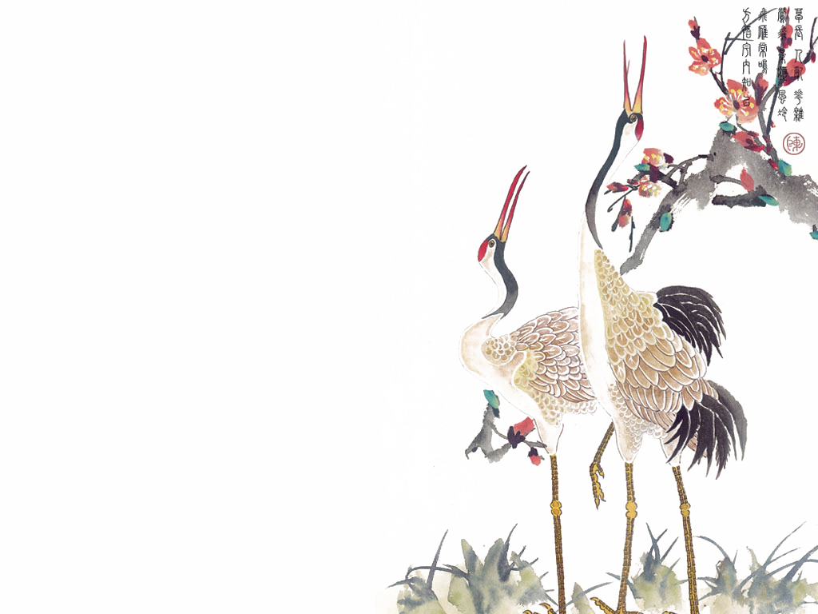

Slide 9
03
The Folklore and Symbols

Slide 10
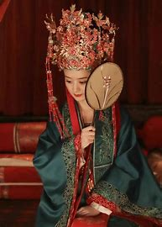
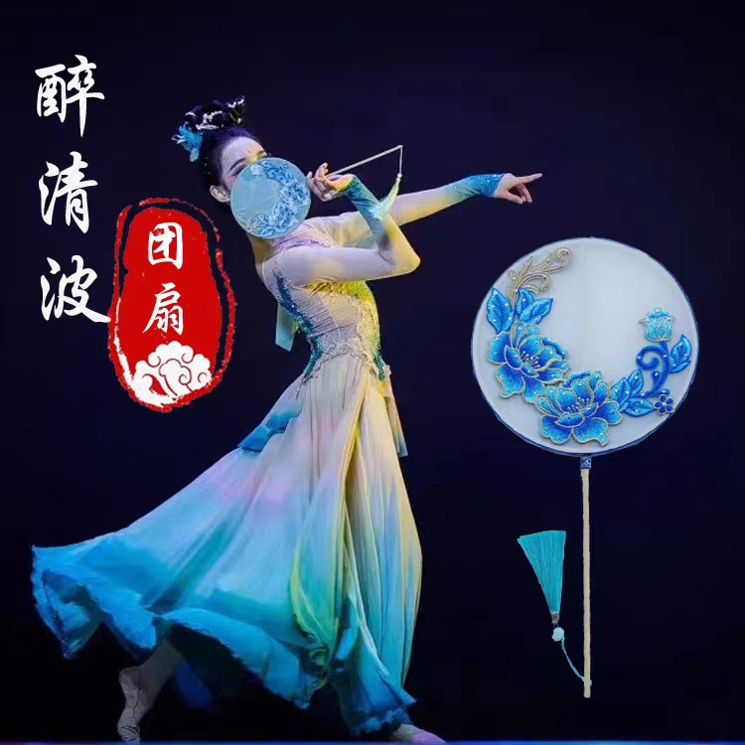
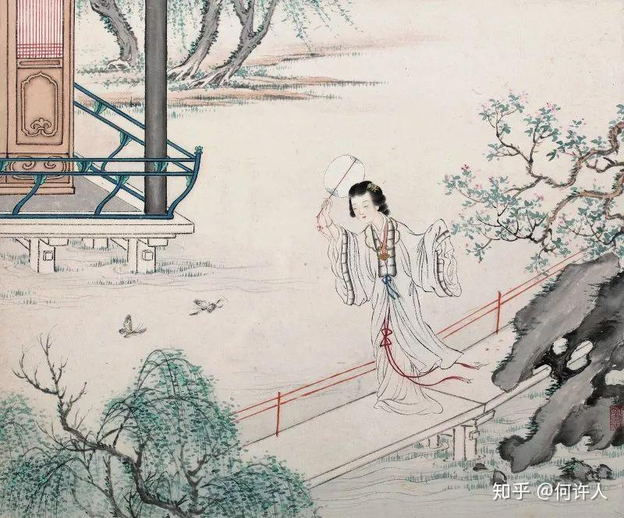
The folklore
Marriage etiquette
Dance performance
daily life

Slide 11
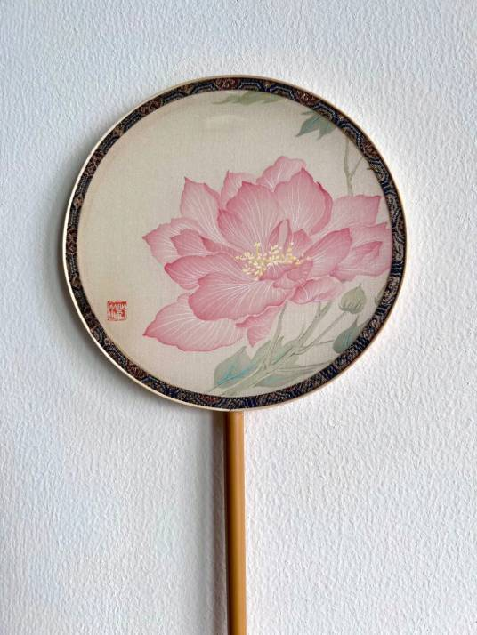
The symbols
Reunion and happiness
Because of the round shape, it is often regarded as a symbol of reunion and happiness.
Wealth and luck
It is often embroidered with peony, phoenix and other rich and auspicious patterns.
Elegance and grace
Ancient literati often use it as the carrier to make beautiful paintings and calligraphy.

Slide 12
04
The Difference between Chinese and Japanese Moon-shaped Fans

Slide 13
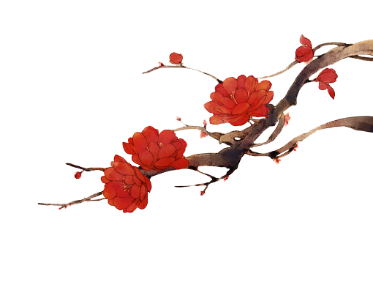
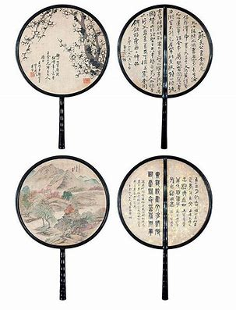
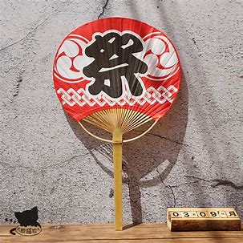

The difference
V.S.

Slide 14
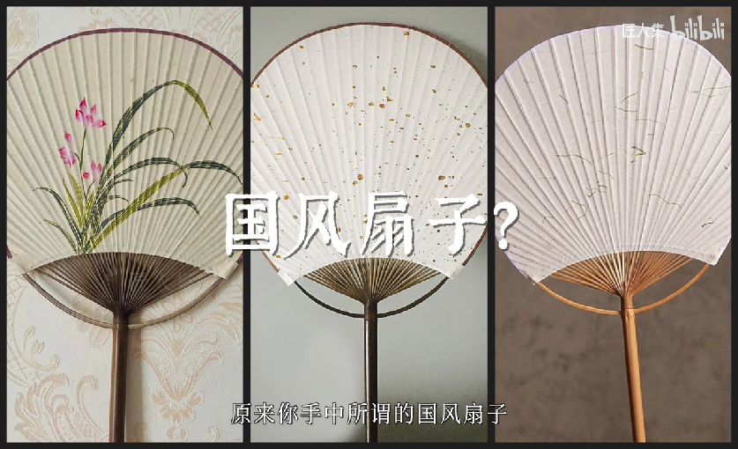

Slide 15
1. What are the three parts of the production process?
2. What are the symbols of a moon-shaped fan?(any two of the three)
3. What is the biggest difference between Chinese and Japanese moon-shaped fans?

Slide 16
Thank you!

