Slide 1

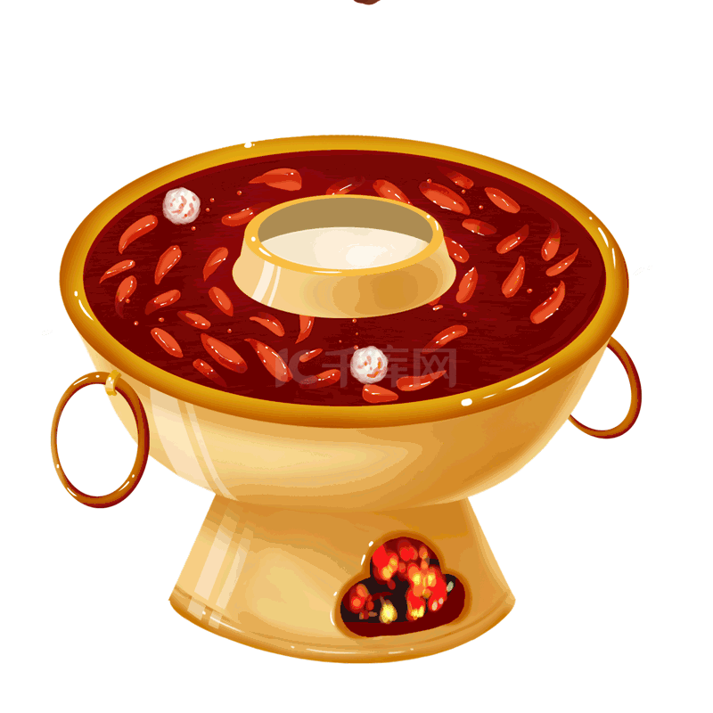
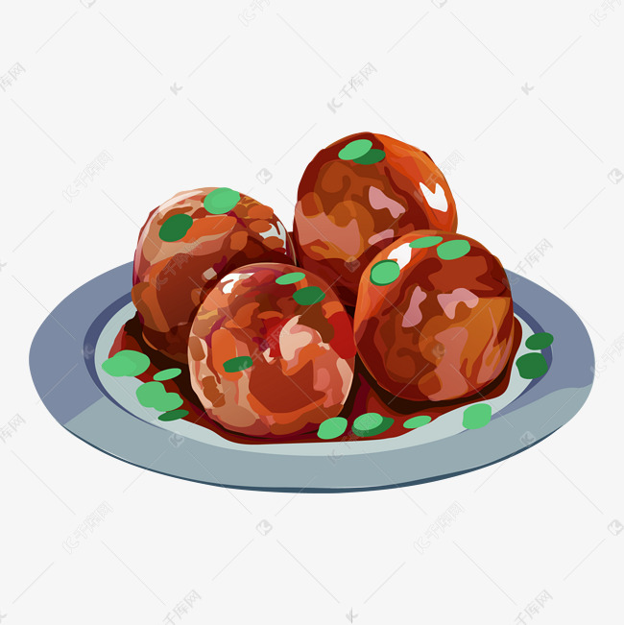

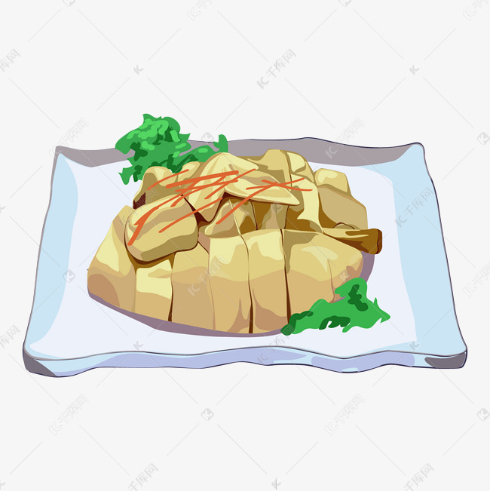
Four Distinct Regional Cuisines
By: 石海瑶 Shi Haiyao
罗雨晴 Luo Yuqing

Slide 2
Contents
Part1 General Knowledge of Chinese Cuisines
Part2 Four Distinct Regional Cuisines
Part3 Translation Methods of Dish Names

Slide 3
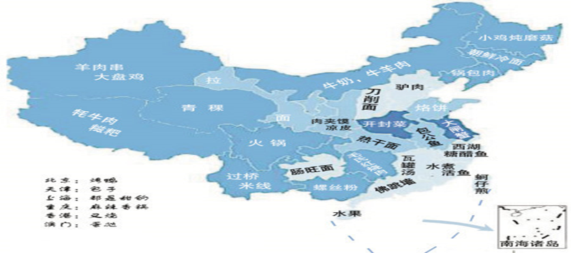
1.General Knowledge of Chinese Cuisines
Four Cuisines: Shandong, Sichuan, Guangdong and Huaiyang cuisines.
Eight Cuisines: Shandong, Sichuan, Guangdong, Jiangsu, Zhejiang, Fujian, Hunan and Anhui cuisines.

Slide 4
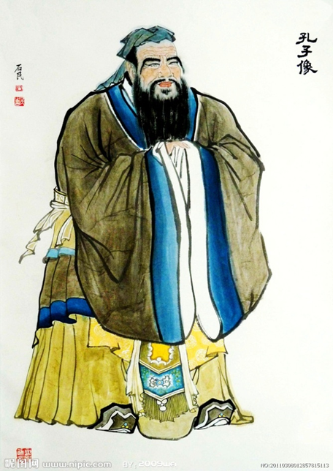
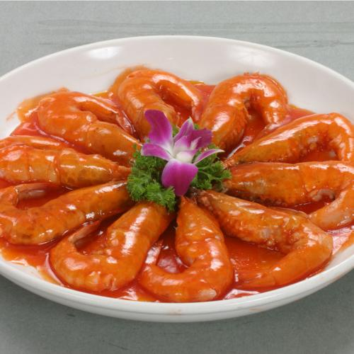
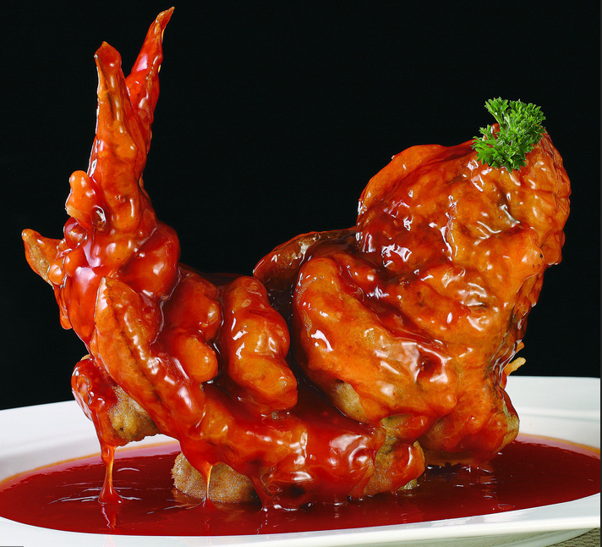
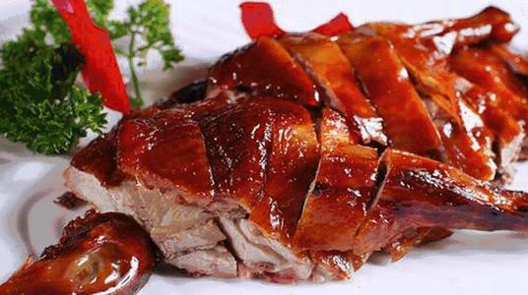
2. Four Distinct Regional Cuisines
Shandong Cuisine
the oldest cuisine in China
Specializes in seafood
Fresh, tasty but not greasy

Slide 5
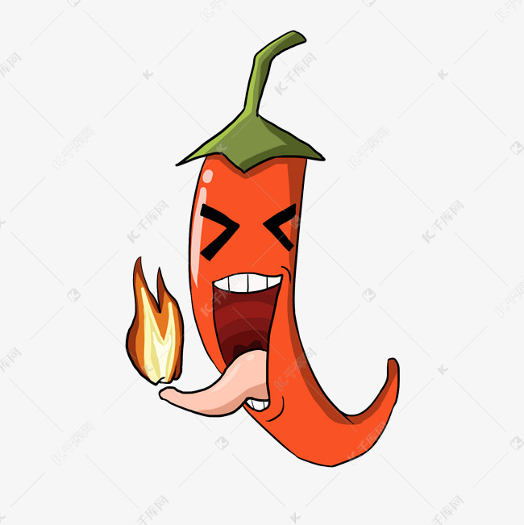
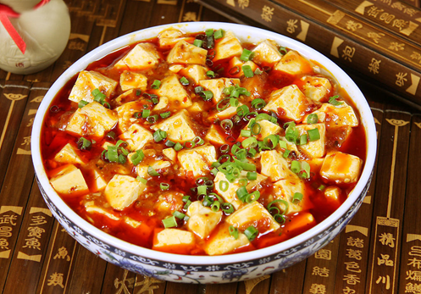
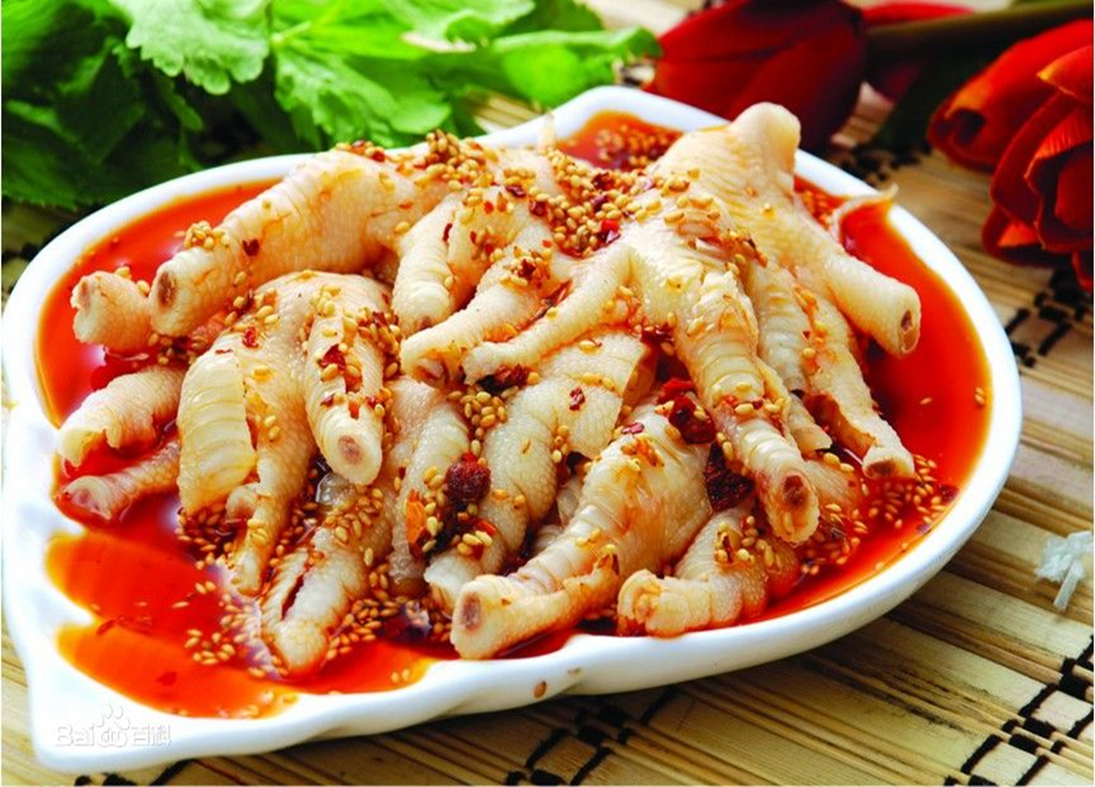
2. Four Distinct Regional Cuisines
Sichuan Cuisine
the fastest growing cuisine
characterized in hot, pungent and numbing flavor
Porkmarked Woman’s Bean Curb
Chicken Feet with Prickled Peppers

Slide 6
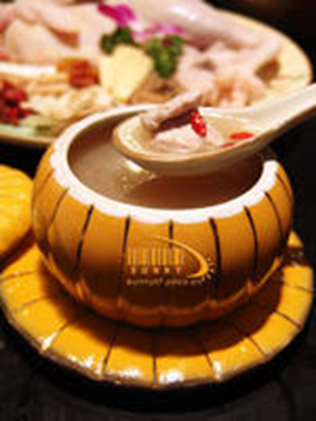
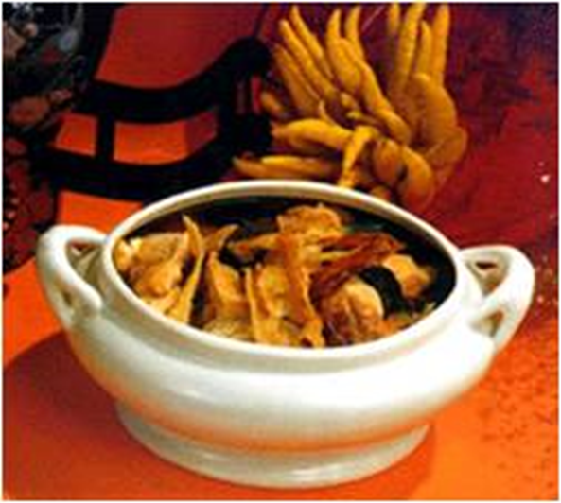
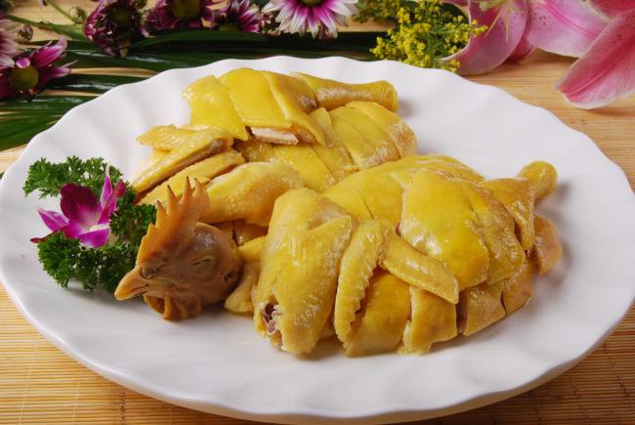
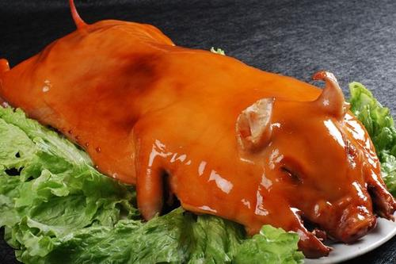
2. Four Distinct Regional Cuisines
Guangdong Cuisine
incorporates almost all edible meats
fresh, tender and lightly seasoned

Slide 7
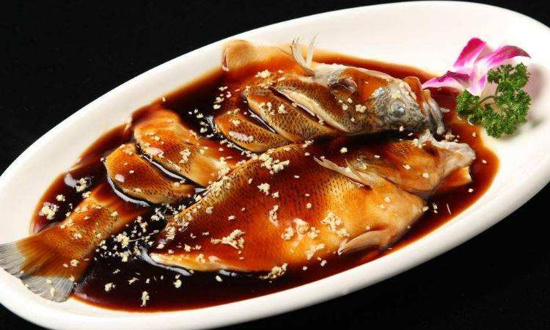
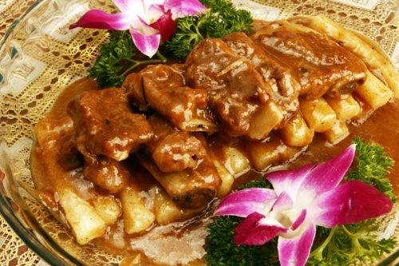
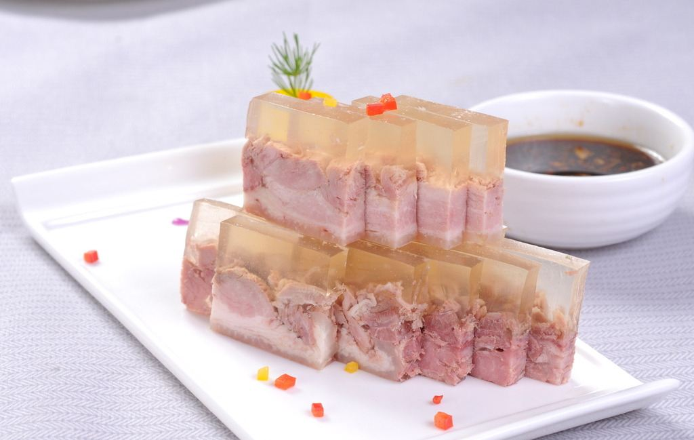
2. Four Distinct Regional Cuisines
Huaiyang Cuisine
Emphasis on cutting technique and temperature control
sweet and not spicy at all.

Slide 8
3. Translation Methods of Dish Names
Naming beginning with the material:
Chicken Feet with Pickled Peppers 泡椒凤爪
Duck Web in Oyster Sauce 耗油鸭掌
Naming beginning with the cooking techniques:
Roast Sucking Pig 烤乳猪
Braised Prawns 油焖大虾
Naming beginning with Person’s name or place name:
Pockmarked Woman’s Bean Curb 麻婆豆腐
Dongpo’s Braised Pork 东坡肉
Beijing Roast Duck 北京烤鸭

Slide 9
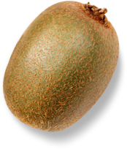

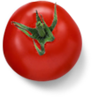

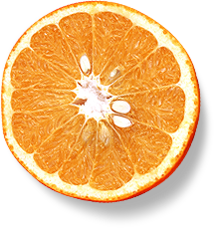
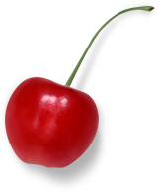
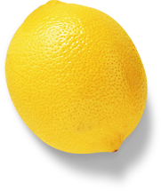

Thanks for your listening!
By: 石海瑶 Shi Haiyao
罗雨晴 Luo Yuqing

