Slide 1
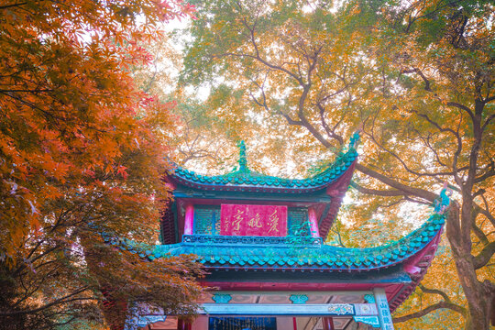



Yuelu Mountain
——the brilliant pearl of Huxiang culture
2023级翻译班朱顺洁

Slide 2

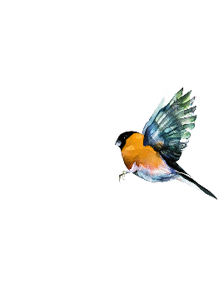
contents
01
Location and natural landscapes
02
Historical and cultural origins and the main attractions
03
04
Cultural events and tourist information
Ecological and cultural values

Slide 3
01
Location and Natural Landscapes

Slide 4

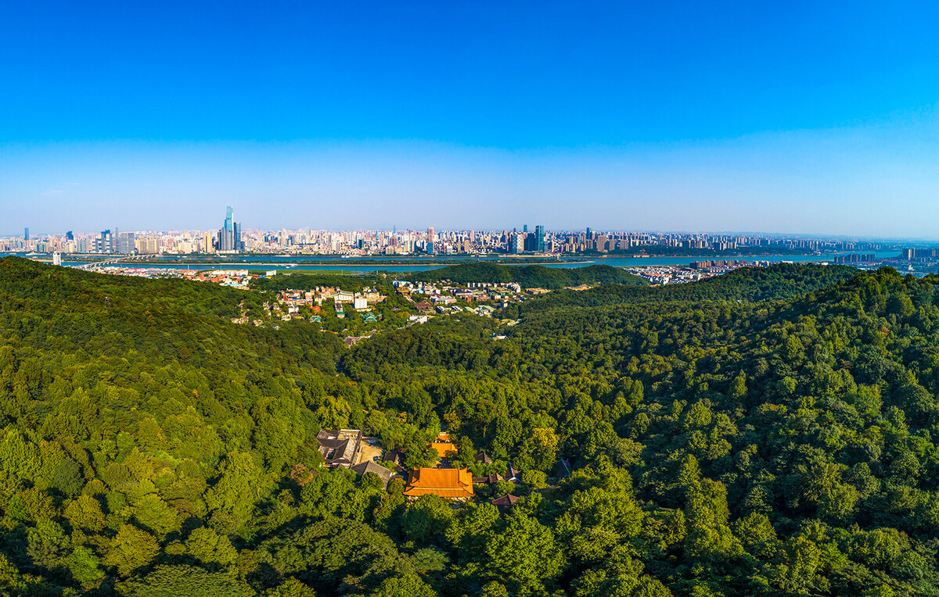
location
Yuelu Mountain is located on the west bank of the Xiangjiang River in Yuelu District, Changsha City, Hunan Province, and is the last peak of the 72 peaks of Nanyue Heng Mountain. The total area of Yuelu Mountain Scenic Area is about 35.20 square kilometers.

Slide 5
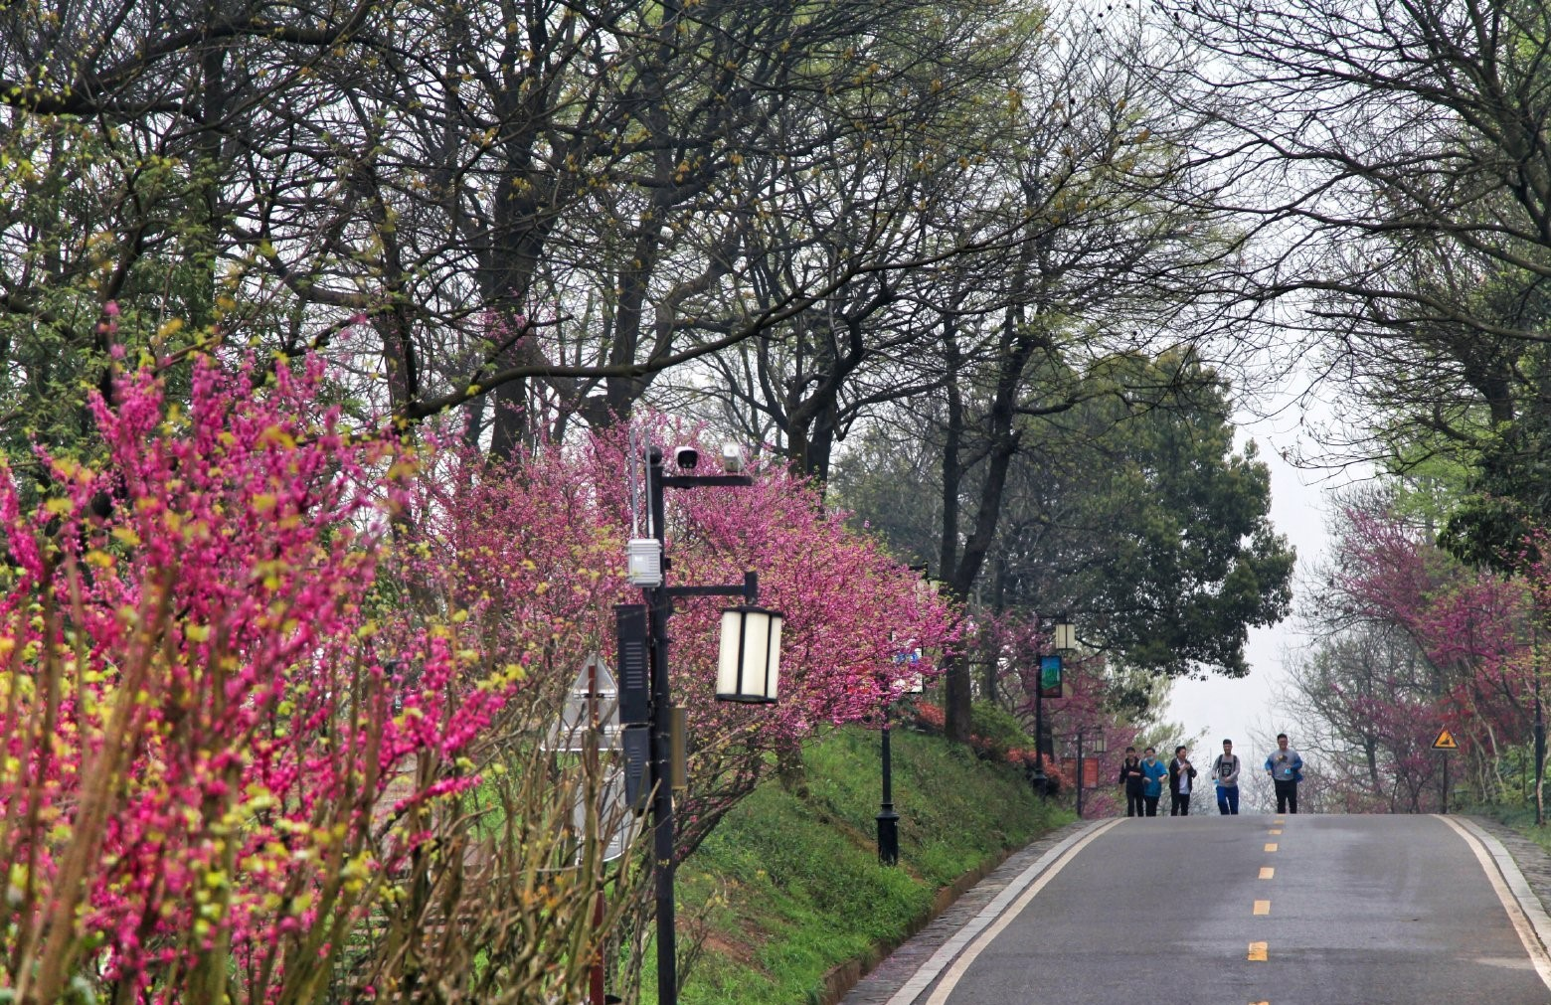
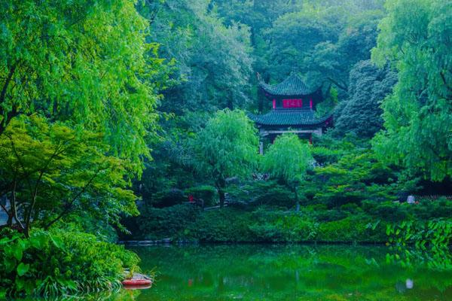
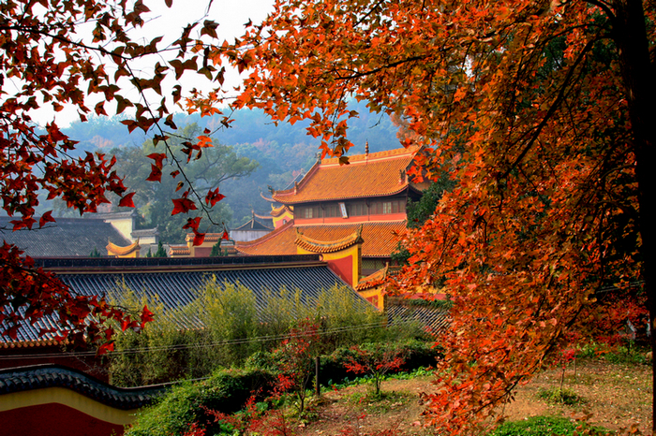
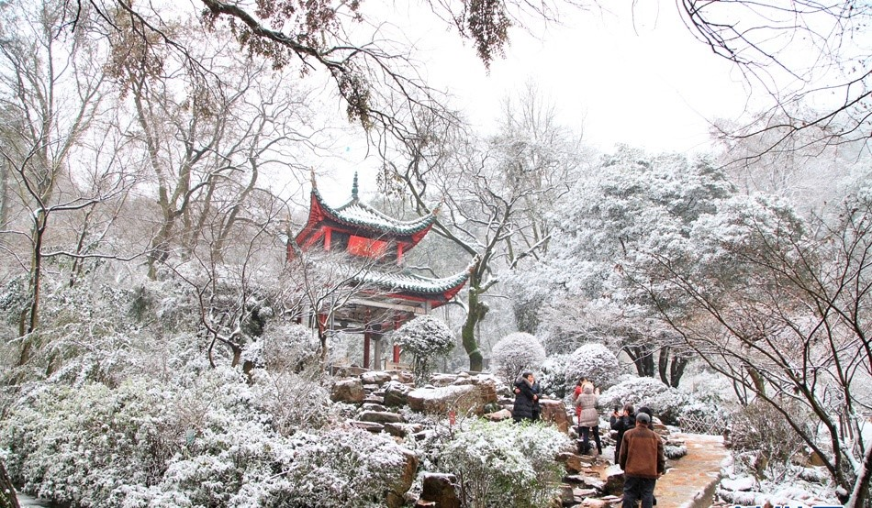
natural landscapes
spring
summer
autumn
winter

Slide 6
02
Historical and Cultural Origins and the Main Attractions

Slide 7
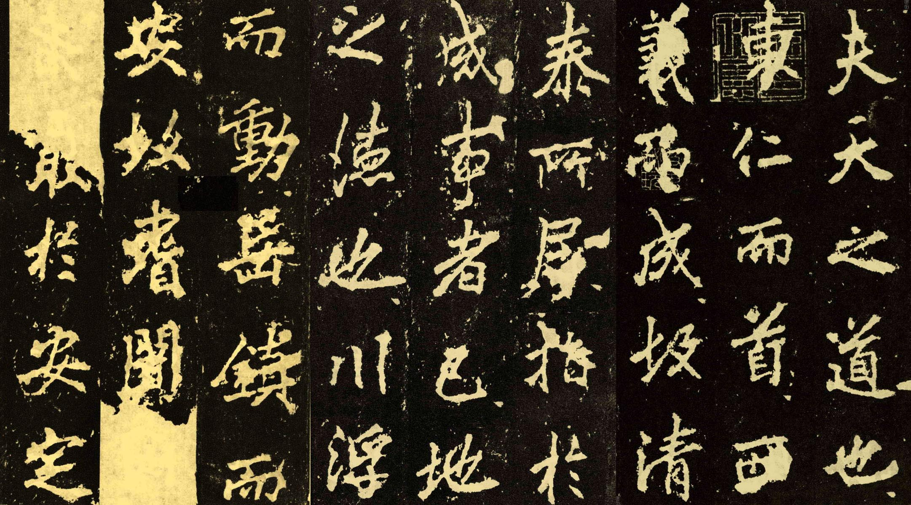
ancient cultural origins
Origin of religious culture:
In the first four years of Emperor Wu(武帝) of the Western Jin Dynasty (268 years), Lushan Temple(麓山寺) was founded, which is one of the birthplaces of Hunan Buddhist culture.

Slide 8
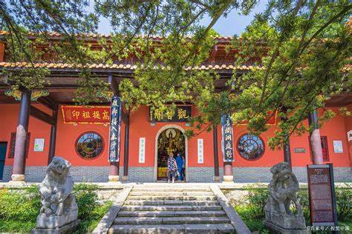
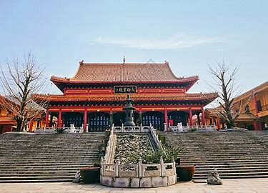
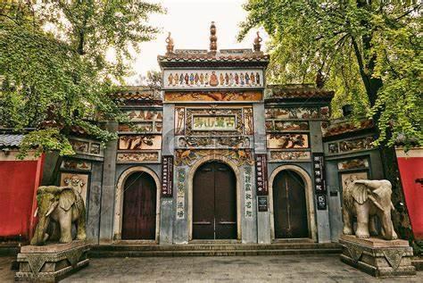
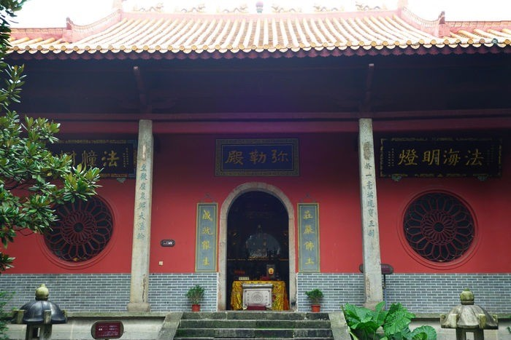
ancient cultural origins
Lushan Temple(麓山寺):
Lushan Temple is one of the earliest Buddhist monasteries in Hunan. The temple has been rebuilt many times, and the existing buildings include the mountain gate(山门), the Maitreya hall(弥勒殿), the Daxiong Treasure Hall(大雄宝殿), the Guanyin Pavilion(观音阁), etc.

Slide 9
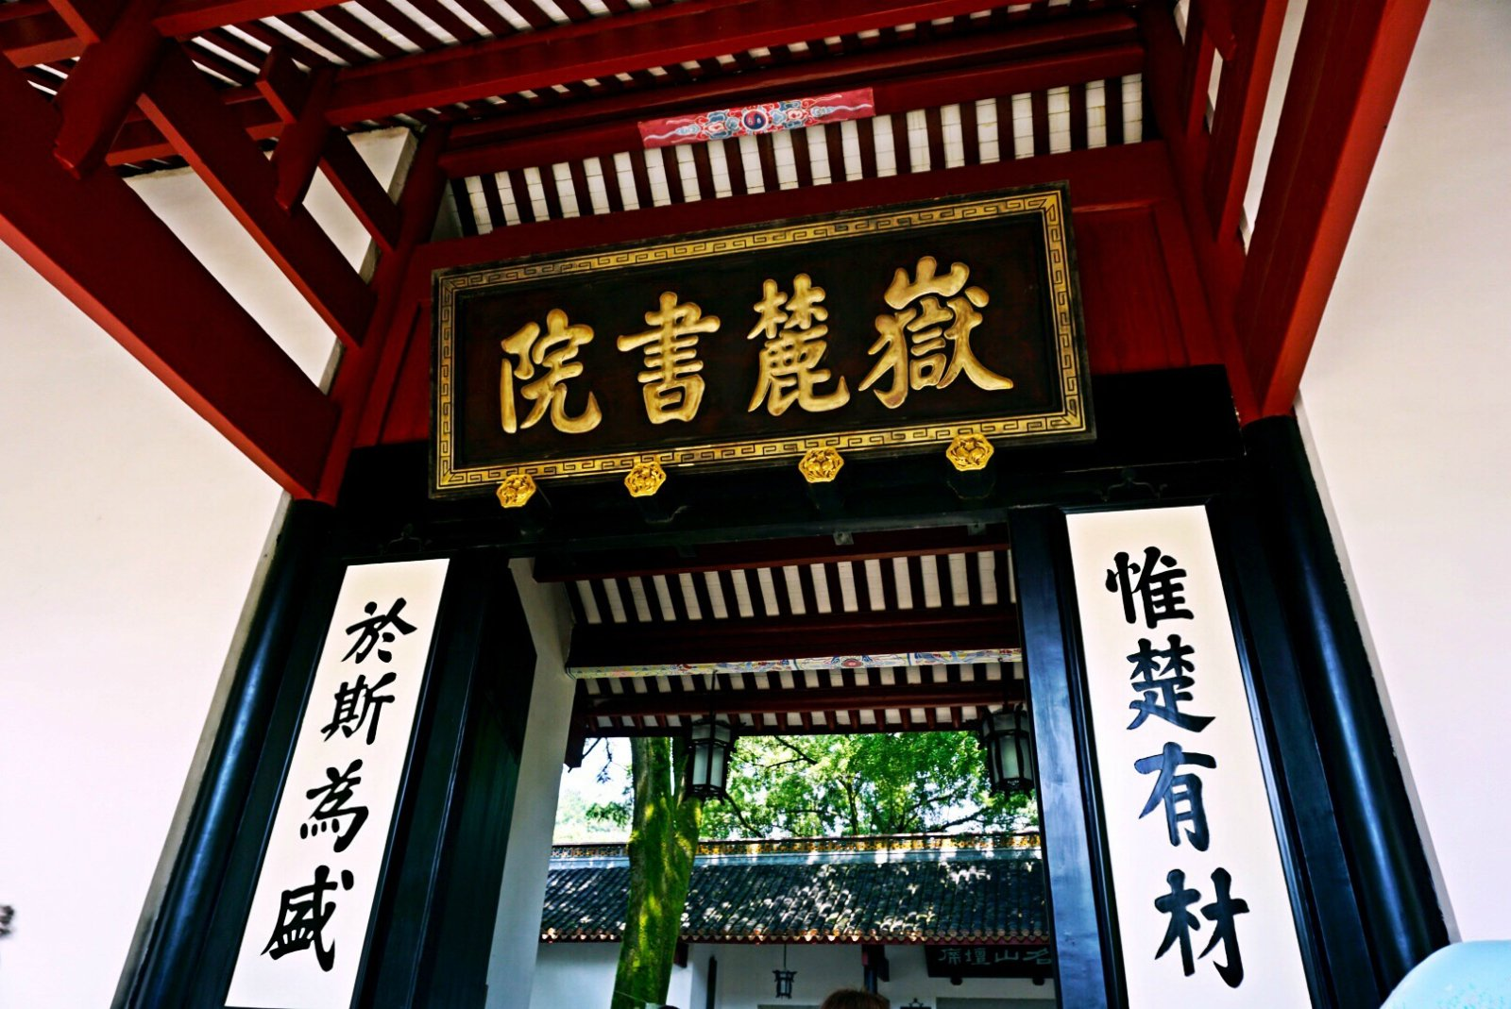
ancient cultural origins
Inheritance of Confucian culture:
In the ninth year of Kaibao(开宝) in the Northern Song Dynasty (976), Tanzhou Prefecture(潭州太守) Zhudong established Yuelu Academy at the foot of Yuelu Mountain, opening a new chapter in Huxiang Confucian culture. Yuelu Academy is one of the four great academies in ancient China, which went through the Song, Yuan, Ming and Qing dynasties. Until 1926, it was named Hunan University. It is known as the "Millennium Academy"(千年学府).

Slide 10
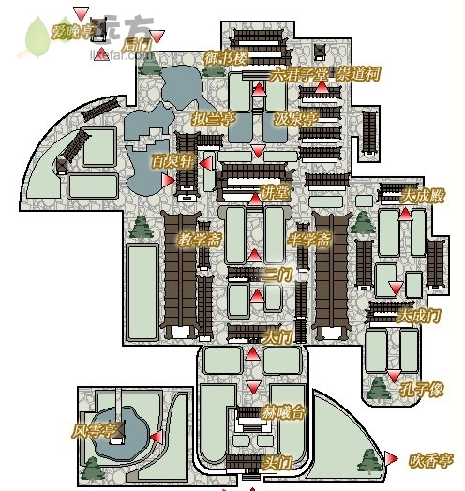
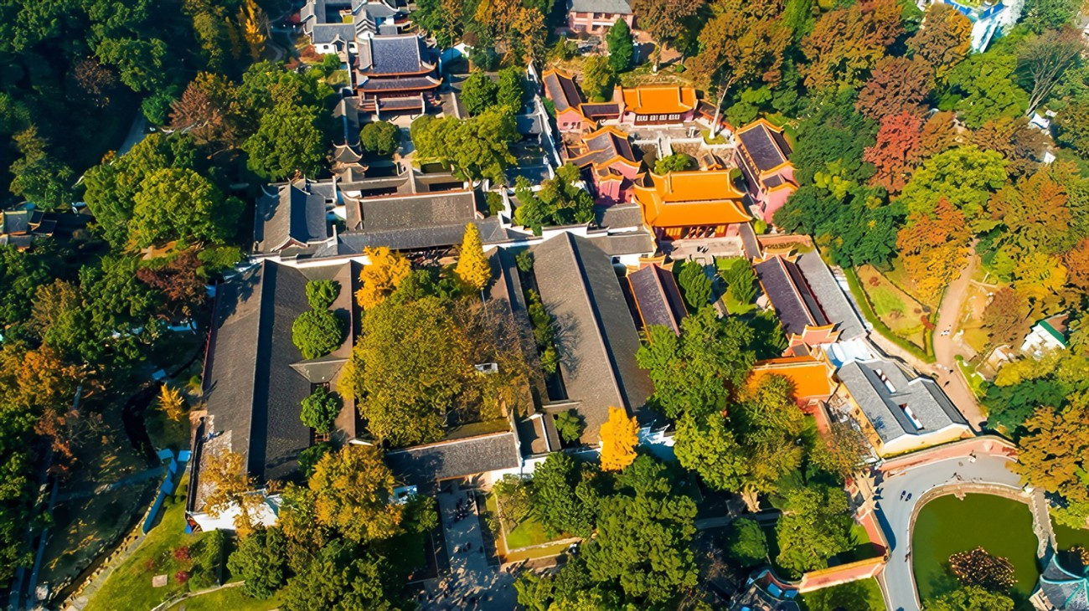
ancient cultural origins
Yuelu Academy(岳麓书院):
The layout of Yuelu Academy takes the central axis as the core, and the main buildings are the front gate, Hexi Terrace(赫曦台), the main gate, the second gate, the lecture hall(讲堂) and the imperial study building(御书楼), which are symmetrically distributed along the central axis, reflecting the regulation of ancient Chinese academy architecture.

Slide 11
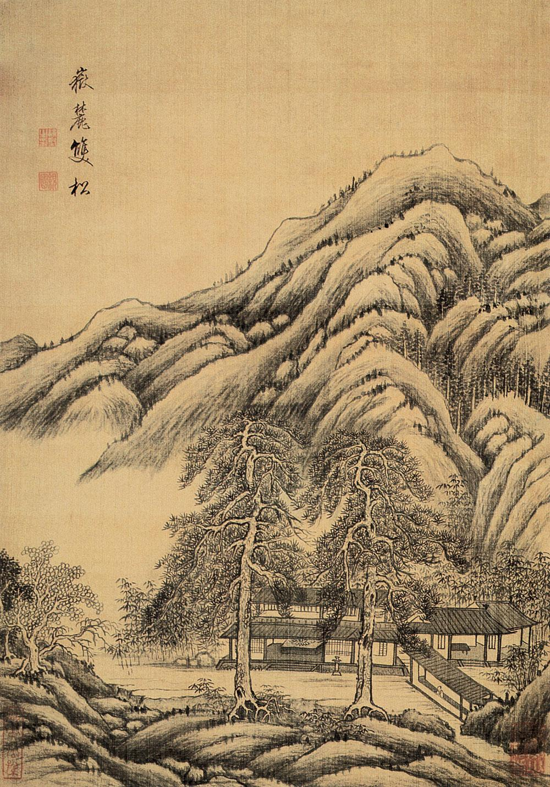

ancient cultural origins
Gathering of literati and artists:
Yuelu Mountain has attracted many literati and artists to visit and write poems. Tang Dynasty poets Zhang Jiuling, Du Fu, Han Yu and others have left poems here, and Confucian and Buddhist cultures are blended here.

Slide 12
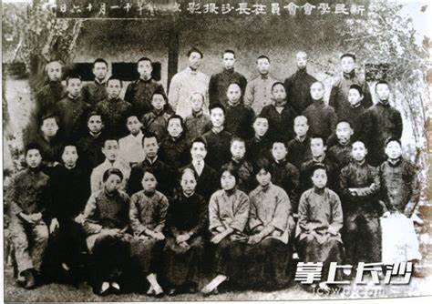
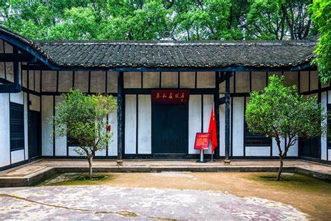
modern culture and revolutionary spirit
The Xinmin Society(新民学会) and the Flame of Revolution:At the foot of Yuelu Mountain is the former site of the Xinmin Society, where 13 people, including Mao Zedong, Cai Hesen and He Shuheng, held an inaugural meeting here and founded the Xinmin Society.
"innovating academics, sharpening conduct, and improving people's hearts and customs"(革新学术，砥砺品行，改良人心风俗)

Slide 13
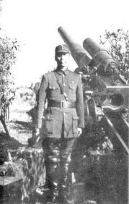
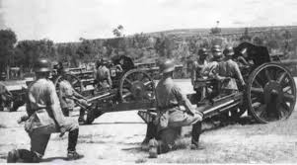
modern culture and revolutionary spirit
Relics of the Battle of Changsha(长沙会战) and the Anti-Japanese Resistance:
Beginning in September 1939, all the officers and men of the Ninth Theater of the Army of the National Revolutionary Army(国民革命军陆军第九战区) fought bravely against Japan in Yuelu Mountain and other places and won major victories.

Slide 14
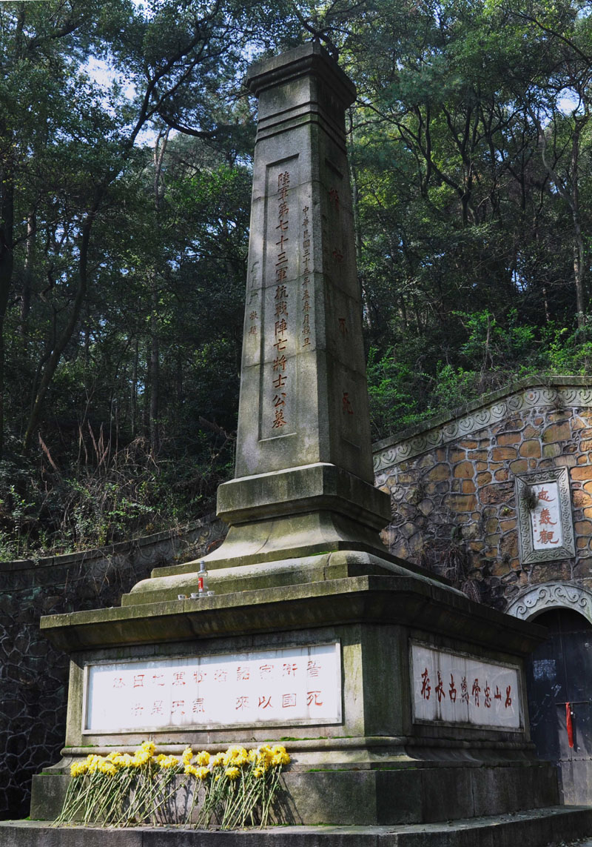
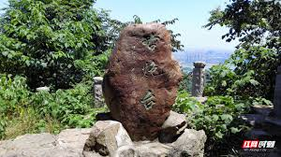
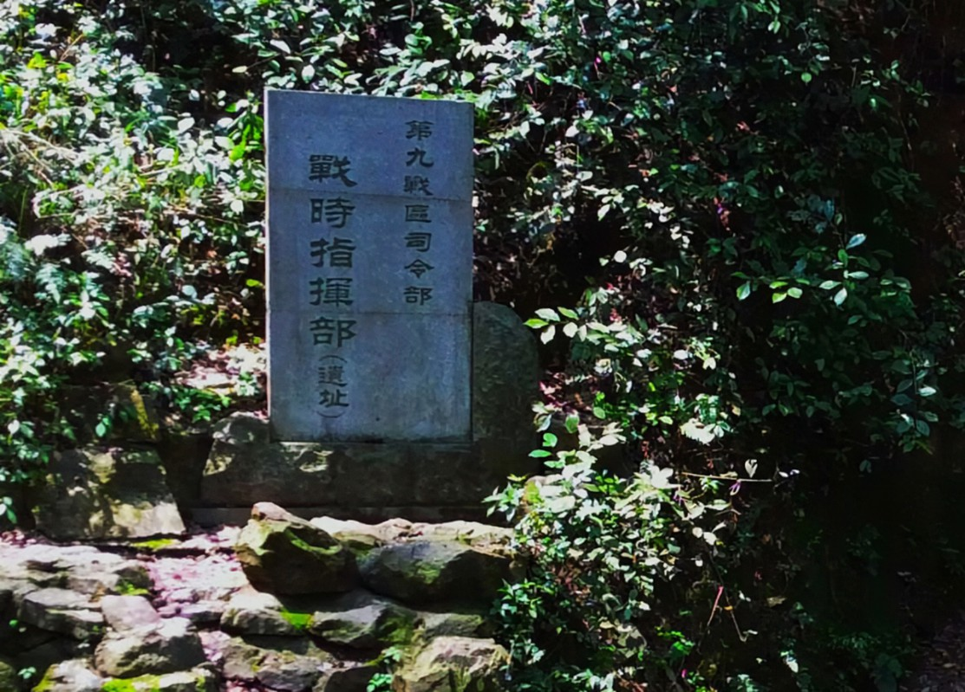
Modern culture and revolutionary spirit

Slide 15
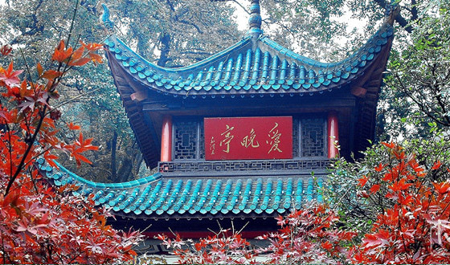
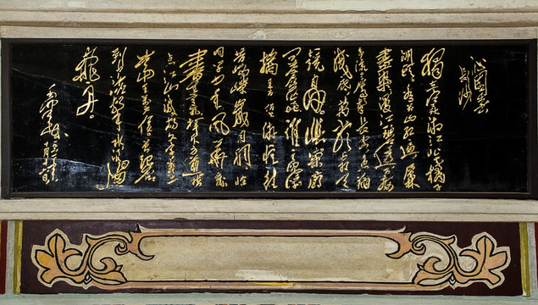
Modern culture and revolutionary spirit
Aiwan Pavilion(爱晚亭) with the Red Spirit:
Aiwan Pavilion is one of the four famous pavilions in China and an important red cultural landmark of Yuelu Mountain. Mao Zedong had many gatherings with progressive classmates here to discuss revolutionary truths. In 1969, Yuelu Mountain Park rebuilt the Aiwan Pavilion and engraved Chairman Mao's cursive handwriting "Qinyuan Spring, Changsha" in the caisson.

Slide 16
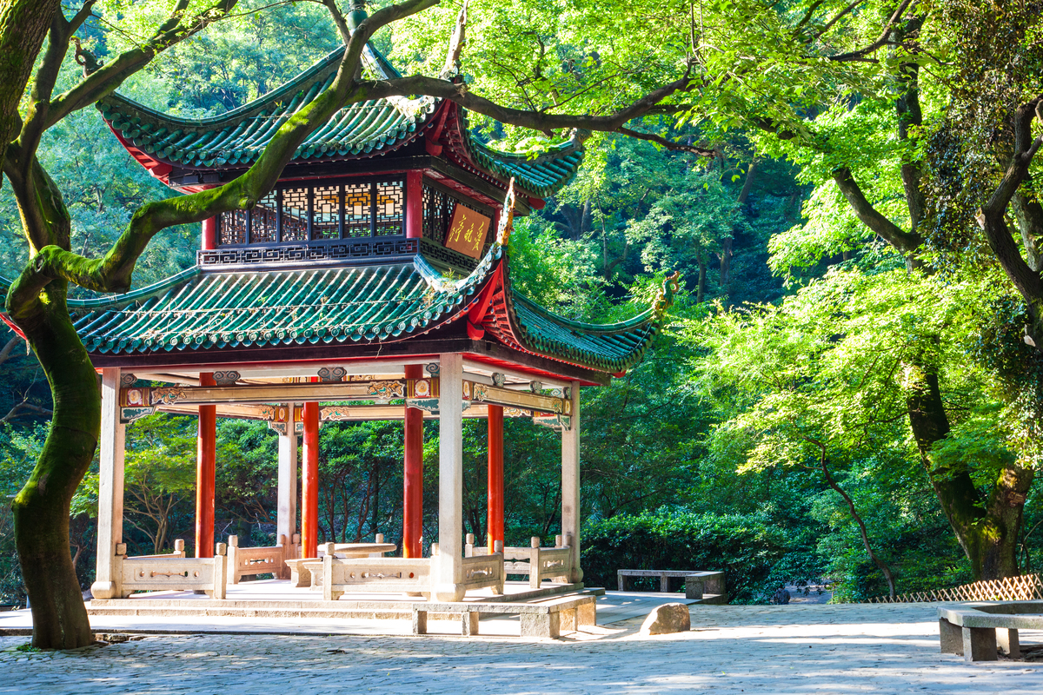
Modern culture and revolutionary spirit
Aiwan Pavilion(爱晚亭) :
Aiwan Pavilion is named after Du Mu's poem "Mountain Walk". The pavilion has eight pillars of heavy eaves, glazed blue tiles, red columns and green columns. It is simple and elegant. Surrounded by maple forests, the autumn leaves are like fire. The scenery is charming.

Slide 17
03
Ecological and Cultural Values

Slide 18
Ecological and Cultural Values
Strong ecological service functions
Rich biodiversity
01
02
03
04
Integration of culture and ecology
High ecosystem stability

Slide 19
04
Cultural Activities and Tourist Information

Slide 20
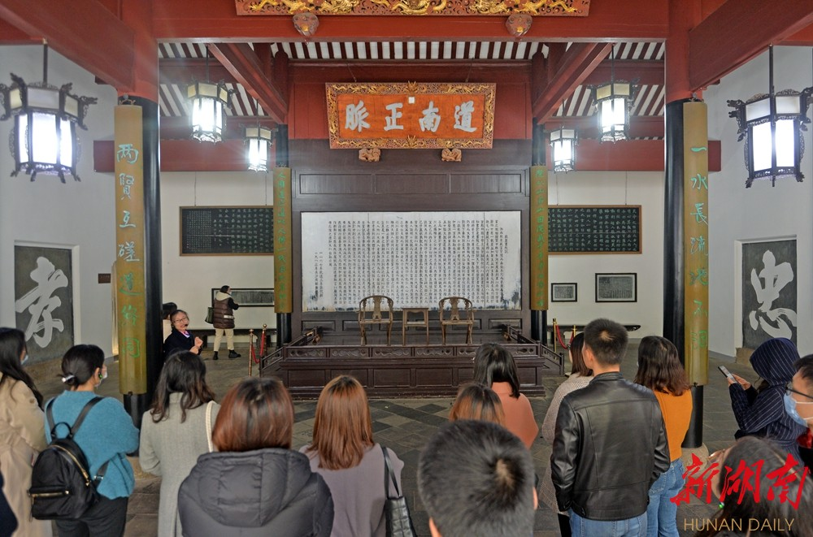
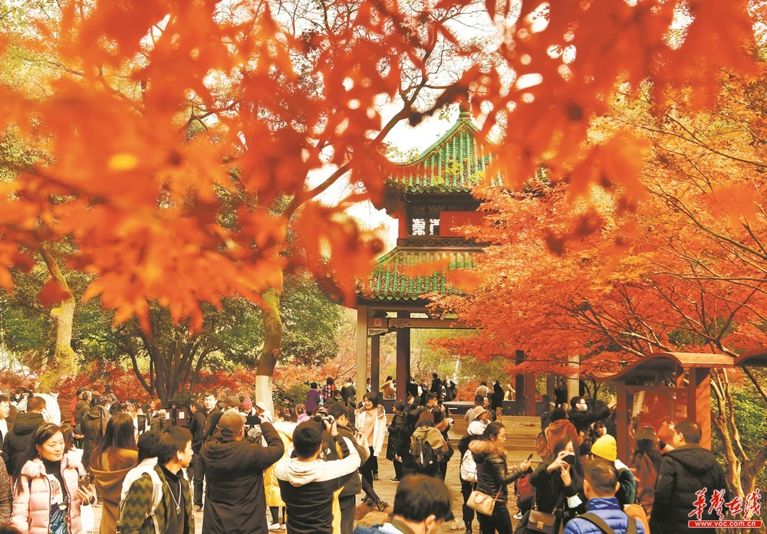
Featured Cultural Activities
Yuelu Academy Cultural Exhibition(岳麓书院文化展):
People regularly hold lectures on Chinese culture, traditional etiquette experience, ancient book exhibitions, etc.
Autumn Leaves Festival (红枫节)：
When the maple leaves in the mountains turn red, there are poetry recitation, Hanfu parade and other activities.

Slide 21
Practical Tourist Information
Main attractions
Recommended route
Seasonal recommendation
Yuelu Academy, Aiwan Pavilion, Lushan Temple, Birdsong Forest [鸟语林](family attraction), Sightseeing Corridor[观光长廊] (overlooking the panoramic view of Changsha) .
Classic route: East Gate→Yuelu Academy→Aiwan Pavilion→Lushan Temple→Cai E's Tomb→Yunlu Palace→Sightseeing Corridor.
Easy route: Take the sightseeing bus (20 yuan one way) directly to the top of the mountain and walk down the mountain for sightseeing.
Autumn (October-November): The best time to view red leaves.
Spring (March-April): The mountain flowers are in full bloom and the climate is pleasant.

Slide 22
THANK YOU!

