Slide 1

Introduction to Yuelu Mountain

Slide 2

Overview of Yuelu Mountain
Contents
01
Cultural Significance
02
Introduction to Scenic Areas
03

Slide 3

01
Overview of Yuelu Mountain

Slide 4


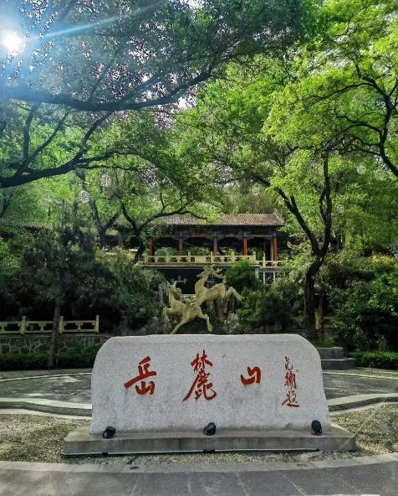


Overview of Yuelu Mountain
Ancient Origins
Yuelu Mountain, located in Changsha, Hunan Province, has a history dating back over 2,000 years, with its name first appearing during the Eastern Han Dynasty.
Current Status
It is a landmark of the city, known to everyone. It is not only a national key scenic spot but also holds the prestigious title of a national AAAAA-level tourist attraction.
Biodiversity Hotspot
Yuelu Mountain boasts extremely rich flora and fauna resources, and is home to numerous endangered tree species.

Slide 5
Introduction to Scenic Areas
02

Slide 6
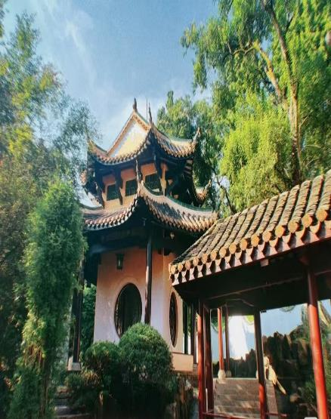
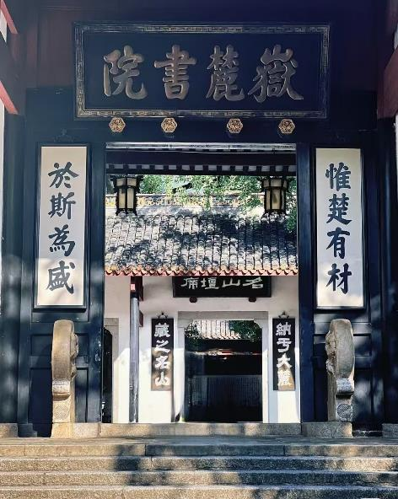
Yuelu Academy
Yuelu Academy, a cultural beacon that has illuminated the path of scholarship for over a millennium. The couplet adorning its gate – "惟楚有才，于斯为盛”, proclaiming "Talents thrive most abundantly in this land of Chu," has inspired generations of scholars to pursue academic excellence.

Slide 7
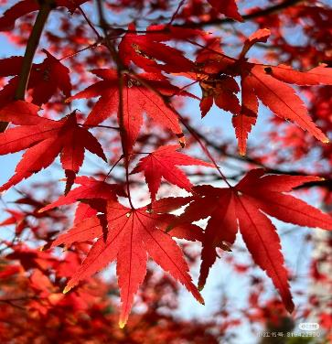
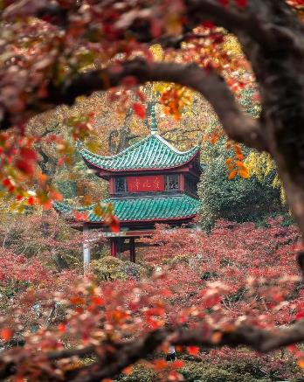
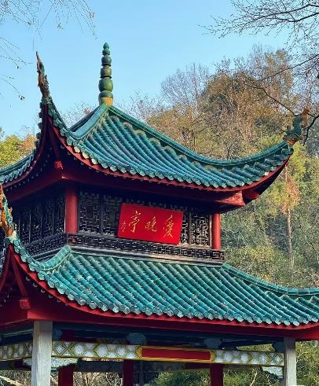

Aiwan Pavilion
Aiwan Pavilion is a quintessential Chinese pavilion celebrated for its poetic charm and autumn beauty. Built in 1792 during the Qing Dynasty, its name was inspired by the Tang Dynasty poet Du Mu’s verse: “停车坐爱枫林晚”. Every late autumn, the maple leaves blaze like fire, creating a scene of intoxicating beauty.

Slide 8
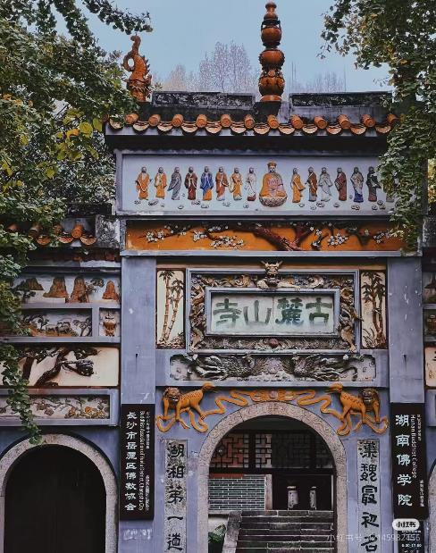
Ancient Lushan Temple
It stands as one of China’s oldest Buddhist temples and a cultural gem of the region. Built in 268 CE during the Western Jin Dynasty, it is revered as the “First Buddhist Temple of Hunan” and “a cradle of Zen Buddhism in Central China”. With a history spanning over 1,700 years, the temple has witnessed the rise and fall of dynasties, surviving wars and reconstructions.

Slide 9
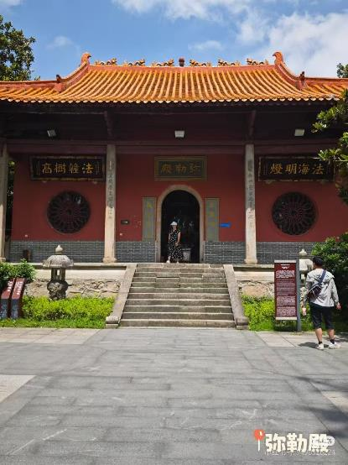
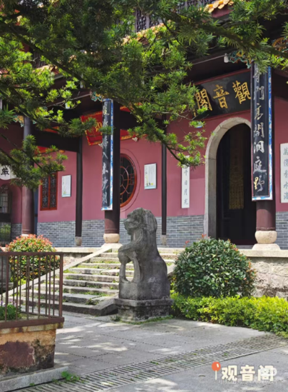
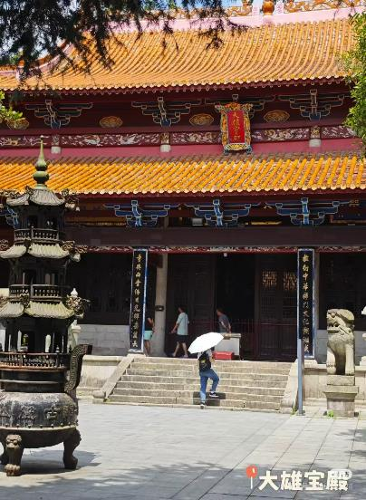
Joy and Harmony
Health and Safety
Wisdom and Enlightenment

Slide 10
Cultural Significance
03

Slide 11

Cultural significance
A cradle of Confucian scholarship
A spiritual sanctuary
A literary and
artistic inspiration
Celebrated in poetry (e.g., Du Fu) and home to landmarks like Aiwan Pavilion, symbolizing the fusion of nature and humanistic ideals.
Blending Buddhism (Ancient Lushan Temple), Taoism (Yunlu Palace), and Confucianism, it reflects China’s tradition of religious harmony.
Yuelu Academy, one of China’s “Four Great Academies,” it shaped Neo-Confucianism during the Song Dynasty and nurtured scholars for imperial examinations.
Its integration of education, spirituality, and natural beauty epitomizes the Chinese philosophy of “harmony between humanity and nature” (天人合一).

Slide 12
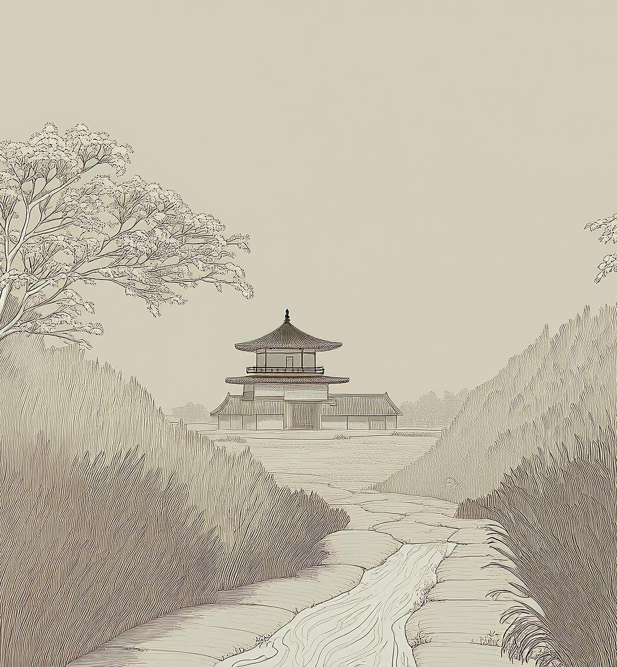
In conclusion, Yuelu Mountain is not just a natural mountain but also a spiritual mountain carrying a profound revolutionary history and cultural heritage. It has witnessed the Hunanese spirit of "caring about the world and daring to be the first." The mission it carries far exceeds its natural beauty. Here, every brick, tile, plant, and tree seems to recount that passionate era, inspiring reverence for that history as visitors explore the site.

Slide 13
THANKS!

