Slide 1
Chinese Food：Jiangxi Cuisine
Liao Dan
2025.3.21

Slide 2
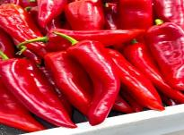
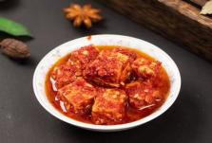
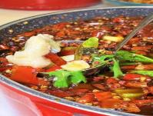
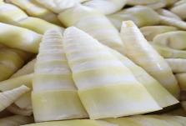
Are You Ready for a Spicy Challenge? Which of these ingredients is a signature of Jiangxi cuisine?” A. Chili peppers 🌶️ B. Fermented tofu 🧈 C. Freshwater fish 🐟 D. Bamboo shoots 🎋

Slide 3
Contents
01
Introduction
02
Historical & Cultural Background
03
Main Features-Flavor & Cooking Techniques
04
Famous Jiangxi Dishes & Snacks
05
Modern Challenges & Translation Perspective
06
Conclusion

Slide 4
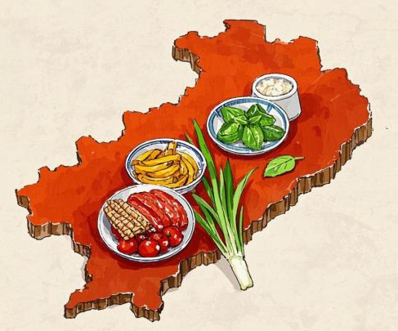
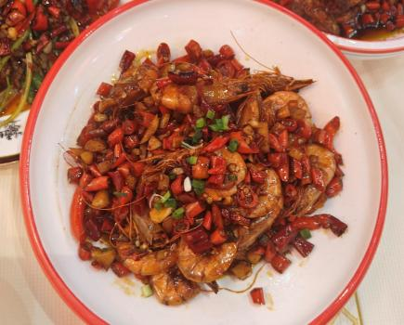
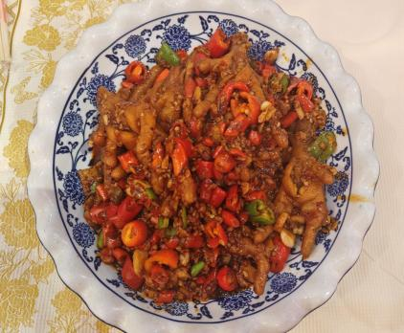
Introduction - What is Jiangxi Cuisine?
Definition of Jiangxi Cuisine
Key ingredients: fish, poultry, seasonal vegetables
Key cooking techniques: stir-frying, stewing, braising
Jiangxi cuisine is still growing in recognition

Slide 5
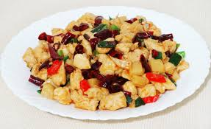

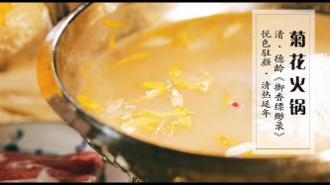
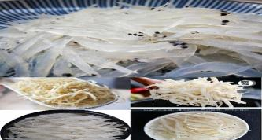
Historical & Cultural Background
Jiangxi cuisine dates back to Han and Jin Dynasties
Influenced by historical literary figures:
Wen Tianxiang (Wenshan Diced Meat)
Tao Yuanming (Chrysanthemum Hotpot)
Fan Zhongyan (Poyang Fish and Rice)
" The literati dishes" concept

Slide 6
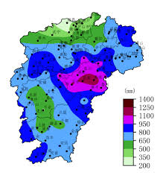
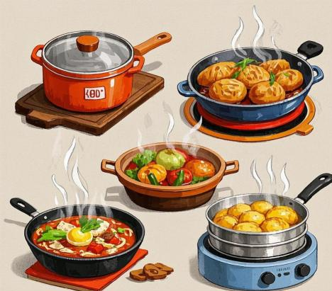
Main Features - Flavor & Cooking Techniques
Flavor : Fragrant and fresh spiciness
Climate influence
Cooking Techniques : Baking, braising, stewing, steaming, stir-frying
Fresh ingredients

Slide 7
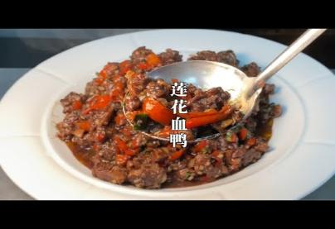
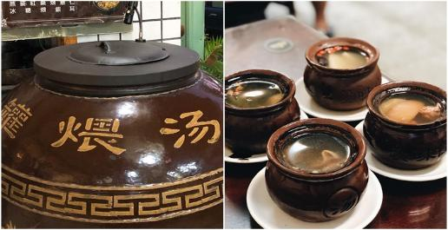
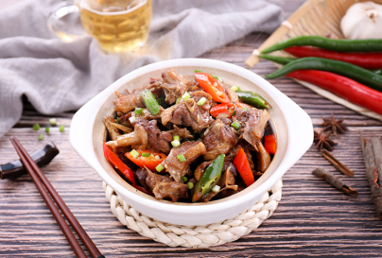
Famous Jiangxi Dishes & Snacks
Lianhua Blood Duck (莲花血鸭) – Pingxiang specialty
Beer Duck (啤酒烧鸭) – Nanchang specialty
Nanchang Rice Noodles (南昌米粉) & Clay Pot Soup (瓦罐煨汤) – Popular breakfast combo

Slide 8
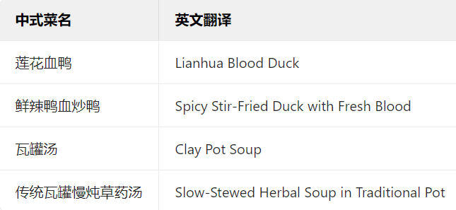
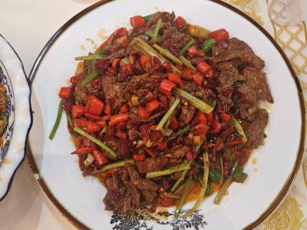
Modern Challenges & Translation Perspective
Jiangxi Cuisine lacks global recognition
Branding efforts by Jiangxi government
Challenges in translation:

Slide 9
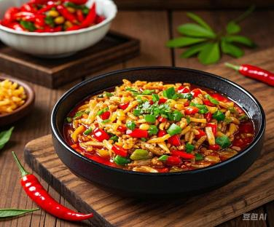
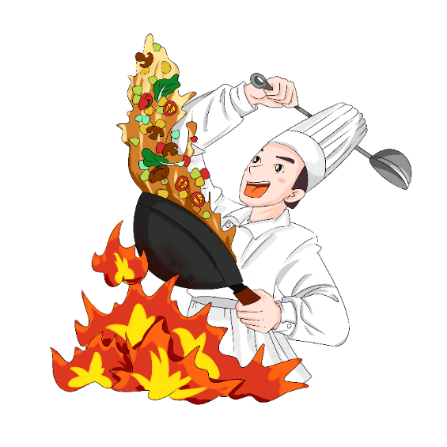

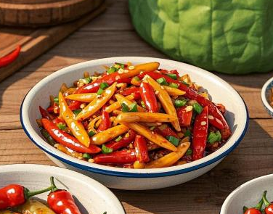
Conclusion - Why Jiangxi Cuisine Matters?
Jiangxi cuisine is a hidden gem in Chinese gastronomy
Proud to be from Pingxiang, the Spicy Capital of China
Food is more than taste—it’s history, culture, and translation

Slide 10
Thank you for listening

