Slide 1





Contents
1. Introduction
2. Beverage Introduction
3. Distinctive Shop Types
4. Sub-brands
Notes:
www.v5ppt.com

Slide 2




Introduction
1
Notes:
www.v5ppt.com

Slide 3
Modern China Tea Shop is the mainland’s first tea shop with a Chinese style, mainly focusing on tea drink and desserts, which adopts the concept of “new Chinese tea”, and emphasizes the creation of “new Chinese-style fresh tea.”
Sexy Tea
Modern China Tea Shop
Notes:
www.v5ppt.com

Slide 4
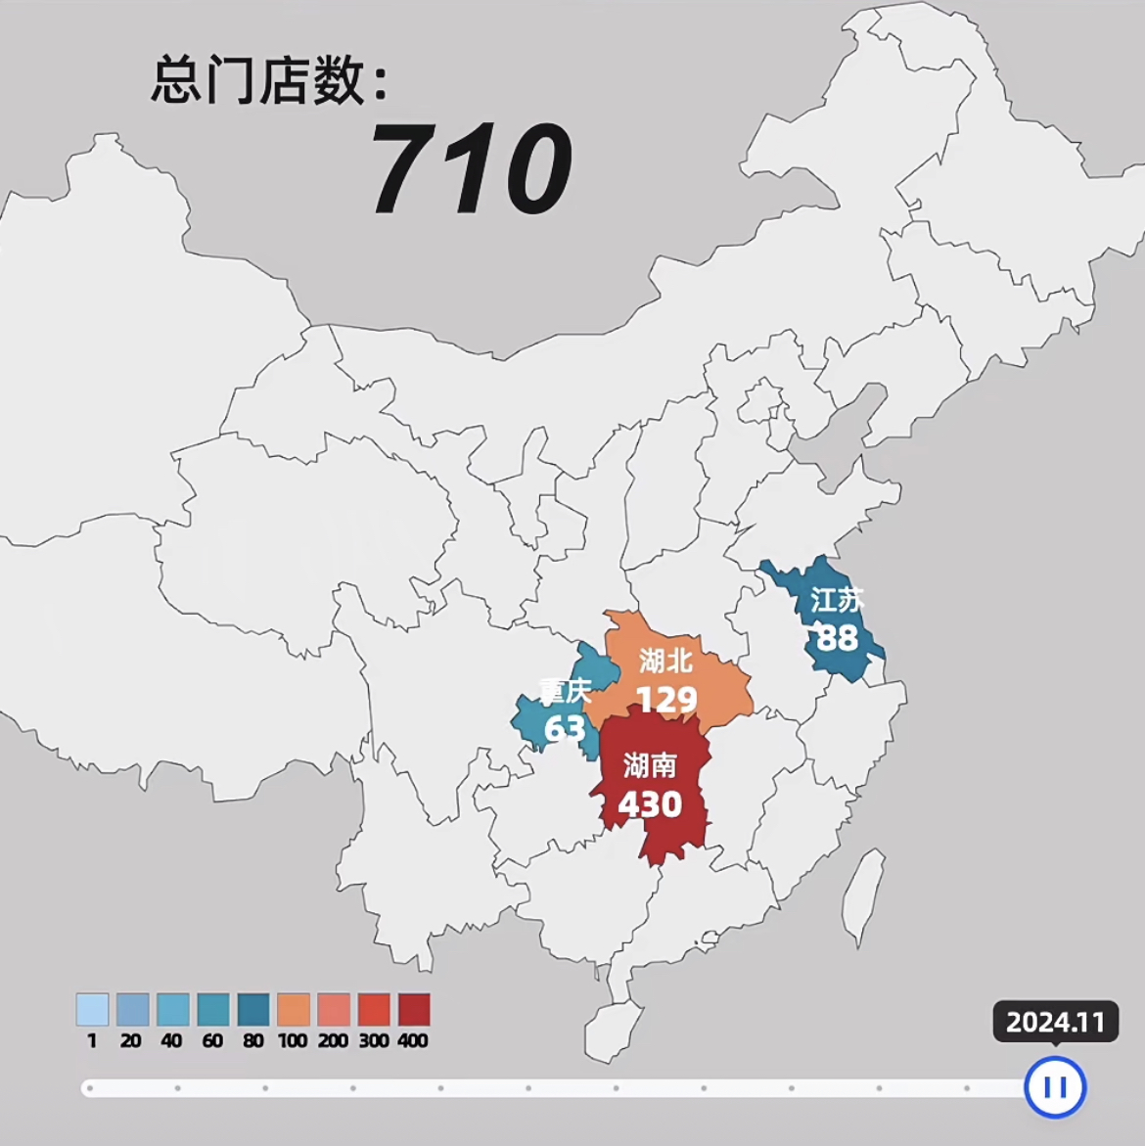
As of November 2024, it has opened over 700 directly operated stores in eighteen cities including Hunan, Wuhan, Chongqing, Nanjing, and Wuxi, with more than 8,000 partners, becoming a new tea beverage brand beloved by the broad young consumer group.
Notes:
www.v5ppt.com

Slide 5
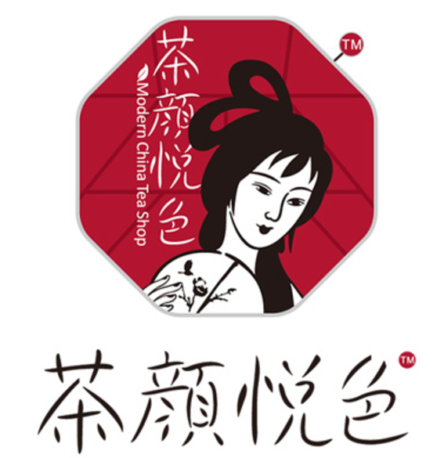
In the design of the brand, Cha Yan uses lots of Chinese traditional elements, such as products naming and packaging.
And the logo is also a woman in ancient costume holding a moon-shaped fan, which is distinctive and memorable.
Notes:
www.v5ppt.com

Slide 6
2
Beverage Introduction
Notes:
www.v5ppt.com

Slide 7
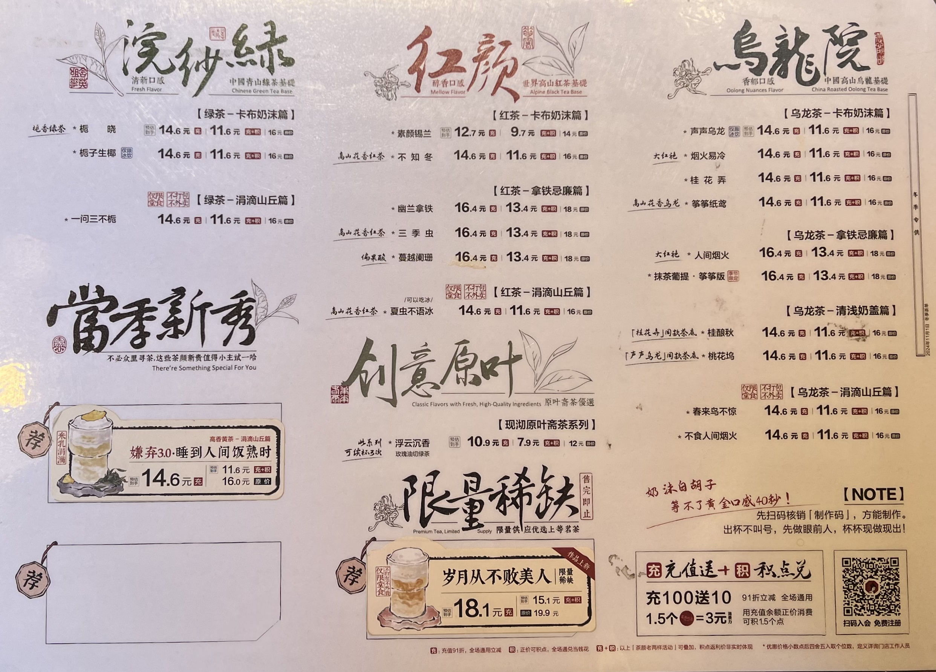
M
e
n
u
Notes:
www.v5ppt.com

Slide 8
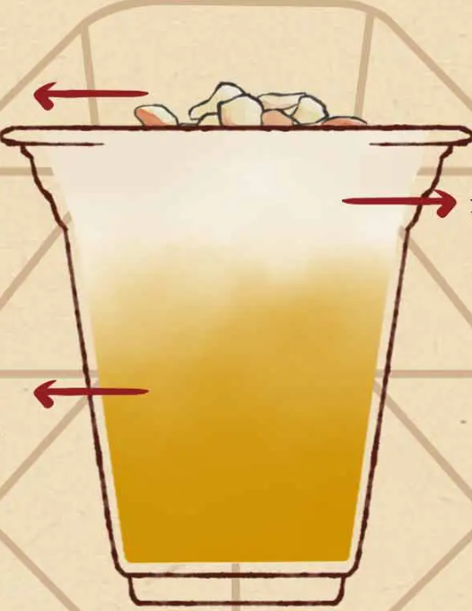


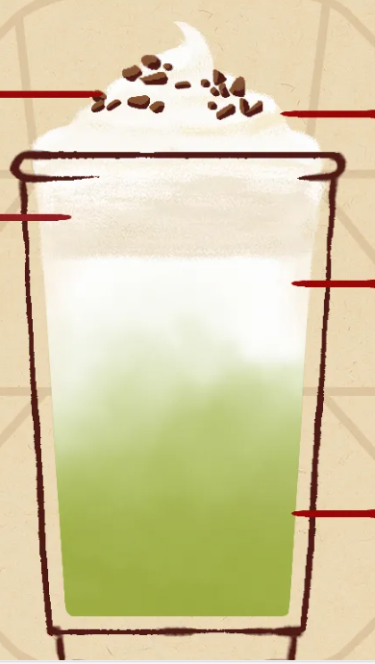

第壹章
Light & refreshing
milk-covered Tea 清浅奶盖篇
Creative Whole Leaf Series
创意原叶篇
Frothy Series
沫泡篇
Light Cream Milk Tea
涓滴山丘系列
Creamy Series忌廉篇
Notes:
www.v5ppt.com

