Slide 1





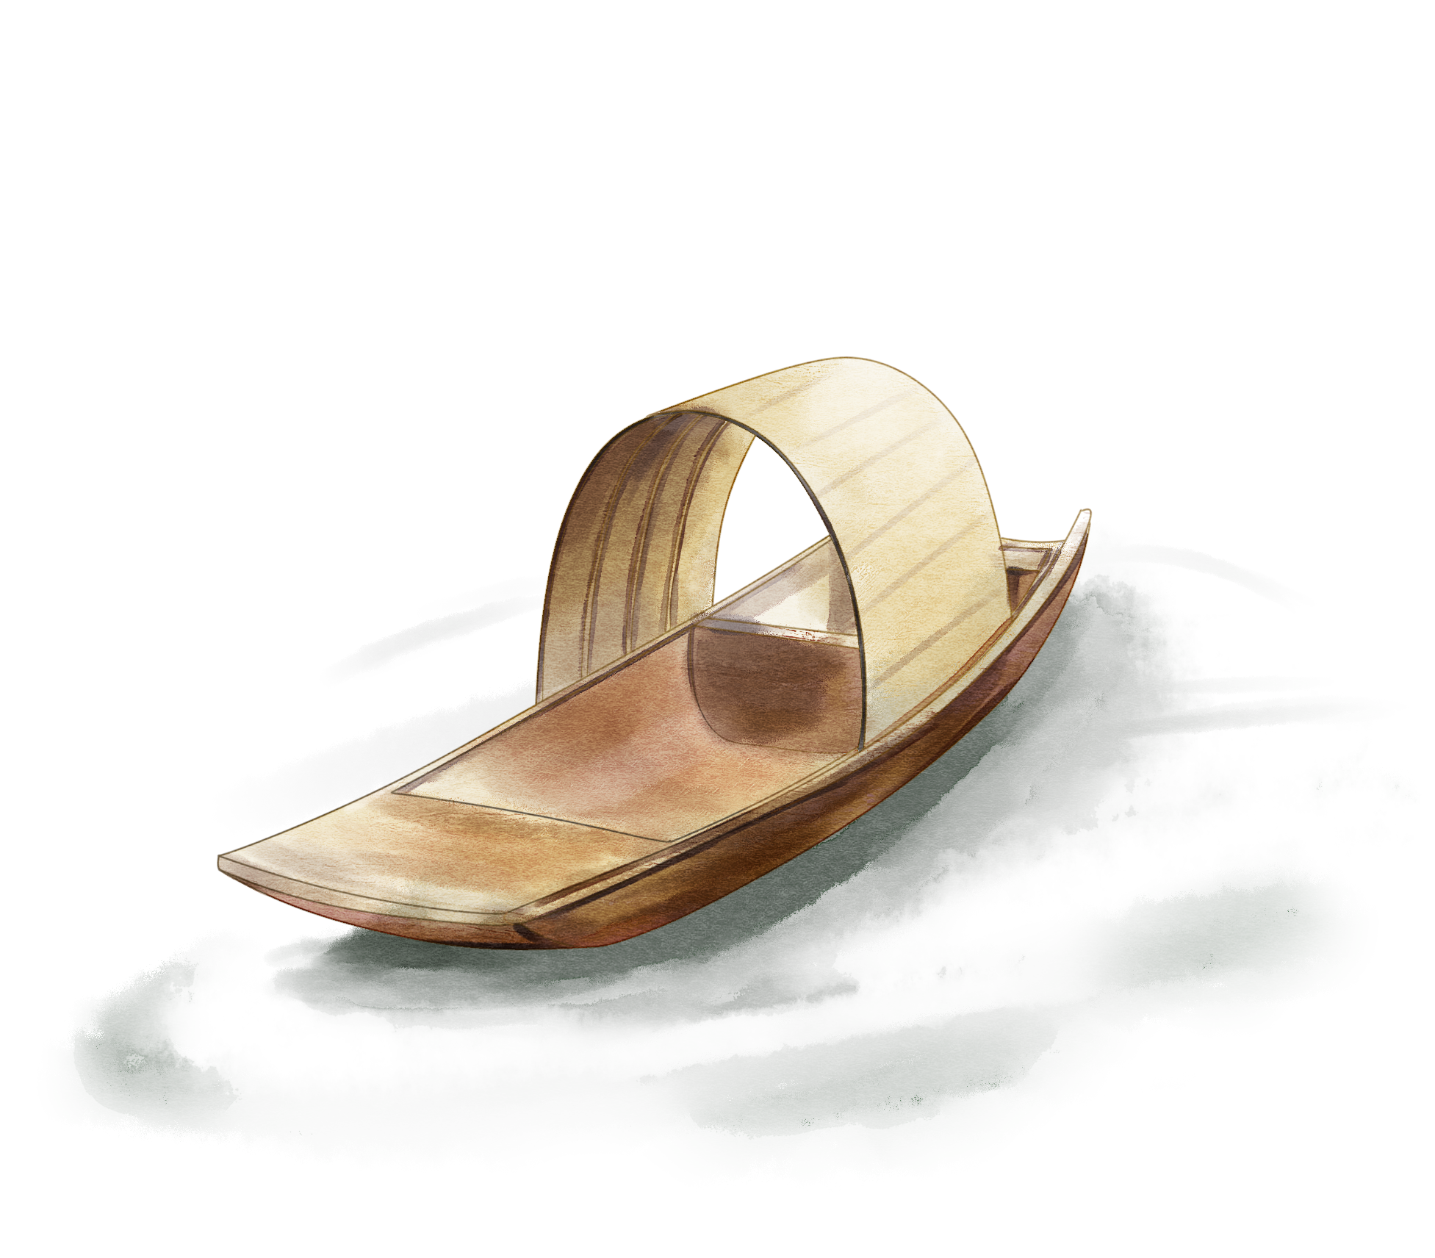
Distinctive Shop Types
3
Notes:
www.v5ppt.com

Slide 2
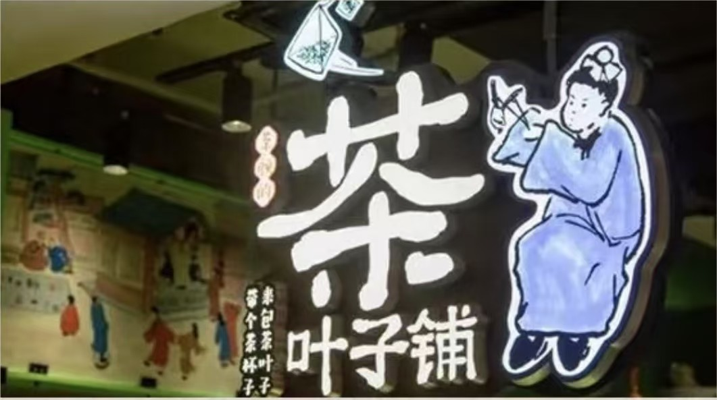
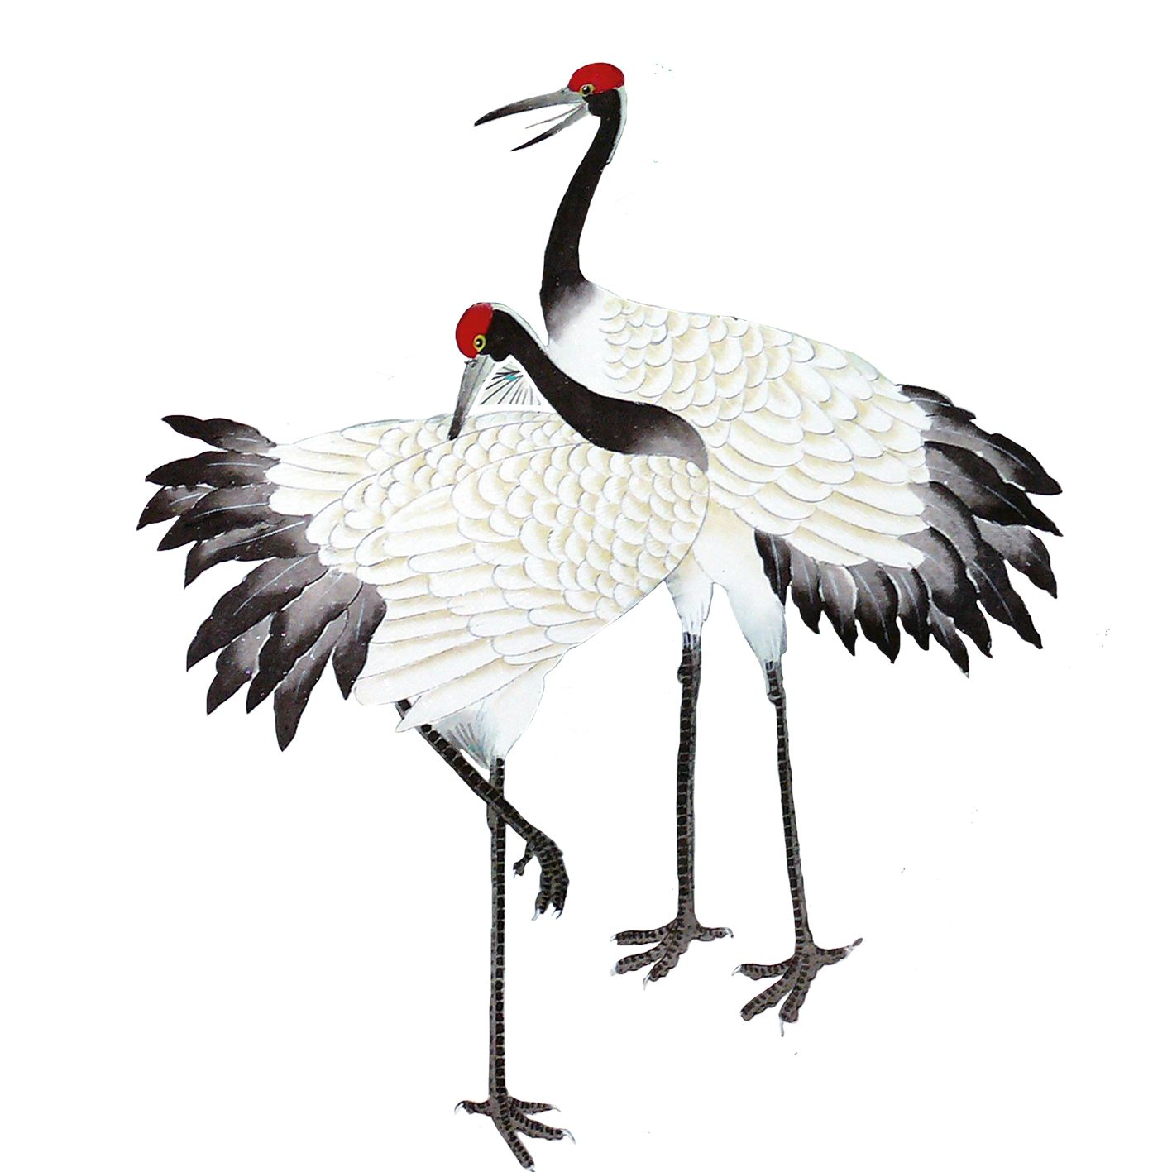
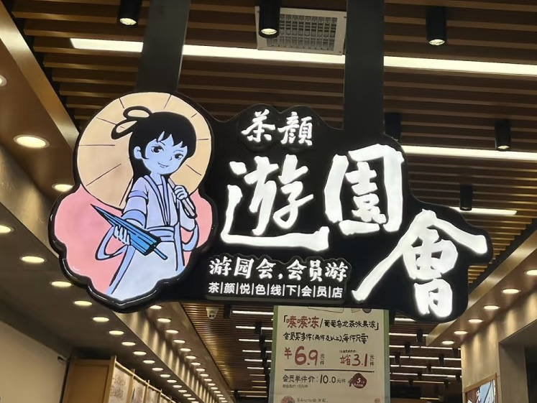
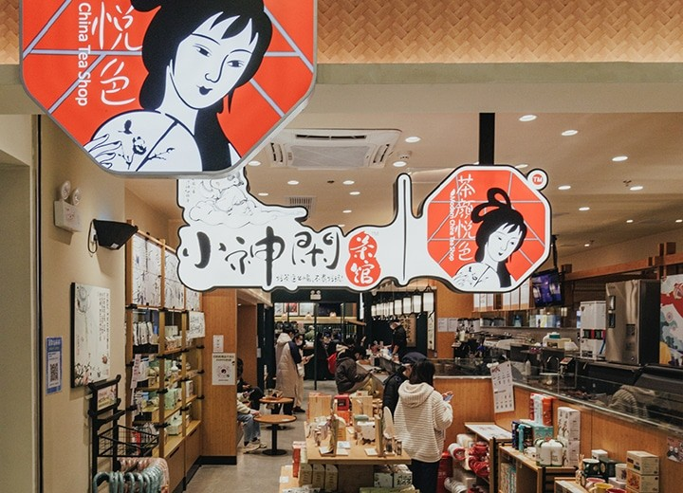
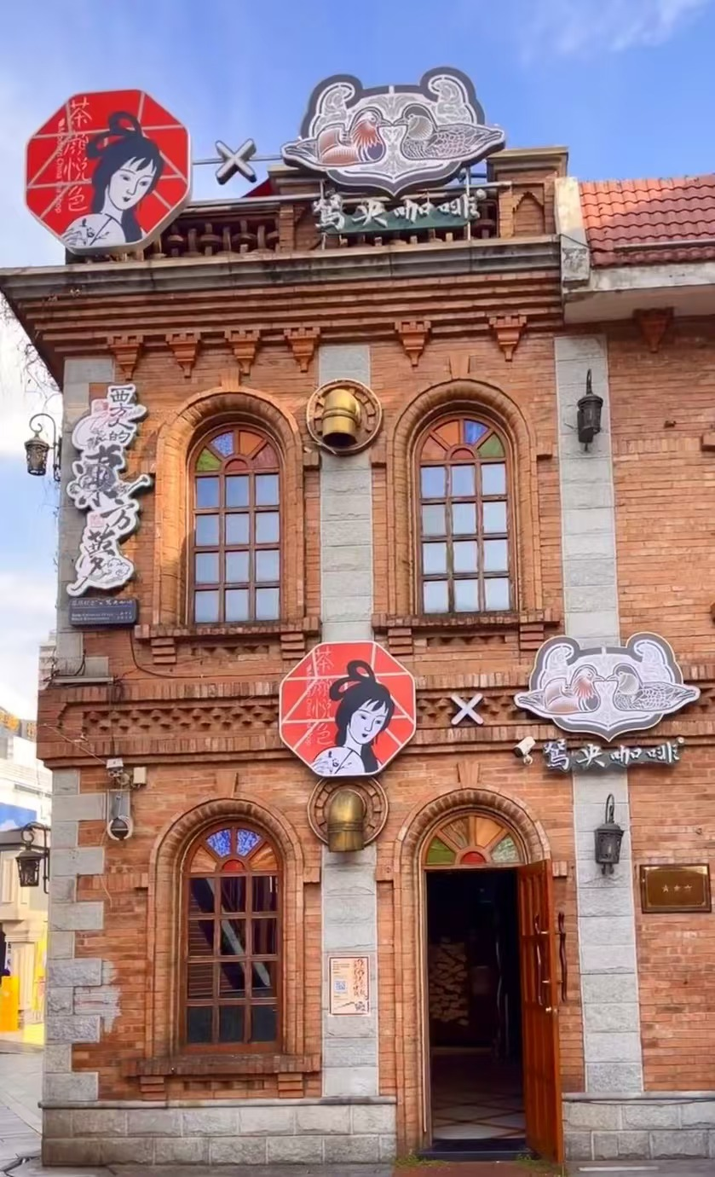
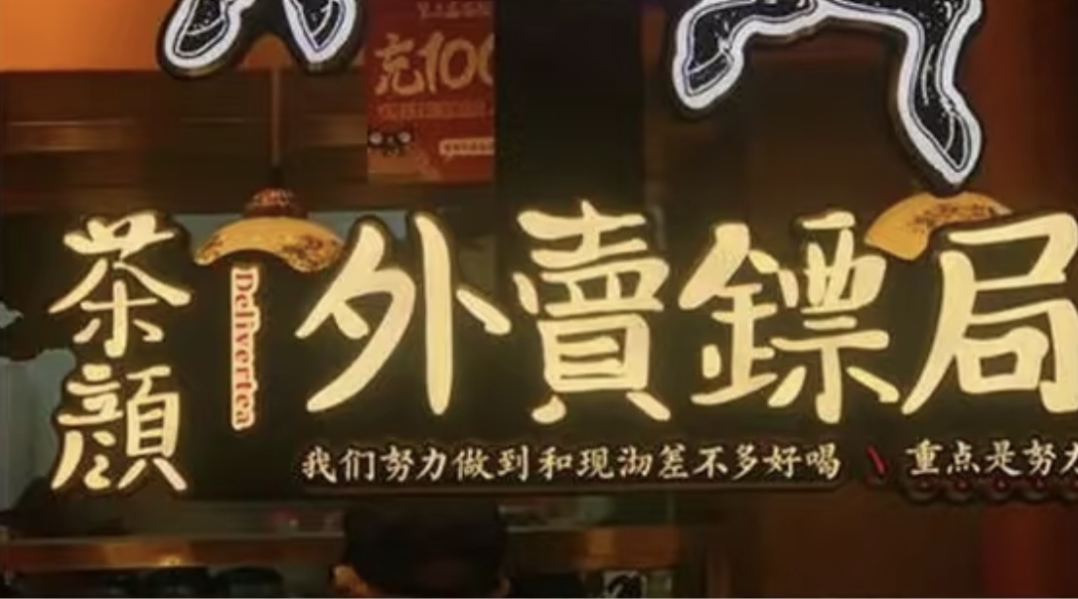
Tea Leaf Shop
05
Amusement Park
Xiaoshenxian Tea House
01
02
Concept Stores
Delivery Escory Station
03
04
Notes:
www.v5ppt.com

Slide 3
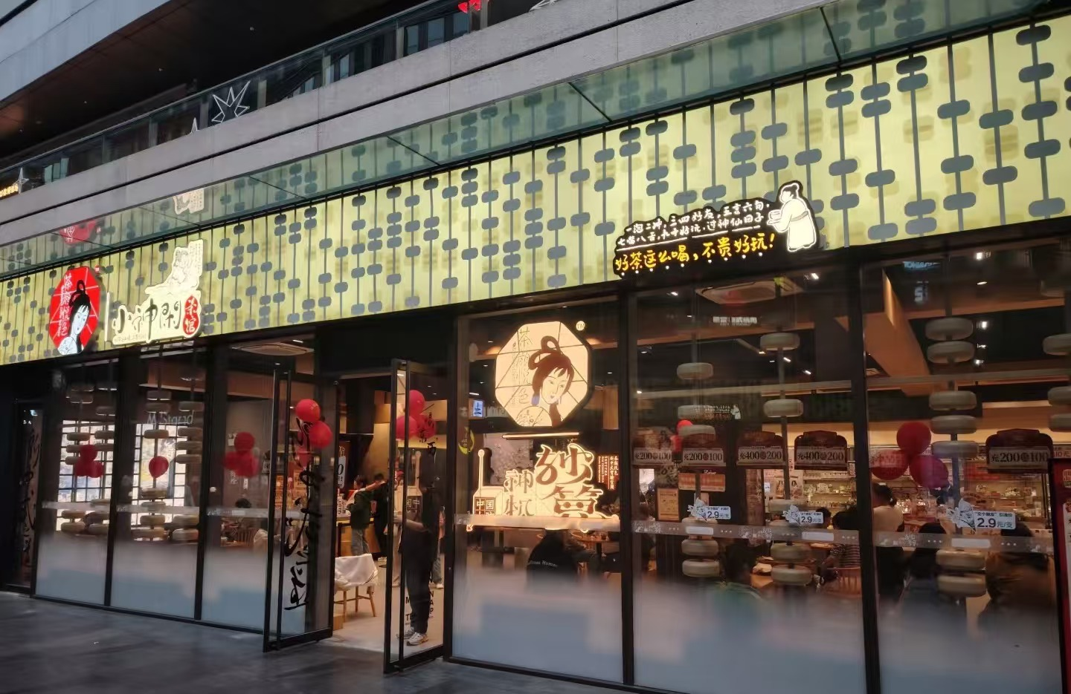
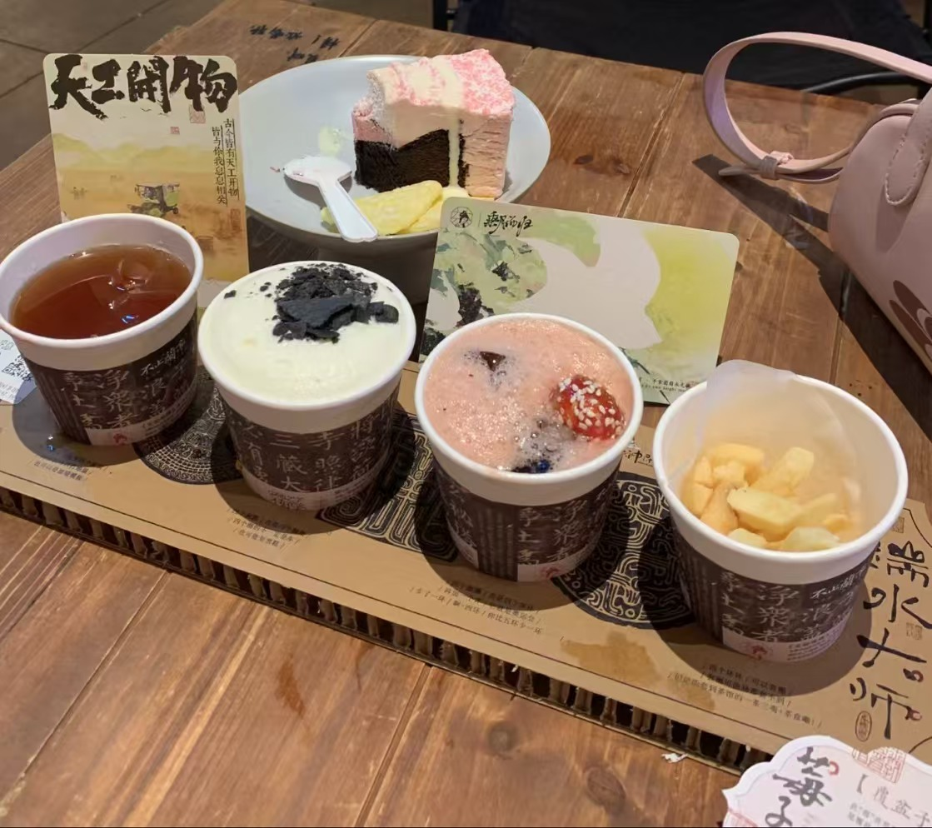

Xiaoshenxian Tea House(小神闲茶馆) serves as the
"laboratory" for Sexy Tea to explore various ways of enjoying tea.
Its menu has three main categories: Creative Whole Leaf Tea, Premium Whole Leaf Brewed Milk Tea, and Premium Hand-brewed Tea. Additionally, the shop provides a variety of snacks and desserts with different flavors. It is worth mentioning that Xiaoshenxian Tea House also features areas for young people to play tabletop games and independent booths.
Xiaoshenxian Tea House
Notes:
www.v5ppt.com

