Slide 1


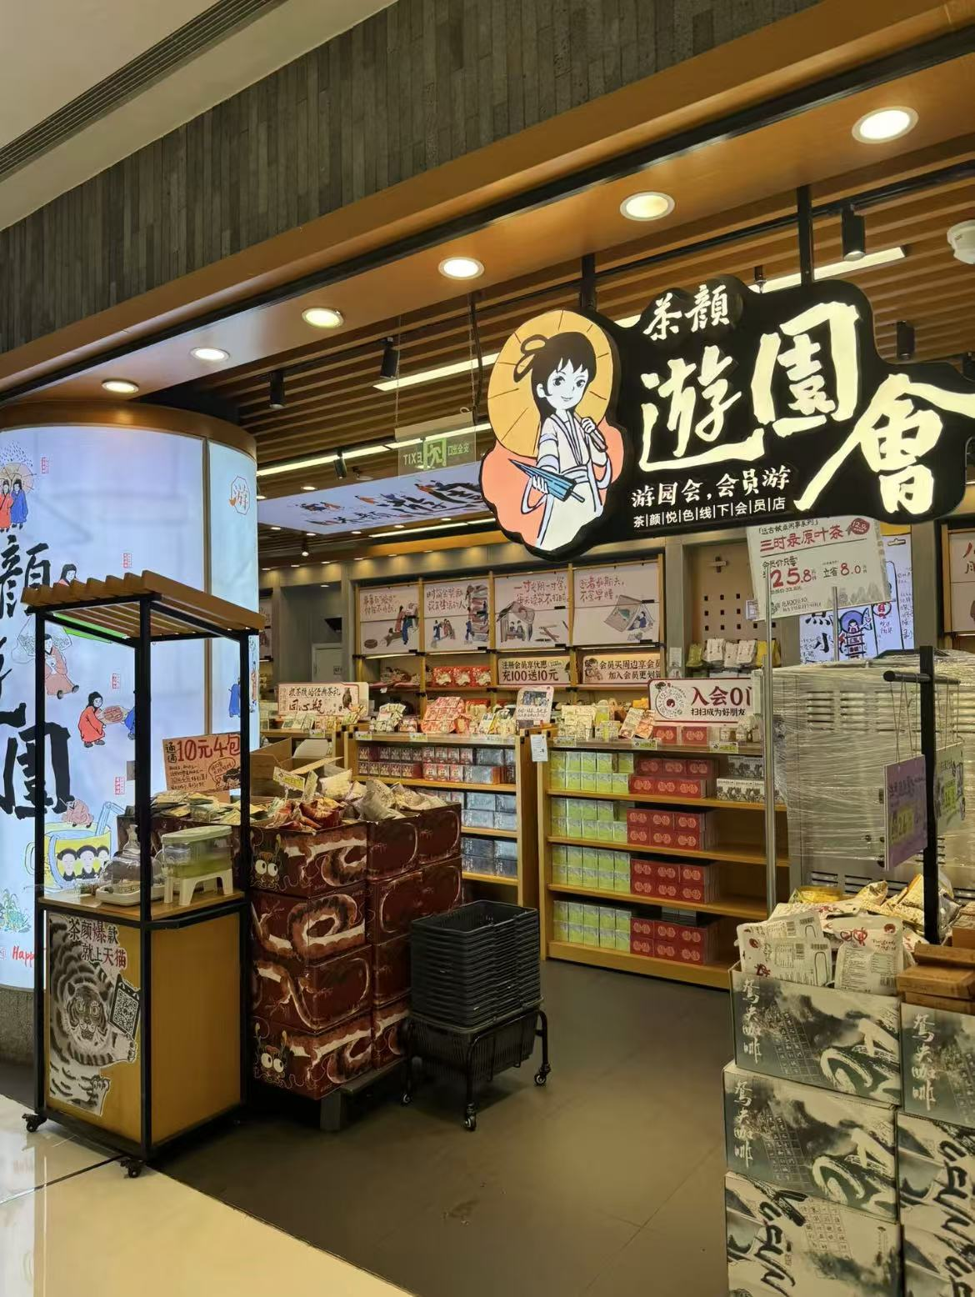
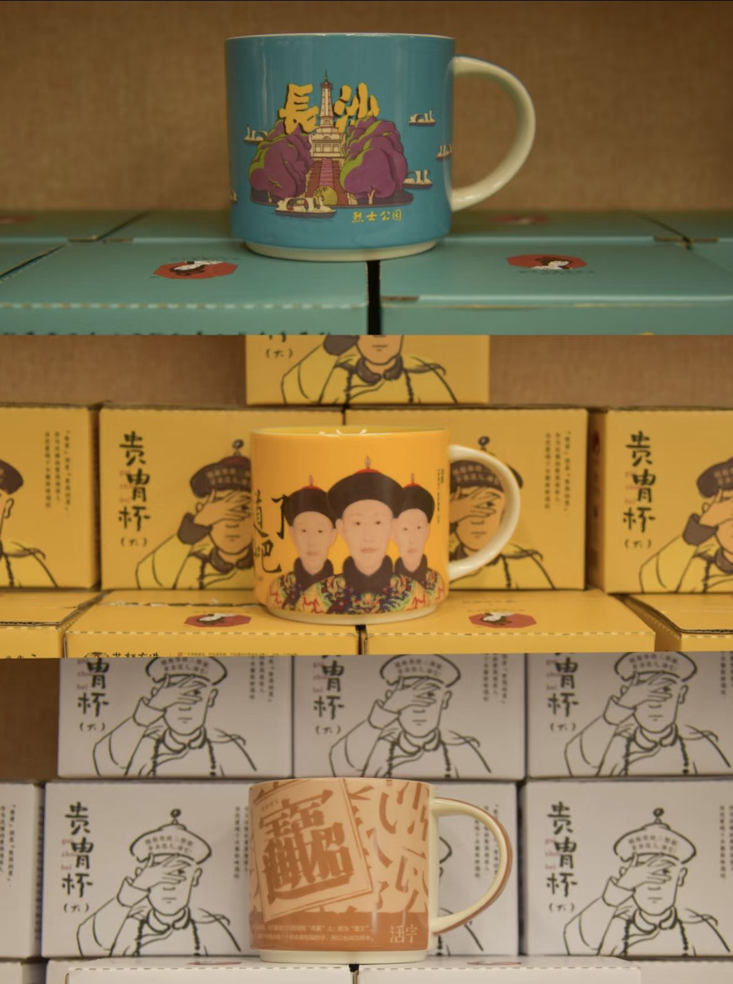
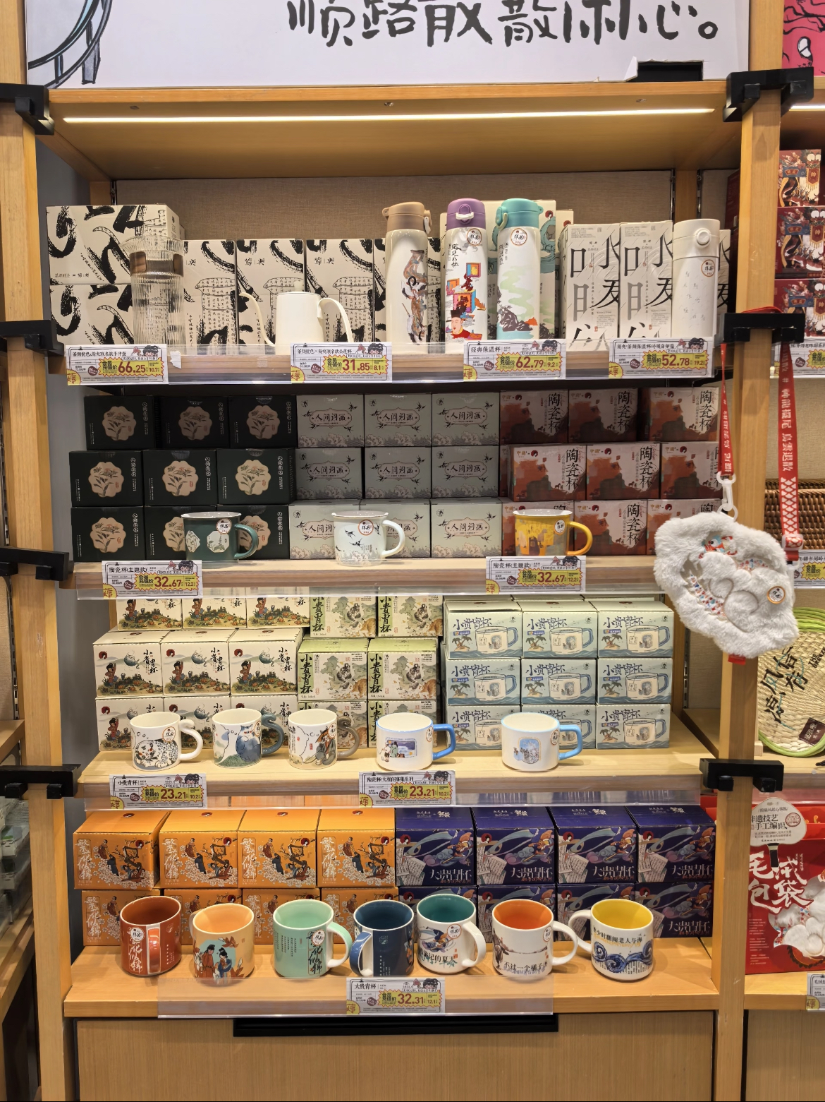
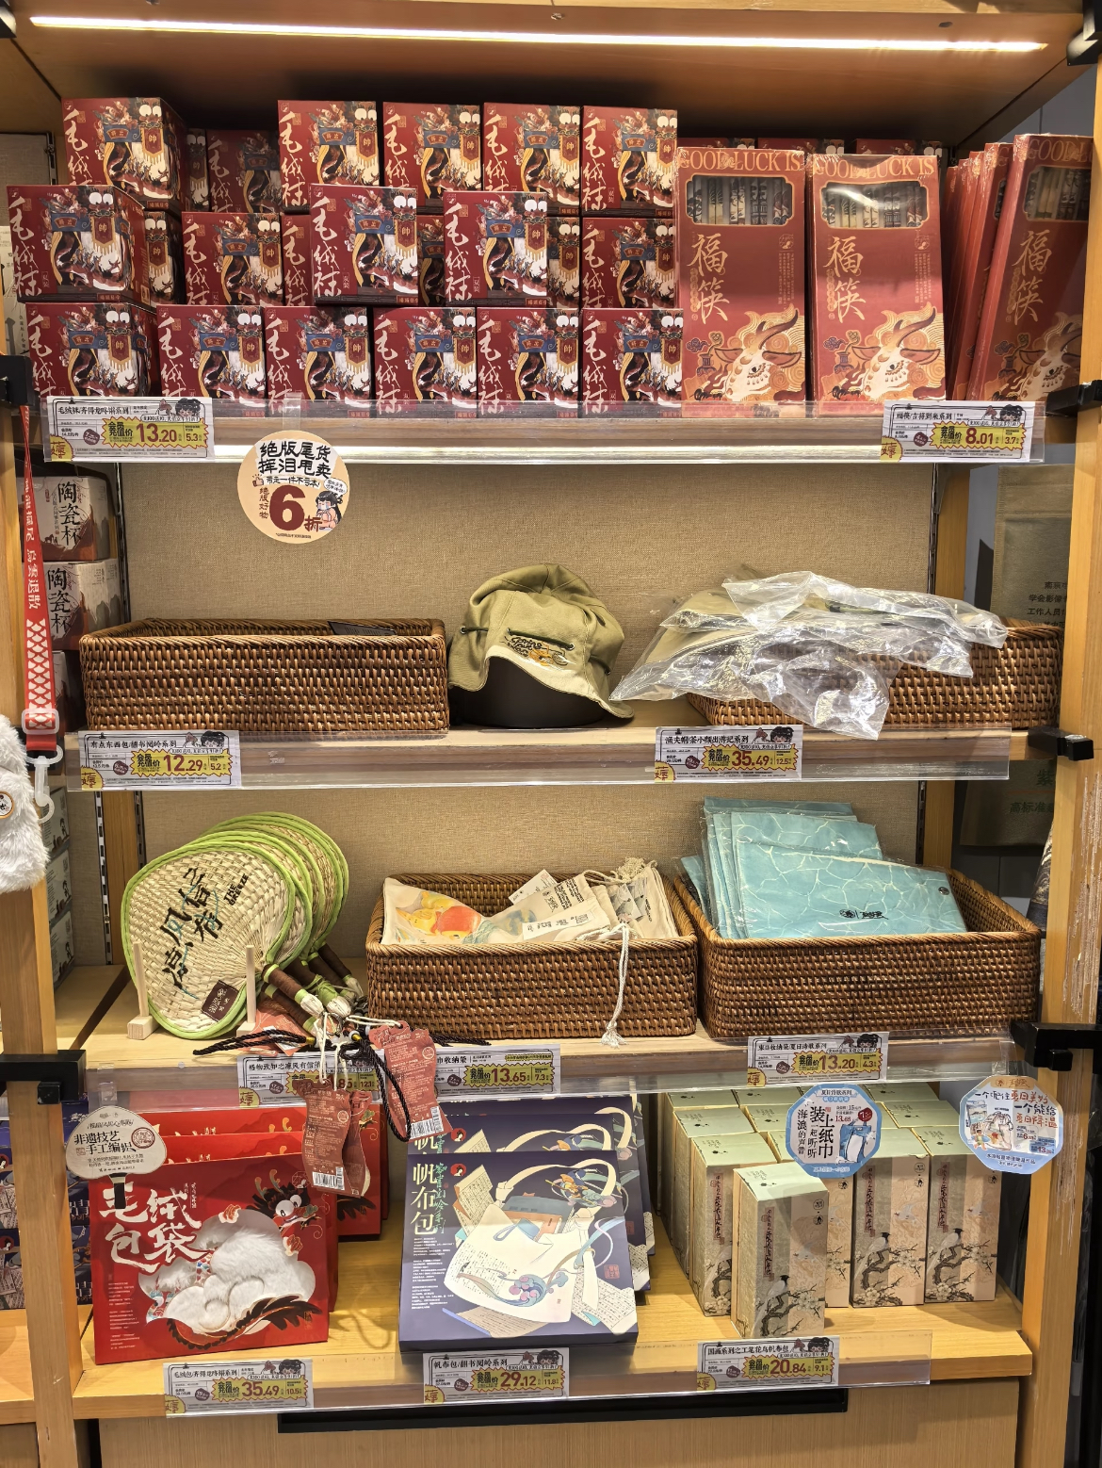

Amusement Park(游园会) serves as an extension of the brand, offering unique snacks and tea bags created by Cha Yan, along with various themed merchandise such as tea cups, postcards, notebooks, fridge magnets, umbrellas, fans, canvas bags, and badges.
Amusement Park
Notes:
www.v5ppt.com

Slide 2
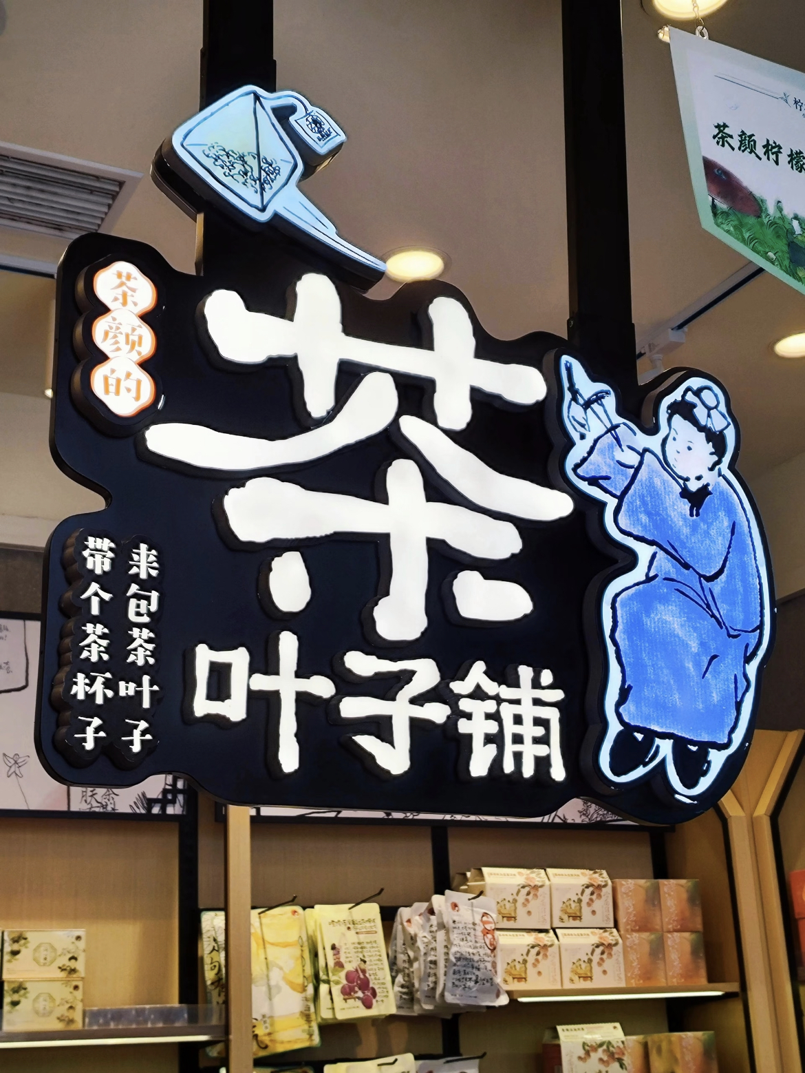
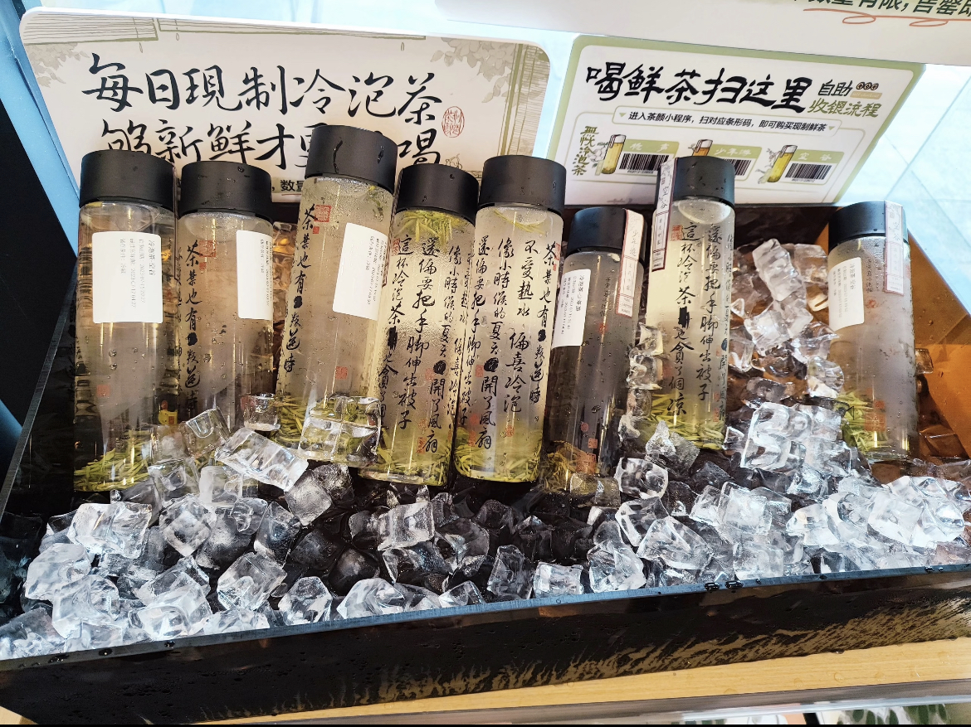
The Tea Leaf Shop(茶叶子铺) specializes in tea leaves, tea bags, and small snacks.
Popular products include "Habitual Tea(习惯茶)," Peach Oolong "Peach Blossom House(桃花坞)," and Grape Oolong "Daughter Red(女儿红)."
Additionally, the Tea Leaf Emporium offers a wide variety of tea bags with floral and fruity aromas, including black tea, green tea, yellow tea, and oolong teas.
Tea Leaf Shop
Notes:
www.v5ppt.com

Slide 3
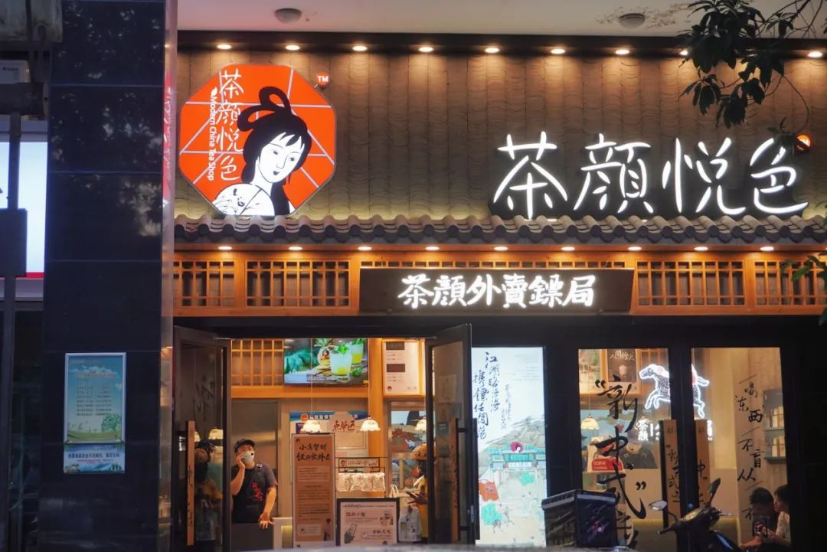
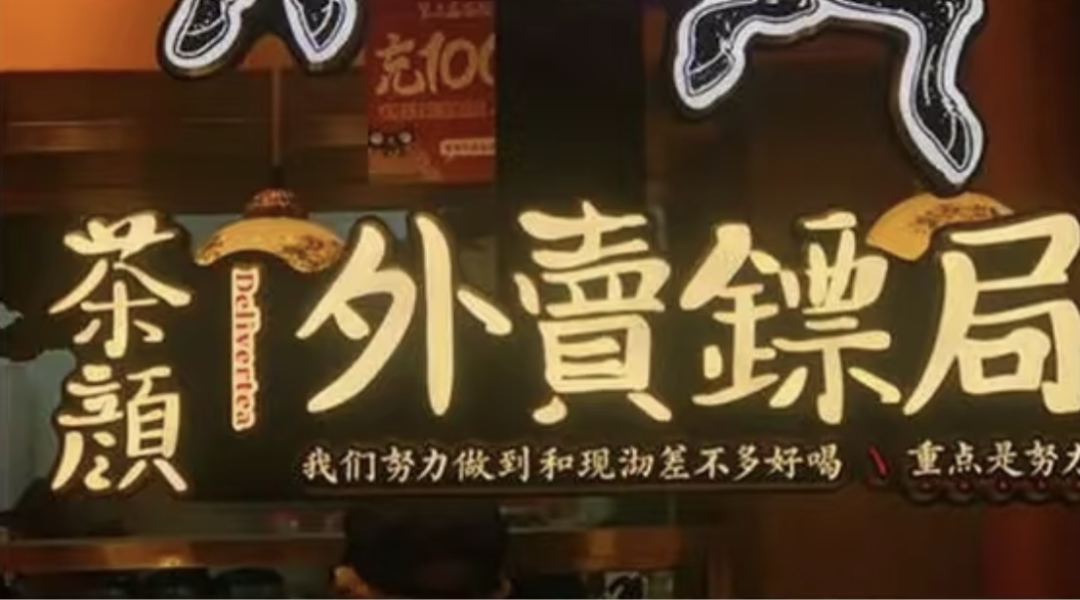
Delivery Escort Agency(外卖镖局) stores specialize in delivery services. Some escort station stores are street shops that offer both delivery and dine-in options, providing versatile services. The station offers special Pu'er tea bases drinks and the light milk cap can also be separately packaged.
Delivery Escort Station
Notes:
www.v5ppt.com

