Slide 1


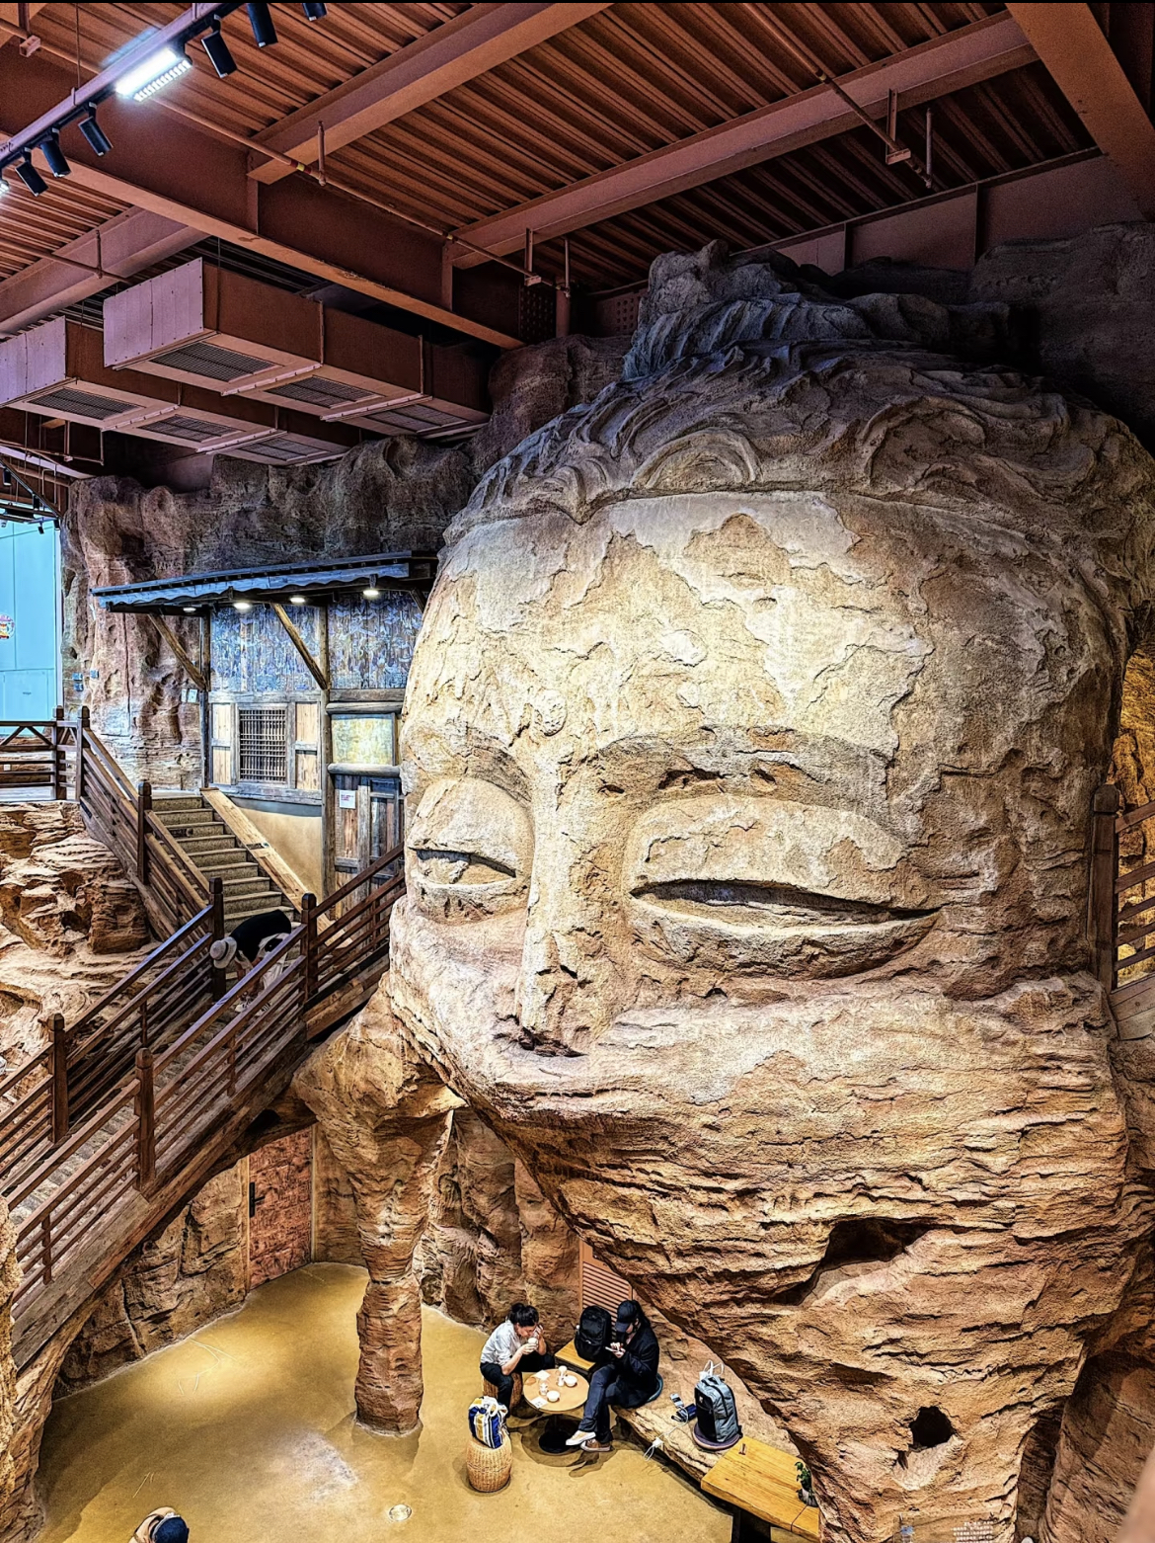
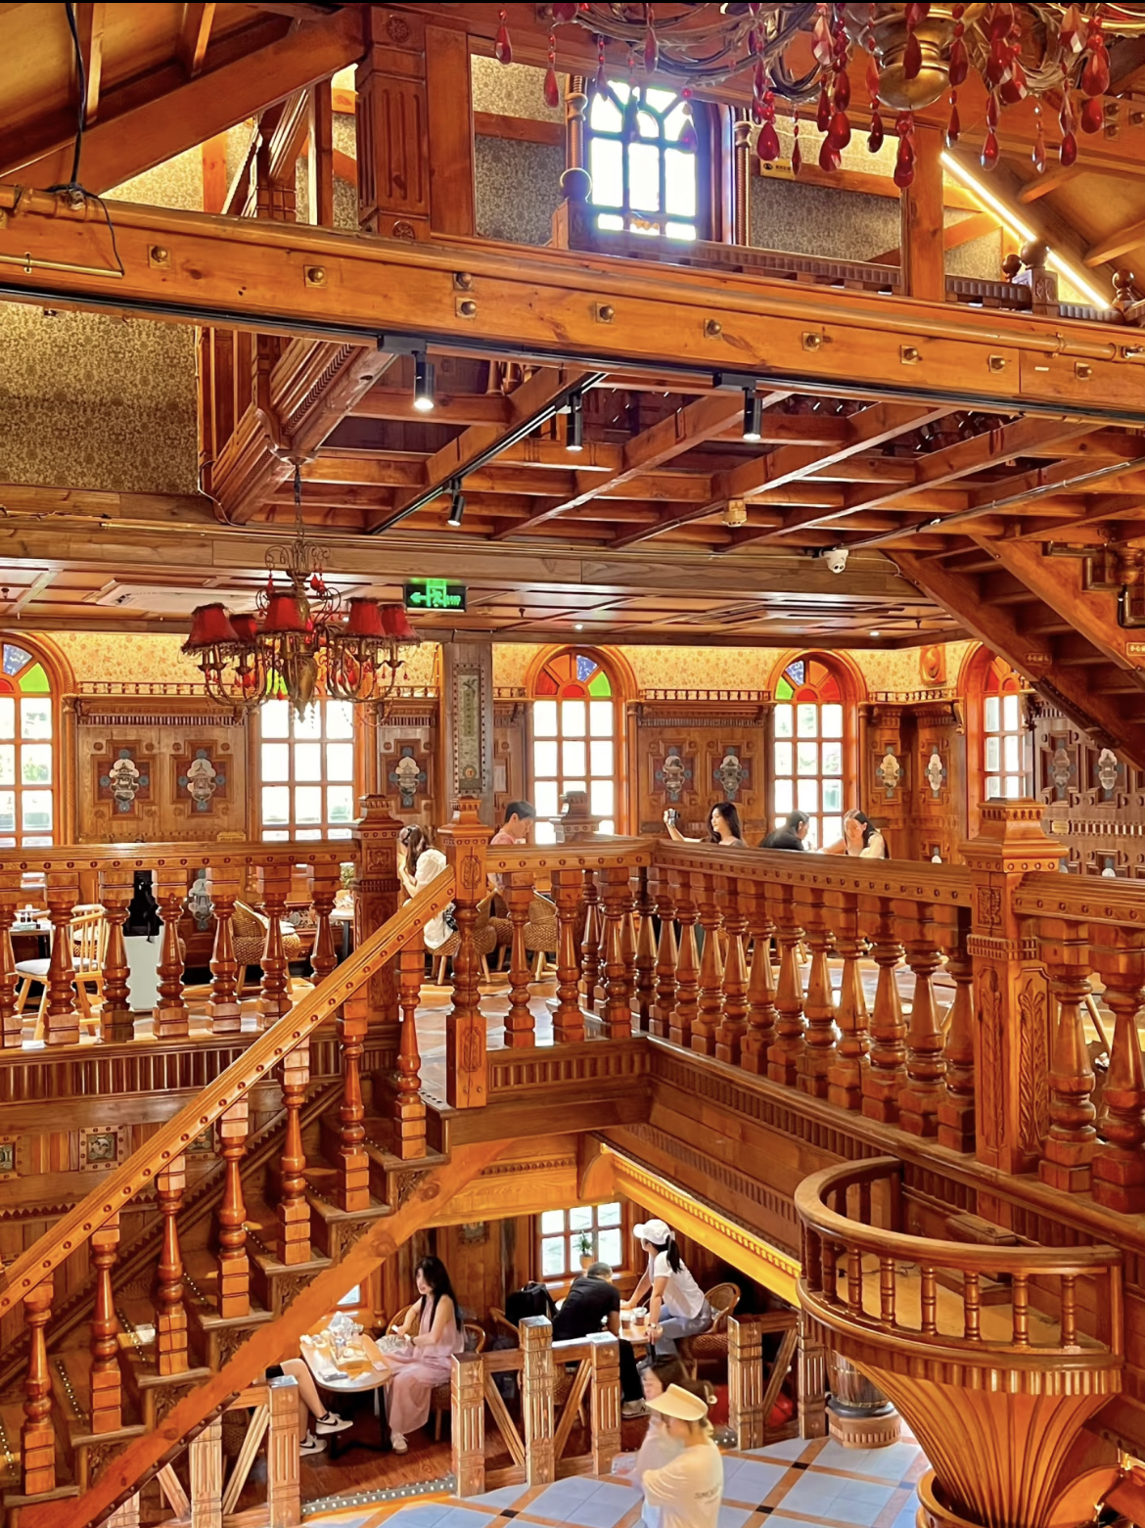
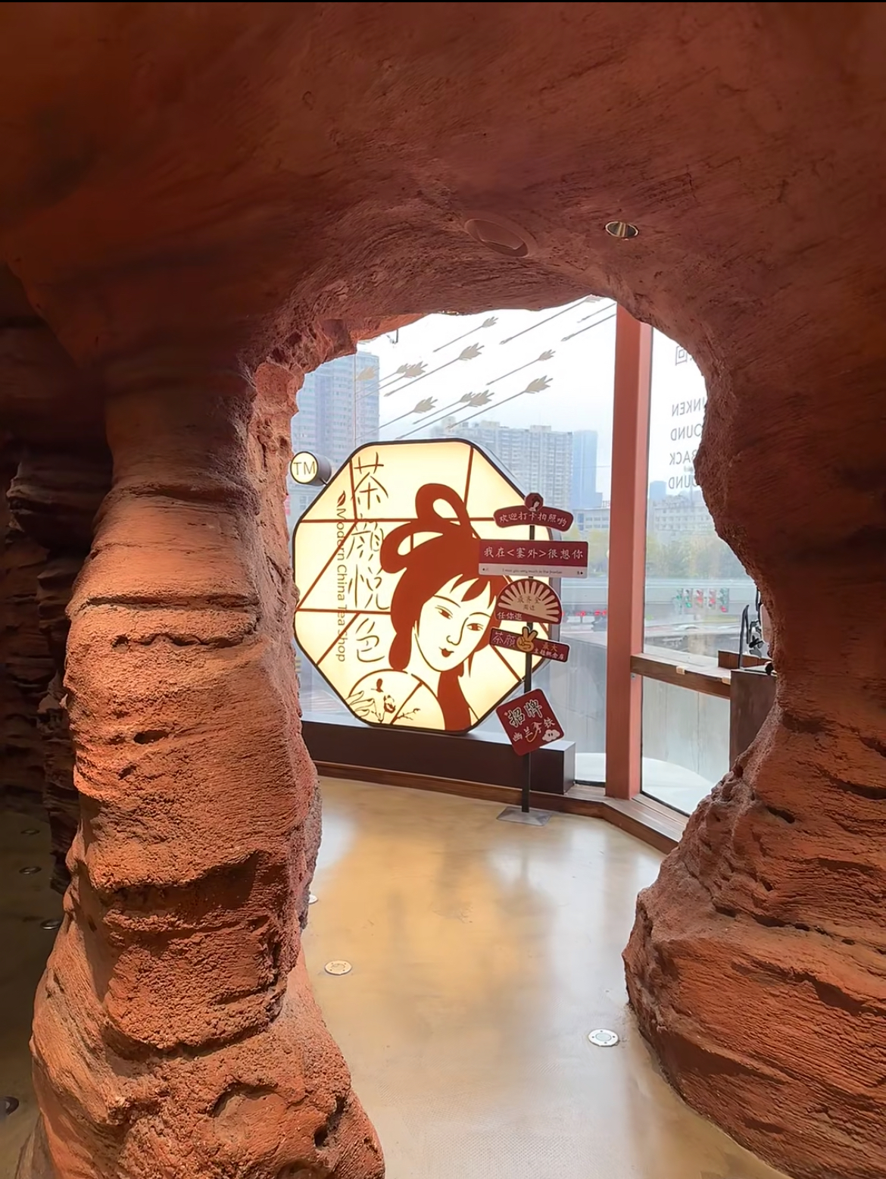
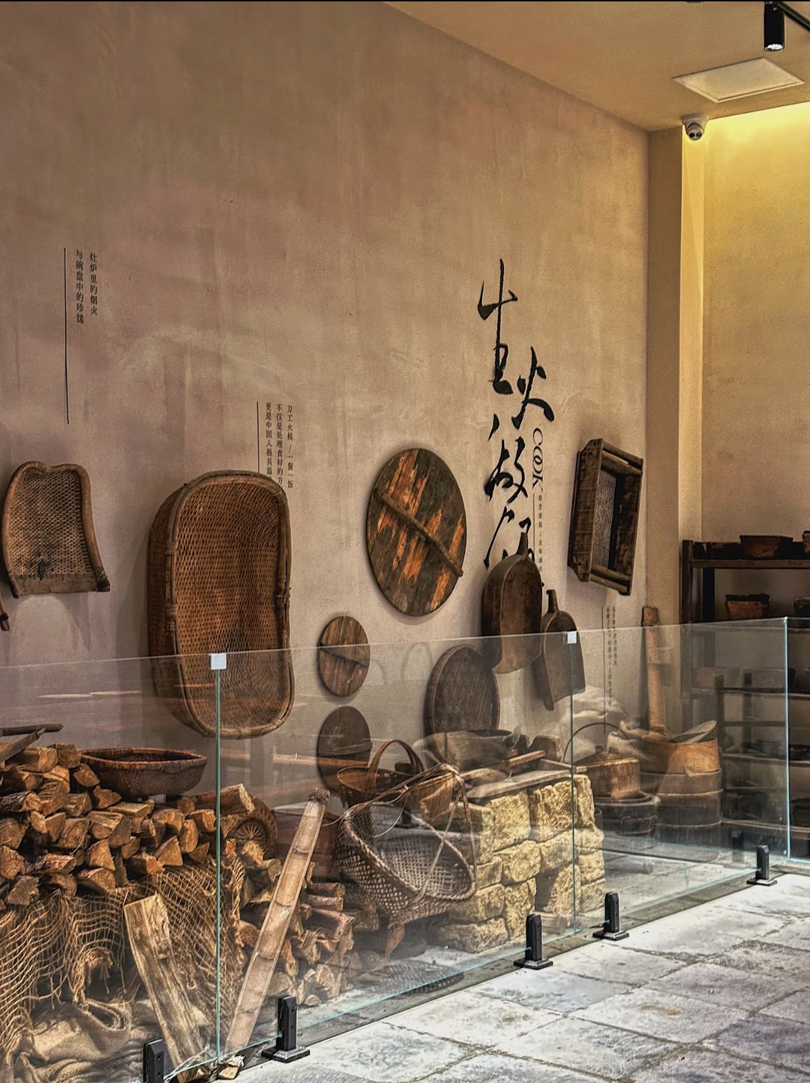

Each concept store has its own theme and serves as an art gallery full of creative ideas. Most concept stores are also branches of the Amusement Park, featuring innovative layouts, spacious areas, and plenty of seating. Customers can also purchase merchandise there.
Concept Stores
概念店
Notes:
www.v5ppt.com

Slide 2

Sub-brands
4
Notes:
www.v5ppt.com

Slide 3
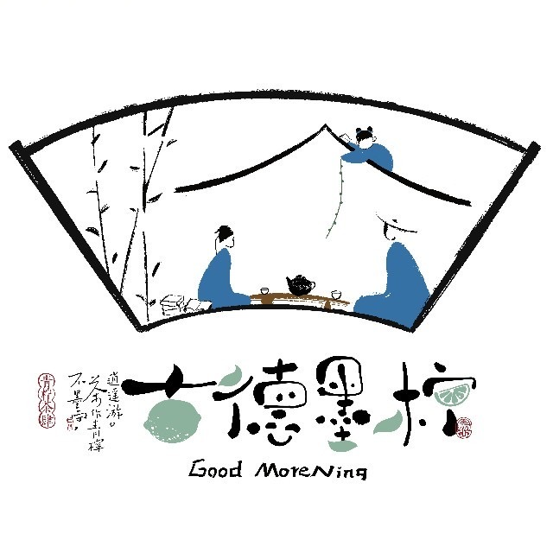



Yuan Yang Coffee
Good MoreNing
(Good Mo Lemon)
Day and Night Tavern
Notes:
www.v5ppt.com

Slide 4
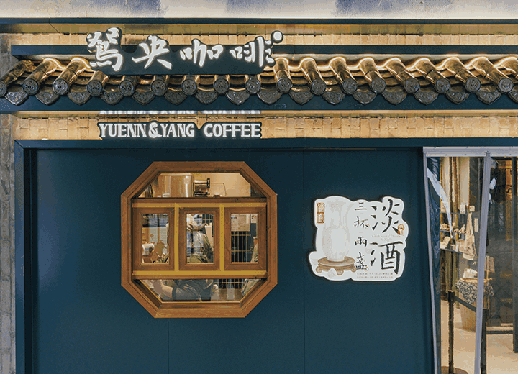
"Learning from the West while progressing in the East, Chinese-style coffee," Yuan Yang Coffee was established on August 10, 2022, dedicating to finding a more balanced taste between coffee bean flavors and tea flavors.
The current product series include Pure Coffee, Chinese Latte, Triple Light Milk Cap, Not Quite Proper Dirty, Fruit Coffee, Liquor Coffee, and Night Liquor.
In addition, more than ten stores in Changsha have had Chinese and Western-style breakfasts, including lotus root boxes, croissants, bagels, and other categories.
Notes:
www.v5ppt.com

Slide 5
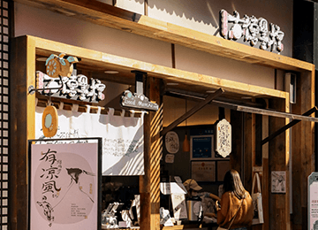
Established on September 19, 2023, "Good Morening" adheres to the concept of "not sticking to conventions, with tea as a leisurely journey in lemon.(不墨守，茶作青柠逍遥游)" It specializes in "New Chinese-style lemon tea"
Good Morening offers two menus: one for tea and one for alcohol(茶肆和酒肆). The tea menu includes a series such as Lemon Milk Tea. Products from the alcohol menu are available after 4:30 PM daily.
Product names are inspired by classic works like the Book of Songs.
Notes:
www.v5ppt.com

