Slide 1

中华典籍外译
Chinese Classics Translation for Master Students of Translation Studies
湖南师范大学 2022年2月25日-2021年6月10日
中国文化基础 周五第九和第十节课14:30-16:10，
上课地点：线上VooV
助教：Li Xin 李欣 – Session no. 5
吴漠汀特聘教授 Distinguished Professor Dr. Martin Woesler
培高德 教授 Professor Dr. Cord Eberspächer
湖南师范大学外国学院 Foreign Studies College, Hunan Normal University

Slide 2
Schedule 学期题目
1 2.25 Organizational things, intro to the concept of a „classic“
2 3.4 Canonization
3 3.11 Early Translation of Chinese Literature
4 3.18 Reception of the Red Chamber Dreams in the West
5 3.25 How to make people read classics again?
6 4.1 Western Classics in Chinese clothes: The example of Utopian Literature
7 4.8 Attractiveness of Chinese Classics as part of softpower
8 4.15 Chinese Classics in the West: The Example of Germany
9 4.22 Sinicization – Politics for Cultural Export: The Example of the Chinese classics
10 4.29 Chinese Classics in World Lit. Anthologies and World Literary History Books
11 5.6 Translation of Modern Classics: Mo Yan, Yu Hua, Liu Cixin etc.
12 5.13 Chinese Classics on Overseas Bookfairs
13 5.20 Cinema Movie Adaptions of Chinese Classics
14 5.27 Lessons to learn from the Classics: Integration or Sharpening the Cultural Profile?
15 6.3 Final Discussion
16 6.10 Final Exam

Slide 3
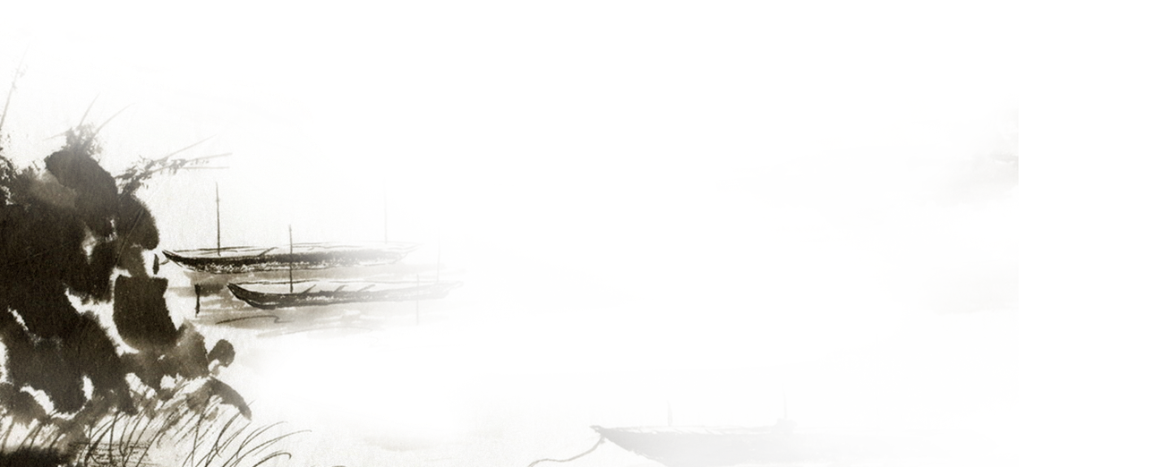



How to make people
read classics again?
for Master Students of Translation Studies
吴漠汀教授
Prof. Dr. Martin Woesler
Hunan Normal University
Spring 2022

Slide 4
Teacher Input
The example of the D-Book (3 video clips)
Discussion
吴漠汀教授
Prof. Dr. Martin Woesler
Hunan Normal University
Spring 2022

Slide 5
Student Input
https://wiki.rub.de/uvu/index.php/How_to_Make_People_Read_Classics_Again%3F
吴漠汀教授
Prof. Dr. Martin Woesler
Hunan Normal University
Spring 2022

Slide 6
Preparation for next session
1 2.25 Organizational things, intro to the concept of a „classic“
2 3.4 Canonization
3 3.11 Early Translation of Chinese Literature
4 3.18 Reception of the Red Chamber Dreams in the West
5 3.25 How to make people read classics again?
6 4.1 Western Classics in Chinese clothes: The example of Utopian Literature
7 4.8 Attractiveness of Chinese Classics as part of softpower
8 4.15 Chinese Classics in the West: The Example of Germany
9 4.22 Sinicization – Politics for Cultural Export: The Example of the Chinese classics
10 4.29 Chinese Classics in World Lit. Anthologies and World Literary History Books
11 5.6 Translation of Modern Classics: Mo Yan, Yu Hua, Liu Cixin etc.
12 5.13 Chinese Classics on Overseas Bookfairs
13 5.20 Cinema Movie Adaptions of Chinese Classics
14 5.27 Lessons to learn from the Classics: Integration or Sharpening the Cultural Profile?
15 6.3 Final Discussion
16 6.10 Final Exam

Slide 7
Preparation for next session
Read paper provided for Western classics in Chinese clothes: The example of Utopian literature
Take the quiz
Translation
Correction of translation
Please choose your final exam paper and start writing (grade)

Slide 8
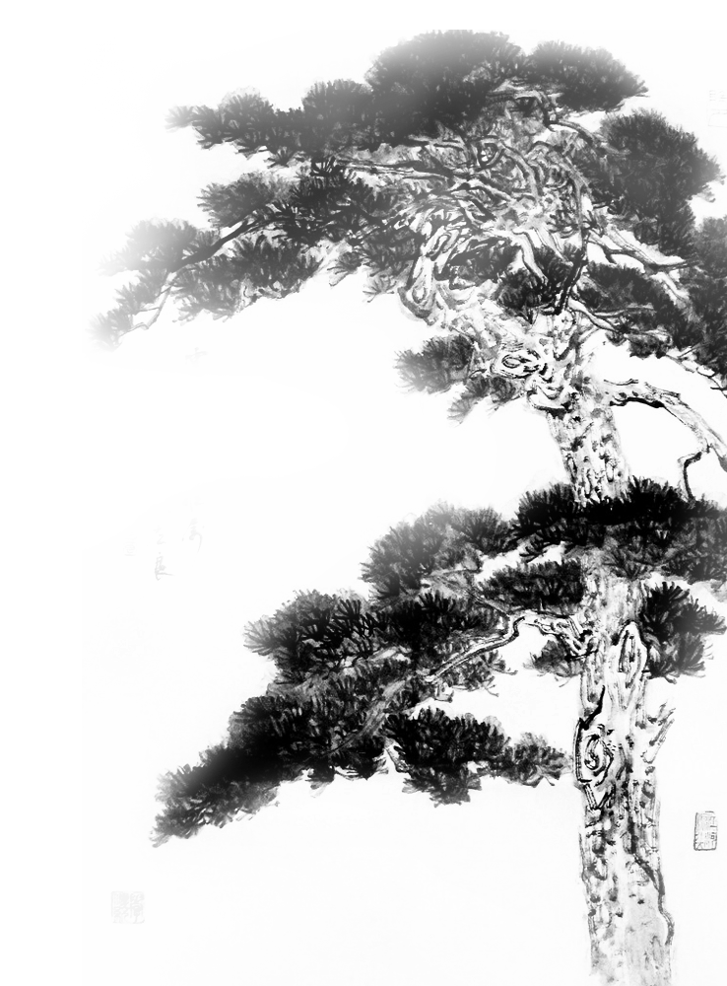
謝謝觀賞

