Slide 1
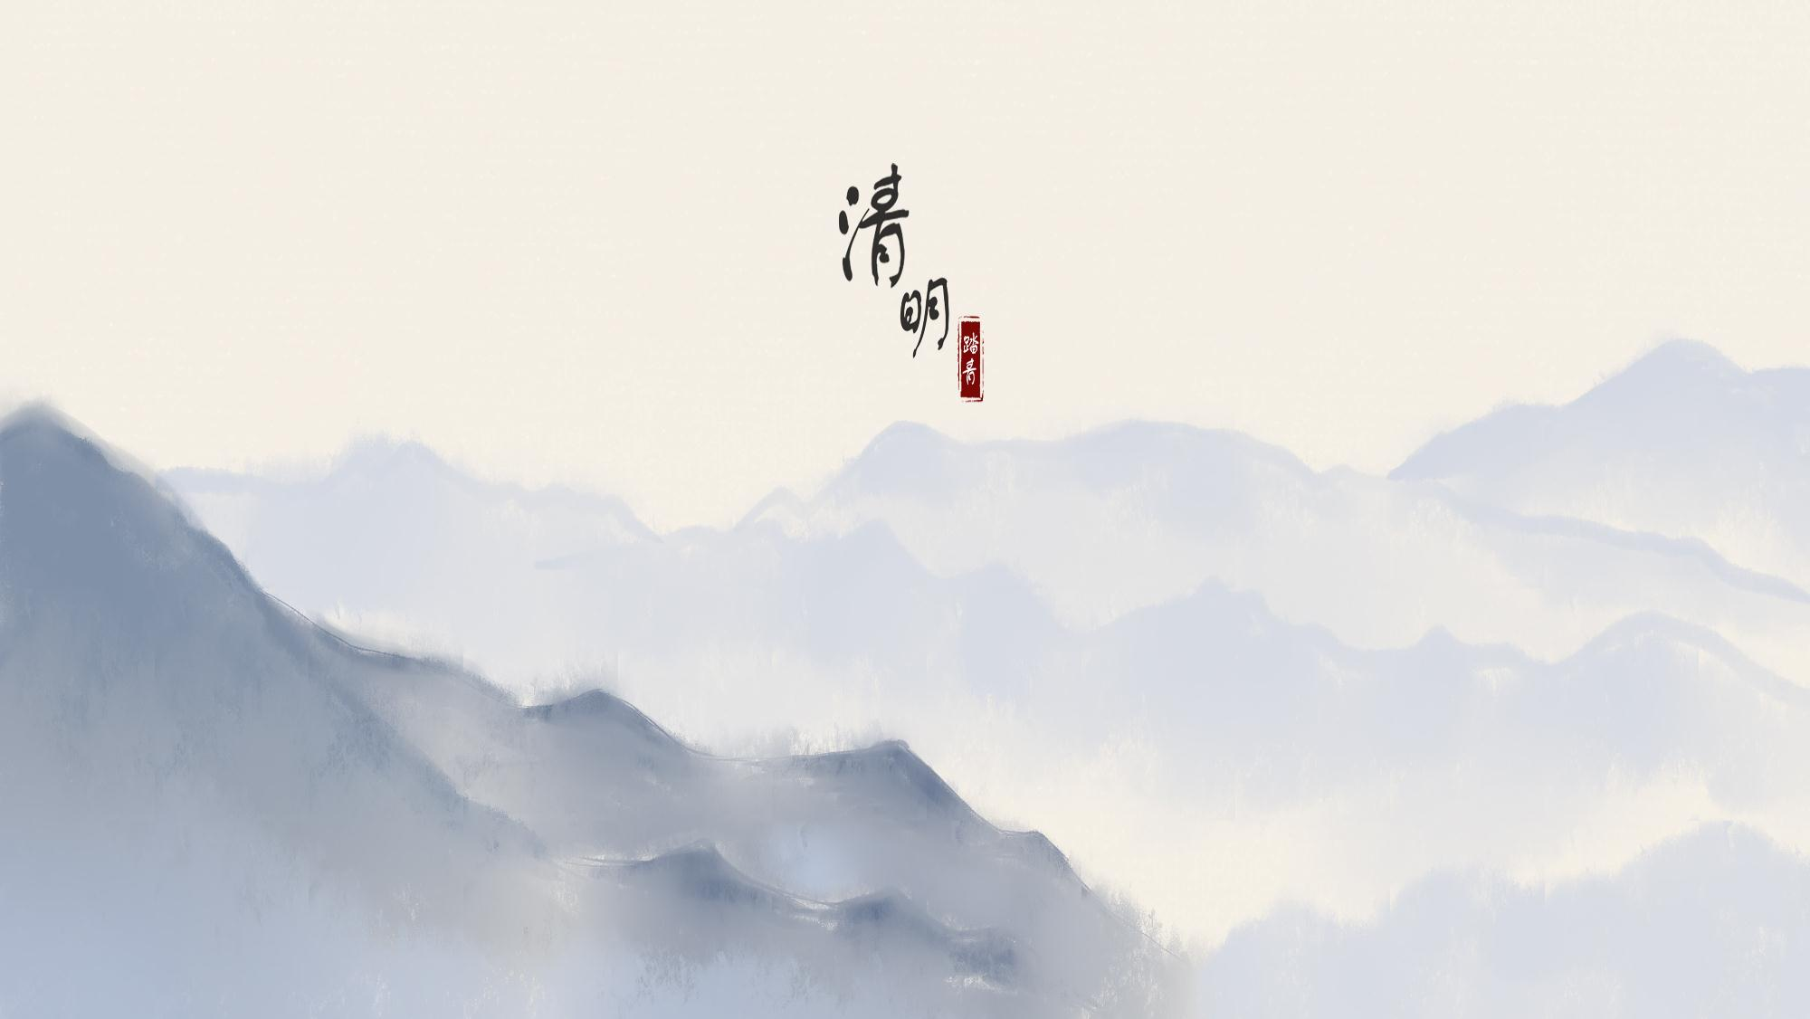
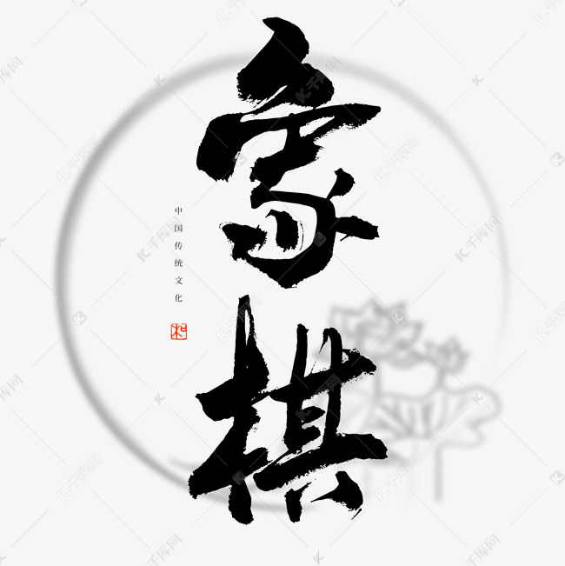
楚河汉界，中分天下
汇报人：周旭凯

Slide 2


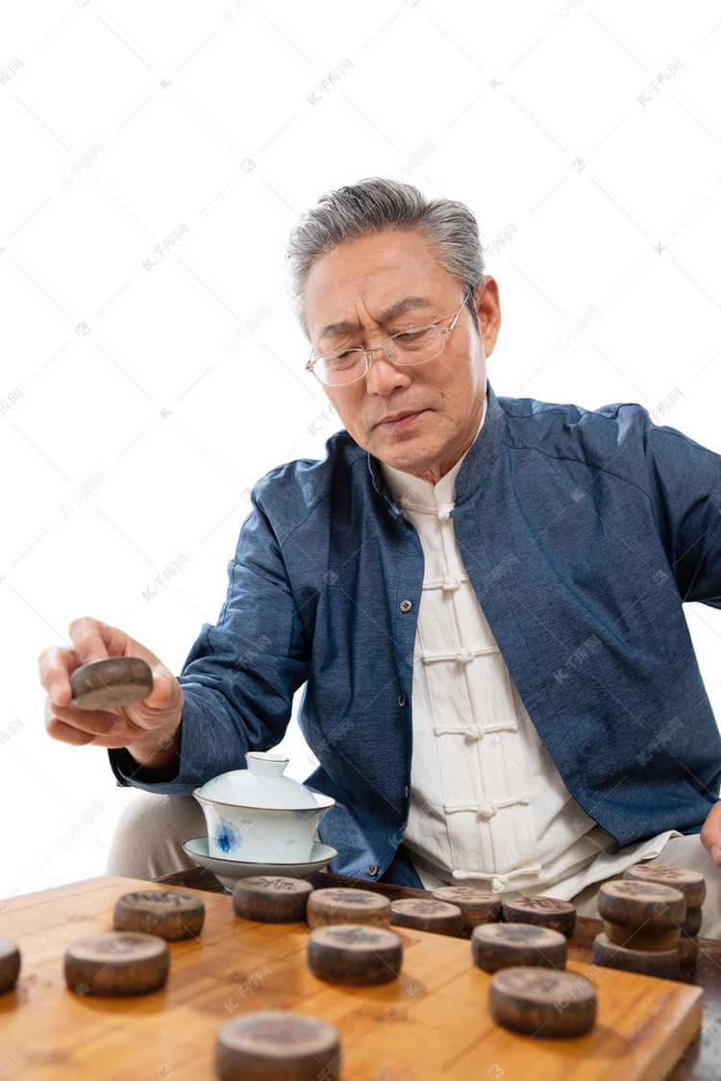
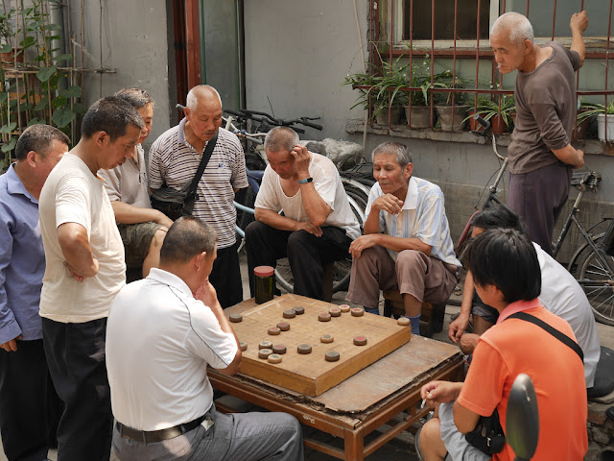
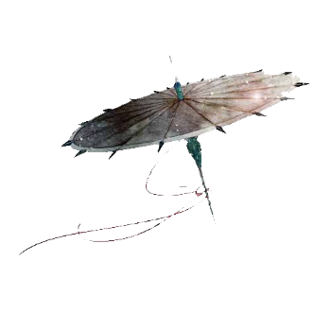
部曲纵横听指挥，元来棋算即兵机。——宋·戴翼

Slide 3
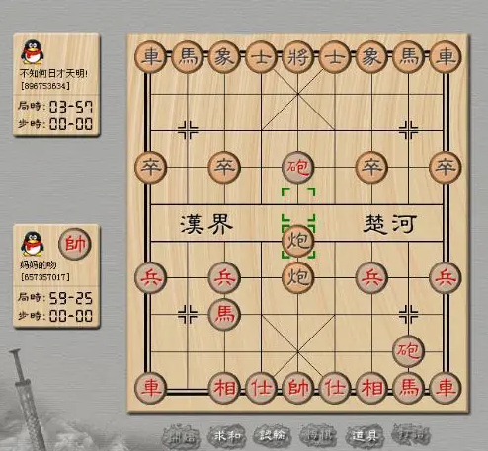
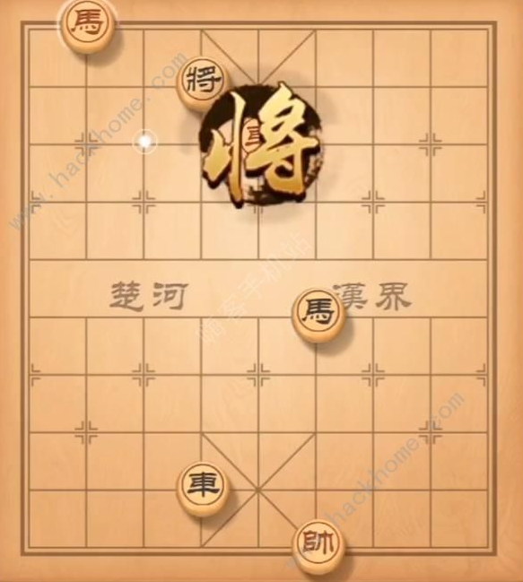
深念远虑，胜乃可必。——汉·马融

Slide 4
Q&A 1:
What are the Four Arts of Ancient China？("Four Arts of the Literati" or "Four Arts of the Scholar-officials")

Slide 5
The famous "Four Arts" of China are:
Qin (a seven-stringed zither), Qi (chess), Shu (calligraphy), and Hua (painting).
Chess occupies one of these four positions and is an essential skill for making friends among the upper-class scholars-officials in ancient China. Xiangqi (Chinese chess) is an indispensable part of China's traditional chess art, possessing a long history and rich cultural connotations.

Slide 6
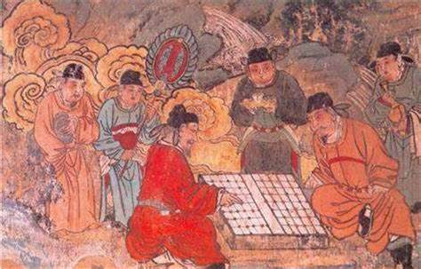
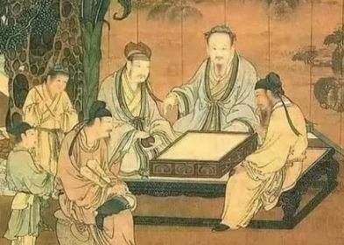
Chinese Chess, a traditional game in China, is also internationally recognized and played. It belongs to the category of two-player competitive board games. Originating from China, it boasts a long history in the country and is predominantly popular among Chinese people and nations within the Sinographic cultural sphere.

Slide 7

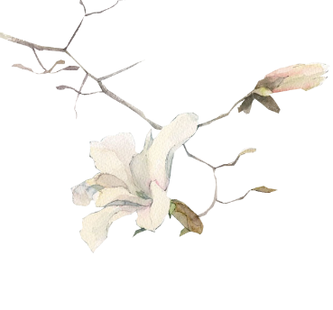

目
录
CONTENTS
壹
History
贰
Introduction
叁
One Step Determines Victory

Slide 8
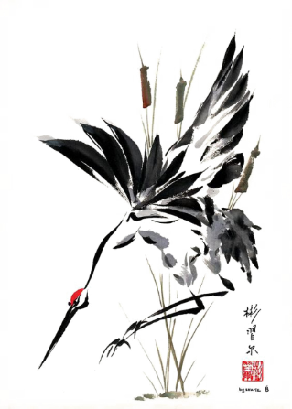
第 一 章
History

Slide 9
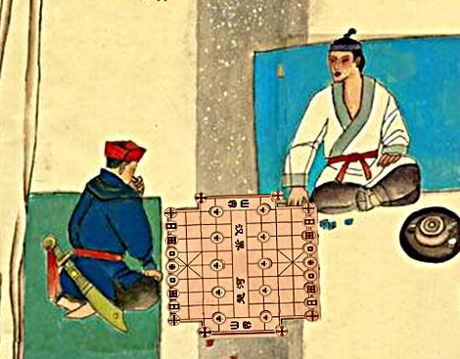
Q&A 2:
Which dynasty did Xiangqi (Chinese chess) originate from?

Slide 10
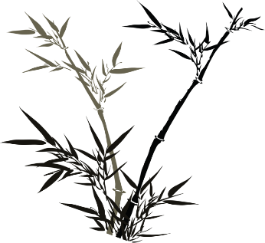
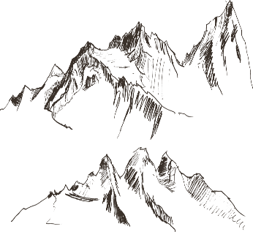
Chinese chess has a long history. During the Warring States period, there were already official records of chess.
《楚辞·招魂》中有“蓖蔽象棋，有六簿些；分曹并进，遒相迫些；成枭而牟，呼五白些。”
《说苑》载：雍门子周以琴见孟尝君，说：“足下千乘之君也，……燕则斗象棋而舞郑女。”

Slide 11
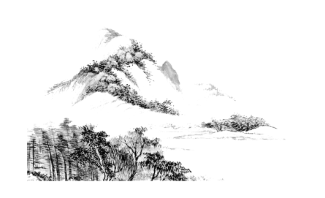
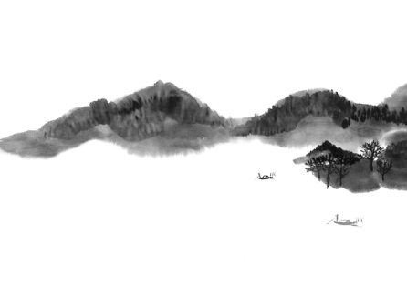
During the late Qin Dynasty and the founding of the Western Han Dynasty, Han Xin made significant changes to chess by introducing the concept of the "Chu River and Han Border," making the game more strategic and entertaining.
During the Northern and Southern Dynasties, Emperor Wu of the Northern Zhou Dynasty compiled the "Xiang Jing" (Classic of Chess), Wang Bao wrote the "Preface to Xiangxi" (Preface to Chess), and Yu Xin wrote the "Xiangxi Jing Fu" (Chess Classic Ode). These works marked the completion of the second major reform of chess.

Slide 12
In the Song Dynasty, the modern form of chess was established. During the Northern Song Dynasty, chess was divided into two types: large chess and small chess, with the latter roughly resembling the modern form of chess. The chessboard was set to have ten vertical and nine horizontal lines, and the king and general were positioned in the center of the nine-palace grid. Over time, through continuous evolution, the names and arrangement of the chess pieces gradually became refined.

Slide 13
During the Ming and Qing dynasties, the development of chess entered a golden age. Renowned experts emerged in succession, and excellent works were numerous, giving rise to a large number of outstanding national chess masters such as Zhou Tingmei, Wang Zaiyue, and Wu Meisheng. The research on chess strategies and tactics became more in-depth, promoting the development of chess culture.
After the founding of the People's Republic of China, chess entered a brand new stage of development. In 1956, chess was recognized as a national sport and national competitions were held almost every year.

Slide 14
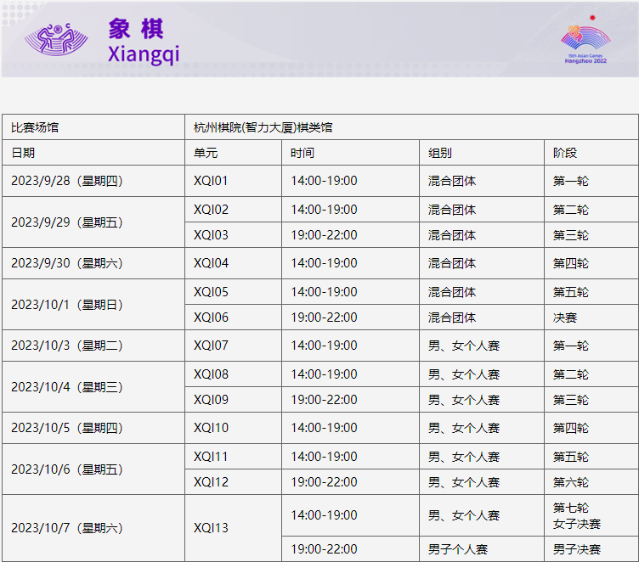
Modern chess has become a widely popular intellectual sport. It not only enjoys a strong following in China but has also gradually made its way onto the world stage. The establishment of the Fédération Internationale des Échecs and the Asian Xiangqi Federation, as well as the appearance of chess in international events such as the Asian Games, all mark significant progress in the internationalization of chess.
来源：杭州第19届亚运会组委会

Slide 15
第 二 章
Introduction

Slide 16
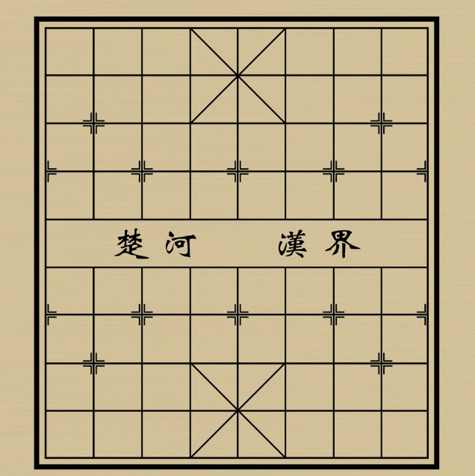
Q&A 3:
The words "Chu River" and "Han Border" on the middle of the chessboard are related to which two historical figures?

Slide 17
In the middle of the chessboard, the words "Chu River" and "Han Border" divide the board into two equal parts, using chess as a metaphor for the historical "Chu-Han Contention." In 203 BC, during the period of competition between Chu and Han, Liu Bang launched an attack on Xiang Yu. Xiang Yu, lacking food and soldiers, was forced to propose a division of the realm, with the west of the Honggou River belonging to Han and the east to Chu. Since then, the expression "Chu River and Han Border" emerged. The boundary river marked on today's chessboard is the "Honggou River," which was about 300 meters wide and located between the two cities where Liu Bang and Xiang Yu faced off at that time.

Slide 18
The ideology of Chinese chess originates from the Yi Ching (Book of Changes) and has a close relationship with the Tai Chi and Eight Trigrams. The Tai Chi and Eight Trigrams embody the dual aspects of Yin and Yang, which are both in opposition and interdependent, mutually nourishing each other. Just as the highest realm in chess, the "draw," represents coexistence after the game, embodying the Chinese philosophy of "peace is precious."

Slide 19
Q&A 4: What are the types of pieces that each side has?

Slide 20
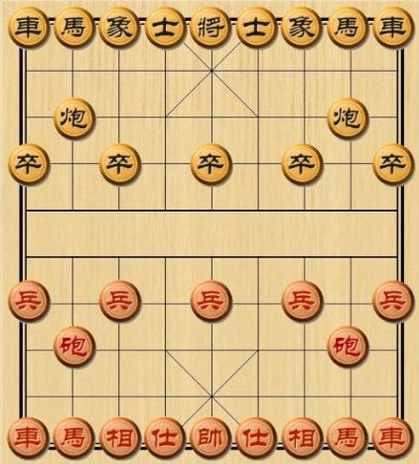
将（帅）King (General)
士 Guard
象（相）Elephant (Bishop)
车 Chariot
马 Horse
炮 Cannon
兵（卒）Soldier (Pawn)

Slide 21
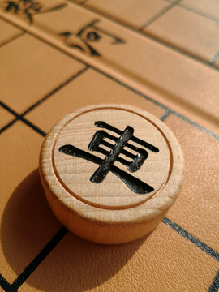
Q&A 5: How does the "chariot" (jū) move?

Slide 22
It can move along both horizontal and vertical lines, with no restriction on the number of steps as long as there are no other pieces blocking its path. This is commonly known as "the chariot moves in a straight line(车行直路)."

Slide 23
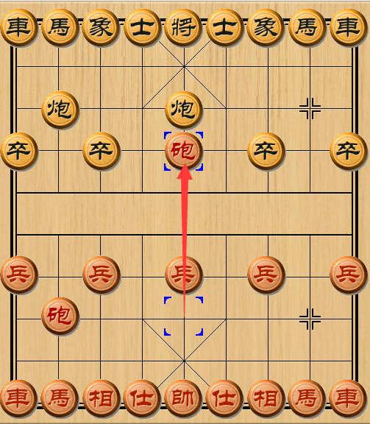
Q&A 6: How does the cannon“炮” move?

Slide 24
When the cannon is not capturing a piece, its movement is exactly the same as the chariot. But when the cannon captures a piece, it must jump over another piece. This is commonly known as "the cannon captures by jumping over(炮打隔子).

Slide 25
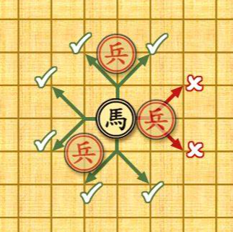
Q&A 7: How does the horse move? What does "blocking the horse's leg(蹩马腿)" refer to?

Slide 26
The horse moves along the diagonals of two vertical squares, commonly known as "the horse moves in a Ri(日)-shape or L-shape." The horse has up to eight potential moves in all directions around it, hence the saying "the horse commands authority on all eight sides." If there is another piece blocking the horse's path in the direction it intends to move, the horse cannot pass through, and this is commonly referred to as "blocking the horse's leg."

Slide 27
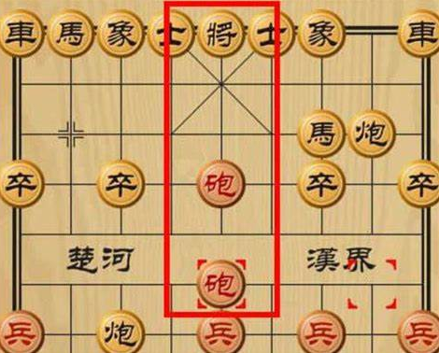
Q&A 8: What does it mean when a player is "checked(将军)" by the opponent?

Slide 28
In chess terminology, "check" (or "jiangjun" in Chinese) refers to a situation where a player's piece is poised to capture the opponent's "king" (jiang or shuai) in the next move. This action is called "jiangjun," abbreviated as "jiang."
Those who have played Chinese chess know that the "king" (jiang or shuai) is the most crucial piece on the board. Regardless of how many pieces either side has lost, the game must continue as long as these two pieces remain on the board, until one side concedes defeat voluntarily. And if one side's "king" is captured first, it signifies that the side whose "king" is taken first loses the game outright.

Slide 29
第 三 章
One Step Determines Victory

Slide 30
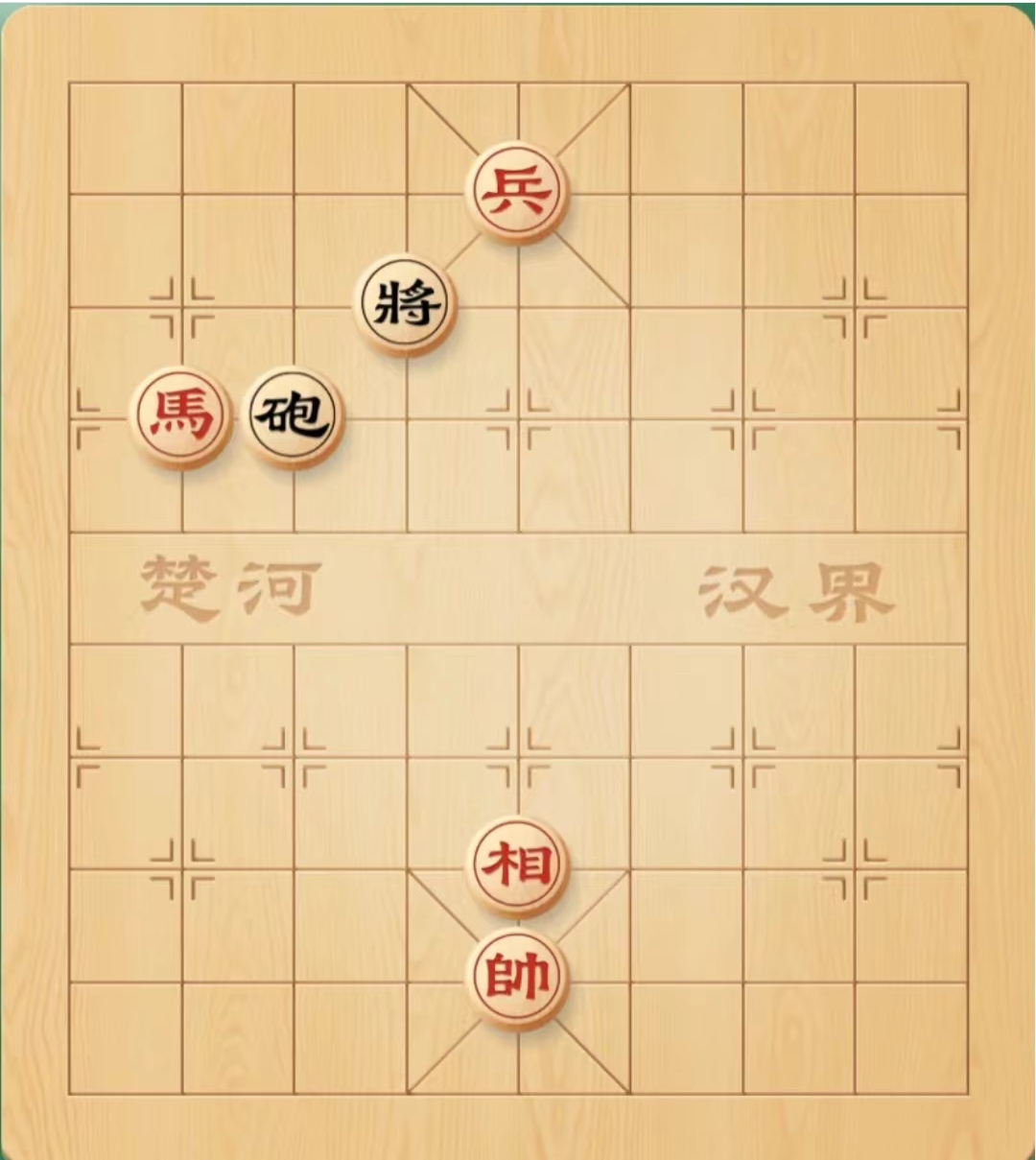
尘
Scenario 1:
You are the Red player, and one move is enough for you to win. Which move should you make?
缘
莫听穿林打叶声，何妨吟啸且徐行。竹杖芒鞋轻胜马，谁怕？一蓑烟雨任平生。 料峭春风吹酒醒，微冷，山头斜照却相迎。回首向来萧瑟处，归去，也无风雨也无晴。

Slide 31
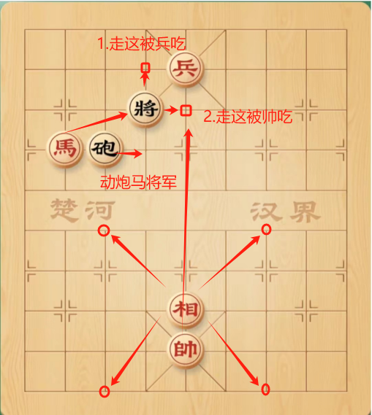
Answer: Move the "xiang" (or bishop).
尘
缘
莫听穿林打叶声，何妨吟啸且徐行。竹杖芒鞋轻胜马，谁怕？一蓑烟雨任平生。 料峭春风吹酒醒，微冷，山头斜照却相迎。回首向来萧瑟处，归去，也无风雨也无晴。

Slide 32
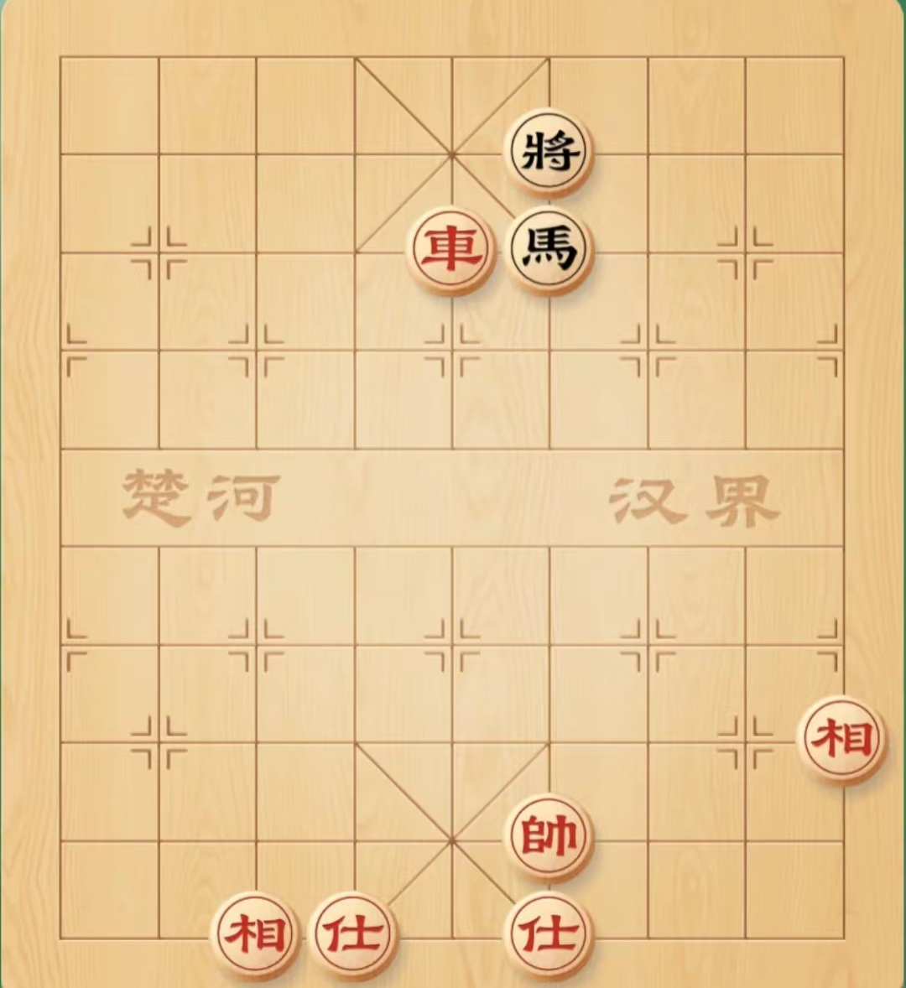
尘
Scenario 2:
You are the Red player, and one move is enough for you to win. Which move should you make?
缘
莫听穿林打叶声，何妨吟啸且徐行。竹杖芒鞋轻胜马，谁怕？一蓑烟雨任平生。 料峭春风吹酒醒，微冷，山头斜照却相迎。回首向来萧瑟处，归去，也无风雨也无晴。

Slide 33
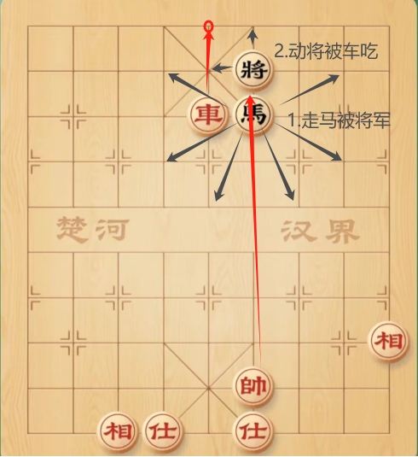
Answer: Move the "chariot" (jū).
尘
缘
莫听穿林打叶声，何妨吟啸且徐行。竹杖芒鞋轻胜马，谁怕？一蓑烟雨任平生。 料峭春风吹酒醒，微冷，山头斜照却相迎。回首向来萧瑟处，归去，也无风雨也无晴。

Slide 34
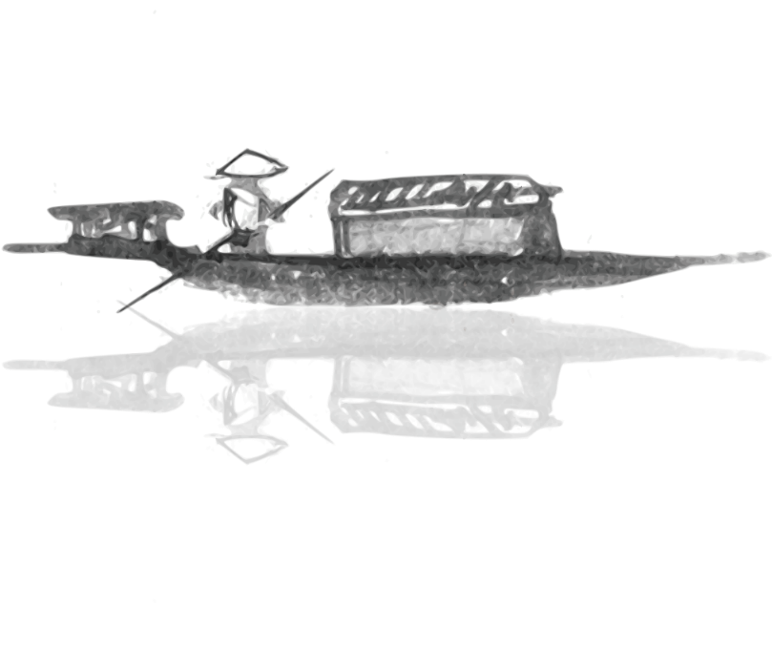
Chinese Chess, with thousands of years of history and imbued with Oriental wisdom, has a far broader mass base among the Chinese people than Go, and it has always been the most widely played board game. Chinese Chess is not merely a pastime for leisure and after-meal entertainment; it possesses cultural characteristics and educational functions in and of itself.

Slide 35
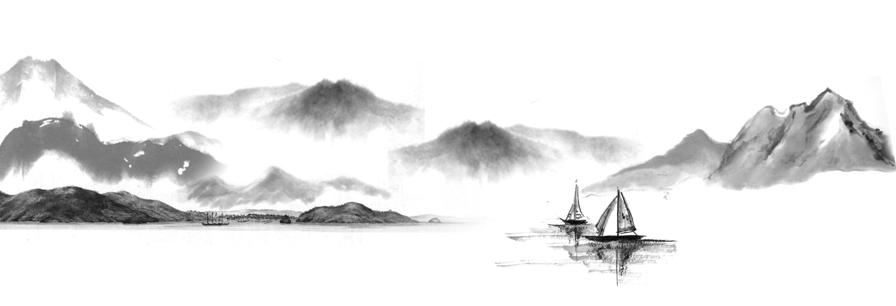
Chinese Chess can cultivate good willpower in people. The rule of "touch and move, no regrets after placing" requires players to be cautious throughout the game and make decisions decisively.

Slide 36

不畏浮云遮望眼，只缘身在最高层
Thanks
For
Watching

