Slide 1
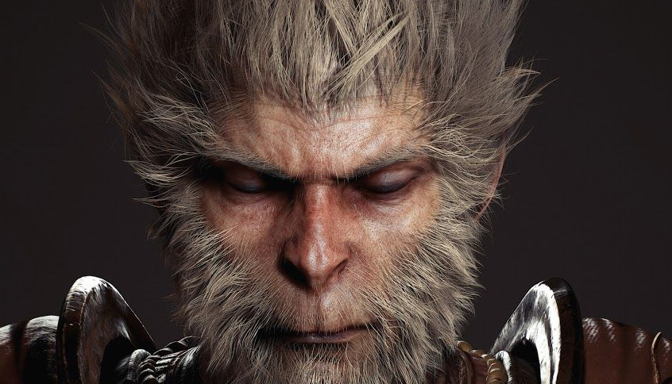
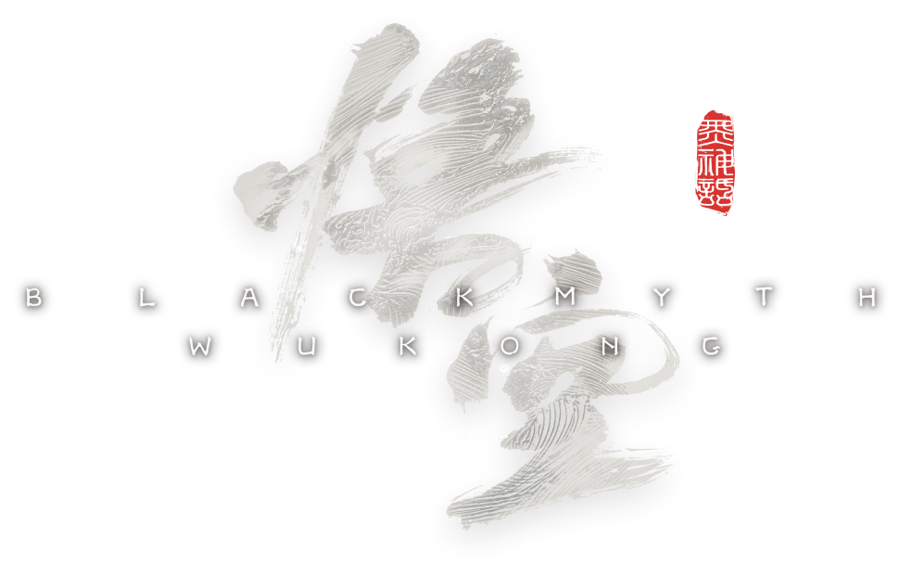

Aesthetics in the BLACK MYTH： WUKONG
202330092058 张宇波（Zhang Yubo）

Slide 2
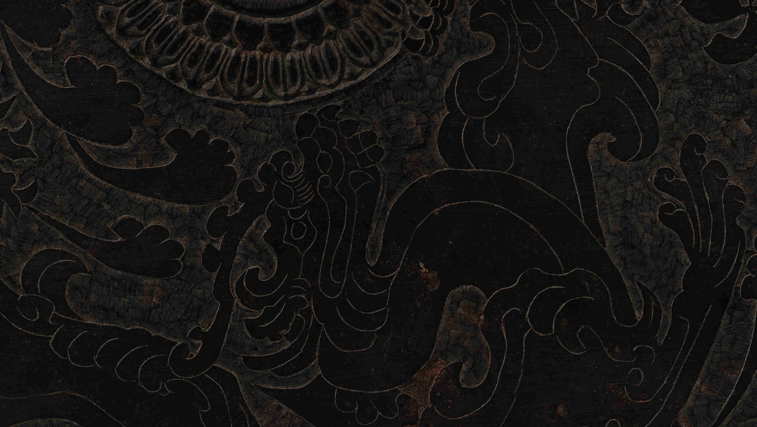

Contents
一
Introduction to Black Myth Wukong
二
Environmental Aesthetics
三
Compat Aesthetics
四
Ruin Aesthetics

Slide 3
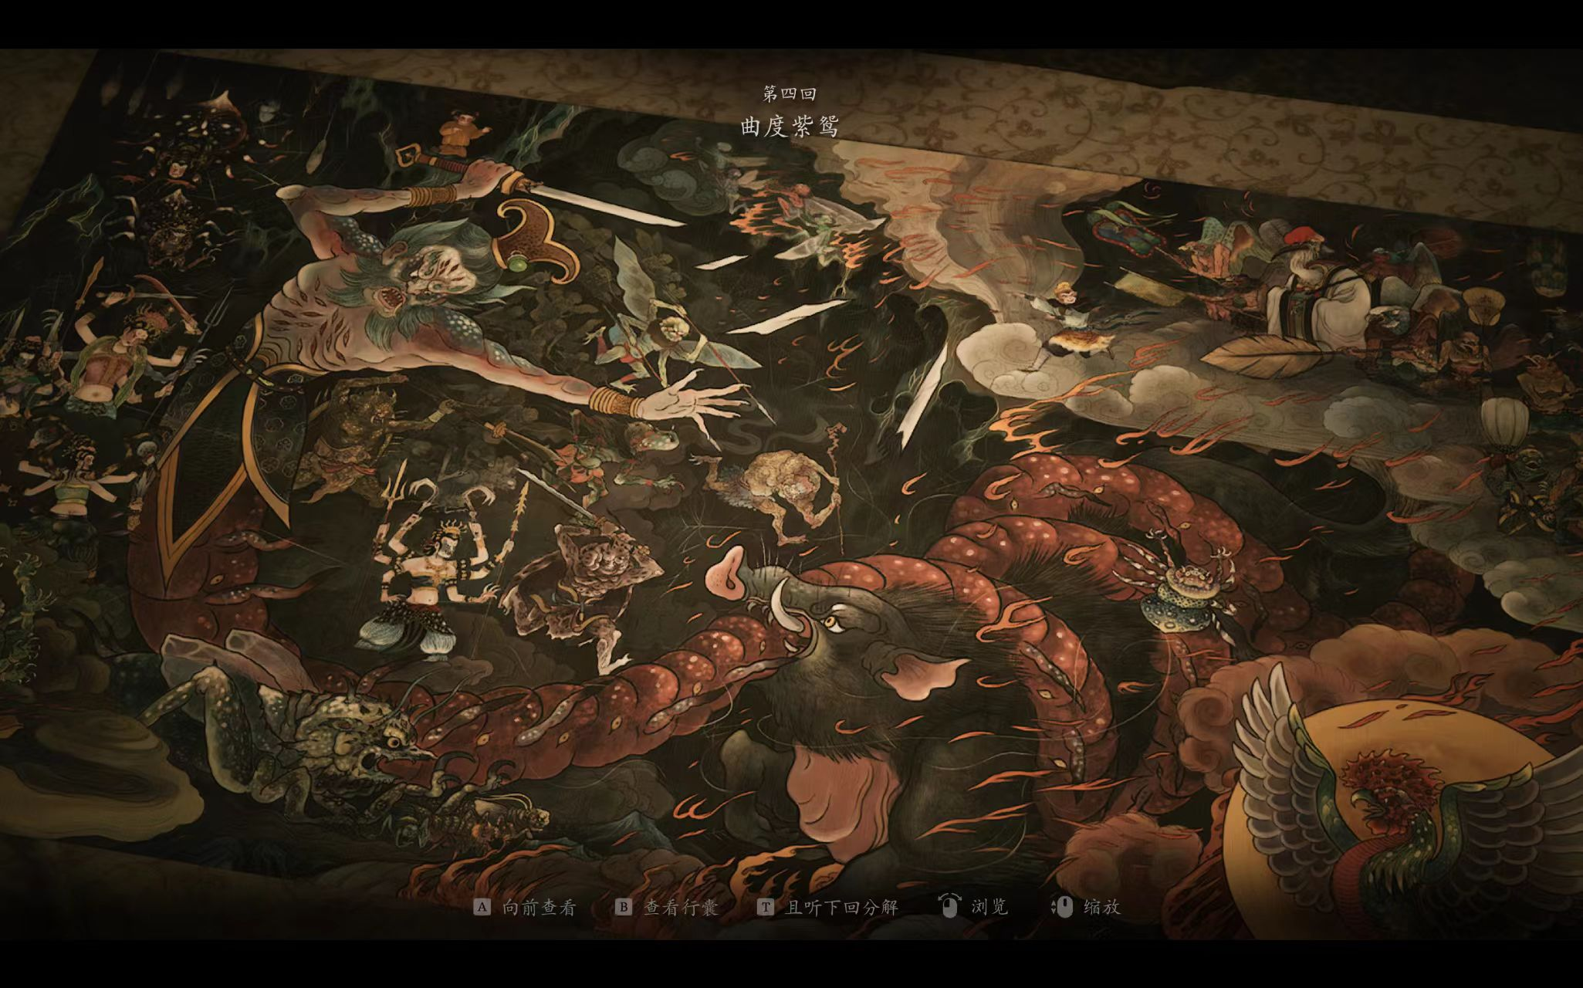
一
Introduction to Black Myth Wukong

Slide 4
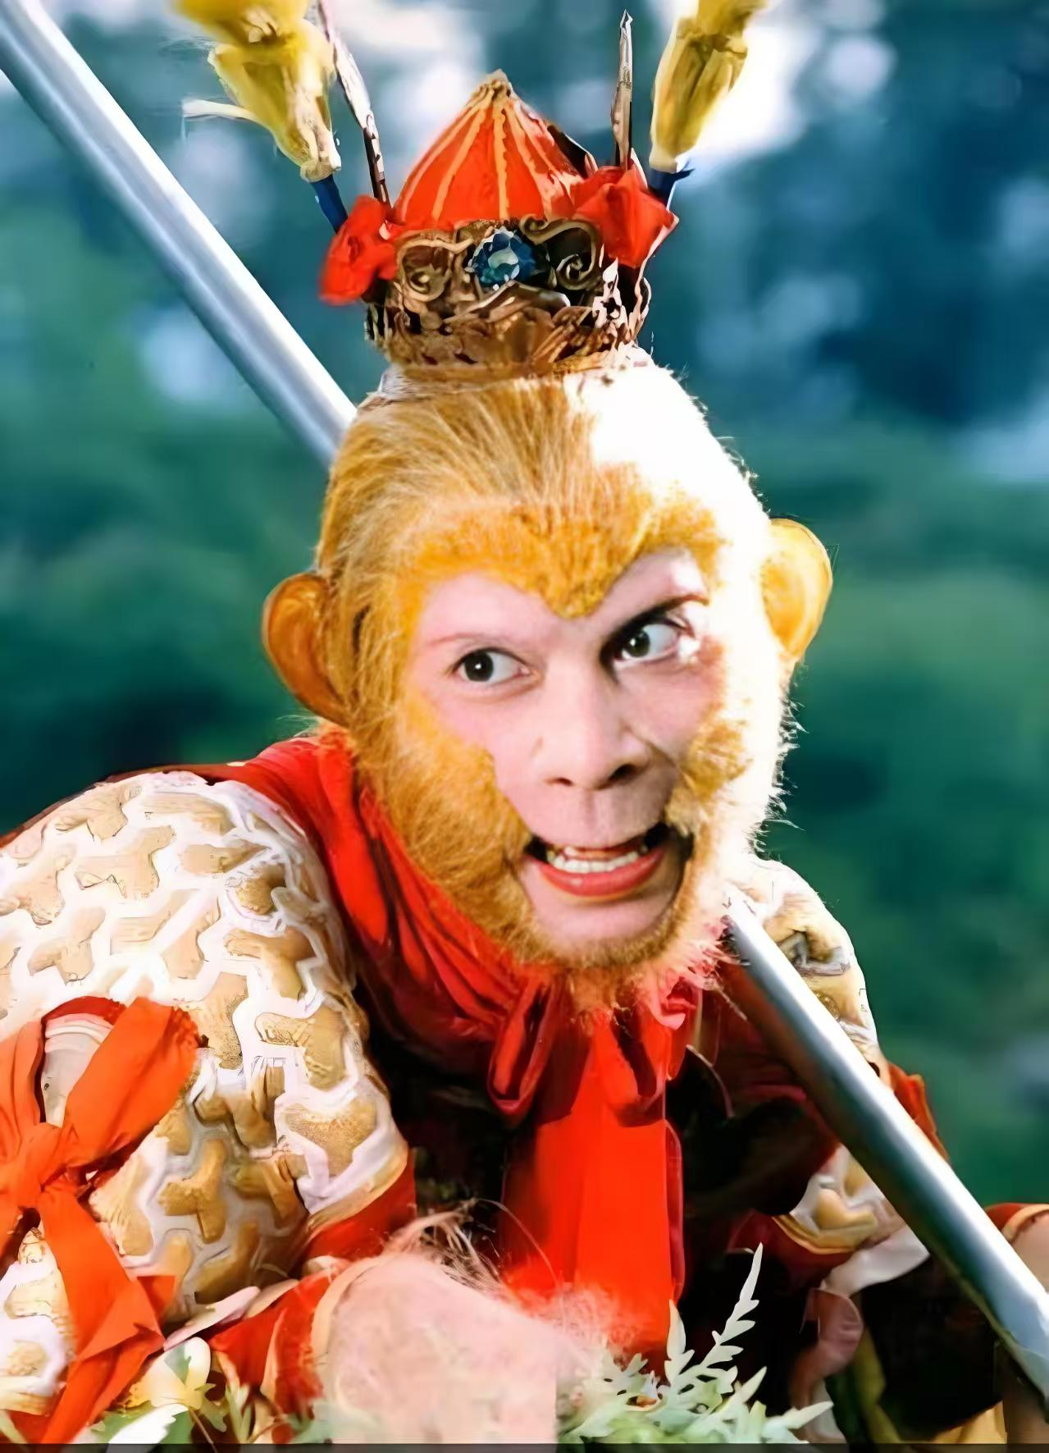
Monkey King
Sun Wukong, or the Monkey King , is a legendary hero from Chinese mythology, famous in the classic novel “Journey to the West”.
Born from a magical stone, he possesses immense strength, speed, and 72 supernatural transformations. He wields the “Ruyi Jingu Bang” , a staff that can change size at will.
After rebelling against heaven, he was imprisoned under a mountain by Buddha. Later, he redeemed himself by escorting the monk “Tang Sanzang” on a journey to retrieve Buddhist scriptures. Clever, mischievous, and fiercely loyal, Sun Wukong symbolizes courage, wit, and the struggle against oppression.

Slide 5

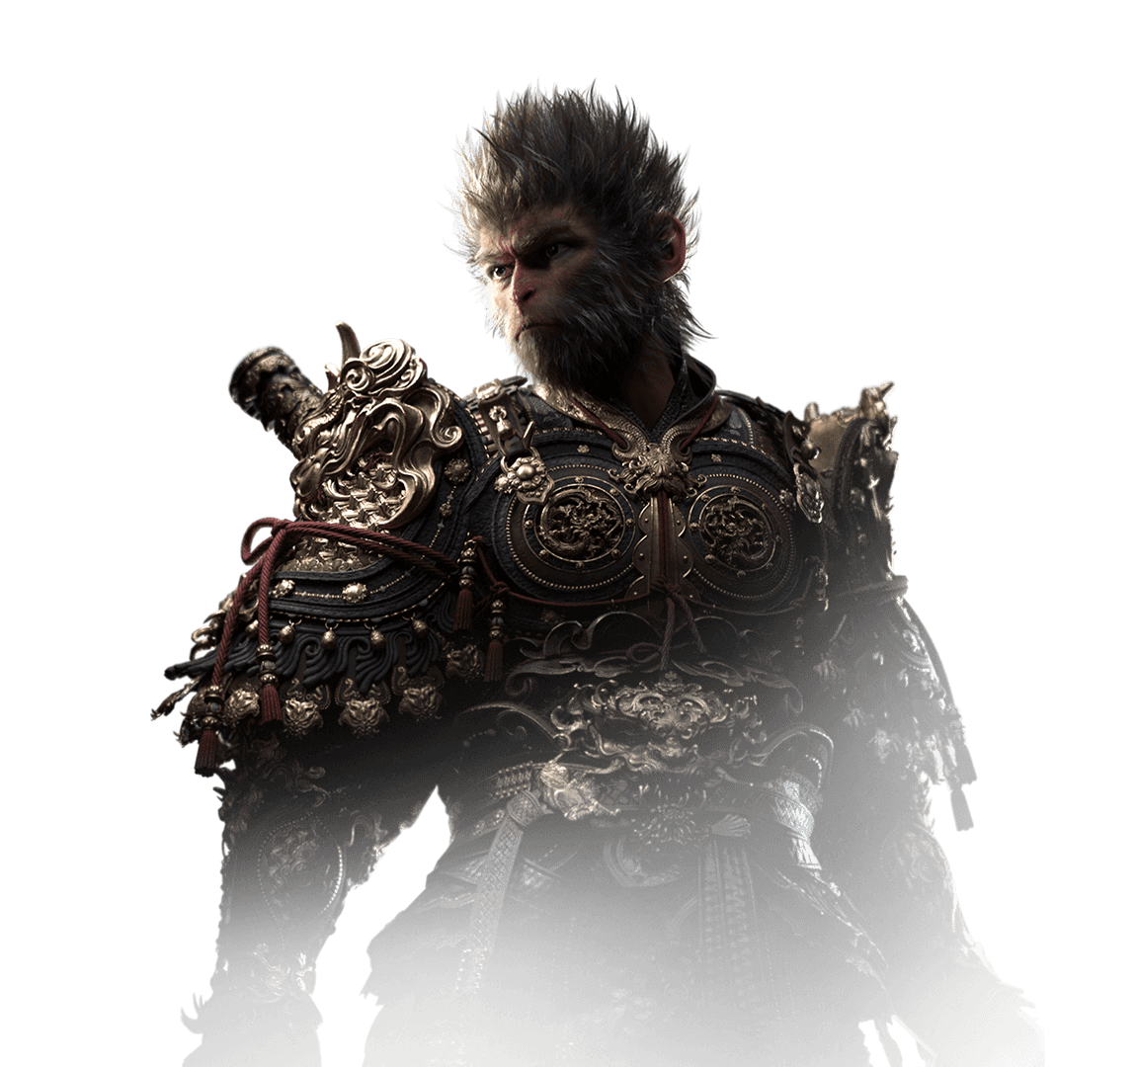
启程
无惧
历练
逢缘
BLACKMYTH
WUKONG
“Black Myth: Wukong ”is a dark fantasy action role-playing game developed by Chinese studio “Game Science”. Based on the classic framework of “Journey to the West”, the game offers a subversive reinterpretation, blending Eastern mythology, Buddhist philosophy, and dark fantasy storytelling.

Slide 6
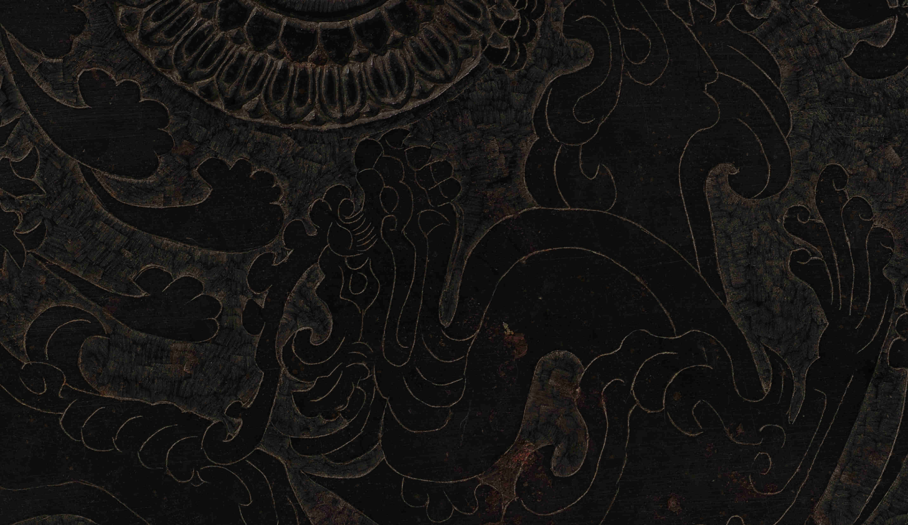

启程
无惧
历练
逢缘
2024 TGA(nomination).
BLACK MYTH: WUKONG
GAME OF THIS YEAR
BEST GAME DIRECTION
BEST ACTION GAME
BEST ART DIRECTION

Slide 7
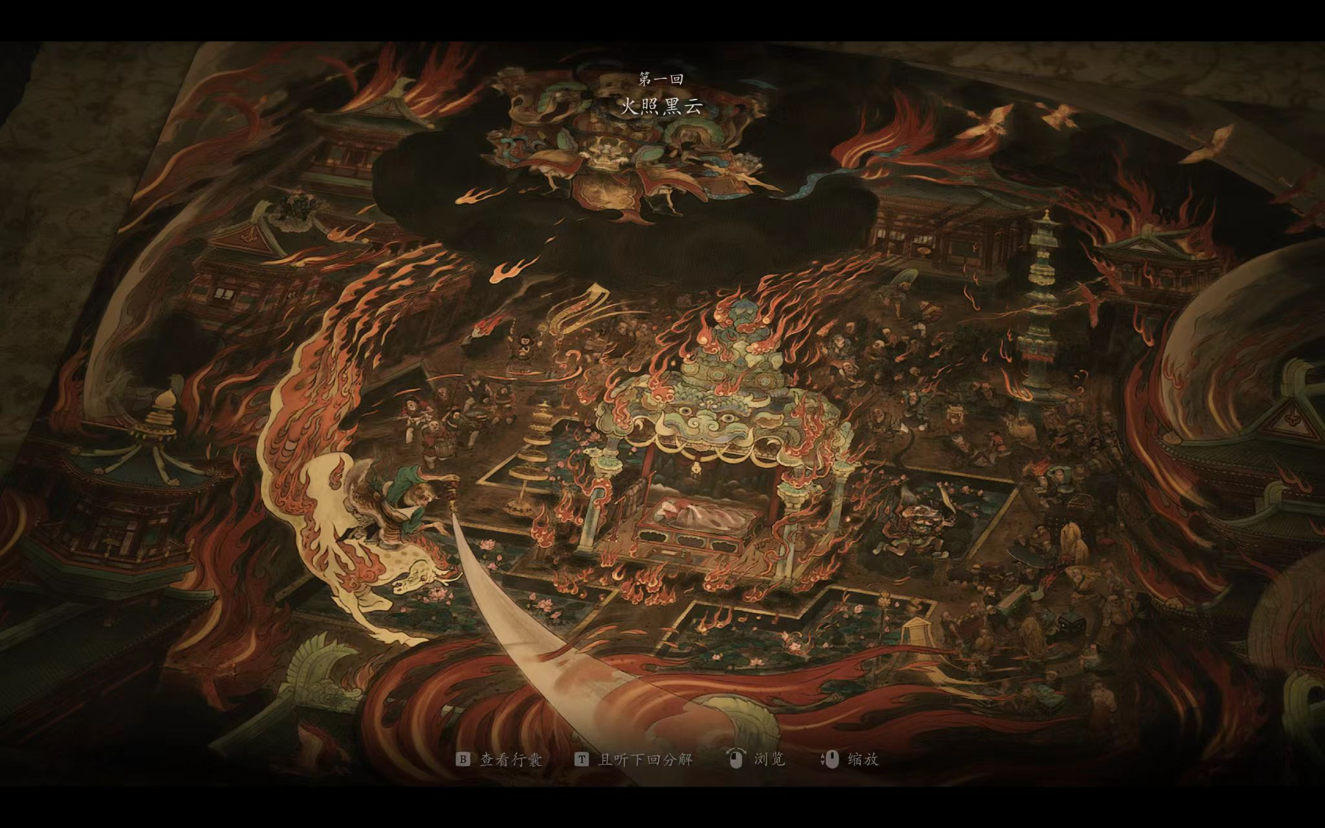
二
Environmental Aesthetics

Slide 8
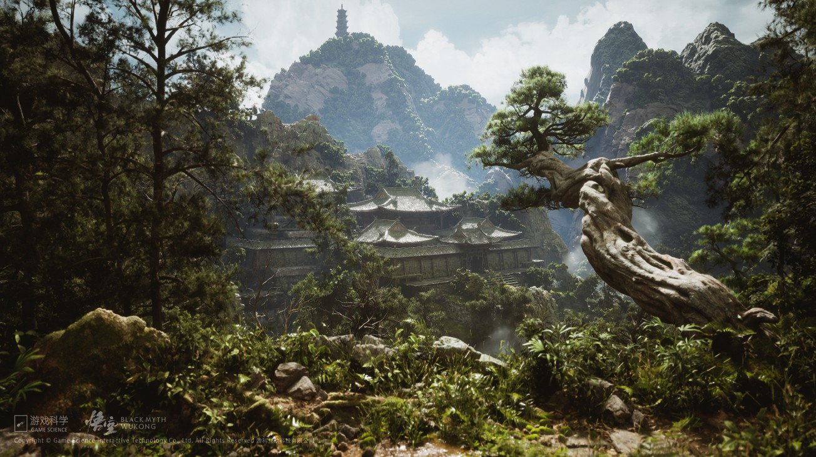

Slide 9
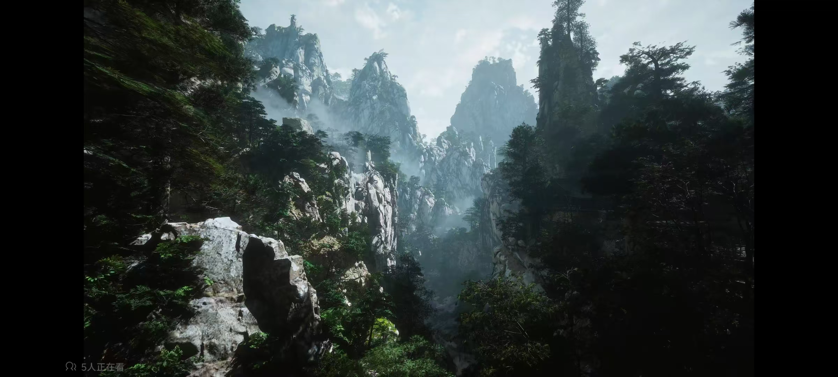

Slide 10
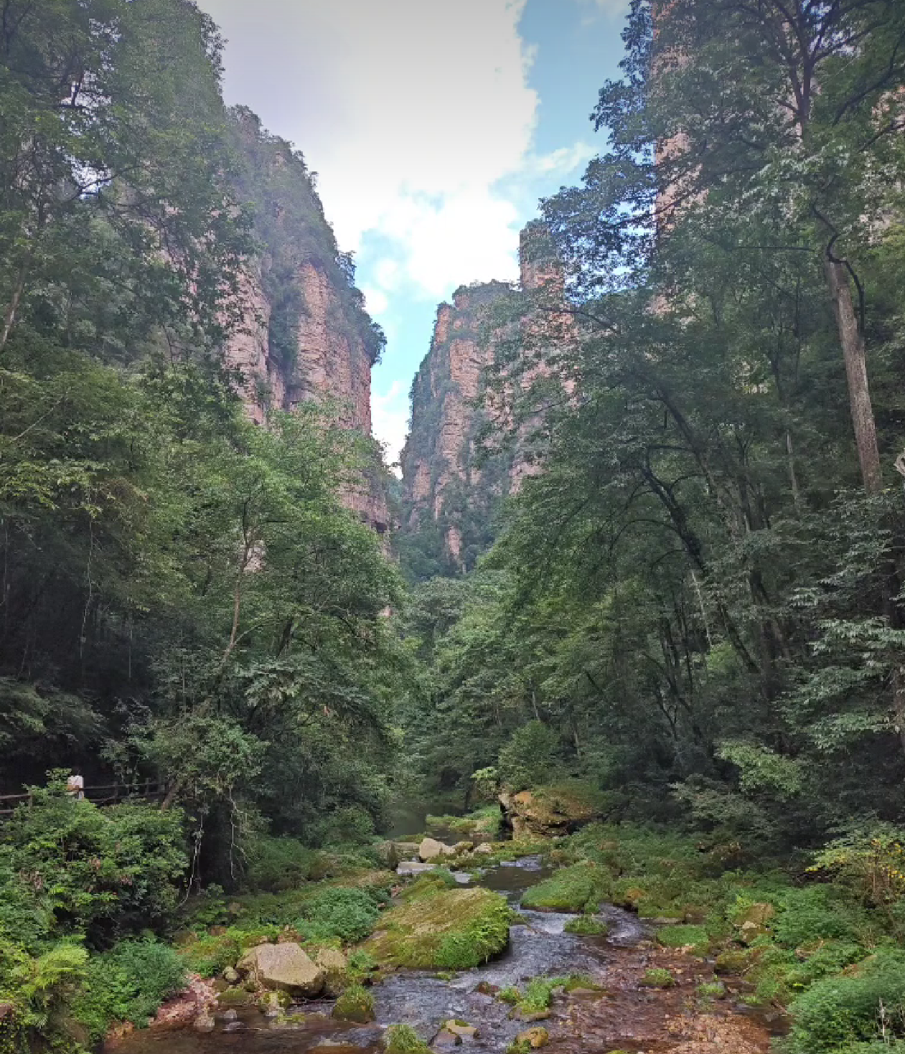
Chinese Landscape
中国山水
The towering peaks (e.g., Flower-Fruit Mountain,) in the game employ the “negative space”（留白） technique from Song Dynasty landscape paintings, where mountains emerge from swirling clouds.
Elements like cloud motifs, cliffside plank paths, and cascading waterfalls evoke the Daoist concept of “cave heavens and blessed lands" (*dongtian fudi*), realms of divine tranquility. 。

Slide 11
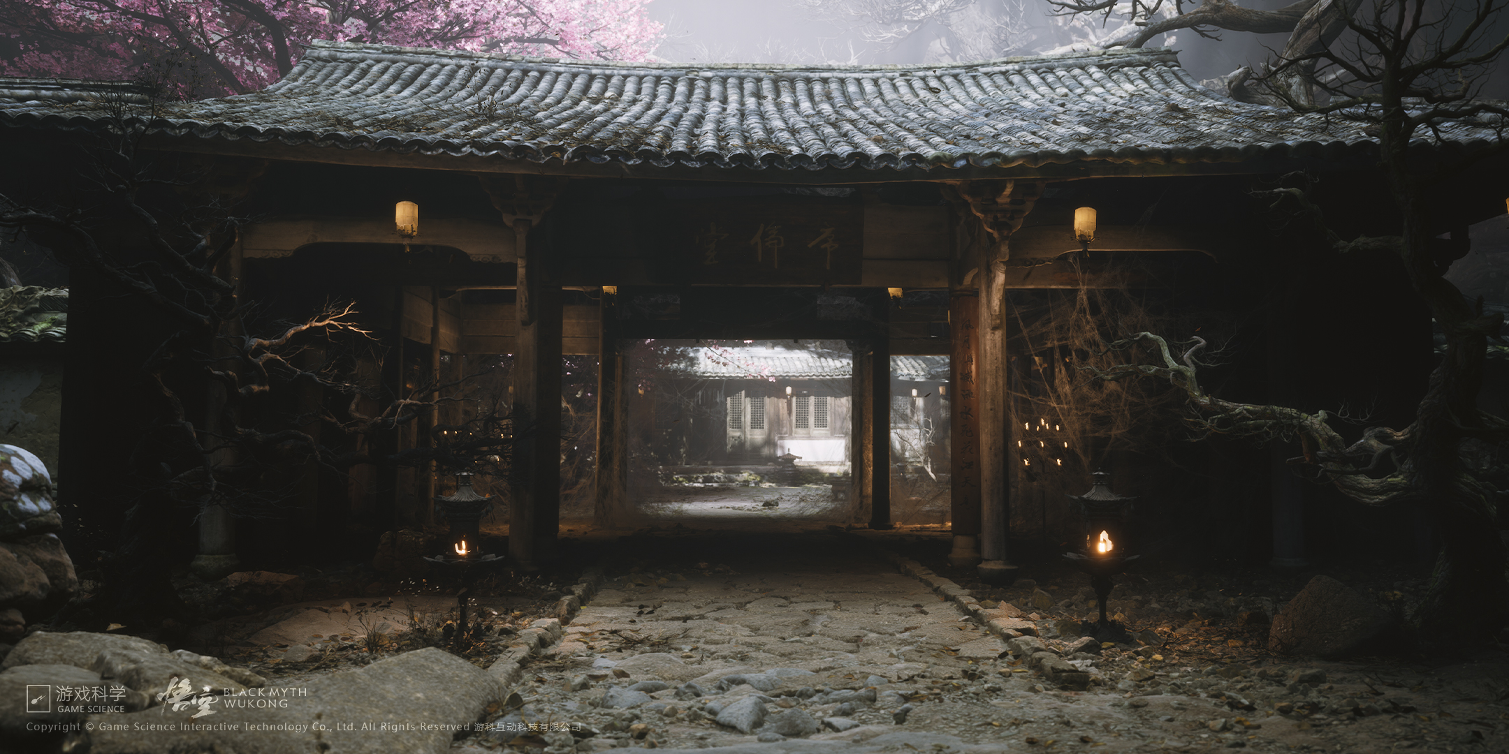
Temple

Slide 12
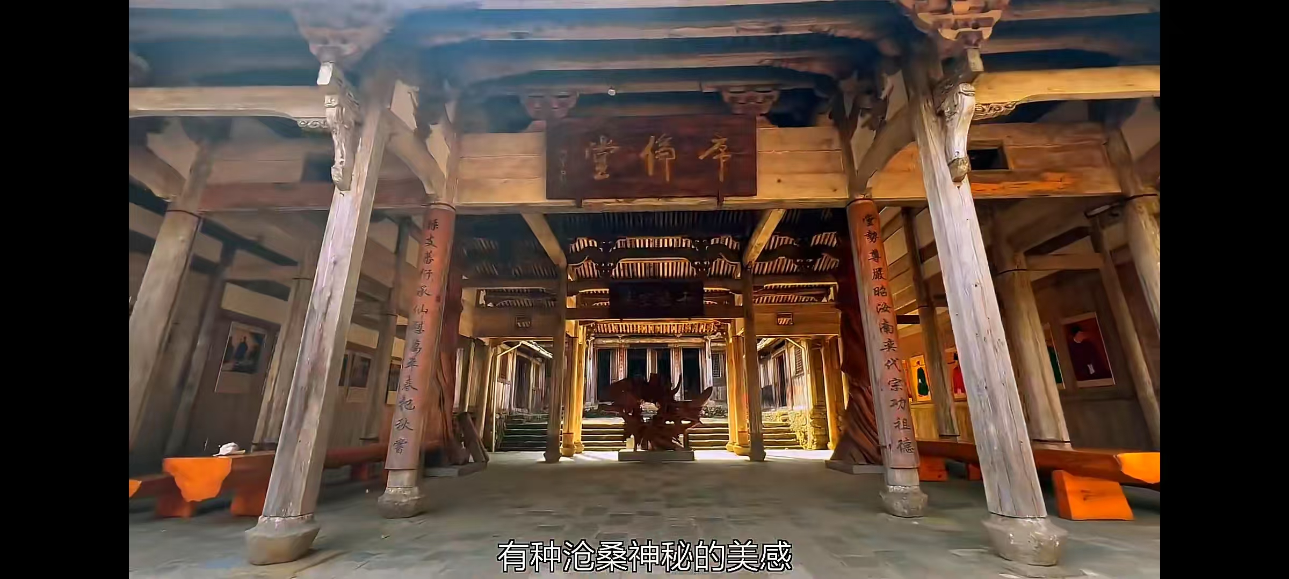

Slide 13
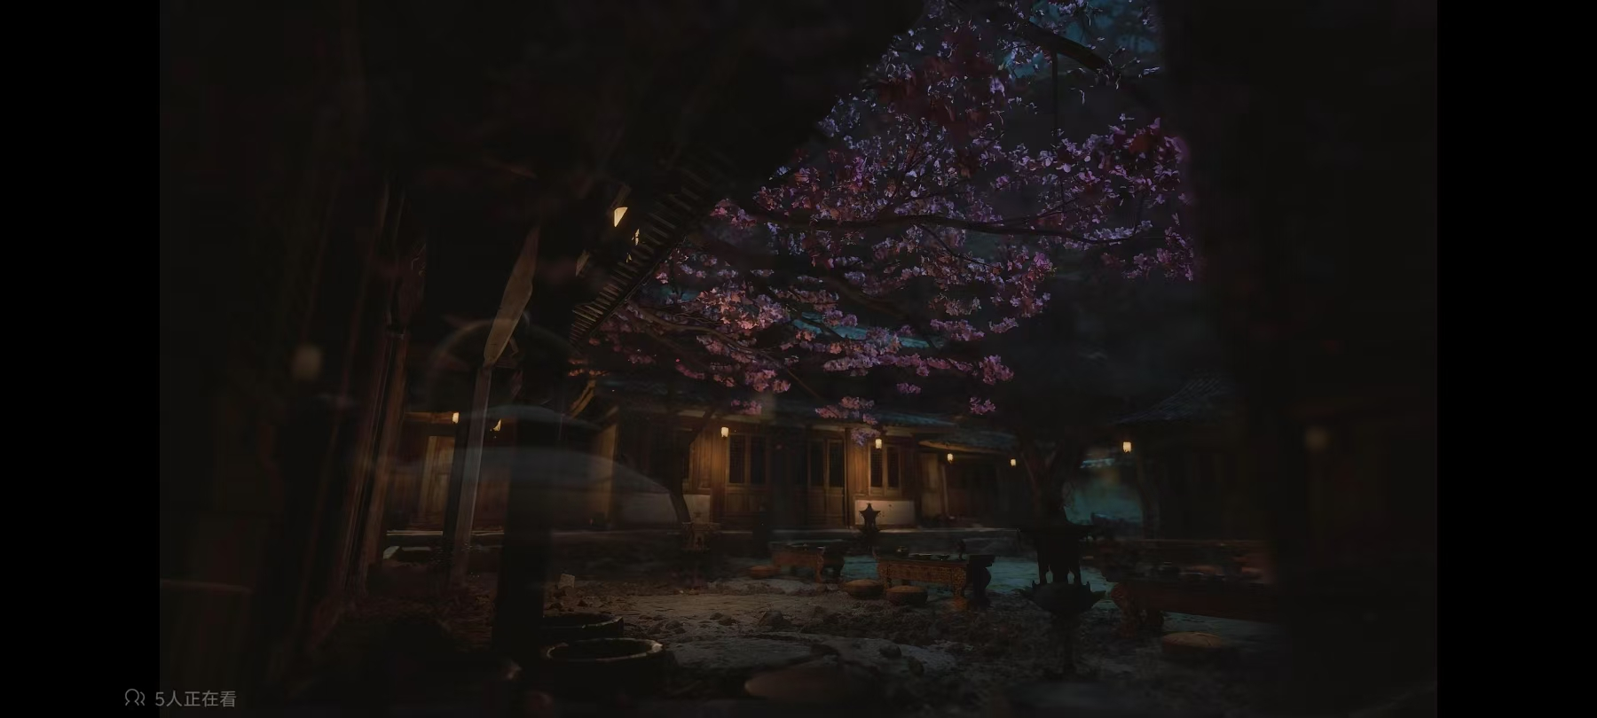
Shisi Temple（时思寺）
Located in Jingning She Autonomous County, Zhejiang Province, Shisi Temple is a thousand-year-old Buddhist monastery .
The aesthetic value of Shisi Temple lies in its physical embodiment of the Chinese cultural pursuit of "finding truth in simplicity."
Built into the mountainside, It integrates seamlessly with its surroundings, creating a poetic scene of "an ancient temple hidden in deep woods." This reflects the Daoist philosophy of "following the natural way."

Slide 14
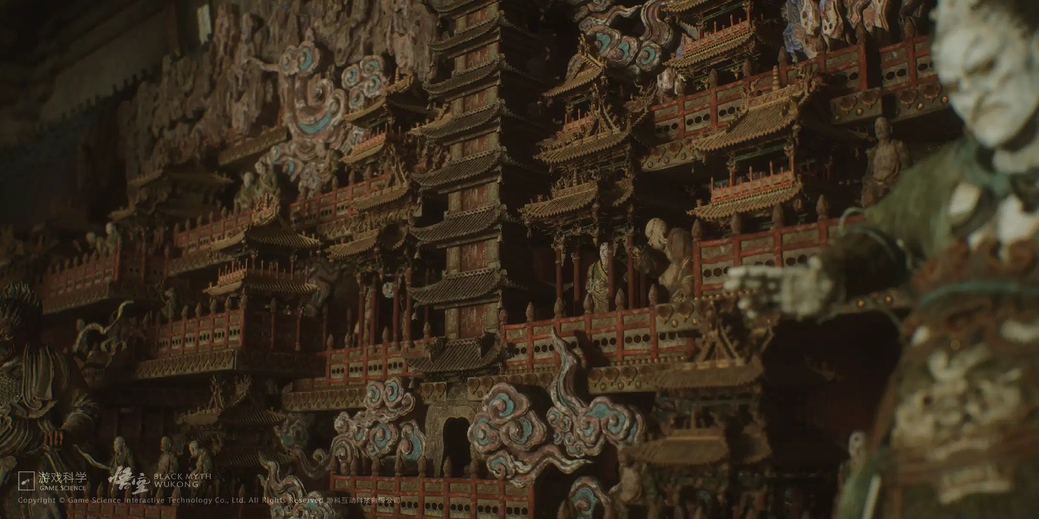

Slide 15
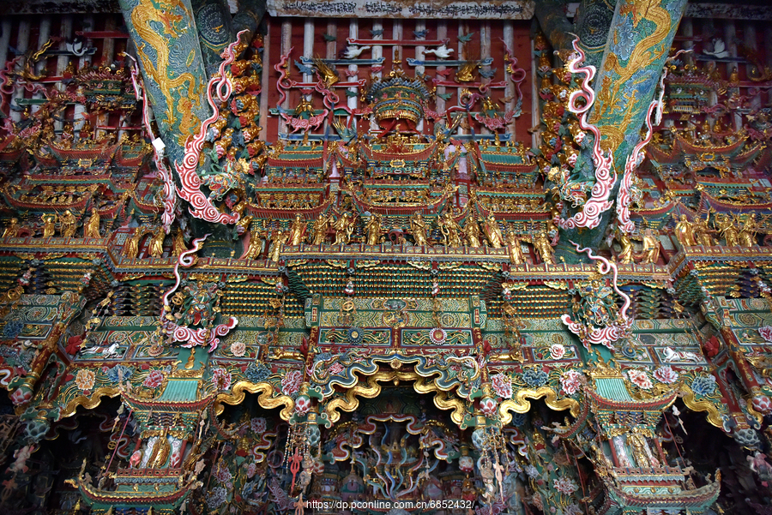
小西天
"Little Western Heaven, also known as the Thousand Buddha Temple, is located in Xi County, Shanxi Province, built in the second year of the Ming Chongzhen era (1629).
Its Mahavira Hall is adorned with thousands of exquisitely painted suspended sculptures, regarded as a masterpiece of Ming Dynasty Buddhist art."

Slide 16
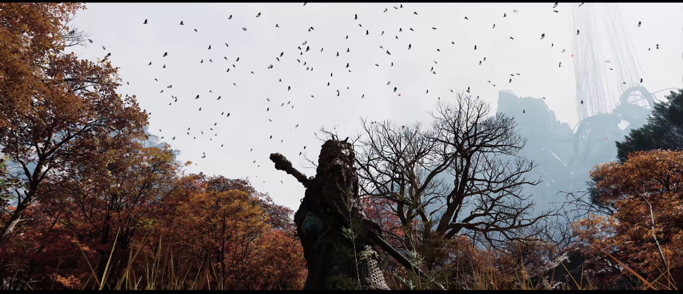
Poetic
scenery
日暮秋风起，萧萧枫树林。
鹧鸪啼别处，相对泪沾襟

Slide 17
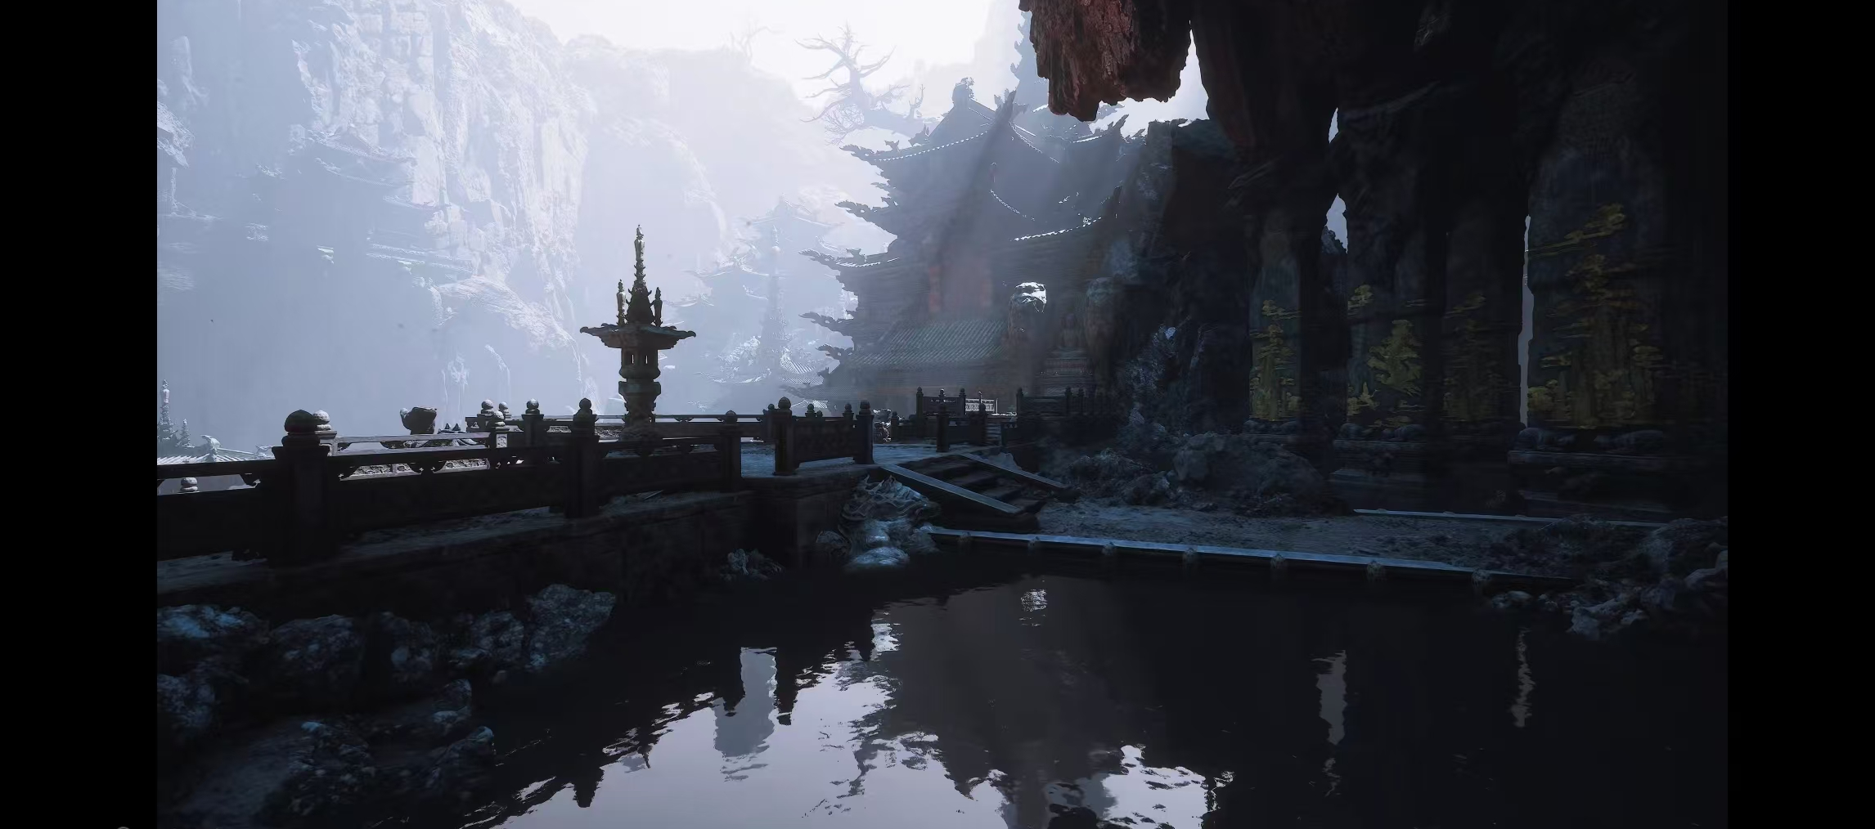

Slide 18
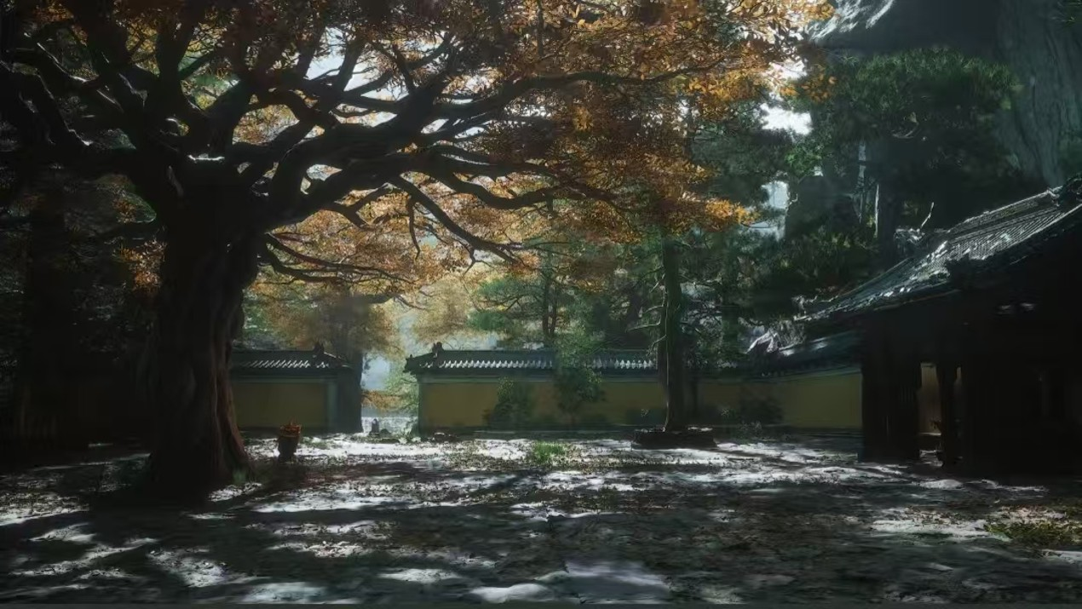

Slide 19
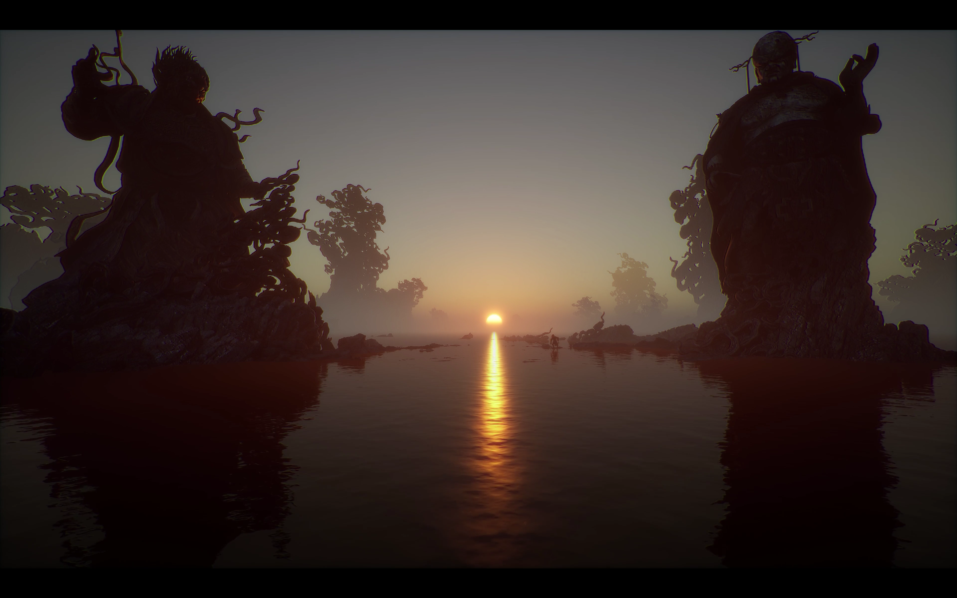

Slide 20
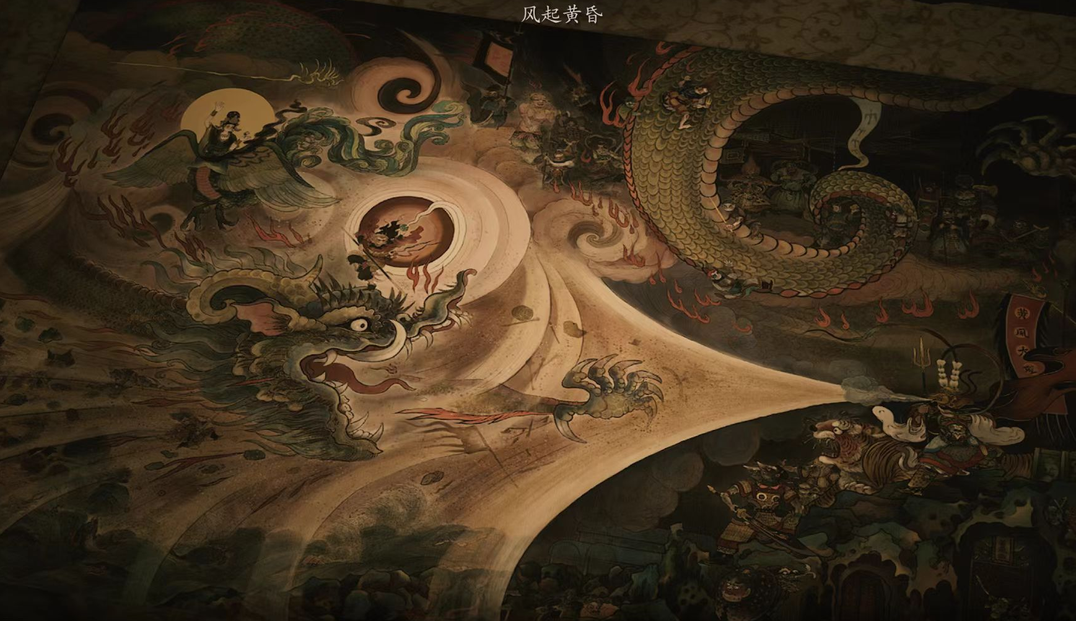
三
Combat Aesthetics

Slide 21
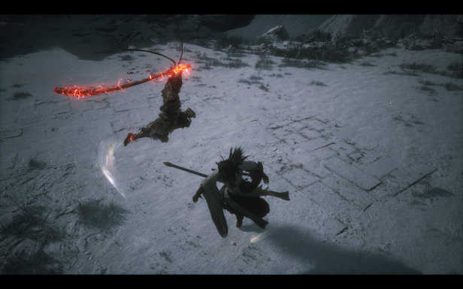
“Unity of Form and Spirit” in Action Design
Martial Arts Foundation Meets Mythological Exaggeration: Wukong’s stick techniques are rooted in traditional Chinese martial arts (e.g., ‘Liuhe Gun’or Six Harmonies Stick technique), featuring smash stance ,

Slide 22
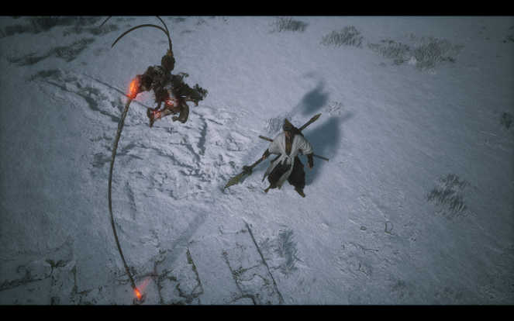
“Unity of Form and Spirit” in Action Design
Martial Arts Foundation Meets Mythological Exaggeration: Wukong’s stick techniques are rooted in traditional Chinese martial arts (e.g., ‘Liuhe Gun’or Six Harmonies Stick technique), featuring smash stance , pillar stance

Slide 23
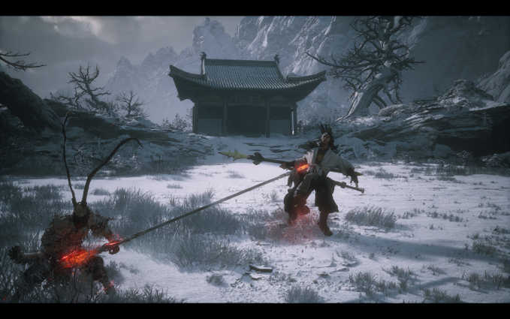
“Unity of Form and Spirit” in Action Design
Martial Arts Foundation Meets Mythological Exaggeration: Wukong’s stick techniques are rooted in traditional Chinese martial arts (e.g., ‘Liuhe Gun’or Six Harmonies Stick technique), featuring smash stance , pillar stance, and thrust stance.

Slide 24
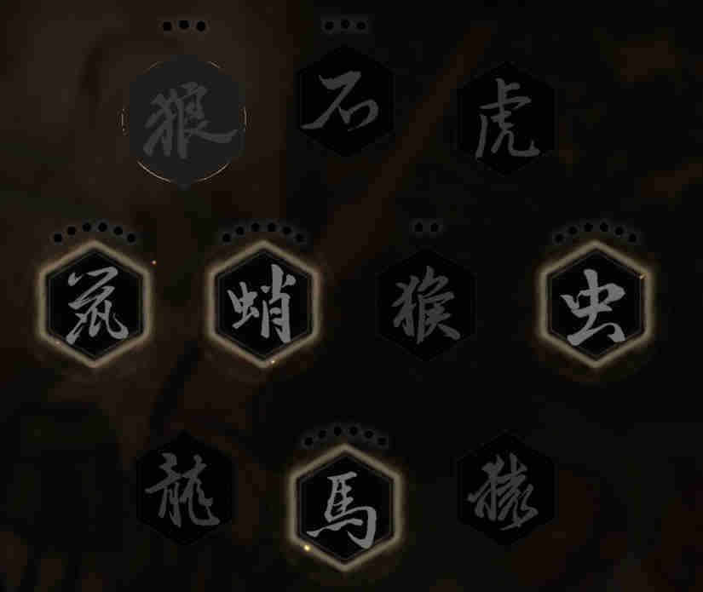
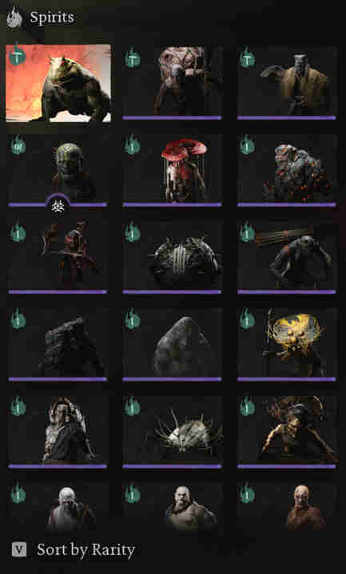
“Unity of Form and Spirit” in Action Design
Meanwhile, Black Myth also faithfully recreates Sun Wukong’s 72 transformations as described in the classic novel. Such as immobilize(定身术), cloud step(聚形散气), a pluck of many（分身） and different spirits to transform，creating a balance between "realism and surrealism".

Slide 25
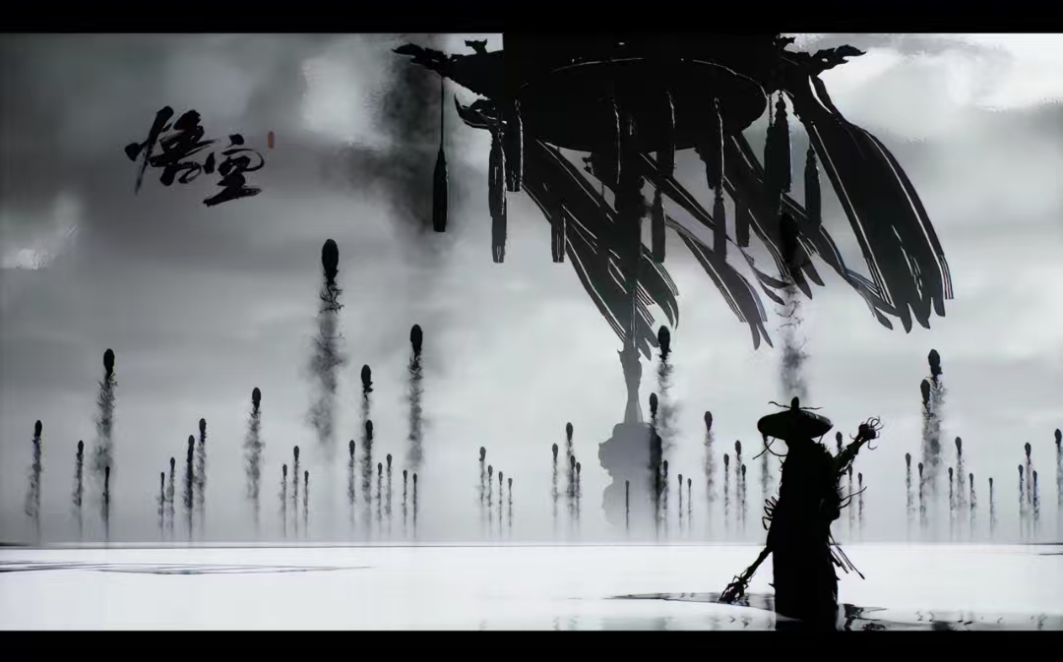

The Aesthetics of the Yin-Yang Fish
阴阳鱼美学

Slide 26
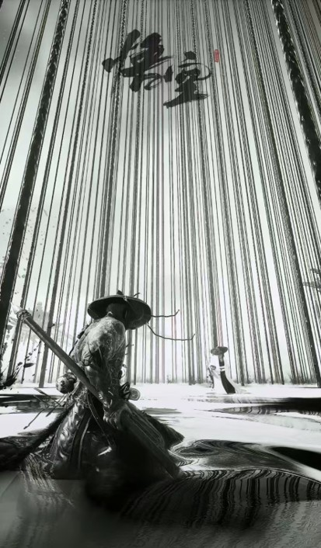
This is, in my opinion, the boss battle scene with the most immersive atmosphere and artistic expression in the entire game. The player stands in this Yin-Yang pool（阴阳池）, as if standing in an inkstone. The water alternates between black and white—sometimes as the surface, sometimes as the base—and when the Yin-Yang fish appears, it transforms into a Taiji symbol: white representing Yang, black representing Yin. Every movement the character makes stirs the water, creating a mesmerizing visual effect where black and white intertwine, Yin and Yang merge, and the colors bleed into each other.
During combat, it feels as though the player embodies a brush, with every gesture resembling the sweeping strokes of calligraphy, continuously painting one breathtaking Chinese ink-wash painting after another. Paired with the gripping battle music, played on the pipa（琵琶）, I was left utterly stunned, my heart filled with awe. The Taiji symbol and Chinese ink-wash painting are each masterpieces of artistic conception on their own, but the way they are so ingeniously fused together here is nothing short of brilliance.

Slide 27
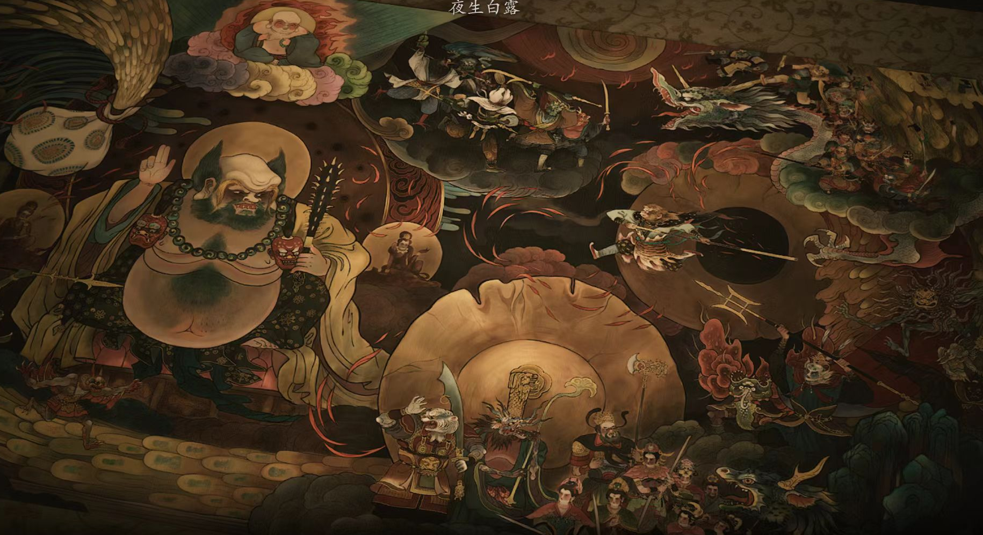
四
Detail-oriented Aesthetics

Slide 28
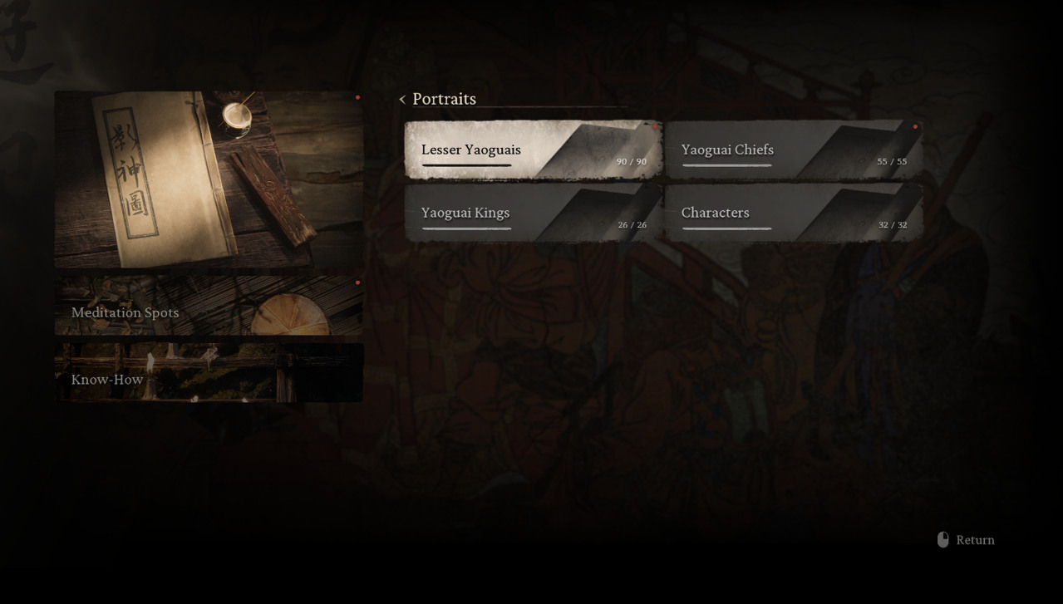
Fragmented narrative

Slide 29
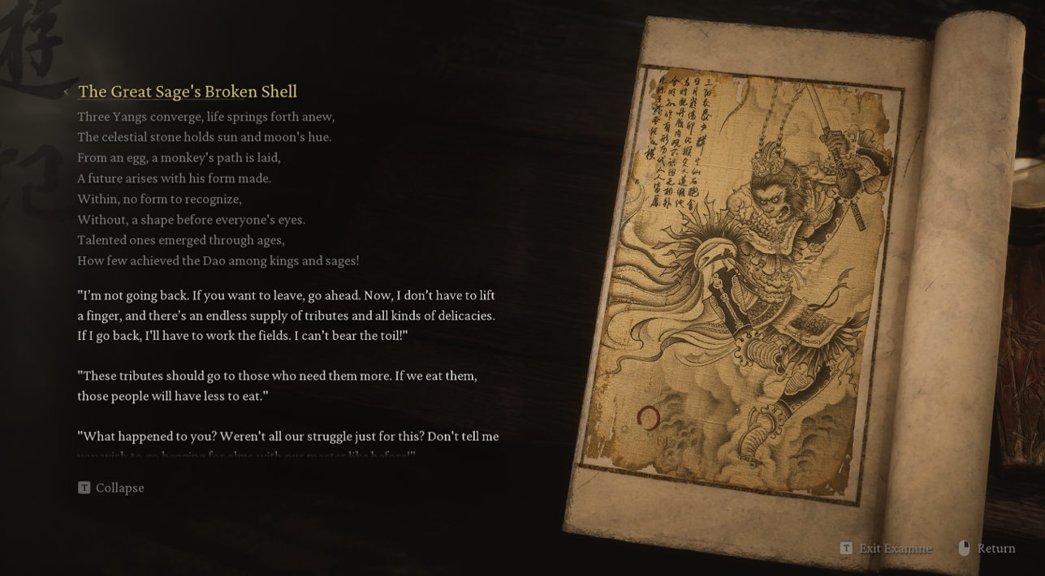
Fragmented narrative

Slide 30
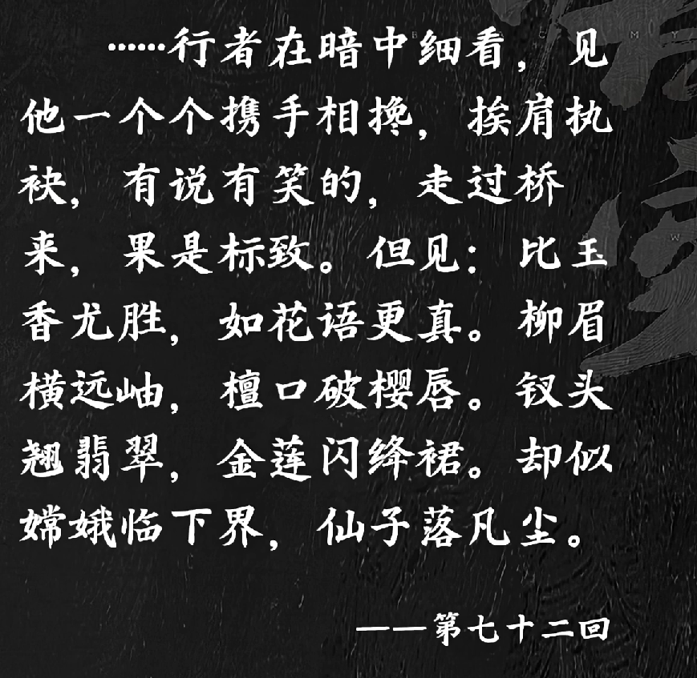
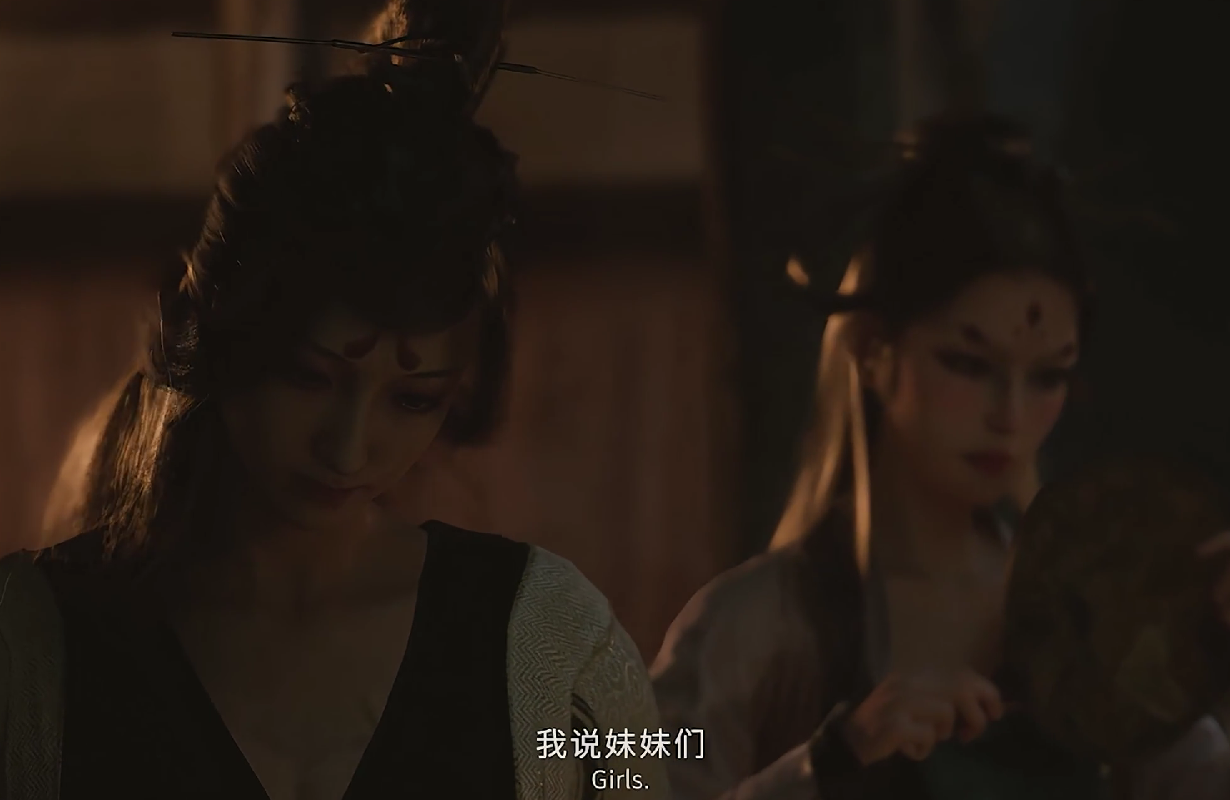
Faithfulness to the original

Slide 31
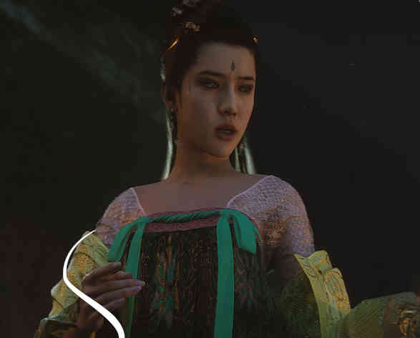
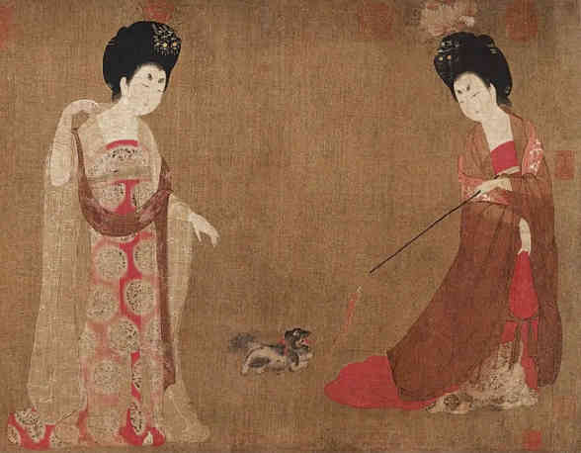
Faithfulness to the costume
Tang Dynasty women's clothing

Slide 32
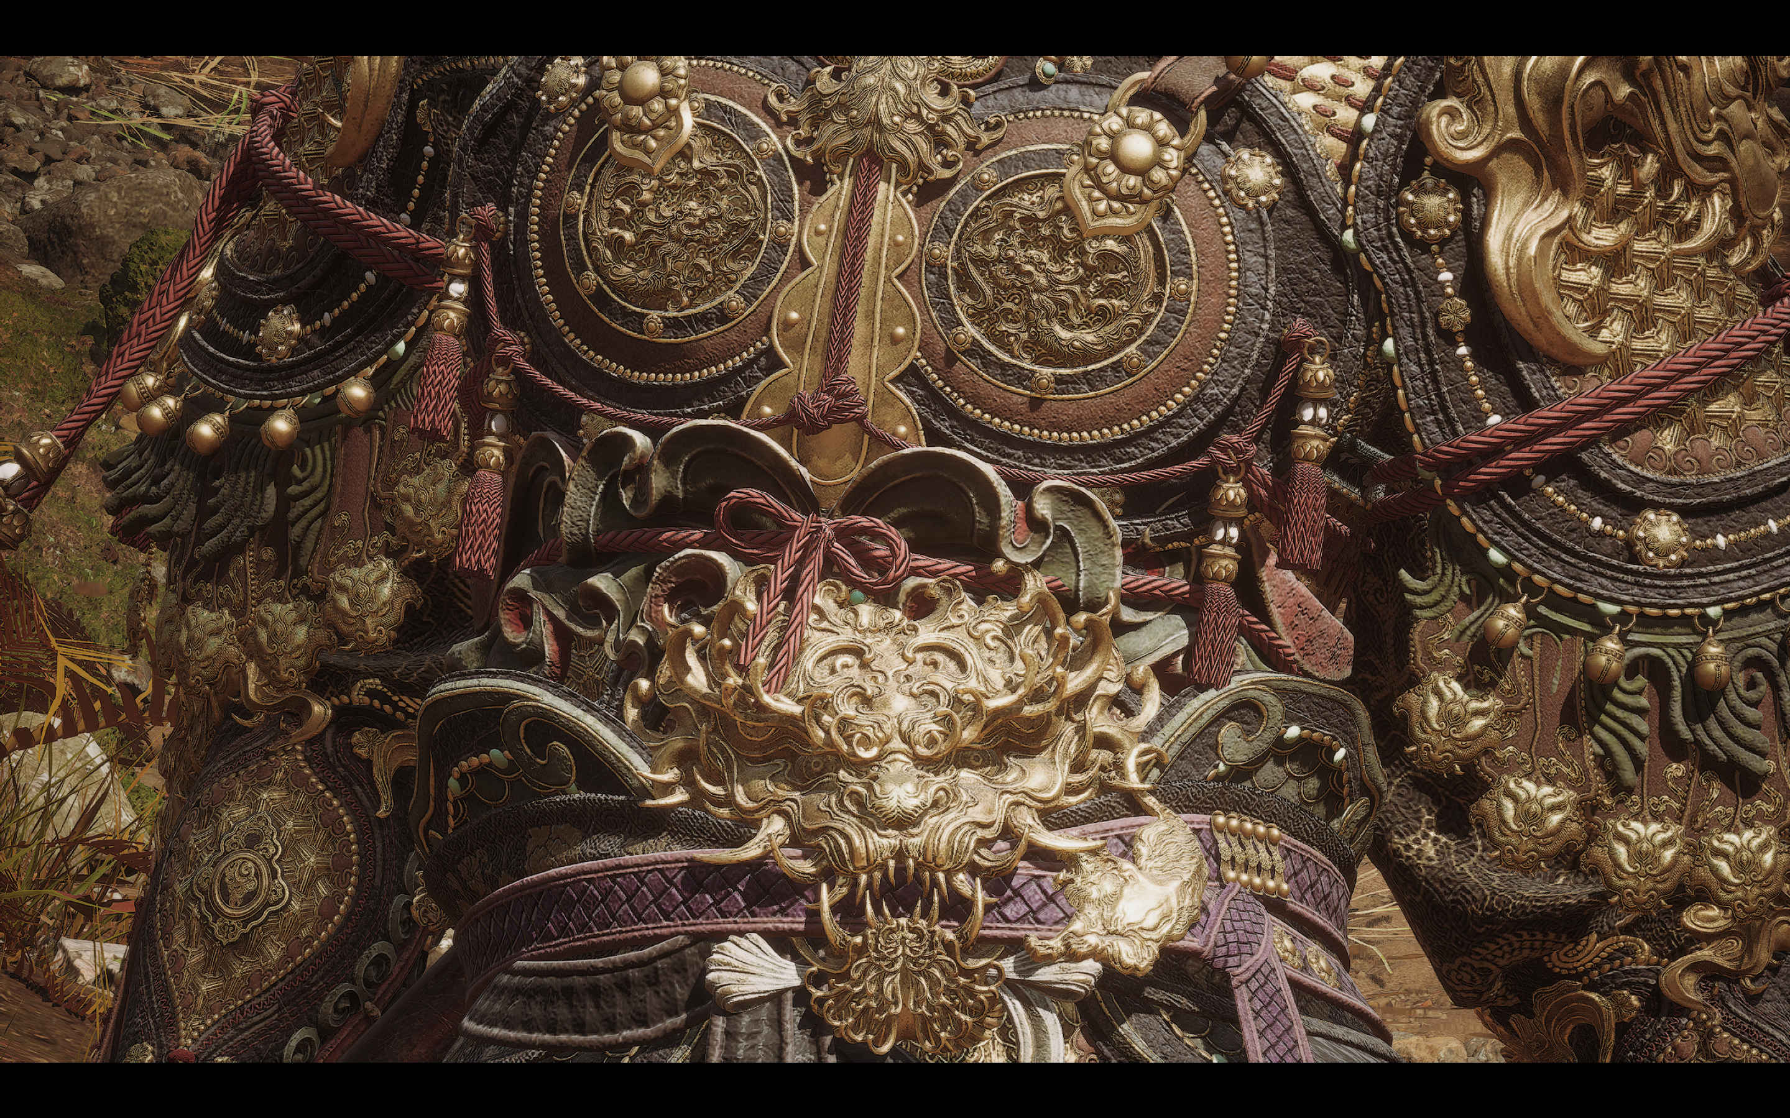

Slide 33
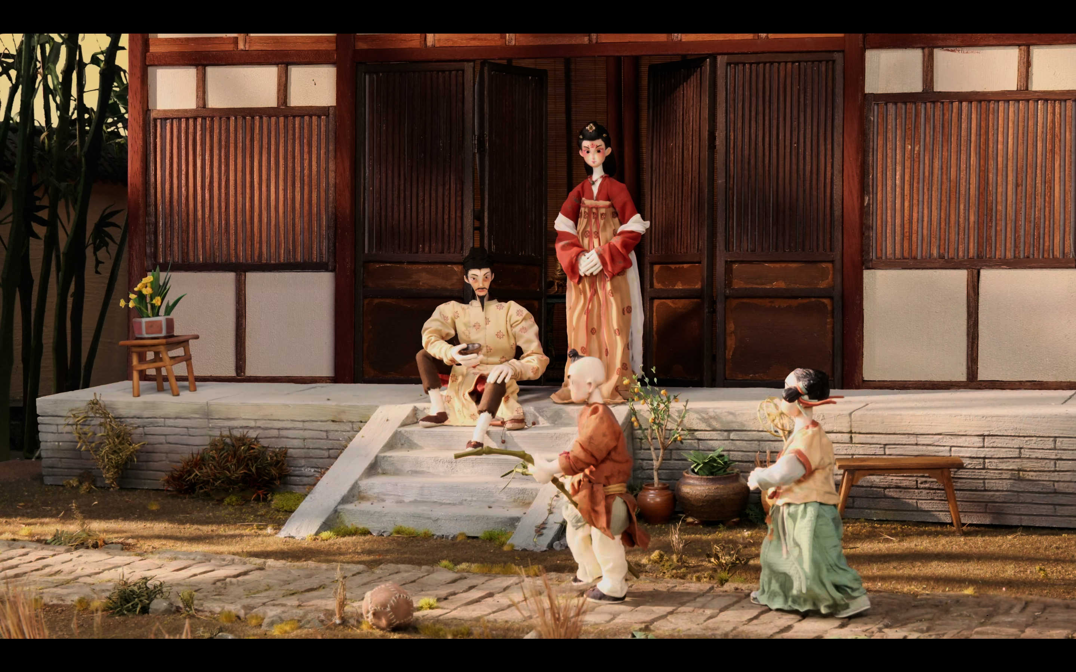
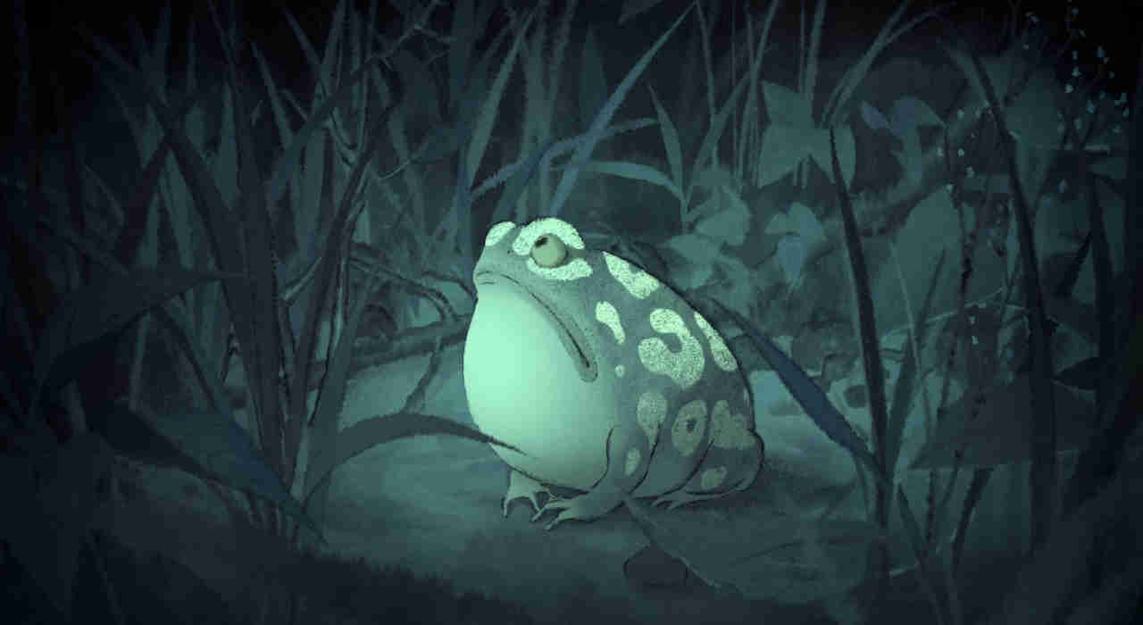
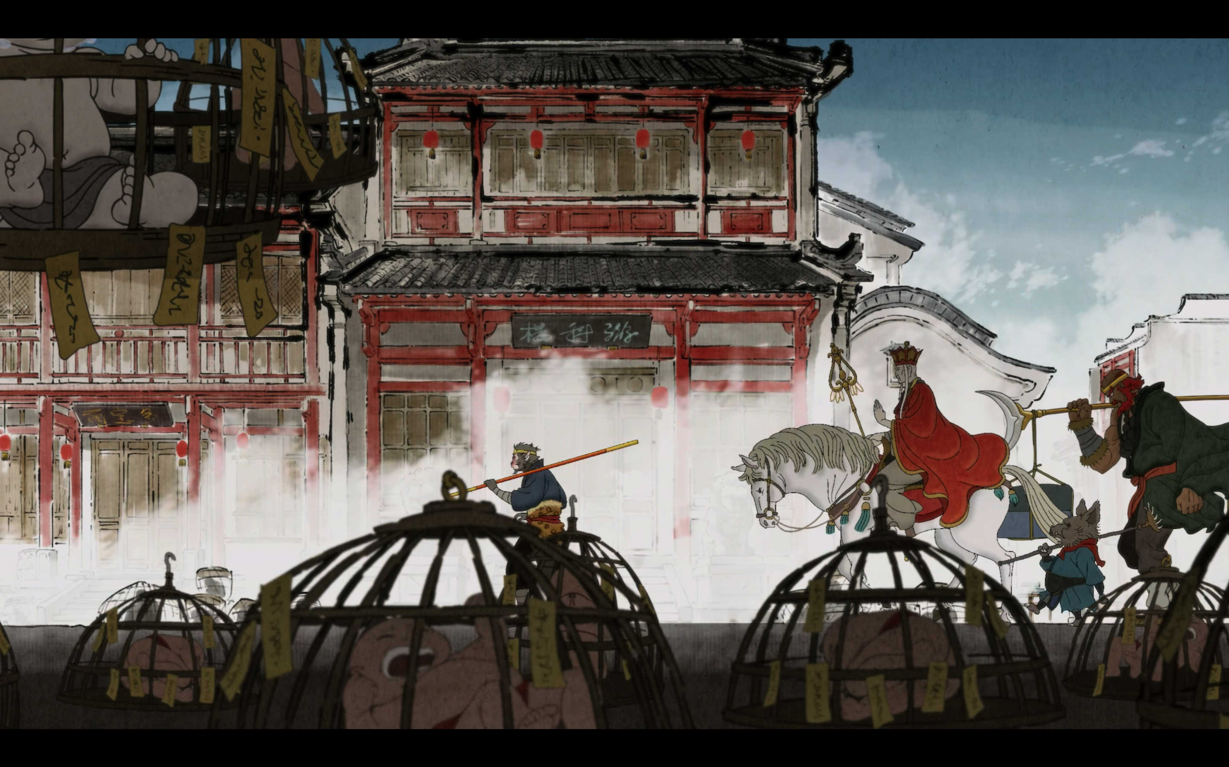
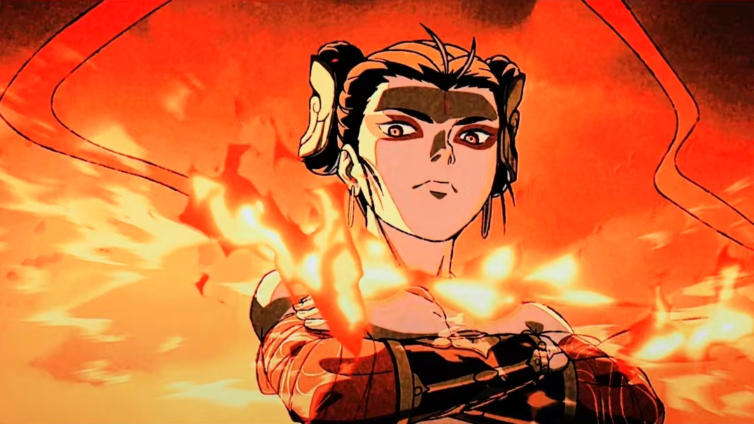
Exquisite Music Video

Slide 34
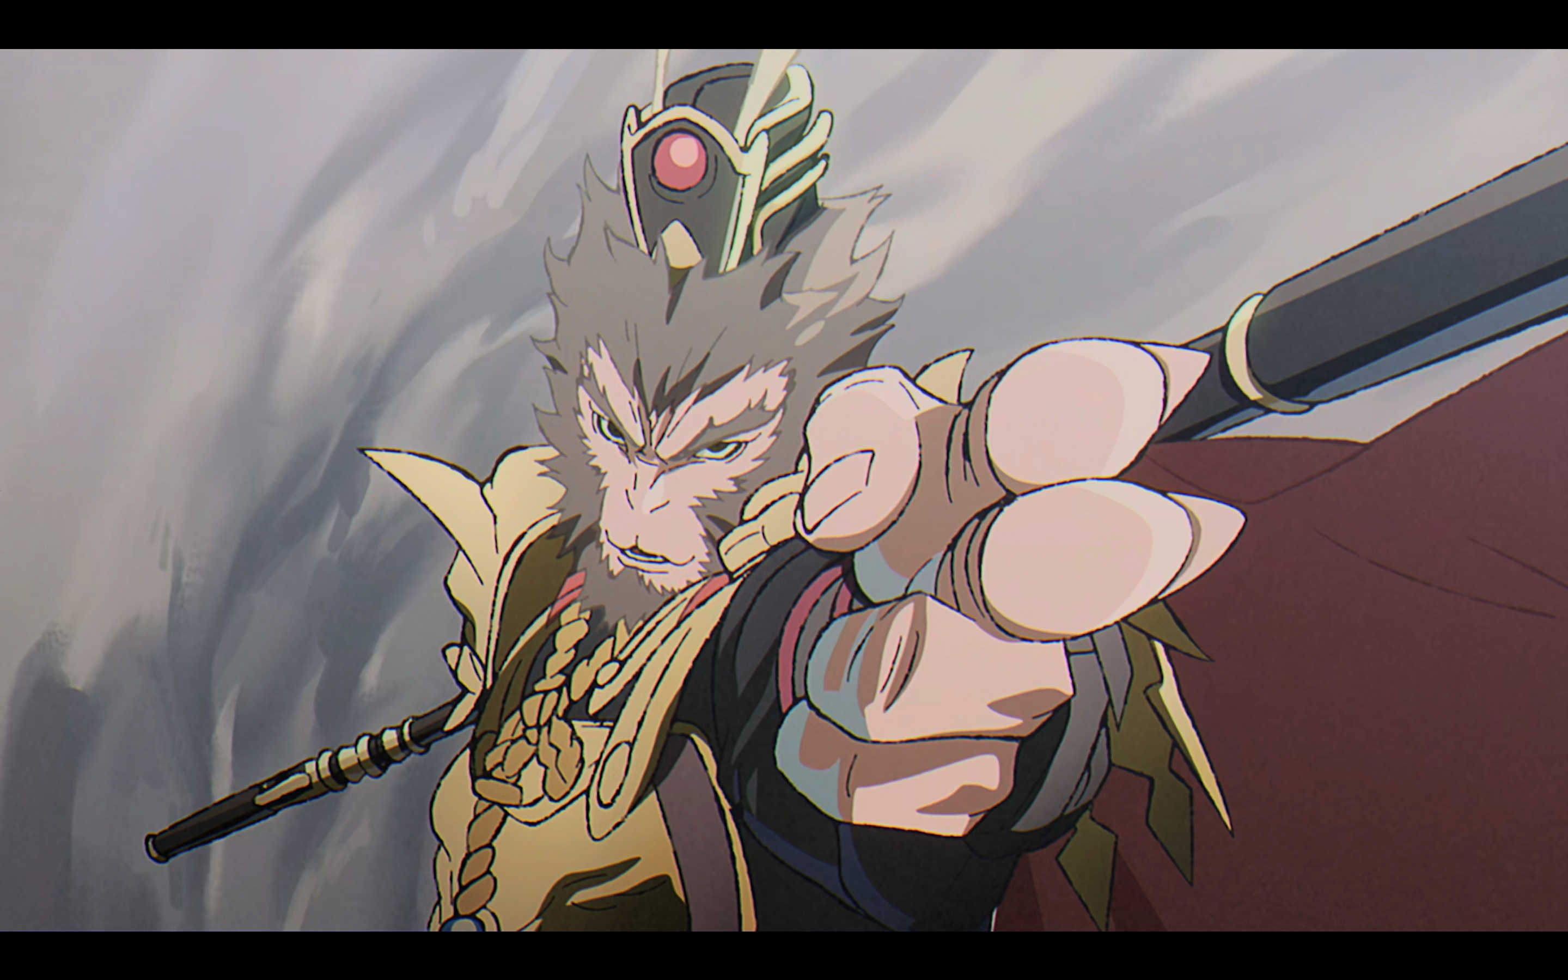

Slide 35
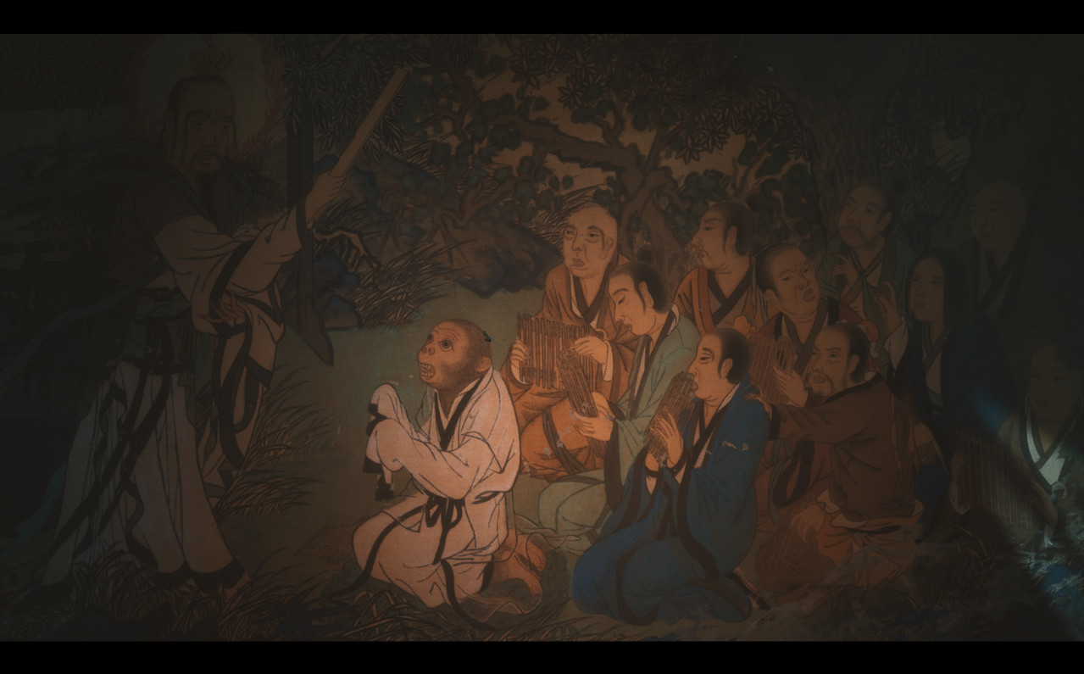
Thank you

