Slide 1

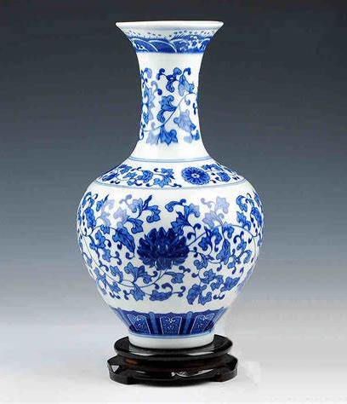

Jingdezhen Porcelain
景德镇瓷器
Xiao Luyu 肖璐雨
2025.04

Slide 2
01.
Introduction to Jingdezhen Porcelain
目录
02.
The History of Jingdezhen Porcelain
Catalogue
The production process of Jingdezhen porcelain
03.
04.
Artistic Features and Types of Jingdezhen Porcelain

Slide 3
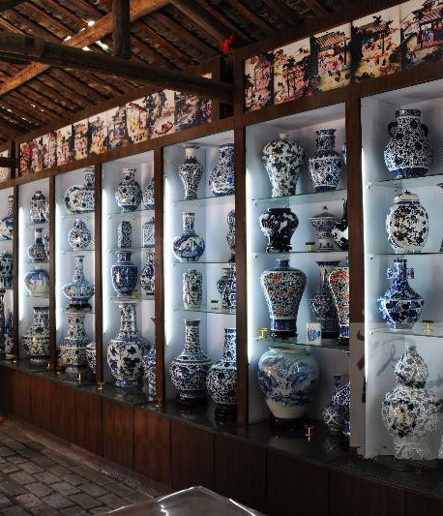

01
Introduction to Jingdezhen Porcelain

Slide 4
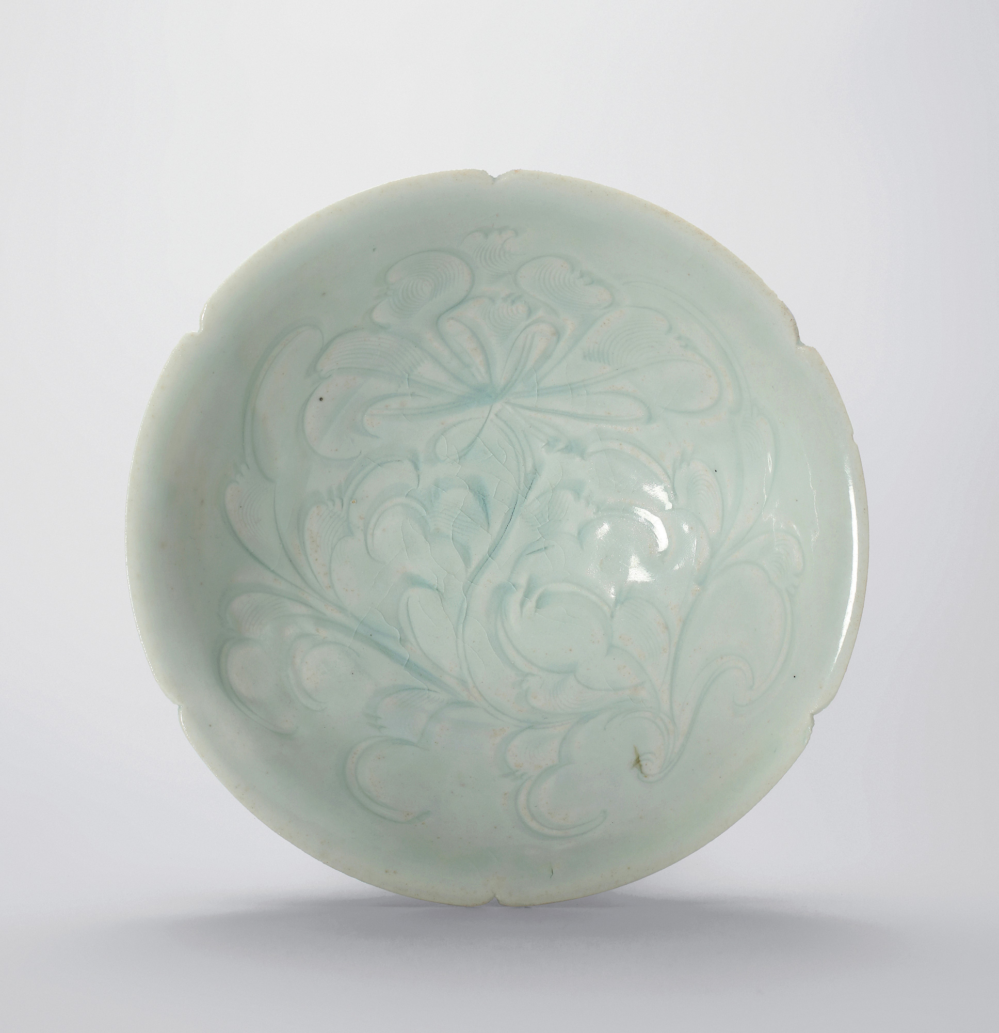
Definition and Overview
Jingdezhen porcelain refers to the exquisite ceramic products made in Jingdezhen, Jiangxi Province. It is renowned for its fine texture, beautiful glaze, and unique artistic style. 景德镇瓷器指的是中国江西省景德镇市生产的精美陶瓷产品。它以其细腻的质地、美丽的釉色和独特的艺术风格而闻名。
Jingdezhen is often called the "Porcelain Capital" of China. Its porcelain has been a symbol of Chinese culture and craftsmanship for centuries. 景德镇常被誉为中国的“瓷都”。几个世纪以来，景德镇瓷器一直是中国文化和工艺的象征。
Today, Jingdezhen porcelain continues to be highly valued for both its artistic and functional qualities. It is used in everything from fine dining to decorative art. 如今，景德镇瓷器因其艺术性和功能性而继续受到高度重视。它被广泛应用于从精致餐饮到装饰艺术的各个领域。

Slide 5
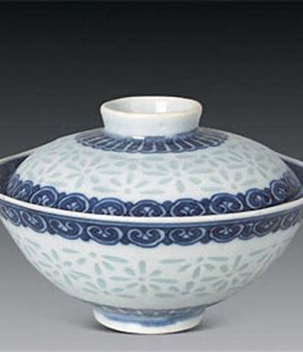
02
The History of Jingdezhen Porcelain

Slide 6
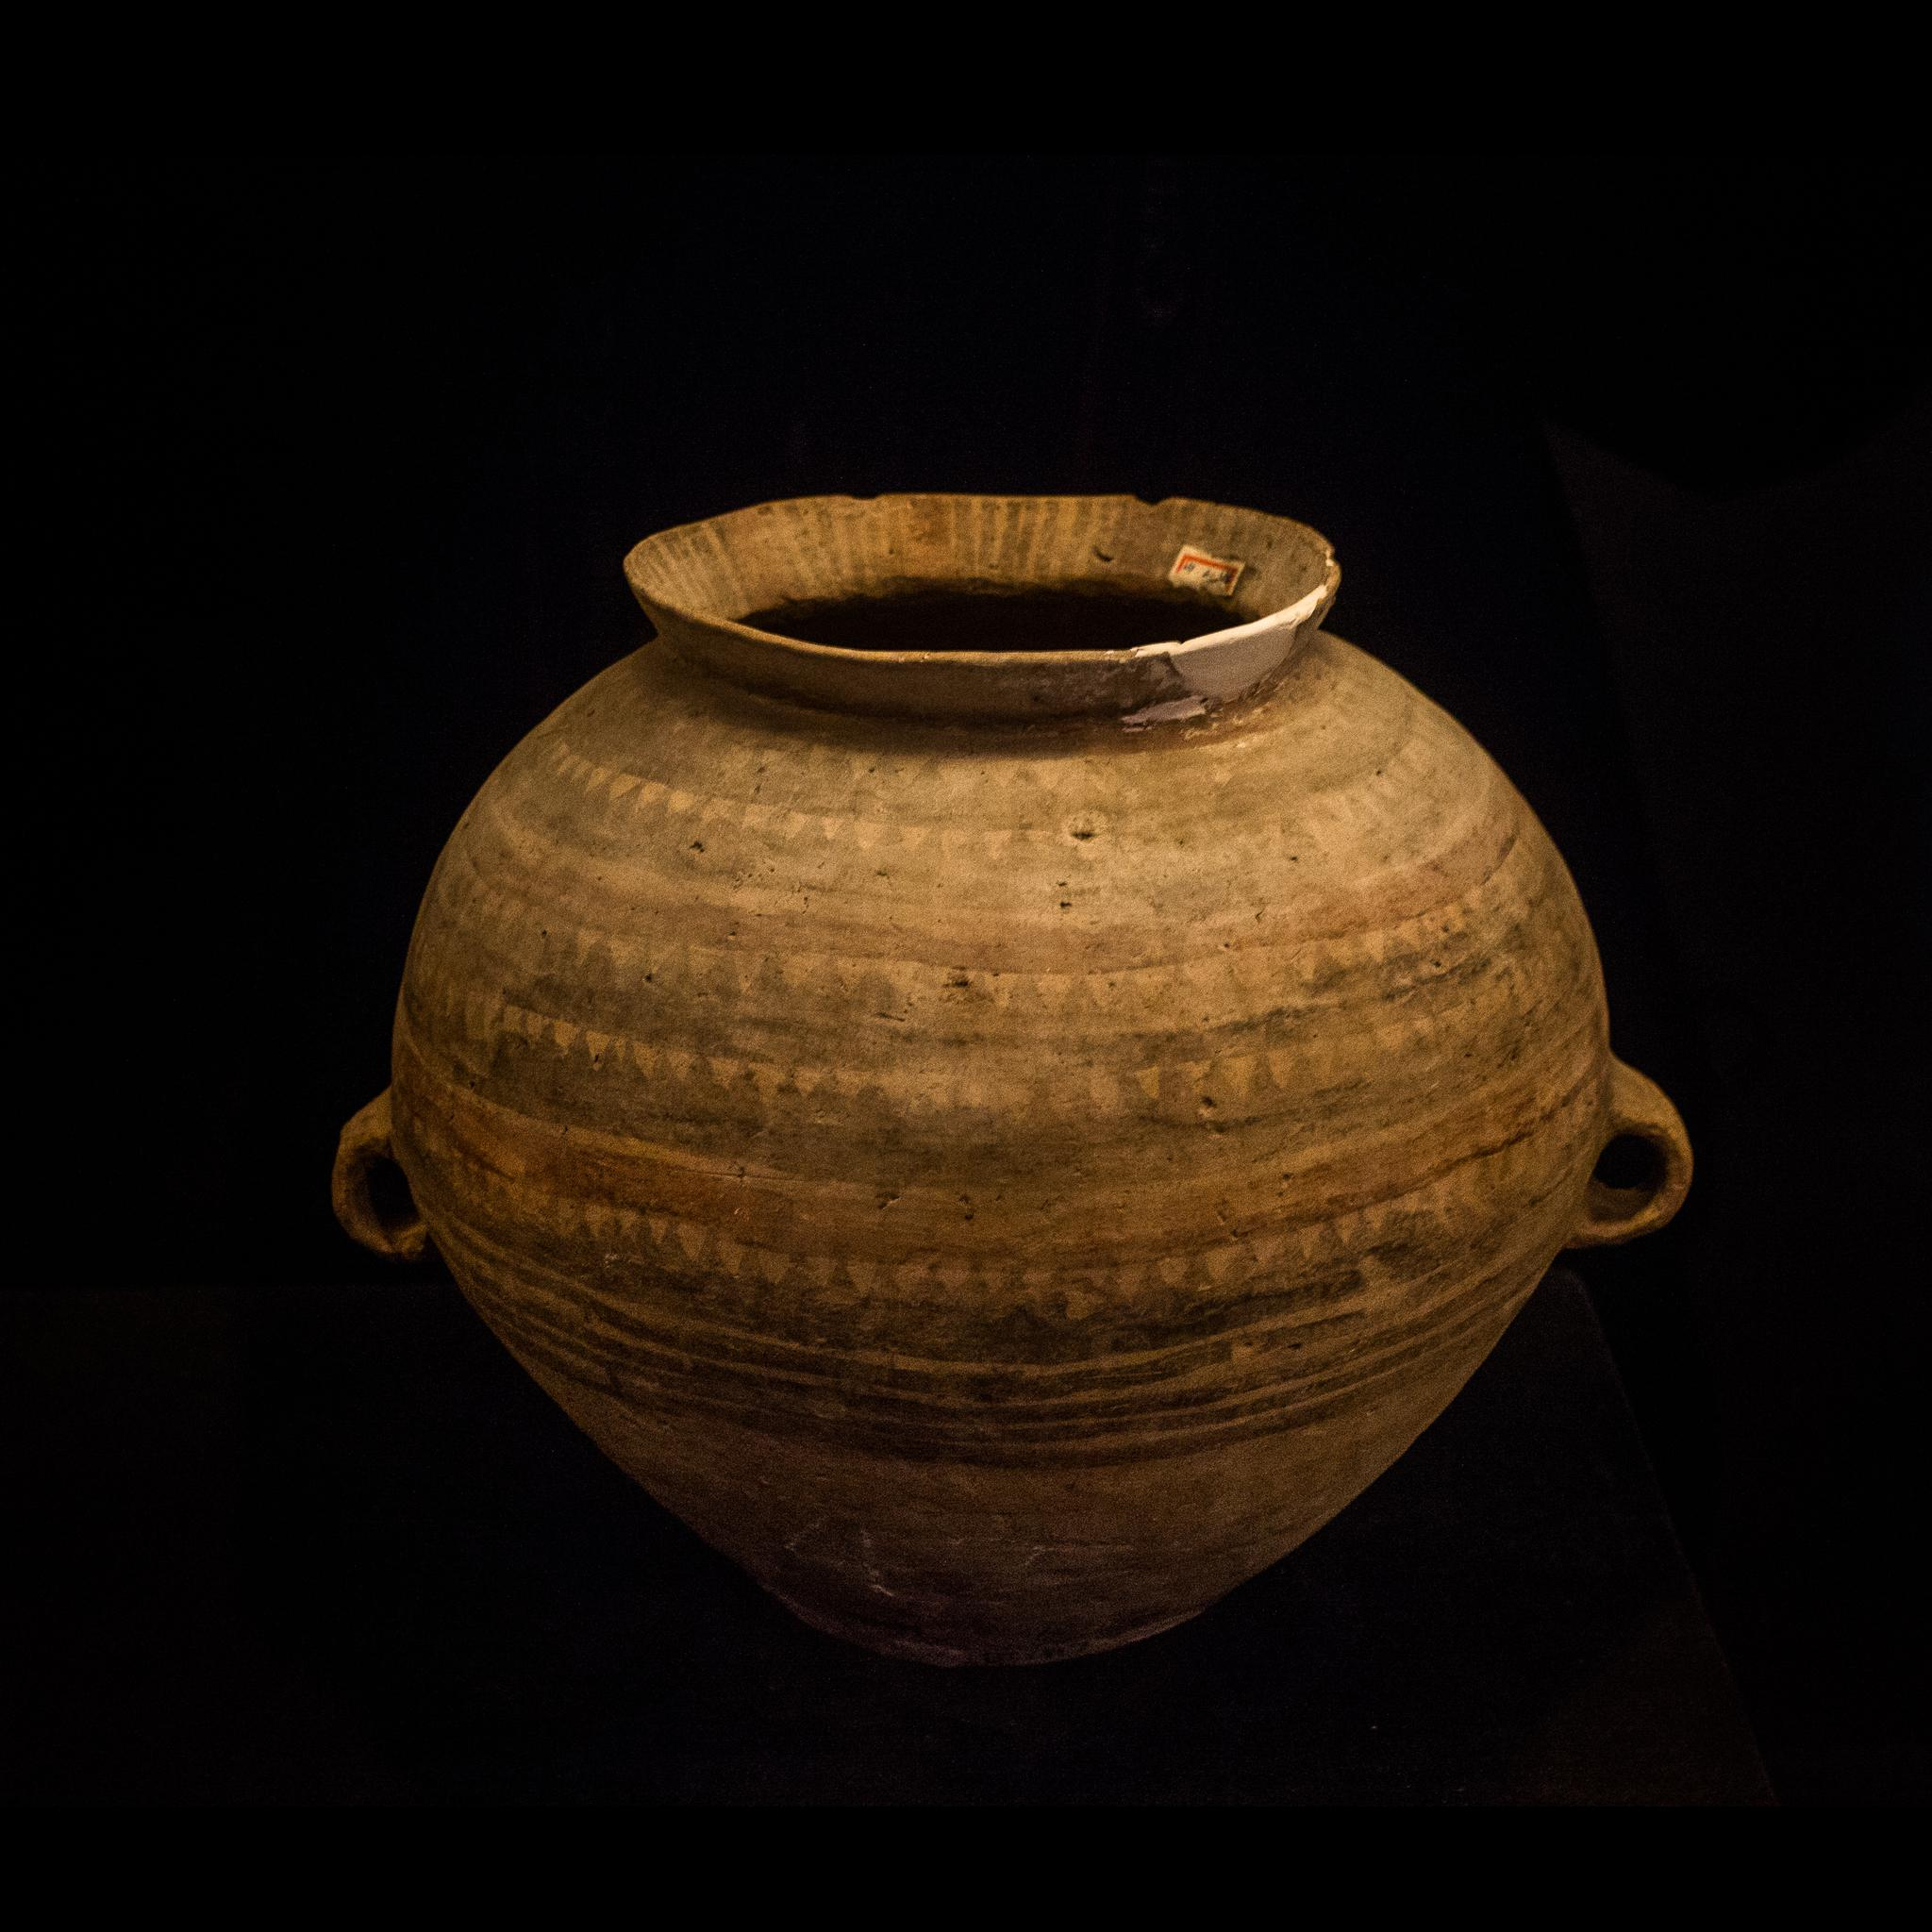
Ancient Origins 景德镇瓷器的历史
Early Kilns and Techniques
早期的窑炉和技术
The history of Jingdezhen porcelain dates back to the Han Dynasty.
Pottery
Simple and practical

Slide 7
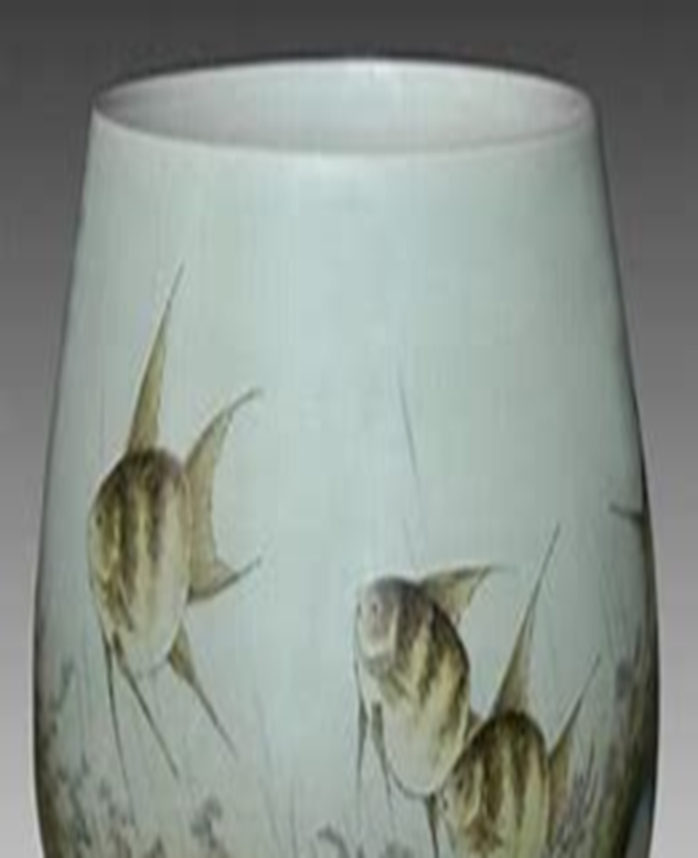
Ancient Origins 景德镇瓷器的历史
Imperial Patronage
皇家赞助
During the Song Dynasty, Jingdezhen became an official imperial kiln site.
Significant advancements in porcelain- making techniques and quality.

Slide 8
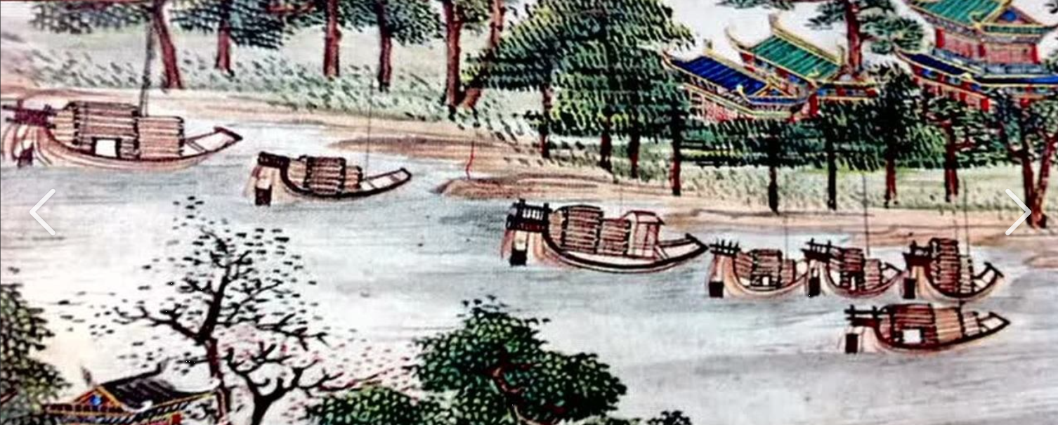
Ancient Origins 景德镇瓷器的历史
Global trade
全球贸易
By the Ming and Qing Dynasties, Jingdezhen porcelain was exported worldwide.
a highly sought-after commodity along the Silk Road and in European markets.

Slide 9
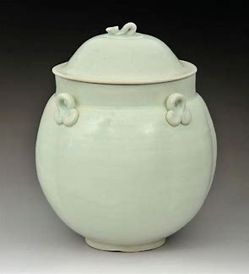
03
The production process of Jingdezhen porcelain

Slide 10
Material Selection and Refinement
原料选择与精炼
1
Kneading the Clay
揉泥
2
Throwing
拉坯
3

Slide 11
Solutions 对策:
Drying
干燥
4
Glazing
上釉
5
Firing
烧制
6

Slide 12
Solutions 对策:
Inspection
检查
7
Decoration
装饰
8
Final Firing (If Required)
最终烧制（如有需要）
9

Slide 13
04
Artistic Features and Types of Jingdezhen Porcelain

Slide 14
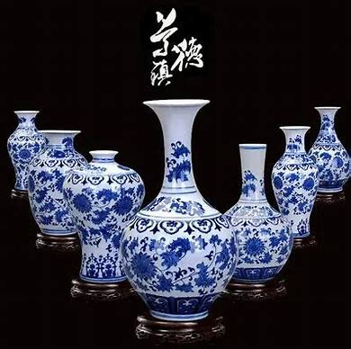
Types of Jingdezhen Porcelain 景德镇瓷器的类型
Blue and White Porcelain 青花瓷
This is the most famous type, characterized by its white body and blue decorations. It has been produced continuously since the Yuan Dynasty. 这是最著名的类型，以其白色的胎体和蓝色的装饰为特征。自元代以来一直持续生产

Slide 15
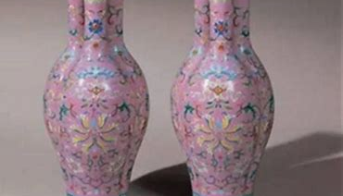
Colored Porcelain
彩瓷 Colored porcelain
Colored porcelain includes pink and green and so on. These types feature vibrant colors and intricate multicolored designs. 彩瓷包括粉瓷和绿瓷等。这些类型以鲜艳的色彩和复杂的多色设计为特点。

Slide 16
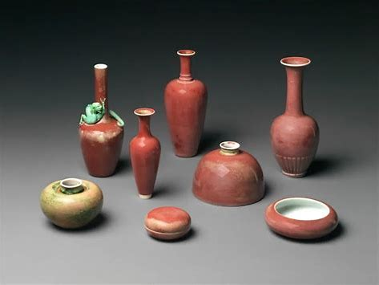
Underglaze Red
釉下红 Underglaze red porcelain
Underglaze red porcelain is known for its rich red color and delicate patterns. It is highly valued for its rarity and beauty. 釉下红瓷器以其丰富的红色和精致的图案而闻名。它因其稀有性和美丽而备受珍视。

Slide 17
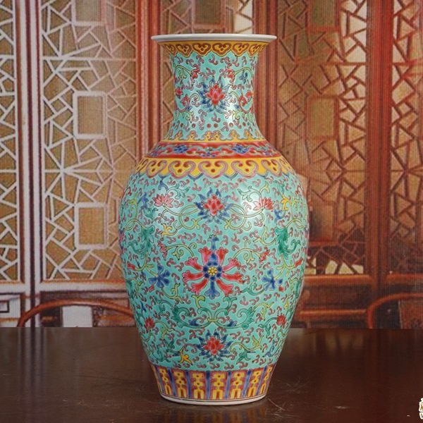
Artistic Characteristics 艺术特征
Intricate Designs 精巧的设计
These often include floral patterns, mythical creatures, and traditional Chinese motifs. 设计常常包括花卉图案、神话生物和中国传统纹样。

Slide 18
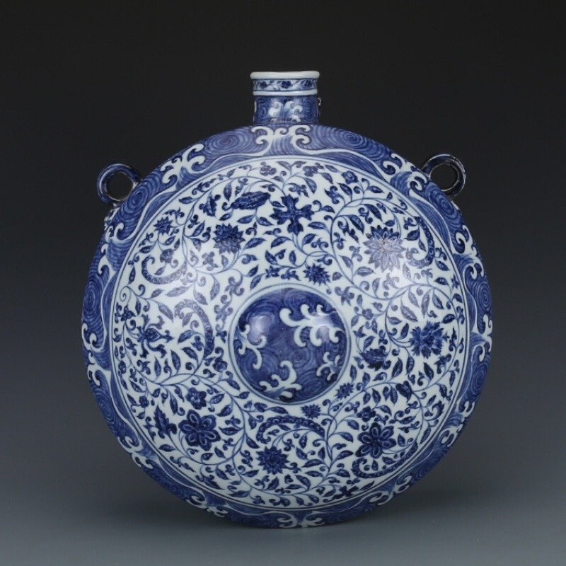
Glaze and color
Glaze 釉色和色彩
A wide range of colors and finishes. Traditional colors like cobalt blue and pink rose are particularly iconic. 拥有广泛的颜色和光泽。传统的钴蓝和粉彩等颜色尤为经典。

Slide 19
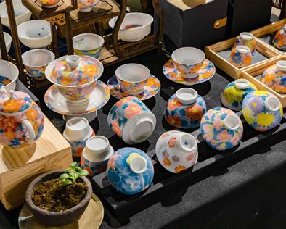
Shapes and Forms
形状和形态
From elegant vases to practical tea sets, each piece is carefully crafted. 从优雅的花瓶到实用的茶具，每一件作品都是精心制作的。

Slide 20
Thanks

