Slide 1

经典化
canonization
汇报人：刘珍 Liu Zhen

Slide 2





一
二
三
四
经典作品在当下the Classics in the Present
目录Contents
何为文化经典What are cultural classics?
影响因素Relative Factors
面临的困难Difficulties

Slide 3



什么是文化经典？
What are cultural classics?
第
一
章

Slide 4

什么是“经典”？ What are cultural classics?
“经典”一词最早源于拉丁语“classicus”，意思是“极好的”或“一流的”，与中国古代的“经书典籍”同义 ；
The word “classic” originated from the Latin “classicus”, meaning “excellent” or “first-class”, which was synonymous with the ancient Chinese “classics”.

Slide 5
而所谓的“文学经典”，则是指“公认的、堪称楷模的优秀文学和艺术作品，对本国和世界文化具有永恒的价值。”
"Literary classics", on the other hand, are "universally recognized and exemplary works of literary and artistic excellence of lasting value to national and global cultures".

Slide 6

文学经典的形成，是一个漫长而复杂的历史过程
The formation of literary classics is a long and complicated historical process
经过反复不断地被阅读、被解释、被评价，然后其价值才能逐渐被认定，也才能最终成为后人心目中的‘经典’。
After repeated reading, interpretation and evaluation, its value can be gradually identified, and finally become a 'classic' in the mind of later generations.

Slide 7
具有丰厚的人生意蕴和永恒的艺术价值，为一代又一代读者反复阅读、欣赏，体现民族审美风尚和美学精神，深具原创性的文学作品。
With rich life implication and eternal artistic value, it is read and appreciated repeatedly by generations of readers, reflecting the national aesthetic fashion and aesthetic spirit, and deeply original literary works.

Slide 8
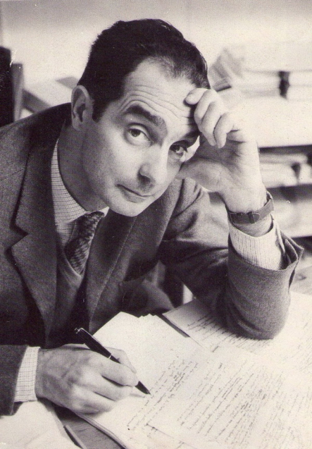



我们为什么要读经典？
Why do we read the classics?
1.文学经典是人认识自身和自身处境的最好方式。
Literary classics are the best way for a man to know himself and his situation.
2.阅读经典是族群自我认同的需要。
Reading classics is the need of ethnic self-identification.

Slide 9
3.阅读经典是文化自我更新的需要。
Reading classics is the need of self-renewal of culture.

Slide 10
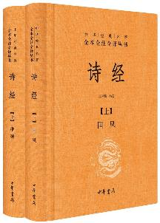

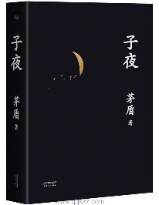

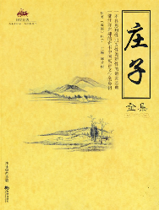

经典化作品代表Classical Works Representation

Slide 11
经典文学代表作Classical Works Representation
《诗经》《红楼梦》曹雪芹 著 《三国演义》罗贯中 《水浒传》施耐庵、罗贯中 著 《西游记》吴承恩 著 《喻世明言》 《警世通言》 《醒世恒言》冯梦龙 《拍案惊奇》凌濛初 《儒林外史》吴敬梓 著 张《聊斋志异》蒲松龄 《镜花缘》李汝珍 著 《封神演义》许仲琳 编 《官场现形记》李宝嘉 著 《二十年目睹之怪现状》吴趼人 著 《老残游记》刘鹗 著 《孽海花》曾朴著
《活着》 余华 著 《围城》 钱钟书 著 《边城》 沈从文 著 《四世同堂》 老舍 著
《呼兰河传》 萧红 著 《丰乳肥臀》 莫言 著 《黄金时代》 王小波 著

Slide 12
文学经典建构的因素Factors in the Construction of Literary Classics
第
二
章

Slide 13

文学经典建构的因素是多种多样的，起码要有如下几个要素 ：
There are various factors in the construction of literary classics, including at least the following elements
（一）文学作品的艺术价值
the artistic value of a literary work
（二）文学作品的可阐释的空间
the interpretable space of a literary work

Slide 14
（三）意识形态和文化权力变动
ideological and cultural power shifts
（四）文学理论和批评的价值取向
the value orientation of literary theory and criticism
（五）特定时期读者的期待视野
the horizon of expectations of readers at a given time
（六）发现人（又可称为‘赞助人’）
discoverer (also called 'patron')

Slide 15

文化经典在当代
Cultural Classics in the Contemporary Era
第
三
章

Slide 16


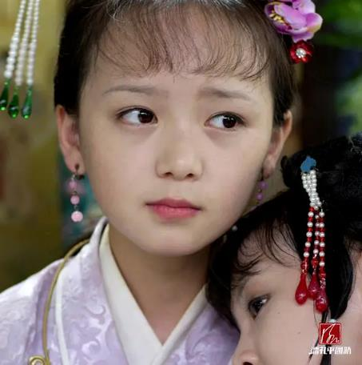
文学经典借助新媒体焕发出新活力
Literary classics are rejuvenated by new media

Slide 17

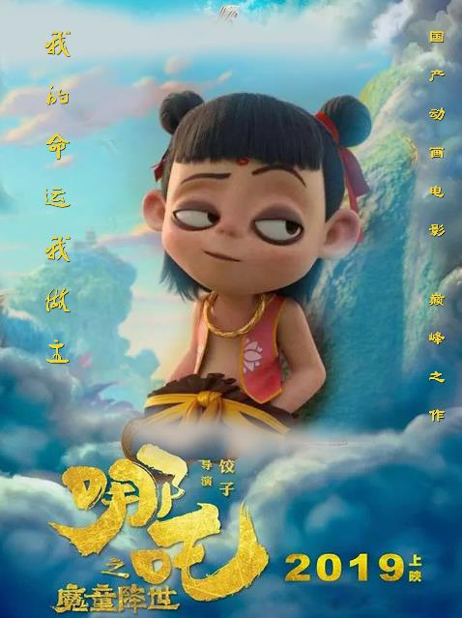


文学经典借助新媒体焕发出新活力Literary classics are rejuvenated by new media
影视剧 the film and television play
动画动漫 animated cartoon
综艺 varieties

Slide 18

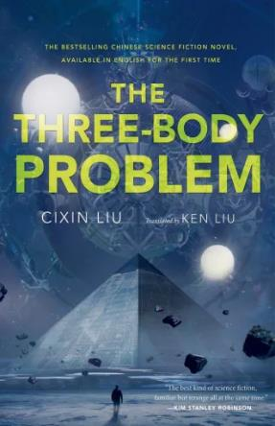
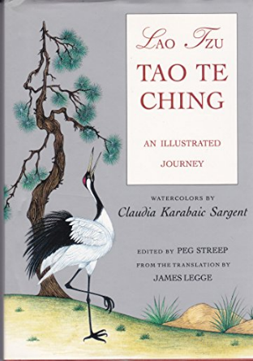
中国经典作品面向世界
Chinese classics are open to the world

Slide 19
文化经典在当代
面临的困难
Difficulties faced by cultural classics in contemporary times
第
四
章

Slide 20

在网络上，曾有网民评出“死活读不下去”的十大文学名著，它们是：
（1）《红楼梦》（2）《百年孤独》（3）《三国演义》（4）《追忆似水年华》（5）《瓦尔登湖》（6）《水浒传》（7）《不能承受的生命之轻》
（8）《西游记》（9）《钢铁是怎样炼成的》（10）《尤利西斯》

Slide 21
On the Internet, there have been netizens rated the top ten literary masterpieces that are "unbearable to read", they are:
(1) A Dream of Red Mansions (2) One Hundred Years of Solitude (3) Romance of The Three Kingdoms (4) In Search of Lost Time (5) Walden Pond (6) Water Margin (7) The Unbearable Lightness of Being"How the Steel was Tempered" (10) "Ulysses"

Slide 22

碎片文化受害者
Victims of Fragmented Culture

Slide 23

新媒体时代背景下，文学经典阅读的背景现状
Under the background of new media era, the background status of literary classics reading
(一）阅读多元化 reading diversity
(二）阅读大众化 popularization of reading
(三）阅读娱乐化 reading for entertainment

Slide 24
参考文献
[1]孙雪梅.新媒体环境下文学经典阅读的选择与背离[J].辽宁师范大学学报(社会科学版),2018,v.41;No.238(02):78-84.
[2]宋剑华.《骆驼祥子》是怎样成为文学经典的?[J].东吴学术,2018,No.44(01):49-61.
[3]汪娟.经典如何成为经典?——论中国当代文学经典问题研究的三个维度[J].嘉兴学院学报,2021,v.33;No.191(05):57-63.
[4]雷鸣.莫言小说的经典化路径考述[J].山东社会科学,2018,No.271(03):81-89.
[5]刘诗杨,唐杨.文学经典影视化：融合、困境与出路[J].戏剧之家,2021,No.398(26):137-138.

Slide 25
Thanks
for
Watching

