Slide 1
ANALECTS (Lunyu 論語)
Guirou Barthelemy
Pingki Tangchangya

Slide 2
Contents
Part I. Introduction
Part II. Main Thouaghts of Analects
Part III. Translation Differences

Slide 3
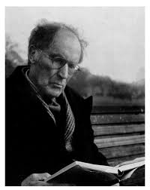
Part I. Introduction (Authors)
Arthur waley’s biography

Slide 4
Arthur waley’s biography
Arthur David Waley, Original name is Arthur David Schloss.
Born in August 19, 1889,Tunbridge Wells, Kent, England.
Died in June 27, 1966, London.
He is an outstanding translator in Chinese and Japanese literary classics into English.
Waley was an assistant keeper in the Department of Prints and Drawing at the British Museum from 1913 to 1929.

Slide 5
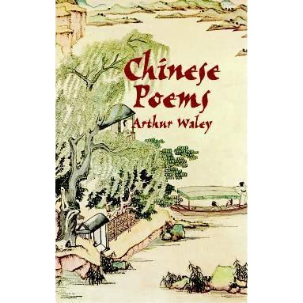
Arthur waley’s biography
His most outstanding and influential translations are 170 Chinese poems (1918), Japanese Poems (1919).
He also wrote on Oriental Philosophy translated and Edited the Analects of Confucius (1930).
The No Plays of Japan (1921).
Introduction to the Study of Chinese Painting (1923).
The Opium War Through Chinese Eyes (1958).
The Ballads and Stories Tun- huang (1960).

Slide 6
His honours
The CBE in 1952.
The Queen’s Gold Medal for Poetry in 1953.
And Companion of Honour in 1956.

Slide 7
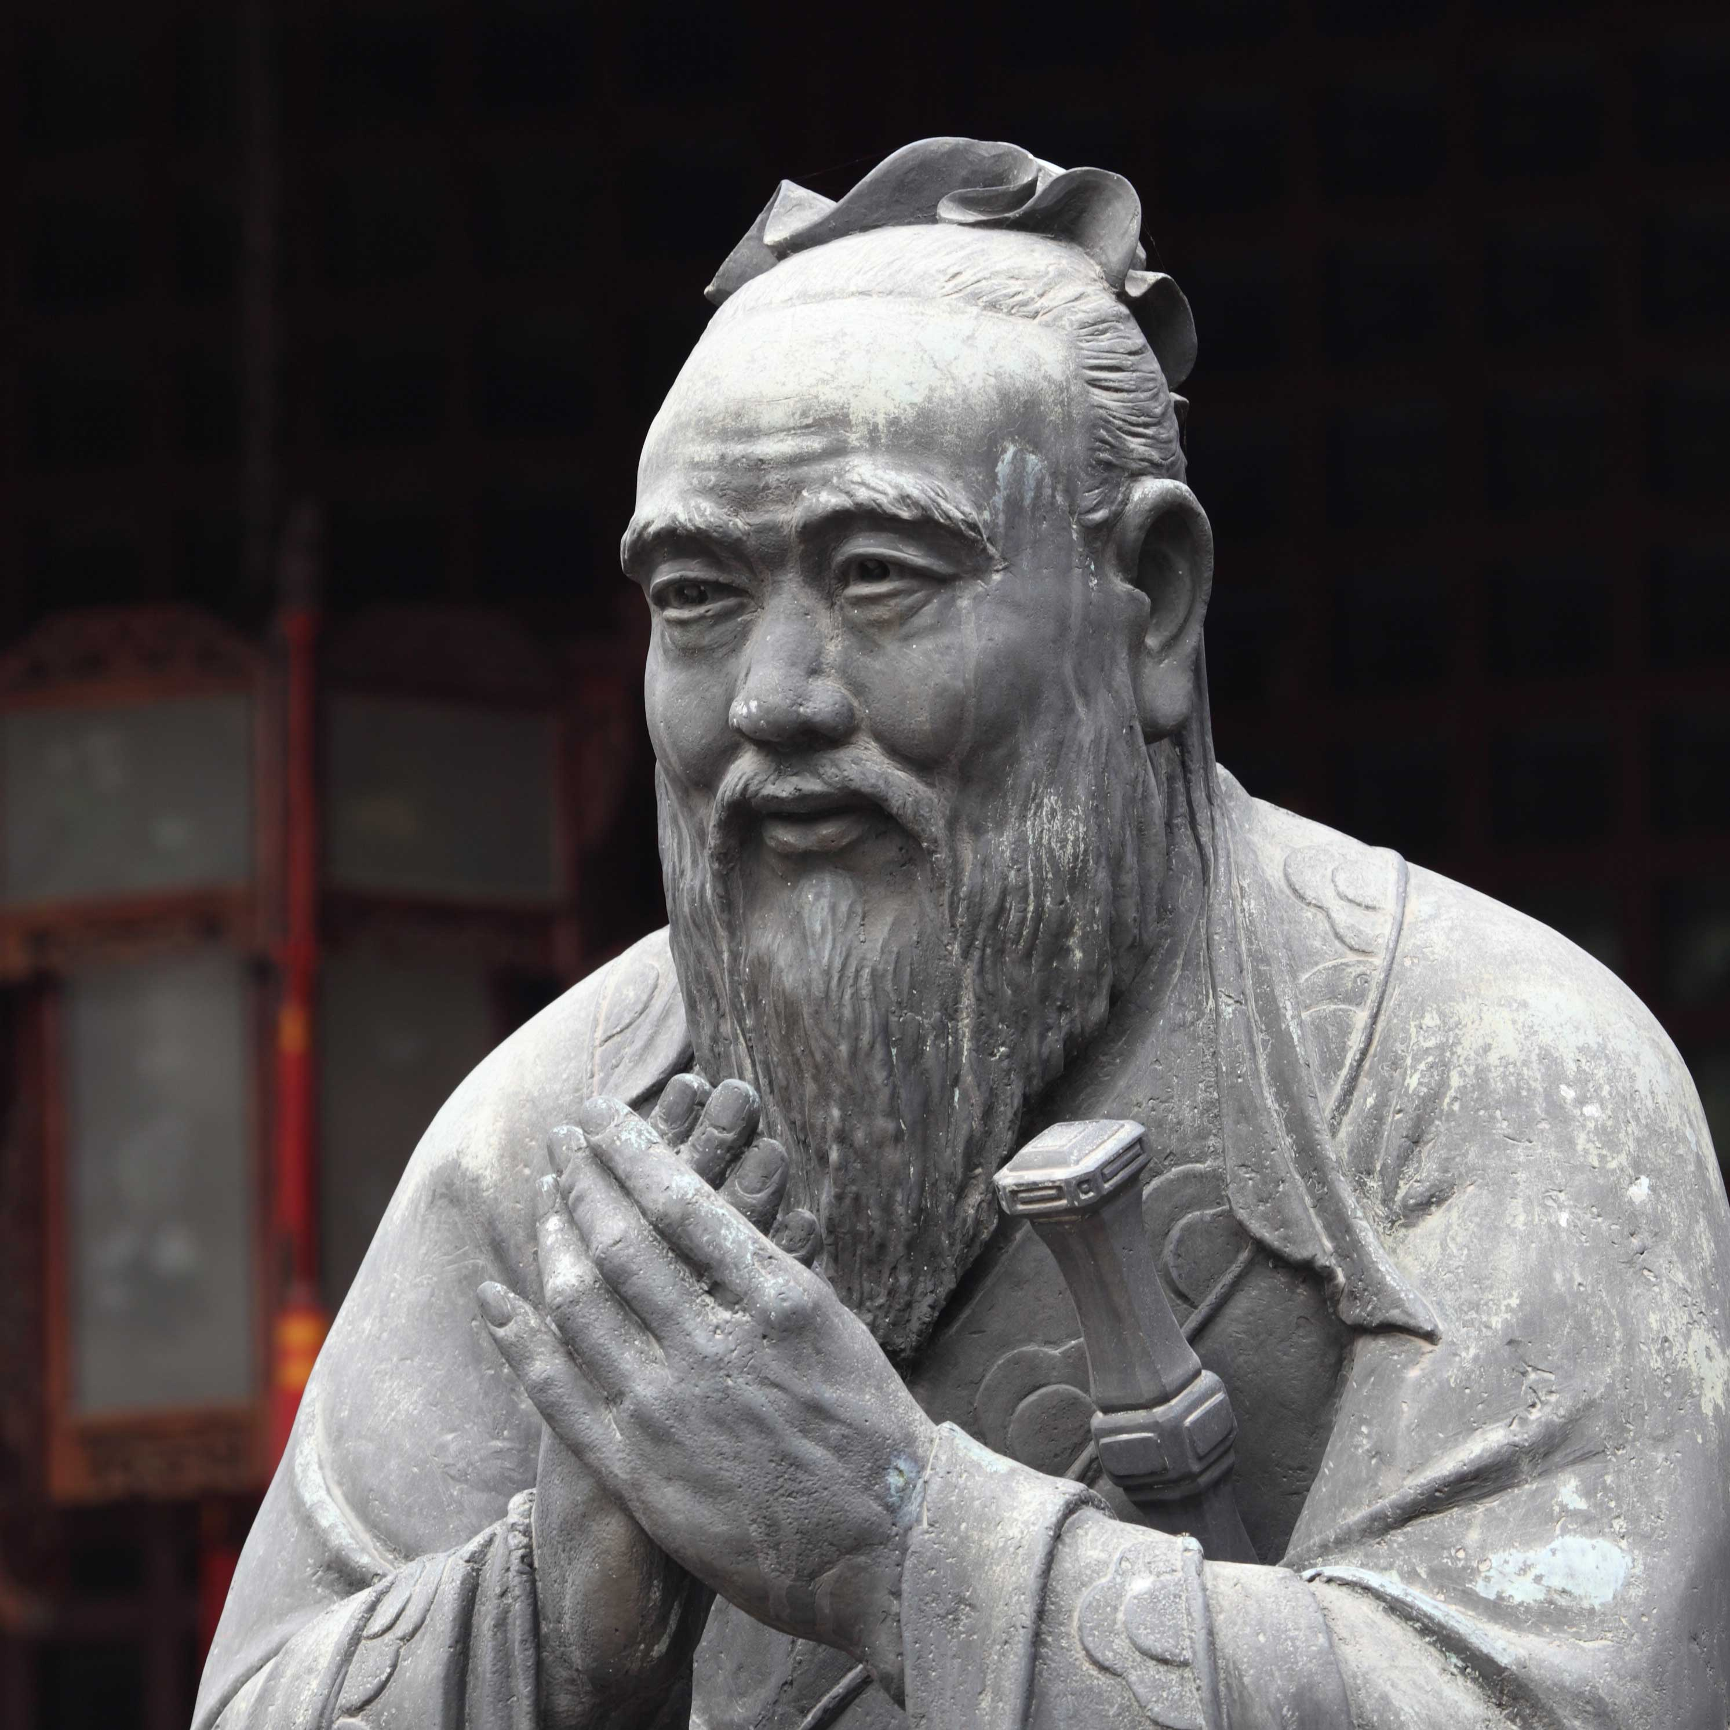
Confucius
Confucius is the Latinized name of Kung Fu-tzu (Great MasterKung 孔夫子) lived around 551 BC to 479 BC in Shantung Province in ancient China during the Zhou dynasty. He was Chinese’s most famous philosopher and politician of the spring and autumn period. He has been also known as a teacher, editor, adviser, and reformer.

Slide 8
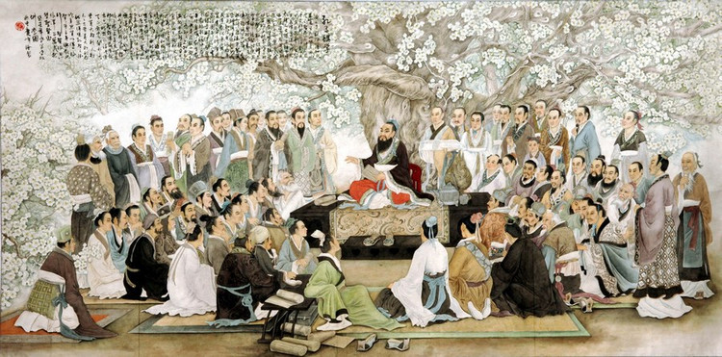
Confucius and his disciples

Slide 9
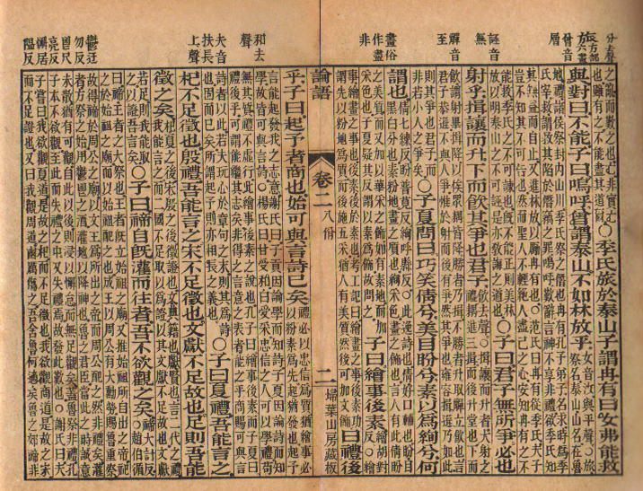
Analects

Slide 10
Definition of Analects
Analects is the China’s sacred book, the representative work of Confucianism. A collection of answers of dialogues between Confucius and his disciples. “The Analects (Lunyu 論語), “Lun” means collection and compilation, and “yu” means words and sayings. Put to gather, Lunyu refers to the words of Confucius and his disciples” (Chu Ming, Qin Kai, & Yin Wei, 039).

Slide 11
Part II Main Toughts of Analects
Human-Hearthedness ( 仁 ) Ren
Ren is the most imporant concept of the Analects and the core of Confucius ideas. Ren means benevolence, to love others, goodness. Here love means the mutual respect and affection of each other begins by one’s family and then extends to others.
Ritual Propriety (禮) Li
Ritual propriety is an important aspect of the Analects, it refers to the rites of Zhou, the rules, regulations rituals and codes of conduct. It refers also to ancestor worship, knowing one’s ancestors and honoring them provides peace and love. It aims to maintain harmony, order and social stability by learning and conforming to its virtue. Without ritual propriety one can not achieve its duties.

Slide 12
Main Toughts of Analects
Filial Piety (孝) Xiao
Filial piety focuses on the importance of family and respect toward old persons.
Rightness (義) Yi
Rightness emphasizes on what is right or good, the ability to distinguish what is right and wrong. It is a kind of moral intuition. Here Confucius cared about the issue of rightness versus gain, he did not deny material benefits but in any material gain activities we should first consider rightness.

Slide 13
Part III Translation Differences
Ren
Example 1. 仁远乎哉?我欲仁，斯仁至矣。(《论语·述 而》)
James Legge: Is virtue a thing remote? I wish to be virtuous, and lo! Virtue is at hand.
Ku Hung-ming: Is moral life something remote or difficult? If a man will only wish to live a moral life— there and then his life becomes moral (XU Xiangqun, 2014, 149).

Slide 14
Xiao
Example 2. 孟懿子问孝。子曰：“无违。” (《论语·为 政》
James Legge: May asked what filial piety was. The Master said, “It is not being disobedient.”
Ku Hung-ming: A noble of the Court in Confucius’ native State asked him what constituted the duty of a good son. Confucius answered, “Do not fail in what is required of you” (XU Xiangqun, 2014,150).

Slide 15
Thank you for listening!

