Slide 1


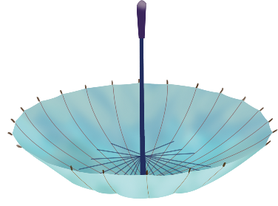
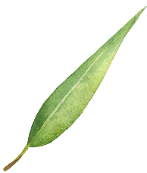


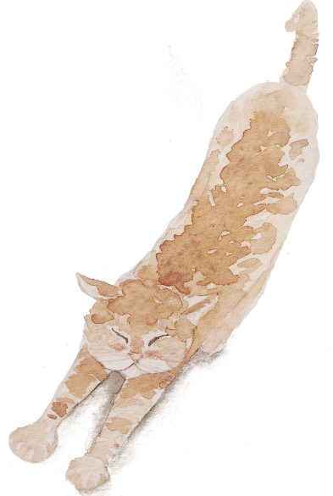
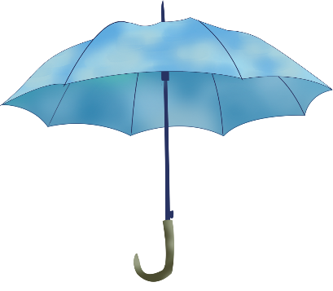

East-West Comparison of
Hypotaxis and Parataxis
presented by Liu Wei

Slide 2

General Introduction
content
Hypotaxis, Parataxis and Instances
Conclusion

Slide 3
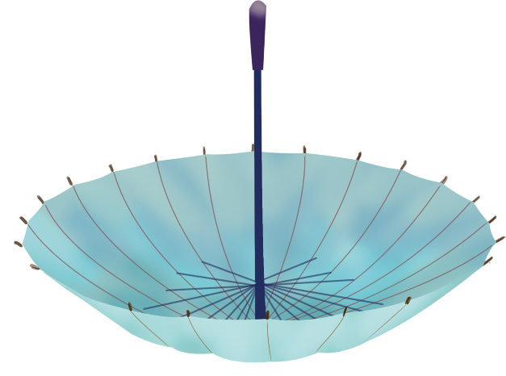

Part.01
General Introduction

Slide 4
English and Chinese
English :the Indo-European Family
Chinese :the Sino-Tibetan Family
Differences:word formation、syntax、pronunciation regulations …
西文句中名物字，多随举随释，如中文之旁支，后乃遥接前文，足意成句。
——严复

Slide 5
Definitions of Hypotaxis and Parataxis
Hypotaxis
Hypotaxis refers to the realization of the connection of the words or phrases, with the help of language forms .

Slide 6

Parataxis
Parataxis refers to the realization of the connection of them without the help of the language form but the logical meaning of the words or phrases.

Slide 7
Part.02
Hypotaxis, Parataxis and Instances

Slide 8
Hypotaxis in English
English is typically a system of grammatical language.
Many methods are used in English sentences to connect words and clauses, which focus much on explicit cohesion.

Slide 9
1 Using relatives and conjunctions
relatives
01
02
conjunctions
include relative pronouns, relative adverbs, conjunctional pronouns and conjunctional adverbs .
such as: who, whom, whose, that, which, what, when, where, why, how etc.
include coordinate conjunctions and subordinate conjunctions.
such as: and, or, but, yet, so, however, (n)either…(n)or, when, as, since, until, unless etc.

Slide 10

instance
It had been a fine, golden autumn, a lovely farewell to those who would lose their youth, and some of them their lives, before the leaves turned again in a peaceful fall.
译文：那是个天气晴朗，金黄可爱的秋天，美好的秋色为那些青年送别。待到战后和平时期，黄叶纷飞的秋天再度来临时，昔日的青年已经失去了青春，有的丧失了生命。

Slide 11
2 Using Prepositions
instance
simple prepositions
combined prepositions
idiom prepositions
He had a disconcerting habit of expressing contradictory ideas in rapid succession.
译文：他有一种令人疑虑不安的习惯：一会儿一个看法，自相矛盾，变化无常。

Slide 12
3 Other Connective Methods
instance
inflections (changing affix, number, person, etc)
using “it” or “there”
He boasts that a slave is free the moment his foot touched British soil . and he sells the children of the poor at six years of age to work under the lash in the factories for sixteen hours a day.
译文：他吹嘘说，任何奴隶一踏上英国的土地就获得自由，而他却出卖穷人家六岁的孩子到工厂干活，每天十六个小时，受尽鞭打责骂。

Slide 13
Parataxis in Chinese
Chinese is typically a system of semantical language.
Few methods are used in Chinese sentences to connect words and clauses, which focus much on implicit coherence.

Slide 14
1 The changing of word order
instance
Few conjunctions because the meaning is highly connected with the word order.
人（若）不犯我，我（则）不犯人。
译文：We will not attack unless we are attacked.

Slide 15
2 Using figures of speech
instance
Such as repetition, parallelism, antithesis and balanced sentences.
种瓜得瓜，种豆得豆。
译文： As a man sows, so he shall reap.

Slide 16
3 Using compressed sentences
instances
狼披羊皮还是狼。
译文：A wolf remains a wolf even though it is in sheep's clothing.
不到黄河心不死。
译文： Until all is over ambition never dies.

Slide 17
4 Using four-character structures
instances
欲盖弥彰
译文： One tries to hide, the more one is exposed.
不进则退
译文：Move forward, or you'll fall behind.

Slide 18
Part.03
Conclusion

Slide 19
English is not absolute hypotaxis and Chinese is not absolute parataxis. the key to translation is to be flexible according to the original text.
Only a thorough understanding of the differences between Chinese and western cultures, can we better grasp the laws in translation.

Slide 20

Thank you for watching !

