Slide 1
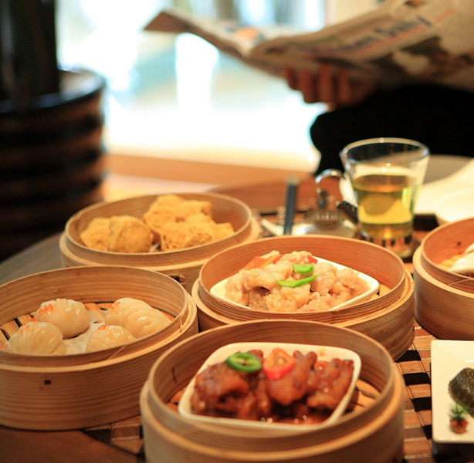
Traditional Cuisine: Breakfast Culture of
Guangdong
23 英语笔译 吴子毅 Andrew

Slide 2
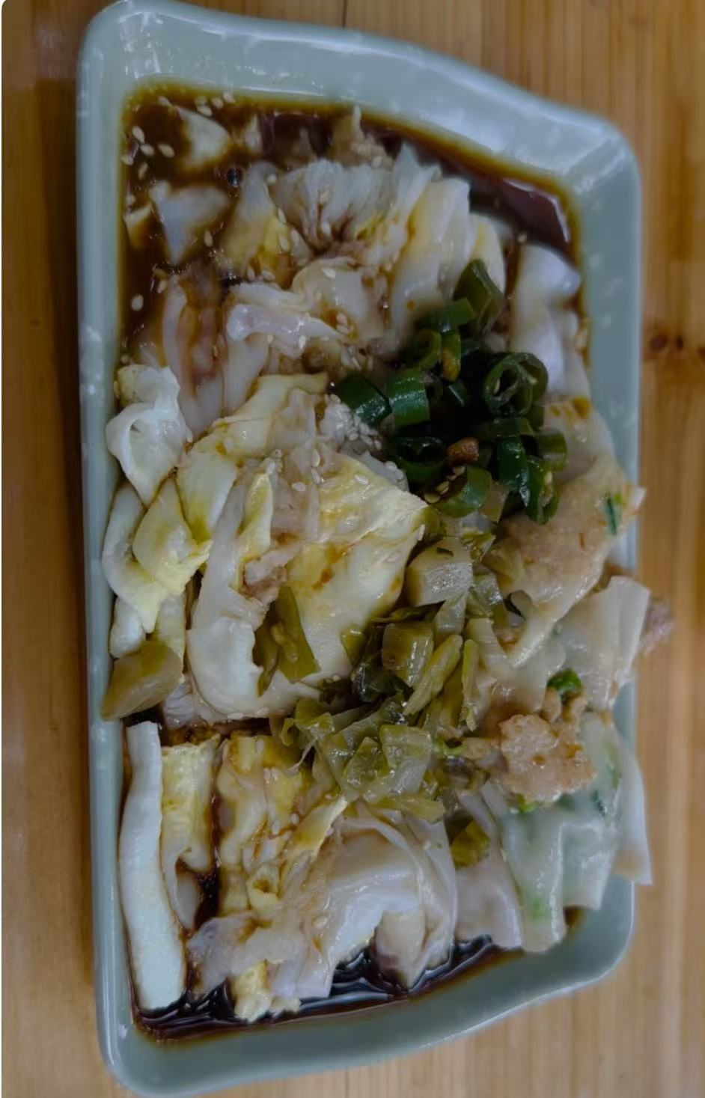
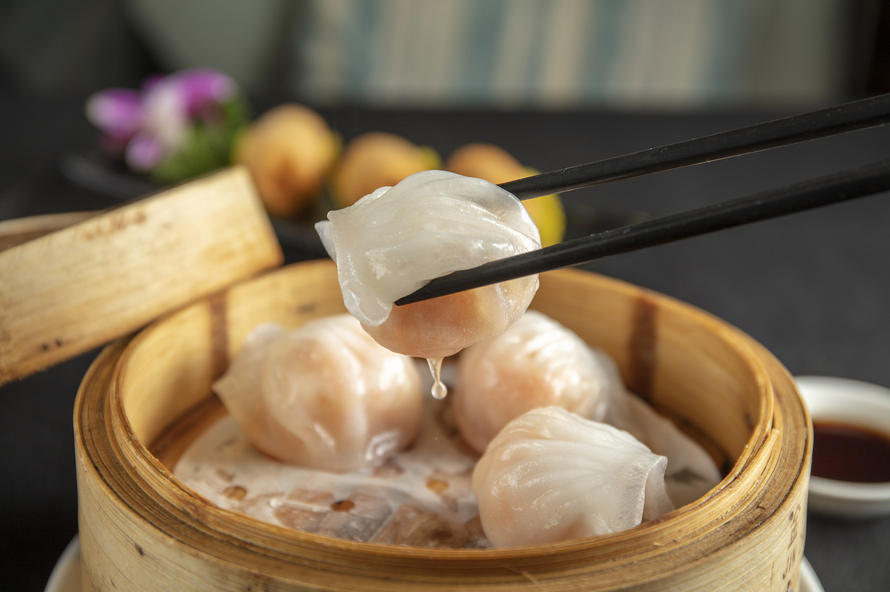
Content
01
02
03
04
05
Introduction to Guangdong Dim Sum Brunch
Introduction to Daily Guangdong Breakfast
Functions of Guangdong Breakfast
Modern Evolution of Guangdong Breakfast
Questions and Bonuses

Slide 3
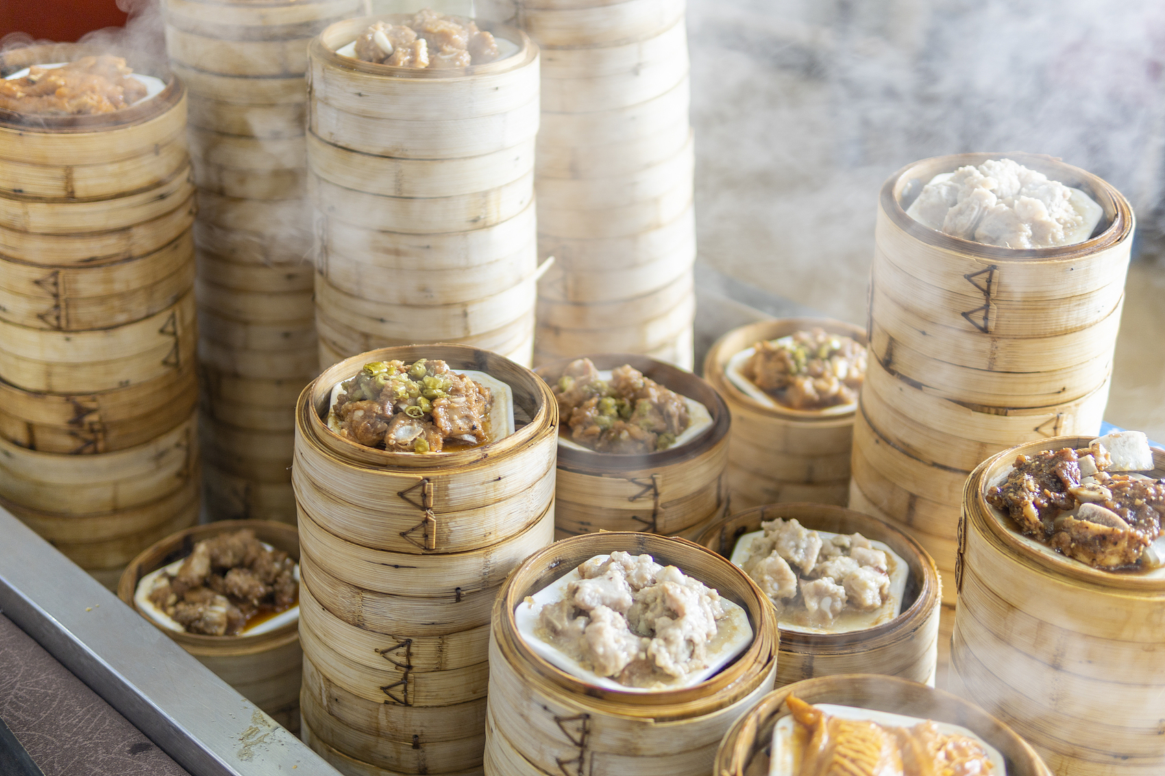
Introduction to Guangdong Dim Sum Brunch

Slide 4
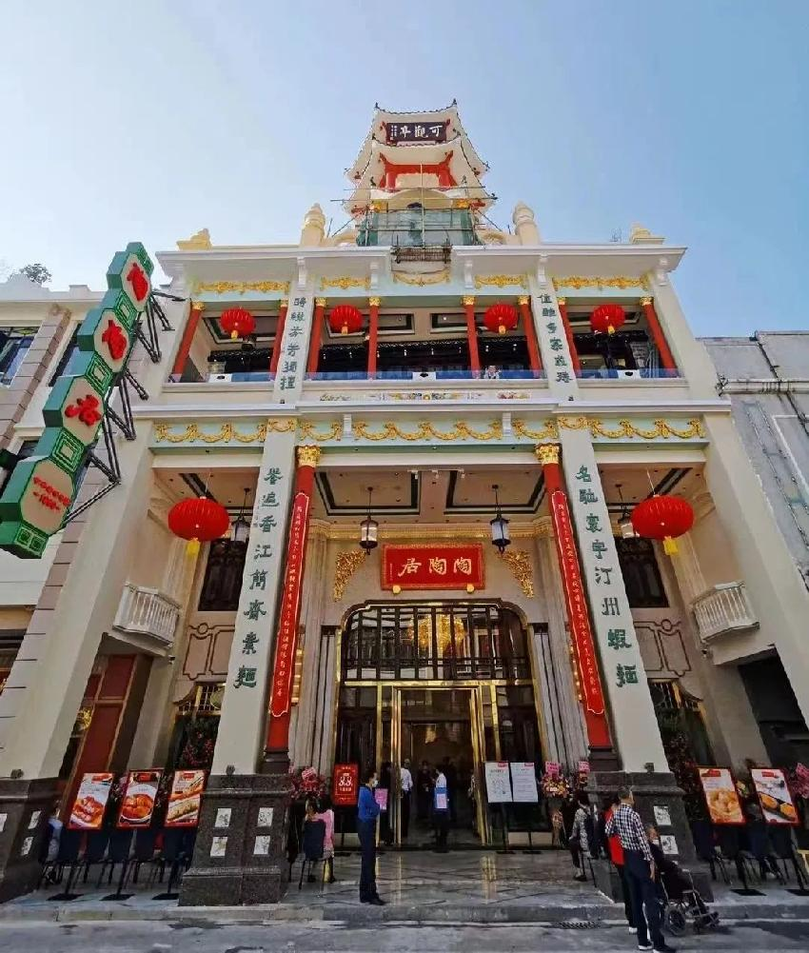
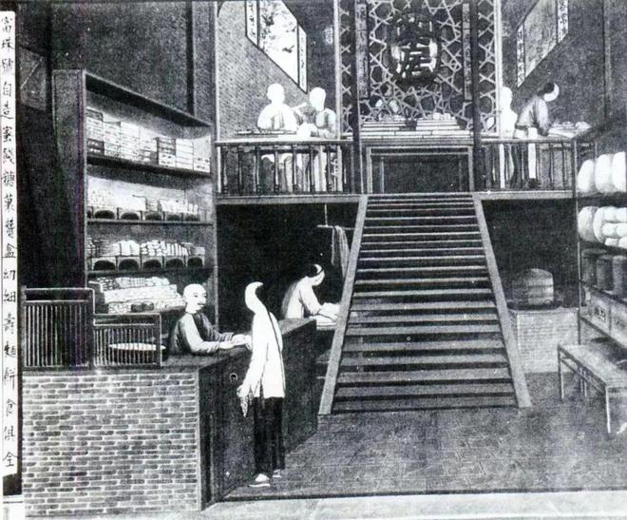
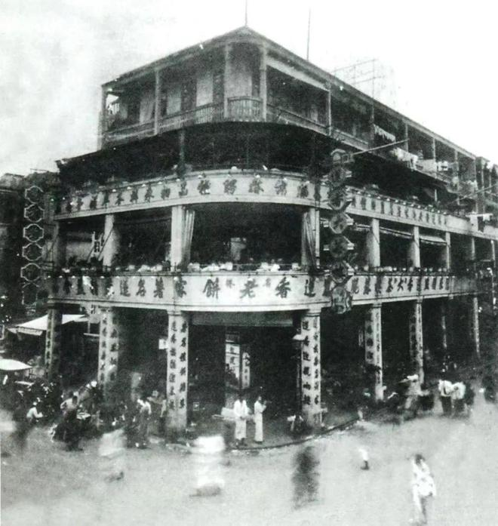
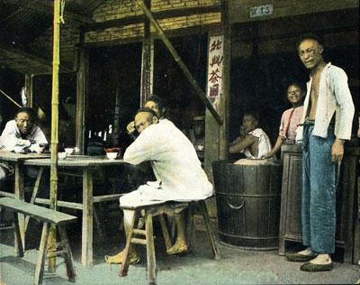
The History of Guangdong Dim Sum Brunch
The 1860s~the 1920s
In the end of the 1920s
Around the 1860s
At Present
“Two Lis” Teashop
二厘馆
Tea Parlour
茶居
Tea House
茶楼
Chain Tea House
连锁茶楼
Woesler , Martin. 2024. Elements of Chinese Culture [M]. Bochum: European University Press
广东早茶文化 [OL]. https://gzgfwh.gzhu.edu.cn/info/1049/1424.htm
金德宁. 2018. 从“二厘馆”到茶楼：近代广州茶文化的兴起 [OL]. https://www.thepaper.cn/newsDetail_forward_1935428

Slide 5
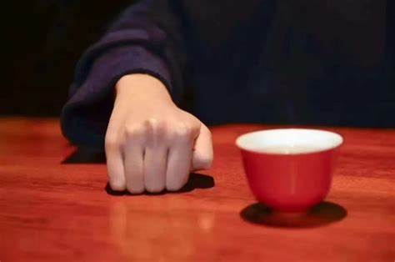
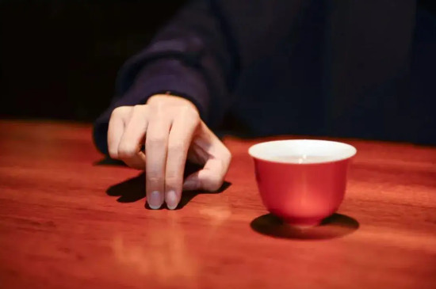
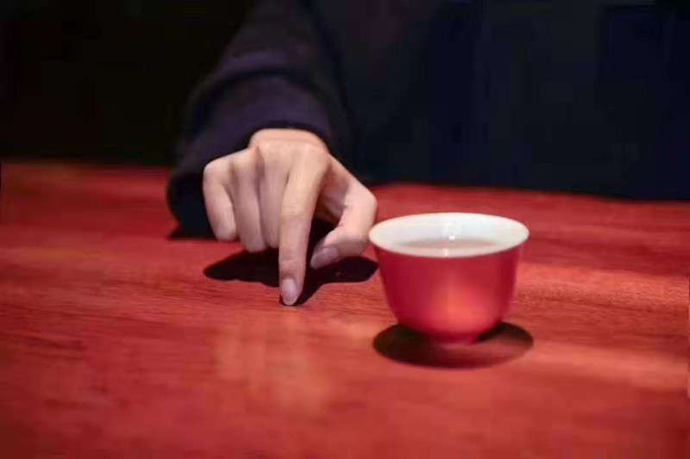
The Tea – 一盅（jat1 zung1）
Various Tea
Chrysanthemum Tea
Pu 'er Tea
菊花茶（guk1 faa1 caa4）
普洱茶（pou2 nei5 caa4）
Tie Guanyin Tea
Black Tea
铁观音（tit3 gun1 jam1）
红茶（hung4 caa4）
Tea Etiquette – Finger Knocking Rules
To the elderly or superior
Knock the table with your fist, symbolizing kneeling to them
To peers
Knock the table with your middle and index fingers, symbolizing bowing to them
To the younger or inferior
Knock the table with your index finger, symbolizing nodding to them
2023. 广东人叩茶礼，喝茶叩手礼三种手势图 [OL]. https://www.yinchar.com/wenhua/cycd/11500.html

Slide 6
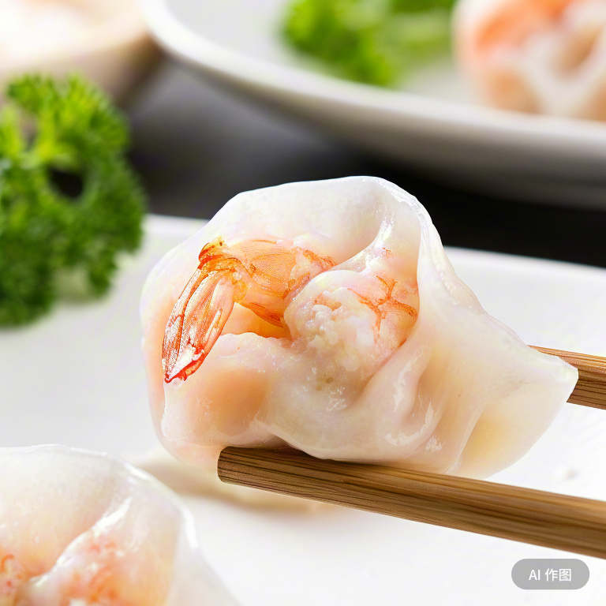
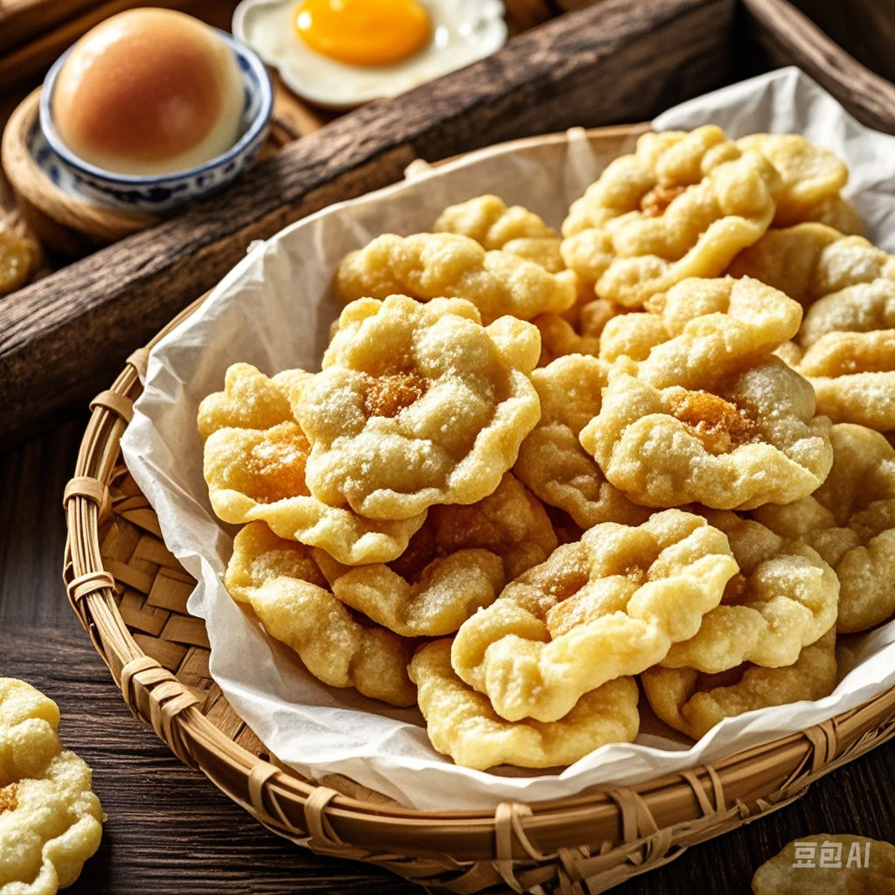
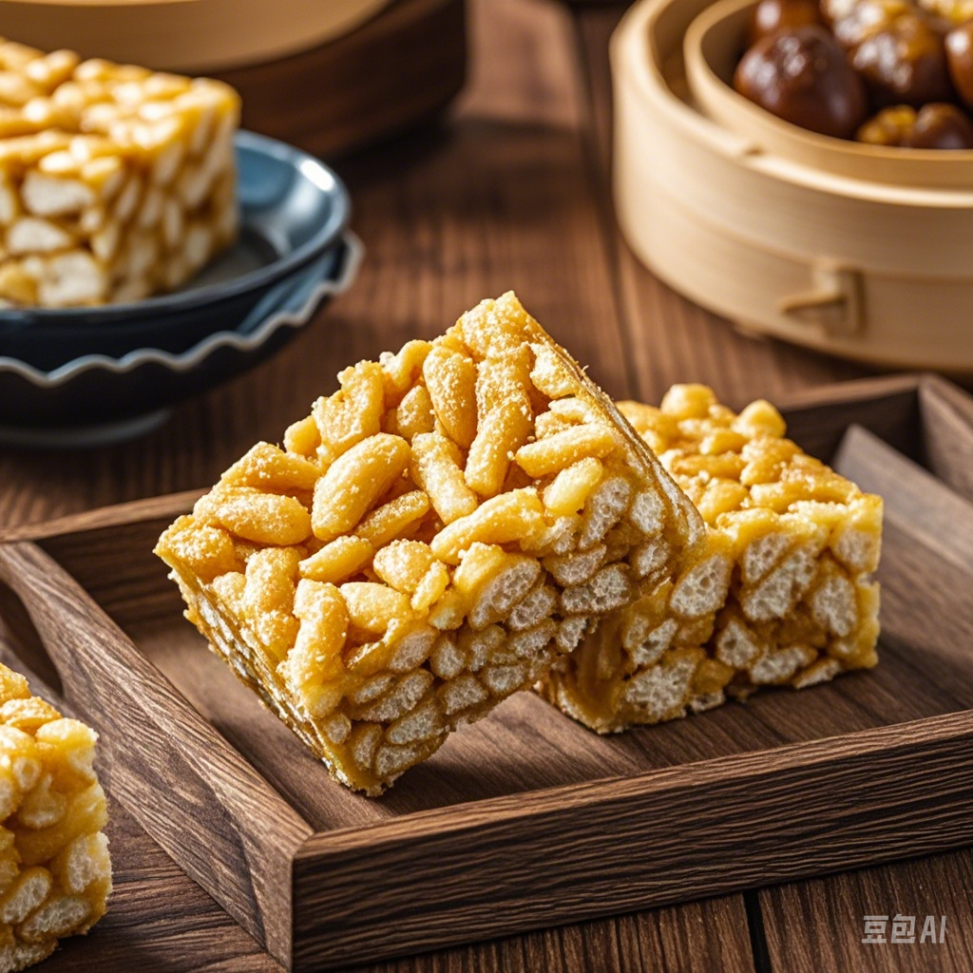
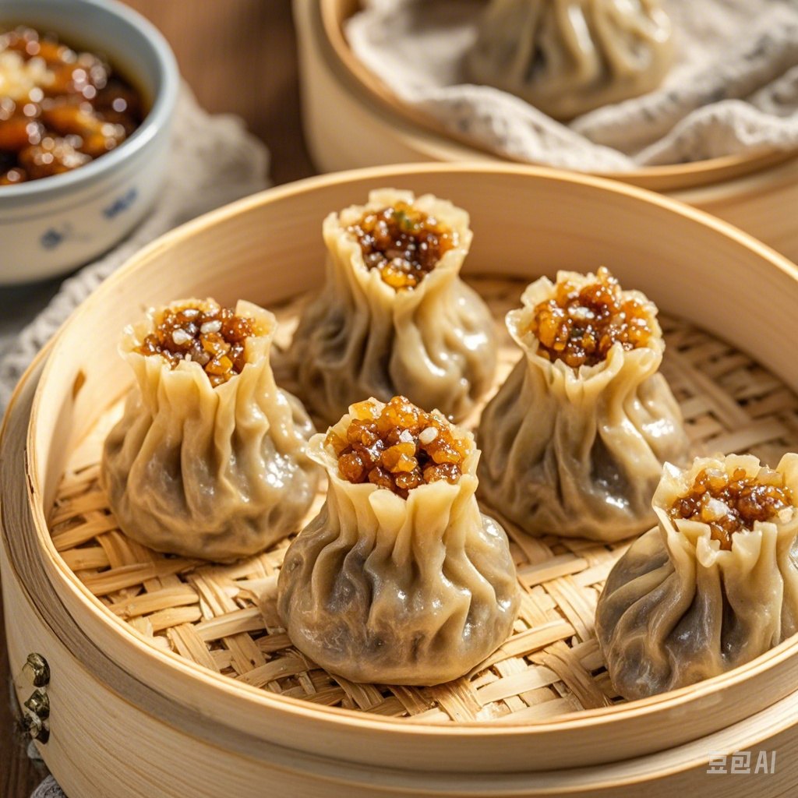
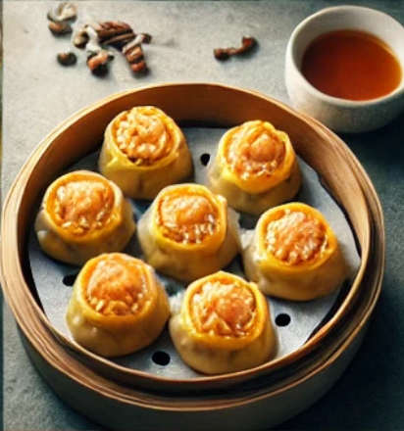
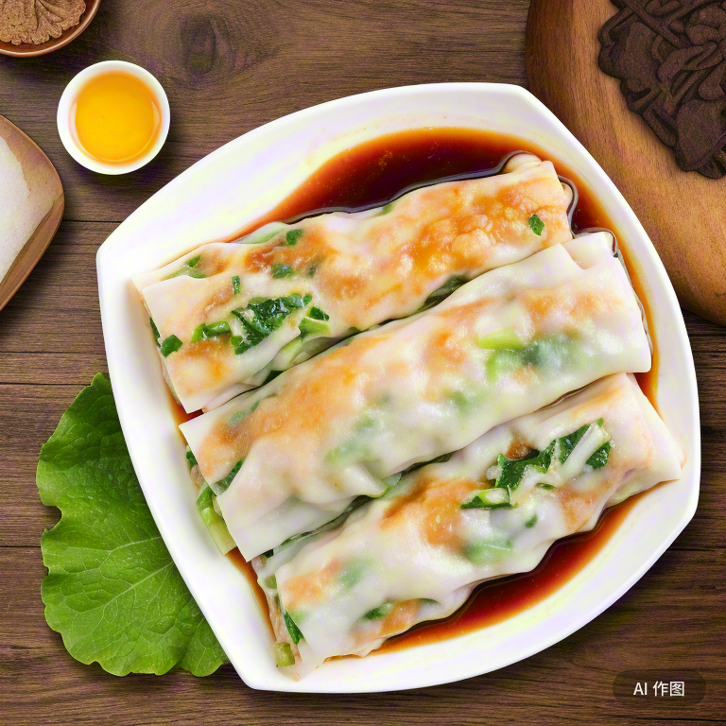
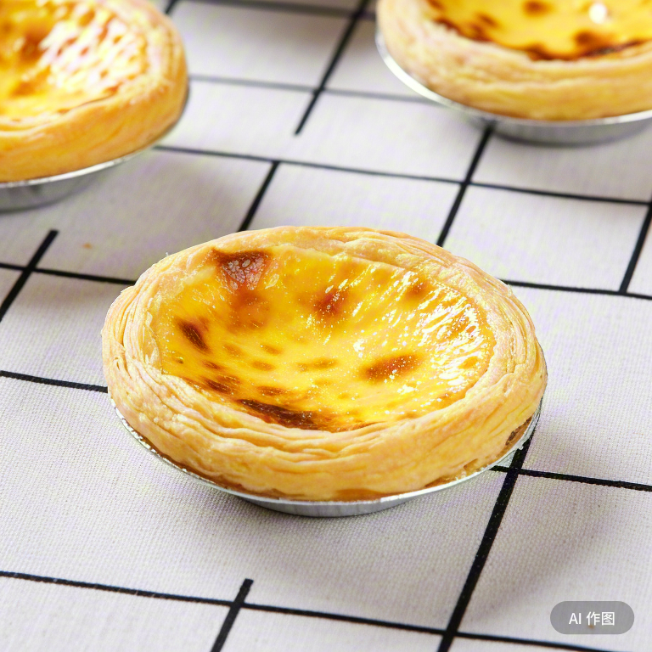
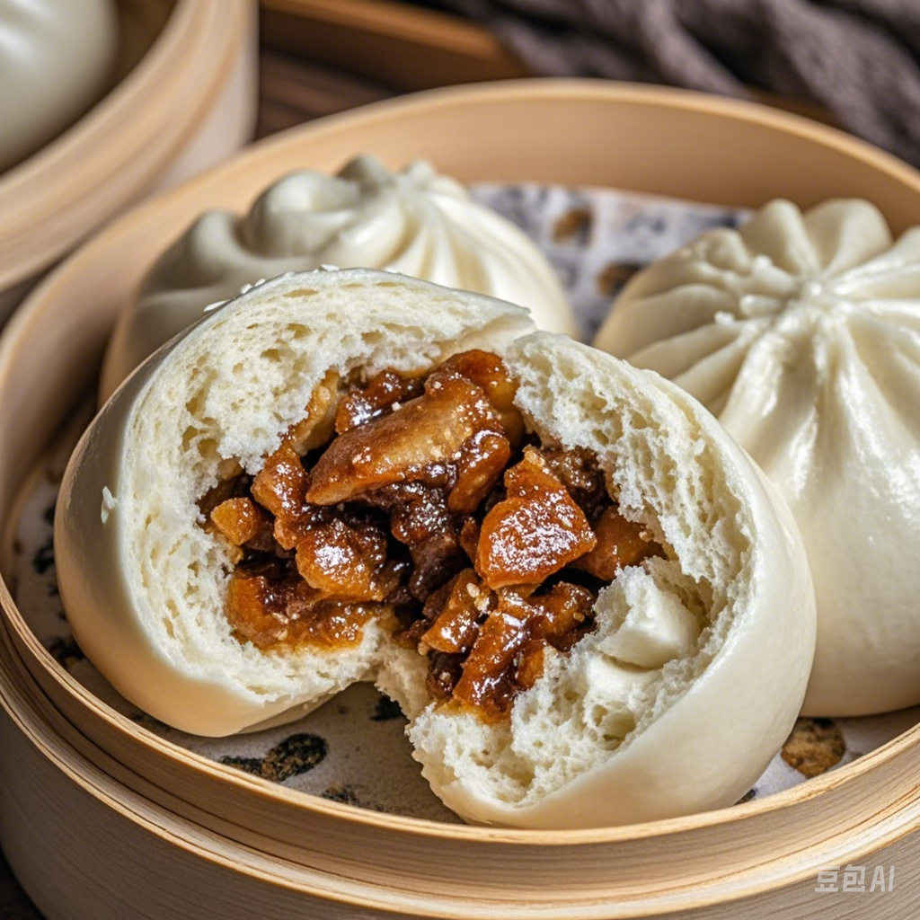
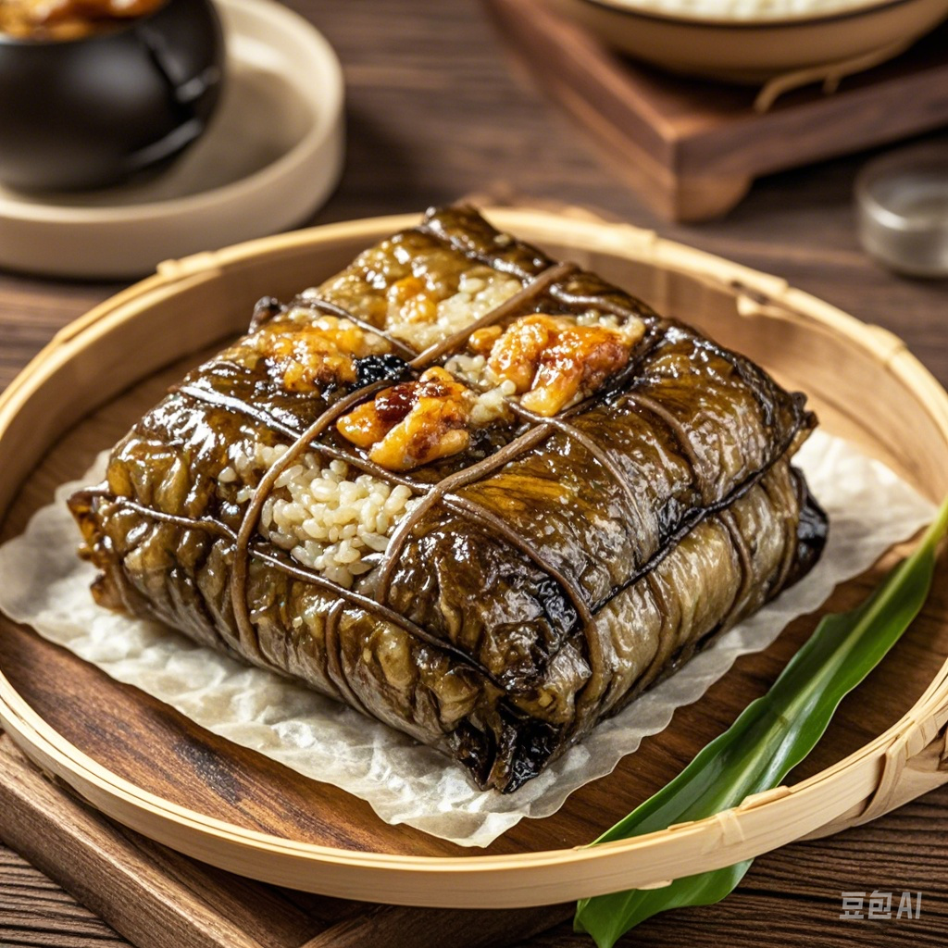
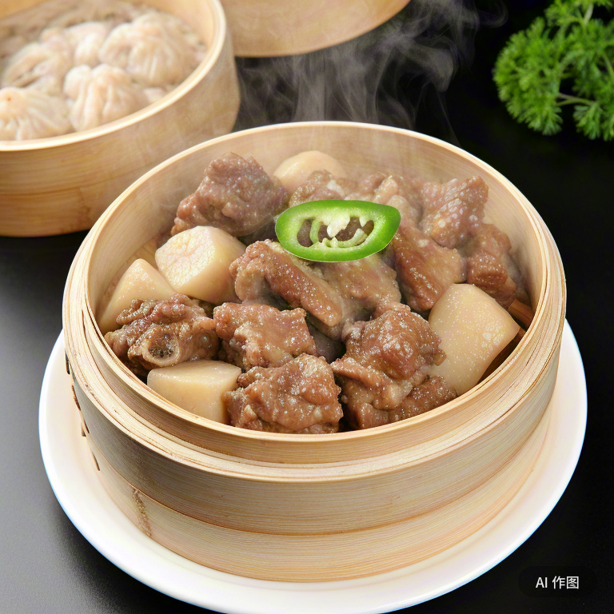
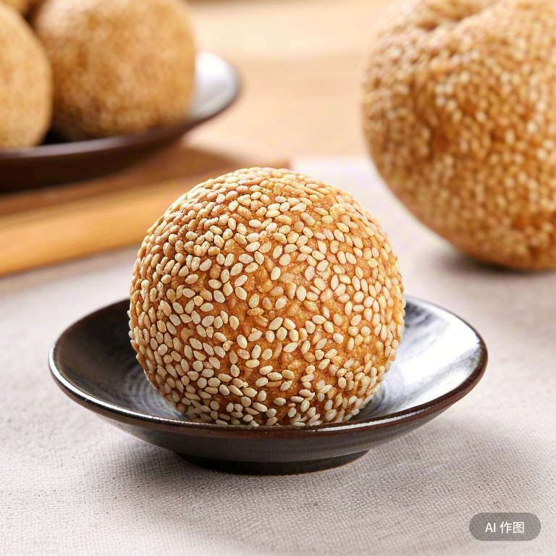
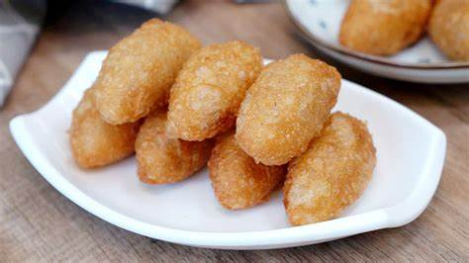
The Dim Sums – 两件（loeng5 gin6）
Four Kings
Shrimp Dumpling 虾饺
Char Siu Bao 叉烧包
（haa1 gaau4）
（caa1 siu1 baau1）
Steamed Shumai干蒸烧麦
Egg Tart 蛋挞
（gon1 zing1 siu1 maai2）
（daan6 taat1）
Eight Guardian Warriors
Sticky Rice Shumai with Minced Beef 牛肉烧麦
Steamed ribs 蒸排骨
Cantonese Rice Rolls 肠粉
Steamed Sticky Rice with Chicken 糯米鸡
Chakima 沙琪玛
Sweet Egg Twists 甜蛋散
Sesame balls 煎堆仔
Fried Glutinous Rice Dumplings 咸水角
2024. 广式早茶：四大天王＆八大金刚 [OL]. https://www.kpfans.com/article/0lWqnd2a5X.html

