Slide 1


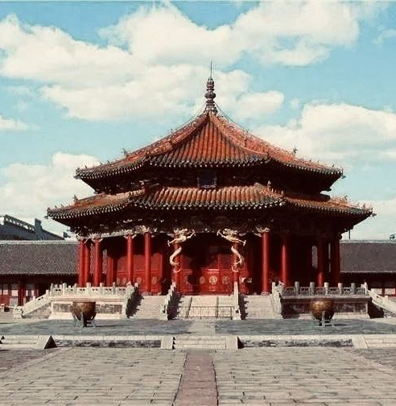
Shengjing Imperial Palace and the integration of Manchu and Han culture
Presenter: 李嫣然

Slide 2


Table of contents
01
02
03
Introduction of the palace
Integragtion of Manchu and Han culture
Reasons behind the palaces’ style

Slide 3


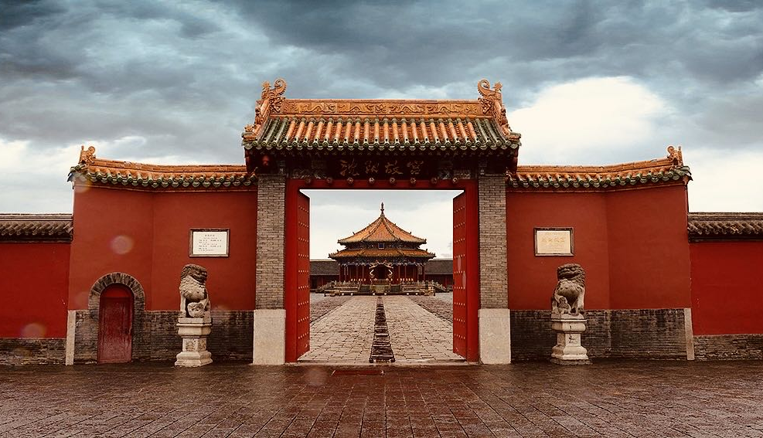
01
Introduction of the palace

Slide 4

Brief Introduction
Shenyang Imperial Palace, also called Shengjing Imperial Palace, was first built in 1625 by Nuerhachi (1559-1626) and excessively extended by Huangtaiji (1592-1643), the son and successor of Nuerhachi before they entered the hintland China and established the Qing Dynasty. The Shenyang Imperial Palace is an excellently well-preserved cultural relic.
The Shenyang Imperial Palace, predating the Qing Dynasty's establishment, stands as a testament to the rich cultural heritage of the early Manchu people. It encapsulates the evolution of Manchu culture and its integration with Han culture.

Slide 5
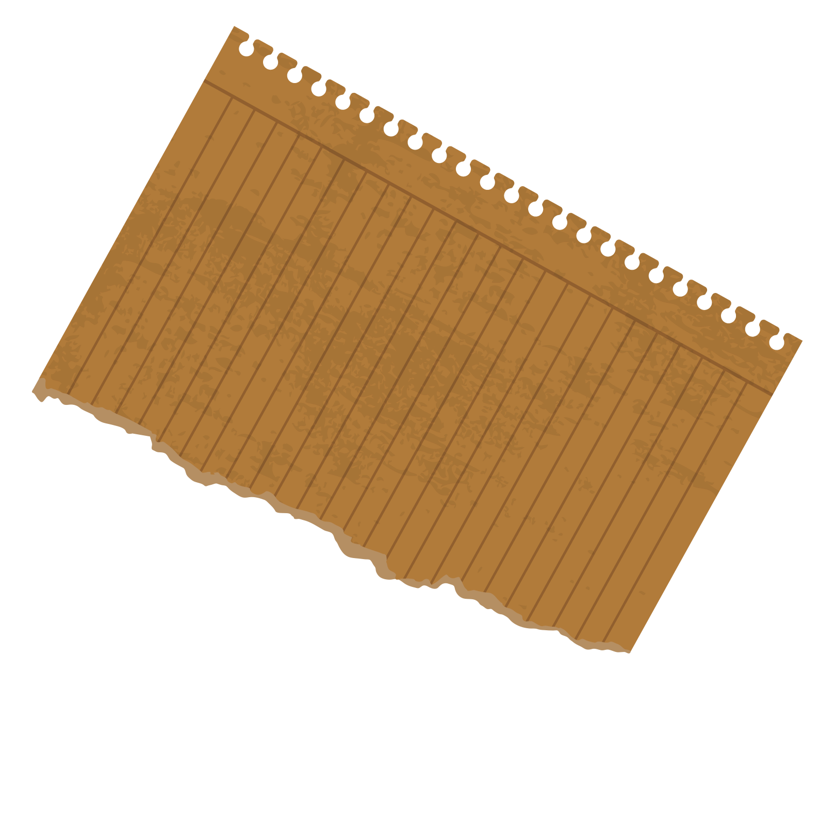
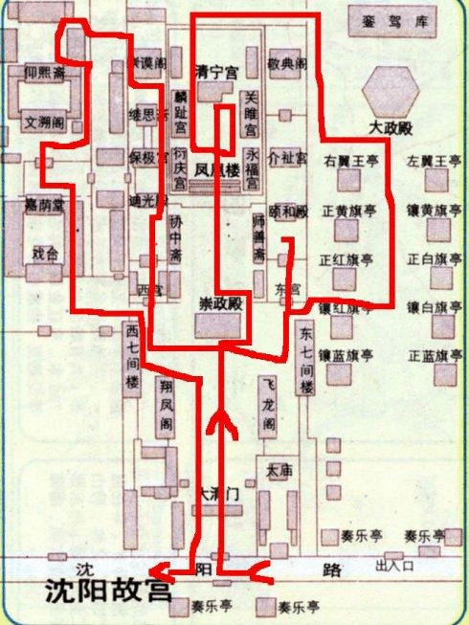
Divisions
Central:
Erected during the reign of Huangtaiji
Fusion of Manchu and Han architectural style
Boasting comprehensive functionalities

Slide 6
Focus
Architectural style
Taking the empress and concubines’ palaces as examples

Slide 7
02
Integration of Manchu and Han culture

Slide 8
Background Information
Five Palaces on the Terrace
Huangtaiji’s view

Slide 9
Five Palaces on the Terrace
Yongfu Palace
Linzhi Palace
Qingning Palace
Yanqing Palace
Guanju Palace

Slide 10
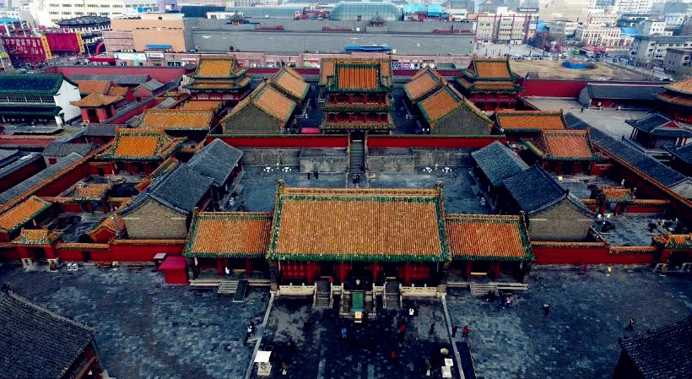
High Palaces Low Halls

Slide 11
Huangtaiji’s view
Inclusiveness
Didn't simply discard the customs and cultural traditions of his own people
transcended the mindset of a regional ruler of the Manchu people
embraced an inclusive and open-minded approach, gathering talents from all walks of life, especially intellectuals among the Han people, to serve his cause of unifying the nation

Slide 12
03
Reasons behind the palaces’ style

Slide 13
Reasons
Manchu culture
Primitive cultural beliefs
Manchu folks
Huangtaiji integrated the beliefs of the Jurchen people into Manchu architectural culure
Example: the myth of the Three Fairy Maidens

Slide 14
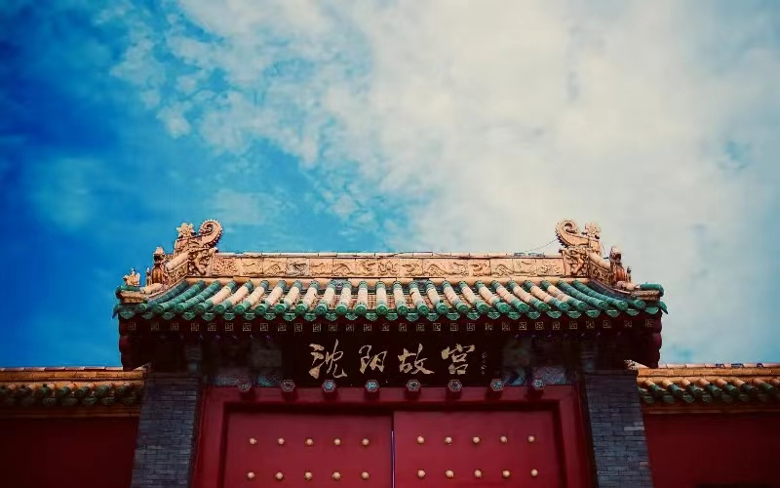
Conclusion
The architectural style of the Shengjing Imperial Palace serves as a striking example of cultural integration, showcasing how different traditions can blend harmoniously to create something truly remarkable. This principle of embracing rather than dominating other cultures finds profound resonance in Chinese history itself.
Throughout its long and storied development, Chinese culture has been characterized by a remarkable openness to outside influences. From the introduction of Buddhism from India to the adoption of Confucianism from ancient scholars, China has continually absorbed and integrated diverse cultural elements into its own rich tapestry.

Slide 15
Conclusion
This tradition of cultural exchange and adaptation has played a crucial role in shaping the vibrant mosaic of Chinese civilization. Rather than resisting foreign ideas or imposing its own dominance, China has often chosen to embrace the best of what other cultures have to offer, enriching its own cultural landscape in the process.
In our contemporary society, marked by increasing globalization and interconnection, the imperative to thrive has never been more pressing. Just as Chinese culture has flourished through openness and inclusivity, so too can our modern civilization benefit from embracing the diversity of the world around us.

Slide 16
References
https://www.dpm.org.cn/Uploads/File/2019/12/15/u5df5f080f167c.pdf
https://www.chinahighlights.com/shenyang/attraction/shenyang-imperial-palace.htm
https://en.chinaculture.org/library/2008-02/15/content_34619.htm

Slide 17
Thanks for listening!

