Slide 1
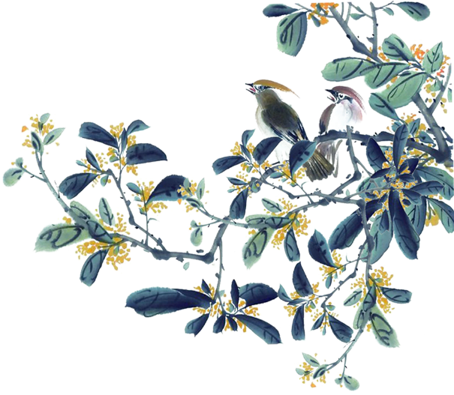






Philosophical
Daoism
余妮（Yu Ni)
杨晨婷(Yang Chenting)

Slide 2
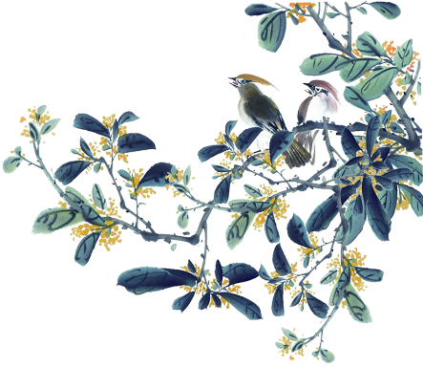
Content
1
Introduction
General Characteristics
2
3
Basic concepts
4
Translation tips

Slide 3
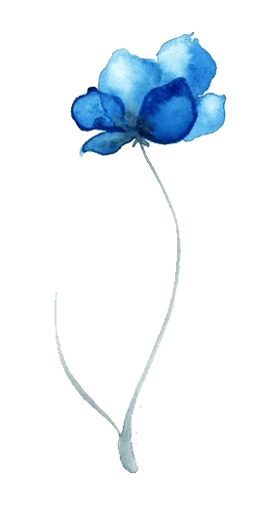

Introduction
Daoism(Taoism), a religion-philosophical tradition that has shaped Chinese life for more than 2,000 years.
Attitude toward life:
accepting and yielding, the joyful and carefree sides of the Chinese character.
Daoism is also characterized by a positive, active attitude toward the occult and the metaphysical (theories on the nature of reality)
中华传承

Slide 4
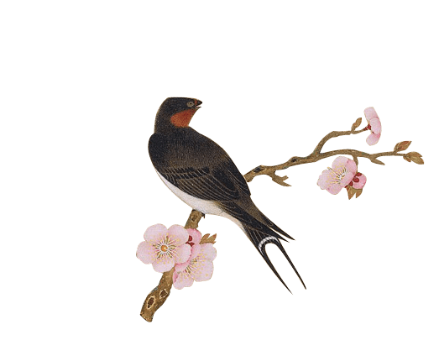


Daoist and Confucian:
The two traditions share many of the same ideas about man, society, the ruler, heaven, and the universe—ideas that were not created by either school but that stem from a tradition prior to either Confucius or Laozi.

Slide 5

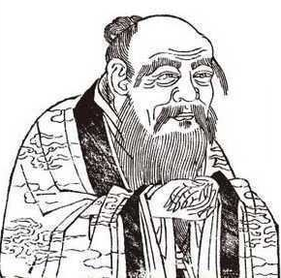
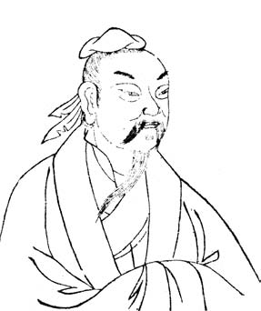
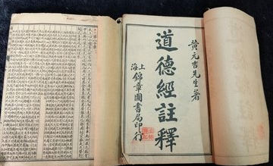
General Characteristics
Laozi
Daodejing
Zhuangzi

Slide 6
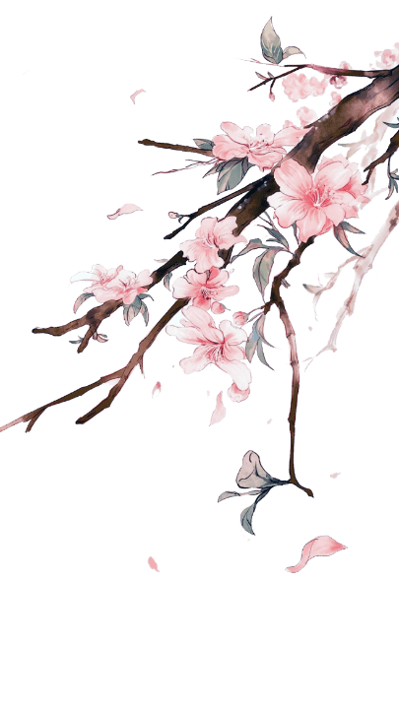
Concepts of the universe and natural order
The name (名) in ancient Chinese thought implied an evaluation assigning an object its place in a hierarchical universe. “It happened of its own accord’ (自然).”

Slide 7

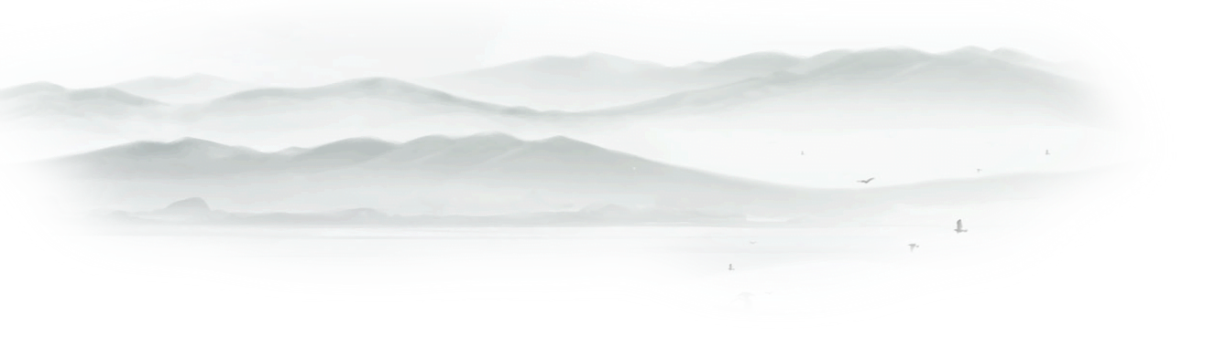
Concepts of Wuwei
The “superior virtue” of Daoism is a latent power that never lays claim to its achievements; it is the “mysterious power” (玄德) of Dao present in the heart of the sage—“persons of superior virtue never act (无为), and yet there is nothing they leave undone.”

Slide 8

Expressions
玄德
mysterious power
仁义
The doctrine of “humanity” and “justice”形而上学
metaphysical
自然
An essential characteristic that governs the Dao is spontaneity.(道法自然)
The people all remark, ‘We have done it ourselves（百姓皆谓:「我自然」）
CHINESE TRADITIONAL CULTURE
中国传统文化
中华传承

Slide 9
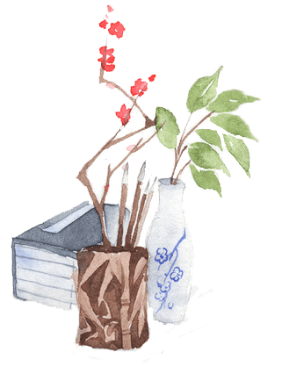
Daodejing
天下皆知美之为美，斯恶已;皆知善之为善，斯不善矣。有无相生，难易相成，长短相形，高下相盈，音声相和，前后相随，恒也。
When the people of the Earth all know beauty as beauty,
There arises (the recognition of) ugliness.
When the people of the Earth all know the good as good,
There arises (the recognition of) evil.
Therefore:
Being and non-being interdepend in growth;
Difficult and easy interdepend in completion;
Long and short interdepend in contrast;
High and low interdepend in position;
Tones and voice interdepend in harmony;
Front and behind interdepend in company. (Lin Yutang）
中华传承

Slide 10
Thank
you!

