Slide 1
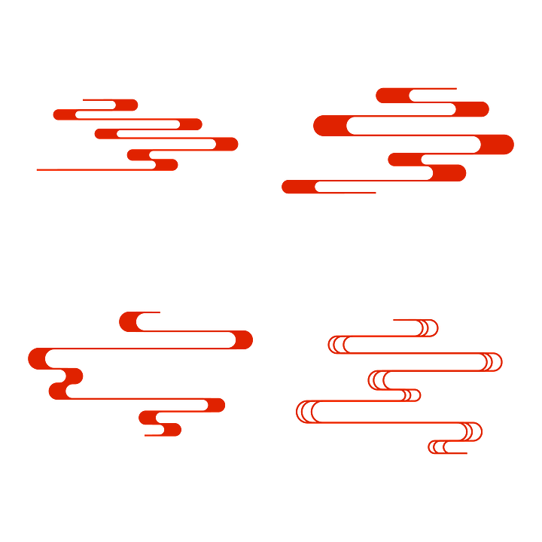


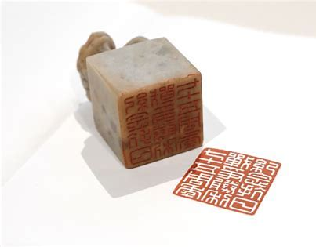
Chinese Seal Carving
汇报人：黄巧巧
时间：2025.4.18

Slide 2
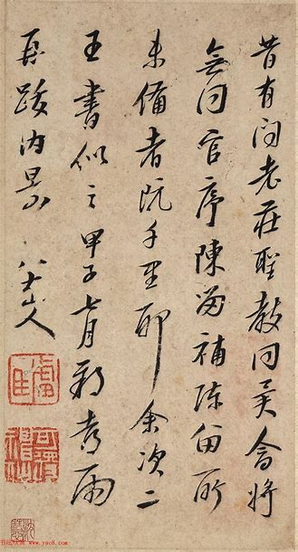
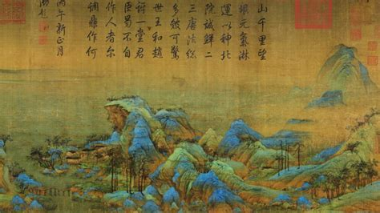

Slide 3
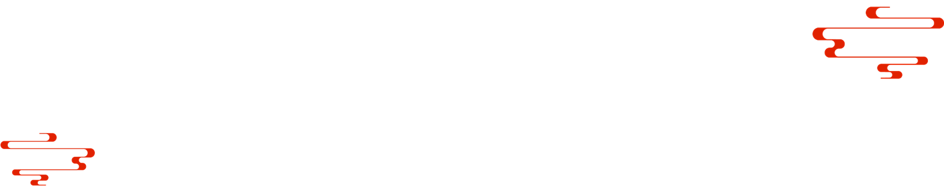
01
Love Story

Slide 4
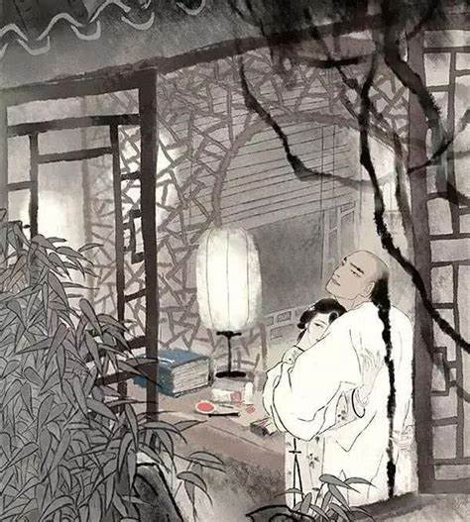
A 200-year-old Love Story
余镌“愿生生世世为夫妇”图章二方，余执朱文，芸执白文，以为往来书信之用。
I had carved two seals saying ‘愿生生世世为夫妇' — May we be husband and wife through all our lifetimes. I kept the seal with the red script, while Yun kept the one with the white script, to be used in correspondence.

Slide 5
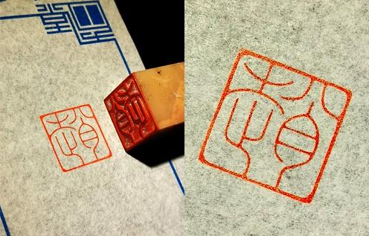
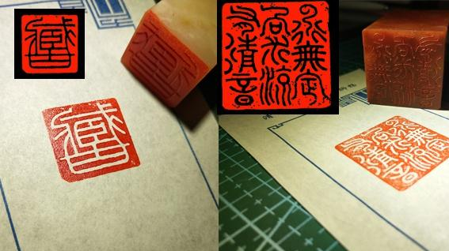
Red Script 朱文
White Script 白文

Slide 6
02
How to Read it?

Slide 7
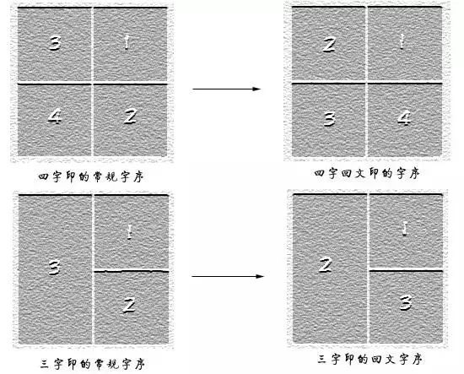
Reading Order
The reading order of seal text generally follows traditional Chinese writing rules
from right to left and top to bottom.

Slide 8
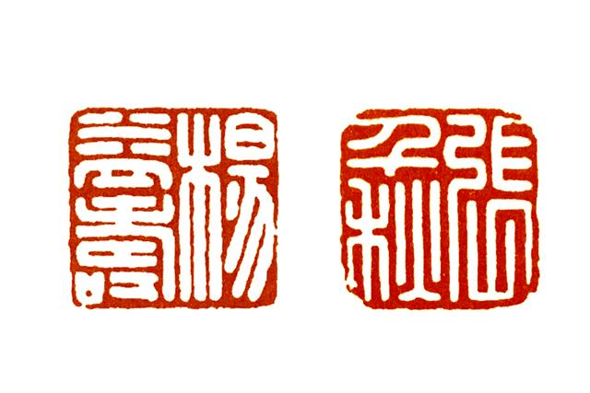

（厚德载物）

Slide 9
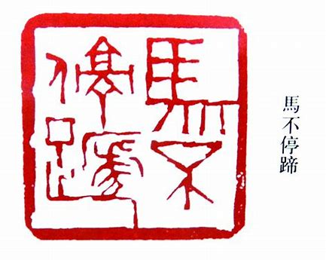
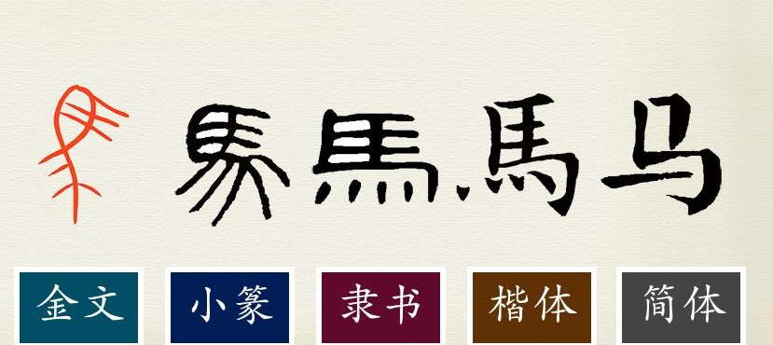
1. Decoding Ancient Characters

Slide 10
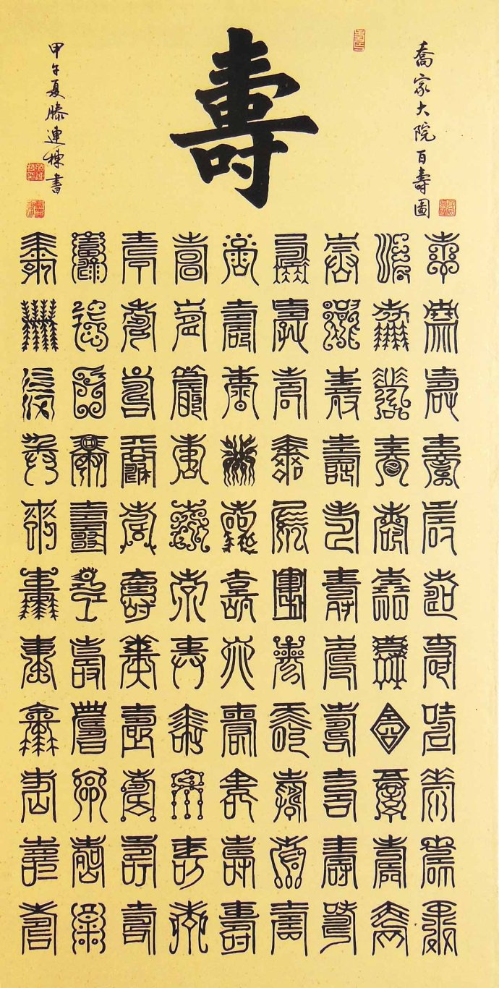
1. Decoding Ancient Characters
（汉印：杨益寿)

Slide 11
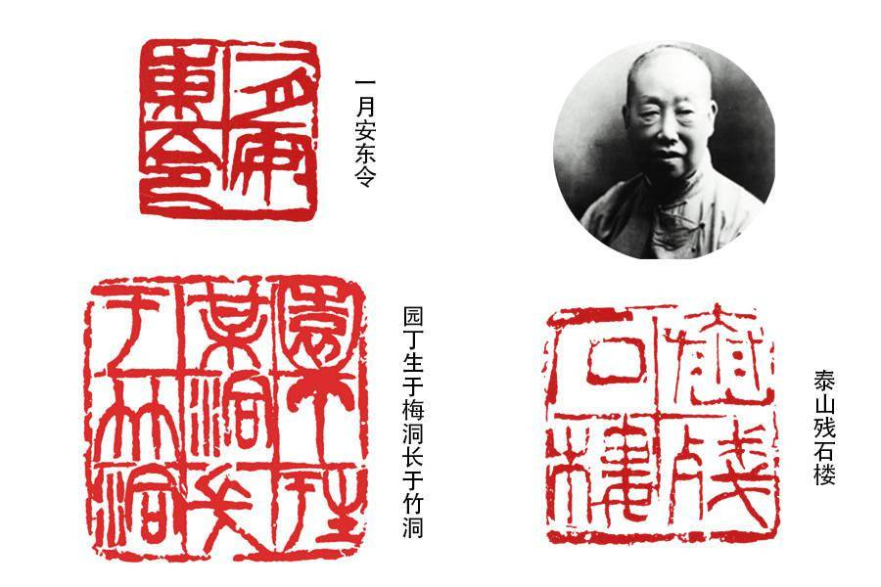
2. The Dance of Deformation
合文：Combined Character

Slide 12
3. The Puzzle of Composition
回文：Huiwen Composition
a unique layout technique in Chinese seal carving where characters are arranged in non-linear patterns to create visual harmony.

Slide 13
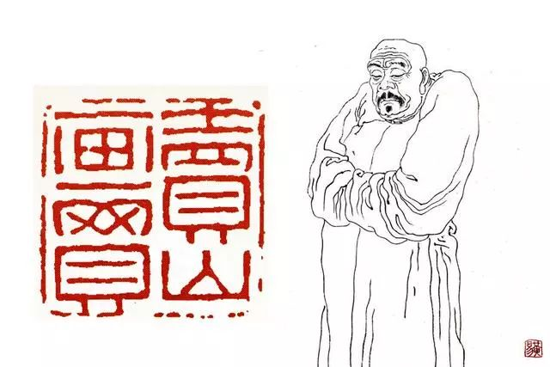
3. The Puzzle of Composition
对角对称
diagonal symmetry
（黄易：卖画买山）

Slide 14
03
Conclusion

Slide 15
Thank you!
汇报人：黄巧巧
时间：2025.4.18

