Slide 1



Yan Fu’s
Translation Thoughts
Handout：魏楚璇（Wei Chuxuan)
PPT：王李菲（Wang Lifei)

Slide 2
01 Introduction
02 Explanation of Translation Thought
CONTENTS
03 Modern Interpretation and Development
04 Significance

Slide 3


PART 1
Introduction

Slide 4


Introduction
Outstanding thinker, scholar and translator
Translation Works:
Evolution and Ethics (Thomas Henry Huxley)
The Wealth of Nations (Adam Smith)
严复 Yan Fu
（1854-1921）

Slide 5
PART 2
Explanation of Translation Thoughts

Slide 6
“Faithfulness, Expressiveness, Elegance”
Faithfulness: the meaning of the target text should be close to that of original one
Expressiveness：the target text should be coherent and clear
Elegance：the target text should be of refined language, namely, the ancient Chinese.
《天演论》 Evolution and Ethics
Written by Thomas Henry Huxley
Translated by Yan Fu

Slide 7
Relationship
Dependent
Controlled and complement each other.
Elegance
Faithfulness
fundamental requirements
goal
contributes to
contributes to
Expressiveness

Slide 8
PART 3
Modern Interpretation
and Development

Slide 9
Lin Yutang
Lin Yutang believed that these translation thoughts indicated that the target text should be responsible for original text, target readers, and art itself.
林语堂 Lin Yutang
（1895-1976）

Slide 10
Liu Zhongde
“Faithfulness, Expressiveness and Closeness”
More suitable for being translation criterion for they take all related aspects into consideration.
刘重德 Liu Zhongde
（1914-2008）

Slide 11
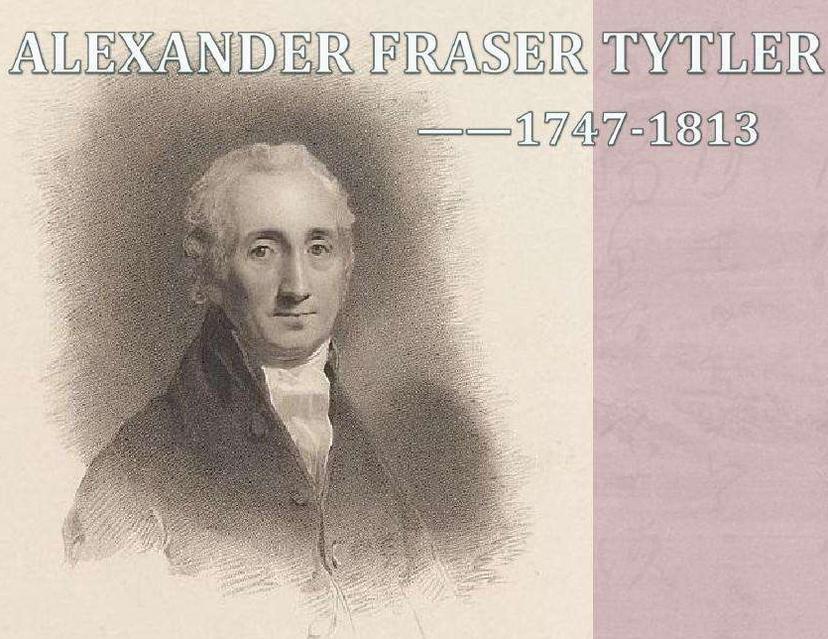
Alexander Fraser Tytler
There is still someone holding the opinion that these translation thoughts took their ideas from the three principles of famous British translator Tytler.
Alexander Fraser Tytler
（1747-1814）

Slide 12
PART 4
Significance

Slide 13
Profound Significance
His translation thoughts are concise, which cater to the taste of Chinese readers.
His translation thoughts that can be put forward at that time under the social conditions are pioneering.
Lay the solid foundation for future translation theories.

Slide 14
References
Xiaoping Tang. Studies on Yan Fu's Translation Thoughts “Faithfulness, Expressiveness, and Elegance”. Advance in Social Science, Education and Humanities Research, volume 329, 2019.
陈福康：《中国译学理论史稿》，上海：上海外语教育出版社，2000年。
冯立新:《论严复“信、达、雅”翻译思想》，《华南农业大学学报(社会科学版)》,2005年第2期。
郭芳：《信达雅翻译理论的发展研究》,《教育理论实践》，2016年第4期。
刘云虹,许钧：《理论的创新与实践的支点——翻译标准“信达雅”的实践再审视》，《中国翻译》，2010年第5期。

Slide 15
Thank you.

