Slide 1
说到武侠，你会想到什么？
我会想到，一座江湖

Slide 2
The Rudimentary Period
1.

Slide 3
The concept of Xia originated in the pre Qin period and developed in the Tang Dynasty.The novel Romance in Tang Dynasty with swordsmanship as its theme should be the earliest martial arts novel in China.

Slide 4
During the Tang Dynasty, the culture of swordsmanship was prevalent, and many literati and scholars enjoyed wearing precious swords with them to express their aspirations or show their admiration for martial arts. This also provides many valuable stories for the creation of martial arts novels in later generations.
Li Bai had a passion for swordsmanship since he was young, and he once traveled around with his sword. His poem Ode to Gallantry also became one of the inspirations for Jin Yong's later work Ode to Gallantry .

Slide 5
During the Ming and Qing dynasties, the Water Margin has had a vague shadow of martial arts novels. And Three Heroes and Five Gallants tells the story of the southern hero Zhan Zhao, the northern hero Ouyang Chun, and the Ding brothers assisting Bao Zheng in the trial and upholding justice. This is the first truly epic martial arts novel in China.

Slide 6
A Period of Great Prosperity
2

Slide 7
After the Revolution of 1911, many new ideas flooded into China, and literature and art experienced unprecedented development. The creation of martial arts novels also reached a climax. The martial arts novels of this period were later known as the old school martial arts, with a relatively single form of expression, emphasizing causality and emphasizing the difference of the good and the evil.

Slide 8
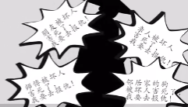

Slide 9
The new martial arts novels are no longer confined to revenge and killing, eliminating violence and ensuring justice. The content is richer, depicting the struggles between sects and good and evil. And the plot is more dramatic and ups and downs.

Slide 10
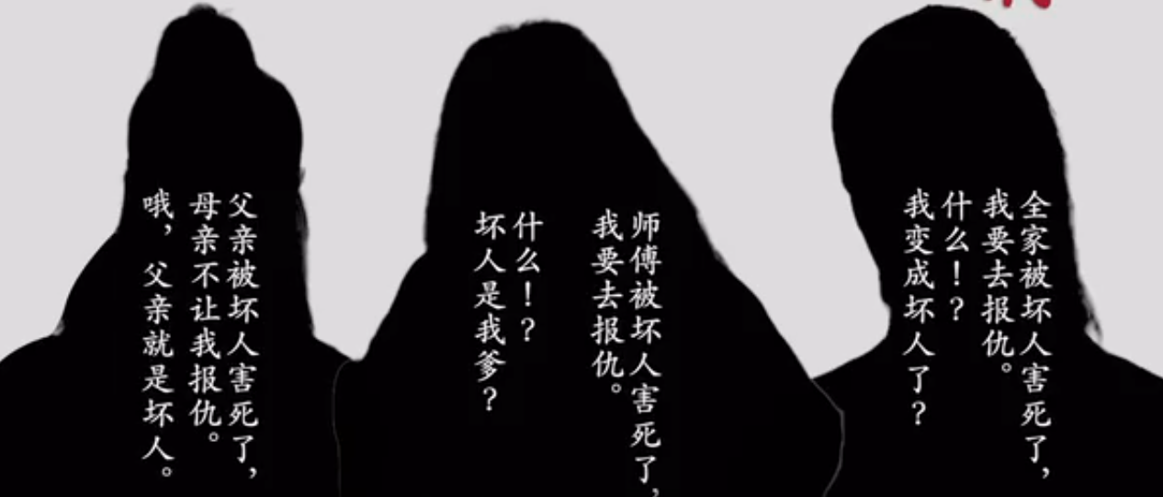

Slide 11
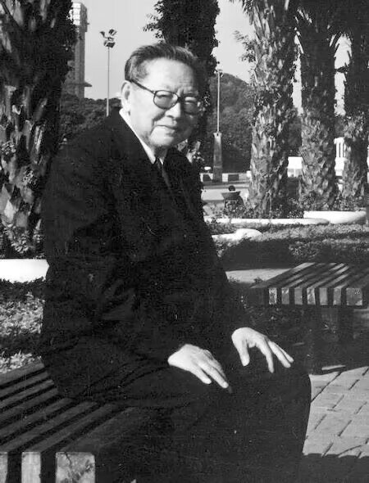
Liang Yusheng
In the early 1950s, Liang Yusheng was invited to serialize his first martial arts novel Gallants Fight in Peking in the New Evening Post. He is the founder of the new school martial arts novels

Slide 12
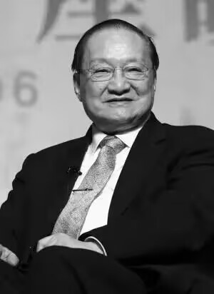
Jin Yong
Jin Yong came from a prestigious family and read extensively from a young age, laying a solid foundation for his future literary creations. The martial arts novels he created are all set at the transition of time, and the content mostly describes the opposition between positions and ethnic political consultative conferences.

Slide 13
Jin Yong
The heroes in his works are no longer simply about eliminating violence and upholding justice, but also about the sentiment that 'the greatest of heroes, serving the country and the people'. The female characters in his works are also brave enough to love and hate, with heroic female figures, which were very rare in martial arts novels that were mainly targeted at male audiences at that time.

Slide 14
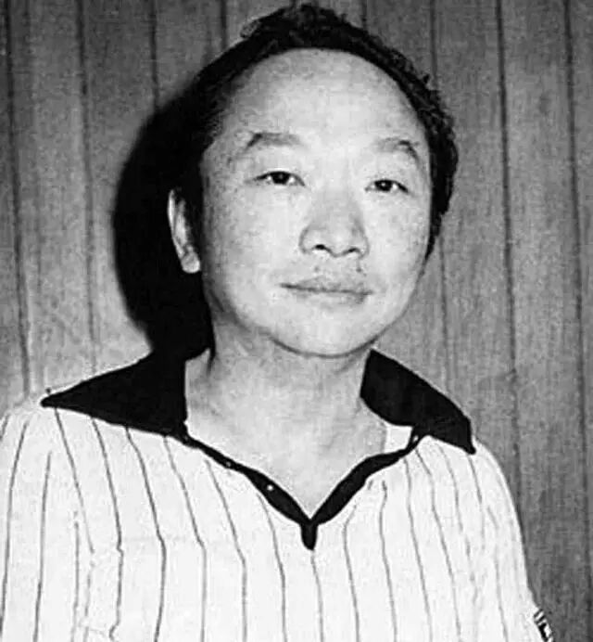
Gu Long
The successor to Jin Yong is a new master in Taiwan, China, Gu Long. He pushed martial arts novels to another climax. Starting from Handsome Siblings, he reached his peak

Slide 15
Gu Long
Gu Long successively created a series of works such as "The Legend of Chu Liuxiang" and "The Legend of Lu Xiaofeng". He added elements of reasoning, suspense, and other elements to traditional martial arts novels. The plot is intricate and captivating, which has peaped iextraordinary influence.

Slide 16
Waning Period
3

Slide 17
After Gu Long, Wen Rui'an took over the leading banner of martial arts novels. He created over a hundred martial arts works, among which the most famous is the "Four Great Captains" series. In order to save the increasingly declining martial arts novels, Wen Rui'an strives for innovation and breakthrough, advocating the extensive introduction of mainstream literary elements into martial arts novels at that time.

Slide 18
However, in the face of the tide of the times, the golden age of martial arts novels has gone.This literary pattern, which has been passed down for thousands of years, is gradually becoming rare and may one day disappear from our lives. However, many writers have incorporated many new elements into martial arts novels, creating fairy fantasy martial arts novels that are more appealing to contemporary readers, which has contributed to the prosperity of fairy fiction today.

Slide 19
Jin Yong once said that the spirit of martial arts novels lies in Xia, not in Wu. I have always believed that no matter how the times change, this spirit will never disappear. It is about sacrificing oneself for others in the darkest moments, standing up for justice and helping in times of crisis, embracing in times of helplessness, and smiling in despair. This spirit has long been deeply rooted in Chinese culture. It is around us and in the hearts of every Chinese. Everyone can be a Xia.

